Slide 1
Graph and Subspace Learning for Domain Adaptation
Dissertation Defense
Presenter: Le Shu
Committee: Dr. Longin Jan Latecki (Advisor)
Dr. Haibin Ling
Dr. Slobodan Vucetic
Dr. Ying Zhu
Notes:
Hi, Good morning, thank you for the coming.
The title for my dissertation is graph and subspace learning for domain adaptation.
My committee member is Prof. Latecki, Ling, Vucetic and Zhu.
Thank you very much for your coming again.

Slide 2
Outline
Introduction and Motivation: Domain Adaptation
Graph Learning for Domain Adaptation
  Transductive Domain Adaptation with Affinity Learning
Subspace Learning for Domain Adaptation
  Latent Subspace Discovery via Subspace Clustering for Domain Adaptation
Notes:
This is the outline of today’s talk.
First, I will give the introduciton and motivation for domain adapataiton.
Then I will introduce two graph learning methods for domain adaptation.
And then I will introduce two subspace learning methods for domain adaptation.

Slide 3
Domain Adaptation
Domain Adaptation is a field of associated with machine learning and transfer learning. This scenario arises when we aim at learning from a source data distribution a well performing model on a different (but related) target data distribution.
Why Domain Adaptation?
Labeled data is limited and very expensive to obtain.
Use labeled data from other “similar” domains and build shared models.
Notes:
What’s the definition for domain adaptation?
Why we need domain adaptation?

Slide 4

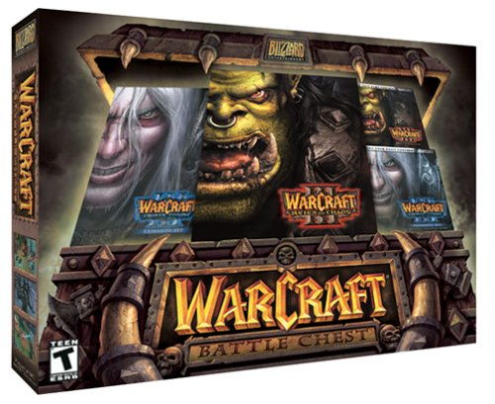


Domain Adaptation for Sentiment Classification
Reviews on Electronics
Reviews on Video Games
Source Domain
Target Domain
‘Compact; easy to operate; very good picture quality; looks sharp!’ | ‘Very fun, lots to do. I am very much hooked on this game!’
‘terrible battery issues; The lens stopped extending or retracting in less than a year’ | ‘it is prone to crashes, including ones that corrupt the save data.
Notes:
We first introduce two examples, the first example is domain adaptation for sentiment classification.
Assume we already reviews with labels on digital cameras and we also have reviews with no labels on video games.
If we consider the bag-of-word models for the reviews, the reviews on electronics are from a different distribution from the reviews on video games.
So we need to domain adaptation if we want to train the model on the left and apply it to the right.

Slide 5
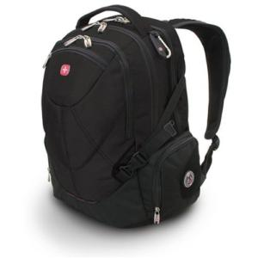
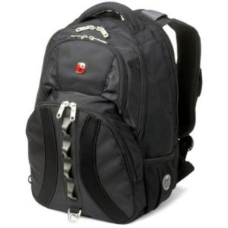
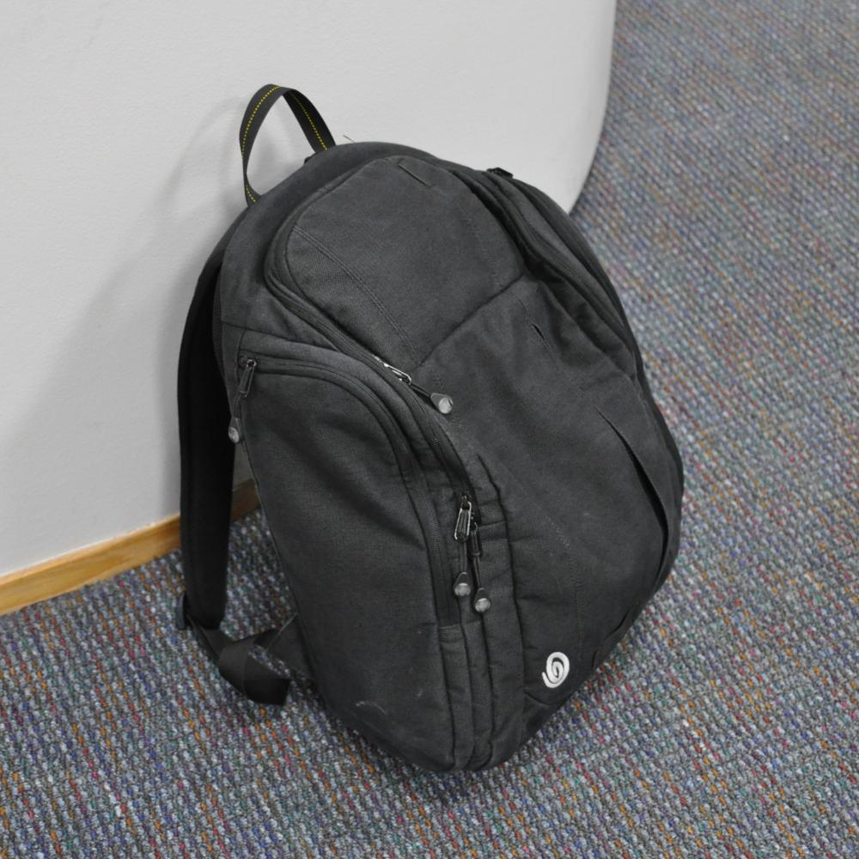
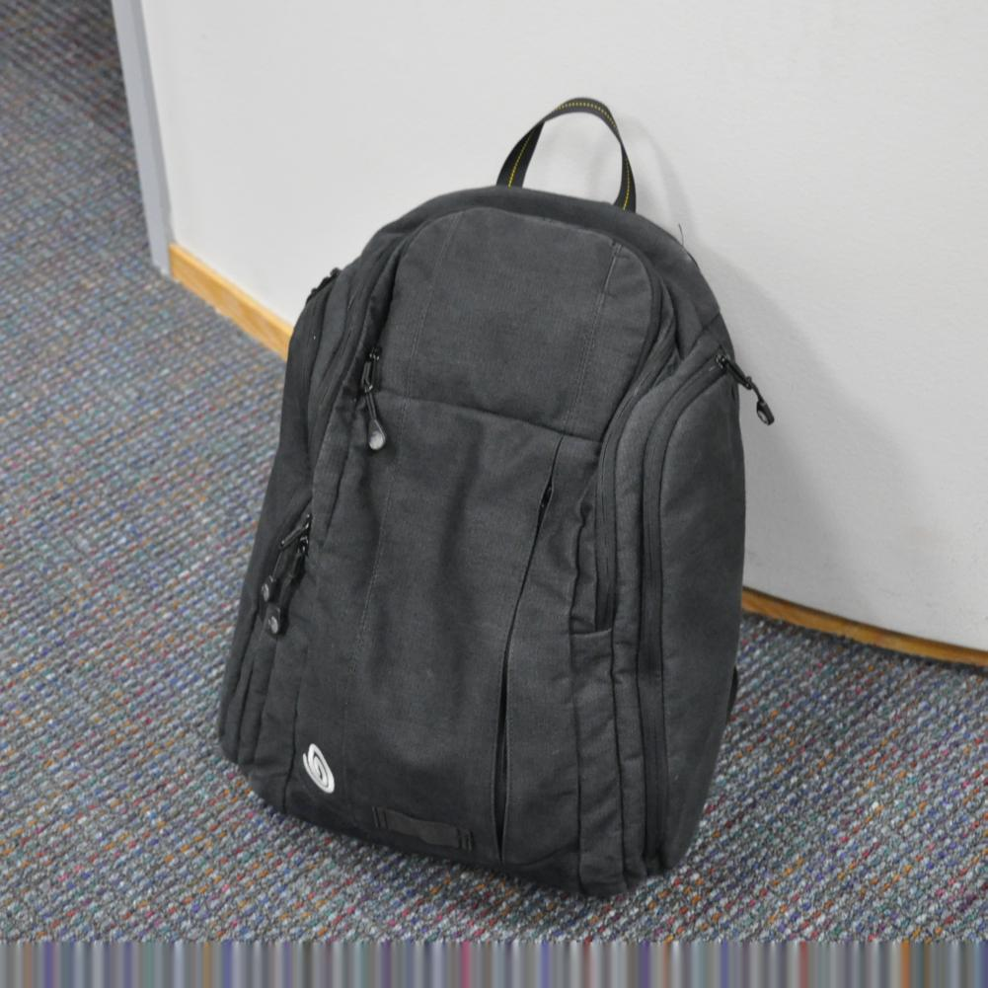

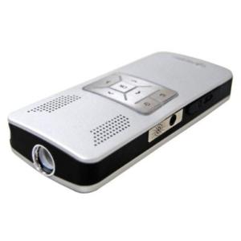
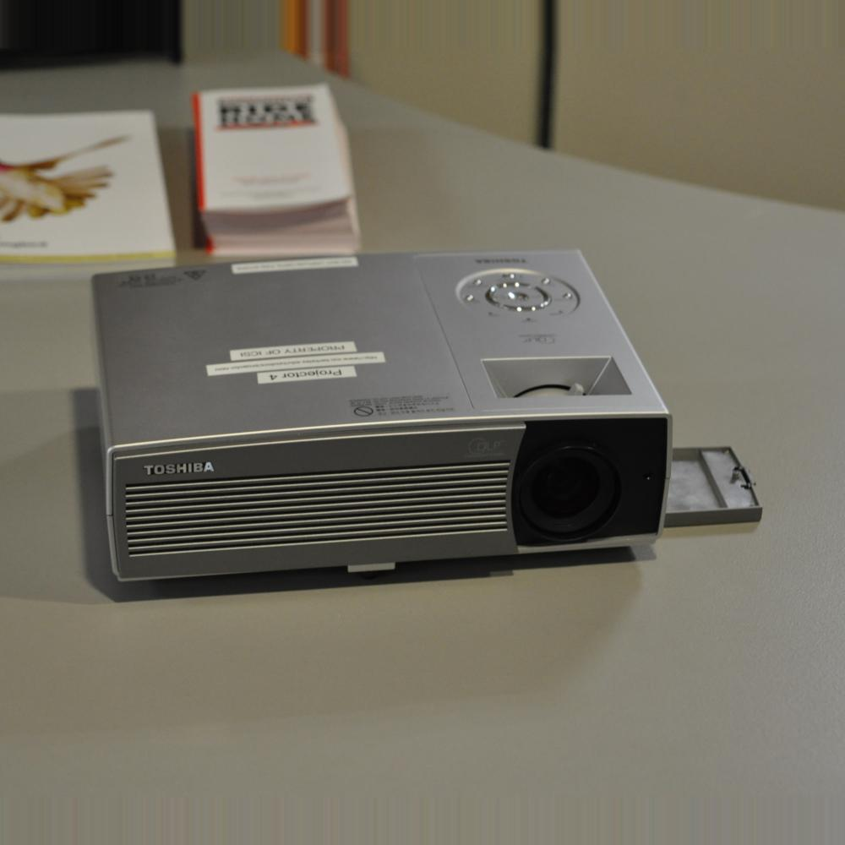


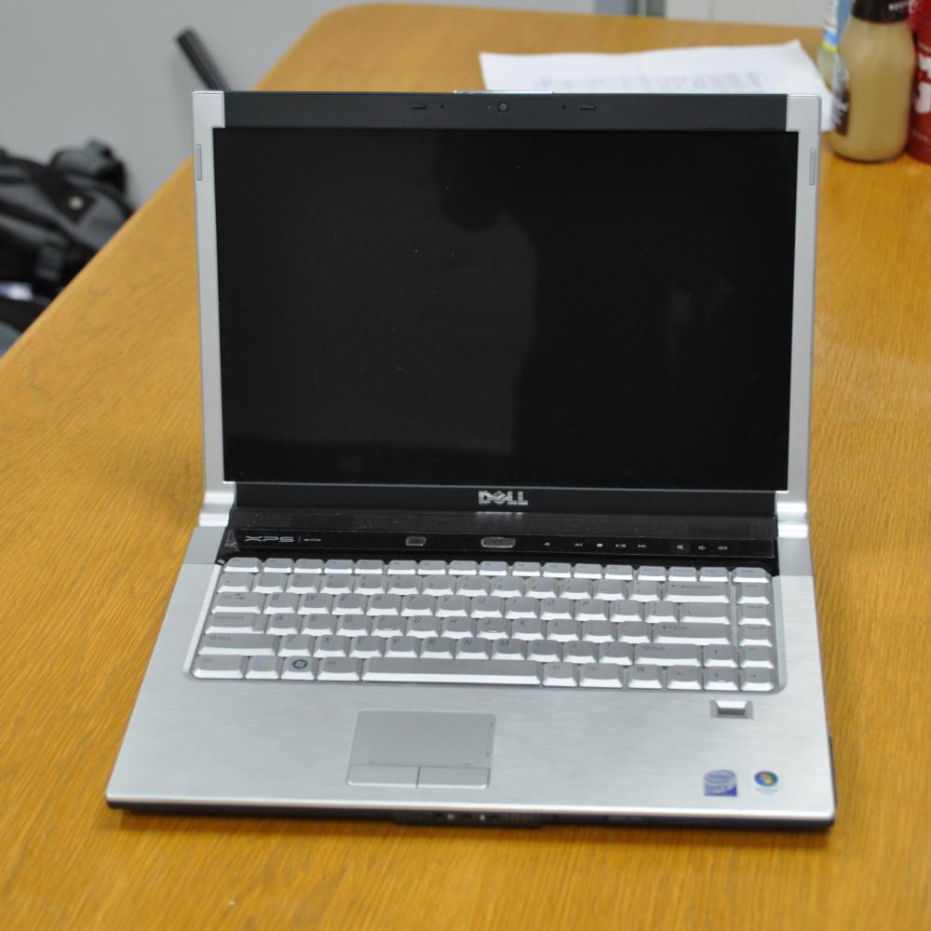
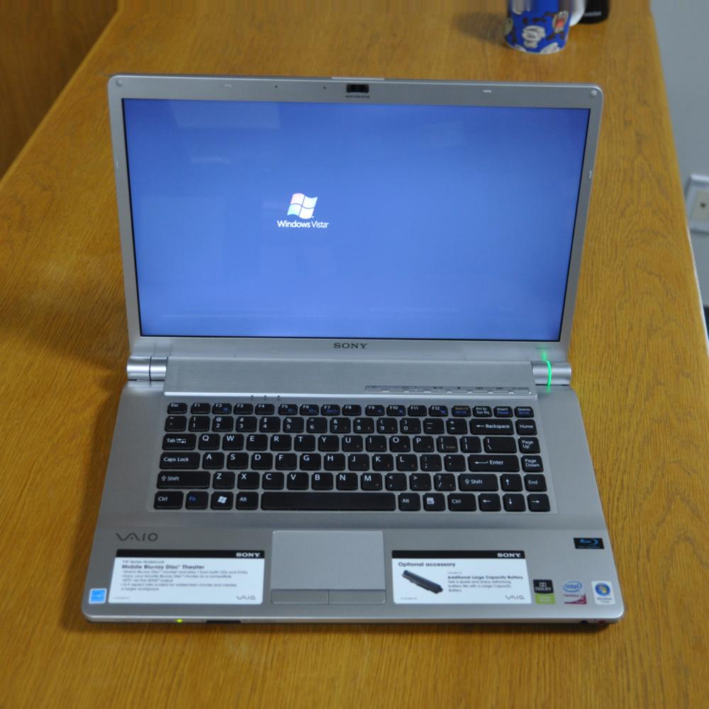
Domain Adaptation for Visual Object Recognition
Amazon
DSLR
Source Domain with labels
Target Domain without labels
Notes:
Here is another example for domain adaptation, which is for visual object recognition.
Assume we have labeld images download from Amazon, we have images which is captured with digital SLR cameras, and we do not have labels for these images.
we may not be able to directly apply the classifiers learned on the images downloaded from Amazon to images obtain with digital SLR camera.

Slide 6
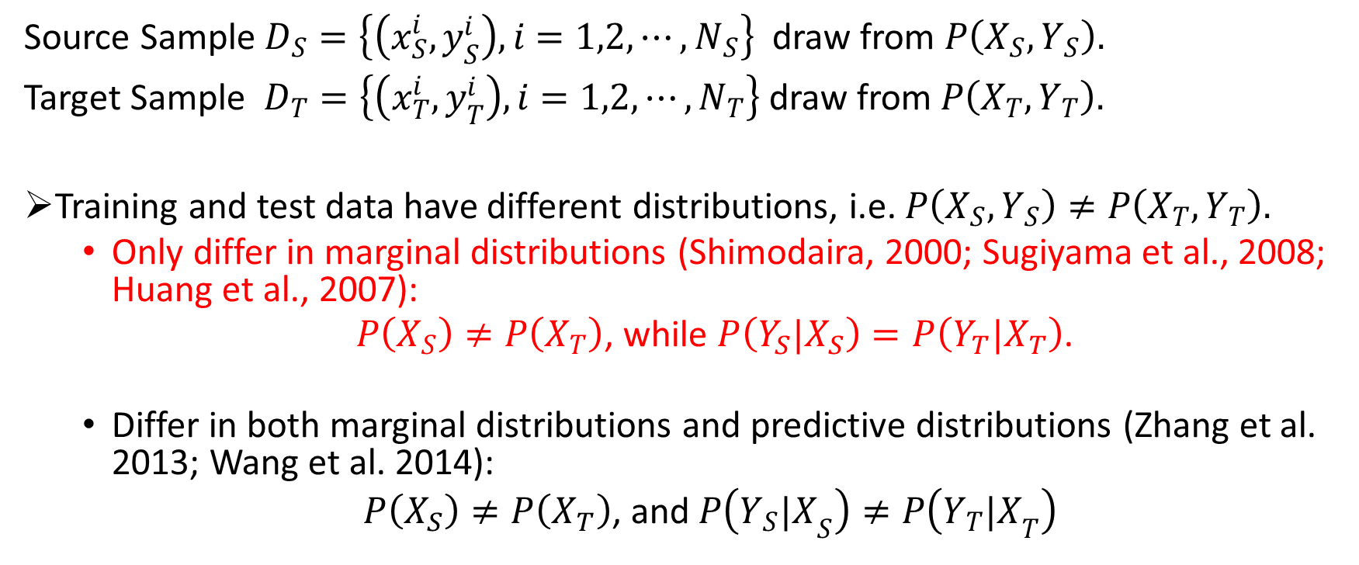
Mathematical Interpretation
Source Sample $D_{S}=\left\{\left(x_{S}^{i},y_{S}^{i}\right), i=1,2,⋯,N_{S}\right\}$ draw from $P\left(X_{S},Y_{S}\right).$
Target Sample $D_{T}=\left\{\left(x_{T}^{i},y_{T}^{i}\right), i=1,2,⋯,N_{T}\right\}$ draw from$P\left(X_{T},Y_{T}\right).$
Training and test data have different distributions, i.e. $P\left(X_{S},Y_{S}\right)≠P\left(X_{T},Y_{T}\right).$
  Only differ in marginal distributions (Shimodaira, 2000; Sugiyama et al., 2008; Huang et al., 2007):
  $P\left(X_{S}\right)≠P\left(X_{T}\right)$, while $P\left({Y_{S}|X}_{S}\right)=P\left({Y_{T}|X}_{T}\right)$.
  Differ in both marginal distributions and predictive distributions (Zhang et al. 2013; Wang et al. 2014):
  $P\left(X_{S}\right)≠P\left(X_{T}\right)$, and $P\left({Y_{S}|X}_{S}\right)≠P\left({Y_{T}|X}_{T}\right)$
?
Notes:
Here is the formal definition for domain adaptation.
We have the source sample and target sample, the distributions are different.
There are two scenatios, first, we assume that the source and target data only differ in the marginal distributions.
The second scenario is that both the marginal and conditional distributions are different, this scenario is much complex.
In our work, we mainly consider the first scenarios.

Slide 7
Outline
Introduction and Motivation: Domain Adaptation
Graph Learning for Domain Adaptation
  Transductive Domain Adaptation with Affinity Learning
Subspace Learning for Domain Adaptation
  Latent Subspace Discovery via Subspace Clustering for Domain Adaptation

Slide 8
Transductive Domain Adaptation with Affinity Learning
Le Shu, Longin Jan Latecki

Slide 9
Motivations
The key idea is to exploit the existence of bridge points.
Use affinity learning to obatain robust pair-wise similarities.
Notes:
The key idea is to exploit the existence of a subset of points in the target domain, which distribute similarly to the source domain, we call this subset of point as bridge points.

Slide 10
Our Contributions
In summary, our contributions include:
We perform affinity learning to bridge the distribution gap of source and target domain.
Adjust intra- and inter- domain similarities to facilitate affinity learning.
Notes:
Here is our contributions:

Slide 11
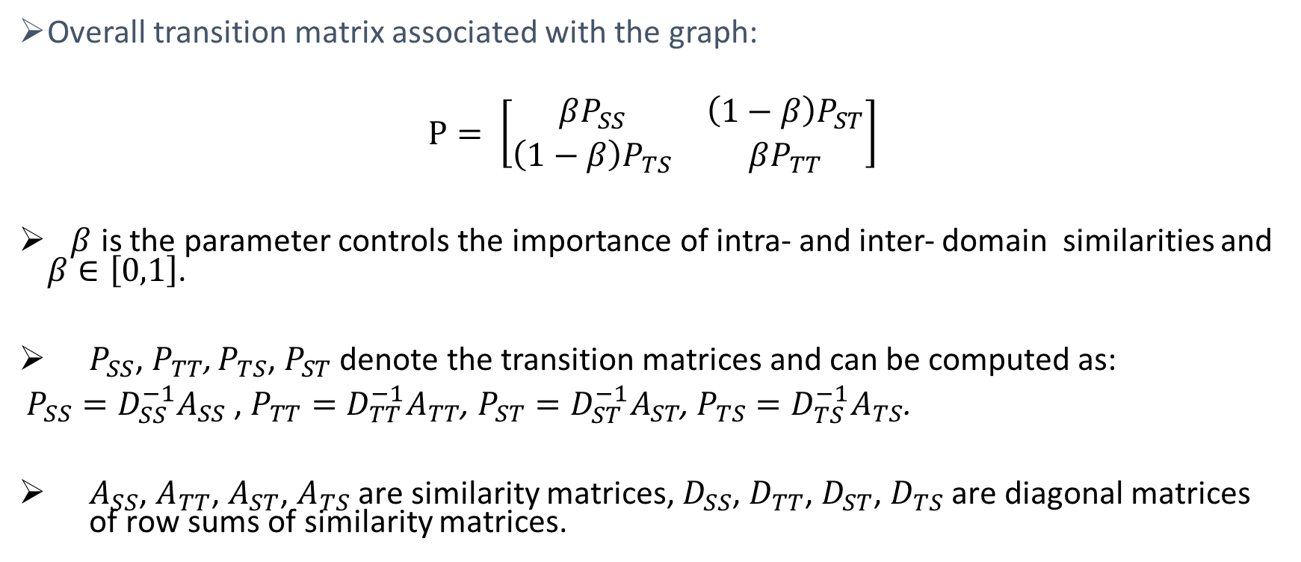
Step 1: Cross-domain Graph Construction
Overall transition matrix associated with the graph:
$P= \left[\begin{matrix}βP_{SS} & \left(1−β\right)P_{ST} \\ \left(1−β\right)P_{TS} & βP_{TT}\end{matrix}\right]$
$β$ is the parameter controls the importance of intra- and inter- domain similarities and $β∈\left[0,1\right]$.
$P_{SS}$, $P_{TT}$, $P_{TS}$, $P_{ST}$ denote the transition matrices and can be computed as:
$P_{SS}=D_{SS}^{−1}A_{SS}$ , $P_{TT}=D_{TT}^{−1}A_{TT}$, $P_{ST}=D_{ST}^{−1}A_{ST}$, $P_{TS}=D_{TS}^{−1}A_{TS}$.
$A_{SS}$, $A_{TT}$, $A_{ST}$, $A_{TS}$ are similarity matrices, $D_{SS}$, $D_{TT}$, $D_{ST}$, $D_{TS}$ are diagonal matrices of row sums of similarity matrices.

Slide 12
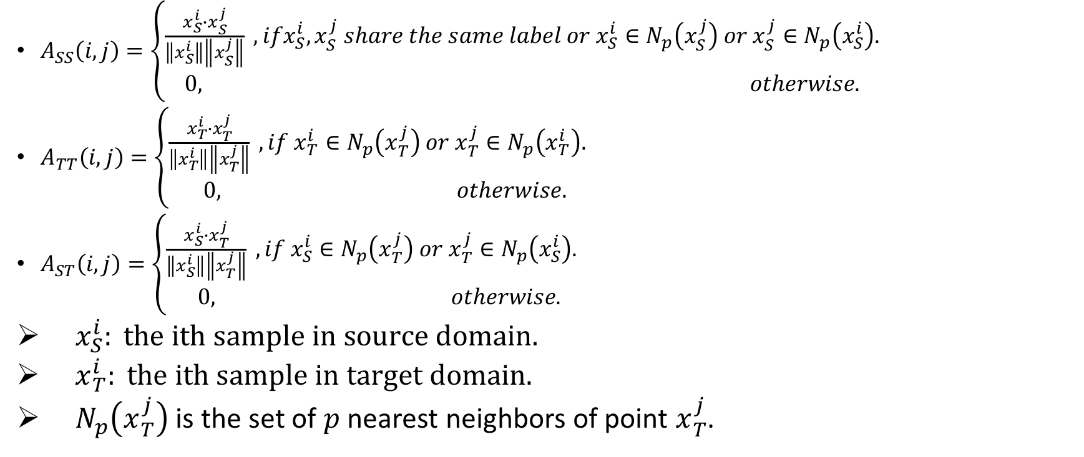
Step 1: Cross-domain Graph Construction
$A_{SS}\left(i,j\right)=\left\{\begin{aligned}\frac{x_{S}^{i}∙x_{S}^{j}}{\left\|x_{S}^{i}\right\|\left\|x_{S}^{j}\right\|} , ifx_{S}^{i}, x_{S}^{j} share the same label or x_{S}^{i}∈N_{p}\left(x_{S}^{j}\right) or{ x}_{S}^{j}∈N_{p}\left(x_{S}^{i}\right). \\ 0, otherwise.\end{aligned}\right.$
$A_{TT}\left(i,j\right)=\left\{\begin{aligned}\frac{x_{T}^{i}∙x_{T}^{j}}{\left\|x_{T}^{i}\right\|\left\|x_{T}^{j}\right\|} , if x_{T}^{i}∈N_{p}\left(x_{T}^{j}\right) or{ x}_{T}^{j}∈N_{p}\left(x_{T}^{i}\right). \\ 0, otherwise.\end{aligned}\right.$
$A_{ST}\left(i,j\right)=\left\{\begin{aligned}\frac{x_{S}^{i}∙x_{T}^{j}}{\left\|x_{S}^{i}\right\|\left\|x_{T}^{j}\right\|} , if x_{S}^{i}∈N_{p}\left(x_{T}^{j}\right) or{ x}_{T}^{j}∈N_{p}\left(x_{S}^{i}\right). \\ 0, otherwise.\end{aligned}\right.$
$x_{S}^{i}: the ith sample in source domain.$
$x_{T}^{i}: the ith sample in target domain.$
$N_{p}\left(x_{T}^{j}\right)$ is the set of $p$ nearest neighbors of point $x_{T}^{j}$.

Slide 13
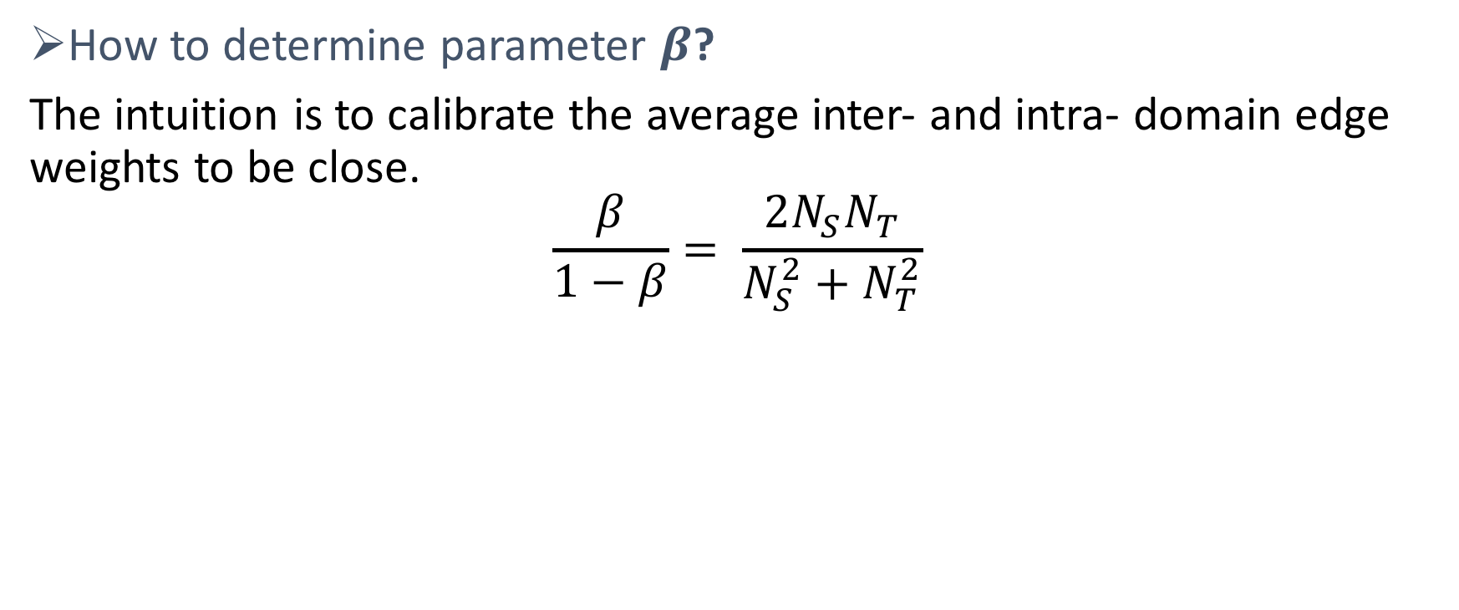
Step 1: Cross-domain Graph Construction
How to determine parameter $β$?
The intuition is to calibrate the average inter- and intra- domain edge weights to be close.
$$\frac{β}{1−β}= \frac{2N_{S}N_{T}}{N_{S}^{2}+N_{T}^{2}}$$

Slide 14
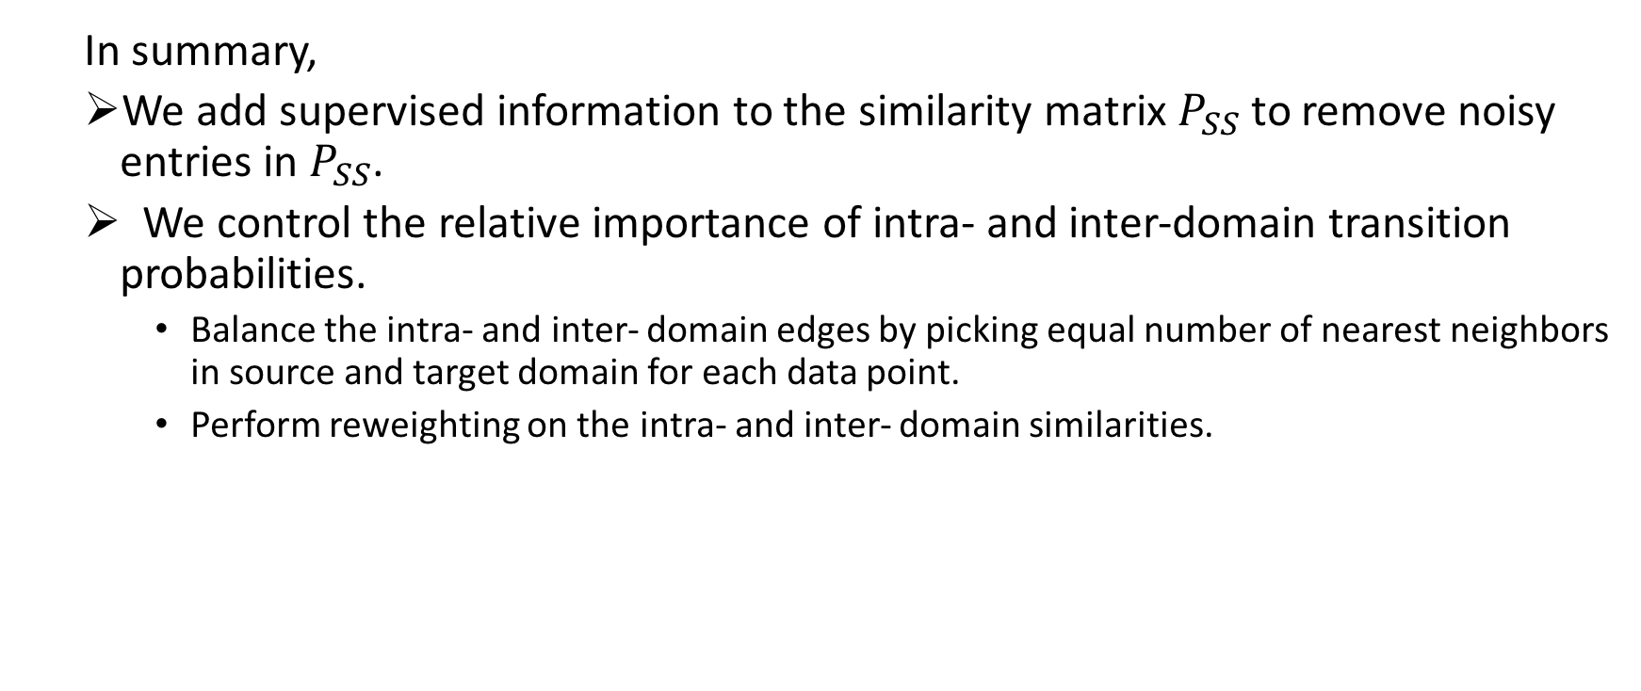
Step 1: Cross-domain Graph Construction
  In summary,
  We add supervised information to the similarity matrix $P_{SS}$to remove noisy entries in $P_{SS}$.
  We control the relative importance of intra- and inter-domain transition probabilities.
    Balance the intra- and inter- domain edges by picking equal number of nearest neighbors in source and target domain for each data point.
    Perform reweighting on the intra- and inter- domain similarities.

Slide 15
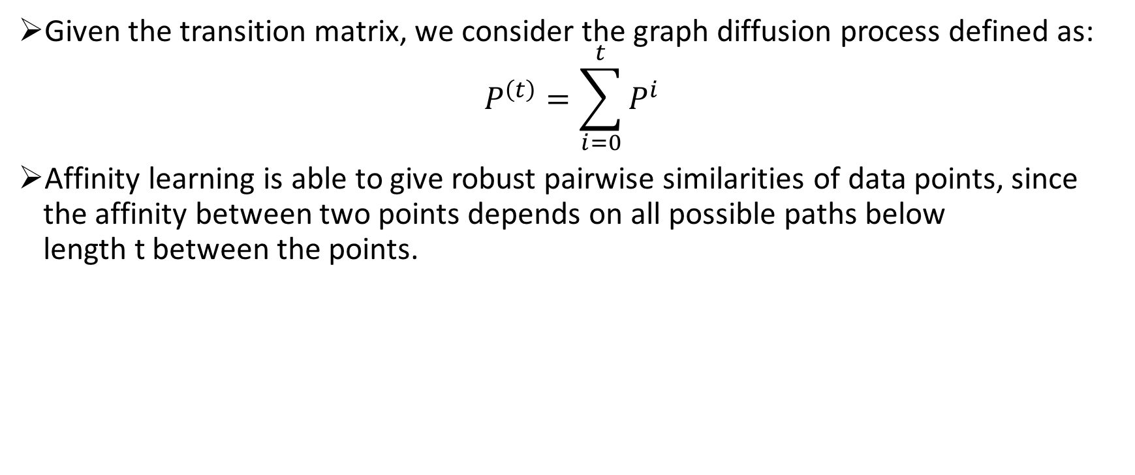
Step 2: Affinity Learning and Graph Diffusion (Yang et.al.)
Given the transition matrix, we consider the graph diffusion process defined as:
$$P^{\left(t\right)}=\sum_{i=0}^{t}{P^{i}}$$
Affinity learning is able to give robust pairwise similarities of data points, since the affinity between two points depends on all possible paths below length t between the points.
Notes:
The simplest way to realize the diffusion process is by computing powers of the graph matrix.
Accumulation of the graph matrix

Slide 16
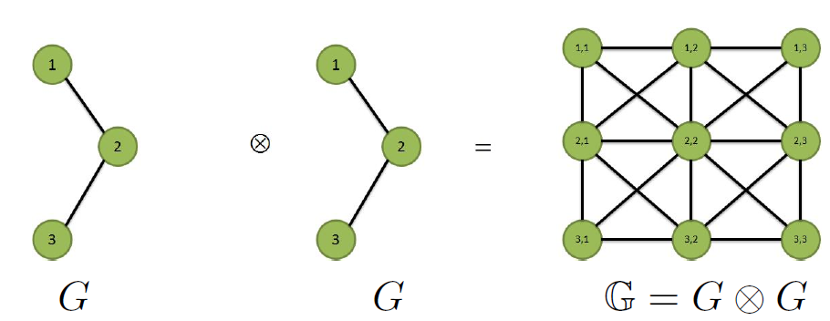

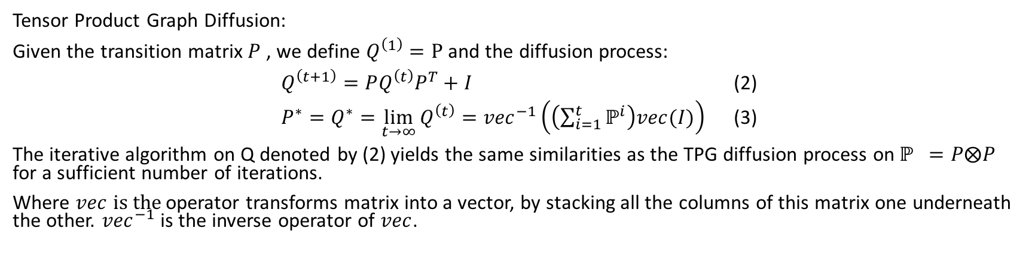
Step 2: Affinity Learning (Yang et.al.)
Tensor Product Graph
Tensor Product Graph Diffusion:
Given the transition matrix $P$, we define $Q^{\left(1\right)}=P$ and the diffusion process:
$Q^{\left(t+1\right)}=PQ^{\left(t\right)}P^{T}+I$ (2)
$P^{∗}=Q^{∗}=\lim_{t→∞}{Q^{\left(t\right)}={vec}^{−1}\left(\left(\sum_{i=1}^{t}{ℙ^{i}}\right)vec(I)\right)}$ (3)
The iterative algorithm on Q denoted by (2) yields the same similarities as the TPG diffusion process on${ ℙ}^{}=P⨂P$ for a sufficient number of iterations.
Where $vec is the$operator transforms matrix into a vector, by stacking all the columns of this matrix one underneath the other. ${vec}^{−1}$ is the inverse operator of $vec$.

Slide 17

Step 3: Spectral Embedding
After we get the diffusion matrix ${ P}^{∗}$, we compute the Laplacian graph and solve the smallest $K$eigenvectors to obtain a new feature representation.

Slide 18
Empirical Study
We evaluated our algorithm on visual object recognition.
Table 1. Performance gain analysis, where: C : Caltech, A : Amazon, W : Webcam, D : DSLR. SE: spectral embedding; SA: similarity adjustment; TPGD: tensor product graph diffusion; Our Method = SA+TPGD+SE.
% | A-D | A-W | D-A | D-W | W-A | W-C | C-D | C-W | Average
Baseline | 40.8 | 41.7 | 32.3 | 73.6 | 34.1 | 29.9 | 42.0 | 40.7 | 41.9
SE | 40.1 | 40.7 | 34.4 | 66.4 | 35.7 | 28.7 | 47.1 | 43.7 | 42.1
SA+SE | 45.8 | 44.4 | 41.1 | 89.5 | 38.7 | 35.0 | 52.8 | 49.1 | 49.6
TPGD+SE | 43.9 | 41.0 | 34.8 | 74.9 | 39.8 | 35.2 | 54.1 | 48.5 | 46.5
Ours | 50.3 | 49.0 | 40.5 | 92.2 | 39.7 | 36.8 | 55.4 | 52.9 | 52.1

Slide 19
Empirical Study
Table 2. Comparison with state-of-the-art methods. For the compared methods, most results are quoted from Landmark(Gong et.al.).
% | A-D | A-W | D-A | D-W | W-A | W-C | C-D | C-W
Baseline | 40.8 | 41.7 | 32.3 | 73.6 | 34.1 | 29.9 | 42.0 | 40.7
TCA | 36.3 | 27.8 | 28.7 | 82.0 | 24.2 | 22.5 | 45.2 | 32.5
KMM | 42.7 | 42.4 | 36.0 | 83.0 | 31.9 | 29.0 | 53.5 | 45.8
GFK | 42.7 | 40.7 | 36.2 | 76.3 | 31.8 | 30.9 | 43.3 | 44.7
Landmark | 47.1 | 46.1 | 33.4 | 78.0 | 40.2 | 35.4 | 57.3 | 49.5
Ours | 50.3 | 49.0 | 40.5 | 92.2 | 39.7 | 36.8 | 55.4 | 52.9

Slide 20
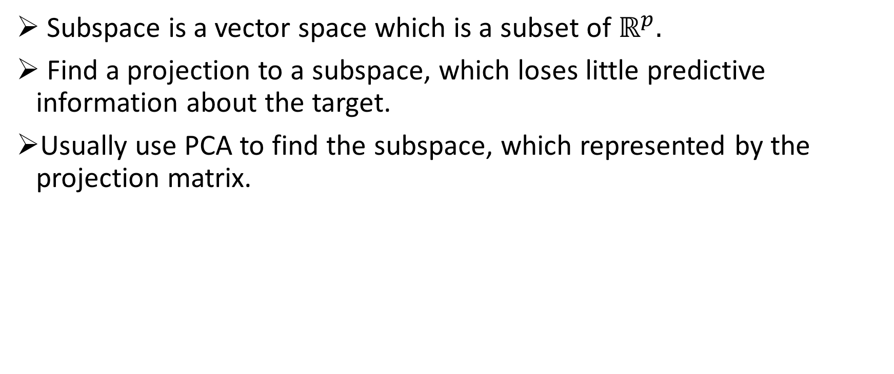
Subspace Learning for Domain Adaptation
Subspace is a vector space which is a subset of $ℝ^{p}.$
Find a projection to a subspace, which loses little predictive information about the target.
Usually use PCA to find the subspace, which represented by the projection matrix.

Slide 21
Latent Subspace Discovery via Subspace Clustering for Domain Adaptation
Le Shu, Longin Jan Latecki

Slide 22
Motivations
The domain could be a mixture of latent domains with significant inner-domain variations or data is from multiple sources.
Single Source Domain
Multiple Source Domain
(Homan et al. 2012), (Gong et al. 2013), (Xiong et al.2014) , (Mansour et al. 2008), (Sun et al. 2011), (Duan et al. 2009),
(Zhang et al. 2015).
Notes:
We use an toy example to illustrate the motivations,
The red dots as the source data and green dots as the target data.
If we follow the single source domain assumption, the left figure, we could see that , if we align the source subspace to the target space, we could lose information.
In the right figure, if we assume that the data lies in a union of two 1-dimensional subspaces, if we identify these two 1-dimenaional subspace first and then align these two subspaces to the target subspaces

Slide 23
Our Contributions
We point out the limitation of the single subspace assumption adopted by the existing subspace based domain adaptation algorithms, and instead assume that data lie in a union of multiple subspaces.
We propose a novel multiple subspace alignment (Multi-SA) algorithm, which aims to find a good subspace by not only maximizing the variance of both source and target domain but also preserving the distinctive information in the source domain.

Slide 24
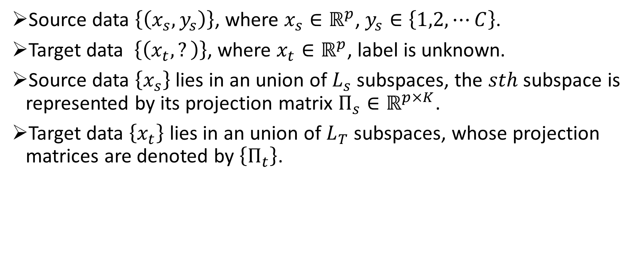
Notations
Source data $\left\{\left(x_{s},y_{s}\right)\right\}$, where $x_{s}∈ℝ^{p}$, $y_{s}∈\left\{1,2,⋯C\right\}$.
Target data $\left\{\left(x_{t},?\right)\right\}$, where $x_{t}∈ℝ^{p}$, label is unknown.
Source data $\left\{x_{s}\right\}$ lies in an union of $L_{s}$ subspaces, the $sth$ subspace is represented by its projection matrix $Π_{s}∈ℝ^{p×K}$.
Target data $\left\{x_{t}\right\}$ lies in an union of $L_{T}$ subspaces, whose projection matrices are denoted by $\left\{Π_{t}\right\}$.

Slide 25
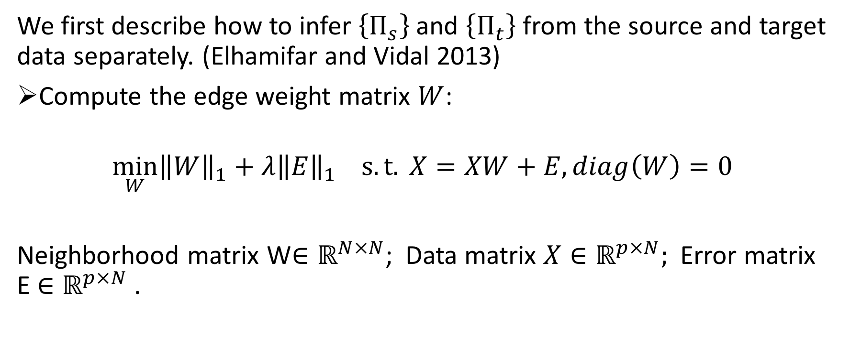
Subspace Discovery via Sparse Subspace Clustering
We first describe how to infer $\left\{Π_{s}\right\}$ and $\left\{Π_{t}\right\}$ from the source and target data separately. (Elhamifar and Vidal 2013)
Compute the edge weight matrix $W$:
$$\min_{W}{{\left\|W\right\|}_{1}}+λ{\left\|E\right\|}_{1} s.t. X=XW+E, diag\left(W\right)=0$$
Neighborhood matrix W$∈ℝ^{N×N}$; Data matrix $X∈ℝ^{p×N};$Error matrix E $∈ℝ^{p×N}$ .
Notes:
Each edge weight in W indicates how likely that pair of nodes lie in the same subspace.
exploit the self-expressiveness property of the data, which states that each data point in a union of subspaces can be efficiently represented as a linear or affine combination of other points.

Slide 26
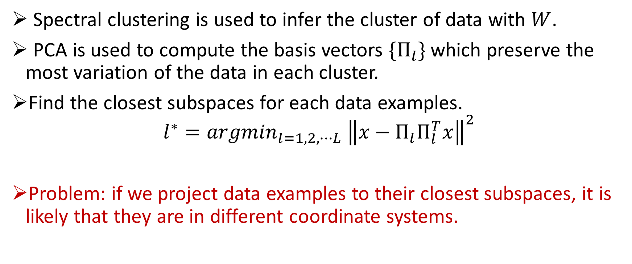
Subspace Discovery via Sparse Subspace Clustering
Spectral clustering is used to infer the cluster of data with $W$.
PCA is used to compute the basis vectors ${\{Π}_{l}\}$which preserve the most variation of the data in each cluster.
Find the closest subspaces for each data examples.
$$l^{∗}={argmin}_{l=1,2,⋯L} {\left\|x−Π_{l}Π_{l}^{T}x\right\|}^{2}$$
Problem: if we project data examples to their closest subspaces, it is likely that they are in different coordinate systems.

Slide 27
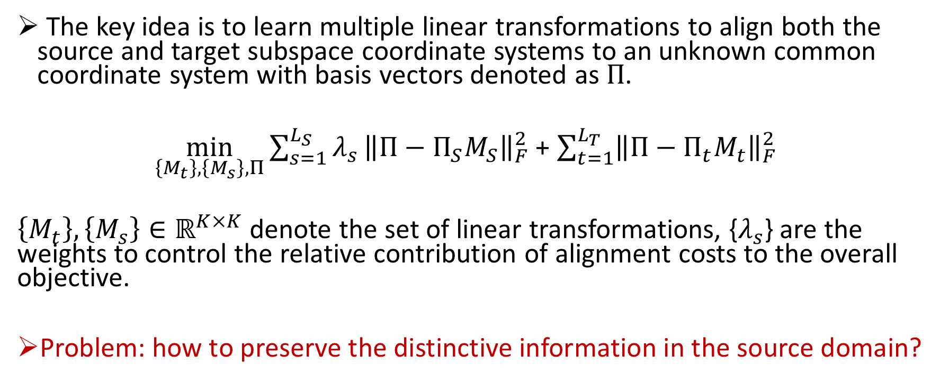
Multiple Subspaces Alignment for Domain Adaptation
The key idea is to learn multiple linear transformations to align both the source and target subspace coordinate systems to an unknown common coordinate system with basis vectors denoted as $Π$.
$\min_{\left\{M_{t}\right\},\left\{M_{s}\right\},Π}{\sum_{s=1}^{L_{S}}{λ_{s}}{\left\|Π−Π_{S}M_{S}\right\|}_{F}^{2}}$ + $\sum_{t=1}^{L_{T}}{{\left\|Π−Π_{t}M_{t}\right\|}_{F}^{2}}$
$\left\{M_{t}\right\},\left\{M_{s}\right\}∈ℝ^{K×K}$ denote the set of linear transformations, {$λ_{s}$} are the weights to control the relative contribution of alignment costs to the overall objective.
Problem: how to preserve the distinctive information in the source domain?

Slide 28
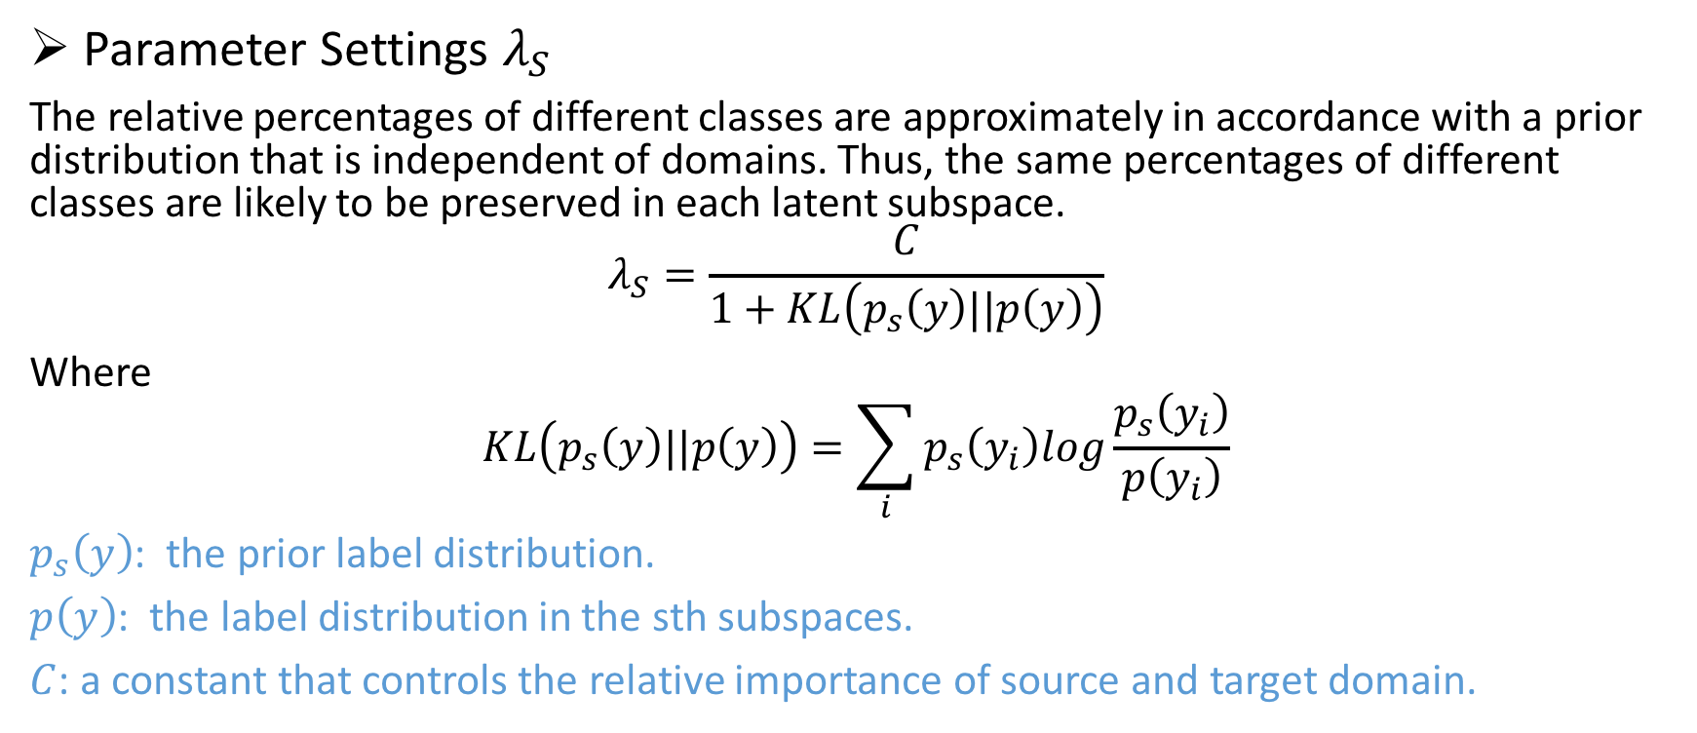
Multiple Subspaces Alignment for Domain Adaptation
Parameter Settings $λ_{S}$
The relative percentages of different classes are approximately in accordance with a prior distribution that is independent of domains. Thus, the same percentages of different classes are likely to be preserved in each latent subspace.
$$λ_{S}=\frac{C}{1+KL\left(p_{s}\left(y\right)||p\left(y\right)\right)}$$
Where
$$KL\left(p_{s}\left(y\right)||p\left(y\right)\right)=\sum_{i}{p_{s}\left(y_{i}\right)log\frac{p_{s}\left(y_{i}\right)}{p\left(y_{i}\right)}}$$
$p_{s}\left(y\right)$: the prior label distribution.
$p\left(y\right)$: the label distribution in the sth subspaces.
$C$: a constant that controls the relative importance of source and target domain.

Slide 29
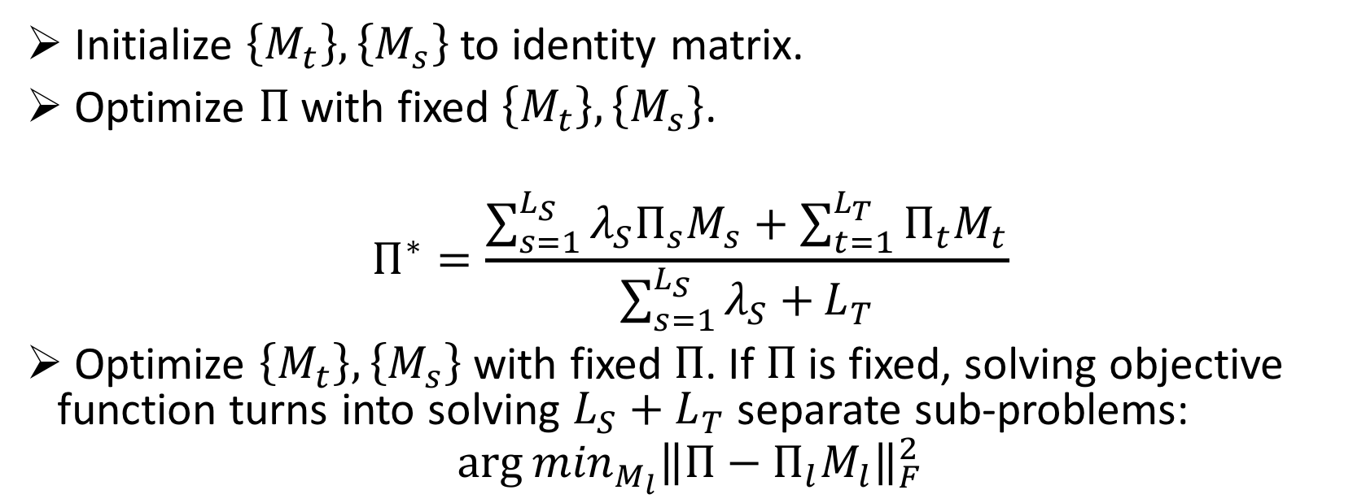
ALTERNATIVE OPTIMIZATION
O$bjective Function: \min_{\left\{M_{t}\right\},\left\{M_{s}\right\},Π}{\sum_{s=1}^{L_{S}}{λ_{s}}{\left\|Π−Π_{S}M_{S}\right\|}_{F}^{2}}$ + $\sum_{t=1}^{L_{T}}{{\left\|Π−Π_{t}M_{t}\right\|}_{F}^{2}}$
Initialize $\left\{M_{t}\right\},\left\{M_{s}\right\}$ to identity matrix.
Optimize $Π$ with fixed $\left\{M_{t}\right\},\left\{M_{s}\right\}$.
$$Π^{∗}=\frac{\sum_{s=1}^{L_{S}}{λ_{S}Π_{s}M_{s}+\sum_{t=1}^{L_{T}}{Π_{t}M_{t}}}}{\sum_{s=1}^{L_{S}}{λ_{S}+}L_{T}}$$
Optimize $\left\{M_{t}\right\},\left\{M_{s}\right\}$ with fixed $Π$. If $Π$ is fixed, solving objective function turns into solving ${L_{S}+L}_{T}$ separate sub-problems:
$${\arg{min}}_{M_{l}}{{\left\|Π−Π_{l}M_{l}\right\|}_{F}^{2}}$$

Slide 30
Multiple Subspace Alignment for Domain Adaption
Notes:
Here is the whole process of multiple subspace alignment algorithm for domain adaptation.

Slide 31
Empirical Study
USPS Digit Recognition
We extract examples from digit 3 and 8, rotate the training examples by both 30 and 60 degrees and we use PCA to project both training and testing data to a 2D space.
Solid shapes represent the test data, shallow shapes represent the training data (different shapes represent different rotation degrees, different color represent different classes).

Slide 32
Empirical Study
Table 1. USPS Digital Recognition
Table 2. Visual Object Recognition
Notes:
Here is more experiments, in the first table, it is the usps digital recognition synthetic datasets.
We randomly select 100 examples for training and select 1000 examples from the rest as testing.
From the table,
Another example is visual object recognition

Slide 33
Future Work
Heterogeneous domain adaptation with different feature spaces.
Domain Adaptation: marginal and conditional distributions are allowed to change with smooth changes.
Efficient domain adaptation methods for large scale applications.
Notes:
For future work, we would like to explore fields in different settings and related tasks.

Slide 34
Publications and Submissions
Le Shu and Longin Jan Latecki, Latent Subspace Discovery via Subspace Clustering for Domain
Adaptation. (In Submission).
Le Shu and Longin Jan Latecki, Subspace Learning with Data Alignment for Domain Adaptation.
(In Submission).
Le Shu and Longin Jan Latecki, Integration of Single-view Graphs with Diusion of Tensor Product
Graphs for Multi-view Spectral Clustering. (to appear in ACML 2015), Hong Kong, China.
Le Shu and Longin Jan Latecki, Transductive Domain Adaptation with Anity Learning. (CIKM
2015), in Melbourne, Australia.
Le Shu, Tianyang Ma, Longin Jan Latecki, Locality Preserving Projection for Domain Adaptation
with Multi-Objective Learning. (AAAI 2014), in Quebec, Canada.
Le Shu, Tianyang Ma, Longin Jan Latecki. Stable Feature Selection with Minimal Independent
Dominating Sets. (ACM BCB 2013), in Washington DC, USA.

Slide 35
Thank you !
Q & A

