Slide 1
Steerable Visual Representations
Steering a frozen Vision Transformer with natural language
Jona Ruthardt, Manu Gaur, Deva Ramanan, Makarand Tapaswi, Yuki M. Asano
Presented by Michael Watkins · CIS 5590 Vision-Language Models · Temple University, Fall 2026

Slide 2
Outline of the session
Part | What we cover
1 · Background | ViT recap, attention, the pretrained encoders, the saliency problem
2 · Landscape | Four families of visual encoding, early vs late fusion, related work
3 · The model | Each component, the cross-attention math, the tanh gate, a full forward pass
4 · Training | Objective, targets, data mixture, recipe, what emerges when
5 · Evaluation | CORE, GeneCIS, MOSAIC, quality, granularity, topology, anomaly transfer
6 · Analysis | Ablations, backbones, scaling, efficiency
7 · Summary | Takeaways and caveats
Steerable Visual Representations · Ruthardt, Gaur et al., 2026
2

Slide 3
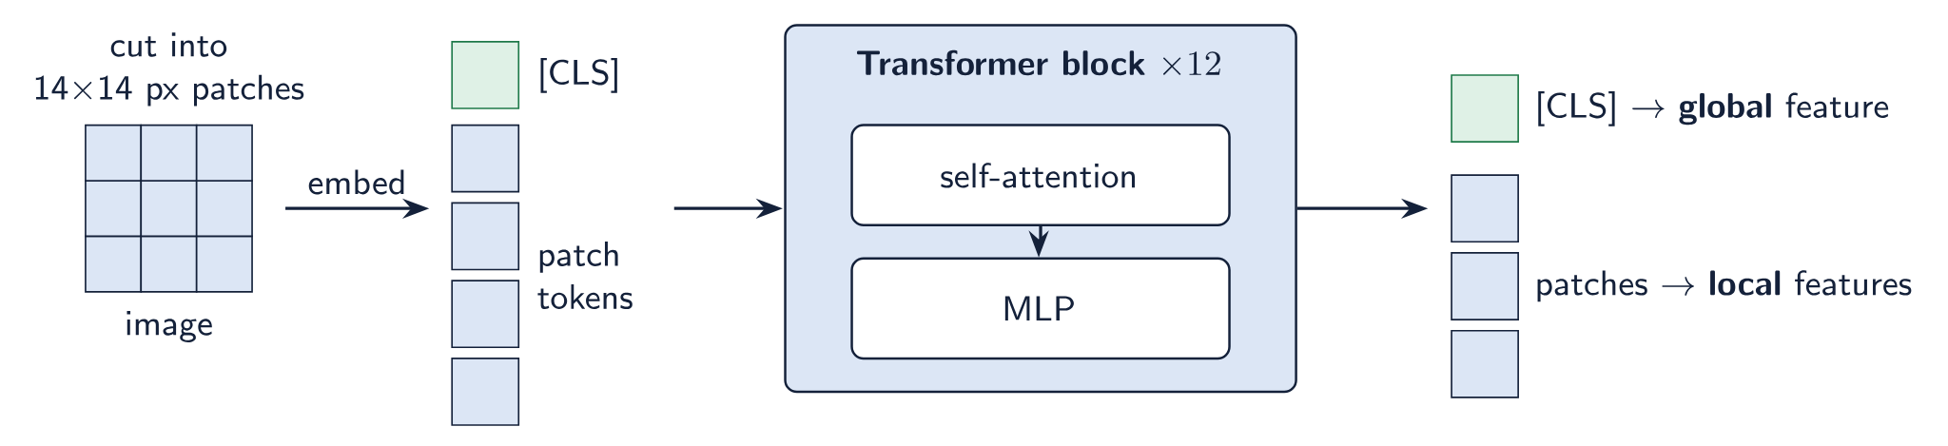
Vision Transformer recap
TOKENS
RESIDUAL STREAM
NO TEXT INPUT
A 336×336 image at 14 px patches gives 24×24 = 576 patch tokens, plus one [CLS] token.
Each block adds its output to the tokens. Nothing is overwritten on the way up.
The same image always gives the same features. There is nowhere to put a prompt.
Diagram drawn for this talk
3

Slide 4
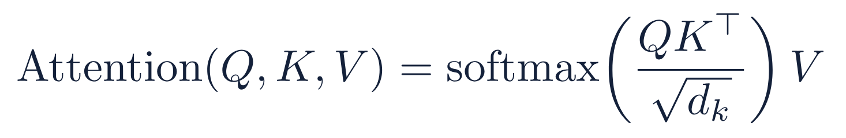
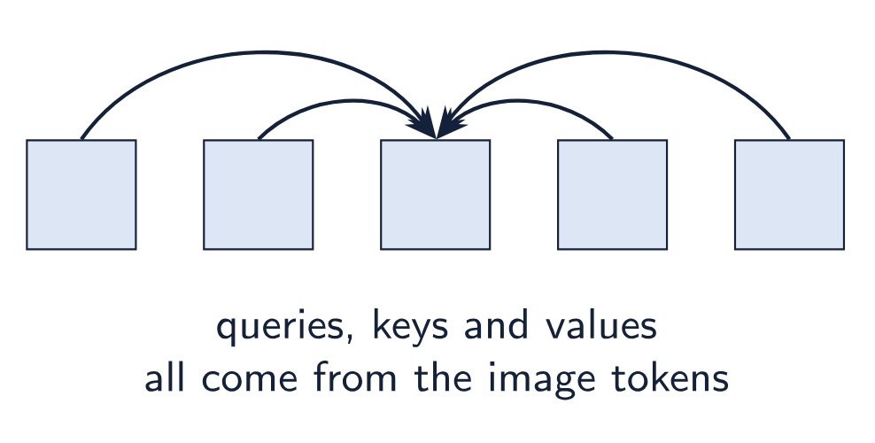
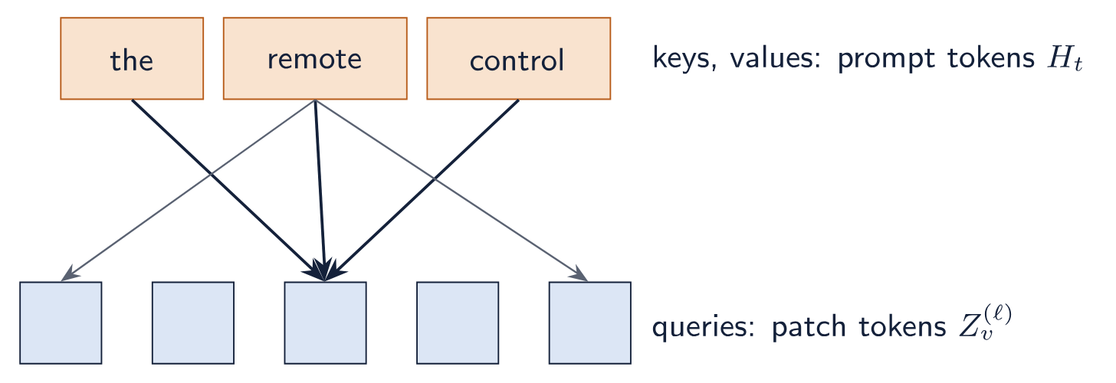
Self-attention and cross-attention
Self-attention
Cross-attention
Already in every ViT block.
Added by SteerViT: the image asks, the text answers.
Formula: scaled dot-product attention (Vaswani et al., 2017). Diagrams drawn for this talk
4

Slide 5
The pretrained encoders in this paper
Encoder | Pretraining | Text used in training | Image encoder sees a prompt
DINOv2 | self-supervised, images only | No | No
MAE | masked image reconstruction | No | No
CLIP | contrastive image–text matching | Yes, as supervision | No
SigLIP | image–text matching, sigmoid loss | Yes, as supervision | No
Trained with text is different from steerable by text. In all four, the image is encoded without the prompt.
Background summary; encoders as cited in Ruthardt, Gaur et al. (2026)
5

Slide 6
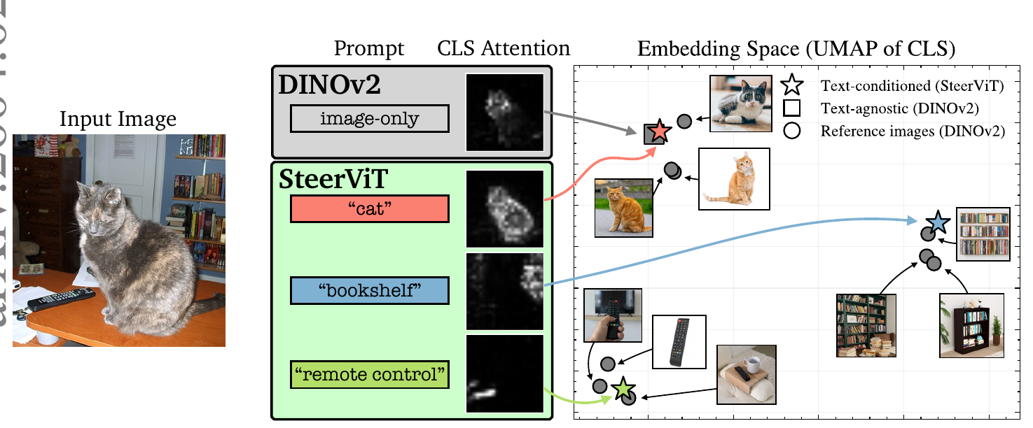
The saliency problem in pretrained ViTs
WHAT HAPPENS
WHAT IS MISSING
STEERVIT
DINOv2 encodes the most prominent object: this photo becomes a “cat” feature.
The bookshelf and remote are barely represented, and no input lets you ask for them.
A prompt moves the attention map and the global feature to the named object.
Figure: Ruthardt, Gaur et al. (2026), Fig. 1
6

Slide 7
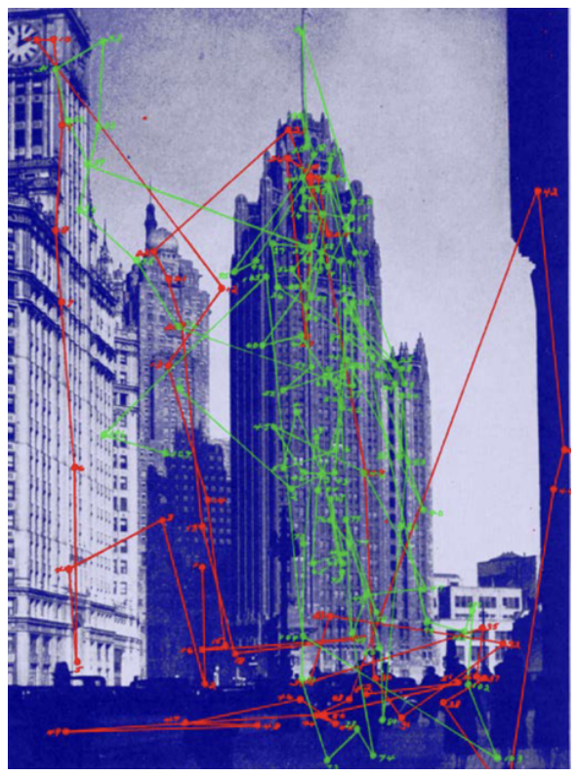
Motivation from human vision
Buswell’s gaze study (1935)
Observers looked at the same photograph of city towers.
Red: no instruction. Eye movements spread across the scene.
Green: asked to find a person looking out of a window in the tower. Fixations concentrate on the tower.
Why it is in the paper
A verbal task changes how people parse an image while they look. Most models receive text only after the image is encoded. SteerViT lets the prompt act during encoding.
An analogy that motivates the design, not evidence for it.
Figure: Ruthardt, Gaur et al. (2026), Fig. 11, adapted there from Buswell (1935)
7

Slide 8
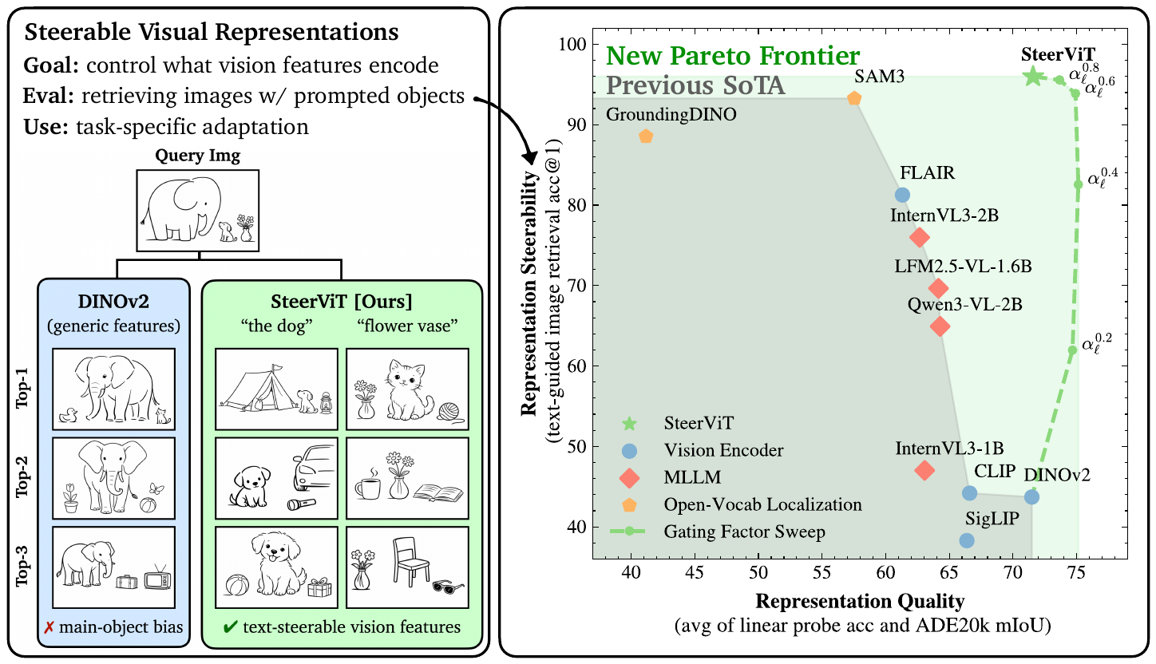
Two requirements for a steerable representation
Desideratum 1
Steerability
Features follow the prompt: what is encoded and how the space is organized. Left panel: retrieval follows “the dog” or “flower vase”.
Desideratum 2
Representation quality
Steered features still serve ordinary vision tasks. Right panel: the horizontal axis.
Figure: Ruthardt, Gaur et al. (2026), Fig. 2
8

Slide 9
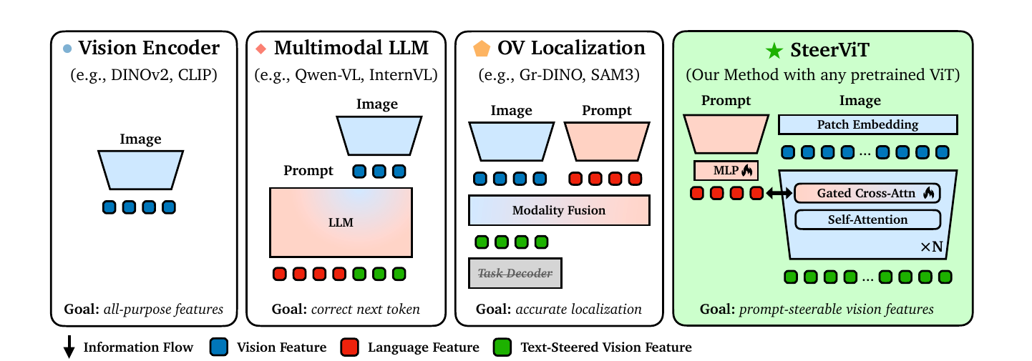
Four families of visual encoding
ASK OF EACH FAMILY
FIRST THREE
STEERVIT
At which point could a text prompt change the visual features?
The image is fully encoded before any text is involved (late fusion).
The prompt enters the ViT blocks themselves (early fusion).
Figure: Ruthardt, Gaur et al. (2026), Fig. 3
9

Slide 10
The families against the two requirements
Method family | Steerable | Feature quality | Fusion | Trainable params
Unimodal ViT (DINOv2) | No | Yes | none | 0
Cross-modal (CLIP) | No | Yes | late | ~200M
OV localization (SAM3) | Yes | No | late | ~200M–1B
Multimodal LLM (Qwen3-VL) | Partial | Partial | late, in the LLM | ≥1B
SteerViT | Yes | Yes | early, in the ViT | 21M
With late fusion the image is encoded first, so text can only act on fixed visual outputs.
Table: Ruthardt, Gaur et al. (2026), Table 1
10

Slide 11
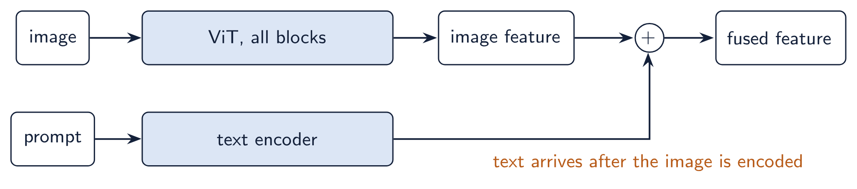
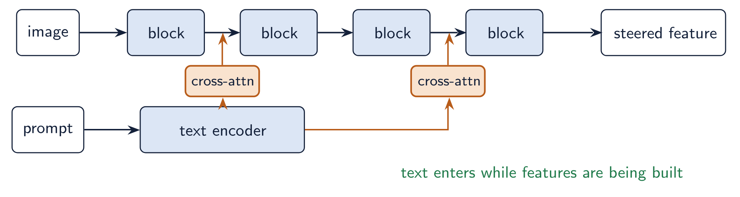
Early fusion and late fusion
LATE FUSION
Late
CLIP or SigLIP with text added; FLAIR’s pooling; MLLMs fusing inside the LLM.
If the encoder discarded the small object, text cannot bring it back.
Early
EARLY FUSION
Text changes which patches matter while features are still being built. Later layers spread that change.
The SteerViT choice.
Diagrams drawn for this talk
11

Slide 12
Closest related work
Work | What it does | How SteerViT differs
FLAIR | text-conditioned attention pooling on frozen SigLIP | late fusion; less steerable, weaker on vision benchmarks
TIE | injects query tokens into the image encoder to cut visual tokens for MLLMs | targets document understanding
ELIP | prepends text in the ViT | targets text-to-image retrieval re-ranking
TEVI | edits CLIP’s final image features with caption-conditional SAE masking | operates on final features only
Flamingo | gated cross-attention so language attends to vision | SteerViT inverts the direction
The authors’ position: prior text-conditioned features serve one pipeline; SteerViT aims at a general-purpose steerable representation.
Steerable Visual Representations · Ruthardt, Gaur et al., 2026
12

Slide 13
Condition vision on language, instead of language on vision.
The core idea
Inject the text prompt into the layers of a frozen ViT through lightweight cross-attention, so the prompt shapes the visual encoding as it happens.

Slide 14
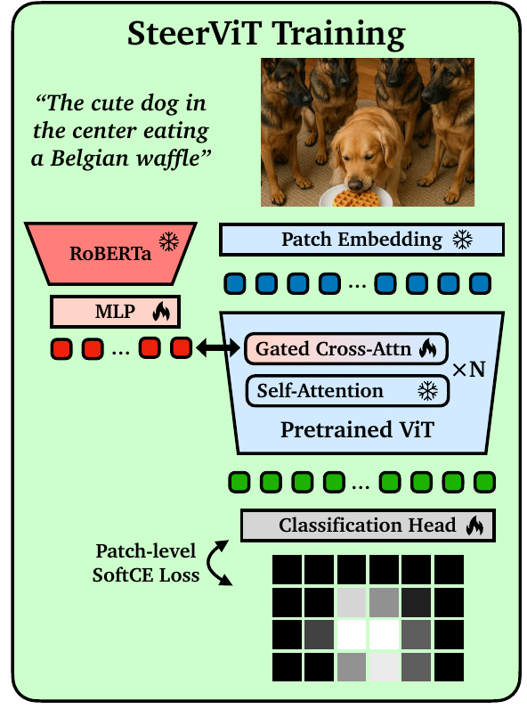
Architecture: four components, two trained
A · FROZEN
Visual encoder. Any pretrained ViT; DINOv2 ViT-B/14 by default.
B · FROZEN
Text encoder. RoBERTa-Large, one embedding per prompt token.
C · TRAINED
Multimodal adapter. A two-layer MLP maps text tokens into ViT space.
D · TRAINED
Gated cross-attention. Patches query the text tokens, in every other block.
In the figure: snowflake = frozen, flame = trained.
Figure: Ruthardt, Gaur et al. (2026), Fig. 4
14

Slide 15
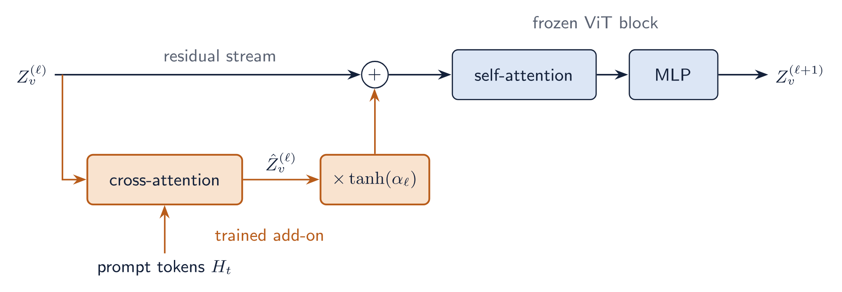
Component A: the frozen visual encoder
FROZEN (BLUE)
TRAINED (ORANGE)
GATES CLOSED
Every original ViT weight stays fixed for the whole of training.
All new capacity sits in the branch that is added into the residual stream.
The model is exactly the original encoder, so its feature quality is the starting point.
Diagram drawn for this talk, after Ruthardt, Gaur et al. (2026), Sec. 3
15

Slide 16
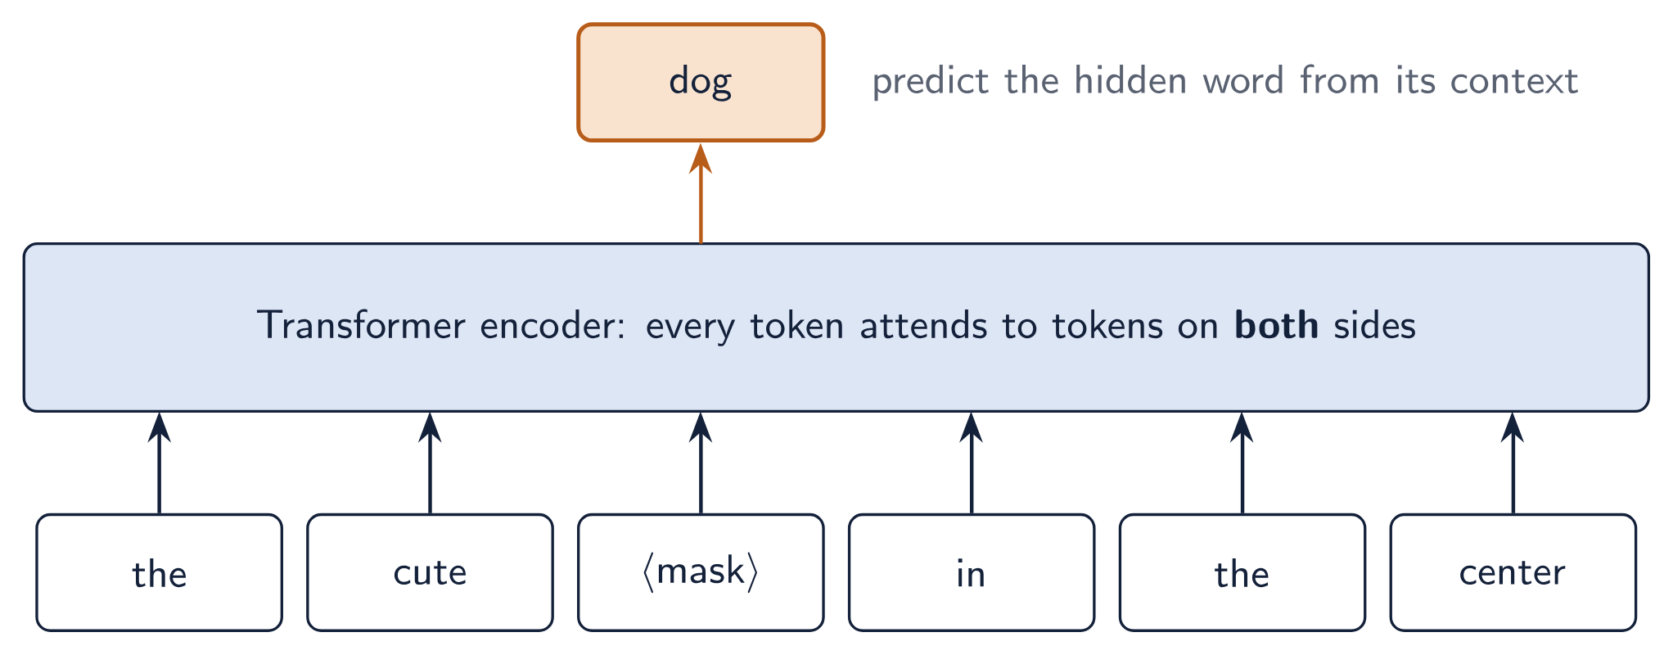
The text encoder: what RoBERTa is
ENCODER-ONLY TRANSFORMER
MASKED LANGUAGE MODELLING
ROBERTA = BERT, TRAINED BETTER
The same building blocks as a ViT, self-attention plus MLP, applied to word tokens. It outputs vectors; it does not generate text.
Pretrained on text alone: hide some words and predict them from the context on both sides.
Same architecture as BERT, with longer training on more text, dynamic masking and no next-sentence task.
Diagram drawn for this talk. RoBERTa: Liu et al. (2019); BERT: Devlin et al. (2019)
16

Slide 17
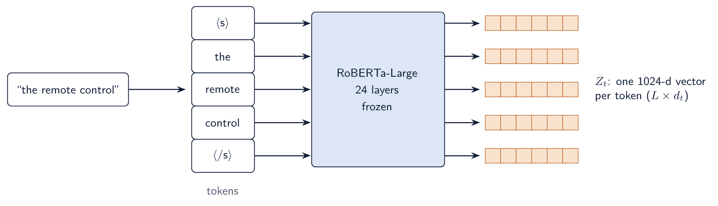
From a prompt to token embeddings
TOKENIZER
CONTEXTUAL VECTORS
ROBERTA-LARGE
The prompt is split into sub-word tokens with start and end markers. Rare words may split into several pieces.
Each output depends on the whole prompt: “black” in “the black sheep” already reflects what it describes.
24 layers, 1024-d vectors, about 355M parameters. SteerViT keeps every token vector, not one sentence vector.
Diagram drawn for this talk. RoBERTa: Liu et al. (2019); BERT: Devlin et al. (2019)
17

Slide 18
What RoBERTa brings and what it lacks
BRINGS
LACKS
Token-level language understanding: attributes, relations, longer descriptions. Frozen, so none of it is lost in training.
It has never seen an image. Its vectors mean nothing to a ViT until the adapter and cross-attention learn the mapping.
Text encoder (ViT-B backbone) | Parameters | FG-CLS | ADE20k | CORE | PODS
RoBERTa-Base | 125M | 87.9 | 53.6 | 95.7 | 57.4
RoBERTa-Large (default) | 355M | 87.7 | 55.4 | 96.0 | 58.1
The smaller text encoder mostly costs dense-task quality. The paper does not test other text encoders, such as CLIP’s.
Table: Ruthardt, Gaur et al. (2026), Table 10 and Sec. C.3
18

Slide 19
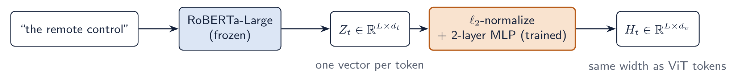
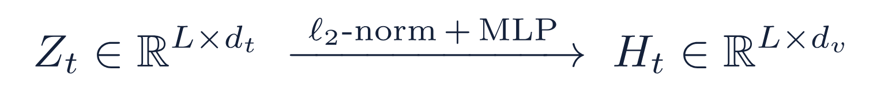
Components B and C: text encoder and adapter
B · FROZEN
C · TRAINED
RoBERTa-Large gives one vector per token, so cross-attention can pick out single words. L varies with the prompt.
The adapter turns language vectors into vectors of the ViT’s width, ready to be read by the patches.
Diagram drawn for this talk, after Ruthardt, Gaur et al. (2026), Sec. 3
19

Slide 20
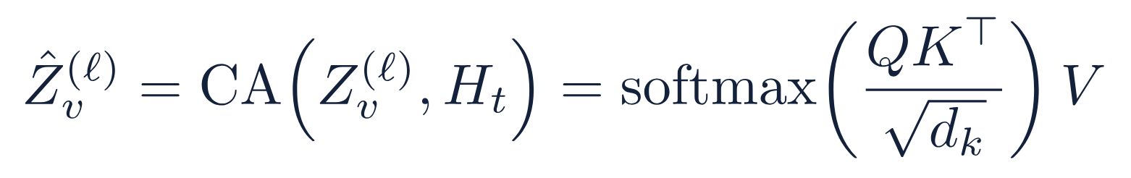
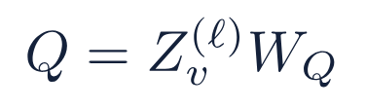


Component D: cross-attention inside the ViT
queries: patch tokens at layer ℓ
keys: adapted prompt tokens
values: adapted prompt tokens
Each patch scores every prompt token and receives its own blend of them.
Formula: Ruthardt, Gaur et al. (2026), Eq. 1. Diagram drawn for this talk
20

Slide 21
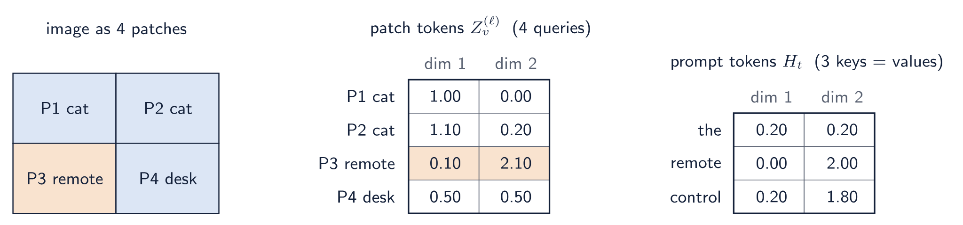
Worked example: the inputs
SETUP
SIMPLIFICATION
QUESTION
An image with 4 patches and the 3-token prompt “the remote control”. Every token is a toy vector of 2 numbers.
The three projection matrices are taken as the identity: queries are the patch tokens, keys and values are the prompt tokens.
How does cross-attention compute a new representation for each of the 4 patch tokens?
Worked example drawn for this talk. Toy numbers; real tokens are 768-dimensional with learned projections
21

Slide 22
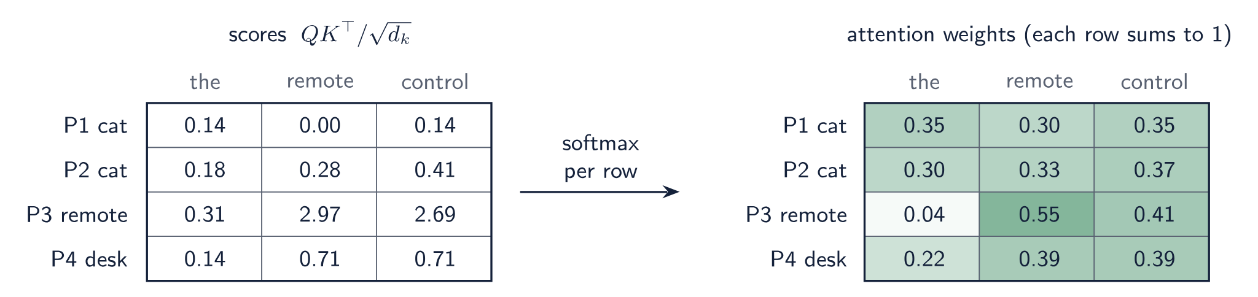
Worked example: scores, then attention weights
STEP 1 · SCORES
STEP 2 · SOFTMAX
READING THE ROWS
Dot product of each patch token with each prompt token, divided by √2. P3 with “remote”: (0.1×0 + 2.1×2) / √2 = 2.97.
Each row becomes weights that sum to 1. The grid is 4×3: one row per patch, one column per prompt token.
The remote patch puts 96% of its weight on “remote” and “control”. The cat patches spread theirs almost evenly.
Worked example drawn for this talk. Toy numbers; real tokens are 768-dimensional with learned projections
22

Slide 23
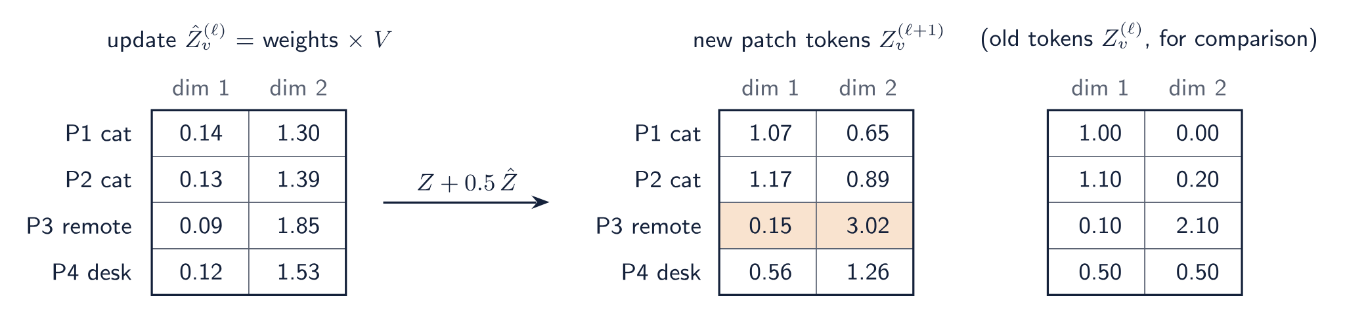
Worked example: the new patch tokens
STEP 3 · BLEND
STEP 4 · GATE AND ADD
RESULT
Each update is that patch’s weighted mix of the prompt values. P3: 0.04×(0.2, 0.2) + 0.55×(0, 2) + 0.41×(0.2, 1.8) = (0.09, 1.85).
With tanh(α) = 0.5, new token = old token + 0.5 × update. P3: (0.1, 2.1) + 0.5×(0.09, 1.85) ≈ (0.15, 3.02).
Four new patch tokens of the same shape, each shifted by its own reading of the prompt. P3 moves the most.
Worked example drawn for this talk. Toy numbers; real tokens are 768-dimensional with learned projections
23

Slide 24
Relation to Flamingo’s gated cross-attention
 | Flamingo | SteerViT
Host model | frozen language model | frozen vision transformer
Who attends to whom | language tokens attend to vision features | vision patch tokens attend to language tokens
Output space | language | vision
Gate | tanh of a zero-initialized scalar | the same
Gated feed-forward after cross-attention | yes | removed
Dropping the feed-forward network keeps the add-on at 21.2M parameters instead of 35.4M, and the ablation shows no loss.
Steerable Visual Representations · Ruthardt, Gaur et al., 2026
24

Slide 25
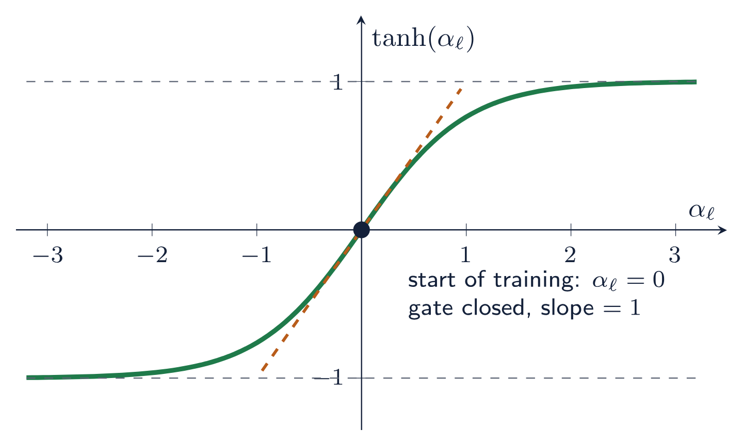
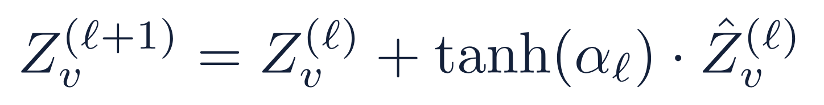
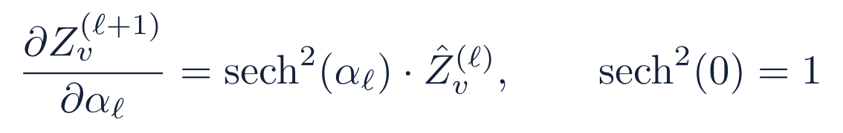
The tanh gate
Starts closed. α is initialized to 0 and tanh(0) = 0, so the model equals the frozen ViT.
Still trainable. The slope of tanh at 0 is 1, so the gate gets a full gradient from step one.
Bounded. One scalar per layer, kept between −1 and 1.
Without the gate: FG-CLS −4.2, CORE −1.4, PODS −11.0.
Formulas: Ruthardt, Gaur et al. (2026), Eq. 2 and Sec. 3.1. Plot drawn for this talk
25

Slide 26
One forward pass, step by step
The prompt is tokenized and encoded by frozen RoBERTa-Large
Each token embedding is normalized and projected by the MLP adapter into the ViT’s width
The image is patchified and embedded by the frozen ViT
In every other block, gated cross-attention lets the patches read the prompt tokens and adds the result to the residual stream
The frozen self-attention and MLP layers that follow operate on the modified tokens
Out come a prompt-conditioned [CLS] feature and prompt-conditioned patch features
The text encoder runs once per prompt; the same prompt tokens are reused at every cross-attention layer.
Figure: Ruthardt, Gaur et al. (2026), Fig. 4
26

Slide 27
Placement and parameter budget
6
21.2M
465M
cross-attention layers for the 12 blocks of ViT-B: one in every other block
trainable parameters added (MLP adapter and cross-attention)
total parameters at inference, including the frozen ViT (86M) and the frozen text encoder
For comparison, the paper lists about 200M trainable multimodal parameters for CLIP-style models and at least 1B for multimodal LLMs.
Steerable Visual Representations · Ruthardt, Gaur et al., 2026
27

Slide 28
What the model outputs and how it is used
Output | Used for | Where in the paper
[CLS] token | global retrieval, linear-probe classification, instance discrimination | CORE, GeneCIS, FG-CLS, PODS
Patch tokens | dense prediction by nearest-neighbour retrieval | ADE20k
[CLS]-to-patch attention, final block | visualizing and scoring where the model looks | MOSAIC
Linear head on patch tokens | patch-level mask for the prompt (the training head) | RefCOCOg, anomaly segmentation
All downstream evaluations keep SteerViT frozen. The prompt is the only thing that changes between tasks.
Steerable Visual Representations · Ruthardt, Gaur et al., 2026
28

Slide 29
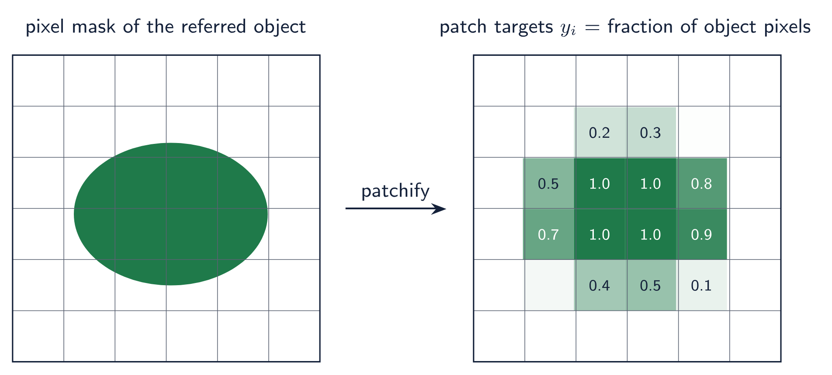
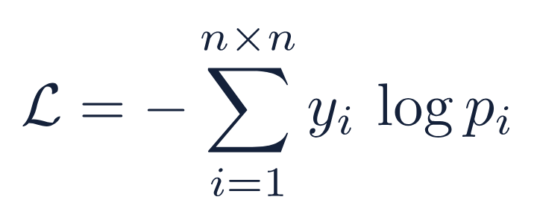
Training objective: referential segmentation
Task. Given an image and a referring expression, predict which patches belong to the referred object.
Prediction. A linear head scores each patch token; a softmax over patches gives pi.
Soft cross-entropy over the n×n patches. No pixel decoder.
Formula: Ruthardt, Gaur et al. (2026), Eq. 3. Schematic drawn for this talk; values illustrative
29

Slide 30
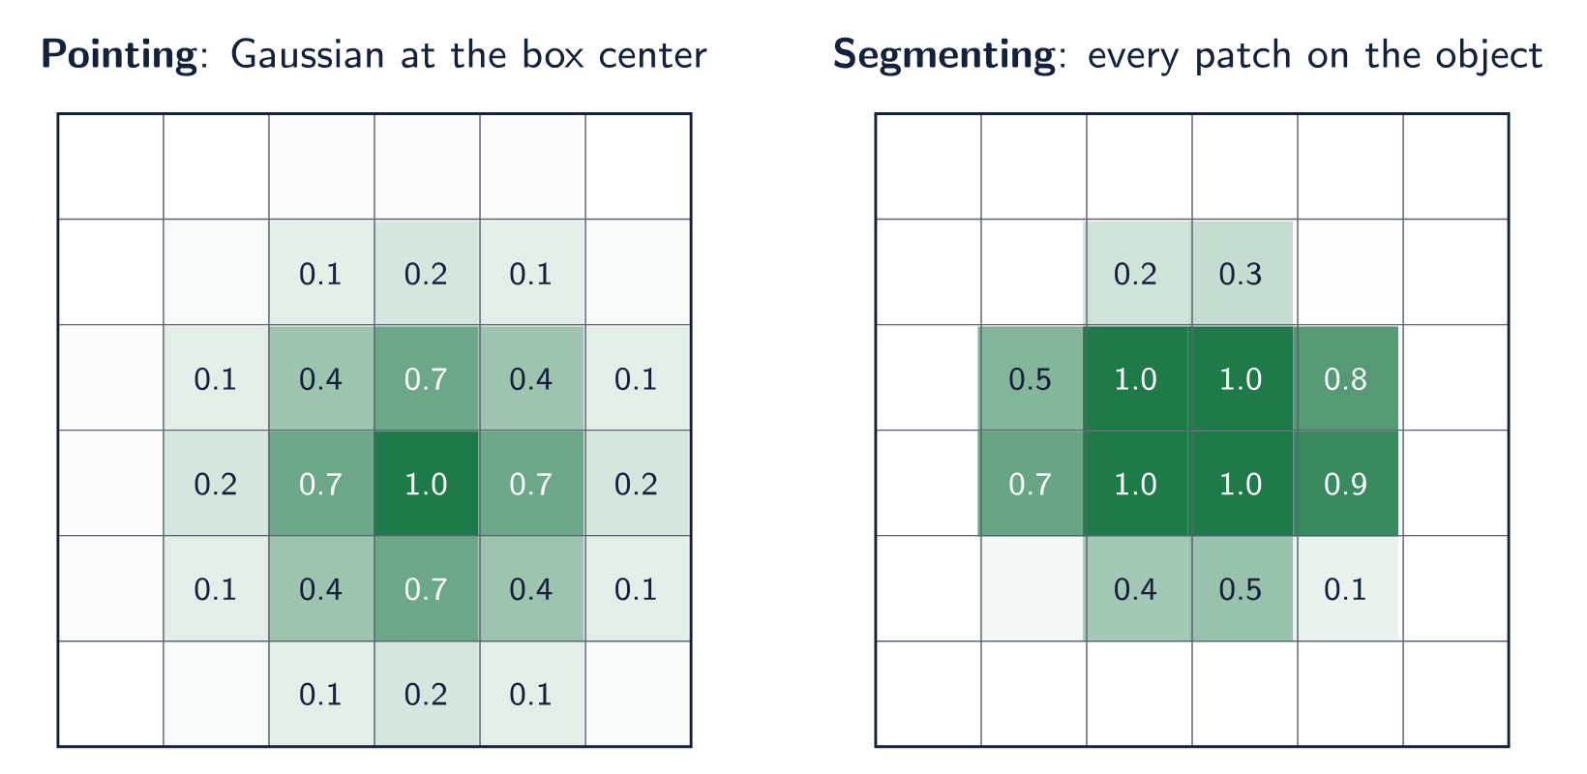
Pointing versus segmenting
Pointing is blind to object shape and size. It teaches where the object is.
Segmenting makes every patch decide whether it shows the object. It also teaches what it looks like.
Training objective | FG-CLS | ADE20k | CORE | PODS
Pointing (Gaussian at the box center, σ = 1.1) | 80.4 | 47.4 | 95.2 | 45.7
Segmentation (patch-level mask) | 87.7 | 55.4 | 96.0 | 58.1
Table: Ruthardt, Gaur et al. (2026), Table 9. Schematic drawn for this talk; values illustrative
30

Slide 31
Training data mixture
Source | Unique images | Referring expressions | What it contributes
RefCOCO / RefCOCO+ / RefCOCOg | 95k (COCO, shared with LVIS) | 137k / 136k / 91k | referring expressions; appearance-only (+); long descriptions (g)
LVIS | same COCO images | 368k | fine-grained and long-tail categories
Visual Genome | 50k | 1,445k | dense region descriptions, wider vocabulary
Mapillary Vistas | 17k | 97k | street-level scenes, synthetic expressions
Total | 162k | 2.28M
Visual Genome boxes are converted to masks with SAM2; Mapillary uses Describe Anything’s synthetic expressions and masks.
Steerable Visual Representations · Ruthardt, Gaur et al., 2026
31

Slide 32
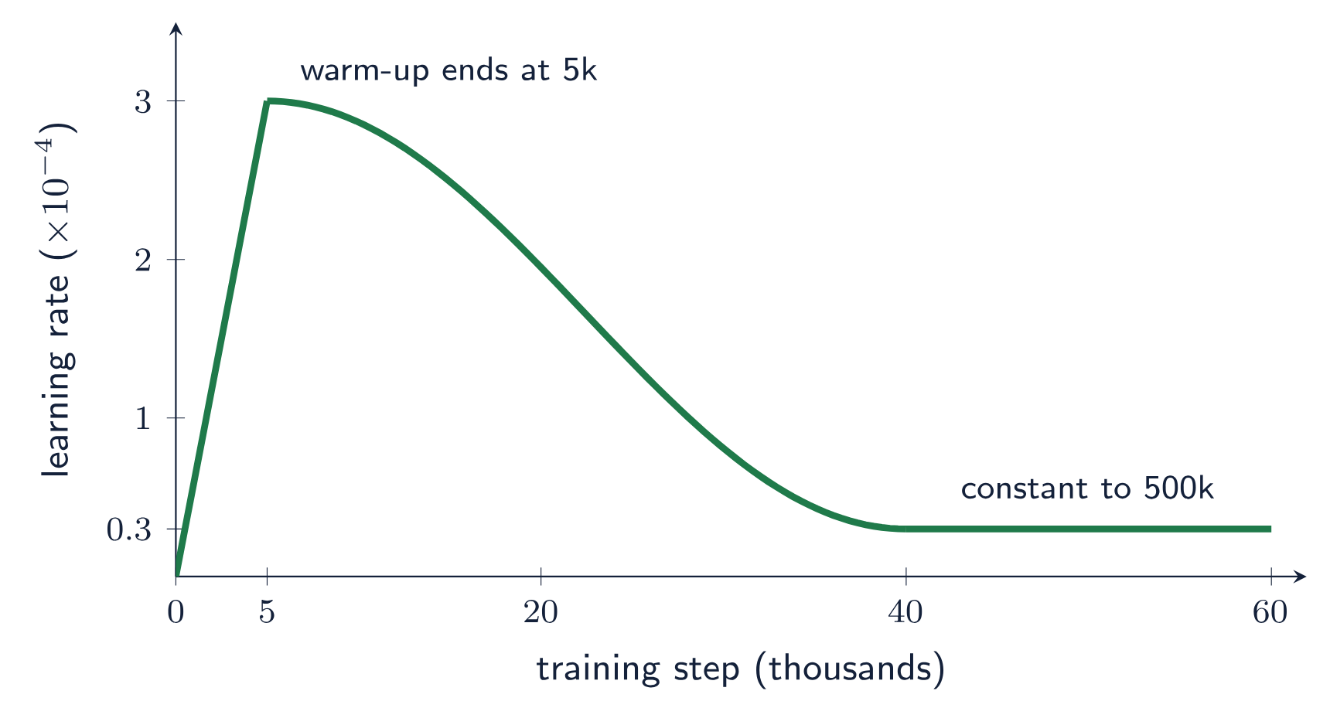
Training recipe
Setting | Value
Resolution | 336×336
Batch size | 12
Iterations | 500k
Optimizer | AdamW
Compute | about 84 H100 GPU-hours
Only the adapter, the cross-attention layers, the gates and the linear head receive gradients.
Schedule plotted from the description in Ruthardt, Gaur et al. (2026), Sec. 4.7
32

Slide 33
What emerges early and what needs time
Metric | Frozen DINOv2 | After 50k iterations | After 450k iterations
CORE (steerability) | 43.7 | 95.3 | not reported (96.0 at 500k)
FG-CLS (quality) | 89.0 | 89.6 | —
PODS (fine-grained language) | 29.6 | 49.9 | 58.1
RefCOCOg (grounding IoU) | — | 63.4 | 70.6
Routing attention to a named object is learned quickly. Using detailed language keeps improving with longer training.
Steerable Visual Representations · Ruthardt, Gaur et al., 2026
33

Slide 34
Evaluation setup and baselines
Family | Models | How text-conditioned features are obtained
Unimodal encoders | DINOv2, MAE | no text; plain features
Cross-modal encoders | CLIP, SigLIP, FLAIR | element-wise addition of text and image embeddings (FLAIR: its own pooling)
Multimodal LLMs | InternVL3, Qwen3-VL, LFM2.5-VL | last-token hidden state after a one-word summary instruction (E5-V style)
Open-vocab localization | SAM3, GroundingDINO | intermediate multimodal encoder features, mean-pooled
SteerViT | DINOv2 ViT-B/14 backbone | [CLS] and patch tokens under the prompt
Where supported, all models process 336×336 images.
Steerable Visual Representations · Ruthardt, Gaur et al., 2026
34

Slide 35
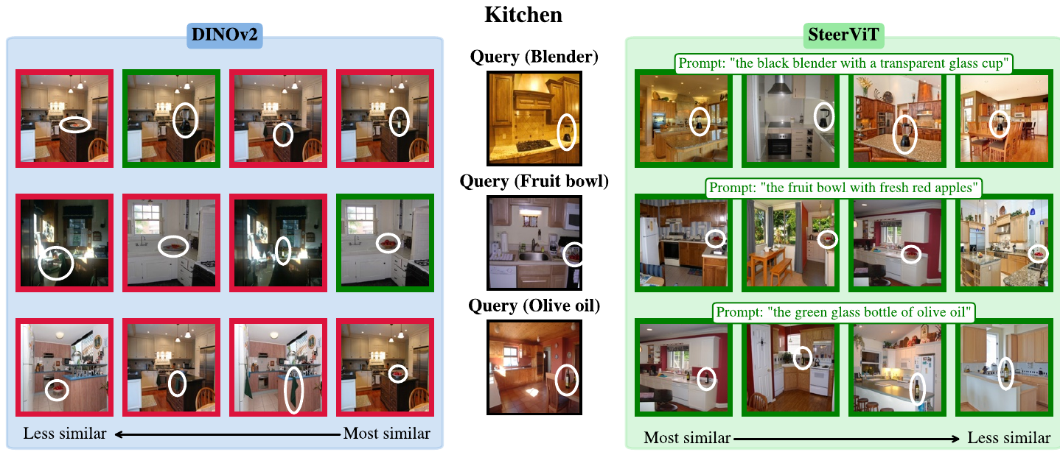
The CORE benchmark: construction
1 · SCENES
2 · INPAINT
3 · RETRIEVE
METRIC
100 images for each of six SUN397 scenes.
Five small objects are painted into each image with FLUX.2 (white circles).
Same object prompt for query and gallery. Is the nearest image one with that object?
Top-1 accuracy over 495 gallery images. Chance is 20%.
Figure: Ruthardt, Gaur et al. (2026), Fig. 12 (kitchen half)
35

Slide 36
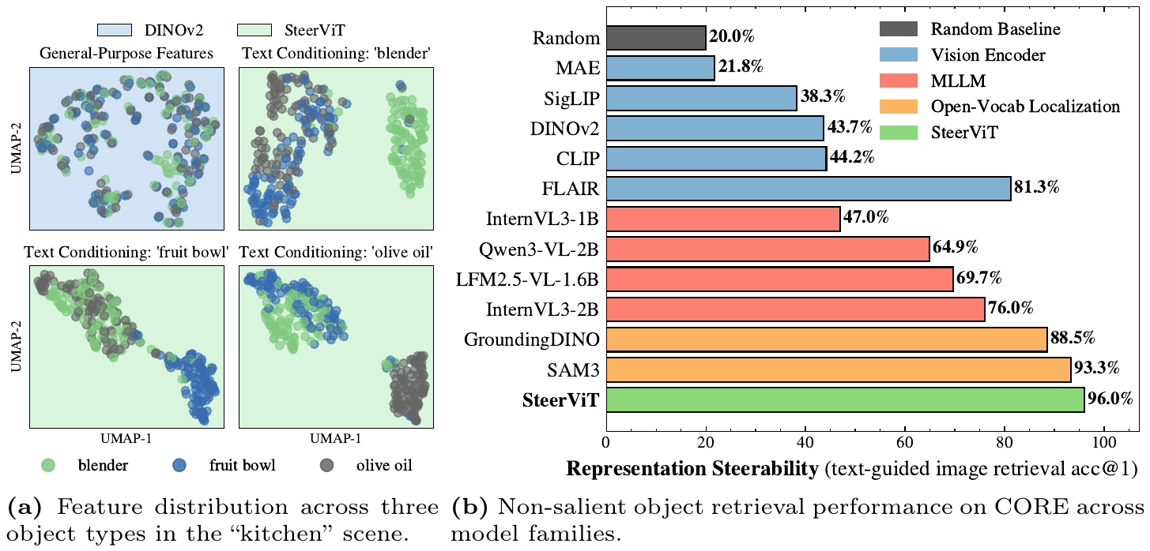
Steerability results on CORE
LEFT
RIGHT
LATE FUSION
DINOv2 features mix the three objects. Each SteerViT prompt pulls its object into a separate cluster.
SteerViT 96.0, against 43.7 for the same DINOv2 without text.
Adding text to CLIP or SigLIP features changes the score by 0.02 points.
Figure: Ruthardt, Gaur et al. (2026), Fig. 5
36

Slide 37
Control: conditioning on the wrong object
Model (kitchen scene) | Correct prompt | Incorrect prompt
CLIP | 37.6 | 37.6
FLAIR | 79.6 | 42.2
InternVL3-2B | 70.2 | 42.2
SAM3 | 95.4 | 27.0
SteerViT | 98.6 | 43.6
Averaged over scenes, a random wrong prompt costs SteerViT 48.3 points and FLAIR 29.4, and leaves CLIP and SigLIP unchanged. The steering is driven by the prompt.
Steerable Visual Representations · Ruthardt, Gaur et al., 2026
37

Slide 38
Real images: GeneCIS focus-object
Method | R@1 | R@2 | R@3
DINOv2 | 9.6 | 19.5 | 28.4
Specialized baseline | 18.7 | 30.3 | 37.4
SteerViT (zero-shot) | 25.4 | 39.1 | 49.9
Task: retrieve the image that matches the reference scene and also contains the queried object. Distractors share the scene without the object, or contain the object in another scene.
This addresses the concern that CORE’s inpainted objects are synthetic.
Steerable Visual Representations · Ruthardt, Gaur et al., 2026
38

Slide 39
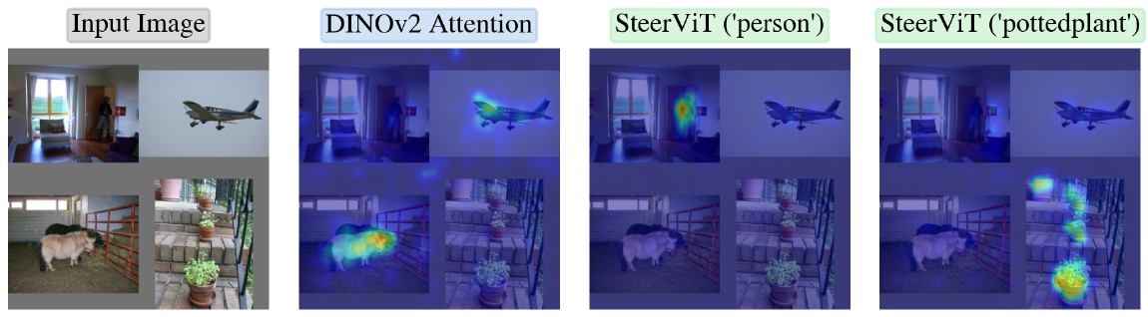
MOSAIC: steering attention
SETUP
RESULT
ALSO SEEN
Four PASCAL-VOC images stitched into a 2×2 mosaic; score the final [CLS]-to-patch attention against the prompted class mask.
PR-AUC rises from 14.3 (DINOv2) to 50.2 (SteerViT).
Covers several instances of a class and follows attributes such as “black sheep”.
Figure: Ruthardt, Gaur et al. (2026), Fig. 6
39

Slide 40
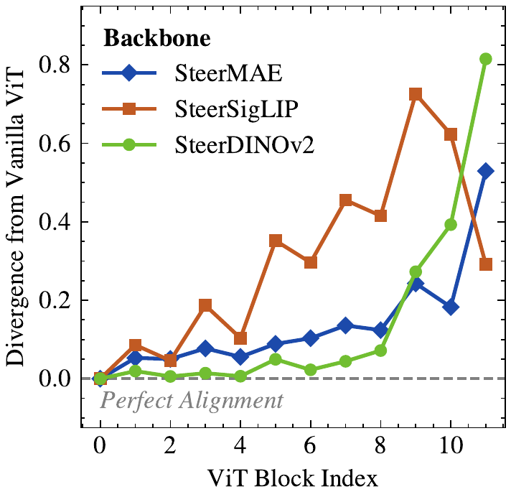
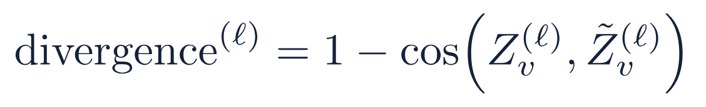
Where in the network the text takes effect
SteerDINOv2 stays close to its base model, then departs sharply in the final blocks.
SteerMAE diverges slowly and gradually across the whole depth.
SteerSigLIP diverges in the middle layers, then moves back toward SigLIP at the end.
Averaged over COCO validation images, prompted with a random object present in the scene.
Figure: Ruthardt, Gaur et al. (2026), Fig. 14
40

Slide 41
Representation quality after steering
98.8%
of DINOv2’s average downstream performance is retained.
Top-left: localizers, steerable with weak features.
Bottom-right: plain encoders, strong features, not steerable.
Top-right: SteerViT. The dashed line is the gate sweep.
Figure: Ruthardt, Gaur et al. (2026), Fig. 2
41

Slide 42
Quality, task by task
Model | Birds | Cars | Dogs | ADE20k | Cityscapes | UCF101 | HMDB51
DINOv2 | 94.7 | 83.8 | 89.1 | 53.7 | 52.8 | 92.3 | 62.3
SteerViT | 91.2 | 77.7 | 94.3 | 55.4 | 53.8 | 89.4 | 60.0
Where it gains
Where it loses
Dogs (+5.2) and both segmentation sets. A prompt naming the object helps dense features.
Birds (−3.5), Cars (−6.1) and action recognition (about −2 to −3). The preservation is good on average, with real per-task variation.
Steerable Visual Representations · Ruthardt, Gaur et al., 2026
42

Slide 43
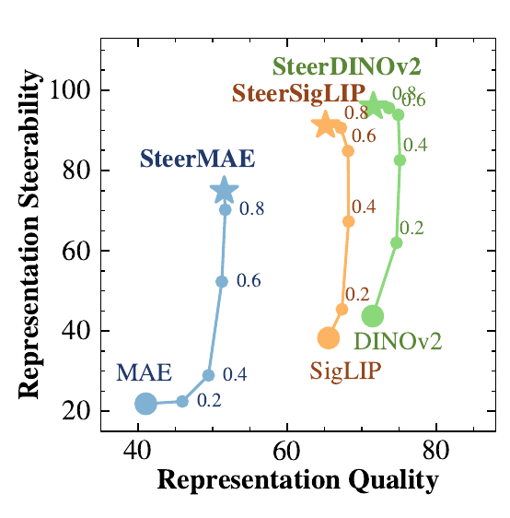
The gate as an inference-time control
ω = 0. The original ViT, unchanged.
ω = 0.6. Best trade-off for DINOv2 and SigLIP: quality slightly above the original, with high steerability.
ω = 1. The fully text-conditioned model as trained.
For MAE, quality rises with ω, from about 40 to about 50: the text pathway adds semantic structure to a weaker backbone.
Figure: Ruthardt, Gaur et al. (2026), Fig. 7. Formula written out from Sec. 4.3
43

Slide 44
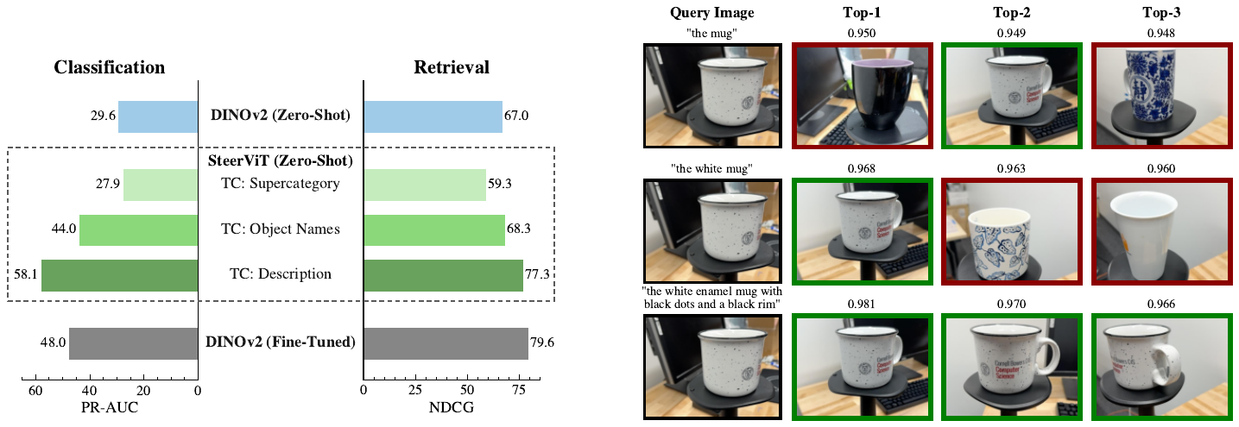
Prompt detail and feature granularity
COARSE PROMPT
DETAILED PROMPT
ONE MODEL
“mug” scores below plain DINOv2 (27.9 vs 29.6 PR-AUC): all mugs look alike.
A full description reaches 58.1 PR-AUC, above per-object fine-tuned DINOv2 (48.0).
The fine-tuned baseline needs 100 separate models; SteerViT changes only the prompt.
Figure: Ruthardt, Gaur et al. (2026), Fig. 8
44

Slide 45
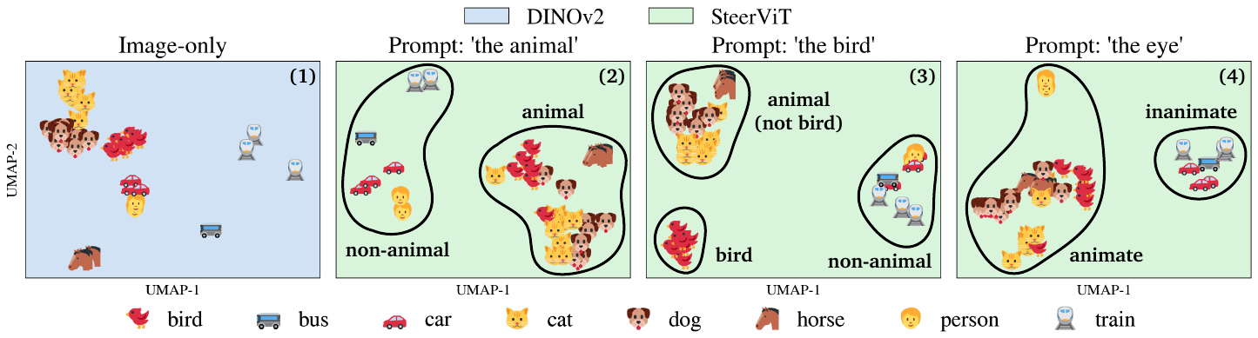
Reorganizing the embedding space with a prompt
(1) IMAGE ONLY
(2) “THE ANIMAL”
(3) “THE BIRD”
(4) “THE EYE”
DINOv2 clusters by object class.
Animals merge; non-animals separate.
Birds pull away; the animal split remains.
Everything with eyes groups, people included.
Figure: Ruthardt, Gaur et al. (2026), Fig. 9
45

Slide 46
Beyond short object names
Negation
Longer expressions
“the vehicle that is a motorcycle” highlights the motorcycle.
On Ref-L4 expressions of 30 or more words, localization accuracy (IoU > 0.5) increases as more words of the description are given to the model.
“the vehicle that is not a motorcycle” highlights the car next to it.
The model uses additional detail instead of being confused by it.
Most evaluation prompts in the paper are short; this is the evidence that richer language is handled too.
Steerable Visual Representations · Ruthardt, Gaur et al., 2026
46

Slide 47
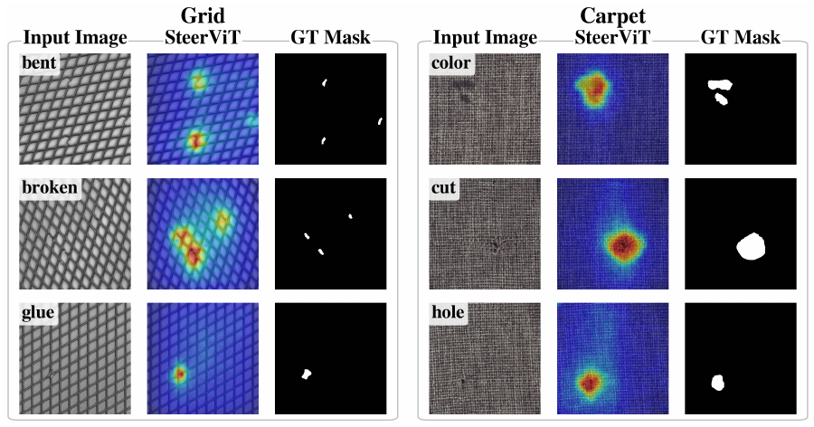
Transfer to industrial anomaly segmentation
Method (MVTec AD) | PRO
CLIPseg | 34.6
MaskCLIP | 40.5
SAM3 | 54.5
WinCLIP (dedicated) | 64.6
DIVAD (dedicated) | 73.3
FADE (dedicated) | 84.5
SteerViT | 82.1
Prompt: “the anomaly in the <object>”. The heat map is the training-time linear head’s output, averaged over ten prompts.
Figure: Ruthardt, Gaur et al. (2026), Fig. 10 and Table 2
47

Slide 48
Anomaly segmentation in full
Method | Dedicated? | MVTec ROC | MVTec PRO | MVTec F1max | VisA ROC | VisA PRO | VisA F1max
MaskCLIP | No | 63.7 | 40.5 | 18.5 | 60.9 | 27.3 | 7.3
CLIPseg | No | 69.0 | 34.6 | 12.5 | 89.5 | 62.4 | 13.9
SAM3 | No | 79.9 | 54.5 | 24.1 | 89.8 | 65.9 | 15.5
WinCLIP | Yes | 85.1 | 64.6 | 31.7 | 79.6 | 59.8 | 14.8
DIVAD | Yes | 88.0 | 73.3 | 35.5 | 93.4 | 78.2 | 24.0
FADE | Yes | 89.6 | 84.5 | 39.8 | 91.5 | 79.3 | 16.7
SteerViT | No | 87.8 | 82.1 | 35.6 | 92.1 | 82.0 | 18.3
Known failure: defects with no visible damage, such as a flipped metal nut, cannot be found without seeing normal examples.
Steerable Visual Representations · Ruthardt, Gaur et al., 2026
48

Slide 49
Ablations of the three design choices
Variant | FG-CLS | ADE20k | CORE | PODS
DINOv2, no text | 89.0 | 53.7 | 43.7 | 29.6
SteerViT (full) | 87.7 | 55.4 | 96.0 | 58.1
Late fusion instead of early | 91.8 | 55.5 | 93.3 | 36.6
No tanh gate | 83.5 | 55.3 | 94.6 | 47.1
Linear projector instead of MLP | 86.7 | 54.5 | 95.2 | 56.4
Early fusion matters most for fine-grained prompts (PODS). With coarse supercategory prompts the early–late gap vanishes (27.9 vs 26.5).
Steerable Visual Representations · Ruthardt, Gaur et al., 2026
49

Slide 50
Generalization across backbones
Backbone | Base (CORE) | Late fusion | SteerViT (early) | Early − late
DINOv2 | 43.7 | 93.3 | 96.0 | +2.7
SigLIP | 38.3 | 75.4 | 91.3 | +15.9
MAE | 21.8 | 41.0 | 74.9 | +33.9
The weaker the backbone’s semantics, the more it benefits from text injected early. DINOv2 gives the strongest steerable features overall.
Steerable Visual Representations · Ruthardt, Gaur et al., 2026
50

Slide 51
Scaling encoders and data
Setting | FG-CLS | ADE20k | CORE | PODS
ViT-S + RoBERTa-Large | 80.0 | 50.8 | 93.6 | 44.1
ViT-B + RoBERTa-Large (default) | 87.7 | 55.4 | 96.0 | 58.1
ViT-L + RoBERTa-Large | 85.8 | 55.5 | 96.8 | 62.8
ViT-B + RoBERTa-Base | 87.9 | 53.6 | 95.7 | 57.4
25% of data, 200k iterations | 88.4 | 53.2 | 95.3 | 55.6
100% of data, 200k iterations | 89.5 | 55.3 | 95.5 | 55.4
Bigger ViTs help steerability and PODS; the method is robust to a quarter of the training images.
Steerable Visual Representations · Ruthardt, Gaur et al., 2026
51

Slide 52
Is the feed-forward network needed?
Backbone | FFN | FG-CLS | ADE20k | CORE | PODS | MVTec PRO
DINOv2 | no | 87.7 | 55.4 | 96.0 | 58.1 | 82.1
DINOv2 | yes | 86.0 | 54.3 | 95.0 | 55.2 | 79.3
SigLIP | no | 82.6 | 47.7 | 91.3 | 27.4 | 74.8
SigLIP | yes | 80.5 | 48.5 | 89.1 | 26.9 | 80.8
MAE | no | 67.3 | 35.9 | 74.9 | 23.8 | 77.3
MAE | yes | 67.8 | 35.5 | 67.7 | 21.8 | 73.9
Adding Flamingo’s gated FFN grows the add-on from 21.2M to 35.4M parameters (+67%) with little or no benefit, so it is omitted.
Steerable Visual Representations · Ruthardt, Gaur et al., 2026
52

Slide 53
Compute efficiency
Model | Parameters | Compute (GFLOPs / image) | Latency (ms / image) | Peak memory (GiB)
DINOv2 | 86M | 98.6 | 6.6 | 1.0
SteerViT | 465M | 133.8 | 9.5 | 3.0
SAM3 | 840M | 556.0 | 35.1 | 5.3
InternVL3-2B | 2.1B | 1591.0 | 12.2 | 6.3
Measured on an A100 over 256 images at 336×336, batch size 16, with 20-word prompts. SteerViT costs about 36% more compute than its backbone and far less than the other steerable options.
Steerable Visual Representations · Ruthardt, Gaur et al., 2026
53

Slide 54
Summary
Takeaways
Costs and caveats
Text injected early, inside a frozen ViT, steers both global and patch features
21M added parameters; base quality is largely kept
Prompts act as zero-shot task adaptation
Per-task quality varies: Cars −6.1, Birds −3.5
Coarse prompts can underperform the unsteered model
CORE is synthetic; baseline feature extraction is the authors’ choice
Steerable Visual Representations · Ruthardt, Gaur et al., 2026
54

Slide 55
Figure and formula sources
Paper figures: J. Ruthardt, M. Gaur, D. Ramanan, M. Tapaswi, Y. M. Asano, “Steerable Visual Representations”, arXiv:2604.02327v2, 2026. The figure number is given at the foot of each slide.
Gaze figure: Fig. 11 of the paper, adapted by its authors from G. T. Buswell, How People Look at Pictures, Univ. of Chicago Press, 1935.
Formulas: Eqs. 1–3 and the gate analysis are from Sec. 3 of the paper. The attention formula is from Vaswani et al., “Attention Is All You Need”, 2017.
Text encoder: Liu et al., “RoBERTa: A Robustly Optimized BERT Pretraining Approach”, 2019; Devlin et al., “BERT”, 2019.
Gated cross-attention: Alayrac et al., “Flamingo: a Visual Language Model for Few-Shot Learning”, NeurIPS 2022.
Diagrams, plots and the worked example marked “drawn for this talk” were made for this presentation; their numbers are illustrative.
All tables and reported numbers are from the paper’s tables and text.
55

