Slide 1
Native Multimodal
Generation
VQGAN, MaskGIT, and Emu3.5
Visual tokens, generation objectives, and multimodal world modeling
Technical lecture · 99 slides
Esser et al., CVPR 2021 / Chang et al., CVPR 2022 / Emu3.5 Team, 2025
01
Notes:
Prerequisites: ViT, causal language modeling, adapter-style VLMs, and RoPE. GPT-style refers to autoregressive token prediction, not a claim about a proprietary GPT Image implementation.
Sources:
Esser, Rombach & Ommer. Taming Transformers for High-Resolution Image Synthesis. CVPR 2021. https://arxiv.org/abs/2012.09841
Chang et al. MaskGIT: Masked Generative Image Transformer. CVPR 2022. https://arxiv.org/abs/2202.04200
Emu3.5 Team (BAAI). Emu3.5: Native Multimodal Models are World Learners. 2025. https://arxiv.org/abs/2510.26583

Slide 2
Questions that organize the lecture
Part 1: How can we learn image codes and predict them autoregressively? VQGAN and its Transformer prior. Patrick Esser, Robin Rombach, and Björn Ommer. “Taming Transformers for High-Resolution Image Synthesis.” CVPR, 2021. Paper
Part 2: Can we generate many image codes at once? MaskGIT and masked refinement. Huiwen Chang, Han Zhang, Lu Jiang, Ce Liu, and William T. Freeman. “MaskGIT: Masked Generative Image Transformer.” CVPR, 2022. Paper
Part 3: How can one model learn text–image tasks? Emu3.5 architecture and training. Speeding up image generation with DiDA (Discrete Diffusion Adaptation). Yufeng Cui et al. (Emu3.5 Team). “Emu3.5: Native Multimodal Models are World Learners.” arXiv preprint arXiv:2510.26583, 2025. Paper
Esser et al., CVPR 2021 / Chang et al., CVPR 2022 / Emu3.5 Team, 2025
07
Notes:
Sources:
Esser, Rombach & Ommer. Taming Transformers for High-Resolution Image Synthesis. CVPR 2021. https://arxiv.org/abs/2012.09841
Chang et al. MaskGIT: Masked Generative Image Transformer. CVPR 2022. https://arxiv.org/abs/2202.04200
Emu3.5 Team (BAAI). Emu3.5: Native Multimodal Models are World Learners. 2025. https://arxiv.org/abs/2510.26583

Slide 3
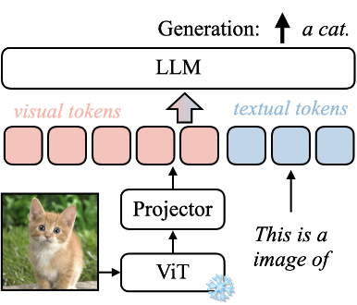
Recall: an adapter VLM generates text
A familiar starting point: a vision encoder supplies image features to a language model.
E encodes image x;
adapter A produces visual features Hᵥ. The model scores the next text token yₜ using those features and earlier text.
This expression predicts text, not pixels. To generate images, we need a vocabulary of image outputs.
Emu3.5 Team, 2025
02
Notes:
A familiar starting point: a vision encoder supplies image features to a language model.
E encodes image x; adapter A produces visual features Hᵥ. The model scores the next text token yₜ using those features and earlier text.
This expression predicts text, not pixels. To generate images, we need a vocabulary of image outputs.
H_V denotes visual features, not visual code indices. This is a conceptual adapter VLM recap.
LaTeX:
H_V=A(E(x)),\qquad p_\theta(y_t\mid H_V,y_{<t})
Sources:
Emu3.5 Team (BAAI). Emu3.5: Native Multimodal Models are World Learners. 2025. https://arxiv.org/abs/2510.26583
Notation and numerical examples are pedagogical unless explicitly identified as reported paper results.

Slide 4
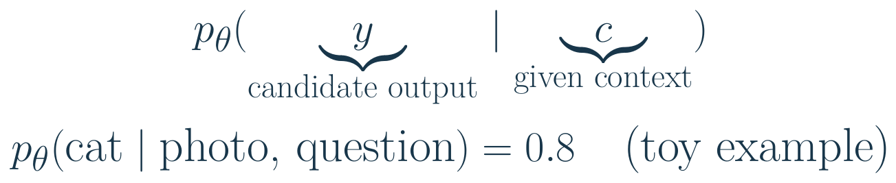
How to read a conditional probability
A probability formula tells us what is being predicted and what information the model may use.
Before the bar: the output being scored. After the bar: the supplied context. θ denotes learned model parameters.
Emu3.5 Team, 2025
06
Notes:
A probability formula tells us what is being predicted and what information the model may use.
Before the bar: the output being scored. After the bar: the supplied context. θ denotes learned model parameters.
During training, the correct output selects the probability to reward. It is not automatically an input merely because it appears in the formula.
A conditional distribution is not by itself a training loss or a sampling algorithm. The toy word probability ignores subword tokenization for simplicity.
LaTeX:
p_\theta(\underbrace{y}_{\text{candidate output}}\mid\underbrace{c}_{\text{given context}})\\p_\theta(\text{cat}\mid\text{photo, question})=0.8\quad\text{(toy example)}
Sources:
Emu3.5 Team (BAAI). Emu3.5: Native Multimodal Models are World Learners. 2025. https://arxiv.org/abs/2510.26583
Notation and numerical examples are pedagogical unless explicitly identified as reported paper results.

Slide 5
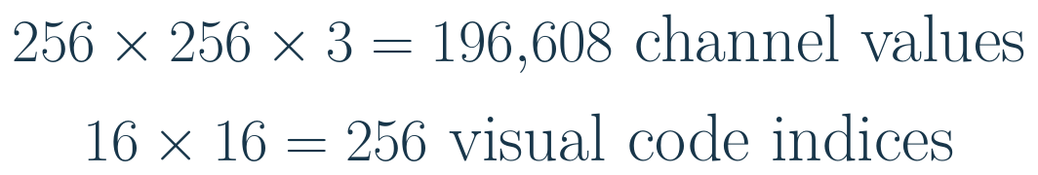
Why not generate every pixel directly?
A Transformer needs a manageable sequence of discrete targets. A learned tokenizer compresses the image first.
Top: the RGB values in one image. Bottom: the locations in a compressed code grid, with one code index per location.
These are different kinds of quantities, not equal-sized symbols. Compression shortens the sequence but can discard detail.
Esser et al., CVPR 2021
03
Notes:
A Transformer needs a manageable sequence of discrete targets. A learned tokenizer compresses the image first.
Top: the RGB values in one image. Bottom: the locations in a compressed code grid, with one code index per location.
These are different kinds of quantities, not equal-sized symbols. Compression shortens the sequence but can discard detail.
LaTeX:
256\times256\times3=196{,}608\ \text{channel values}\\16\times16=256\ \text{visual code indices}
Sources:
Esser, Rombach & Ommer. Taming Transformers for High-Resolution Image Synthesis. CVPR 2021. https://arxiv.org/abs/2012.09841
Notation and numerical examples are pedagogical unless explicitly identified as reported paper results.

Slide 6
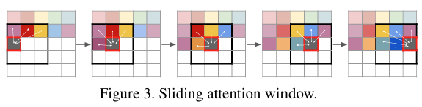
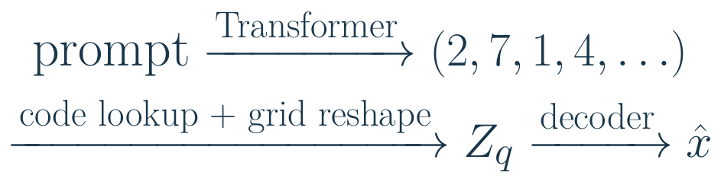
Image generation as next-token prediction
Given “a cat on a chair,” generate image-code indices just as a language model generates word pieces.
The numbers label entries in a learned visual codebook; code 7 is a category, not a brightness value. The Transformer predicts the code sequence. A separate decoder turns the completed grid into pixels.
Esser et al., CVPR 2021 / Emu3.5 Team, 2025
04
Notes:
Given “a cat on a chair,” generate image-code indices just as a language model generates word pieces.
The numbers label entries in a learned visual codebook; code 7 is a category, not a brightness value.
The Transformer predicts the code sequence. A separate decoder turns the completed grid into pixels.
Invented codes illustrate the interface, not actual codes for the prompt. This previews Emu3.5 rather than attributing its text interface to VQGAN.
LaTeX:
\text{prompt}\xrightarrow{\text{Transformer}}(2,7,1,4,\ldots)\\\xrightarrow{\text{code lookup + grid reshape}}Z_q\xrightarrow{\text{decoder}}\hat x
Sources:
Esser, Rombach & Ommer. Taming Transformers for High-Resolution Image Synthesis. CVPR 2021. https://arxiv.org/abs/2012.09841
Emu3.5 Team (BAAI). Emu3.5: Native Multimodal Models are World Learners. 2025. https://arxiv.org/abs/2510.26583
Notation and numerical examples are pedagogical unless explicitly identified as reported paper results.

Slide 7
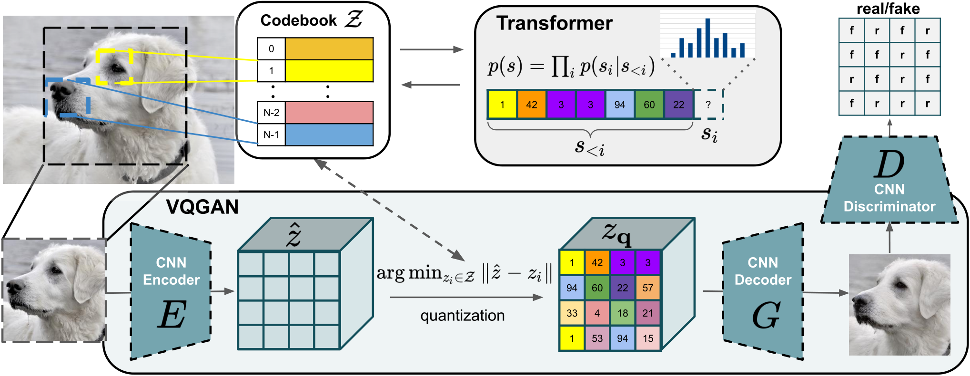
VQGAN and the Transformer prior
Reproduced from Esser et al., CVPR 2021, Fig. 2
Stage 1: learn to compress an image into codes and reconstruct it. This supplies training targets for generation.
Stage 2: freeze that representation and train the Transformer prior, a probability model of code sequences.
Esser et al., CVPR 2021
08
Notes:
Read the figure from the image autoencoder to the sequence model. The discriminator belongs to tokenizer training, not token sampling.
Sources:
Esser, Rombach & Ommer. Taming Transformers for High-Resolution Image Synthesis. CVPR 2021. https://arxiv.org/abs/2012.09841
Reproduced from Esser et al., CVPR 2021, Fig. 2

Slide 8
Text and images as inputs and outputs
An image block contains many visual tokens. The same model can use it as context or generate it.
Task | Given to the model | Model generates
Understanding | Cat photo + “What is here?” | “A cat on a chair.”
Image generation | “A cat on a chair.” | Codes for a new image
Image editing | Cat photo + “Make the chair blue.” | Codes for the edited image
Illustrated story | “Tell an illustrated cat story.” | Text, image, more text, next image
Emu3.5 Team, 2025
05
Notes:
Original task examples. Given context and generated continuation are separate columns. Images in either column use visual token sequences. A decoder renders generated visual codes as pixels. These tasks motivate the Emu3.5 section; the earlier VQGAN and MaskGIT papers provide selected foundations, not every capability in this table.
Sources:
Emu3.5 Team (BAAI). Emu3.5: Native Multimodal Models are World Learners. 2025. https://arxiv.org/abs/2510.26583

Slide 9
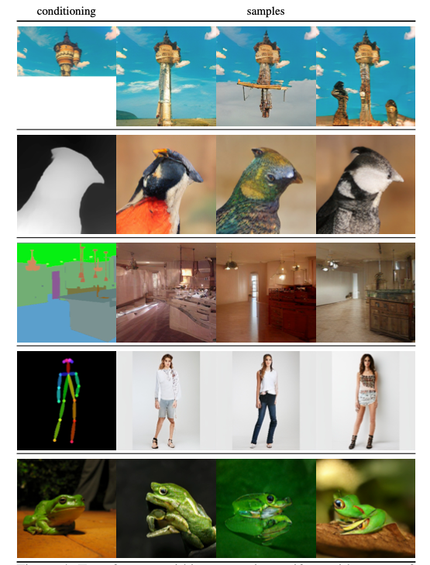
Top row: Completions from unconditional training on ImageNet.
2nd row: Depth-to-Image synthesis.
3rd row: A semantically guided synthesis.
4th row: Pose-guided person generation.
Bottom row: Class-conditional synthesis. (Source: Esser et al.)
Taming Transformers for High-Resolution Image Synthesis

Slide 10
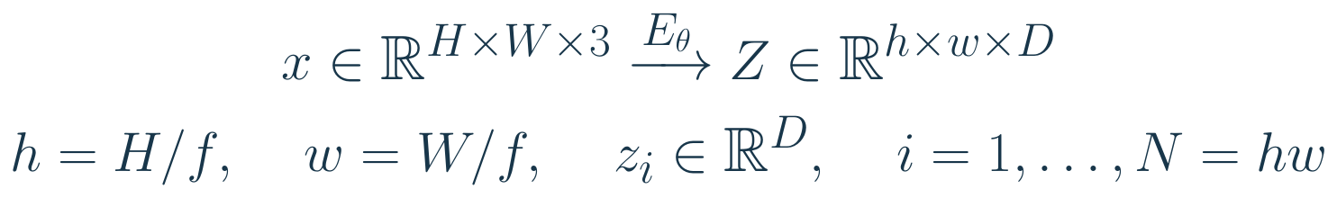
The encoder produces a grid of vectors
First replace the large pixel grid with a smaller grid of continuous feature vectors.
For a 256 × 256 image and f = 16, there are 256 vectors. Index i labels a spatial location; a component of zᵢ is one scalar feature.
These are learned spatial features, not raw pixel patches. The encoder’s receptive fields may overlap.
Esser et al., CVPR 2021
09
Notes:
First replace the large pixel grid with a smaller grid of continuous feature vectors.
For a 256 × 256 image and f = 16, there are 256 vectors. Index i labels a spatial location; a component of zᵢ is one scalar feature.
These are learned spatial features, not raw pixel patches. The encoder’s receptive fields may overlap.
LaTeX:
x\in\mathbb R^{H\times W\times3}\xrightarrow{E_\theta}Z\in\mathbb R^{h\times w\times D}\\h=H/f,\quad w=W/f,\quad z_i\in\mathbb R^D,\quad i=1,\ldots,N=hw
Sources:
Esser, Rombach & Ommer. Taming Transformers for High-Resolution Image Synthesis. CVPR 2021. https://arxiv.org/abs/2012.09841
Notation and numerical examples are pedagogical unless explicitly identified as reported paper results.

Slide 11
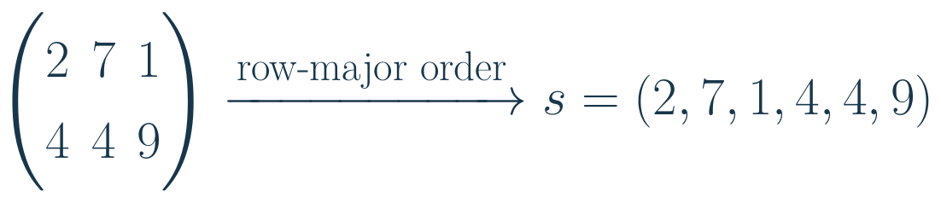
Turn the code grid into a sequence
A GPT-style prior expects a one-dimensional sequence, so we choose an ordering of the image’s code locations.
Read the first row left to right, then the next row. Positional information tells the Transformer which location each index occupies.
The ordering creates a prediction prefix; it does not imply that nearby code numbers represent nearby colors.
Esser et al., CVPR 2021
20
Notes:
A GPT-style prior expects a one-dimensional sequence, so we choose an ordering of the image’s code locations.
Read the first row left to right, then the next row. Positional information tells the Transformer which location each index occupies.
The ordering creates a prediction prefix; it does not imply that nearby code numbers represent nearby colors.
LaTeX:
\begin{pmatrix}2&7&1\\4&4&9\end{pmatrix}\xrightarrow{\text{row-major order}}s=(2,7,1,4,4,9)
Sources:
Esser, Rombach & Ommer. Taming Transformers for High-Resolution Image Synthesis. CVPR 2021. https://arxiv.org/abs/2012.09841
Notation and numerical examples are pedagogical unless explicitly identified as reported paper results.

Slide 12
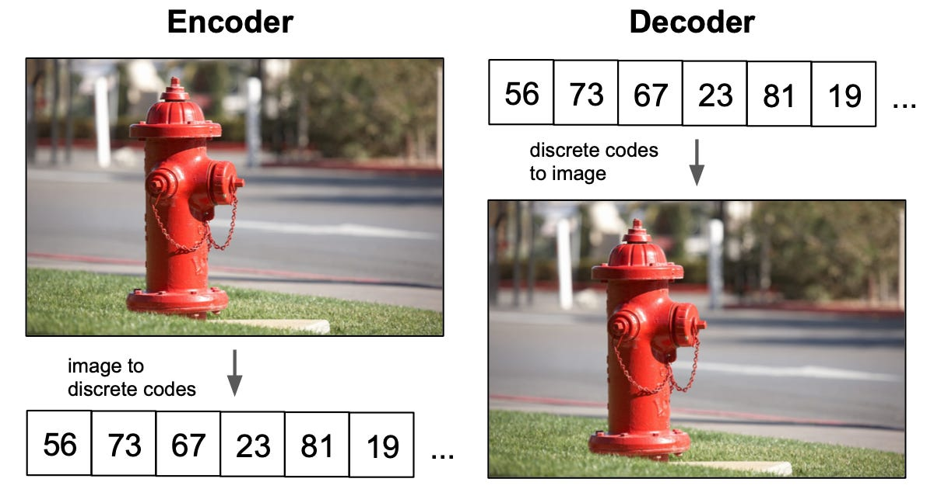

Slide 13
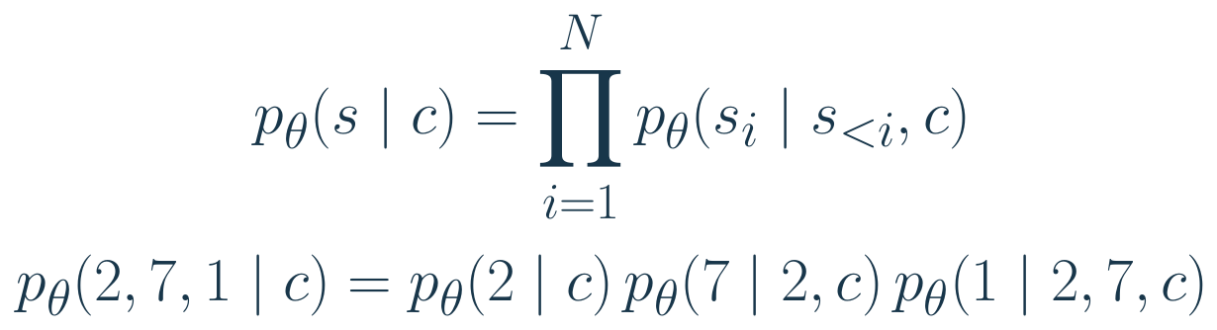
Why a product gives a whole-image probability
The chain rule builds a probability for the entire image-code sequence from next-code probabilities.
sᵢ is the code at sequence position i; s<ᵢ contains earlier codes. c is a supplied condition, such as a class label.
Each prediction can depend on the existing image prefix. The formula does not assume that image locations are independent.
Esser et al., CVPR 2021
21
Notes:
The chain rule builds a probability for the entire image-code sequence from next-code probabilities.
sᵢ is the code at sequence position i; s<ᵢ contains earlier codes. c is a supplied condition, such as a class label.
Each prediction can depend on the existing image prefix. The formula does not assume that image locations are independent.
LaTeX:
p_\theta(s\mid c)=\prod_{i=1}^{N}p_\theta(s_i\mid s_{<i},c)\\p_\theta(2,7,1\mid c)=p_\theta(2\mid c)\,p_\theta(7\mid2,c)\,p_\theta(1\mid2,7,c)
Sources:
Esser, Rombach & Ommer. Taming Transformers for High-Resolution Image Synthesis. CVPR 2021. https://arxiv.org/abs/2012.09841
Notation and numerical examples are pedagogical unless explicitly identified as reported paper results.

Slide 14
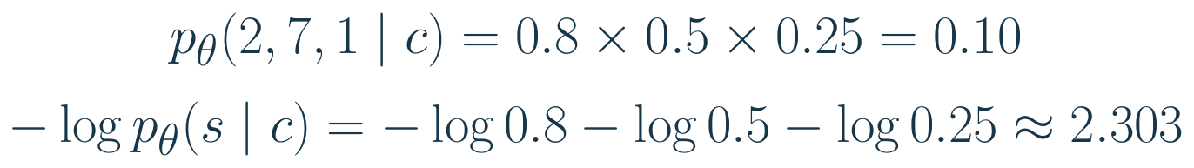
From sequence probability to a trainable loss
Training should increase the probability assigned to the true image-code sequence.
The product becomes a sum after taking the negative logarithm. These are three next-code cross-entropy terms.
Giving more probability to each correct code lowers the loss. The targets are supplied by the trained image tokenizer.
Esser et al., CVPR 2021
22
Notes:
Training should increase the probability assigned to the true image-code sequence.
The product becomes a sum after taking the negative logarithm. These are three next-code cross-entropy terms.
Giving more probability to each correct code lowers the loss. The targets are supplied by the trained image tokenizer.
Toy probabilities; natural logarithms; summed loss. A mean over tokens would divide by three.
LaTeX:
p_\theta(2,7,1\mid c)=0.8\times0.5\times0.25=0.10\\-\log p_\theta(s\mid c)=-\log0.8-\log0.5-\log0.25\approx2.303
Sources:
Esser, Rombach & Ommer. Taming Transformers for High-Resolution Image Synthesis. CVPR 2021. https://arxiv.org/abs/2012.09841
Notation and numerical examples are pedagogical unless explicitly identified as reported paper results.

Slide 15
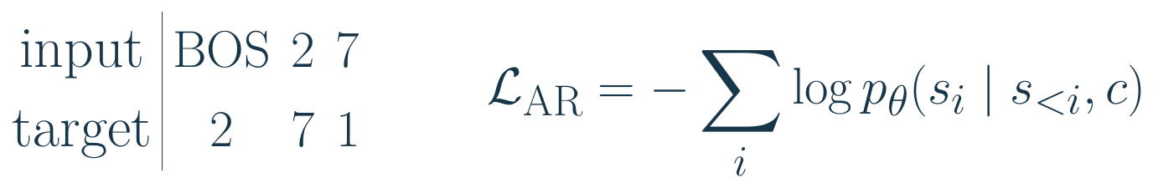
Teacher forcing: inputs are shifted targets
Training can score all next-code positions in one pass because the correct earlier codes are available.
The prediction of 7 can read BOS and 2, but cannot read its own target 7. A causal attention mask enforces this restriction.
Training predicts many positions in parallel using known prefixes. Inference must build the prefix using sampled codes.
Esser et al., CVPR 2021
23
Notes:
Training can score all next-code positions in one pass because the correct earlier codes are available.
The prediction of 7 can read BOS and 2, but cannot read its own target 7. A causal attention mask enforces this restriction.
Training predicts many positions in parallel using known prefixes. Inference must build the prefix using sampled codes.
LaTeX:
\begin{array}{c|ccc}\text{input}&\mathrm{BOS}&2&7\\\text{target}&2&7&1\end{array}\qquad\mathcal L_{\rm AR}=-\sum_i\log p_\theta(s_i\mid s_{<i},c)
Sources:
Esser, Rombach & Ommer. Taming Transformers for High-Resolution Image Synthesis. CVPR 2021. https://arxiv.org/abs/2012.09841
Notation and numerical examples are pedagogical unless explicitly identified as reported paper results.

Slide 16
Sampling: make one categorical choice at a time
At inference, the model has logits for the next code,but must choose an actual index to extend the sequence.
ℓᵢ is the vector of code scores. Softmax gives probabilities; sampling selects a code. Append it and repeat.
Lower positive temperature sharpens the distribution; higher temperature flattens it. After all locations are filled, decode the grid.
Esser et al., CVPR 2021
25
Notes:
At inference, the model has logits for the next code, but must choose an actual index to extend the sequence.
ℓᵢ is the vector of code scores. Softmax gives probabilities; sampling selects a code. Append it and repeat.
Lower positive temperature sharpens the distribution; higher temperature flattens it. After all locations are filled, decode the grid.
T_sample is sampling temperature, not a denoising time or number of refinement rounds.
LaTeX:
\pi_i=\operatorname{softmax}(\ell_i/T_{\rm sample}),\qquad s_i\sim\operatorname{Categorical}(\pi_i)
Sources:
Esser, Rombach & Ommer. Taming Transformers for High-Resolution Image Synthesis. CVPR 2021. https://arxiv.org/abs/2012.09841
Notation and numerical examples are pedagogical unless explicitly identified as reported paper results.

Slide 17
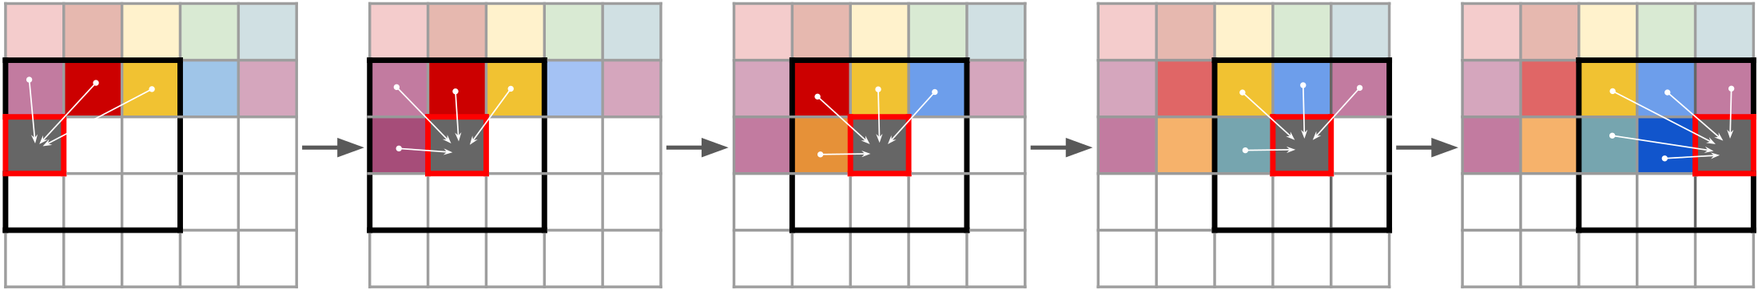
Sliding windows for larger images
Reproduced from Esser et al., CVPR 2021, Fig. 3
When a latent grid exceeds the training context, a sliding window limits the codes used for each prediction.
Red square: next code. Black box: current window. Colored squares: available earlier codes.
Spatial conditions can constrain content, such as road and sky regions in a segmentation map.
Esser et al., CVPR 2021
26
Notes:
Do not present this 2021 system as a modern text-to-image foundation model. Its conditioning experiments establish a more general token-based conditional generation principle.
Sources:
Esser, Rombach & Ommer. Taming Transformers for High-Resolution Image Synthesis. CVPR 2021. https://arxiv.org/abs/2012.09841
Reproduced from Esser et al., CVPR 2021, Fig. 3

Slide 18
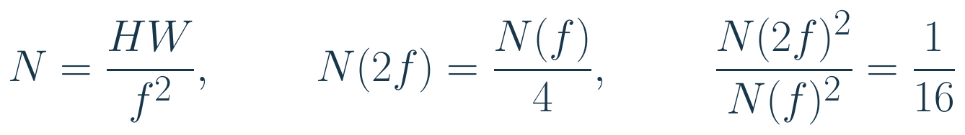
Compression trades detail for shorter sequences
At fixed image size, stronger spatial compression gives fewer image-code targets.
For 512 × 512 pixels, f = 8 gives 4,096 codes; f = 16 gives 1,024. Dense attention has 16 times fewer position pairs.
This is an attention-pair comparison, not a guaranteed 16× runtime speedup. More compression may remove small text or fine detail.
Esser et al., CVPR 2021
27
Notes:
At fixed image size, stronger spatial compression gives fewer image-code targets.
For 512 × 512 pixels, f = 8 gives 4,096 codes; f = 16 gives 1,024. Dense attention has 16 times fewer position pairs.
This is an attention-pair comparison, not a guaranteed 16× runtime speedup. More compression may remove small text or fine detail.
LaTeX:
N=\frac{HW}{f^2},\qquad N(2f)=\frac{N(f)}4,\qquad\frac{N(2f)^2}{N(f)^2}=\frac1{16}
Sources:
Esser, Rombach & Ommer. Taming Transformers for High-Resolution Image Synthesis. CVPR 2021. https://arxiv.org/abs/2012.09841
Notation and numerical examples are pedagogical unless explicitly identified as reported paper results.

Slide 19
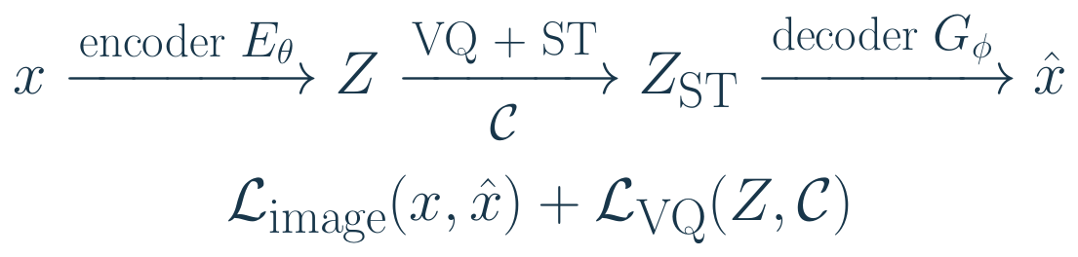
The complete tokenizer-training system
VQGAN — Vector-Quantized Generative Adversarial Network
The quantizer is one component. Its usefulness is judged by the image reconstructed from all selected codes.
Image losses compare x with x̂ and use a discriminator for realism. ST means straight-through: discrete codes forward, surrogate gradients backward.
Codebook and commitment losses connect encoder vectors to selected codes. All spatial locations participate in one training step.
Esser et al., CVPR 2021
10
Notes:
The quantizer is one component. Its usefulness is judged by the image reconstructed from all selected codes.
Image losses compare x with x̂ and use a discriminator for realism. ST means straight-through: discrete codes forward, surrogate gradients backward.
Codebook and commitment losses connect encoder vectors to selected codes. All spatial locations participate in one training step.
Complete pedagogical VQGAN tokenizer flow. The discriminator has its own optimization objective; it is not part of inference. Z_ST equals the selected code grid in the forward pass.
LaTeX:
x\xrightarrow{\text{encoder }E_\theta}Z\xrightarrow[\mathcal C]{\text{VQ + ST}}Z_{\rm ST}\xrightarrow{\text{decoder }G_\phi}\hat x\\\mathcal L_{\rm image}(x,\hat x)+\mathcal L_{\rm VQ}(Z,\mathcal C)
Sources:
Esser, Rombach & Ommer. Taming Transformers for High-Resolution Image Synthesis. CVPR 2021. https://arxiv.org/abs/2012.09841
Notation and numerical examples are pedagogical unless explicitly identified as reported paper results.

Slide 20
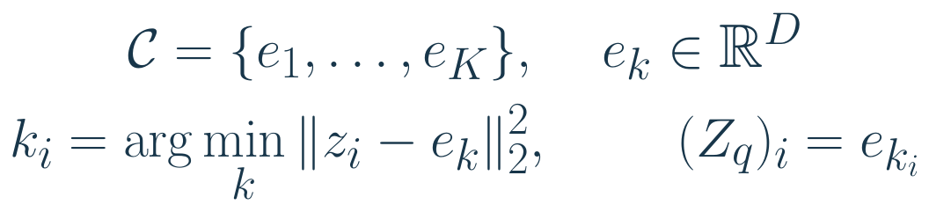
Vector quantization chooses the nearest code
We need to replace each continuous feature vector by one of K reusable visual symbols.
Compare zᵢ with every code vector. The arg min returns the winning index kᵢ; the decoder receives the corresponding vector eₖᵢ.
One codebook is shared across all image locations and all training images. The code sequence is the collection of winning indices.
Esser et al., CVPR 2021
11
Notes:
We need to replace each continuous feature vector by one of K reusable visual symbols.
Compare zᵢ with every code vector. The arg min returns the winning index kᵢ; the decoder receives the corresponding vector eₖᵢ.
One codebook is shared across all image locations and all training images. The code sequence is the collection of winning indices.
LaTeX:
\mathcal C=\{e_1,\ldots,e_K\},\quad e_k\in\mathbb R^D\\k_i=\arg\min_k\|z_i-e_k\|_2^2,\qquad (Z_q)_i=e_{k_i}
Sources:
Esser, Rombach & Ommer. Taming Transformers for High-Resolution Image Synthesis. CVPR 2021. https://arxiv.org/abs/2012.09841
Notation and numerical examples are pedagogical unless explicitly identified as reported paper results.

Slide 21
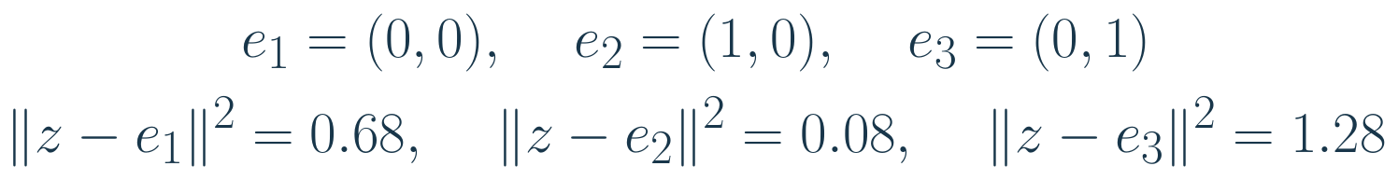
A nearest-code example
Let the encoder output z = (0.8, 0.2). Which of these three code vectors should replace it?
The smallest squared distance is 0.08, so the tokenizer emits index 2. The decoder uses vector (1, 0).
The discrete symbol is “2”; its reconstruction meaning comes from a learned vector, not from the numerical value of the index.
Esser et al., CVPR 2021
12
Notes:
Let the encoder output z = (0.8, 0.2). Which of these three code vectors should replace it?
The smallest squared distance is 0.08, so the tokenizer emits index 2. The decoder uses vector (1, 0).
The discrete symbol is “2”; its reconstruction meaning comes from a learned vector, not from the numerical value of the index.
LaTeX:
e_1=(0,0),\quad e_2=(1,0),\quad e_3=(0,1)\\\|z-e_1\|^2=0.68,\quad\|z-e_2\|^2=0.08,\quad\|z-e_3\|^2=1.28
Sources:
Esser, Rombach & Ommer. Taming Transformers for High-Resolution Image Synthesis. CVPR 2021. https://arxiv.org/abs/2012.09841
Notation and numerical examples are pedagogical unless explicitly identified as reported paper results.

Slide 22
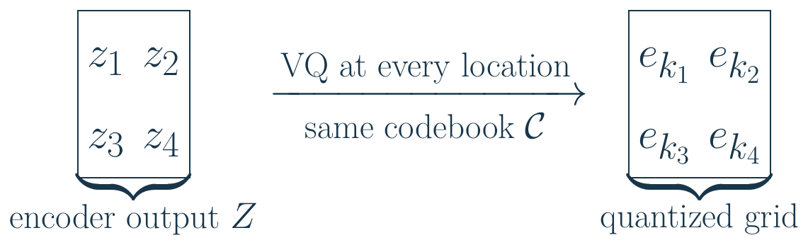
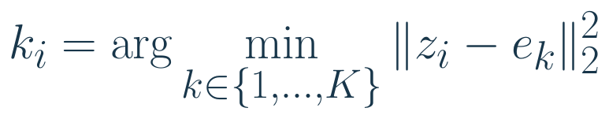
VQ acts at every latent location
A 2 × 2 latent grid illustrates four separate code selections:
i = spatial location d = vector component k = codebook entry
Example: a 256 × 256 image with downsampling factor 16 gives 256 vectors.
These convolutional features have overlapping spatial context.
Esser et al., CVPR 2021
14b
Notes:
14b. We use z_i for an entire D-dimensional latent vector at spatial location i. z_{i,d} is one scalar feature, e_k is one shared codebook vector, and k_i is the code selected at location i. Flattening h by w changes indexing, not feature content. In the Taming architecture, a convolutional encoder produces context-rich vectors with overlapping receptive fields; these are not independent nonoverlapping ViT input patches. The numerical resolution example is illustrative. The 2 by 2 grid in the figure is an illustrative four-location grid. Each entry in that grid is a D-dimensional vector, not a scalar. The 16 by 16 example in the text is separate. The scalar z_{i,d} is one component at one location.
Source: https://arxiv.org/abs/2012.09841

Slide 23
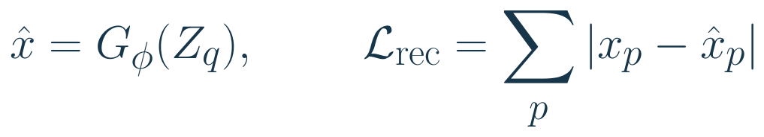
Reconstruction makes image codes useful
A good code grid should retain enough information for the decoder to reconstruct the original image.
Here p labels scalar pixel-channel values. If one target value is 0.7 and the reconstruction is 0.4, its L1 error is 0.3.
The sum evaluates the whole reconstructed image. Decoder gradients depend on how all selected code vectors affect that image.
Esser et al., CVPR 2021
13
Notes:
A good code grid should retain enough information for the decoder to reconstruct the original image.
Here p labels scalar pixel-channel values. If one target value is 0.7 and the reconstruction is 0.4, its L1 error is 0.3.
The sum evaluates the whole reconstructed image. Decoder gradients depend on how all selected code vectors affect that image.
The L1 term is an explanatory reconstruction example, not a claim that this single term is the complete paper objective.
LaTeX:
\hat x=G_\phi(Z_q),\qquad\mathcal L_{\rm rec}=\sum_p|x_p-\hat x_p|
Sources:
Esser, Rombach & Ommer. Taming Transformers for High-Resolution Image Synthesis. CVPR 2021. https://arxiv.org/abs/2012.09841
Notation and numerical examples are pedagogical unless explicitly identified as reported paper results.

Slide 24
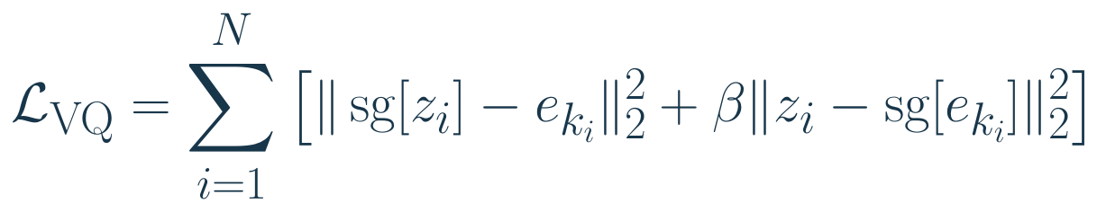
Two losses coordinate encoder and codebook
The selected code should approach the encoder output, while the encoder should stay near an available code.
First term: update selected code vectors. Second term: update the encoder; β controls this commitment penalty.
Stop-gradient sg keeps the forward value but makes its derivative zero. The sum trains all spatial locations, not one patch in isolation.
Esser et al., CVPR 2021
14
Notes:
The selected code should approach the encoder output, while the encoder should stay near an available code.
First term: update selected code vectors. Second term: update the encoder; β controls this commitment penalty.
Stop-gradient sg keeps the forward value but makes its derivative zero. The sum trains all spatial locations, not one patch in isolation.
Standard VQ/VQGAN explanatory objective with gradient-based codebook updates. Do not present this as the exact IBQ objective used by Emu3.5.
LaTeX:
\mathcal L_{\rm VQ}=\sum_{i=1}^{N}\left[\|\operatorname{sg}[z_i]-e_{k_i}\|_2^2+\beta\|z_i-\operatorname{sg}[e_{k_i}]\|_2^2\right]
Sources:
Esser, Rombach & Ommer. Taming Transformers for High-Resolution Image Synthesis. CVPR 2021. https://arxiv.org/abs/2012.09841
Notation and numerical examples are pedagogical unless explicitly identified as reported paper results.

Slide 25
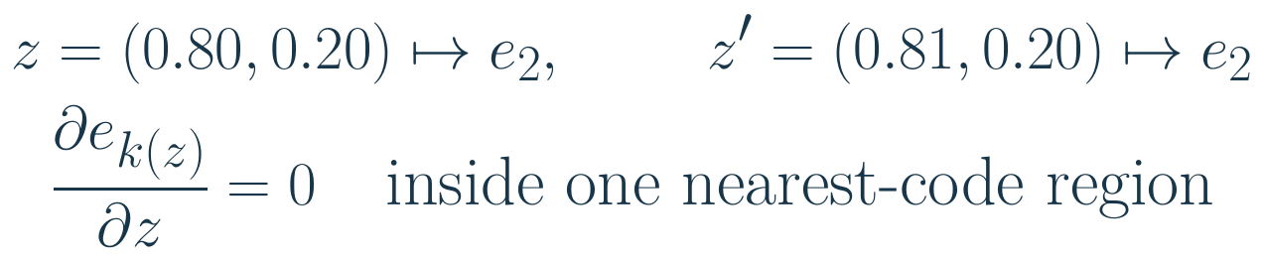
Why the quantizer blocks an ordinary gradient
Reconstruction must teach the encoder, but nearest-code selection is locally unchanged by small input perturbations.
Both vectors choose the same code. At a region boundary the selected vector jumps, so the derivative is not a useful learning signal.
Straight-through estimation deliberately substitutes a backward rule. It is not the true derivative of discrete selection.
Esser et al., CVPR 2021
16
Notes:
Reconstruction must teach the encoder, but nearest-code selection is locally unchanged by small input perturbations.
Both vectors choose the same code. At a region boundary the selected vector jumps, so the derivative is not a useful learning signal.
Straight-through estimation deliberately substitutes a backward rule. It is not the true derivative of discrete selection.
LaTeX:
z=(0.80,0.20)\mapsto e_2,\qquad z'=(0.81,0.20)\mapsto e_2\\\frac{\partial e_{k(z)}}{\partial z}=0\quad\text{inside one nearest-code region}
Sources:
Esser, Rombach & Ommer. Taming Transformers for High-Resolution Image Synthesis. CVPR 2021. https://arxiv.org/abs/2012.09841
Notation and numerical examples are pedagogical unless explicitly identified as reported paper results.

Slide 26
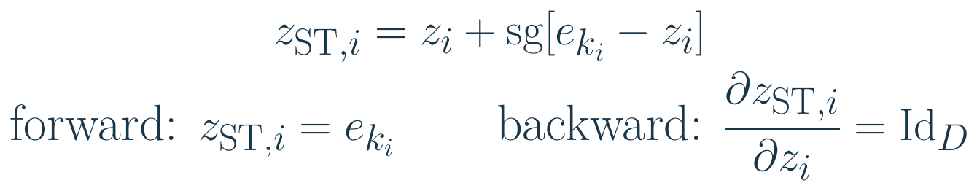
Straight-through: one forward value, another gradient
Pass the selected code to the decoder, but allow reconstruction gradients to reach the encoder.
Forward: zᵢ cancels inside the expression, so decoding still uses a discrete code vector. Backward: the sg term contributes zero.
The identity Jacobian passes the incoming gradient through unchanged. It does not specify what that incoming gradient is.
Esser et al., CVPR 2021
17
Notes:
Pass the selected code to the decoder, but allow reconstruction gradients to reach the encoder.
Forward: zᵢ cancels inside the expression, so decoding still uses a discrete code vector. Backward: the sg term contributes zero.
The identity Jacobian passes the incoming gradient through unchanged. It does not specify what that incoming gradient is.
J is a matrix of first partial derivatives, not a second derivative. The displayed straight-through construction blocks the reconstruction gradient into e_k; the standard codebook loss updates it.
LaTeX:
z_{{\rm ST},i}=z_i+\operatorname{sg}[e_{k_i}-z_i]\\\text{forward: }z_{{\rm ST},i}=e_{k_i}\qquad\text{backward: }\frac{\partial z_{{\rm ST},i}}{\partial z_i}=\mathrm{Id}_D
Sources:
Esser, Rombach & Ommer. Taming Transformers for High-Resolution Image Synthesis. CVPR 2021. https://arxiv.org/abs/2012.09841
Notation and numerical examples are pedagogical unless explicitly identified as reported paper results.

Slide 27
Why VQGAN uses more than pixel error
Pixel error alone can prefer blurry textures. Perceptual and adversarial terms penalize different reconstruction failures.
Reconstruction: pixel agreement. Perceptual: feature similarity. VQ: usable codes. Adversarial: realistic local appearance.
For grass, average green pixels are not enough: structure and texture also matter. The discriminator is trained with a separate objective.
Esser et al., CVPR 2021
19
Notes:
Pixel error alone can prefer blurry textures. Perceptual and adversarial terms penalize different reconstruction failures.
Reconstruction: pixel agreement. Perceptual: feature similarity. VQ: usable codes. Adversarial: realistic local appearance.
For grass, average green pixels are not enough: structure and texture also matter. The discriminator is trained with a separate objective.
Pedagogical decomposition of the generator/tokenizer objective. Taming Transformers uses adaptive adversarial weighting; this is not the entire min-max training specification.
LaTeX:
\mathcal L_{\rm tokenizer}=\mathcal L_{\rm rec}+\mathcal L_{\rm perceptual}+\mathcal L_{\rm VQ}+\lambda_{\rm adv}\mathcal L_{\rm adv}
Sources:
Esser, Rombach & Ommer. Taming Transformers for High-Resolution Image Synthesis. CVPR 2021. https://arxiv.org/abs/2012.09841
Notation and numerical examples are pedagogical unless explicitly identified as reported paper results.

Slide 28
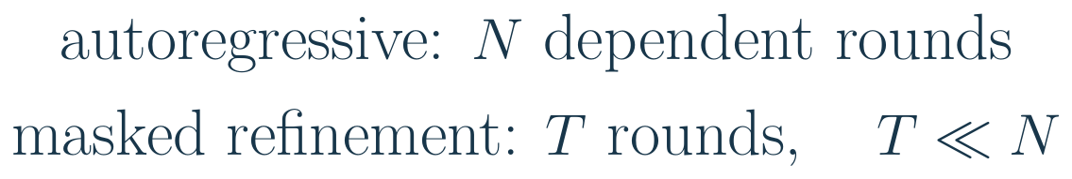
Can we avoid one decoding round per code?
Autoregressive generation has a serial dependency: choose one code before predicting the next.
MaskGIT predicts many locations in each round, then revises uncertain locations. A round can use bidirectional image context.
Fewer rounds reduce serial work, but each round processes many positions. N/T is not automatically the wall-clock speedup.
Chang et al., CVPR 2022
28
Notes:
Autoregressive generation has a serial dependency: choose one code before predicting the next.
MaskGIT predicts many locations in each round, then revises uncertain locations. A round can use bidirectional image context.
Fewer rounds reduce serial work, but each round processes many positions. N/T is not automatically the wall-clock speedup.
LaTeX:
\text{autoregressive: }N\ \text{dependent rounds}\\\text{masked refinement: }T\ \text{rounds},\quad T\ll N
Sources:
Chang et al. MaskGIT: Masked Generative Image Transformer. CVPR 2022. https://arxiv.org/abs/2202.04200
Notation and numerical examples are pedagogical unless explicitly identified as reported paper results.

Slide 29
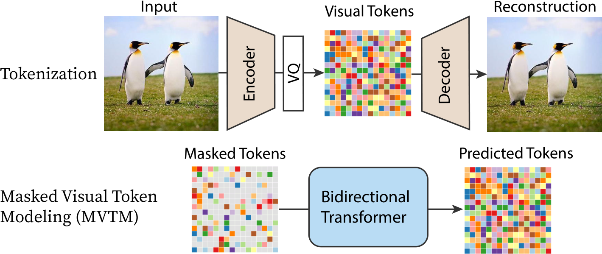
MaskGIT architecture
Reproduced from Chang et al., CVPR 2022, Fig. 3
The tokenizer still defines the visual vocabulary. The new task is to recover missing codes from visible ones.
Bidirectional attention lets each hidden location use context on both sides. Iterative prediction then fills the grid.
Chang et al., CVPR 2022
29
Notes:
Sources:
Chang et al. MaskGIT: Masked Generative Image Transformer. CVPR 2022. https://arxiv.org/abs/2202.04200
Reproduced from Chang et al., CVPR 2022, Fig. 3

Slide 30
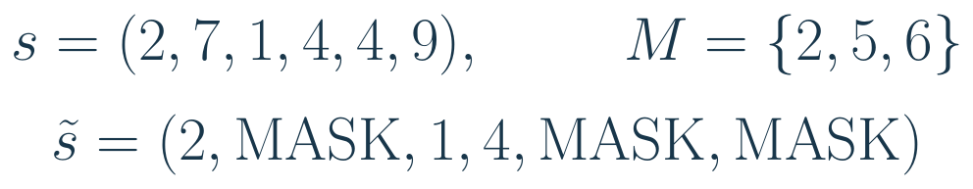
Construct the masked prediction task
Unlike Taming Transformers, which uses a GPT-like causal (autoregressive) Transformer to generate image tokens one at a time, MaskGIT uses a BERT-like bidirectional Transformer to predict masked image tokens in parallel and refine them over successive iterations.
Hide some code indices and ask the Transformer to recover them from the remaining image context.
M is a set of positions, not code values. Targets at positions 2, 5, and 6 are respectively 7, 4, and 9.
The input contains visible codes and MASK symbols. The uncorrupted sequence supplies supervision, not hidden input.
Chang et al., CVPR 2022
30
Notes:
Hide some code indices and ask the Transformer to recover them from the remaining image context.
M is a set of positions, not code values. Targets at positions 2, 5, and 6 are respectively 7, 4, and 9.
The input contains visible codes and MASK symbols. The uncorrupted sequence supplies supervision, not hidden input.
LaTeX:
s=(2,7,1,4,4,9),\qquad M=\{2,5,6\}\\\tilde s=(2,\mathrm{MASK},1,4,\mathrm{MASK},\mathrm{MASK})
Sources:
Chang et al. MaskGIT: Masked Generative Image Transformer. CVPR 2022. https://arxiv.org/abs/2202.04200
Notation and numerical examples are pedagogical unless explicitly identified as reported paper results.

Slide 31
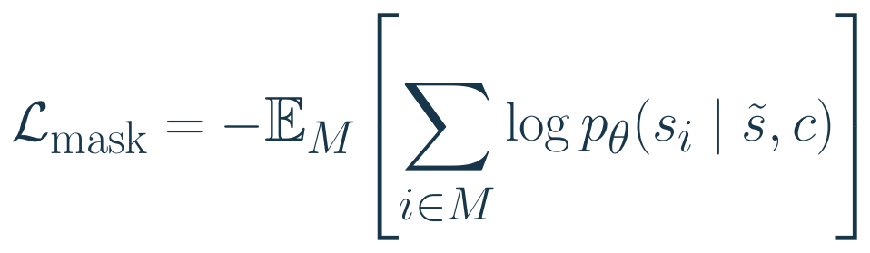
The masked loss rewards recovery at hidden locations
Only the masked locations contribute prediction targets in this objective.
pθ scores the true code sᵢ using the corrupted sequence and condition c. The sum selects masked positions; the expectation averages masking choices.
Visible codes provide context without being targets in this loss. Changing M teaches recovery under different amounts of missing information.
Chang et al., CVPR 2022
31
Notes:
Only the masked locations contribute prediction targets in this objective.
pθ scores the true code sᵢ using the corrupted sequence and condition c. The sum selects masked positions; the expectation averages masking choices.
Visible codes provide context without being targets in this loss. Changing M teaches recovery under different amounts of missing information.
LaTeX:
\mathcal L_{\rm mask}=-\mathbb E_M\!\left[\sum_{i\in M}\log p_\theta(s_i\mid\tilde s,c)\right]
Sources:
Chang et al. MaskGIT: Masked Generative Image Transformer. CVPR 2022. https://arxiv.org/abs/2202.04200
Notation and numerical examples are pedagogical unless explicitly identified as reported paper results.

Slide 32
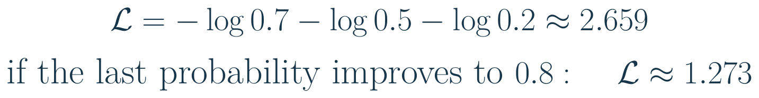
A masked-loss example
Return to M = {2, 5, 6}. Suppose the model assigns probabilities 0.7, 0.5, and 0.2 to the three correct codes.
The model was least confident about the correct code at position 6. Raising its probability reduces the total loss.
Each hidden position predicts a distribution over the codebook. Training rewards the correct index; it does not regress the integer code value.
Chang et al., CVPR 2022
32
Notes:
Return to M = {2, 5, 6}. Suppose the model assigns probabilities 0.7, 0.5, and 0.2 to the three correct codes.
The model was least confident about the correct code at position 6. Raising its probability reduces the total loss.
Each hidden position predicts a distribution over the codebook. Training rewards the correct index; it does not regress the integer code value.
Toy single-mask realization of the summed masked cross-entropy, not an additional loss in MaskGIT.
LaTeX:
\mathcal L=-\log0.7-\log0.5-\log0.2\approx2.659\\\text{if the last probability improves to }0.8:\quad\mathcal L\approx1.273
Sources:
Chang et al. MaskGIT: Masked Generative Image Transformer. CVPR 2022. https://arxiv.org/abs/2202.04200
Notation and numerical examples are pedagogical unless explicitly identified as reported paper results.

Slide 33
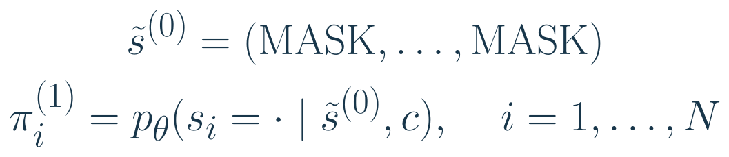
Start generation with every location unknown
MaskGIT has no true image prefix at inference. Initialize the entire target grid with MASK symbols.
The dot means “all candidate code values”: each position receives a categorical distribution, not one fixed code yet.
Position embeddings distinguish locations even when all code identities are MASK. Sampling produces a first candidate image grid.
Chang et al., CVPR 2022
33
Notes:
MaskGIT has no true image prefix at inference. Initialize the entire target grid with MASK symbols.
The dot means “all candidate code values”: each position receives a categorical distribution, not one fixed code yet.
Position embeddings distinguish locations even when all code identities are MASK. Sampling produces a first candidate image grid.
LaTeX:
\tilde s^{(0)}=(\mathrm{MASK},\ldots,\mathrm{MASK})\\\pi_i^{(1)}=p_\theta(s_i=\cdot\mid\tilde s^{(0)},c),\quad i=1,\ldots,N
Sources:
Chang et al. MaskGIT: Masked Generative Image Transformer. CVPR 2022. https://arxiv.org/abs/2202.04200
Notation and numerical examples are pedagogical unless explicitly identified as reported paper results.

Slide 34
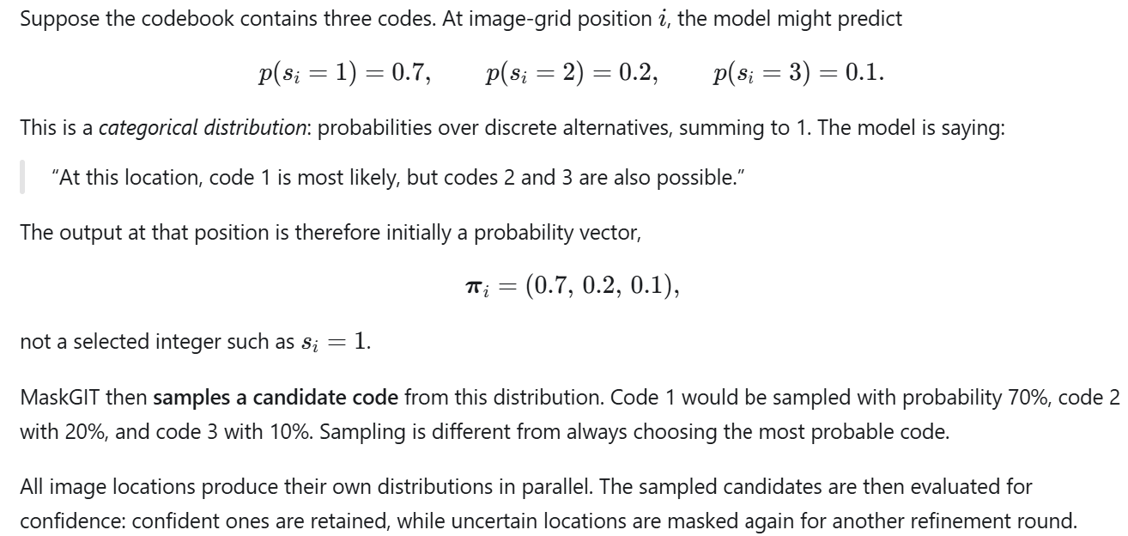
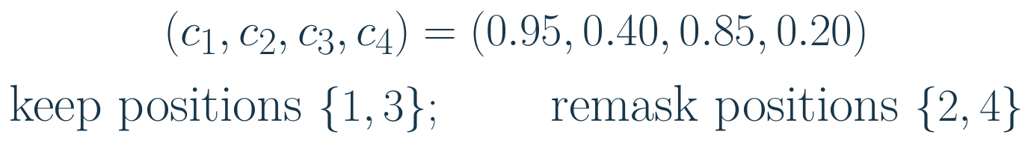
Keep confident predictions; revisit uncertain ones
Chang et al., CVPR 2022
35
Notes:
Suppose a refinement round must retain two of four candidate codes.
The next pass uses the retained codes as context and predicts replacements for the uncertain locations.
This is iterative commitment to a coherent grid, not four independent final predictions in one pass.
Toy ranking without sampling noise. The actual inference procedure includes a scheduling rule and stochastic confidence perturbation.
LaTeX:
(c_1,c_2,c_3,c_4)=(0.95,0.40,0.85,0.20)\\\text{keep positions }\{1,3\};\qquad\text{remask positions }\{2,4\}
Sources:
Chang et al. MaskGIT: Masked Generative Image Transformer. CVPR 2022. https://arxiv.org/abs/2202.04200
Notation and numerical examples are pedagogical unless explicitly identified as reported paper results.

Slide 35
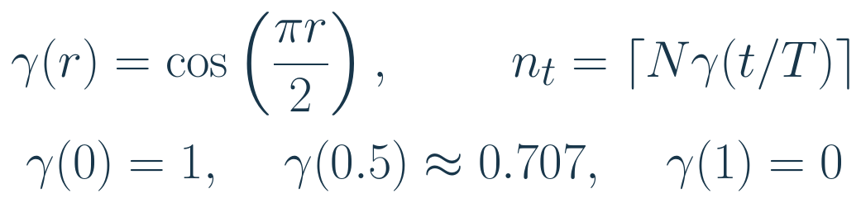
A schedule controls how much remains unknown
The masking schedule gradually reduces the number of locations that will be revised.
N is the grid size; T is the number of rounds; t/T is progress. At halfway, about 71% of locations remain masked.
The schedule sets a count, not which locations to hide. Confidence ranking chooses the locations.
Chang et al., CVPR 2022
36
Notes:
The masking schedule gradually reduces the number of locations that will be revised.
N is the grid size; T is the number of rounds; t/T is progress. At halfway, about 71% of locations remain masked.
The schedule sets a count, not which locations to hide. Confidence ranking chooses the locations.
Cosine schedule from MaskGIT; ceiling is the lecture’s illustrative rounding convention. Production sampling includes endpoint/count constraints.
LaTeX:
\gamma(r)=\cos\left(\frac{\pi r}{2}\right),\qquad n_t=\left\lceil N\gamma(t/T)\right\rceil\\\gamma(0)=1,\quad\gamma(0.5)\approx0.707,\quad\gamma(1)=0
Sources:
Chang et al. MaskGIT: Masked Generative Image Transformer. CVPR 2022. https://arxiv.org/abs/2202.04200
Notation and numerical examples are pedagogical unless explicitly identified as reported paper results.

Slide 36
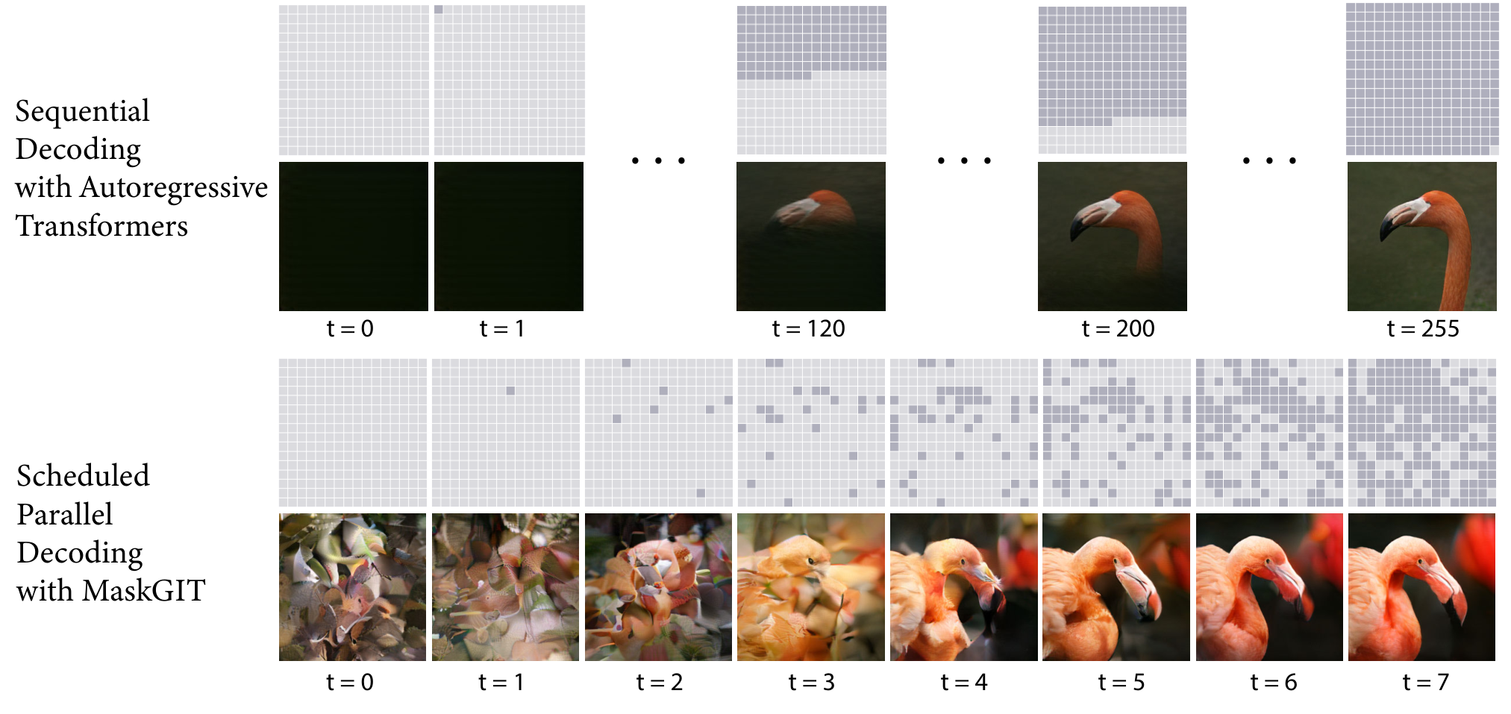
Refinement: a worked schedule
Reproduced from Chang et al., CVPR 2022, Fig. 2 (paper example uses 8 rounds)
Chang et al., CVPR 2022
37
Notes:
The 4-round counts are an original calculation using ceil(16 cos(pi t/8)). The paper figure illustrates its own 8-round example; do not conflate the two schedules.
Sources:
Chang et al. MaskGIT: Masked Generative Image Transformer. CVPR 2022. https://arxiv.org/abs/2202.04200
Reproduced from Chang et al., CVPR 2022, Fig. 2 (paper example uses 8 rounds)

Slide 37
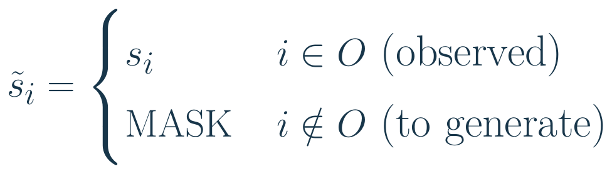
Inpainting keeps observed codes fixed
To replace an object while preserving its surroundings, mark a region of the latent grid as unknown.
O contains the observed locations. Keep their codes unchanged while refining the missing region with context from all sides.
A fixed latent boundary need not preserve pixels exactly at that boundary: decoder receptive fields span neighboring codes.
Chang et al., CVPR 2022
38
Notes:
To replace an object while preserving its surroundings, mark a region of the latent grid as unknown.
O contains the observed locations. Keep their codes unchanged while refining the missing region with context from all sides.
A fixed latent boundary need not preserve pixels exactly at that boundary: decoder receptive fields span neighboring codes.
LaTeX:
\tilde s_i=\begin{cases}s_i&i\in O\ \text{(observed)}\\\mathrm{MASK}&i\notin O\ \text{(to generate)}\end{cases}
Sources:
Chang et al. MaskGIT: Masked Generative Image Transformer. CVPR 2022. https://arxiv.org/abs/2202.04200
Notation and numerical examples are pedagogical unless explicitly identified as reported paper results.

Slide 38
Two meanings of “mask”
The corruption mask controls which input code identities are hidden.
The attention mask controls which positions can exchange information.
Property | Autoregressive prior as in Taming Transformers | MaskGIT
Training context | Earlier codes | Visible codes on either side
Attention | Causal | Bidirectional
Generation | One new code per round | Several codes per round
MaskGIT hides selected token identities while allowing bidirectional attention across the image.
Esser et al., CVPR 2021 / Chang et al., CVPR 2022
39
Notes:
Sources:
Esser, Rombach & Ommer. Taming Transformers for High-Resolution Image Synthesis. CVPR 2021. https://arxiv.org/abs/2012.09841
Chang et al. MaskGIT: Masked Generative Image Transformer. CVPR 2022. https://arxiv.org/abs/2202.04200

Slide 39
The bridge from MaskGIT to Emu3.5
VQGAN gives us image codes. Its autoregressive prior generates one code at a time.
MaskGIT demonstrates parallel code refinement using a different training objective and bidirectional attention.
Emu3.5 first learns interleaved text and images autoregressively, then adapts image generation for parallel refinement.
Chang et al., CVPR 2022 / Emu3.5 Team, 2025
40
Notes:
MaskGIT is the conceptual foundation for masked parallel image-token refinement. DiDA additionally preserves an interleaved text-image interface and adapts an already trained autoregressive model.
Sources:
Chang et al. MaskGIT: Masked Generative Image Transformer. CVPR 2022. https://arxiv.org/abs/2202.04200
Emu3.5 Team (BAAI). Emu3.5: Native Multimodal Models are World Learners. 2025. https://arxiv.org/abs/2510.26583

Slide 40
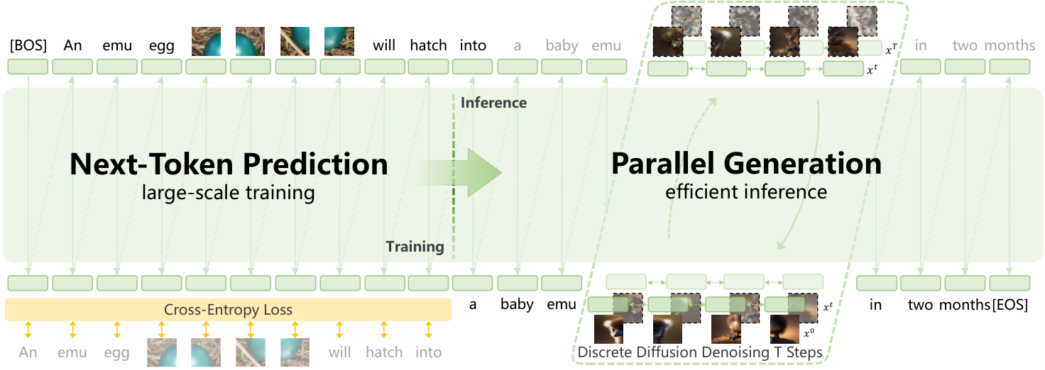
Emu3.5: next-token learning and parallel generation
Reproduced from Emu3.5 Team, 2025, Fig. 3
Left: a shared Transformer learns next-token prediction across text and image blocks.
Right: later adaptation supports parallel image refinement while text generation remains sequential.
Emu3.5 Team, 2025
41
Notes:
The large-scale sequence training is next-token prediction. DiDA is a later adaptation for parallel image generation. Native audio tokens are not described here.
Sources:
Emu3.5 Team (BAAI). Emu3.5: Native Multimodal Models are World Learners. 2025. https://arxiv.org/abs/2510.26583
Reproduced from Emu3.5 Team, 2025, Fig. 3

Slide 41
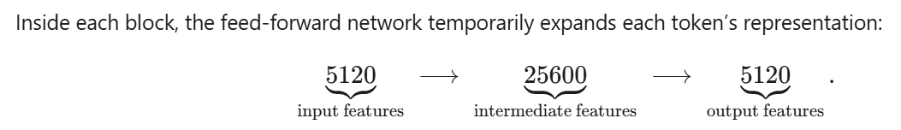
Transformer configuration
The sequence backbone is a decoder-only Transformer: 64 layers, width 5,120, and feed-forward width 25,600. 64 query heads share 8 key/value heads: eight query heads per KV group, reducing KV storage.
Parameter group | Reported size
Transformer layers | 31.2 billion
Embedding layers | 2.9 billion
Total (Table 1) | 34.1 billion
Other components: pre-RMSNorm, QK-Norm, SwiGLU, and RoPE. Context: 32,768 tokens.
Emu3.5 Team, 2025
42
Notes:
Use the exact Table 1 total rather than the informal 32B label in parts of the prose. Do not derive attention head dimension from hidden width alone without implementation verification.
The eight-query-heads-per-KV-group count is 64/8. This does not infer head dimension from hidden width.
Sources:
Emu3.5 Team (BAAI). Emu3.5: Native Multimodal Models are World Learners. 2025. https://arxiv.org/abs/2510.26583

Slide 42
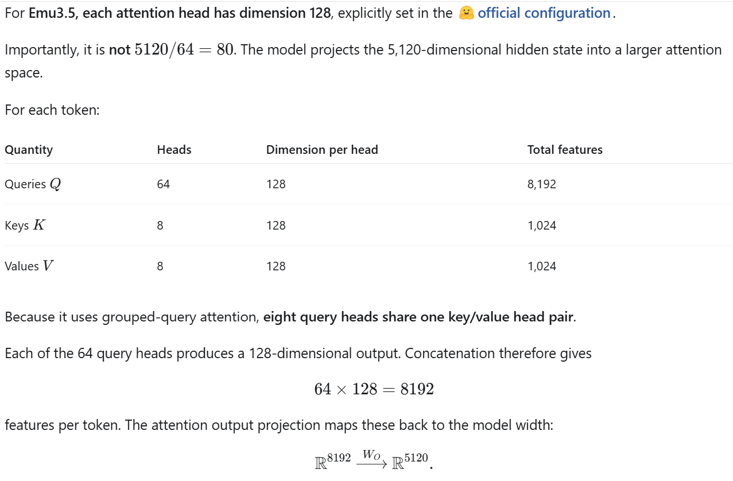

Slide 43
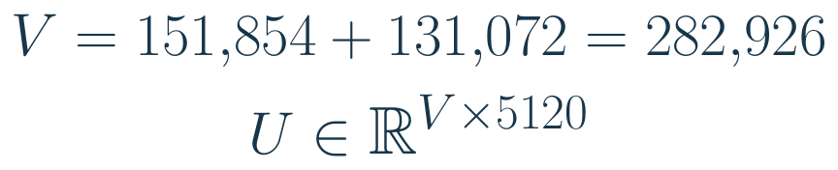
One vocabulary allows two kinds of output
A shared Transformer must represent both text symbols and visual code indices at its input and output.
V counts the total text and vision symbols. U has one learned input-embedding row per symbol; each row has 5,120 features.
Emu3.5 Team, 2025
43
Notes:
A shared Transformer must represent both text symbols and visual code indices at its input and output.
V counts the total text and vision symbols. U has one learned input-embedding row per symbol; each row has 5,120 features.
Vocabulary size counts choices. Hidden width counts features used to represent a choice. They are not the same dimension.
LaTeX:
V=151{,}854+131{,}072=282{,}926\\U\in\mathbb R^{V\times5120}
Sources:
Emu3.5 Team (BAAI). Emu3.5: Native Multimodal Models are World Learners. 2025. https://arxiv.org/abs/2510.26583
Notation and numerical examples are pedagogical unless explicitly identified as reported paper results.

Slide 44
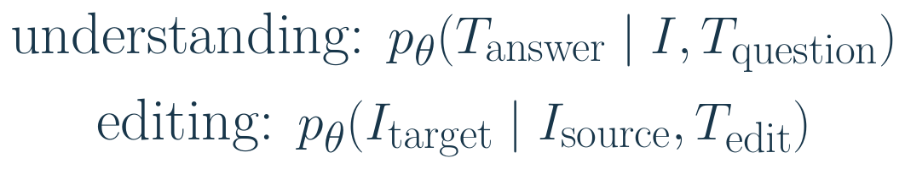
A task is defined by its context and continuation
The same token interface supports understanding and editing, but the target modality changes.
For “make the chair blue,” the source image and instruction are given. The target is the edited image-code block.
The target before the bar is what the model must learn to predict. It is not provided as its own conditioning image.
Emu3.5 Team, 2025
44
Notes:
The same token interface supports understanding and editing, but the target modality changes.
For “make the chair blue,” the source image and instruction are given. The target is the edited image-code block.
The target before the bar is what the model must learn to predict. It is not provided as its own conditioning image.
Conceptual task-level conditional distributions; actual sequence likelihood factors into token predictions during autoregressive training.
LaTeX:
\text{understanding: }p_\theta(T_{\rm answer}\mid I,T_{\rm question})\\\text{editing: }p_\theta(I_{\rm target}\mid I_{\rm source},T_{\rm edit})
Sources:
Emu3.5 Team (BAAI). Emu3.5: Native Multimodal Models are World Learners. 2025. https://arxiv.org/abs/2510.26583
Notation and numerical examples are pedagogical unless explicitly identified as reported paper results.

Slide 45
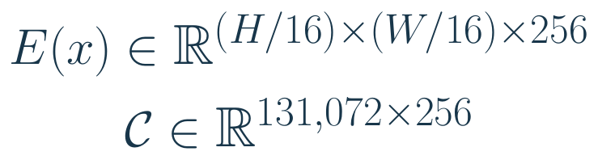
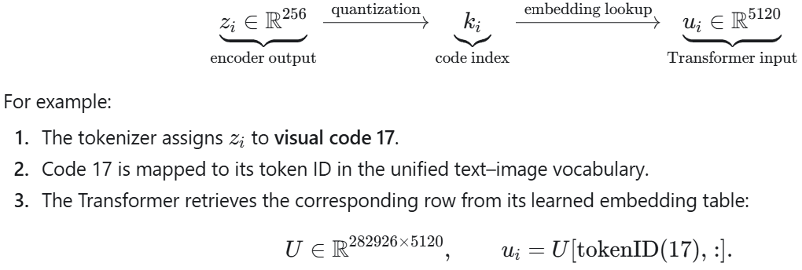
Emu3.5 uses a learned visual tokenizer
Its visual vocabulary is learned for reconstruction and semantic representation—not supplied by a CLIP patch encoder.
The encoder grid has one 256-dimensional vector per location. The codebook offers 131,072 possible vectors of that width. The earlier VQGAN discussion provides the foundation for the Emu3.5 tokenizer, not its exact quantizer implementation.
Emu3.5 Team, 2025
45
Notes:
Its visual vocabulary is learned for reconstruction and semantic representation—not supplied by a CLIP patch encoder.
The encoder grid has one 256-dimensional vector per location. The codebook offers 131,072 possible vectors of that width.
Emu3.5 scales an IBQ-based tokenizer to 455M parameters. The earlier VQGAN discussion provides foundations, not its exact quantizer implementation.
LaTeX:
E(x)\in\mathbb R^{(H/16)\times(W/16)\times256}\\\mathcal C\in\mathbb R^{131{,}072\times256}
Sources:
Emu3.5 Team (BAAI). Emu3.5: Native Multimodal Models are World Learners. 2025. https://arxiv.org/abs/2510.26583
Notation and numerical examples are pedagogical unless explicitly identified as reported paper results.

Slide 46
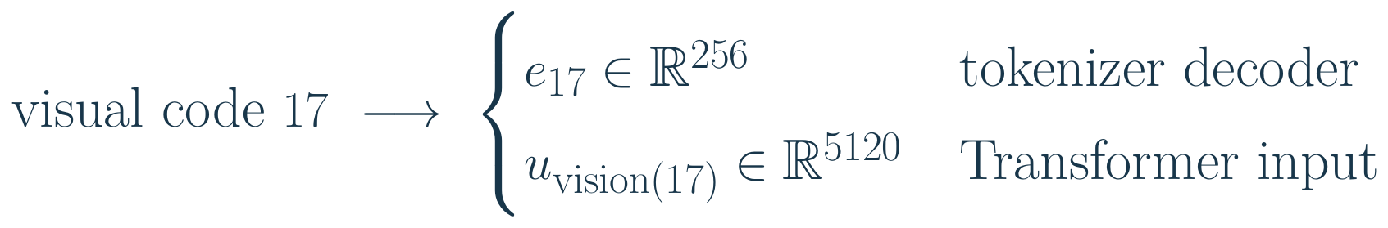
One code index, two different embedding spaces
The image decoder and language model use the same discrete code identity for different computations.
The decoder looks up a reconstruction vector. The Transformer looks up an embedding in its unified token vocabulary.
These are separate learned tables. A 256-dimensional code vector is not directly the 5,120-dimensional Transformer token.
Emu3.5 Team, 2025
49
Notes:
The image decoder and language model use the same discrete code identity for different computations.
The decoder looks up a reconstruction vector. The Transformer looks up an embedding in its unified token vocabulary.
These are separate learned tables. A 256-dimensional code vector is not directly the 5,120-dimensional Transformer token.
vision(17) denotes the unified vocabulary identity assigned to visual code 17; it avoids falsely assuming identical numerical ids in both tables.
LaTeX:
\text{visual code }17\ \longrightarrow\ \begin{cases}e_{17}\in\mathbb R^{256}&\text{tokenizer decoder}\\u_{\operatorname{vision}(17)}\in\mathbb R^{5120}&\text{Transformer input}\end{cases}
Sources:
Emu3.5 Team (BAAI). Emu3.5: Native Multimodal Models are World Learners. 2025. https://arxiv.org/abs/2510.26583
Notation and numerical examples are pedagogical unless explicitly identified as reported paper results.

Slide 47
Token counts at different resolutions
Divide each image dimension by 16, then multiply the latent dimensions.
These counts exclude text, boundaries, and shape metadata.
Image size | Latent grid | Visual codes
512 × 512 | 32 × 32 | 1,024
512 × 1,024 | 32 × 64 | 2,048
1,024 × 1,024 | 64 × 64 | 4,096
A longer visual sequence affects both context consumption and generation latency.
Emu3.5 Team, 2025
46
Notes:
Original arithmetic from the reported compression factor. Resizing/bucketing determines actual supported input shapes.
Sources:
Emu3.5 Team (BAAI). Emu3.5: Native Multimodal Models are World Learners. 2025. https://arxiv.org/abs/2510.26583

Slide 48
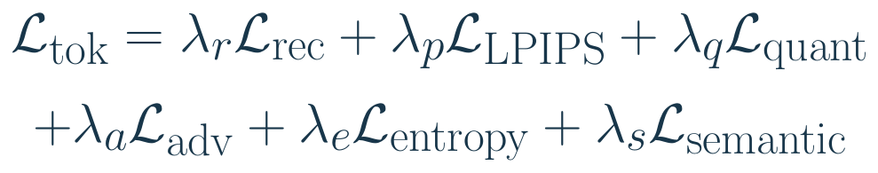
Tokenizer losses preserve several kinds of information
The tokenizer must preserve detail, code usage, and semantics. The λ coefficients weight these different objectives.
Pixel and LPIPS terms assess reconstruction; adversarial supervision encourages realism; quantization and entropy shape code usage.
Semantic distillation uses SigLIP (a version of CLIP) features during training. It does not replace the tokenizer with SigLIP at inference.
Emu3.5 Team, 2025
48
Notes:
The tokenizer must preserve detail, code usage, and semantics. The λ coefficients weight these different objectives.
Pixel and LPIPS terms assess reconstruction; adversarial supervision encourages realism; quantization and entropy shape code usage.
Semantic distillation uses SigLIP features during training. It does not replace the tokenizer with SigLIP at inference.
Schematic weighted sum of loss families reported in Emu3.5 §5.2. The symbols do not assert particular unpublished coefficients or the exact IBQ formula.
LaTeX:
\mathcal L_{\rm tok}=\lambda_r\mathcal L_{\rm rec}+\lambda_p\mathcal L_{\rm LPIPS}+\lambda_q\mathcal L_{\rm quant}\\+\lambda_a\mathcal L_{\rm adv}+\lambda_e\mathcal L_{\rm entropy}+\lambda_s\mathcal L_{\rm semantic}
Sources:
Emu3.5 Team (BAAI). Emu3.5: Native Multimodal Models are World Learners. 2025. https://arxiv.org/abs/2510.26583
Notation and numerical examples are pedagogical unless explicitly identified as reported paper results.

Slide 49
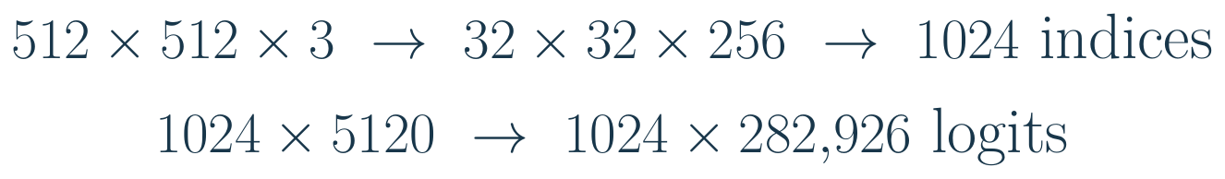
Track a 512 × 512 image through the system
Following the shapes makes clear what is an image, a code, an embedding, and a prediction.
Top: encode and quantize. Bottom: embed the indices and produce a distribution over the unified vocabulary at each prediction position. Ordinary autoregressive inference generates one new position at a time.
Emu3.5 Team, 2025
50
Notes:
Following the shapes makes clear what is an image, a code, an embedding, and a prediction.
Top: encode and quantize. Bottom: embed the indices and produce a distribution over the unified vocabulary at each prediction position.
The full logit array describes teacher-forced training. Ordinary autoregressive inference generates one new position at a time.
LaTeX:
512\times512\times3\ \to\ 32\times32\times256\ \to\ 1024\ \text{indices}\\1024\times5120\ \to\ 1024\times282{,}926\ \text{logits}
Sources:
Emu3.5 Team (BAAI). Emu3.5: Native Multimodal Models are World Learners. 2025. https://arxiv.org/abs/2510.26583
Notation and numerical examples are pedagogical unless explicitly identified as reported paper results.

Slide 50
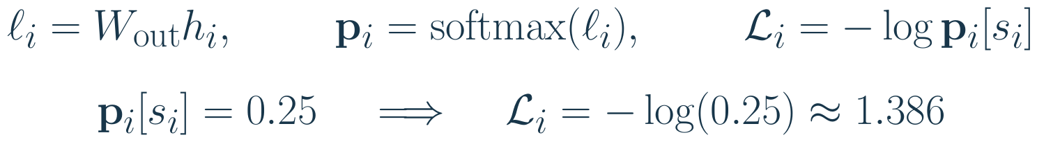
Logits become probabilities and a learning signal
The output layer produces a logit for every vocabulary token. Softmax converts these logits into probabilities for the next token.
i: target position. hᵢ: hidden vector from preceding tokens (5,120 features).
Wout: learned output matrix. ℓᵢ: vector of 282,926 logits, one per token.
Bold pᵢ: probability vector. sᵢ: correct target token. [sᵢ] selects its entry.
Lᵢ: cross-entropy loss for that target, using the natural logarithm.
Logits can be any real numbers. Probabilities are nonnegative and sum to one.
Training increases the probability of the correct text token or visual code.
Emu3.5 Team, 2025
51
Notes:
Source: Emu3.5 Team (2025), Emu3.5: Native Multimodal Models are World Learners, Section 2.2 and Table 1. https://arxiv.org/html/2510.26583v1#S2.SS2
The output projection maps a 5,120-dimensional hidden vector to 282,926 logits, spanning text tokens and visual-code tokens. With column vectors, W_out has shape 282926 by 5120. A logit is an unnormalized real-valued score. Softmax gives one probability per vocabulary entry.
Prediction-index convention: i labels the target, and h_i is computed from the shifted input prefix preceding that target. Therefore p_i[s_i] equals p_theta(s_i | s_<i), where theta denotes model parameters. A conventional unshifted implementation would use the hidden state at the preceding input-token position. Bold p_i is the complete probability vector and p_i[s_i] is one scalar entry. No new distribution is introduced by this notation change.
Natural logarithms: -log(0.25) = 1.3862943611. This is a teaching example, not a reported model prediction. Cross-entropy penalizes low probability on the true token, rather than distance between numerical token IDs. The slide describes the raw full-vocabulary output, before any optional inference-time restrictions on allowed tokens.

Slide 51
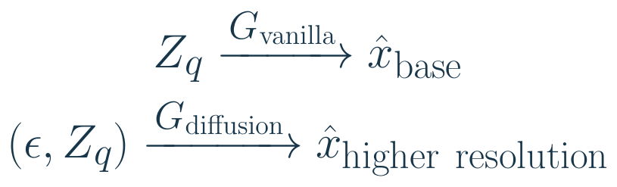
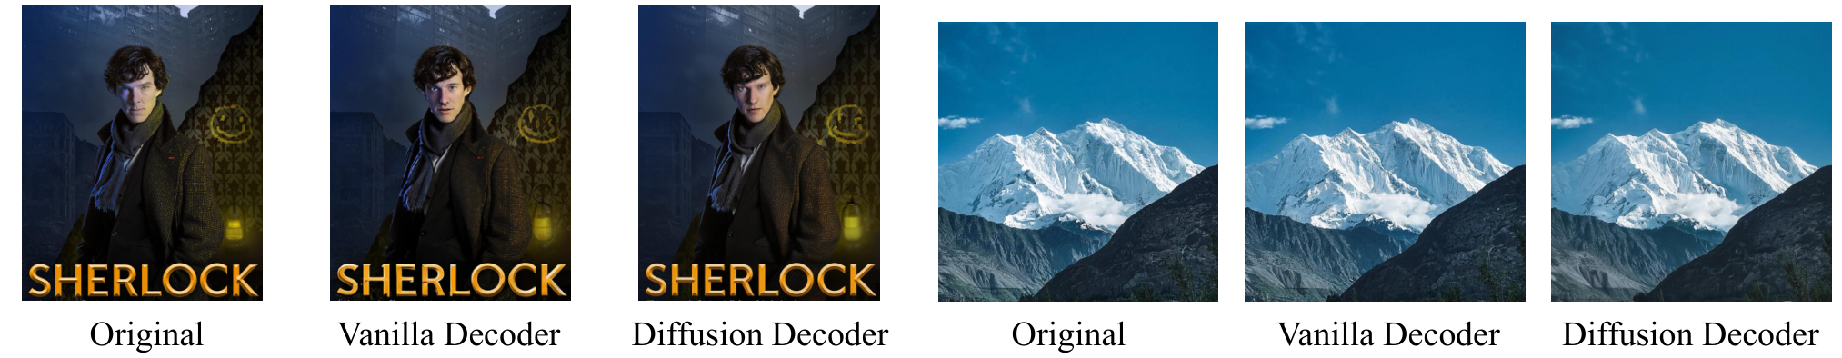
The same codes can feed different pixel decoders
After generating image codes, we still need to render pixels. Emu3.5 offers two routes.
The vanilla decoder reconstructs directly. The diffusion-based decoder starts from noise ε and uses code grid Zq as its condition.
Reproduced from Emu3.5 Team, 2025, Fig. 11 (bottom-row crop)
Emu3.5 Team, 2025
53
Notes:
After generating image codes, we still need to render pixels. Emu3.5 offers two routes.
The vanilla decoder reconstructs directly. The diffusion-based decoder starts from noise ε and uses code grid Zq as its condition.
The optional decoder produces twice the spatial resolution. This pixel-decoding stage is distinct from DiDA’s visual-code generation.
Schematic input/output notation, not an exact diffusion sampler equation. The optional image decoder is trained with a flow-matching objective.
LaTeX:
Z_q\xrightarrow{G_{\rm vanilla}}\hat x_{\rm base}\\(\epsilon,Z_q)\xrightarrow{G_{\rm diffusion}}\hat x_{\rm higher\ resolution}
Sources:
Emu3.5 Team (BAAI). Emu3.5: Native Multimodal Models are World Learners. 2025. https://arxiv.org/abs/2510.26583
Notation and numerical examples are pedagogical unless explicitly identified as reported paper results.

Slide 52
From sparse keyframes to a continuous video
Predicting a few meaningful frames does not yet generate every frame of a video.
For “pour water into the cup,” keyframes can describe important visual states. The video decoder synthesizes a temporally dense sequence. The Transformer models the interleaved keyframe-level content; the video decoder supplies motion between those sparse conditions.
Emu3.5 Team, 2025
54
Notes:
Predicting a few meaningful frames does not yet generate every frame of a video.
For “pour water into the cup,” keyframes can describe important visual states. The video decoder synthesizes a temporally dense sequence.
The Transformer models the interleaved keyframe-level content; the video decoder supplies motion between those sparse conditions.
Conceptual separation of sparse multimodal sequence generation and the diffusion video decoder described in Emu3.5 §2.3.
LaTeX:
\text{text + sparse keyframe codes}\xrightarrow{\text{video decoder}}(F_1,F_2,\ldots,F_L)
Sources:
Emu3.5 Team (BAAI). Emu3.5: Native Multimodal Models are World Learners. 2025. https://arxiv.org/abs/2510.26583
Notation and numerical examples are pedagogical unless explicitly identified as reported paper results.

Slide 53
Pretraining data mixture
Interleaved video provides examples of how descriptions and visual states change together.
Other sources support text, paired generation, and editing. Entries below are sampling percentages.
Data type | Stage 1 | Stage 2
Video-interleaved | 55% | 55%
Text-only | 20% | 18%
Image–text pairs | 20% | 16%
Video–text pairs | 5% | 8%
Any-to-image | 0% | 3%
Sampling weights describe the training recipe, not necessarily unique corpus proportions.
Emu3.5 Team, 2025
55
Notes:
Source: Table 2. Each column sums to 100%.
Sources:
Emu3.5 Team (BAAI). Emu3.5: Native Multimodal Models are World Learners. 2025. https://arxiv.org/abs/2510.26583

Slide 54
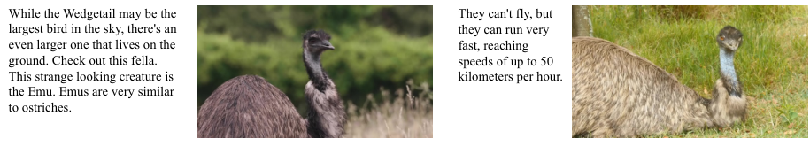
Aligning speech transcripts with frames
Reproduced from Emu3.5 Team, 2025, Fig. 6 (first-row excerpt)
Timestamped transcripts associate spoken descriptions with nearby visual states.
Whisper converts speech into text. Chronological merging creates text–image sequences, without native audio tokens.
Emu3.5 Team, 2025
57
Notes:
Sources:
Emu3.5 Team (BAAI). Emu3.5: Native Multimodal Models are World Learners. 2025. https://arxiv.org/abs/2510.26583
Reproduced from Emu3.5 Team, 2025, Fig. 6 (first-row excerpt)

Slide 55
Interleaved sequences teach contextual prediction
Video-derived training data connect language to changes in visual state over time.
Each image is a block of visual tokens. Later tokens are predicted using earlier words and image blocks as context.
The learning signal rewards plausible continuations of observed sequences. Predictive co-occurrence alone does not prove causal understanding.
Emu3.5 Team, 2025
58
Notes:
Video-derived training data connect language to changes in visual state over time.
Each image is a block of visual tokens. Later tokens are predicted using earlier words and image blocks as context.
The learning signal rewards plausible continuations of observed sequences. Predictive co-occurrence alone does not prove causal understanding.
Invented teaching example, not a quoted training record.
LaTeX:
\text{“empty cup”},\ I_1,\ \text{“pour water”},\ I_2,\ \text{“full cup”},\ I_3
Sources:
Emu3.5 Team (BAAI). Emu3.5: Native Multimodal Models are World Learners. 2025. https://arxiv.org/abs/2510.26583
Notation and numerical examples are pedagogical unless explicitly identified as reported paper results.

Slide 56
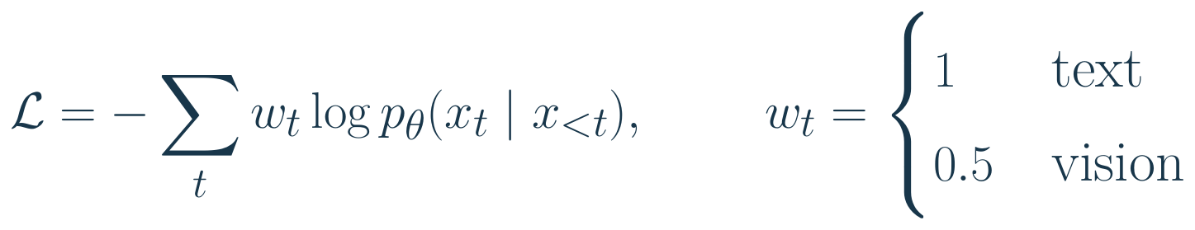
Weighted next-token loss balances token types
Images introduce many code targets. A per-token weight controls their contribution to training.
At each position, select the probability of the true next symbol, take its negative log, and multiply by that modality’s weight.
A visual weight of 0.5 halves each visual token’s contribution. It does not guarantee that images contribute half the total loss.
Emu3.5 Team, 2025
59
Notes:
Images introduce many code targets. A per-token weight controls their contribution to training.
At each position, select the probability of the true next symbol, take its negative log, and multiply by that modality’s weight.
A visual weight of 0.5 halves each visual token’s contribution. It does not guarantee that images contribute half the total loss.
Summed notation illustrates the reported pre-training modality weights; training may normalize the aggregate. SFT has stage-specific visual weights (1.0 then 0.5).
LaTeX:
\mathcal L=-\sum_t w_t\log p_\theta(x_t\mid x_{<t}),\qquad w_t=\begin{cases}1&\text{text}\\0.5&\text{vision}\end{cases}
Sources:
Emu3.5 Team (BAAI). Emu3.5: Native Multimodal Models are World Learners. 2025. https://arxiv.org/abs/2510.26583
Notation and numerical examples are pedagogical unless explicitly identified as reported paper results.

Slide 57

A token weight is not a modality percentage
Suppose an example has 1,024 visual tokens and 32 text tokens, each with unweighted loss 1.
Even with half weight per visual token, this example is dominated by image targets because there are many more of them.
Total influence depends on token counts, prediction difficulty, weights, and normalization—not just the coefficient 0.5.
Emu3.5 Team, 2025
60
Notes:
Suppose an example has 1,024 visual tokens and 32 text tokens, each with unweighted loss 1.
Even with half weight per visual token, this example is dominated by image targets because there are many more of them.
Total influence depends on token counts, prediction difficulty, weights, and normalization—not just the coefficient 0.5.
Toy equal-loss values, not an empirical measurement of Emu3.5 gradients or loss shares.
LaTeX:
\mathcal L_{\rm vision}=1024\times0.5=512,\qquad\mathcal L_{\rm text}=32\times1=32\\\frac{\mathcal L_{\rm vision}}{\mathcal L_{\rm total}}=\frac{512}{544}\approx94.1\%
Sources:
Emu3.5 Team (BAAI). Emu3.5: Native Multimodal Models are World Learners. 2025. https://arxiv.org/abs/2510.26583
Notation and numerical examples are pedagogical unless explicitly identified as reported paper results.

Slide 58

A weighted cross-entropy calculation
Compare a correctly predicted text token with a difficult visual-code target.
The low probability of the correct visual code produces a large penalty, even after its 0.5 weight is applied.
Training lowers this loss by increasing the correct targets’ probabilities. It does not directly compare reconstructed pixels here.
Emu3.5 Team, 2025
61
Notes:
Compare a correctly predicted text token with a difficult visual-code target.
The low probability of the correct visual code produces a large penalty, even after its 0.5 weight is applied.
Training lowers this loss by increasing the correct targets’ probabilities. It does not directly compare reconstructed pixels here.
Toy probabilities with natural logarithms; the tokenizer has a separate image-reconstruction training objective.
LaTeX:
\mathcal L_{\rm text}=-\log0.8\approx0.223\\\mathcal L_{\rm vision}=-0.5\log0.1\approx1.151,\qquad\mathcal L_{\rm total}\approx1.374
Sources:
Emu3.5 Team (BAAI). Emu3.5: Native Multimodal Models are World Learners. 2025. https://arxiv.org/abs/2510.26583
Notation and numerical examples are pedagogical unless explicitly identified as reported paper results.

Slide 59
Two pretraining stages
Stage 1 emphasizes scale with lower-resolution image codes.
Stage 2 increases resolution diversity and enriches annotations.
Reported recipe | Stage 1 | Stage 2
Seen tokens | 10.3 trillion | 3.5 trillion
Visual tokens per image | Up to 1,024 | 1,024–4,096
Learning rate | 5 × 10⁻⁴ | 1 × 10⁻⁵
Both stages use a 32,768-token context.
Emu3.5 Team, 2025
62
Notes:
Table 2 totals 13.8T seen tokens; prose rounds stages to about 10T and 3T. Preserve source labels instead of presenting these as exactly identical counts.
Sources:
Emu3.5 Team (BAAI). Emu3.5: Native Multimodal Models are World Learners. 2025. https://arxiv.org/abs/2510.26583

Slide 60
Higher-quality annotations and filtering
Stage 1 video-interleaved data uses extracted frames and speech transcripts, without added captions for that stream.
Stage 2 adds summaries and Qwen2.5-VL-7B captions. A caption can describe a visible object never mentioned in speech.
Example: speech says “put it here”, while a visual caption identifies the cup and table. Next-token targets exist in both stages.
Emu3.5 Team, 2025
63
Notes:
This statement applies to video-interleaved preprocessing; other training sources can already contain paired annotations. No added annotations does not mean no supervision: next-token targets still exist.
Sources:
Emu3.5 Team (BAAI). Emu3.5: Native Multimodal Models are World Learners. 2025. https://arxiv.org/abs/2510.26583

Slide 61

The complete training sequence
Reproduced from Emu3.5 Team, 2025, Fig. 4
Pretraining learns to continue multimodal sequences. Supervised fine-tuning (SFT) adds demonstrations of requested tasks. Reinforcement learning (RL) favors higher-reward outputs. Discrete Diffusion Adaptation (DiDA) enables parallel image prediction.
Emu3.5 Team, 2025
66
Notes:
Sources:
Emu3.5 Team (BAAI). Emu3.5: Native Multimodal Models are World Learners. 2025. https://arxiv.org/abs/2510.26583
Reproduced from Emu3.5 Team, 2025, Fig. 4

Slide 62

SFT teaches the requested continuation
Instruction data specify a context and a desired response—text, image codes, or an interleaved sequence.
c is the supplied prompt and input images. A selects supervised response positions; true earlier response tokens provide teacher-forced context.
The basic next-token loss remains familiar. Task-formatted data and supervised positions teach what to generate in response to an instruction.
Emu3.5 Team, 2025
67
Notes:
Instruction data specify a context and a desired response—text, image codes, or an interleaved sequence.
c is the supplied prompt and input images. A selects supervised response positions; true earlier response tokens provide teacher-forced context.
The basic next-token loss remains familiar. Task-formatted data and supervised positions teach what to generate in response to an instruction.
Conceptual response-supervised SFT expression, not a claim about every exact loss mask in the released pipeline. Emu3.5 reports visual weights 1.0 in SFT stage 1 and 0.5 in stage 2.
LaTeX:
\mathcal L_{\rm SFT}=-\sum_{t\in\mathcal A}w_t\log p_\theta(y_t\mid c,y_{<t})
Sources:
Emu3.5 Team (BAAI). Emu3.5: Native Multimodal Models are World Learners. 2025. https://arxiv.org/abs/2510.26583
Notation and numerical examples are pedagogical unless explicitly identified as reported paper results.

Slide 63

RL rewards evaluate qualities beyond token likelihood
A completed answer or image can be scored for alignment, appearance, text fidelity, or task-specific consistency.
The report normalizes reward signals to a common range. In this illustrative sum, αⱼ weights the contribution of quality criterion j. A reward is a quality score, not a probability. The relevant scorers and their balance depend on the task.
GRPO samples several responses for the same context and compares their rewards within that group. Emu3.5 reports 8 rollouts per prompt. This two-response example only explains the relative signal, not the complete GRPO objective.
Emu3.5 Team, 2025
69
Notes:
A completed answer or image can be scored for alignment, appearance, text fidelity, or task-specific consistency.
The report normalizes reward signals to a common range. In this illustrative sum, αⱼ weights the contribution of quality criterion j.
A reward is a quality score, not a probability. The relevant scorers and their balance depend on the task.
Schematic aggregation: the report specifies normalization and multiple reward components, not one universal set of alpha coefficients.
LaTeX:
R=\sum_j\alpha_j\widetilde R_j,\qquad\widetilde R_j\in[1,10]
Sources:
Emu3.5 Team (BAAI). Emu3.5: Native Multimodal Models are World Learners. 2025. https://arxiv.org/abs/2510.26583
Notation and numerical examples are pedagogical unless explicitly identified as reported paper results.

Slide 64
Reward comparison: an editing example
Instruction: “make the cup blue; preserve the rest.”
Candidate A changes the cup and the background. Candidate B changes only the cup.
Toy score, 1–10 | Candidate A | Candidate B
Instruction match | 8 | 9
Preservation | 3 | 9
Visual appeal | 9 | 8
Equal-weight mean | 6.67 | 8.67
A task-aware reward must penalize unintended changes, even when both images look attractive.
Emu3.5 Team, 2025
72
Notes:
All numbers are original illustrative scores, not Emu3.5 measurements. With two candidates, population-standardized advantages would be -1 and +1 before epsilon.
Sources:
Emu3.5 Team (BAAI). Emu3.5: Native Multimodal Models are World Learners. 2025. https://arxiv.org/abs/2510.26583

Slide 65
Why mix tasks before focused RL?
The first RL phase mixes tasks, so reward-driven updates address several output formats.
The subsequent phase focuses on text-to-image and any-to-image generation, concentrating updates on image outputs.
This changes which tasks supply optimization signals. It does not introduce a separate Transformer for each task.
Emu3.5 Team, 2025
73
Notes:
Source: Section 4.2.3. Sequence modeling remains autoregressive at this stage. DiDA is discussed separately after RL.
Sources:
Emu3.5 Team (BAAI). Emu3.5: Native Multimodal Models are World Learners. 2025. https://arxiv.org/abs/2510.26583

Slide 66
Reward improvement has limits
A higher reward means better performance according to the chosen scoring system.
Example: an image may look attractive yet contain misspelled text. An aesthetic reward can miss that failure.
Combining rewards broadens the criteria, but biased or incomplete judges can still reward incorrect outputs.
Emu3.5 Team, 2025
74
Notes:
The report shows reward rising from roughly 4.5 to above 7.1. Its language about avoiding reward hacking should be treated as a claim, not a theorem.
Sources:
Emu3.5 Team (BAAI). Emu3.5: Native Multimodal Models are World Learners. 2025. https://arxiv.org/abs/2510.26583

Slide 67

Why image generation is the inference bottleneck
An image can require thousands of sequential next-code decisions even when the prompt is short.
An autoregressive decoder has roughly 4,096 dependent code predictions for this image. That serial path motivates DiDA.
DiDA adapts a trained autoregressive model to parallel within-image refinement. Changing an attention mask alone is not sufficient training.
Emu3.5 Team, 2025
75
Notes:
An image can require thousands of sequential next-code decisions even when the prompt is short.
An autoregressive decoder has roughly 4,096 dependent code predictions for this image. That serial path motivates DiDA.
DiDA adapts a trained autoregressive model to parallel within-image refinement. Changing an attention mask alone is not sufficient training.
LaTeX:
N=\left(\frac{1024}{16}\right)^2=4096\ \text{image codes}
Sources:
Emu3.5 Team (BAAI). Emu3.5: Native Multimodal Models are World Learners. 2025. https://arxiv.org/abs/2510.26583
Notation and numerical examples are pedagogical unless explicitly identified as reported paper results.

Slide 68


Slide 69
DiDA training: learning to recover clean image codes
Why create a noisy copy? It trains the model to recover clean image codes, preparing it for parallel image generation through repeated denoising.
Notation: qτ denotes a corruption rule at noise level τ. Context C contains the preceding text and image codes. All image symbols denote code sequences.
Training target: predict the original clean codes from the noisy copy and context. The denoising branch cannot read the clean target image codes.
The report does not specify the exact corruption rule here.
It is similar to MaskGIT-style prediction.
Emu3.5 Team, 2025, §4.3.1 and Fig. 9. Diagram uses explanatory notation.
77
Notes:
Source: https://arxiv.org/html/2510.26583v1#S4.SS3.SSS1
Emu3.5 Team (2025), Section 4.3.1 and Figure 9.
Each target image has a noisy duplicate. Noisy tokens attend to preceding clean context and bidirectionally within their own noisy image block. They do not attend to their own clean target image. Clean image and text tokens retain the original causal pattern.
The diagram is a conceptual explanation rather than an equation quoted from the report. I is the clean visual-code sequence, I tilde is a noisy copy, I hat is the predicted clean sequence, C is preceding text/image context, and q_tau is an abstract corruption rule at noise level tau. This notation does not establish a specific corruption kernel, schedule, or explicit timestep-conditioning architecture. The report's training description does not fully specify the corruption rule. Do not replace the removed masking example with another invented implementation.
Masking can be a corruption mechanism in general, but the term corruption alone does not identify a MASK-token implementation.

Slide 70

What does the denoising probability say?
The model must score possible clean image codes using the noisy image and preceding multimodal context.
Example: C contains a cup photo and “make it blue.” Ĩ is a noisy target block.
τ labels noise level. The model should assign high probability to codes for the edited image.
This names a prediction problem, not a loss or sampler. The clean target is supervision—not its own input.
Emu3.5 Team, 2025
78
Notes:
The model must score possible clean image codes using the noisy image and preceding multimodal context.
Example: C contains a cup photo and “make it blue.” Ĩ is a noisy target block. The model should assign high probability to codes for the edited image.
This names a prediction problem, not a loss or sampler. The clean target is supervision—not its own input.
Teaching-level conditional notation, not a verbatim Emu3.5 equation. Explicit tau-conditioning is conceptual bookkeeping; the report does not establish a separate timestep-embedding interface. The attention pattern, not this formula alone, establishes parallel prediction.
LaTeX:
p_\theta(\underbrace{I}_{\text{clean target}}\mid\underbrace{C,\tilde I,\tau}_{\text{conditioning information}})
Sources:
Emu3.5 Team (BAAI). Emu3.5: Native Multimodal Models are World Learners. 2025. https://arxiv.org/abs/2510.26583
Notation and numerical examples are pedagogical unless explicitly identified as reported paper results.

Slide 71

From a denoising prediction to a training signal
At one corrupted location, suppose the correct clean code is 7. Inspect the probability assigned to that code.
If the model assigned only 0.1 to code 7, the penalty would be 2.303. Learning should increase the correct code’s probability.
Emu3.5 Team, 2025
79
Notes:
At one corrupted location, suppose the correct clean code is 7. Inspect the probability assigned to that code.
If the model assigned only 0.1 to code 7, the penalty would be 2.303. Learning should increase the correct code’s probability.
This illustrates a categorical denoising loss. It is not a claim that the report specifies this exact DiDA loss, weighting, or supervised-position set.
Invented three-code example; natural logarithms. The report describes the adaptation task and attention structure but does not provide a full reproducible loss/noise specification in §4.3.1.
LaTeX:
p(2)=0.1,\quad p(7)=0.7,\quad p(9)=0.2\\\mathcal L_{\rm location}=-\log p(7)=-\log0.7\approx0.357
Sources:
Emu3.5 Team (BAAI). Emu3.5: Native Multimodal Models are World Learners. 2025. https://arxiv.org/abs/2510.26583
Notation and numerical examples are pedagogical unless explicitly identified as reported paper results.

Slide 72

Denoising training and generation use different information
During training the clean image exists. During generation it is precisely the unknown output we want.
Training uses I to construct examples and evaluate predictions. The denoising branch must not read the clean target block it is trying to recover.
At inference, initialize an entire image-code block and refine it. No ground-truth target image is available.
Emu3.5 Team, 2025
80
Notes:
During training the clean image exists. During generation it is precisely the unknown output we want.
Training uses I to construct examples and evaluate predictions. The denoising branch must not read the clean target block it is trying to recover.
At inference, initialize an entire image-code block and refine it. No ground-truth target image is available.
Schematic distinction. Does not assert an exact initialization distribution, corruption type, timestep interface, denoising-step count, or sampling schedule.
LaTeX:
\text{training: }I\to\tilde I\quad\xrightarrow[\text{compare prediction with }I]{\text{model given }C,\tilde I}\text{parameter update}\\\text{inference: }C+\text{noisy block}\to\text{iterative refinement}\to\hat I\to\text{pixels}
Sources:
Emu3.5 Team (BAAI). Emu3.5: Native Multimodal Models are World Learners. 2025. https://arxiv.org/abs/2510.26583
Notation and numerical examples are pedagogical unless explicitly identified as reported paper results.

Slide 73
DiDA attention permissions
The mask permits within-image denoising while blocking access to the clean target.
Example: noisy image 2 can read earlier clean image 1, but not clean image 2.
Query | Keys it may read
Clean stream | Causal clean positions
Noisy image k | Clean context before image k
Noisy image k | All noisy positions of image k
Forbidden for noisy image k | Clean target k, future context, other noisy blocks
Emu3.5 Team, 2025
81
Notes:
At shifted-input level, the conventional diagonal self-position can be included. Cross-image noisy attention is not permitted by the described mask.
Clean positions follow shifted-input causal self-attention, including the ordinary diagonal. A noisy copy may access earlier clean images, but not its own clean target or another noisy image block.
Sources:
Emu3.5 Team (BAAI). Emu3.5: Native Multimodal Models are World Learners. 2025. https://arxiv.org/abs/2510.26583

Slide 74

DiDA training construction
Reproduced from Emu3.5 Team, 2025, Fig. 9
Left: the original causal attention pattern. Right: adaptation adds a noisy copy of each clean image block. The noisy copy learns parallel prediction from earlier context and its own noisy block. The clean stream keeps its causal role.
Emu3.5 Team, 2025
76
Notes:
Explain both panels: the original next-token regime and the adaptation mask. The noise process is not simply the optional pixel-space diffusion decoder.
Sources:
Emu3.5 Team (BAAI). Emu3.5: Native Multimodal Models are World Learners. 2025. https://arxiv.org/abs/2510.26583
Reproduced from Emu3.5 Team, 2025, Fig. 9

Slide 75

Read the DiDA attention matrix by rows
A row is a query; a column is a key. Each entry says whether that query can read that key: 1 allows it, 0 blocks it.
c: preceding clean context. i: clean target-image branch. n: its noisy duplicate. Noisy tokens can see each other, but not i₁ or i₂.
Clean rows retain causal attention. The noisy block uses bidirectional attention without leaking the clean image it must predict.
Emu3.5 Team, 2025
82
Notes:
A row is a query; a column is a key. Each entry says whether that query can read that key: 1 allows it, 0 blocks it.
c: preceding clean context. i: clean target-image branch. n: its noisy duplicate. Noisy tokens can see each other, but not i₁ or i₂.
Clean rows retain causal attention. The noisy block uses bidirectional attention without leaking the clean image it must predict.
Small illustrative mask following Emu3.5 Fig.9, not a full batch tensor. Diagonal entries in the clean stream refer to shifted inputs, not permission to read a token’s own prediction target.
LaTeX:
\begin{array}{c|cccccc}&c_1&c_2&i_1&i_2&n_1&n_2\\\hline c_1&1&0&0&0&0&0\\c_2&1&1&0&0&0&0\\i_1&1&1&1&0&0&0\\i_2&1&1&1&1&0&0\\n_1&1&1&0&0&1&1\\n_2&1&1&0&0&1&1\end{array}
Sources:
Emu3.5 Team (BAAI). Emu3.5: Native Multimodal Models are World Learners. 2025. https://arxiv.org/abs/2510.26583
Notation and numerical examples are pedagogical unless explicitly identified as reported paper results.

Slide 76

An attention mask changes information access
The mask is added to attention scores before softmax, so forbidden keys receive zero probability.
QKᵀ measures query–key compatibility; dₖ is key width. A blocks forbidden connections. The resulting weights mix the value vectors V.
This attention mask controls what can be read. A loss mask separately controls which output positions receive supervision.
Emu3.5 Team, 2025
83
Notes:
The mask is added to attention scores before softmax, so forbidden keys receive zero probability.
QKᵀ measures query–key compatibility; dₖ is key width. A blocks forbidden connections. The resulting weights mix the value vectors V.
This attention mask controls what can be read. A loss mask separately controls which output positions receive supervision.
LaTeX:
\operatorname{Attn}(Q,K,V)=\operatorname{softmax}\!\left(\frac{QK^\top}{\sqrt{d_k}}+A\right)V,\quad A_{ij}=\begin{cases}0&\text{allowed}\\-\infty&\text{blocked}\end{cases}
Sources:
Emu3.5 Team (BAAI). Emu3.5: Native Multimodal Models are World Learners. 2025. https://arxiv.org/abs/2510.26583
Notation and numerical examples are pedagogical unless explicitly identified as reported paper results.

Slide 77

A blocked key contributes exactly zero
Suppose one query has scores 1, 2, and 3, but the third key belongs to a forbidden clean-target location.
The largest raw score was blocked, so it contributes no value-vector information to this query.
In DiDA this protects the denoising task: noisy tokens can coordinate with each other without copying their clean answers.
Emu3.5 Team, 2025
84
Notes:
Suppose one query has scores 1, 2, and 3, but the third key belongs to a forbidden clean-target location.
The largest raw score was blocked, so it contributes no value-vector information to this query.
In DiDA this protects the denoising task: noisy tokens can coordinate with each other without copying their clean answers.
Toy single-query attention example. Numerical implementations use a suitable masked-softmax operation or large negative sentinel.
LaTeX:
(1,2,3)+(0,0,-\infty)=(1,2,-\infty)\\\operatorname{softmax}(1,2,-\infty)\approx(0.269,0.731,0)
Sources:
Emu3.5 Team (BAAI). Emu3.5: Native Multimodal Models are World Learners. 2025. https://arxiv.org/abs/2510.26583
Notation and numerical examples are pedagogical unless explicitly identified as reported paper results.

Slide 78
DiDA inference refines codes before pixel decoding
Initialize all image-code positions together, then repeatedly improve the noisy block.
Each refinement pass can predict multiple image positions using the context and current noisy block. The final block is decoded into pixels. T labels refinement rounds in this schematic. The conditional-probability formula alone does not determine T or the update schedule.
DiDA predicts across the entire current image-token block in parallel during each denoising iteration. Each position receives a distribution over possible visual codes. The iterations themselves remain sequential. It starts from random categorical tokens and repeatedly refines the whole sequence, allowing previously predicted tokens to change. This is a different process than in MaskGIT.
Emu3.5 Team, 2025
85
Notes:
Initialize all image-code positions together, then repeatedly improve the noisy block.
Each refinement pass can predict multiple image positions using the context and current noisy block. The final block is decoded into pixels.
T labels refinement rounds in this schematic. The conditional-probability formula alone does not determine T or the update schedule.
Conceptual sequence, not a claimed exact sampler implementation or step count for Emu3.5.
LaTeX:
I^{(T)}\xrightarrow{\text{denoise}}I^{(T-1)}\to\cdots\to I^{(0)}\xrightarrow{\text{code lookup + decoder}}\hat x
Sources:
Emu3.5 Team (BAAI). Emu3.5: Native Multimodal Models are World Learners. 2025. https://arxiv.org/abs/2510.26583
Notation and numerical examples are pedagogical unless explicitly identified as reported paper results.

Slide 79
MaskGIT vs DiDA (Discrete Diffusion Adaptation)
Both predict tokens in parallel within an iteration. Iterations proceed sequentially.
Aspect | MaskGIT | DiDA
Starting image state | MASK at every image position | Noisy visual codes for the entire image
Predictions per iteration | All currently masked positions, in parallel | All visual tokens of the current image, in parallel
How generation progresses | Keep confident predictions and re-mask uncertain ones | Repeatedly denoise and refine the entire image-code sequence
Can tokens change later? | Accepted tokens remain fixed in standard decoding | Global refinement allows previous predictions to change
Attention | Bidirectional across image tokens | Bidirectional across all visual tokens of the current image, with access to preceding text and images
Training approach | Train a bidirectional masked-token predictor | Adapt a pretrained autoregressive multimodal model
Sources: MaskGIT (2022), §3.2. Emu3.5 (2025), §4.3.1. URSA (2025), §3 and Algorithm 2.
Notes:
MaskGIT: https://arxiv.org/html/2202.04200#S3.SS2
Emu3.5: https://arxiv.org/html/2510.26583v1#S4.SS3.SSS1
URSA: https://arxiv.org/html/2510.24717v1
Official relationship: https://github.com/baaivision/URSA (README identifies URSA as part of Emu3.5, named DiDA).
The table compares standard MaskGIT decoding with DiDA, the discrete diffusion adaptation in Emu3.5. Both process multiple target positions in parallel in one forward pass, followed by sequential refinement iterations. For MaskGIT, the currently masked positions are the prediction targets. Standard decoding retains accepted tokens; the confidence-based remasking schedule applies to remaining uncertain predictions.
In Emu3.5, the noisy tokens of an image attend bidirectionally to tokens in that same image, with causal access to preceding clean multimodal context. The phrase current image refers to the entire image-token sequence, not a spatial subregion or an attention window. Preceding text and images remain context. This is not bidirectional attention over the entire multimodal conversation.
Emu3.5 describes whole-sequence initialization and iterative discrete denoising. The global-refinement interpretation and ability to revise token values are supported by its URSA foundation, whose uniform discrete diffusion allows categorical tokens to change at subsequent steps. This does not mean that every token must change on every iteration. Emu3.5 does not publish all exact sampler settings or its DiDA inference iteration count. Do not equate the separate optional 4-step pixel diffusion decoder with DiDA.
The start states describe generation of a new target image. Conditional editing and other tasks may use additional visual inputs. The MaskGIT attention row summarizes image-token self-attention, not an assertion that MaskGIT has no class or other conditioning.

Slide 80

Two different places where “diffusion” appears
Do not confuse generating the discrete image codes with rendering those codes as pixels.
DiDA changes the Transformer’s image-code generation. The optional diffusion decoder changes how a completed code grid is rendered.
They operate at different stages and solve different problems: efficient code prediction versus high-quality pixel synthesis.
Emu3.5 Team, 2025
86
Notes:
Do not confuse generating the discrete image codes with rendering those codes as pixels.
DiDA changes the Transformer’s image-code generation. The optional diffusion decoder changes how a completed code grid is rendered.
They operate at different stages and solve different problems: efficient code prediction versus high-quality pixel synthesis.
The report describes DiDA in §4.3 and the optional image decoder in §2.3/§5.2. This stage separation does not require the two mechanisms to share a sampler.
LaTeX:
C\xrightarrow{\text{DiDA: refine discrete codes}}\hat I\\\hat I\xrightarrow{\text{vanilla decoder OR optional diffusion decoder}}\hat x
Sources:
Emu3.5 Team (BAAI). Emu3.5: Native Multimodal Models are World Learners. 2025. https://arxiv.org/abs/2510.26583
Notation and numerical examples are pedagogical unless explicitly identified as reported paper results.

Slide 81

Hybrid generation alternates text and image blocks
An illustrated response alternates between sequential text generation and parallel image refinement.
After an image block is completed, its codes become context for subsequent text and images.
Within an image, DiDA reduces serial decoding. Across the response, the model still follows the order of the multimodal sequence.
Emu3.5 Team, 2025
87
Notes:
An illustrated response alternates between sequential text generation and parallel image refinement.
After an image block is completed, its codes become context for subsequent text and images.
Within an image, DiDA reduces serial decoding. Across the response, the model still follows the order of the multimodal sequence.
LaTeX:
T_{\rm prefix}\to\underbrace{I_1}_{\text{parallel refinement}}\to T_{\rm continuation}\to\underbrace{I_2}_{\text{parallel refinement}}
Sources:
Emu3.5 Team (BAAI). Emu3.5: Native Multimodal Models are World Learners. 2025. https://arxiv.org/abs/2510.26583
Notation and numerical examples are pedagogical unless explicitly identified as reported paper results.

Slide 82
Executing the text–image switch
A finite-state scheduler tracks whether generation is currently producing text or refining an image.
At an image boundary, it allocates the visual block and runs refinement. After completion, text generation can resume.
Caching and block-sparse attention reduce execution costs. They affect latency in addition to the number of decoding rounds.
Emu3.5 Team, 2025
88
Notes:
Source: Section 4.3.2. The report uses FlexAttention, hybrid training parallelism, asynchronous requests, state reuse, and FP8. Avoid attributing all implementation acceleration to the probabilistic model.
Sources:
Emu3.5 Team (BAAI). Emu3.5: Native Multimodal Models are World Learners. 2025. https://arxiv.org/abs/2510.26583

Slide 83

Text-to-image generation
Reproduced from Emu3.5 Team, 2025, Fig. 12 (selected crop)
These examples span stylized scenes, portraits, and images containing text, including the recipe at upper right.
Visual quality and correct lettering are separate criteria. Selected examples do not estimate a success rate.
Emu3.5 Team, 2025
90
Notes:
Use one readable portion of the paper montage. The paper evaluates both general prompt following and English/Chinese text rendering.
Sources:
Emu3.5 Team (BAAI). Emu3.5: Native Multimodal Models are World Learners. 2025. https://arxiv.org/abs/2510.26583
Reproduced from Emu3.5 Team, 2025, Fig. 12 (selected crop)

Slide 84

Any-to-image editing
Reproduced from Emu3.5 Team, 2025, Fig. 13 (selected crop)
The temple example requests different viewpoints, including front, side, and top-down views.
The generated view should change perspective while preserving the building and its surroundings.
Emu3.5 Team, 2025
91
Notes:
Check identities, geometry, and background preservation. These are selected paper examples, not a random test sample.
Sources:
Emu3.5 Team (BAAI). Emu3.5: Native Multimodal Models are World Learners. 2025. https://arxiv.org/abs/2510.26583
Reproduced from Emu3.5 Team, 2025, Fig. 13 (selected crop)

Slide 85

Visual narratives
Reproduced from Emu3.5 Team, 2025, Fig. 16 (selected crop)
Given a request for a robot friendship story, the model generates successive passages and illustrations.
The robot and child should remain recognizable as the story advances. Earlier outputs supply context for later ones.
Emu3.5 Team, 2025
92
Notes:
Long-horizon coherence differs from independent single-image quality. A later illustration should remain compatible with earlier generated state.
Sources:
Emu3.5 Team (BAAI). Emu3.5: Native Multimodal Models are World Learners. 2025. https://arxiv.org/abs/2510.26583
Reproduced from Emu3.5 Team, 2025, Fig. 16 (selected crop)

Slide 86

Visual procedural guidance
Reproduced from Emu3.5 Team, 2025, Fig. 17 (selected crop)
Given a fox sketch, the model proposes a sequence for producing a finished figurine, with text and images.
Each illustration should match its described step. Plausible pictures alone do not validate the procedure.
Emu3.5 Team, 2025
93
Notes:
Evaluate task completion and ordering. Avoid interpreting a polished instructional sequence as validated safe procedural advice.
Sources:
Emu3.5 Team (BAAI). Emu3.5: Native Multimodal Models are World Learners. 2025. https://arxiv.org/abs/2510.26583
Reproduced from Emu3.5 Team, 2025, Fig. 17 (selected crop)

Slide 87

Interactive world exploration
Reproduced from Emu3.5 Team, 2025, Fig. 18 (selected crop)
The room examples generate new views after movement instructions. Overlay controls indicate requested transitions.
Furniture and scene layout should remain consistent across views, even as objects move in and out of sight.
Emu3.5 Team, 2025
94
Notes:
The overlaid controls are instructions for the transition to the next frame. This is learned visual prediction, not evidence of an explicit 3D scene representation.
Sources:
Emu3.5 Team (BAAI). Emu3.5: Native Multimodal Models are World Learners. 2025. https://arxiv.org/abs/2510.26583
Reproduced from Emu3.5 Team, 2025, Fig. 18 (selected crop)

Slide 88

Embodied manipulation: what is generated?
The bottle example predicts four subtask descriptions and keyframes: grasp, move, place, and release.
A video decoder can interpolate motion between keyframes. These outputs depict a proposed task sequence.
Generated robot imagery alone does not establish successful physical robot execution.
Reproduced from Emu3.5 Team, 2025, Fig. 19 (selected crop)
Emu3.5 Team, 2025
95
Notes:
The paper formulates long-horizon manipulation as interleaved subtask/keyframe generation. Most initial prompt images in this figure were generated with Gemini 2.5 Flash Image, as stated in Section 6.6.
Sources:
Emu3.5 Team (BAAI). Emu3.5: Native Multimodal Models are World Learners. 2025. https://arxiv.org/abs/2510.26583
Reproduced from Emu3.5 Team, 2025, Fig. 19 (selected crop)

Slide 89
Evaluation requires several kinds of evidence
Image benchmarks test prompt following, editing, and text rendering.
Interleaved tasks also require temporal and cross-image consistency.
Evidence | What it supports | What it does not prove
Held-out token loss | Predictive fit | Causal understanding
Image benchmark | Specified visual criteria | All-task reliability
VLM preference judge | Judge-scored quality | Objective physical truth
Generated trajectory | Visual plausibility | Executed robot success
Automated judges, curated examples, and physical execution tests answer different questions.
Emu3.5 Team, 2025
96
Notes:
Original critical evaluation framework based on the reported task types. Control for judge bias, leakage, sample selection, and accumulated errors.
Sources:
Emu3.5 Team (BAAI). Emu3.5: Native Multimodal Models are World Learners. 2025. https://arxiv.org/abs/2510.26583

Slide 90

Prediction is not proof of physical correctness
A model can generate a plausible next observation conditioned on earlier observations and actions.
o denotes observations; a denotes supplied actions or action descriptions. The formula names a conditional next-state prediction problem.
A convincing prediction is not proof of causal correctness, calibrated uncertainty, or safe control. Those require separate tests.
Emu3.5 Team, 2025
97
Notes:
A model can generate a plausible next observation conditioned on earlier observations and actions.
o denotes observations; a denotes supplied actions or action descriptions. The formula names a conditional next-state prediction problem.
A convincing prediction is not proof of causal correctness, calibrated uncertainty, or safe control. Those require separate tests.
Conceptual world-model interface, not a claim that Emu3.5 uses this exact observation/action formalization or guarantees physically valid dynamics.
LaTeX:
p_\theta(o_{t+1}\mid o_{\le t},a_{\le t})
Sources:
Emu3.5 Team (BAAI). Emu3.5: Native Multimodal Models are World Learners. 2025. https://arxiv.org/abs/2510.26583
Notation and numerical examples are pedagogical unless explicitly identified as reported paper results.

Slide 91


Slide 92
Review questions and references
Why do discrete image codes make language-model machinery reusable?
How do the corruption mask and attention mask?
Why does DiDA require an adaptation stage? What remains autoregressive?
What experiment would distinguish visually plausible prediction from reliable world modeling?
Esser et al. (CVPR 2021) · arXiv:2012.09841
Chang et al. (CVPR 2022) · arXiv:2202.04200
Emu3.5 Team (2025) · arXiv:2510.26583
Esser et al., CVPR 2021 / Chang et al., CVPR 2022 / Emu3.5 Team, 2025
99
Notes:
Suggested answers: common categorical interface; hidden identities versus permitted dependencies versus supervised targets; bidirectional denoising differs from causal NTP, while text remains sequential; controlled counterfactual/closed-loop tests with consistency and task-success metrics. References: Esser, Rombach & Ommer. Taming Transformers for High-Resolution Image Synthesis. CVPR 2021. https://arxiv.org/abs/2012.09841
Chang et al. MaskGIT: Masked Generative Image Transformer. CVPR 2022. https://arxiv.org/abs/2202.04200
Emu3.5 Team (BAAI). Emu3.5: Native Multimodal Models are World Learners. 2025. https://arxiv.org/abs/2510.26583
Sources:
Esser, Rombach & Ommer. Taming Transformers for High-Resolution Image Synthesis. CVPR 2021. https://arxiv.org/abs/2012.09841
Chang et al. MaskGIT: Masked Generative Image Transformer. CVPR 2022. https://arxiv.org/abs/2202.04200
Emu3.5 Team (BAAI). Emu3.5: Native Multimodal Models are World Learners. 2025. https://arxiv.org/abs/2510.26583

