Slide 1

Grounded Vision Models and Explainability
CheWei Hsu
tuu94754@temple.edu
Computer & Information Science
MingChun Lee
tuu95941@temple.edu
Computer & Information Science
CIS 5590: Vision-Language Models
Fall 2026

Slide 2
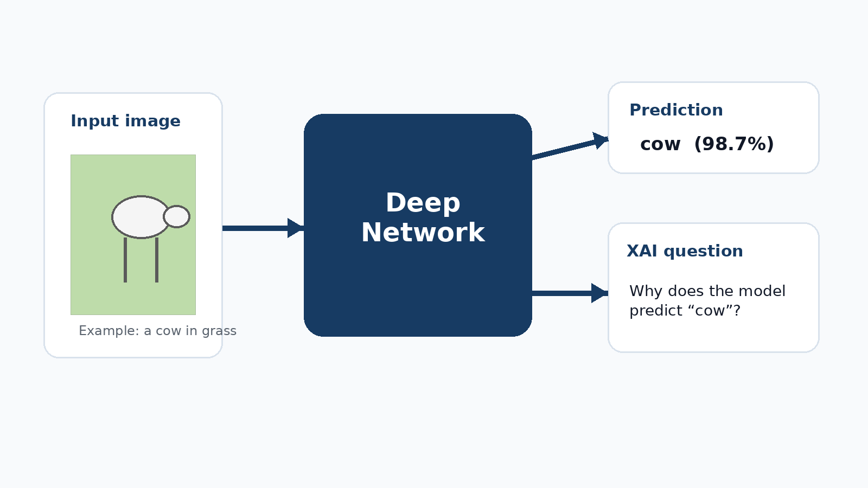
Part A — Explainable AI & Grad-CAM
Main question
Why does the model make this prediction?
This part explains how Grad-CAM turns class-specific gradients into a spatial heatmap.
Prediction
The model predicts "cow" with high confidence.
The Black-Box Problem
We don't know which image features influenced its decision.
Explainable AI (XAI)
Grad-CAM helps visualize which image regions contributed to the prediction.
1. Prediction
The model predicts "cow" with high confidence.
Storyline: XAI motivation → feature maps → gradients → Grad-CAM → limitations → Grad-CAM++.

Slide 3
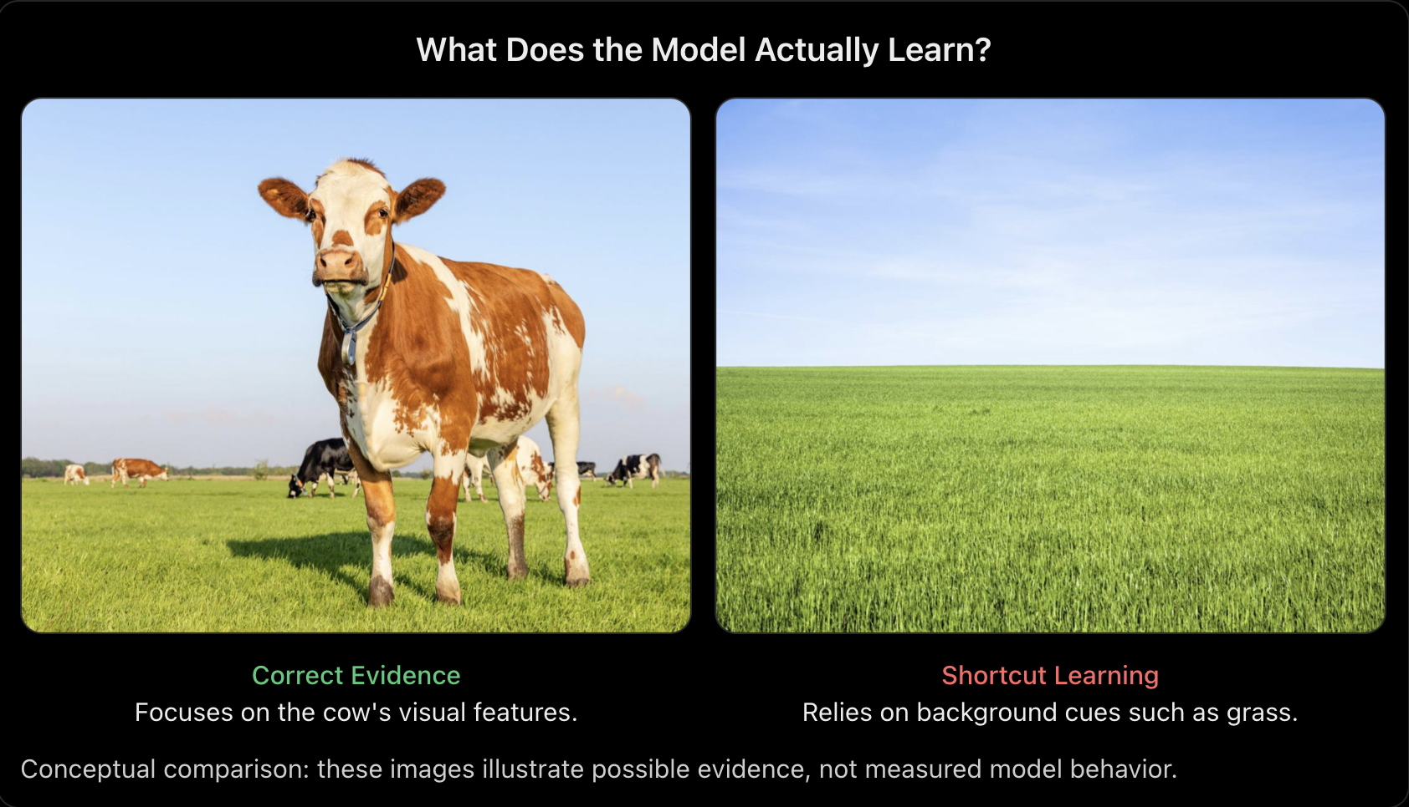
1. Why Explainability?
Correct predictions do not always mean the model learned the right features.
Key points
Black-Box Problem
Deep networks do not directly reveal which visual features drive their predictions.
2. Shortcut Learning
Models may rely on irrelevant background cues instead of the target object.
3. Why Explainability Matters
XAI helps us investigate which image regions contribute to a prediction.

Slide 4
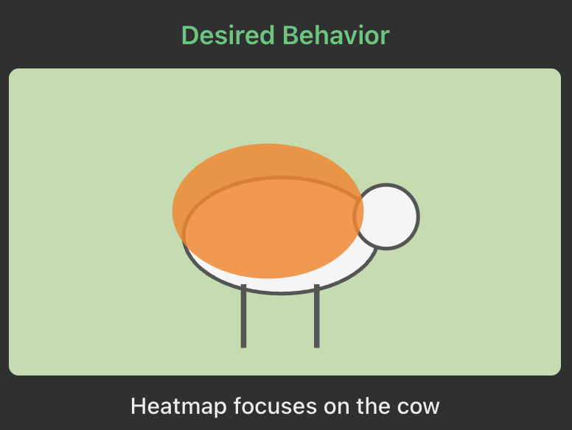
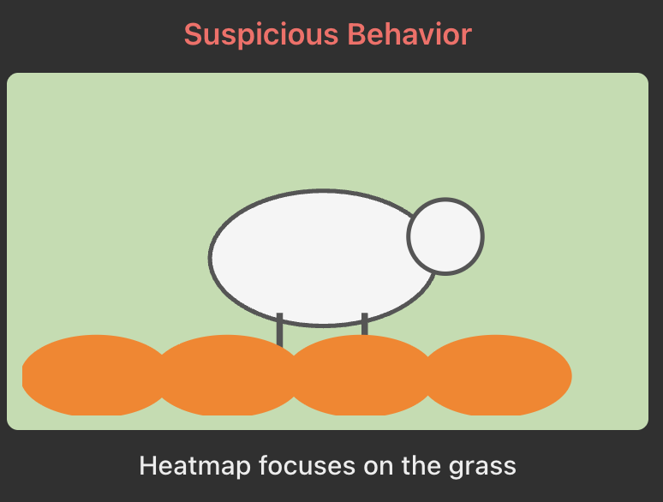
2. Shortcut learning example
Heatmaps can reveal potentially misleading visual evidence.
Key Takeaway
If the heatmap mainly highlights grass, the model may be relying on a background shortcut.

Slide 5
CNN Basics — What Is a Convolutional Neural Network?
A CNN learns visual patterns from an image and builds increasingly useful representations.
INPUT IMAGE
CONVOLUTION
FEATURE MAPS
PREDICTION
→
→
→
Pixels (RGB)
Learned filters
Spatial responses
Class scores
Early CNN layers
Deeper CNN layers
Respond to edges, corners, and textures.
Combine patterns into object parts and concepts.
KEY TAKEAWAY · CNNs produce feature maps that Grad-CAM will analyze.

Slide 6
CNN Basics — How Convolution Works
A small learned filter scans local regions and computes a response at every location.
Input patch (3 × 3)
Filter (3 × 3)
What the filter does
1
2
0
1
0
-1
1. Slides over an input image or feature map.
×
→
−1
0
1
3
1
0
-1
2. Computes a weighted sum at each position.
2
1
1
1
0
-1
3. Produces an output feature map.
Multiply matching cells and add: (1−0) + (0−3) + (2−1) = −1
4. Learns useful visual patterns during training.
KEY TAKEAWAY · One learned filter produces one output channel (feature map).

Slide 7
CNN Basics — Activations and Feature Maps
An activation is a numeric response; a feature map keeps the responses arranged spatially.
Example: two filters respond to different local patterns
How to interpret them
Each cell = one activation at one spatial location.
Larger values = stronger response to that learned pattern.
K feature maps form an activation tensor, A ∈ ℝᴷˣᴴˣᵂ.
Feature Map A: vertical pattern
Feature Map B: horizontal pattern
Grad-CAM uses these maps plus target-class gradients.
KEY TAKEAWAY · Aᵏ is the k-th feature map; Aᵏᵢⱼ is one activation at location (i, j).

Slide 8
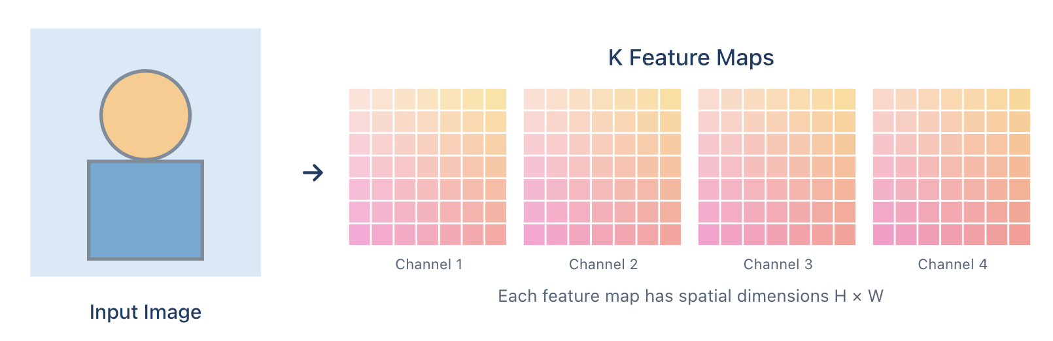
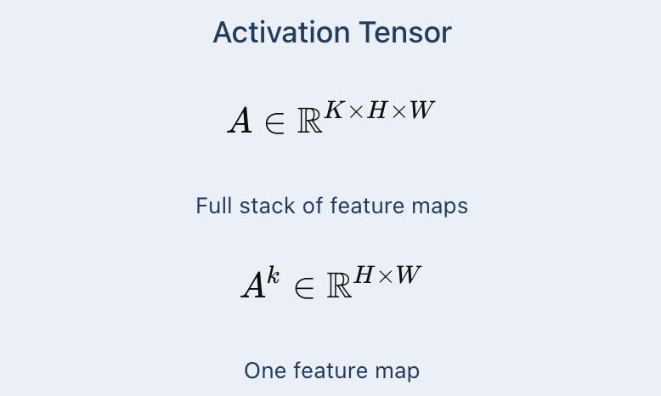
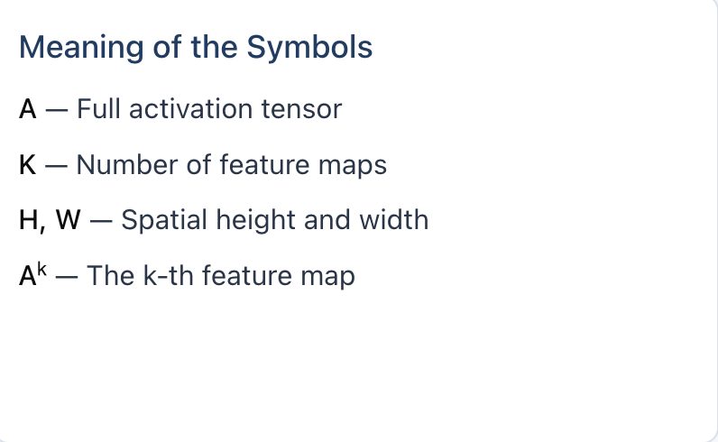
3. CNN feature maps
Before Grad-CAM, we define the activation tensor.

Slide 9
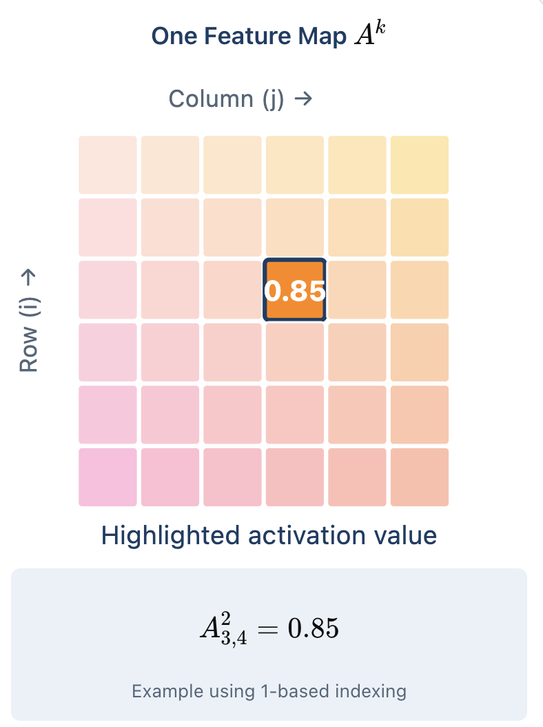
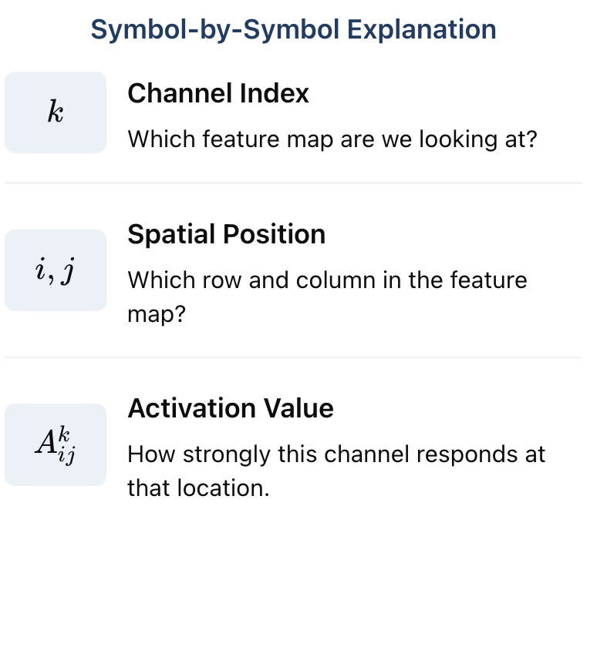
4. What does Aᵏᵢⱼ mean?
Each cell in a feature map represents an activation value at a specific spatial position.

Slide 10
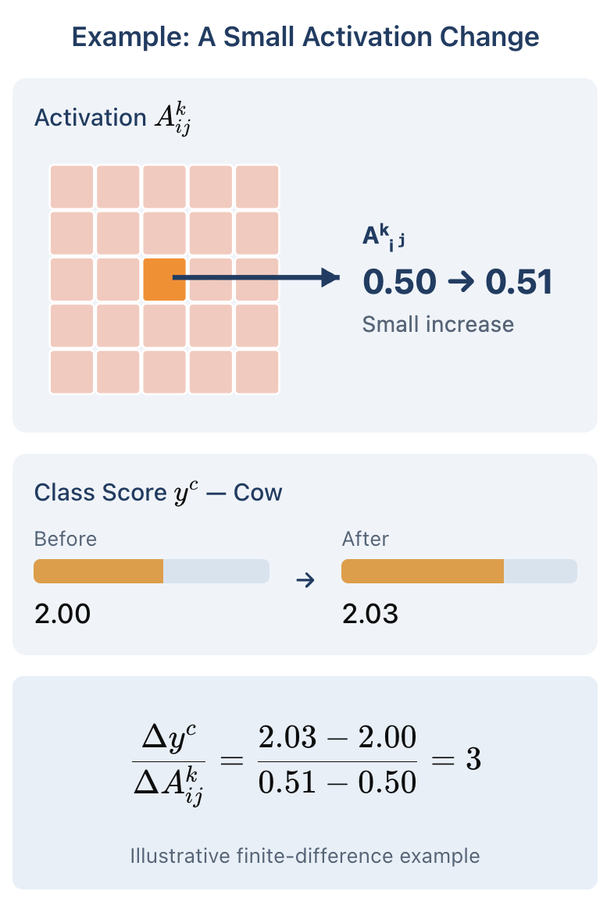
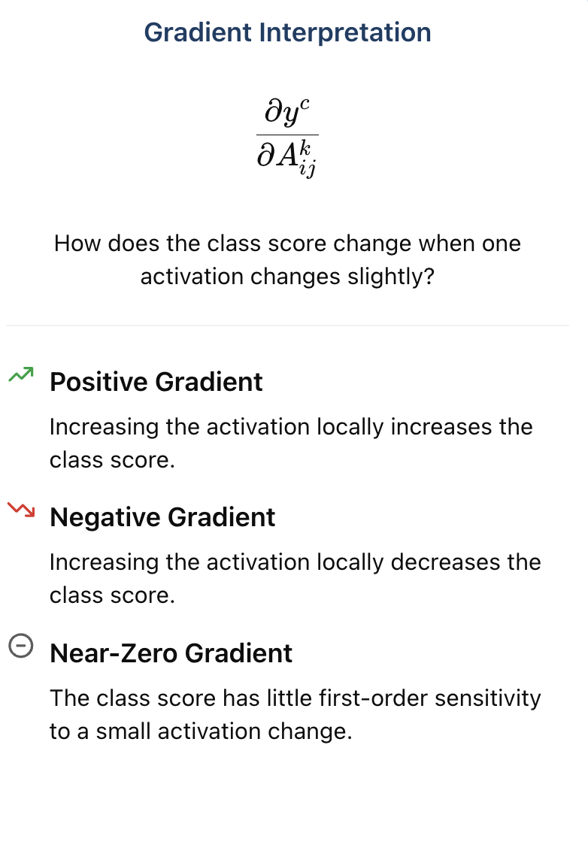
5. What does a gradient mean?
A gradient measures how sensitive the class score is to a small change in an activation

Slide 11
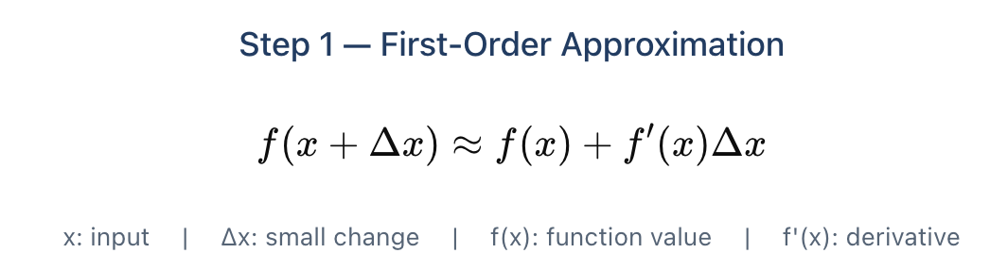
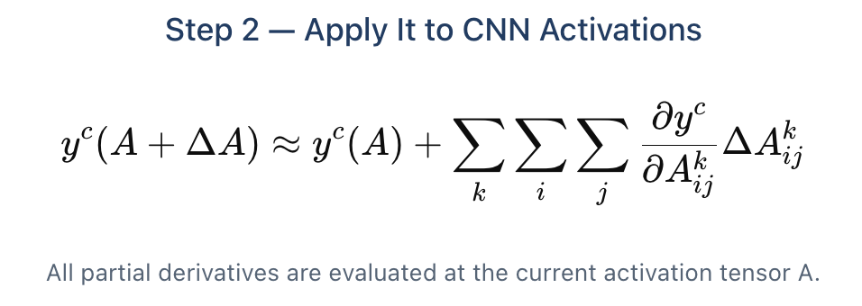
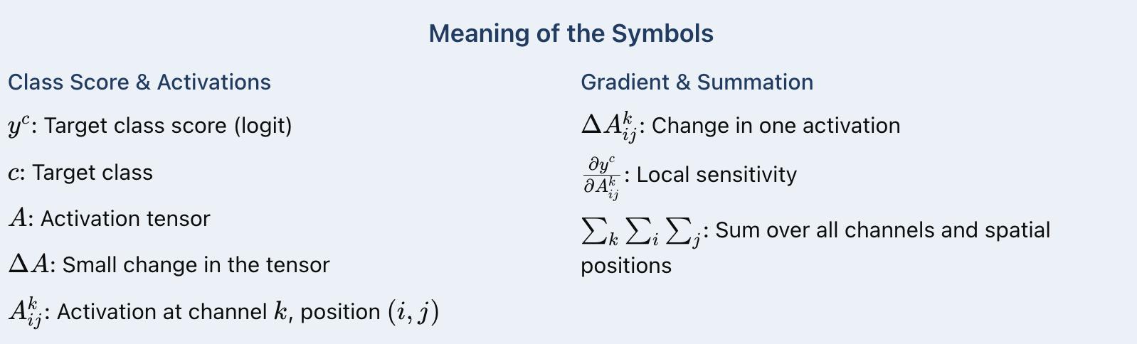
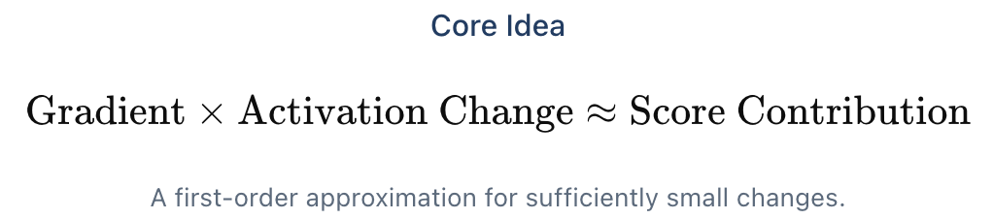
6. First-Order Taylor Approximation
How do gradients approximate changes in the class score?

Slide 12

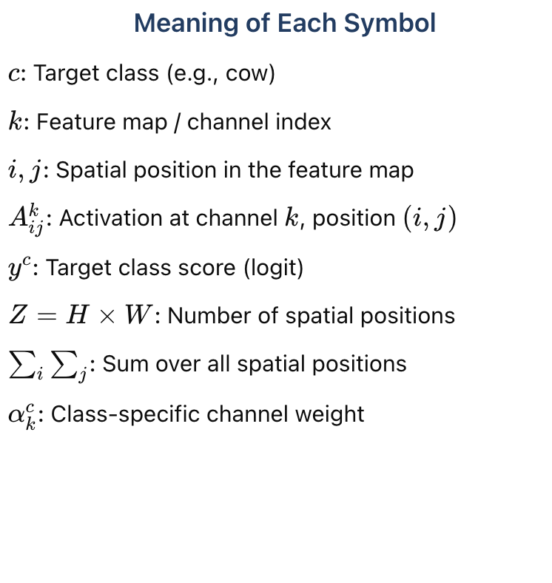
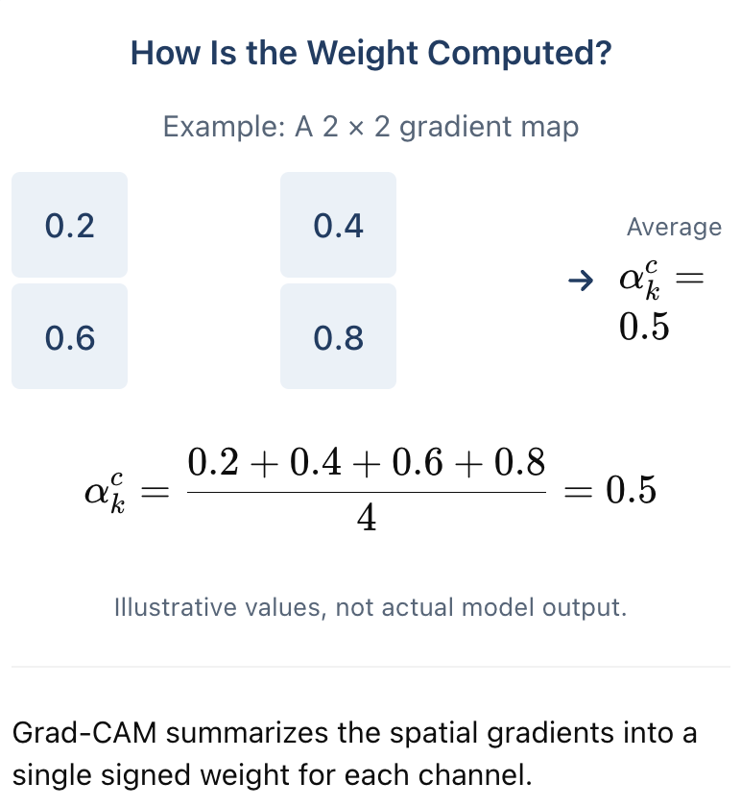
7. Grad-CAM Step 1 — channel importance
Average spatial gradients to get one class-specific weight per channel.

Slide 13
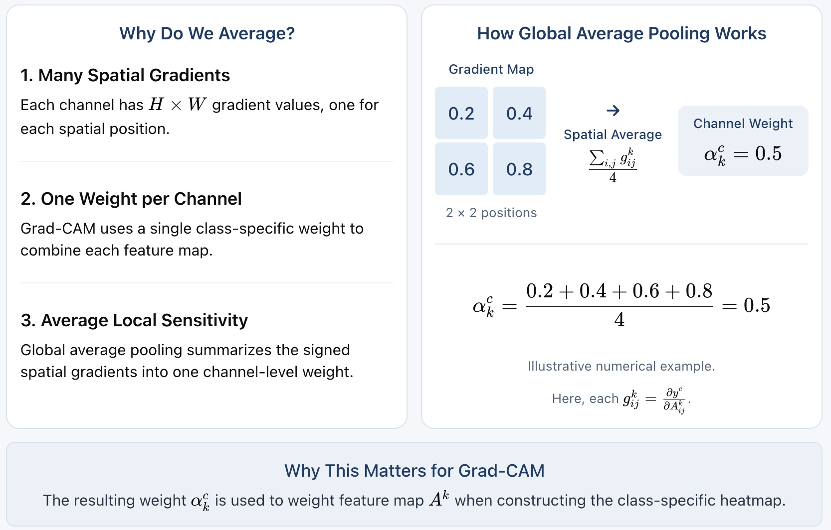
8. Why global average pooling the gradients?
Grad-CAM summarizes spatial gradients into one class-specific weight per channel.
Gradient map: gᵏᵢⱼ = ∂yᶜ/∂Aᵏᵢⱼ (target class c)
Each gᵏᵢⱼ is a gradient for class c.

Slide 14
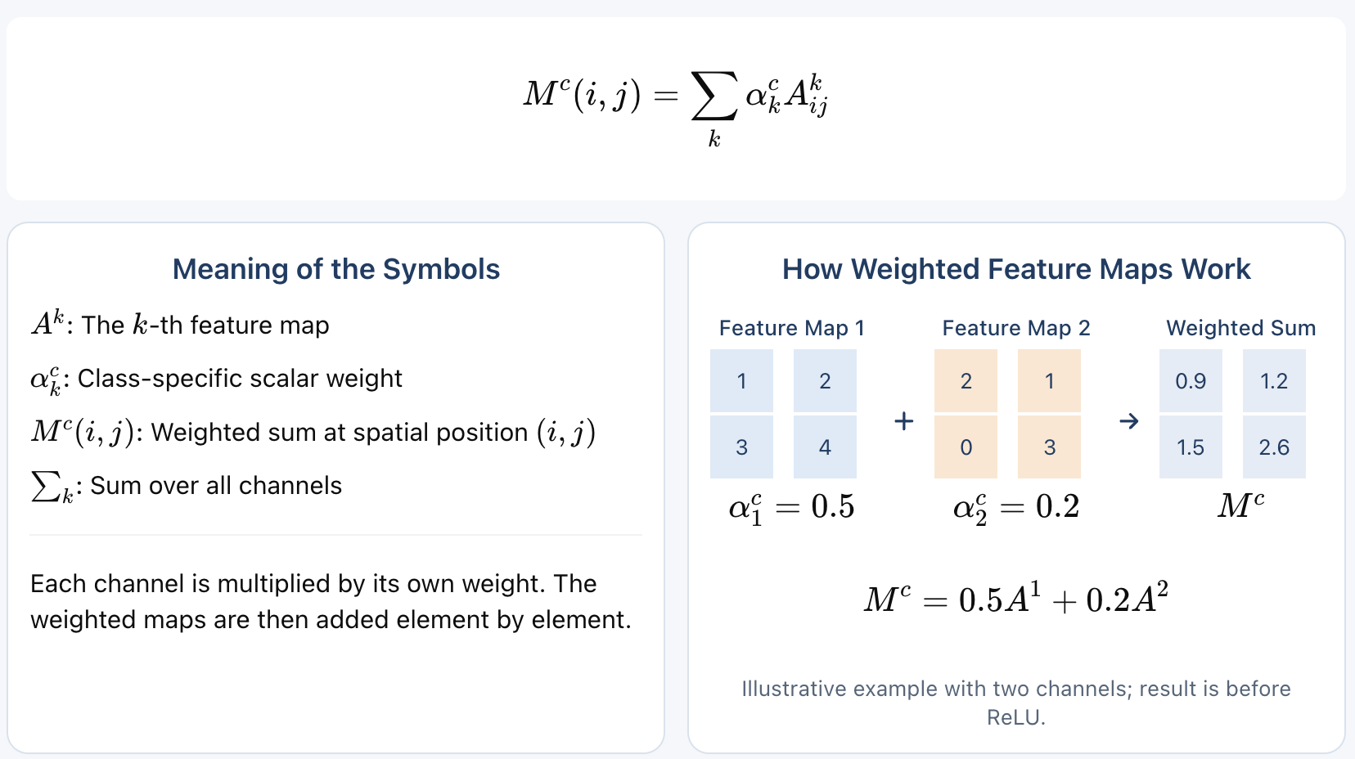
9. Grad-CAM Step 2 — weighted feature maps
Multiply each feature map by its class-specific weight, then sum across channels.

Slide 15
10. Grad-CAM Step 3 — ReLU and Final Heatmap
Keep positive values in the class-specific weighted map and suppress negative values.
LᶜGrad-CAM = ReLU( Σₖ αᶜₖ Aᵏ )
ReLU(x) = max(0, x)
Meaning of the Symbols
Before and After ReLU
LᶜGrad-CAM
Final heatmap for target class c
Before ReLU · Mᶜ
After ReLU · Lᶜ
c
Target class (e.g., cow)
Aᵏ
The k-th feature map
1.2
-0.5
1.2
0.0
αᶜₖ
Class-specific channel weight
Σₖ
Sum over all channels
0.8
-1.0
ReLU
0.8
0.0
ReLU
Set negative values to zero
ReLU(−0.5) = 0 · ReLU(1.2) = 1.2
x
Input value to ReLU(x)
ReLU keeps positive weighted-map values.
Illustrative numbers; ReLU is applied element by element.
Next: resize and overlay the resulting heatmap on the input image for visualization.

Slide 16
11. Full Grad-CAM Pipeline
From an input image to a class-specific visual explanation
01
Input Image
02
CNN Feature Maps
03
Target-Class Gradients
Choose the image
Extract spatial activations
Choose target class c = cow
∂yᶜ / ∂Aᵏᵢⱼ
gradient for class “cow”
Continue to steps 04–06 below ↓
04
Average Gradients
05
Weighted Sum
06
ReLU Heatmap
One weight per channel
Combine feature maps
Keep positive weighted values
αᶜₖ = (1/Z) Σᵢ Σⱼ ∂yᶜ/∂Aᵏᵢⱼ
Mᶜ = Σₖ αᶜₖ Aᵏ
Lᶜ = ReLU(Mᶜ)
Z = H × W
spatial map before ReLU
Visualize:
Upsample → normalize/colorize → overlay heatmap on the input image

Slide 17
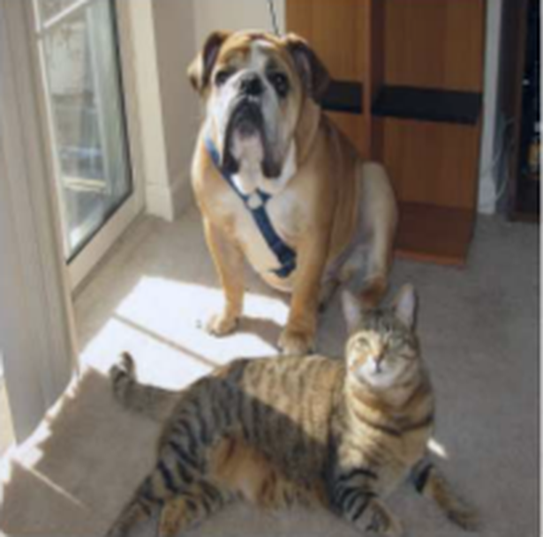
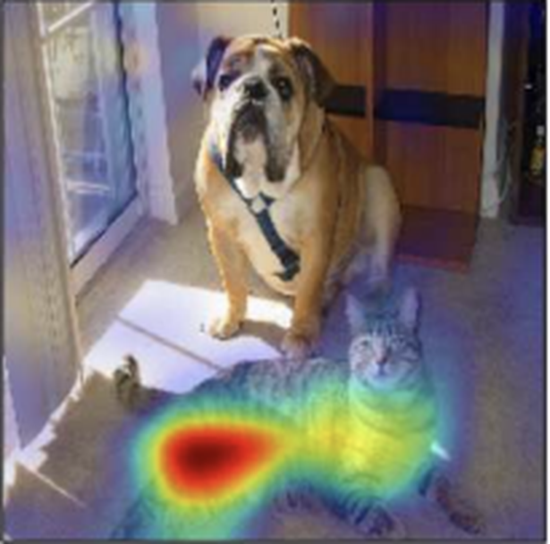
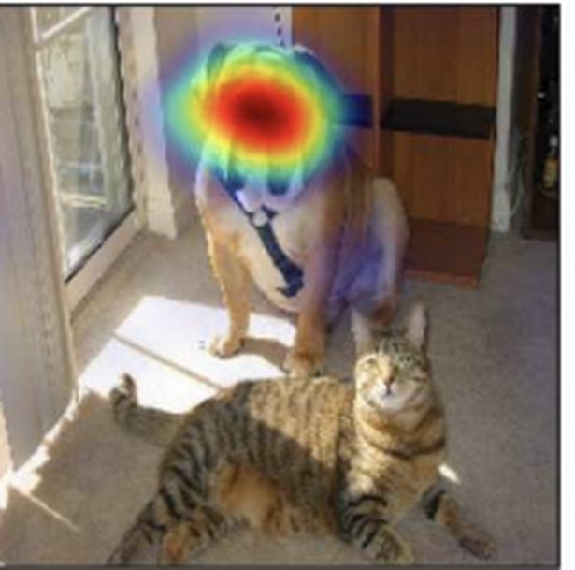
12.Published Experiment — Does the Target Class Matter?
From Grad-CAM steps to a real ICCV 2017 result: one input image, two target classes.
01 Same input image
02 Target: “Cat”
03 Target: “Dog”
A cat and a dog appear together.
High-response region: the cat.
High-response region: the dog’s head.
Research question
Does the highlighted region change when we change only the target class?
RESULT The heatmap shifts from cat to dog → Grad-CAM is class-discriminative.
Selvaraju et al., “Grad-CAM: Visual Explanations from Deep Networks via Gradient-based Localization,” ICCV 2017, Fig. 1.

Slide 18
13. Why the Last Convolutional Layer?
It offers a useful balance between semantic information and spatial structure.
Semantic Information vs. Spatial Detail
Why Grad-CAM Commonly Uses It
Early Conv Layers
Last Conv Layer
Fully Connected
Early layers
Fine spatial detail, but predominantly lower-level features.
Last convolutional layer
More class-relevant semantic features while retaining spatial organization.
More spatial detail
Useful trade-off
Less spatial layout
Edges, textures, local patterns
Richer semantic features
High-level classification features
Fully connected layers
Usually higher-resolution maps
Still preserves a spatial grid
Typically no explicit H × W map
Often encode class information but lack an explicit 2D spatial feature map.
Conceptual comparison; actual resolution and semantics depend on the CNN architecture.
Other suitable spatial layers may also be used.
Grad-CAM commonly computes target-class gradients with respect to the last convolutional feature maps.

Slide 19
14. Limitations of Grad-CAM
Grad-CAM is useful for visualization, but its explanations have important limitations.
Coarse Resolution
Local Gradient Sensitivity
Multiple-Instance Localization
Not a Causal Proof
Model
?
Heatmaps are often low-resolution and may miss fine image details.
Important regions may have weak gradients due to saturation or local insensitivity.
Grad-CAM may highlight only some instances of the same class.
A heatmap suggests class-supporting regions but does not establish causality.
Key point: Grad-CAM provides an approximate spatial explanation—not pixel-precise localization or causal proof.

Slide 20
15. Grad-CAM++ — Refined Channel Weighting
What changes from Grad-CAM? The method used to compute each channel weight.
Ordinary Grad-CAM
Grad-CAM++
Uniform spatial averaging of gradients
Spatially weighted positive gradients
αᶜₖ = (1/Z) Σᵢⱼ ∂yᶜ/∂Aᵏᵢⱼ
wᶜₖ = Σᵢⱼ βᵏᶜᵢⱼ ReLU(∂Yᶜ/∂Aᵏᵢⱼ)
Meaning of the Symbols
What is actually different?
c
target class (e.g., cow)
Grad-CAM averages gradients uniformly.
Grad-CAM++ uses location-dependent coefficients when computing weights.
Both methods end with one scalar weight per channel.
k
feature-map / channel index
(i, j)
spatial position in a feature map
Aᵏᵢⱼ
activation at channel k, location (i, j)
βᵏᶜᵢⱼ
location-dependent coefficient (uses higher-order derivatives)
wᶜₖ
final class-specific scalar weight for channel k
Precision note: Yᶜ is a positive class-score function in the Grad-CAM++ derivation; do not silently substitute a raw logit.

Slide 21
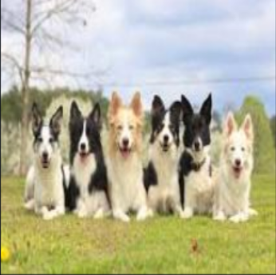
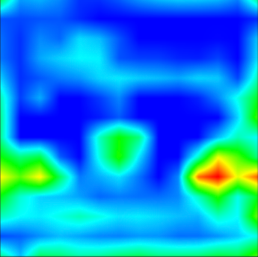
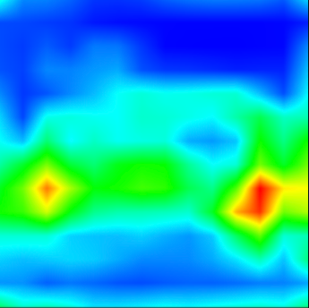
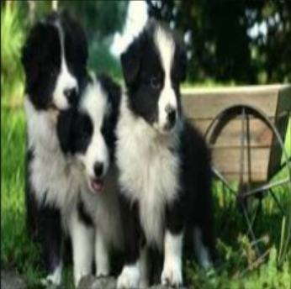
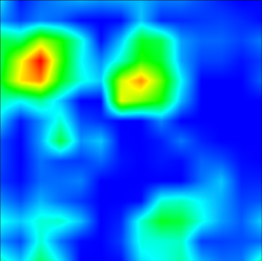
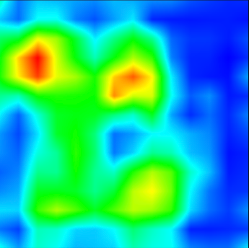
16. Grad-CAM++ — Real Comparison: Multiple Dogs
Published results: does spatially weighted gradient pooling cover more instances?
Original image
Grad-CAM
Grad-CAM++
01
Multiple dogs — example 1
02
Multiple dogs — example 2
KEY FINDING The paper reports improved coverage of multiple same-class instances in these examples.
Source: Chattopadhyay et al., “Grad-CAM++: Generalized Gradient-Based Visual Explanations for Deep Convolutional Networks,” WACV 2018. Author-provided qualitative comparison: github.com/adityac94/Grad_CAM_plus_plus (images/grad-campp.png).

Slide 22
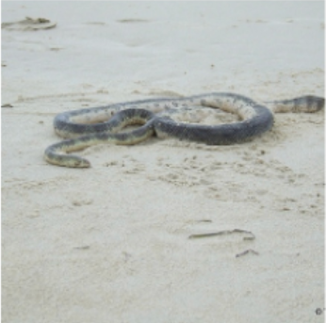
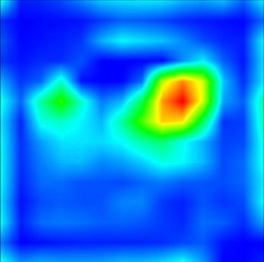
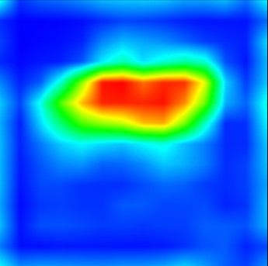
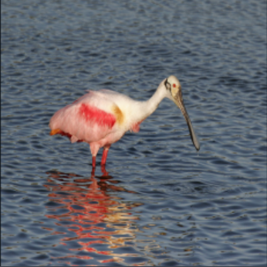
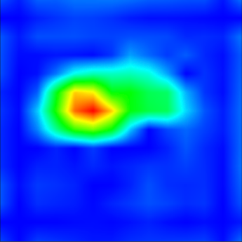
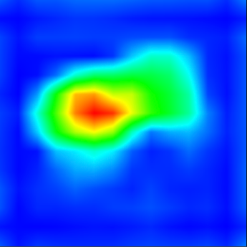
17. Grad-CAM++ — Does the Difference Generalize?
The authors also compare localization for a snake and a bird, beyond multi-dog scenes.
Original image
Grad-CAM
Grad-CAM++
01
Snake (single-object example)
02
Bird (single-object example)
KEY FINDING The paper shows improvements in some single-object examples; results are image-dependent.
Source: Chattopadhyay et al., “Grad-CAM++: Generalized Gradient-Based Visual Explanations for Deep Convolutional Networks,” WACV 2018. Author-provided qualitative comparison: github.com/adityac94/Grad_CAM_plus_plus (images/grad-campp.png).

Slide 23
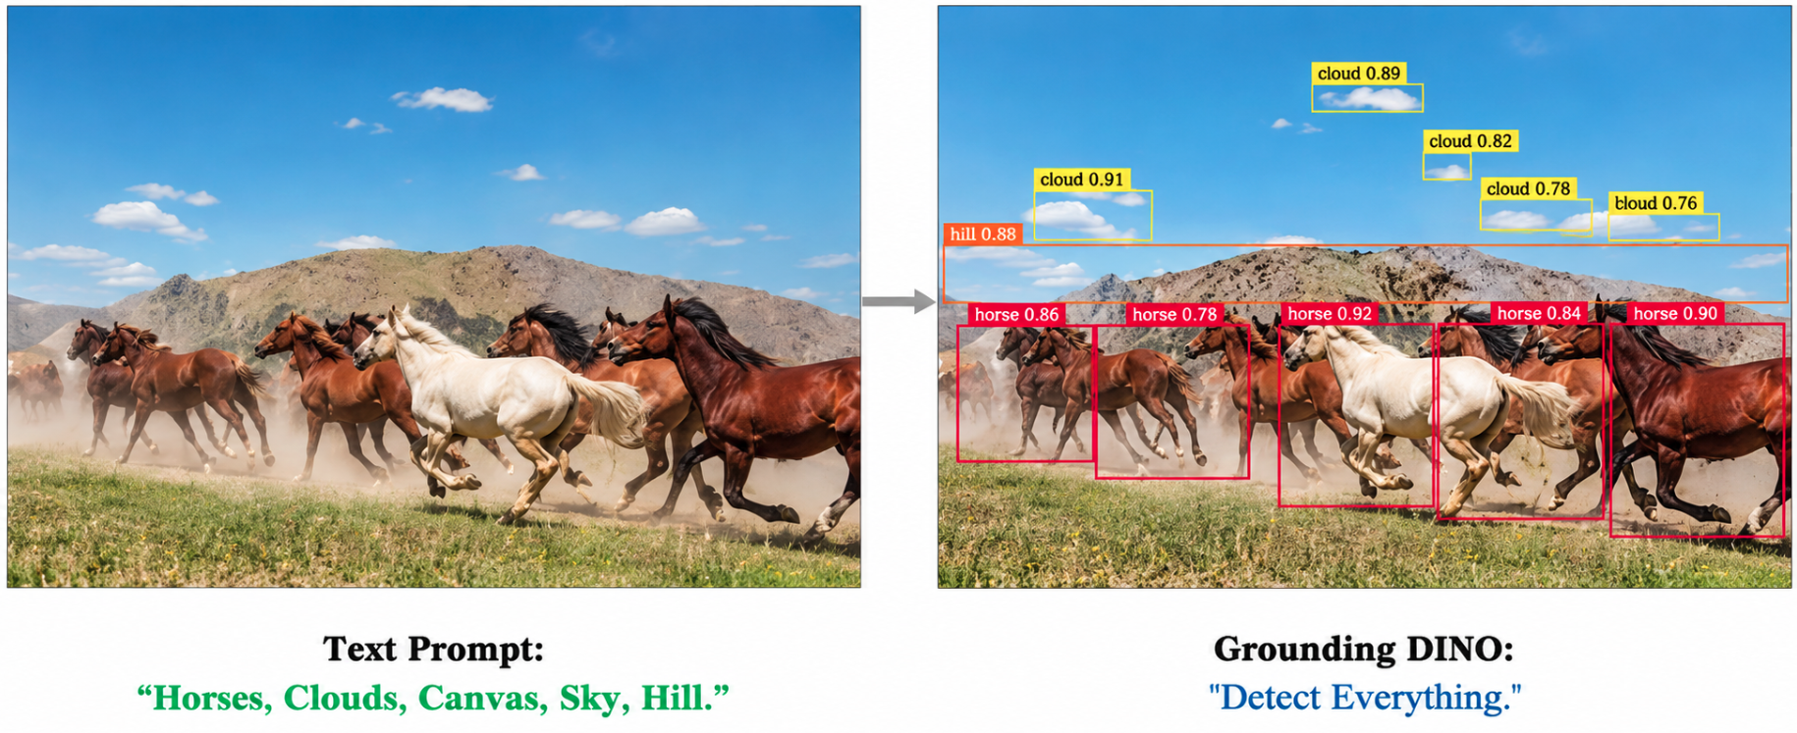
Grounding DINO

Slide 24
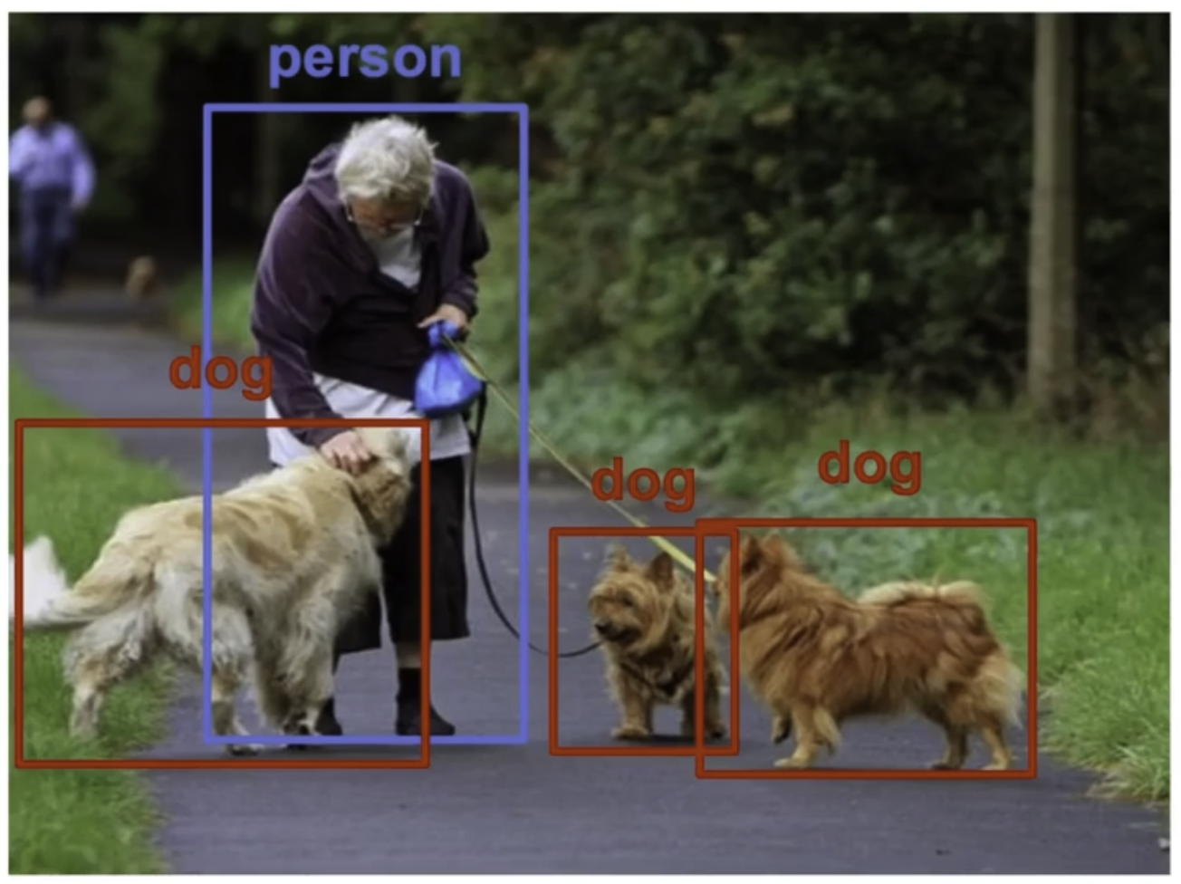

Closed-Set Object Detection
Find me all the object you have been trained to detect.

Slide 25
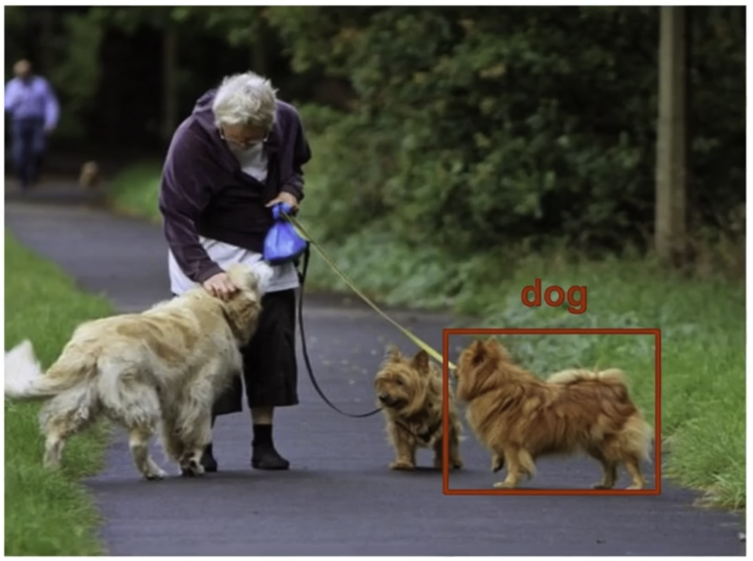
Opened-Set Object Detection
Find me the right-most dog in this stage.

Slide 26
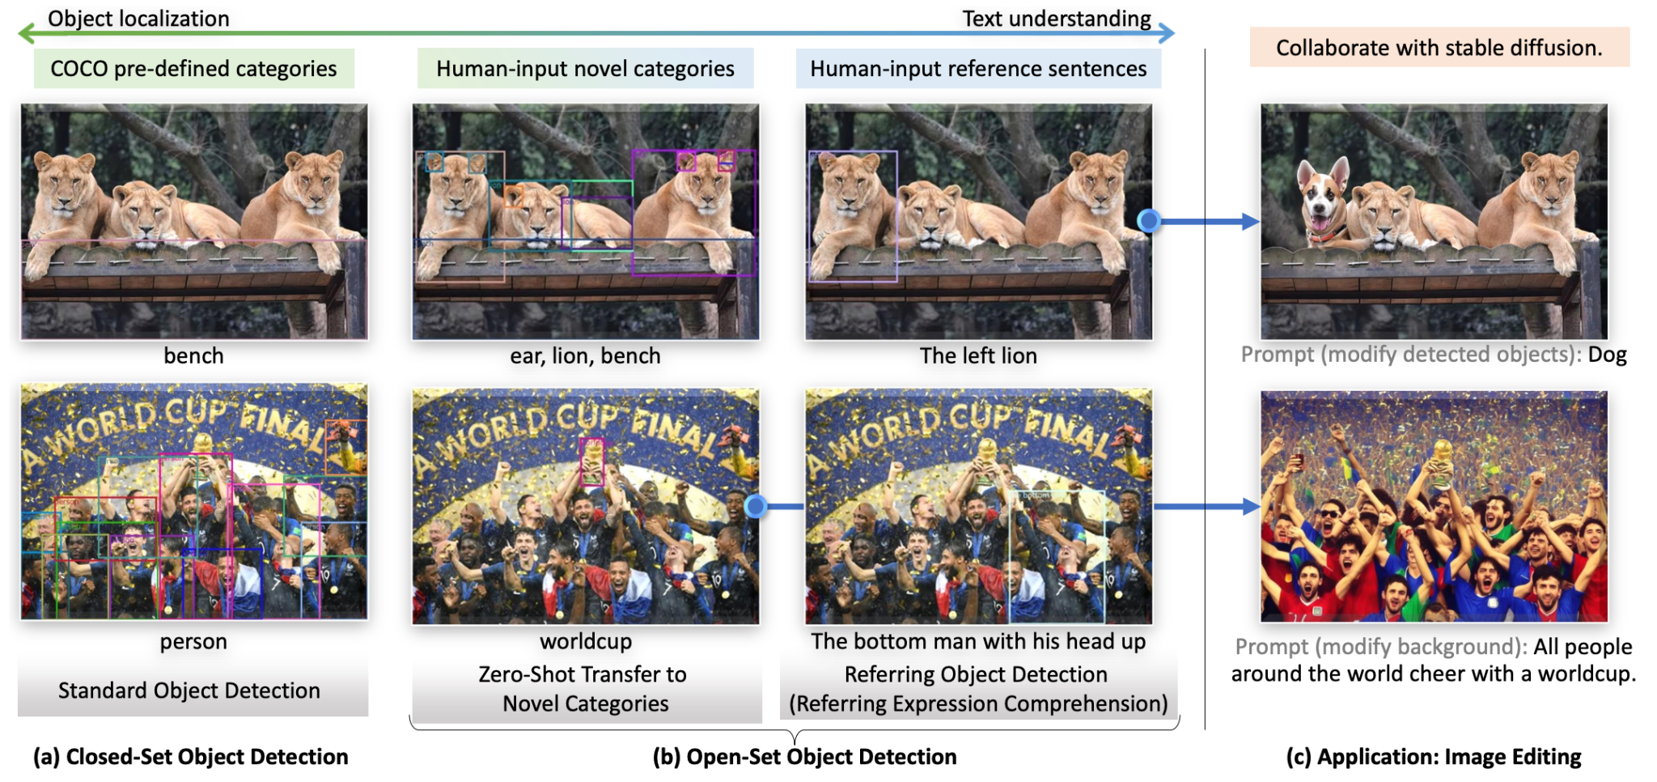

Slide 27
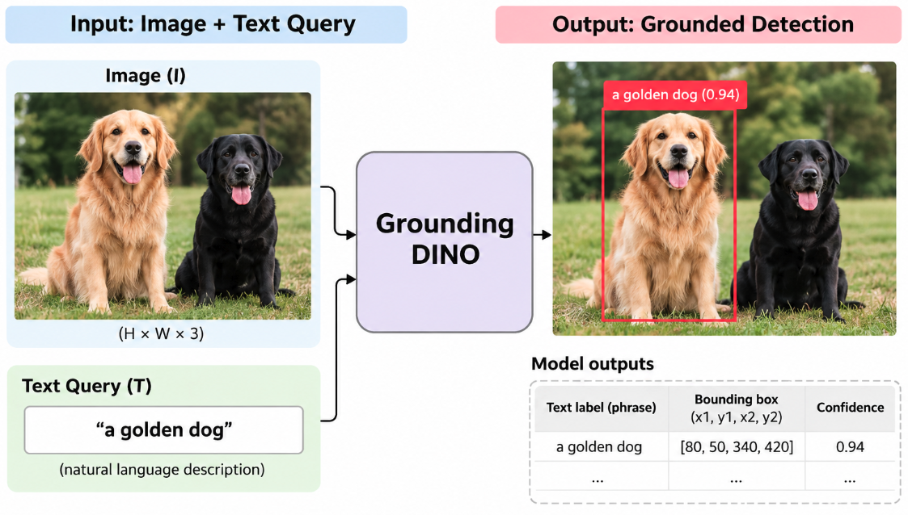
Grounding DINO: Input and Output
Key Points
Input: An image and a text prompt describing target objects.
Output: Bounding boxes and text-alignment scores for detected objects.
Grounding DINO enables open-set object detection using natural language.

Slide 28
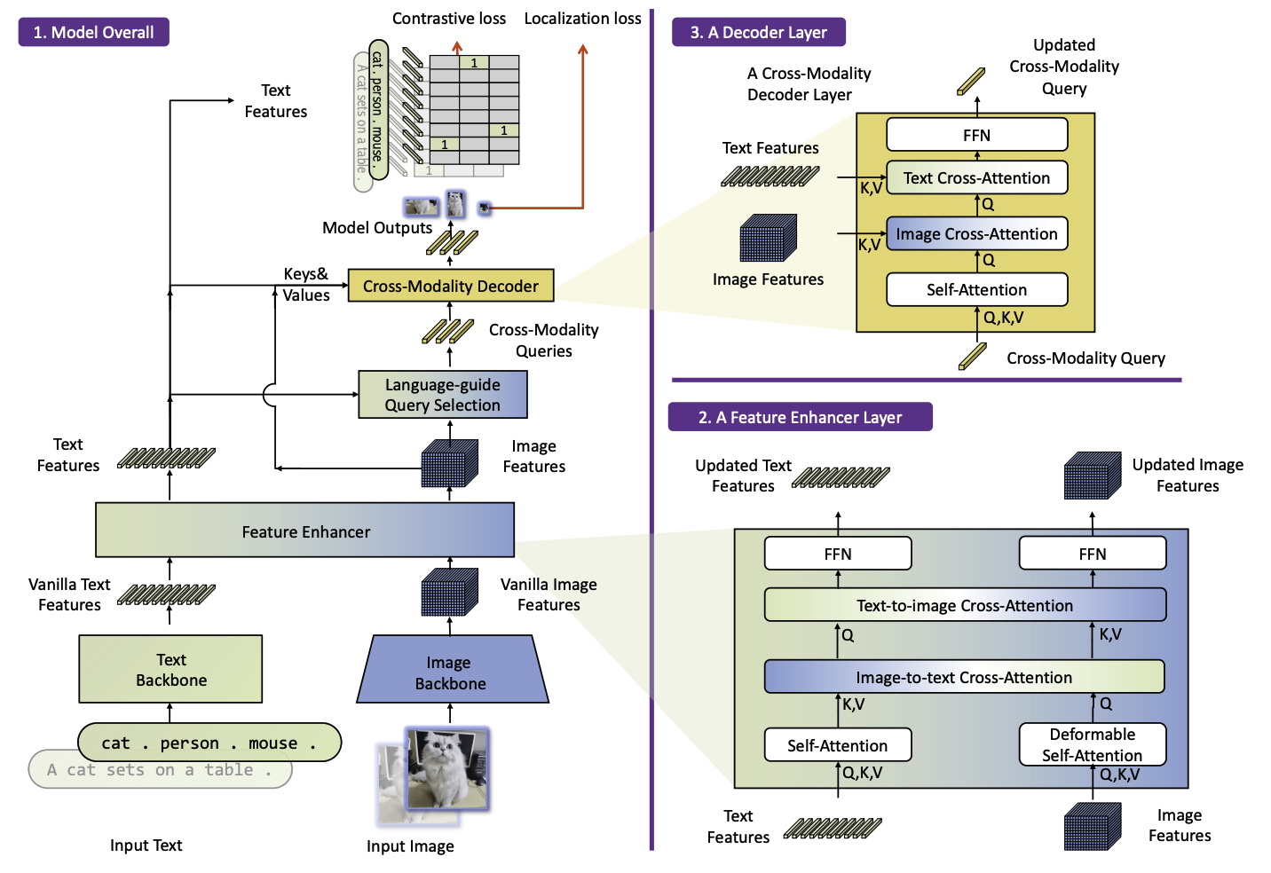
Grounding DINO Architecture

Slide 29
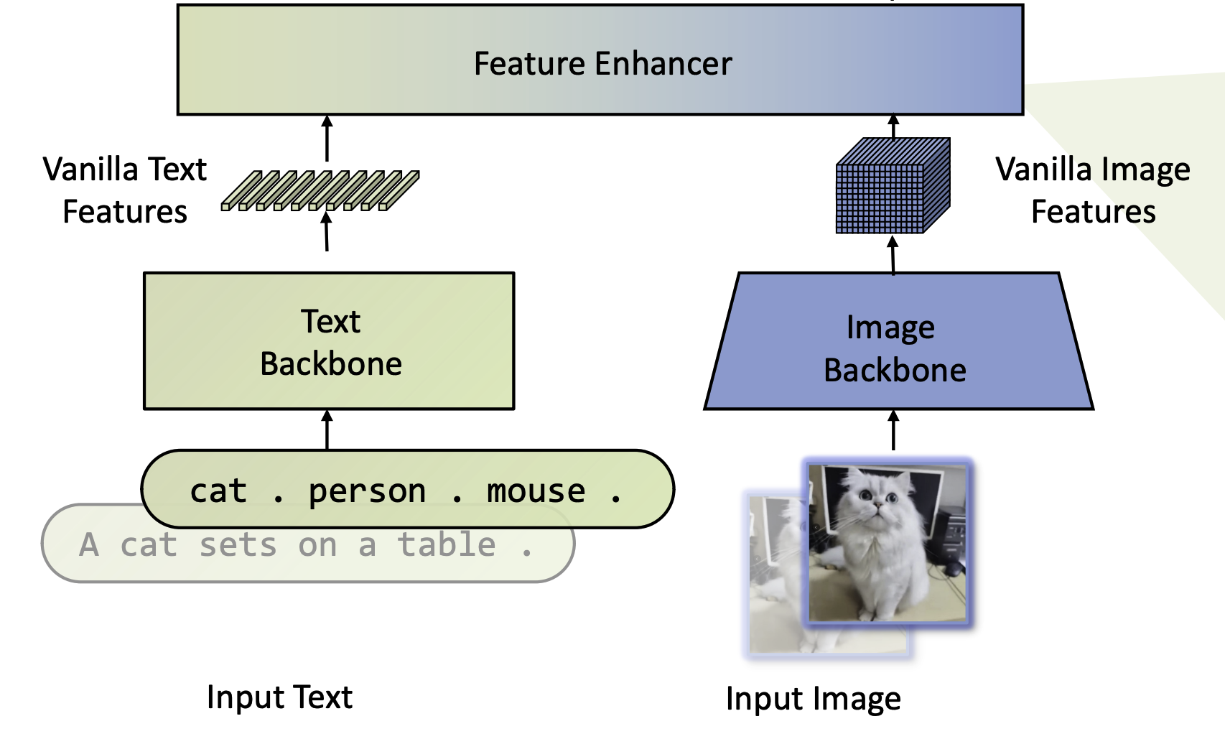
Feature Enhancer

Slide 30
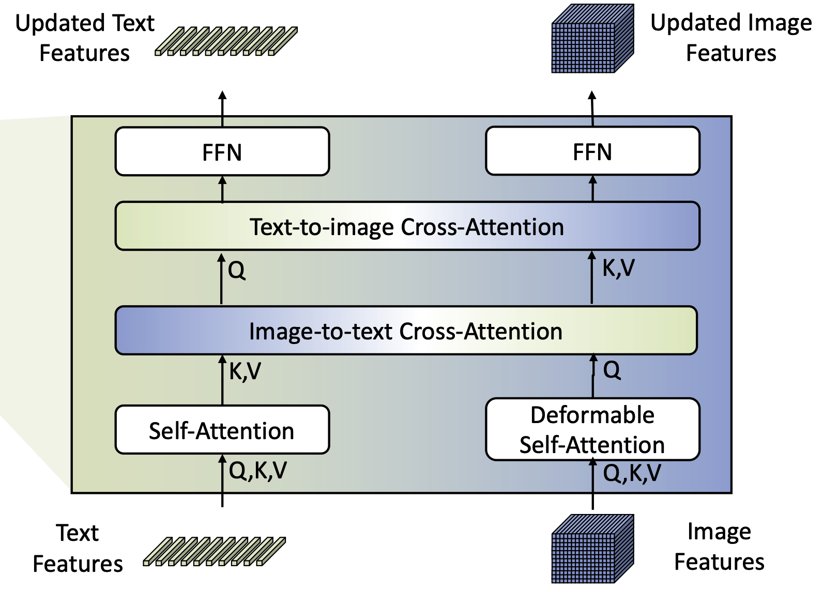
Feature Enhancer

Slide 31
Feature Enchancer

Slide 32
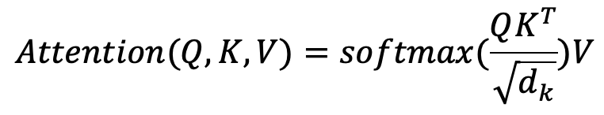
Feature Enhancer
Scaled Dot-Product Attention
Q(Query): Represents the information being searched for.
K(Key): Determines the relevance of different features.
V (Value): Provides the information to be aggregated.
d_{k} : Dimension of the key vectors, used for scaling.
Core Components
Self-Attention: Refines features within each modality.
Cross-Attention: Exchanges information between image and text features.
FFN (Feed-Forward Network): Further transforms the updated features.

Slide 33
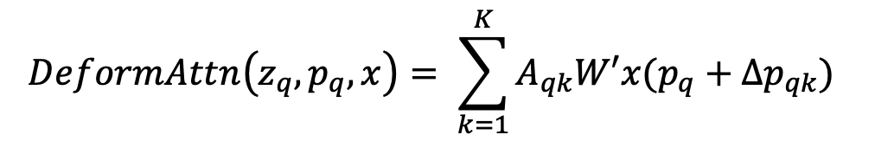
Feature Enhancer: Adaptive Spatial Feature Aggregation
Spatial Sampling and Aggregation
p_{q}: Reference point.
Δp_{qk}: Learned sampling offset.
A_{qk}: Attention weight.
K: Number of sampling points.
Key Idea
Samples a small set of spatial locations around reference points.
Uses learned offsets to determine where to sample features.
Aggregates sampled visual features using learned attention weights.
Unlike standard self-attention, it does not rely on explicit query–key dot-product matching.

Slide 34
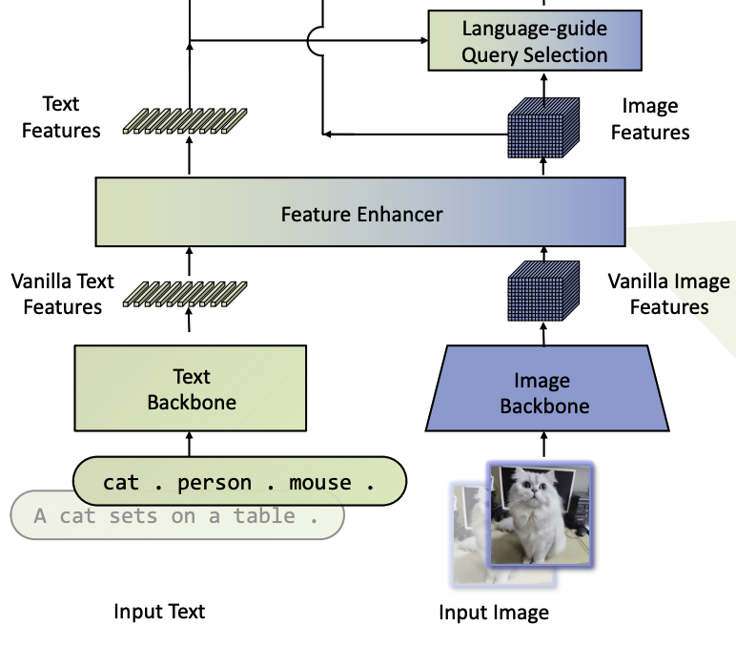
Language-guide Query Selection

Slide 35
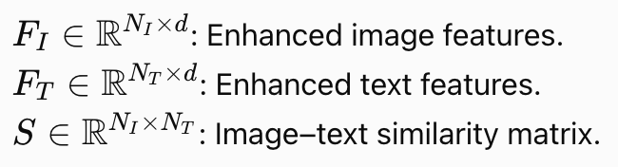

Language-guide Query Selection: Similarity Calculation
Image–Text Similarity
Core Steps
Compute dot-product similarities between image and text features.
Generate an image–text similarity matrix.
Use similarity scores to identify text-relevant image features.
Key Idea: Language provides semantic guidance for selecting relevant image regions.

Slide 36


Language-guide Query Selection: Top-K Selection
Step 1: Maximum Similarity
Step 2: Top-K Selection
For each image feature, find its highest similarity score across all text tokens.
Select the indices of the K highest-scoring image features.
Query Initialization
Selected image positions initialize the positional part of decoder queries.
Query content embeddings are learnable parameters.
Key Idea: Text relevance determines which image positions are selected for detection.

Slide 37
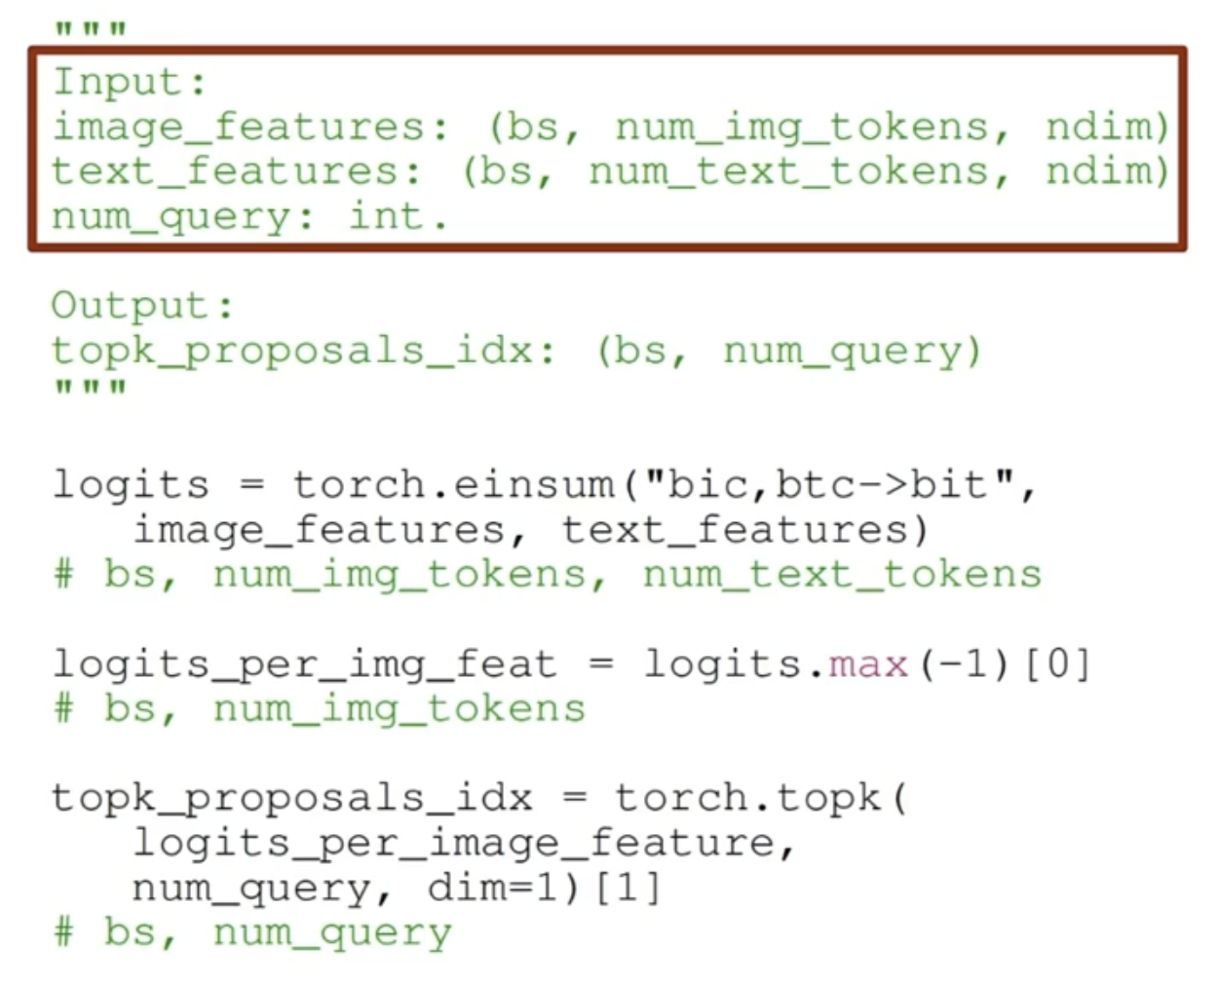
Language-guide Query Selection
Generates a ixt matrix

Slide 38
Language-guide Query Selection
Returns the top num_query most relevant features.

Slide 39
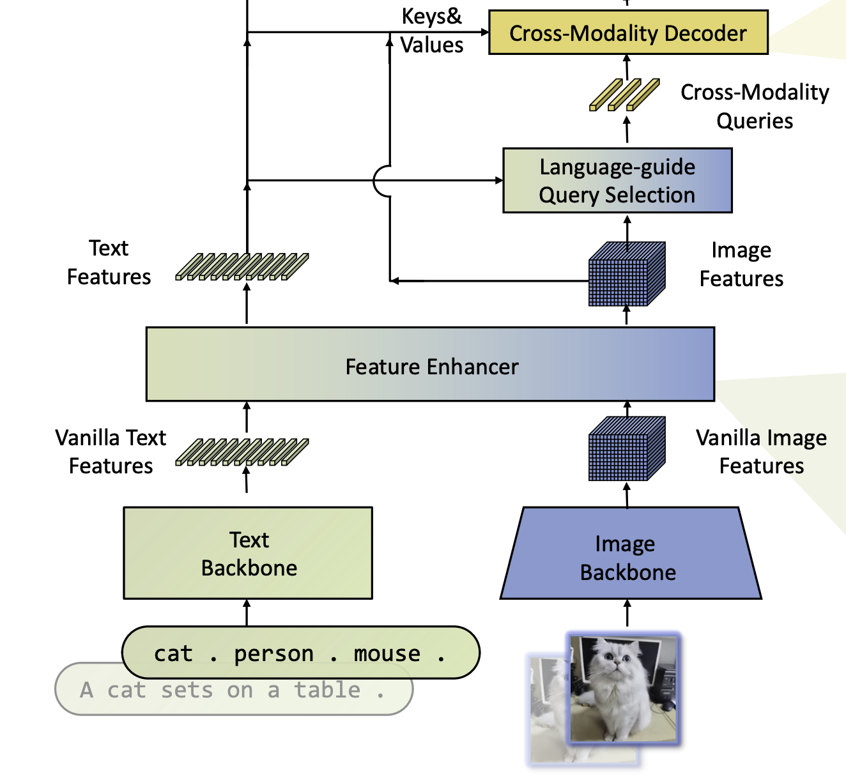
Cross-Modality Decoder

Slide 40
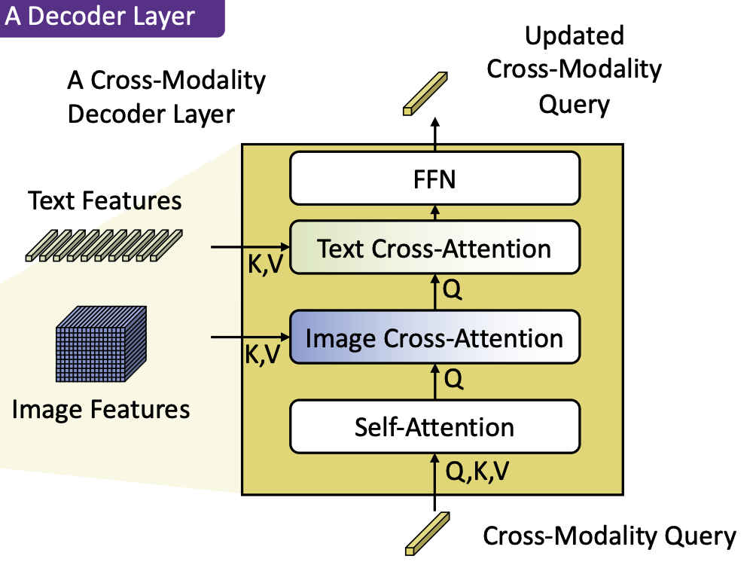
Cross-Modality Decoder

Slide 41
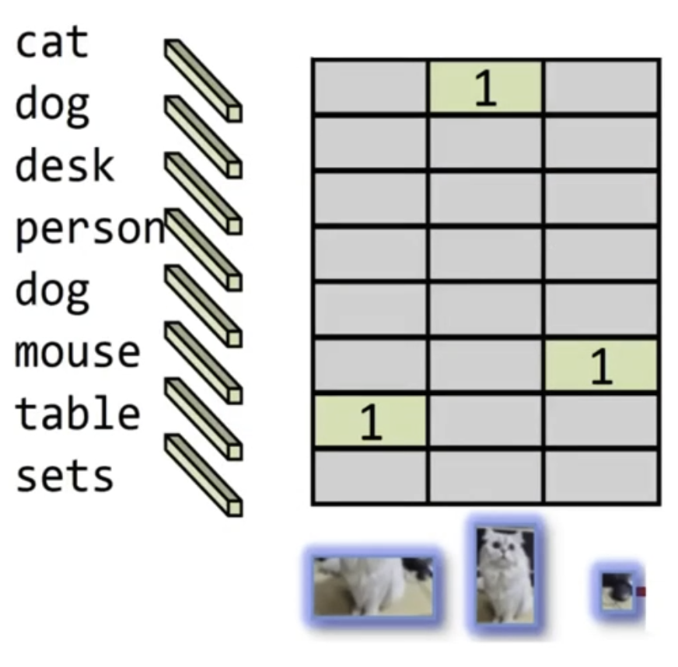

Loss
Contrastive Loss
DETR Loss

Slide 42



Contrastive Classification Loss
Object–Text Matching Logits
Sigmoid Focal Loss
Key Idea: The classification objective encourages correct alignment between predicted objects and text tokens.

Slide 43




Bounding Box Localization Loss
Combined Bounding Box Loss
Intersection over Union (IoU)
Generalized IoU (GIoU)
Key Idea: L1 Loss improves coordinate accuracy, while GIoU Loss improves spatial alignment.

Slide 44
Thank you

