Slide 1
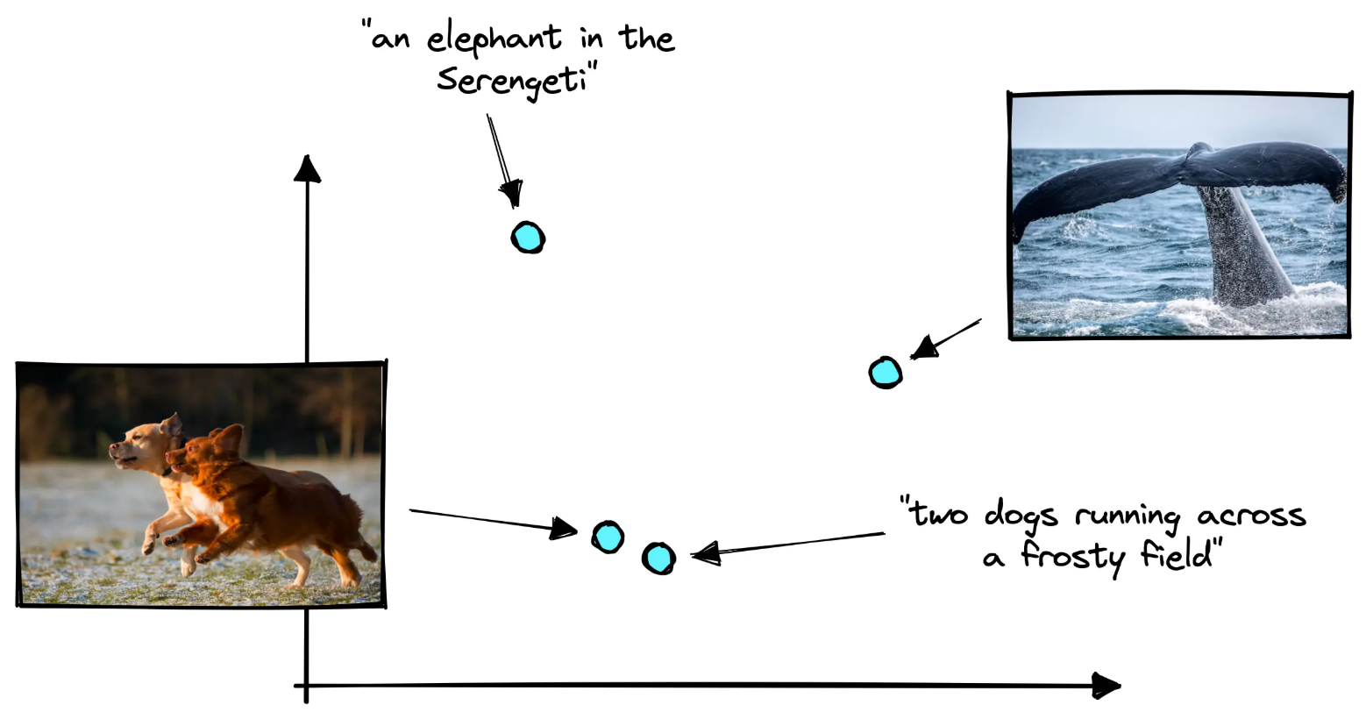
Contrastive
Vision–Language Models
Ying Jin · Temple University
CIS 5590 · Fall 2026
1
Notes:
contrastive vision–language models

Slide 2
COURSE MAP
Lecture roadmap
I
Motivation
II
Contrastive foundations
III
CLIP architecture and use
Why align images and language in one space?
How does a contrastive loss learn a shared space?
How is CLIP built, trained, and used?
IV
Evaluation and robustness
V
Reproduction
VI
Limitations and takeaways
Does it generalize under distribution and task shift?
Can we watch the mechanism run on a few examples?
Where does it break, and what should we remember?
Contrastive Vision–Language Models · CIS 5590 · Fall 2026

Slide 3
COURSE MAP
Lecture roadmap
I
Motivation
II
Contrastive foundations
III
CLIP architecture and use
Why align images and language in one space?
How does a contrastive loss learn a shared space?
How is CLIP built, trained, and used?
IV
Evaluation and robustness
V
Reproduction
VI
Limitations and takeaways
Does it generalize under distribution and task shift?
Can we watch the mechanism run on a few examples?
Where does it break, and what should we remember?
Contrastive Vision–Language Models · CIS 5590 · Fall 2026

Slide 4
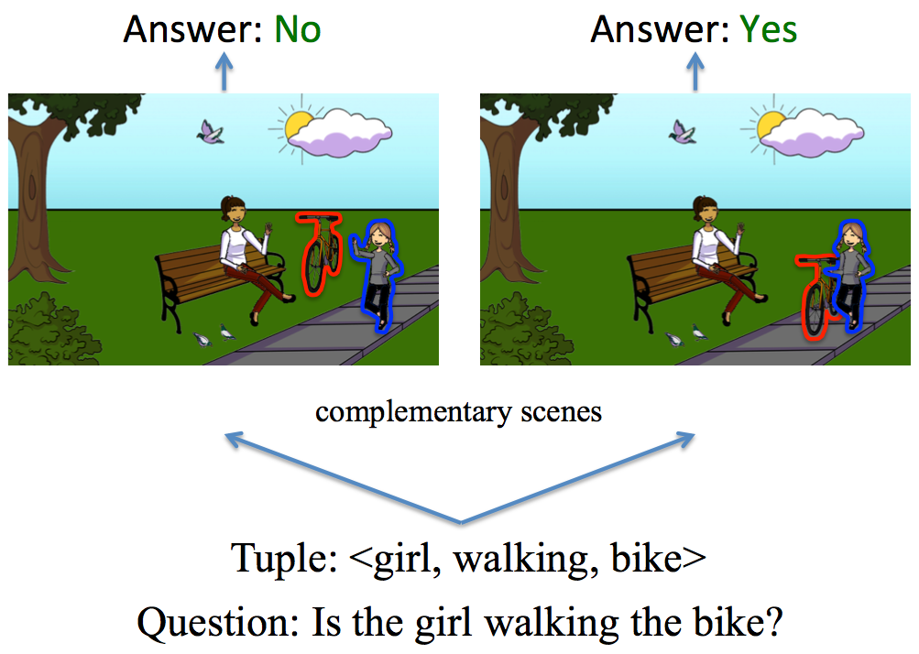
PART I · MOTIVATION
Why vision–language models?
Vision models alone
Classify, detect, segment — over a fixed label set.
Language models alone
Predict the next token, generate and answer text.
Tasks that need both
Captioning · VQA · image–text retrieval · zero-shot classification with text prompts
VQA: the same question needs the image to be answered (Goyal et al., 2017).
Contrastive Vision–Language Models · CIS 5590 · Fall 2026
Notes:
two separate fields.

Slide 5

PART I · MOTIVATION
The image–text alignment problem
Image = continuous signal
An H × W × 3 array of pixel intensities.
Text = discrete symbols
A sequence of tokens from a finite vocabulary.
Goal: one shared space
Learn two encoders whose outputs are directly comparable.
Matched image–caption pairs close together; unrelated pairs far apart.
Contrastive Vision–Language Models · CIS 5590 · Fall 2026
Notes:
the goal is written at the bottom: matched image–caption pairs should be close together, and unrelated pairs should be far apart.

Slide 6
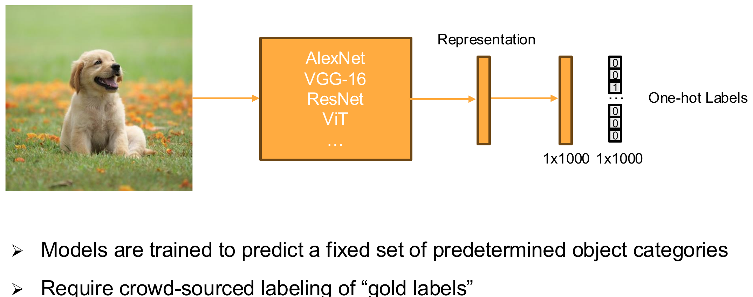
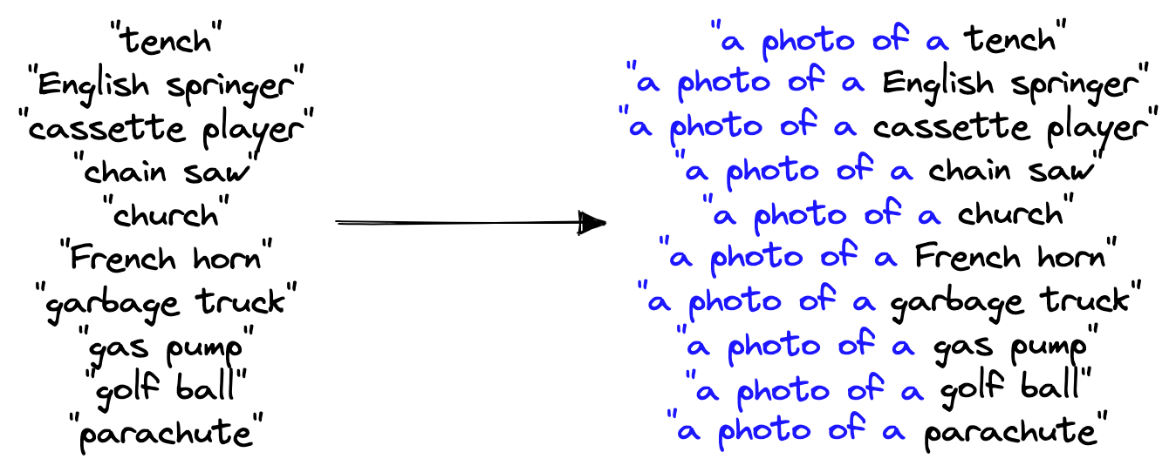
PART I · MOTIVATION
From a fixed label set to natural-language supervision
Before: closed label set
Labels fixed at training time; a new class needs new labels and retraining.
CLIP: language as the label interface
Any concept expressible in words; a new class only needs a new prompt.
Contrastive Vision–Language Models · CIS 5590 · Fall 2026
Notes:
We know language is open-ended. Any concept you can describe in words becomes something the model can work with. If you want a new class. You don't retrain; you just write a new prompt.

Slide 7
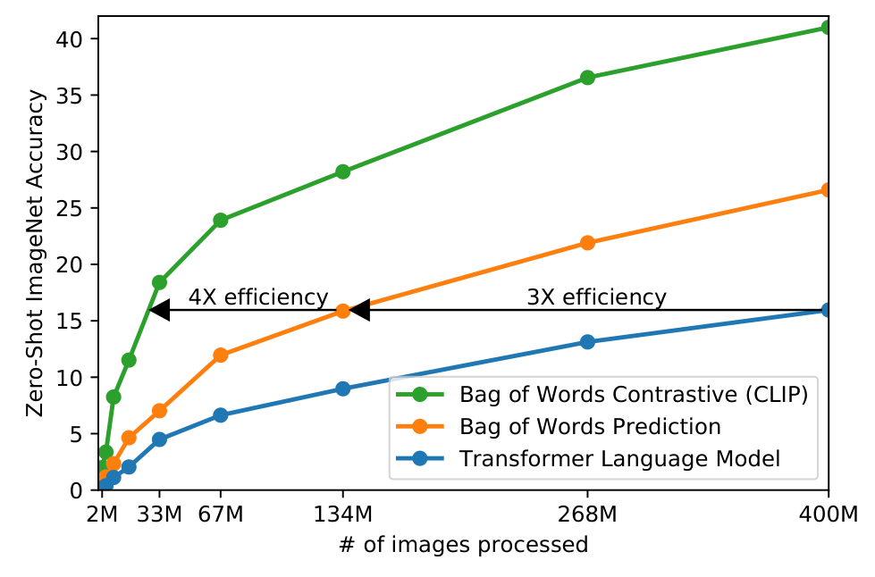
PART I · MOTIVATION
Why contrastive? A more efficient training target
Transformer language model
Predict the exact caption, word by word. Slowest baseline.
Bag-of-words prediction
Predict which words appear, ignoring order. ≈ 3× more efficient.
Bag-of-words contrastive (CLIP)
Pick the right caption inside the batch. A further ≈ 4×.
Matching is an easier, more scalable target than reproducing every word.
Zero-shot ImageNet accuracy vs. images processed. Radford et al. (2021), Fig. 2.
Contrastive Vision–Language Models · CIS 5590 · Fall 2026

Slide 8
COURSE MAP
Lecture roadmap
I
Motivation
II
Contrastive foundations
III
CLIP architecture and use
Why align images and language in one space?
How does a contrastive loss learn a shared space?
How is CLIP built, trained, and used?
IV
Evaluation and robustness
V
Reproduction
VI
Limitations and takeaways
Does it generalize under distribution and task shift?
Can we watch the mechanism run on a few examples?
Where does it break, and what should we remember?
Contrastive Vision–Language Models · CIS 5590 · Fall 2026

Slide 9
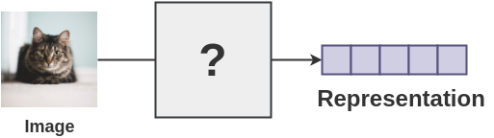
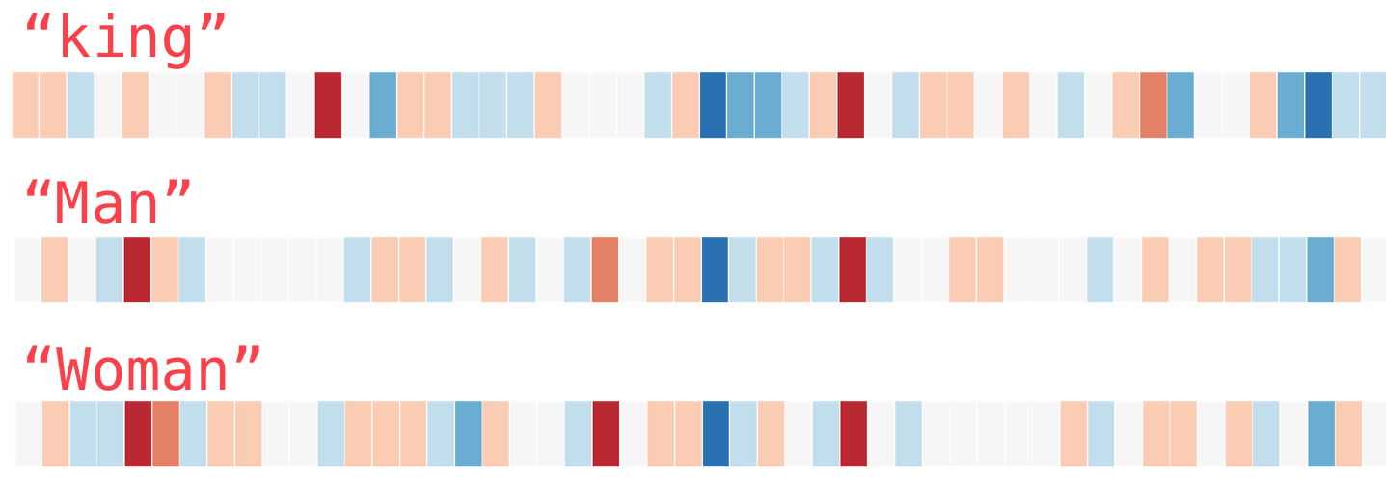
PART II · FOUNDATIONS
Embeddings: geometry that supports comparison
1
An embedding is a learned vector
z = f(x) ∈ ℝ^d. Each input becomes d numbers; training shapes them.
2
Similarity becomes proximity
Related inputs get nearby vectors; relations become directions (king − man + woman ≈ queen).
3
One dimension across modalities
CLIP's image and text vectors share the same d (e.g. 512), so they are directly comparable.
Contrastive Vision–Language Models · CIS 5590 · Fall 2026

Slide 10
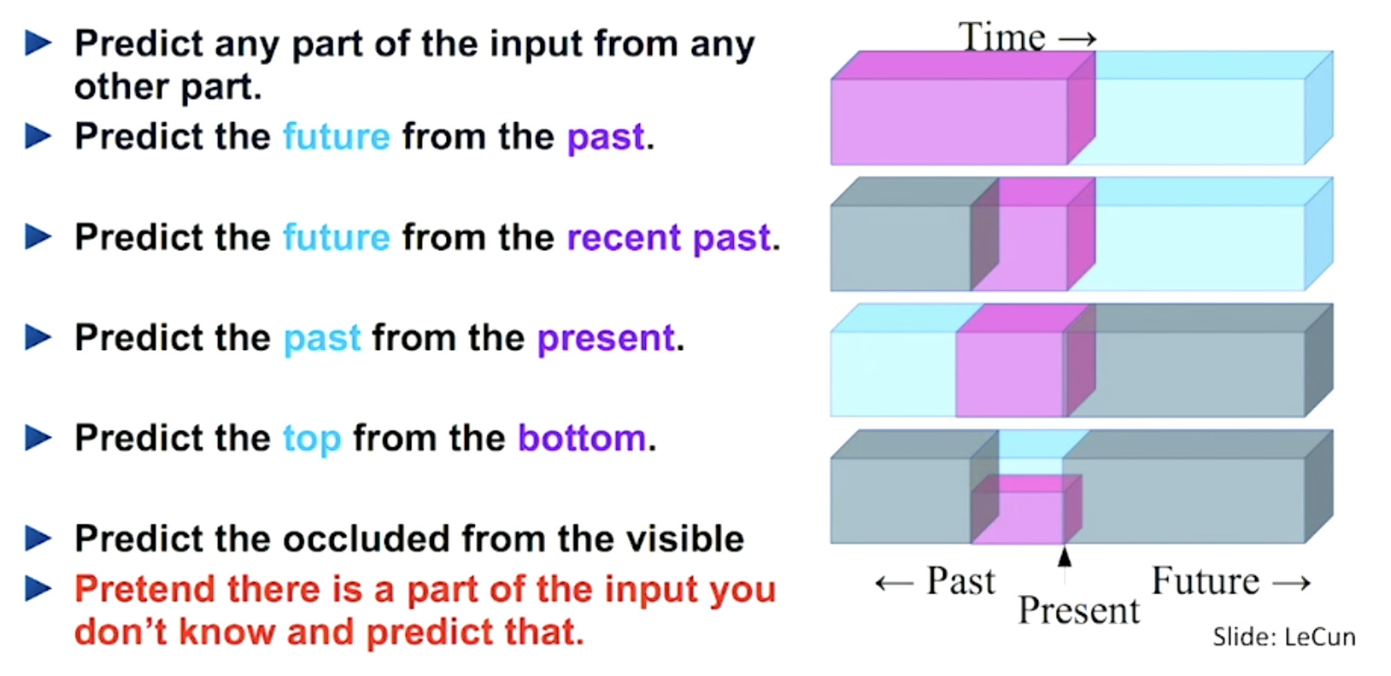
PART II · FOUNDATIONS
Self-supervised learning: labels from the data itself
1
Supervision from data structure
Hide or transform part of the input; predict or match it from the rest.
2
Instance discrimination
Treat each training example as its own "class".
3
Paired observations
Two views of one image, or an image and its caption, form a positive pair.
CLIP uses the most natural pairing on the web: an image and the text published next to it — no annotator needed.
Contrastive Vision–Language Models · CIS 5590 · Fall 2026

Slide 11
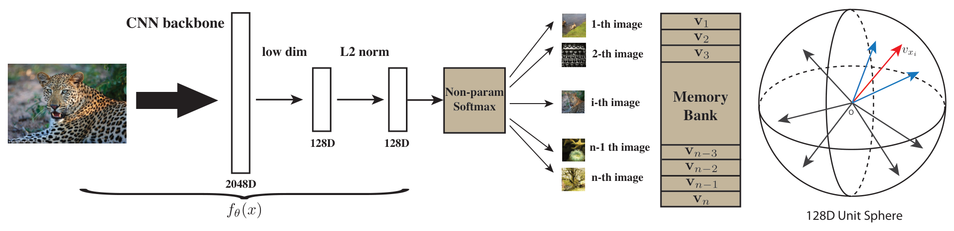
PART II · FOUNDATIONS
Instance discrimination and paired observations
Image–image pairs (SimCLR)
Two augmented views of the same image are positives; views of other images are negatives.
Image–text pairs (CLIP)
An image and its own caption are positives; every other caption in the batch is a negative.
Contrastive Vision–Language Models · CIS 5590 · Fall 2026

Slide 12
PART II · FOUNDATIONS
Similarity and normalization
cos(u, v) = u·v / (‖u‖ ‖v‖)
longer, same direction
u = (3, 4) v = (6, 8) v′ = (1.5, 2)
image
u · v = 50 u · v′ = 12.5 (length matters)
cos(u, v) = cos(u, v′) = 1.00 (direction only)
θ
û = u / ‖u‖₂ ⇒ û · v̂ = cos θ
text
After L2 normalization every embedding has length 1, so the dot product is the cosine similarity. CLIP stores unit-length embeddings: all image and text vectors live on one hypersphere.
cos θ = image · text
Contrastive Vision–Language Models · CIS 5590 · Fall 2026
Notes:
If we normalize every vector to length one first, then the dot product and the cosine become exactly the same thing

Slide 13
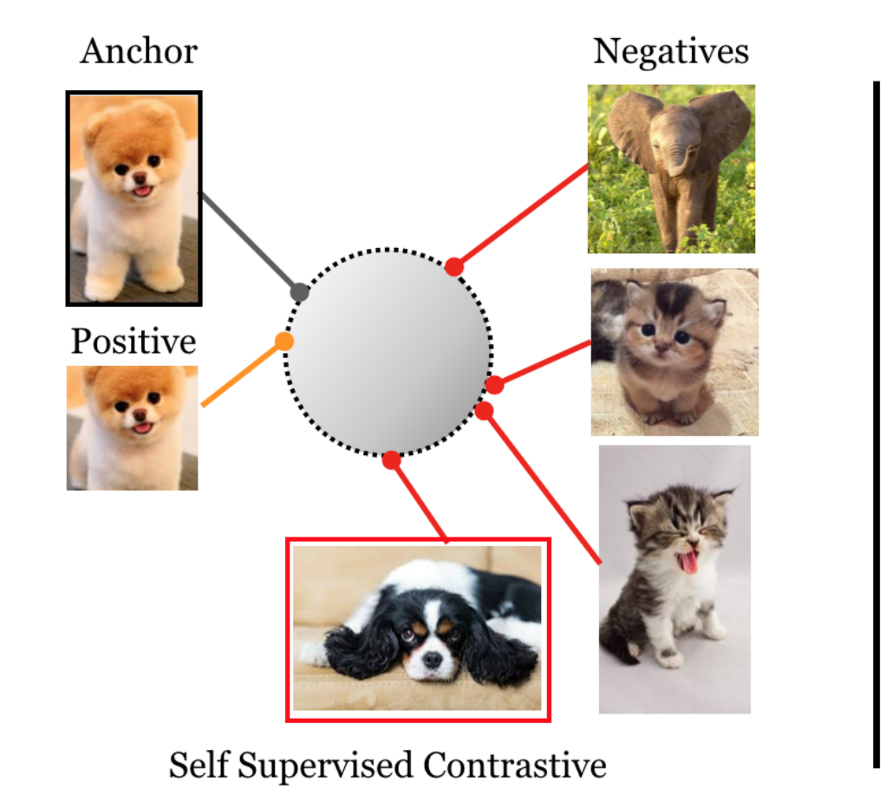

PART II · FOUNDATIONS
Positive and negative pairs
Image–image (instance discrimination)
Image–text (vision–language)
a dog running on snow
a red sports car
waves at the beach
anchor
a bowl of ramen
positive: pull together negatives: push apart
Contrastive Vision–Language Models · CIS 5590 · Fall 2026

Slide 14
PART II · FOUNDATIONS
The batch similarity matrix
texts (columns)
Diagonal: N assigned positives
T₁
T₂
T₃
T₄
Image i and its own caption i.
I₁
I₁·T₁
I₁·T₂
I₁·T₃
I₁·T₄
Off-diagonal: N² − N negatives
I₂
I₂·T₁
I₂·T₂
I₂·T₃
I₂·T₄
Image i against every other caption.
images (rows)
Row i: image → text
I₃
I₃·T₁
I₃·T₂
I₃·T₃
I₃·T₄
One image compared with all N captions.
I₄
I₄·T₁
I₄·T₂
I₄·T₃
I₄·T₄
Column j: text → image
One caption compared with all N images.
score s_{ij} = cosine( image i, text j )
N = 4 matched pairs → 4 × 4 = 16 scores
Contrastive Vision–Language Models · CIS 5590 · Fall 2026

Slide 15
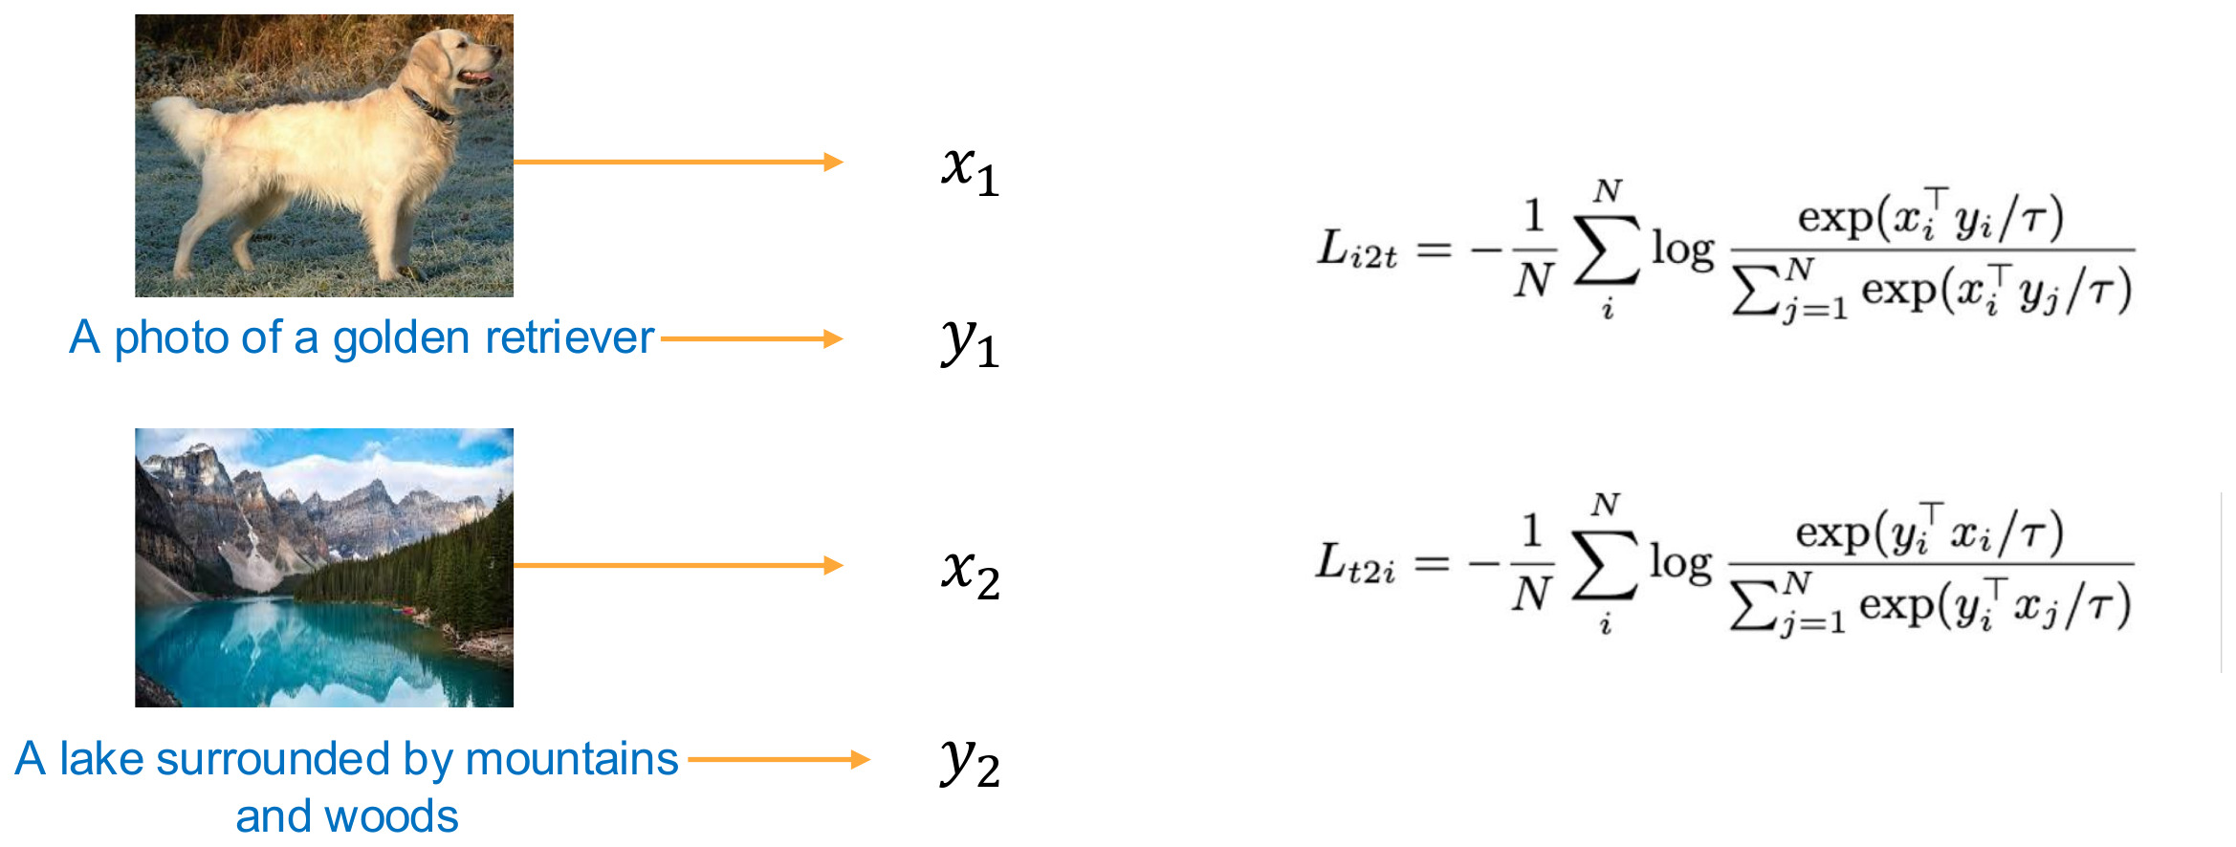
PART II · FOUNDATIONS
Image–text pairs inside one batch
Each image must find its caption among the batch — and each caption must find its image.
Contrastive Vision–Language Models · CIS 5590 · Fall 2026

Slide 16
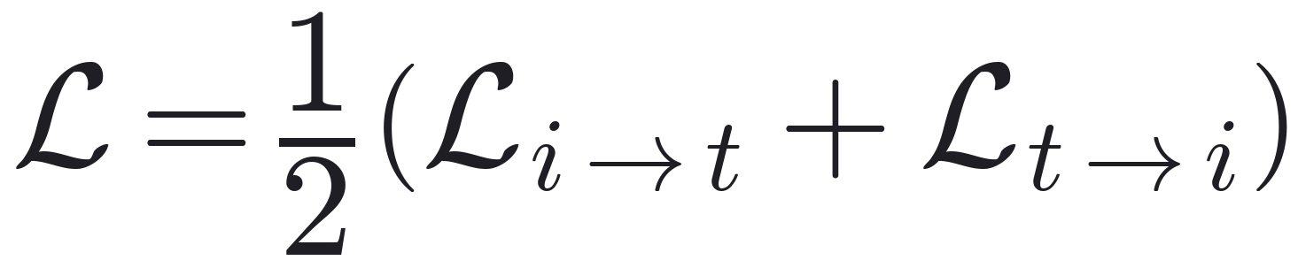
PART II · FOUNDATIONS
Text → image, and the symmetric loss
image → text
text → image
Final objective
T₁
T₂
T₃
T₄
T₁
T₂
T₃
T₄
I₁
I₁
I₂
I₂
I₃
I₃
• Trains both retrieval directions
• Both encoders get gradient from both terms
• In code: two cross-entropies, labels = arange(N)
I₄
I₄
softmax across a row
softmax down a column
One matrix, two classification problems, one averaged loss.
Contrastive Vision–Language Models · CIS 5590 · Fall 2026

Slide 17
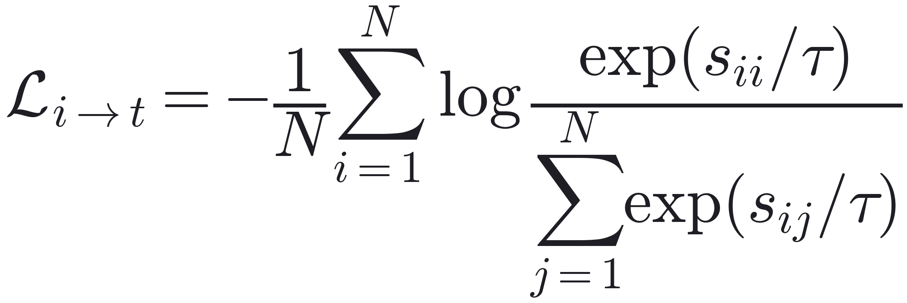
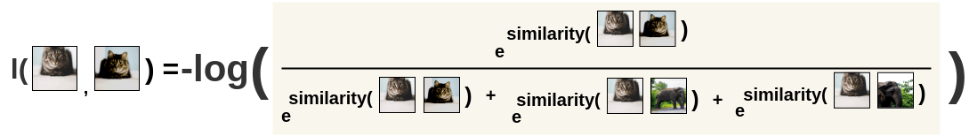
PART II · FOUNDATIONS
InfoNCE: each image picks its caption
Worked example: one row, τ = 0.1
T₁
T₂
T₃
T₄
cosine s
0.30
0.12
0.05
0.10
s / τ
3.0
1.2
0.5
1.0
Numerator: score of the true caption
Denominator: scores of all N captions in the batch
Effect: raise the positive relative to every alternative
softmax p
0.72
0.12
0.06
0.10
T₁ is the positive (diagonal).
loss = −log p_{pos} = −log 0.72 = 0.32
An N-way classification: cross-entropy with the diagonal as the label.
Contrastive Vision–Language Models · CIS 5590 · Fall 2026

Slide 18
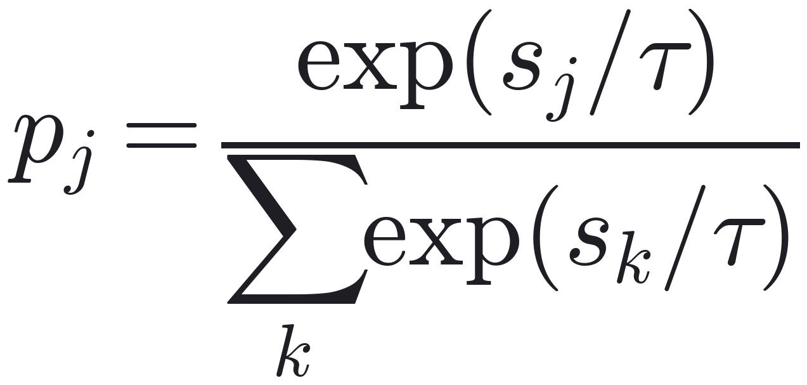
PART II · FOUNDATIONS
Temperature scaling
τ | T₁ (pos) | T₂ | T₃ | T₄
1 | 0.29 | 0.24 | 0.23 | 0.24
0.5 | 0.34 | 0.24 | 0.20 | 0.23
0.1 | 0.72 | 0.12 | 0.06 | 0.10
0.05 | 0.95 | 0.03 | 0.01 | 0.02
Small τ: sharper, more pressure on hard negatives
Large τ: flatter, weaker signal
logits = img_e @ txt_e.T * logit_scale.exp()
# exp(logit_scale) = 1/τ (multiply!)
CLIP initializes τ = 0.07 and learns it; the scale 1/τ is clipped at 100.
Contrastive Vision–Language Models · CIS 5590 · Fall 2026

Slide 19
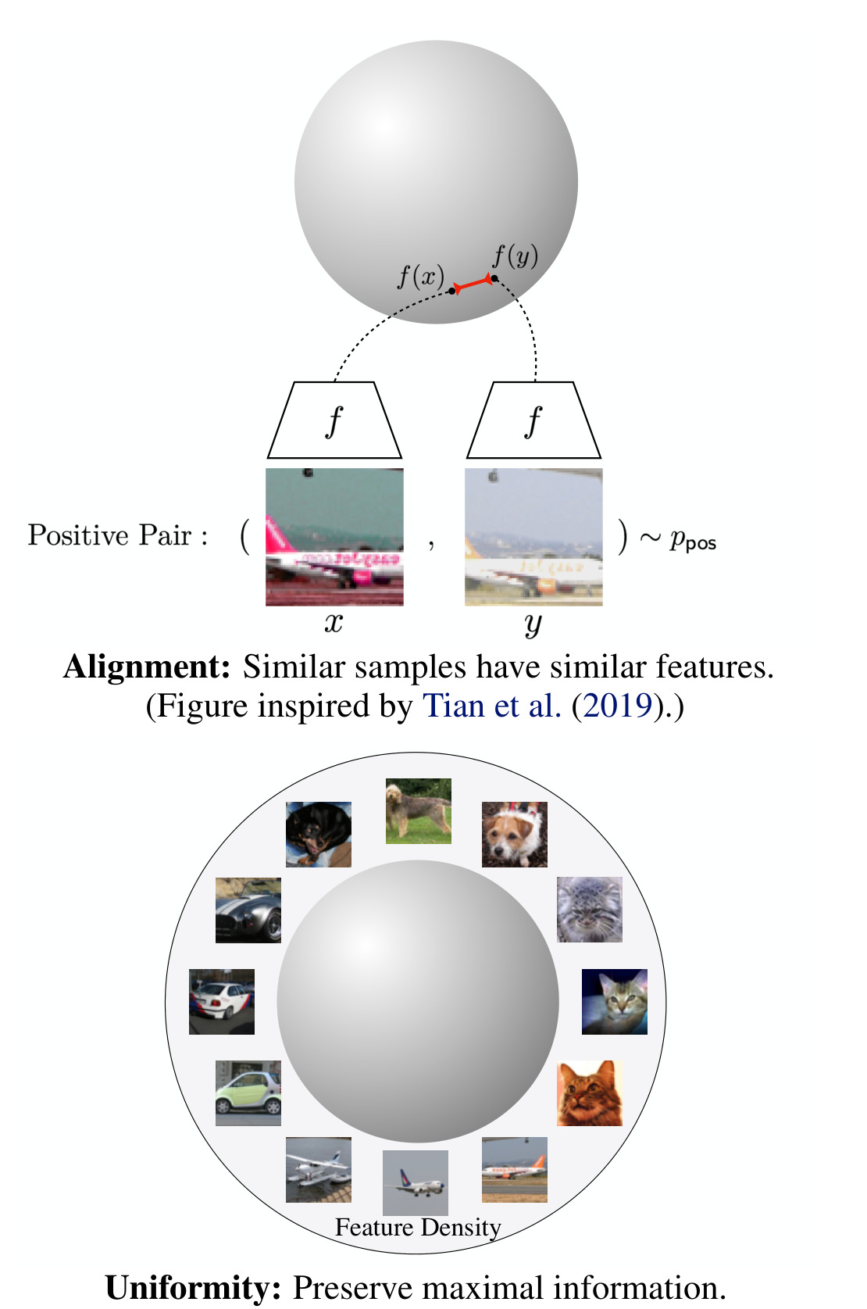
PART II · FOUNDATIONS
Negatives prevent representation collapse
1
Alignment (attraction)
Positive pairs should have similar features — f(x) ≈ f(y).
2
Uniformity (repulsion)
Features should spread over the sphere and preserve information — this is what negatives buy.
3
Without negatives → collapse
Mapping every input to one constant vector makes all positives "perfect"; every logit ties, p = 1/N, loss = ln N.
Batch N | 64 | 512 | 4,096 | 32,768 (CLIP)
Loss of a collapsed embedding = ln N | 4.16 | 6.24 | 8.32 | 10.4
Left: alignment and uniformity on the hypersphere. Wang & Isola (2020), Fig. 1.
Contrastive Vision–Language Models · CIS 5590 · Fall 2026

Slide 20
COURSE MAP
Lecture roadmap
I
Motivation
II
Contrastive foundations
III
CLIP architecture and use
Why align images and language in one space?
How does a contrastive loss learn a shared space?
How is CLIP built, trained, and used?
IV
Evaluation and robustness
V
Reproduction
VI
Limitations and takeaways
Does it generalize under distribution and task shift?
Can we watch the mechanism run on a few examples?
Where does it break, and what should we remember?
Contrastive Vision–Language Models · CIS 5590 · Fall 2026

Slide 21
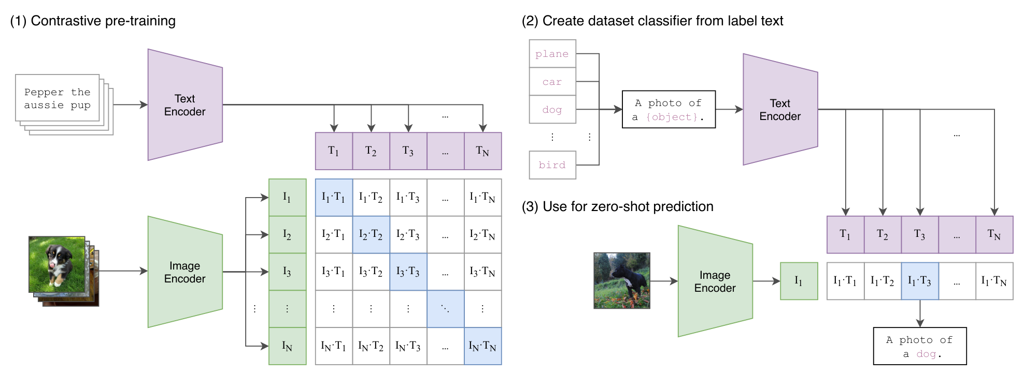
PART III · CLIP
CLIP: Contrastive Language–Image Pre-training
Natural-language supervision
400 million image–text pairs
Zero-shot transfer through prompts
Contrastive Vision–Language Models · CIS 5590 · Fall 2026

Slide 22
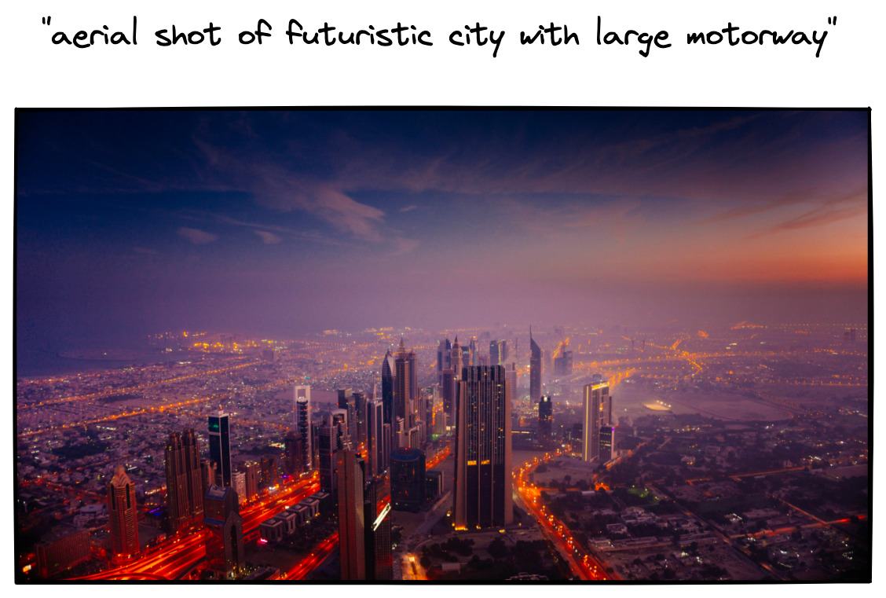
PART III · CLIP
Training data: 400 million web image–text pairs
WebImageText (WIT)
400M (image, text) pairs collected from the public internet.
Query-based collection
Text must contain one of 500,000 queries; at most 20,000 pairs per query to balance concepts.
Compute
ResNets and ViTs up to ~300M parameters, trained 32 epochs on 256–592 GPUs for up to 18 days.
Noisy, but vast and open-vocabulary.
Contrastive Vision–Language Models · CIS 5590 · Fall 2026

Slide 23
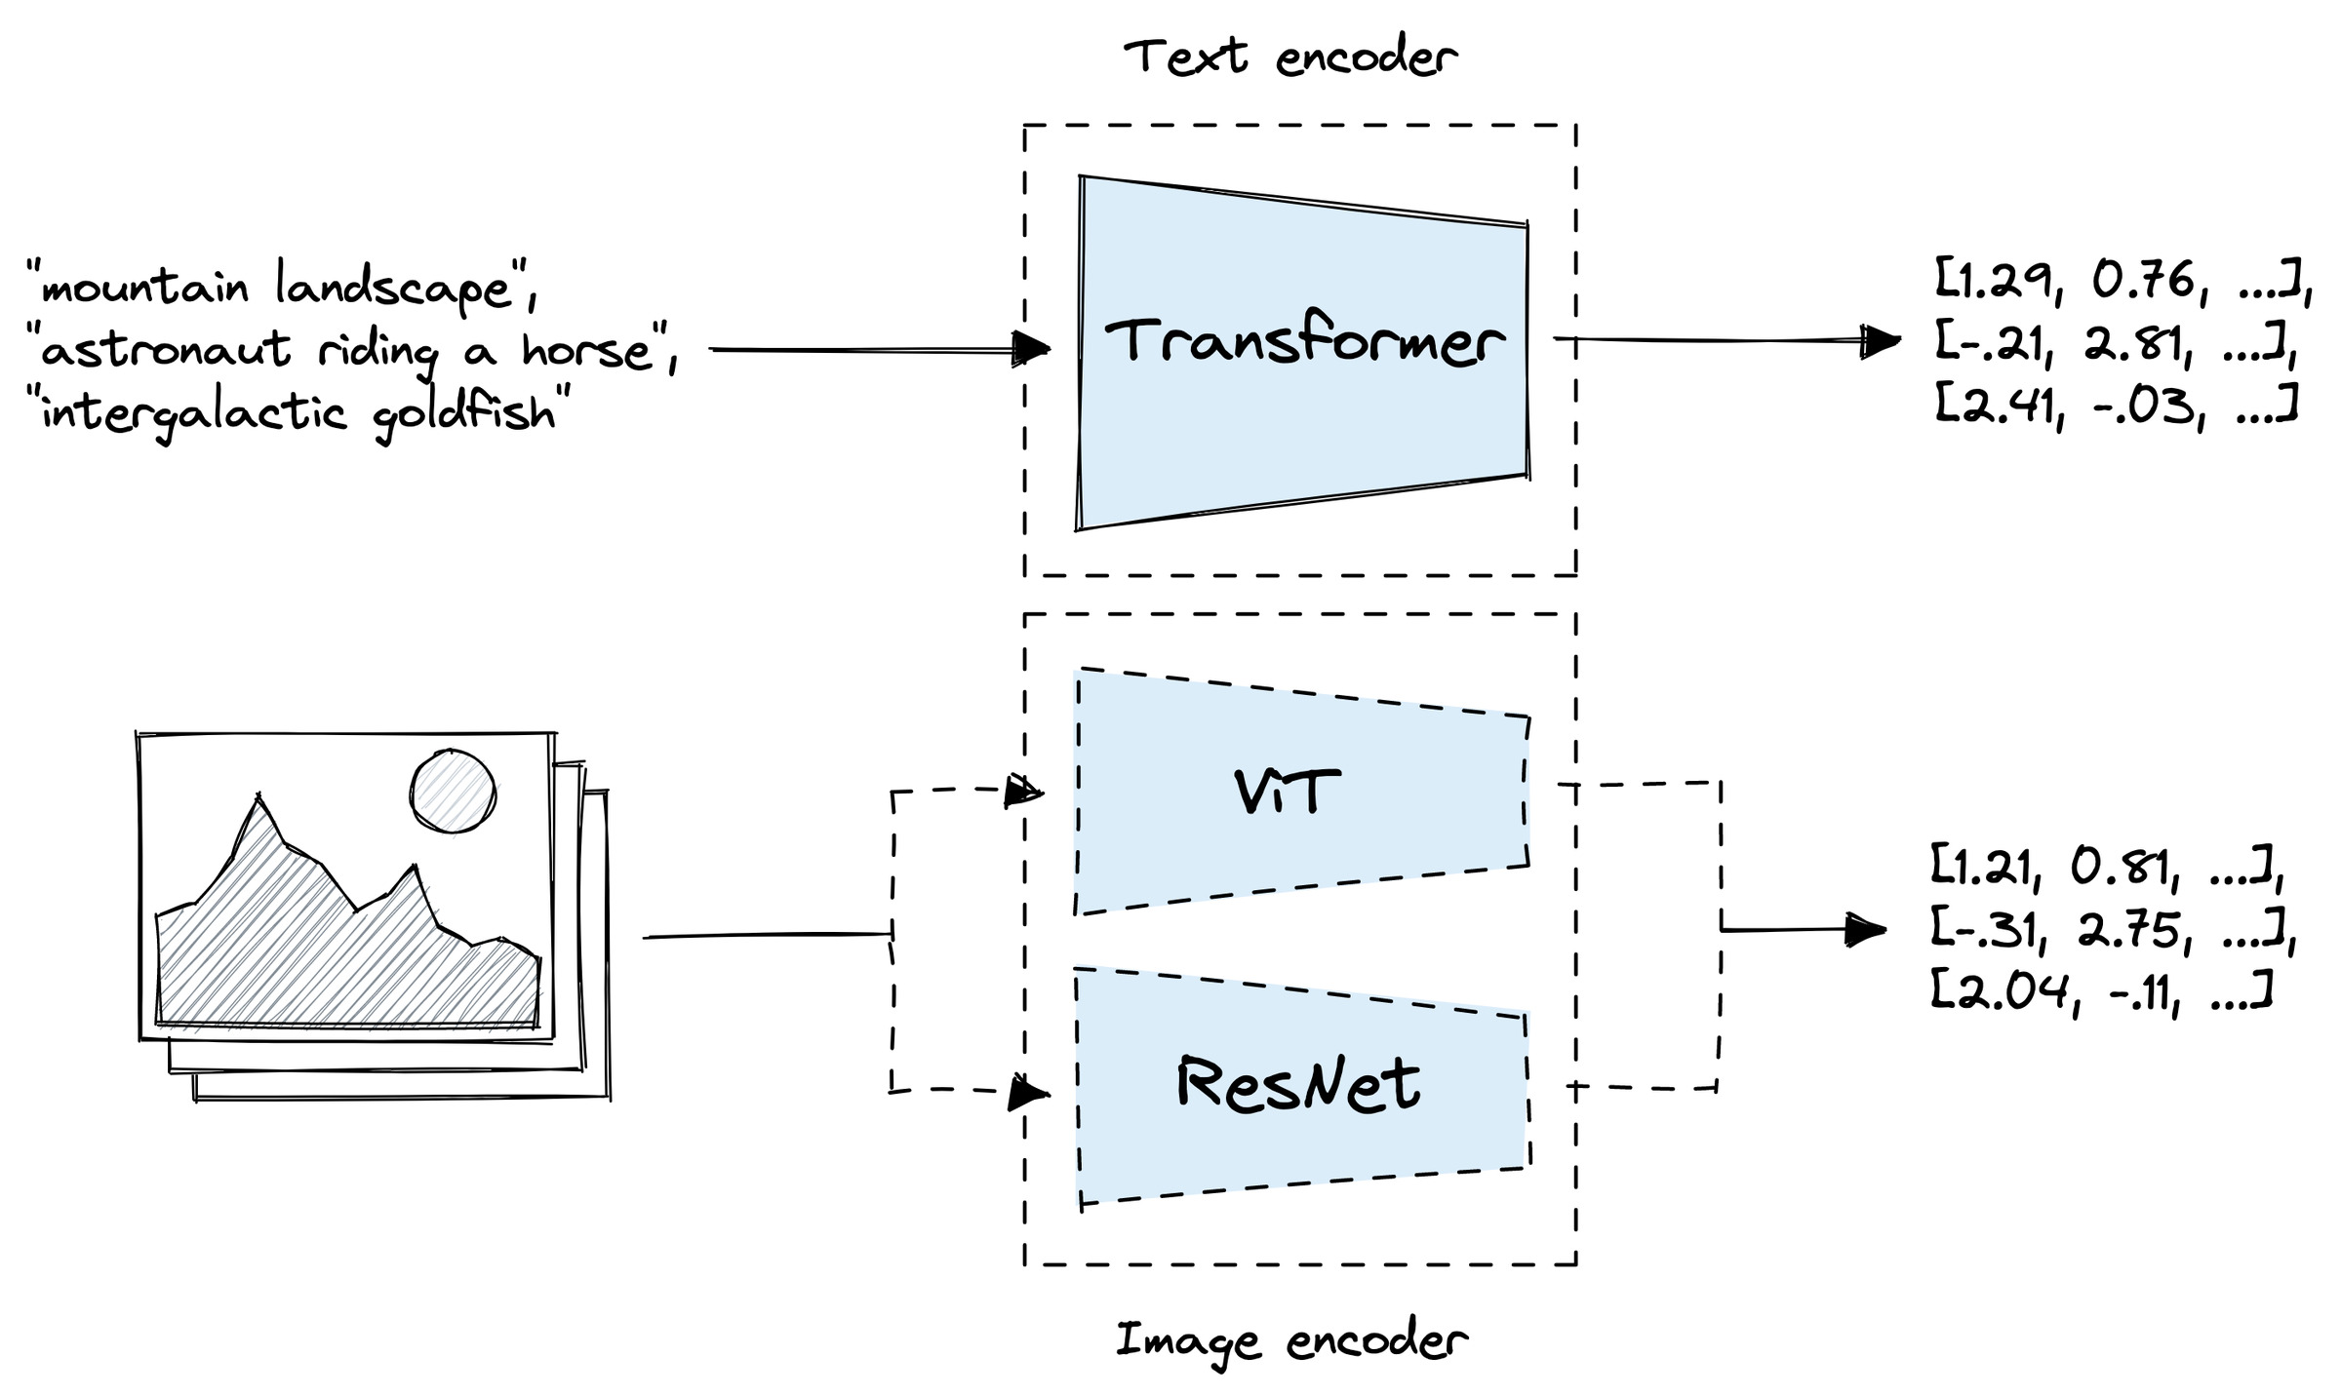
PART III · CLIP
Dual-encoder architecture
Image encoder
5 modified ResNets or 3 Vision Transformers.
Text encoder
Transformer: 12 layers, 512 wide, 8 heads (≈ 63M params).
Output
One vector per image, one per text.
No cross-attention: each side is encoded independently, then compared.
Contrastive Vision–Language Models · CIS 5590 · Fall 2026

Slide 24
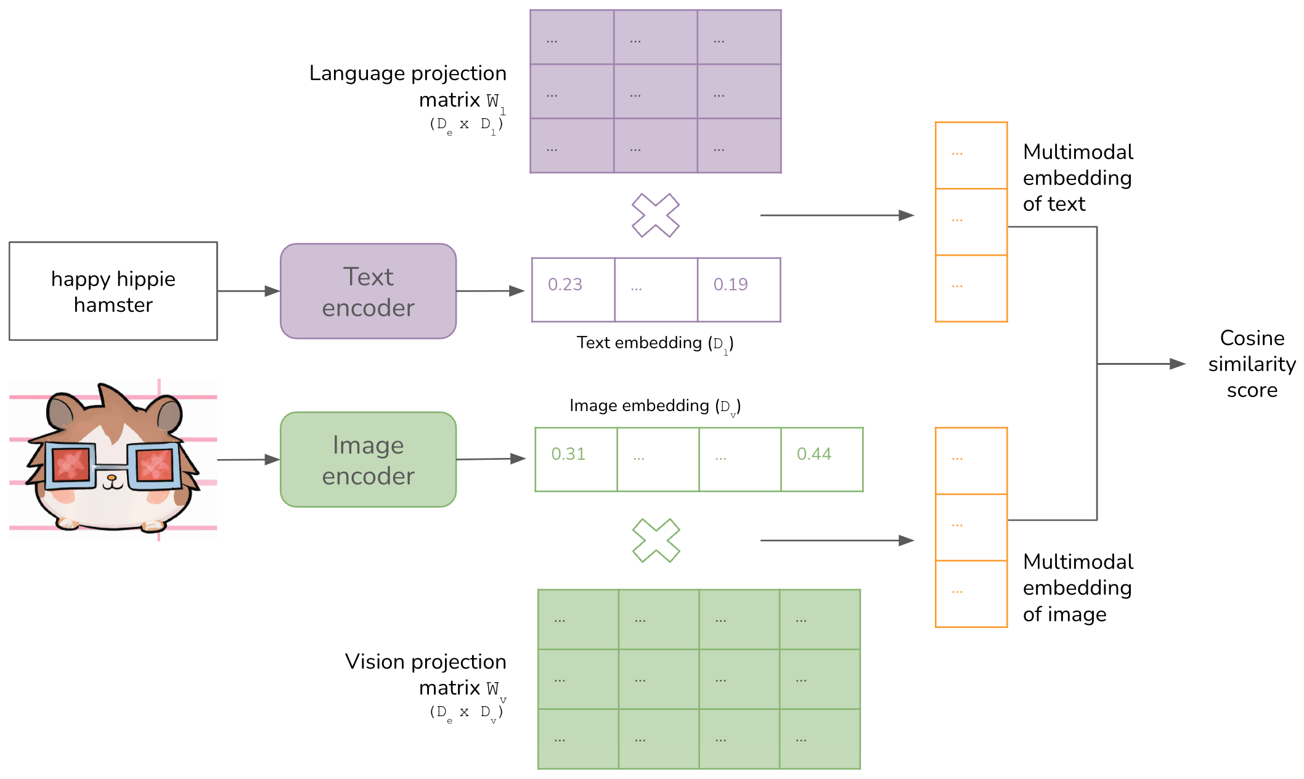
PART III · CLIP
Projection heads, shared dimension, L2 normalization
I_f = image_encoder(I) → [n, d_i]
T_f = text_encoder(T) → [n, d_t]
Linear projections W_i [d_i, d_e], W_t [d_t, d_e] — no MLP head
L2 normalize → unit length
Cosine = dot product in the d_e-dim joint space (512 for ViT-B/32)
Different widths inside; one shared d_e outside.
Contrastive Vision–Language Models · CIS 5590 · Fall 2026

Slide 25
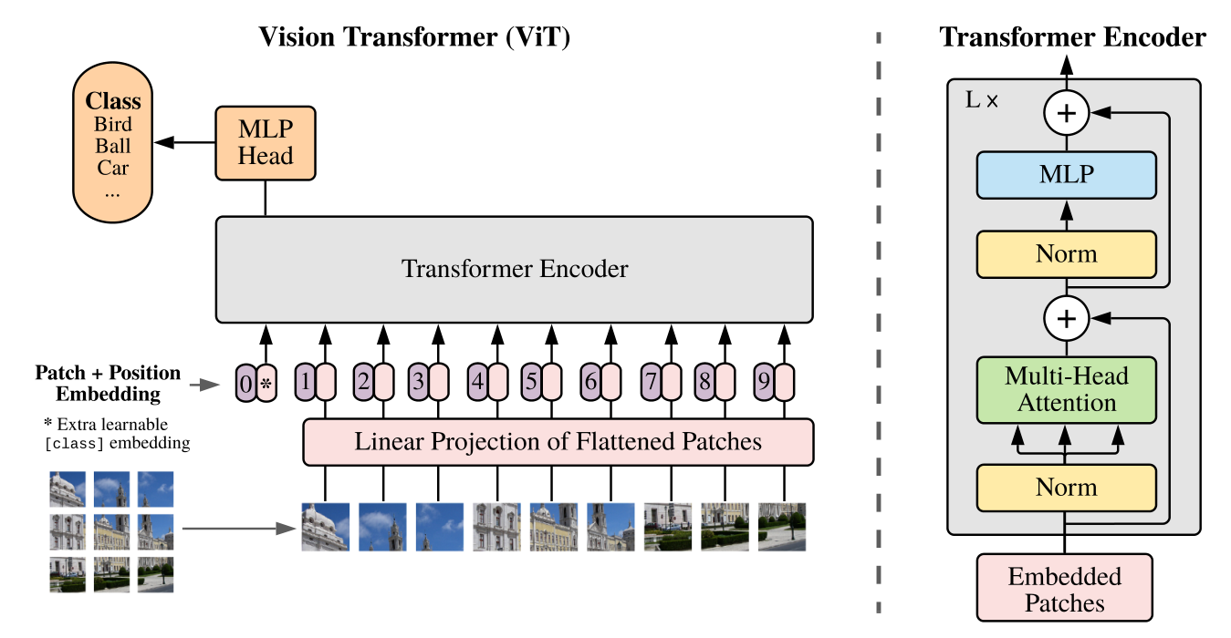
PART III · IMAGE ENCODER
Image encoder: modified ResNet or Vision Transformer
Vision Transformer
Image → 32/16/14-px patches → linear patch embedding + position embedding + [CLS] → Transformer. [CLS] output → LayerNorm → projection.
Modified ResNet
ResNet-D stem, anti-aliased pooling, and attention pooling instead of global average pooling.
Vision Transformer. Dosovitskiy et al. (2021), Fig. 1.
Family | Models trained in the paper | Best model
ResNet / ViT | RN50, RN101, RN50x4, RN50x16, RN50x64 · ViT-B/32, ViT-B/16, ViT-L/14 | ViT-L/14 @ 336 px
Contrastive Vision–Language Models · CIS 5590 · Fall 2026

Slide 26
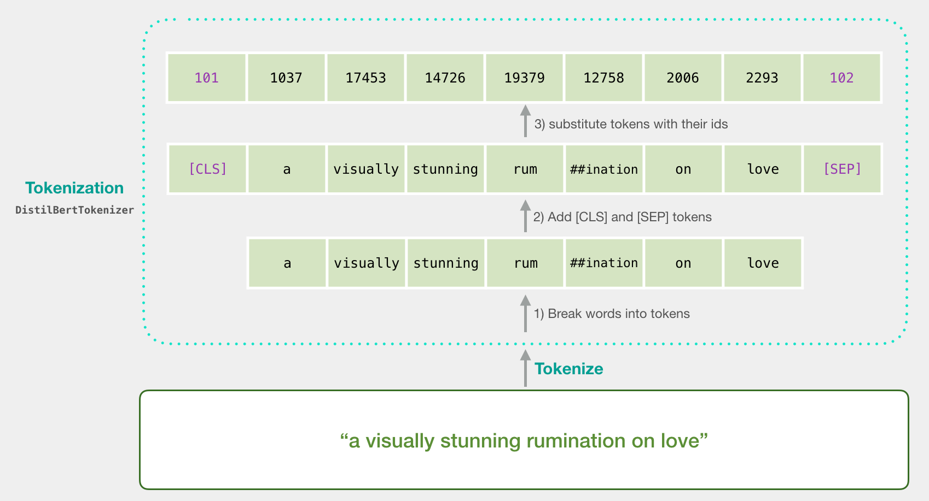
PART III · TEXT ENCODER
Text encoder, step 1: from prompt to tokens
Lower-cased byte-pair encoding (BPE), 49,152-token vocabulary
Frequent character pairs merged into sub-words: "playing" → play + ing
Wrap with [SOS] and [EOS]; pad to 77 tokens
clip.tokenize("Hello World!")
# tensor([[49406, 3306, 1002, 256, 49407, 0, 0, ...]]) 49406 = [SOS], 49407 = [EOS]
Contrastive Vision–Language Models · CIS 5590 · Fall 2026

Slide 27
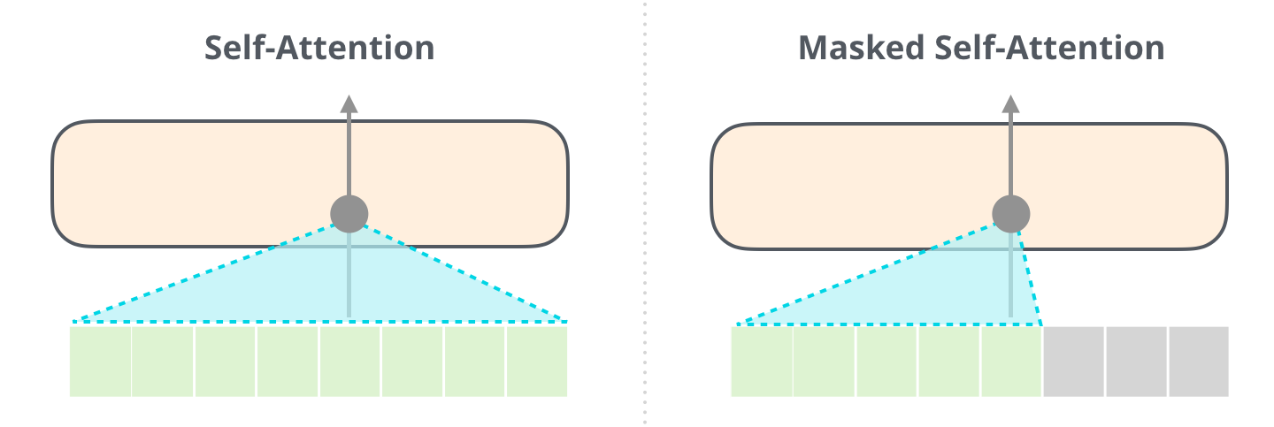
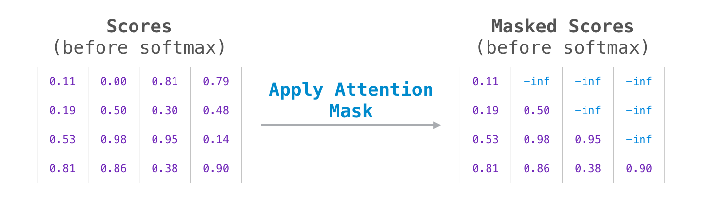
PART III · TEXT ENCODER
Text encoder, step 2: a GPT-2-style Transformer body
Shared building blocks with GPT-2
Token + learned position embeddings
Pre-LayerNorm residual Transformer blocks
Masked (causal) self-attention
Self-attention vs. masked (causal) self-attention.
CLIP size
12 layers · width 512 · 8 heads · ≈ 63M parameters (GPT-2 small: 12 layers · width 768)
The mask sets future scores to −∞ before the softmax.
Why causal? It keeps the option to initialize from / add a language model.
Contrastive Vision–Language Models · CIS 5590 · Fall 2026

Slide 28
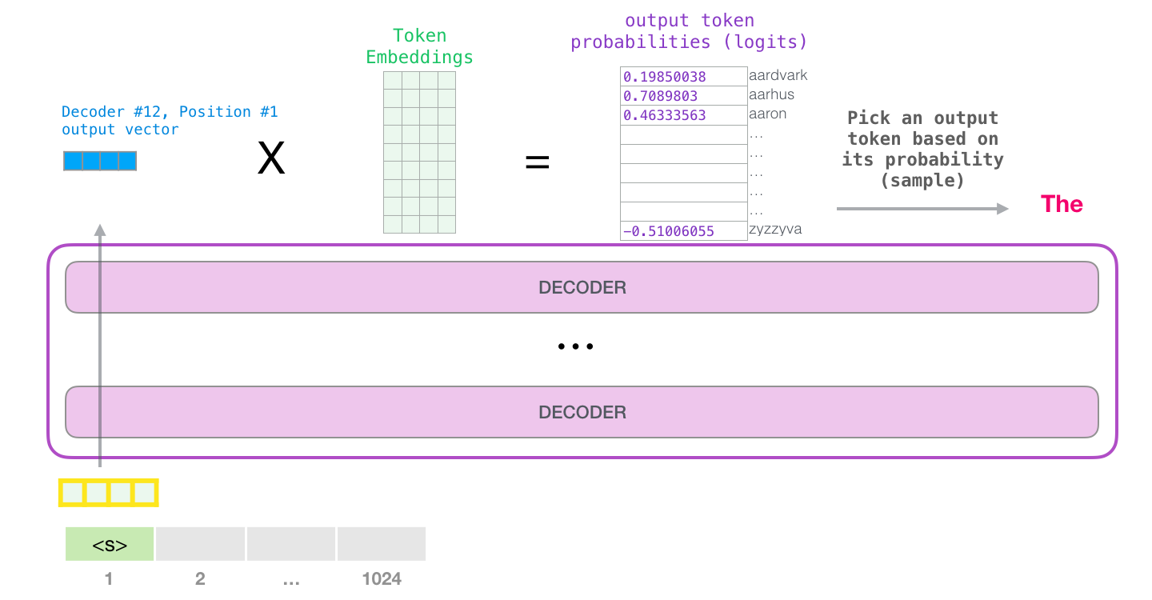
PART III · TEXT ENCODER
GPT: the output is a next-token distribution
1
Every position predicts
A score for every word in the vocabulary.
2
Trained on the next token
Cross-entropy at each position.
3
Used autoregressively
Append the sampled token, run again, generate word by word.
Last hidden state × token-embedding matrix → 50,257 logits → sample.
GPT answers "what word comes next?" — CLIP's text encoder never asks that question.
Contrastive Vision–Language Models · CIS 5590 · Fall 2026

Slide 29
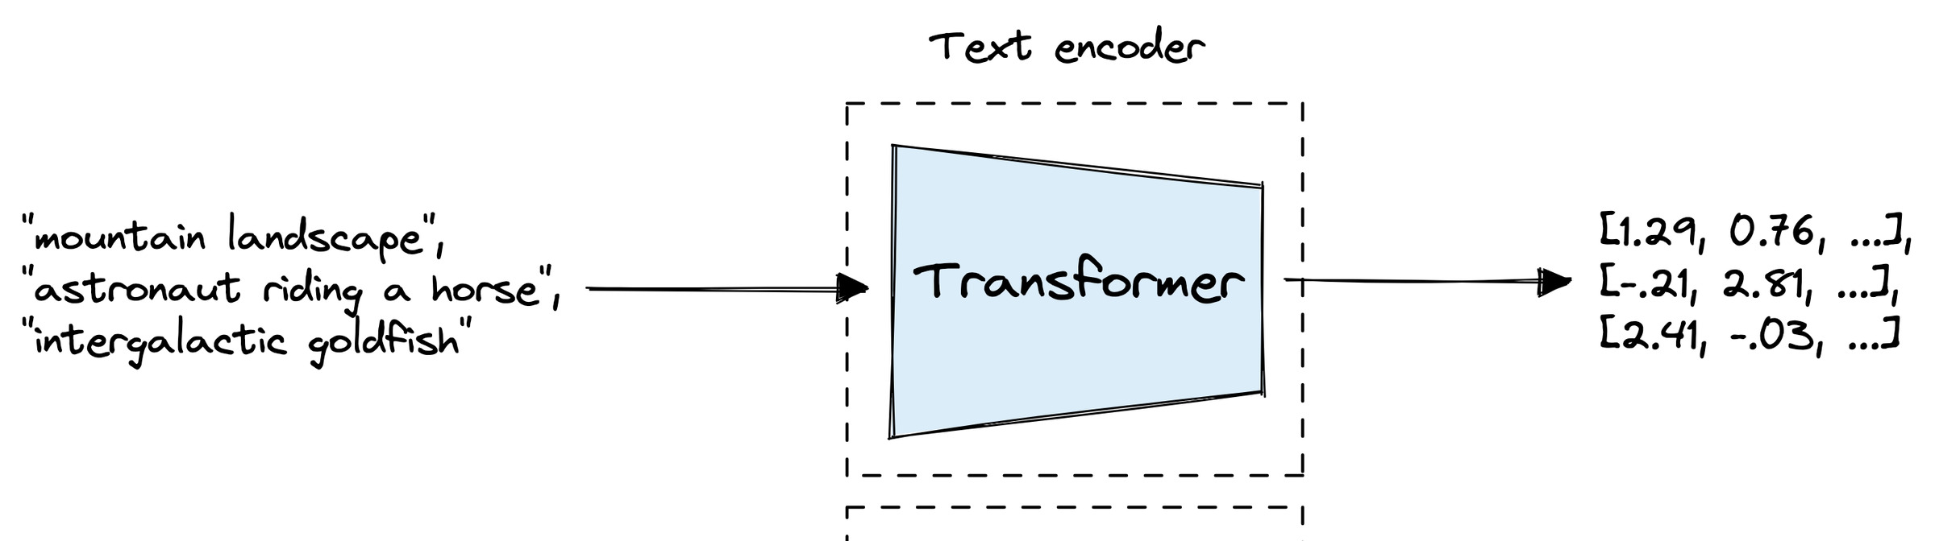
PART III · TEXT ENCODER
CLIP: the output is one sentence embedding
 | GPT-2 | CLIP text encoder
Output | Vocabulary distribution at every position | One vector: [EOS] hidden state → LN → W_t → L2 norm
Training | Next-token cross-entropy | Batch-level contrastive cross-entropy
Inference | Autoregressive decoding, token by token | One forward pass, then compare with image vectors
Because of the causal mask, only [EOS] has attended to every token → it summarizes the sentence
No vocabulary head, no generation loop — the vector is compared, not decoded
Same family of blocks, different objective: predict the next token vs. match the image.
Contrastive Vision–Language Models · CIS 5590 · Fall 2026

Slide 30
PART III · TRAINING
One CLIP training step
N images
[N, 3, H, W]
Image encoder
image
[N, d_e]
L_{i→t}
cross-entropy over rows
logits [N, N]
average → backprop
N captions
[N, L]
Text encoder
text
[N, d_e]
L_{t→i}
cross-entropy over columns
exp(t) · I·Tᵀ
1
Encode independently
2
All pairwise similarities
3
Temperature scaling
4
Optimize both losses
Contrastive Vision–Language Models · CIS 5590 · Fall 2026
Notes:
encoders, both projection matrices, and even the temperature itself are learned

Slide 31
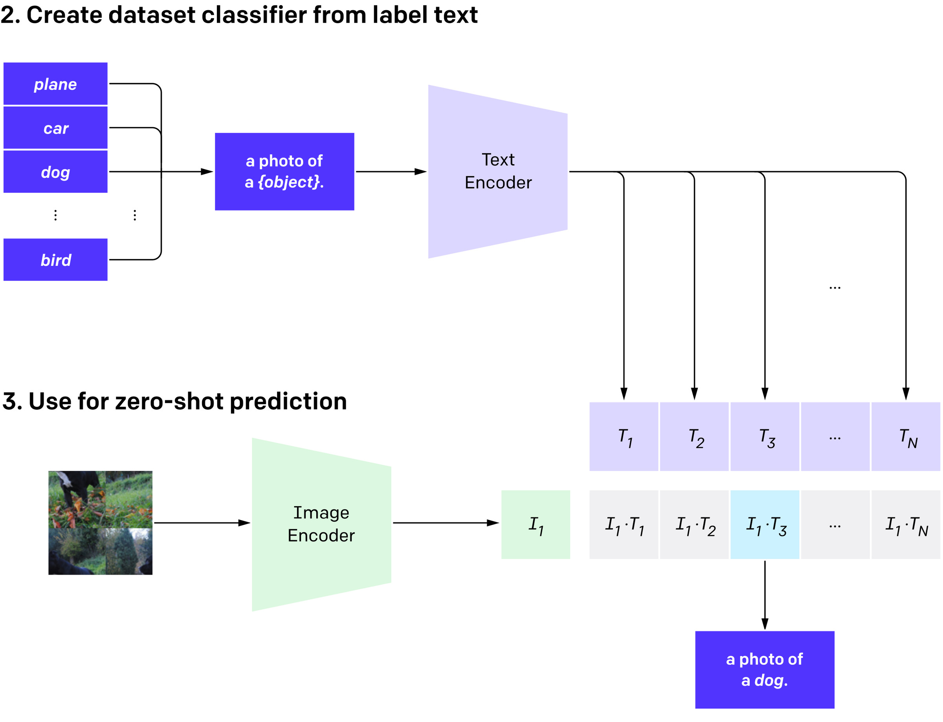
PART III · ZERO-SHOT
Zero-shot classification
1
Prompts from class names
"plane", "car", "dog" → "A photo of a {object}."
2
Encode once as text embeddings
These K vectors ARE the classifier weights.
3
Rank classes by similarity
Encode the image; prediction = argmax cos(I, Tₖ).
prediction = argmaxₖ cos(I, Tₖ)
Contrastive Vision–Language Models · CIS 5590 · Fall 2026

Slide 32
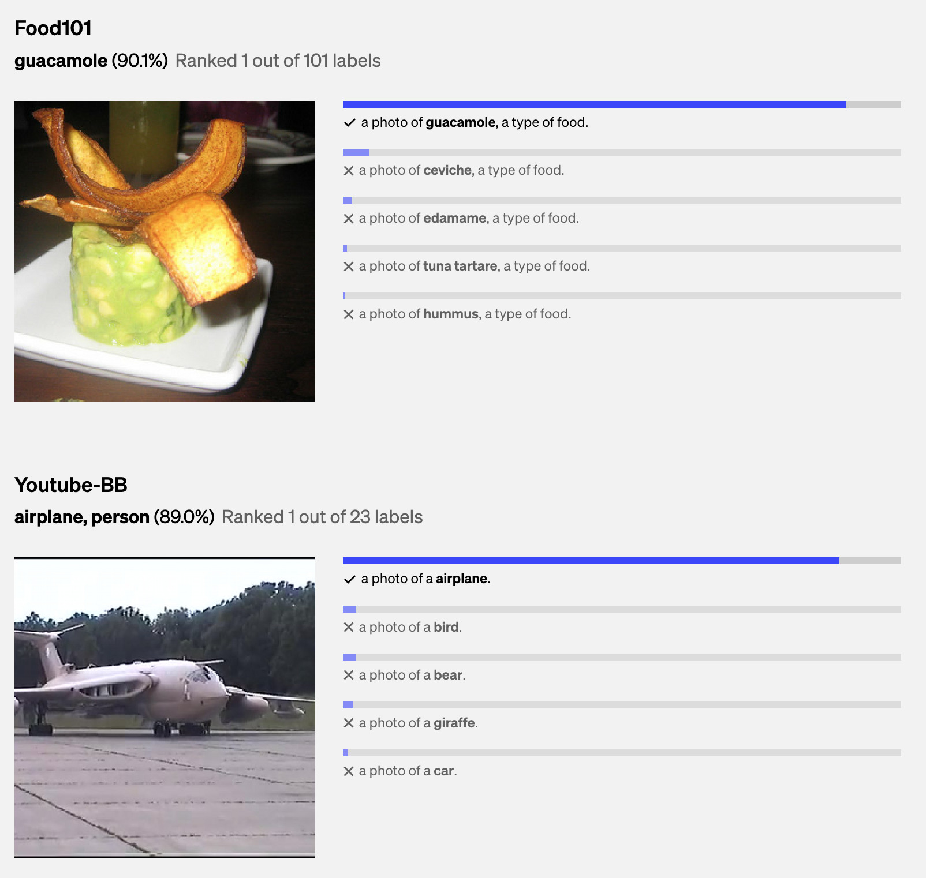
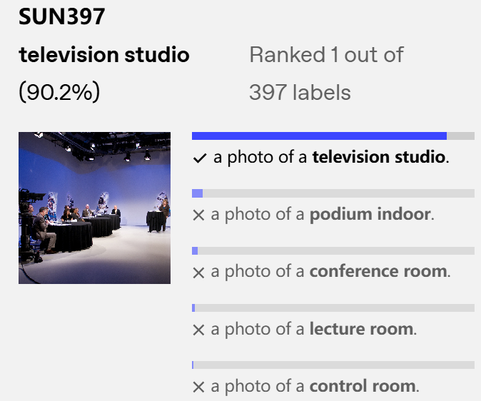
PART III · ZERO-SHOT
Zero-shot in action
One model, different label sets, no retraining: each dataset only supplies its class names.
Contrastive Vision–Language Models · CIS 5590 · Fall 2026

Slide 33
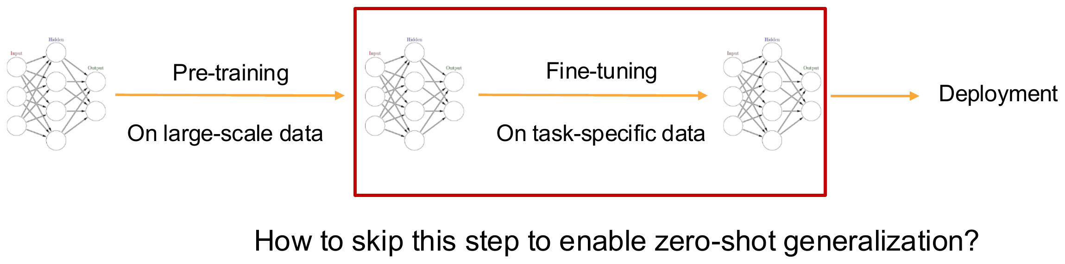
PART III · ZERO-SHOT
Zero-shot is not training a new head
Zero-shot skips the red "fine-tuning on task-specific data" box.
 | Zero-shot | Linear probe | Fine-tuning
Encoder | frozen | frozen | updated
Trained on target data | nothing | one linear classifier | all weights
Classes defined by | text prompts | classifier weights | classifier head
Adding a class | write a new prompt | collect labels, retrain head | retrain the model
Zero-shot is inference with a text-generated classifier, not a training procedure.
Contrastive Vision–Language Models · CIS 5590 · Fall 2026

Slide 34
PART III · PROMPTS
Prompt engineering: give the class name context
Polysemy
"crane": machine or bird? "boxer": dog breed or athlete?
Distribution gap
Captions are sentences, not single words → +1.3 points on ImageNet.
Labels → "a photo of a {label}".
A bare label is a poor query for a model trained on full captions
The prompt is part of the classifier
Domain wording
"a photo of a {label}, a type of pet." "a satellite photo of a {label}."
Contrastive Vision–Language Models · CIS 5590 · Fall 2026

Slide 35
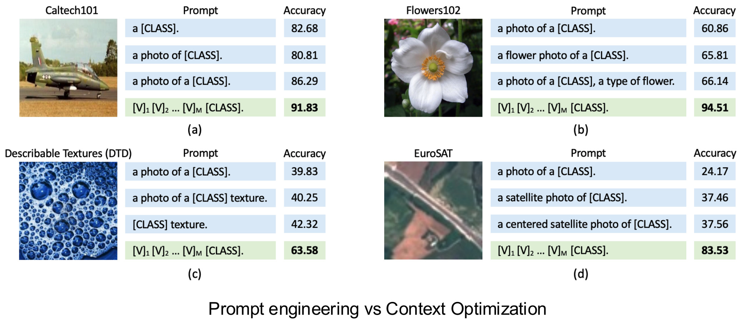
PART III · PROMPTS
Prompt wording matters
EuroSAT: "a photo of a [CLASS]" 24.2% → "a centered satellite photo of a [CLASS]" 37.6%
Flowers102: "a flower photo of a [CLASS]" +5 points
Learning the context vectors (green) helps more — but needs labeled data
Contrastive Vision–Language Models · CIS 5590 · Fall 2026

Slide 36
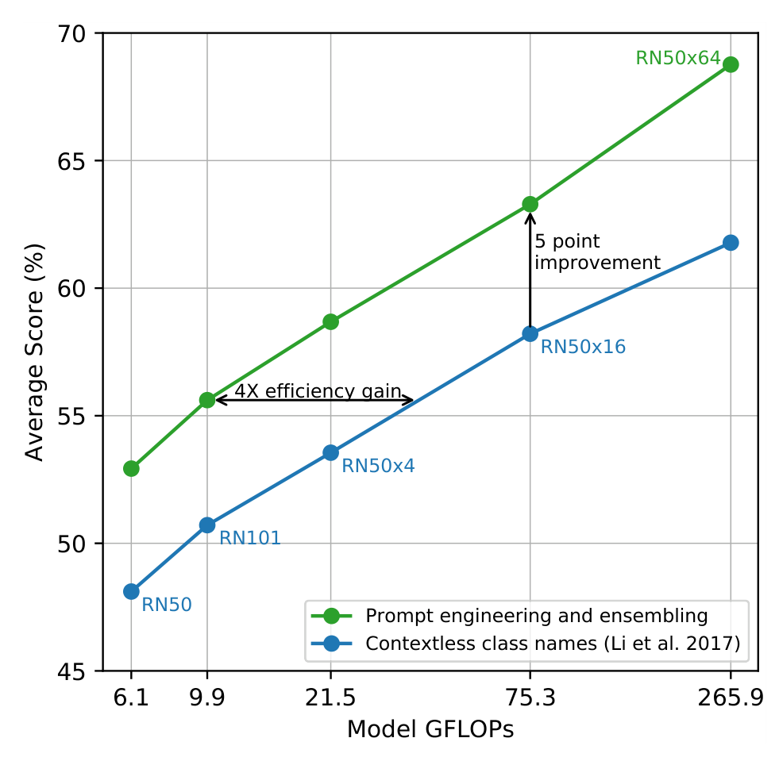
PART III · PROMPTS
Prompt ensembling: average several wordings
w_c = normalize( (1/M) Σₘ T( templateₘ(c) ) )
"a photo of a {c}."
"a bad photo of the {c}."
"a sculpture of a {c}." ... (80 for ImageNet)
+1.3
+3.5
default template (ImageNet)
80-prompt ensemble (ImageNet)
Contrastive Vision–Language Models · CIS 5590 · Fall 2026

Slide 37
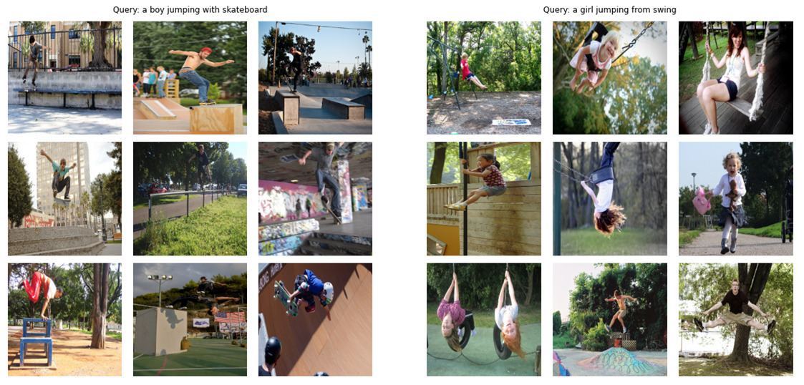
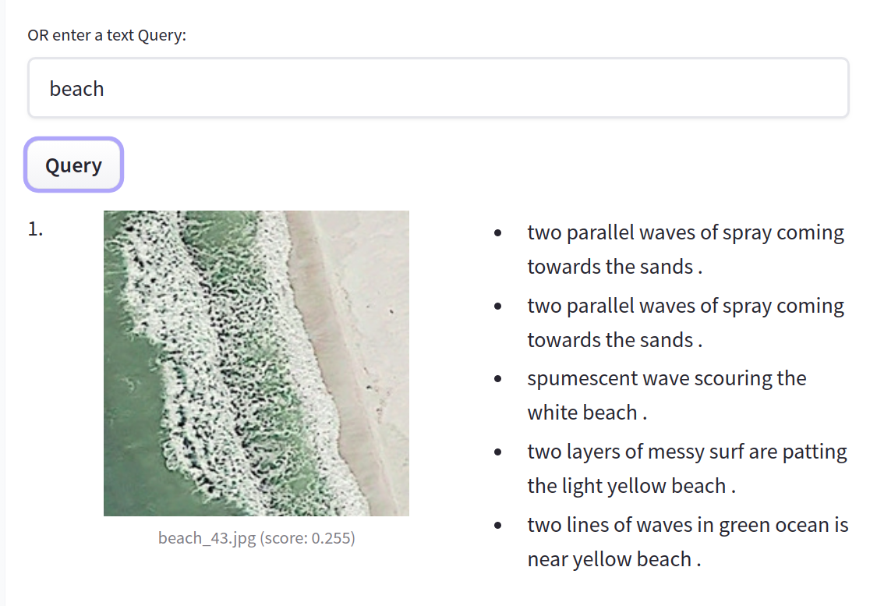
PART III · RETRIEVAL
Cross-modal retrieval in both directions
Text → image: "a boy jumping with skateboard" / "a girl jumping from swing
Query "beach" on satellite images. HF blog.
Text → image
Encode the query sentence; rank indexed image vectors.
Image → text
Encode the image; rank caption / prompt vectors.
Contrastive Vision–Language Models · CIS 5590 · Fall 2026

Slide 38
COURSE MAP
Lecture roadmap
I
Motivation
II
Contrastive foundations
III
CLIP architecture and use
Why align images and language in one space?
How does a contrastive loss learn a shared space?
How is CLIP built, trained, and used?
IV
Evaluation and robustness
V
Reproduction
VI
Limitations and takeaways
Does it generalize under distribution and task shift?
Can we watch the mechanism run on a few examples?
Where does it break, and what should we remember?
Contrastive Vision–Language Models · CIS 5590 · Fall 2026

Slide 39
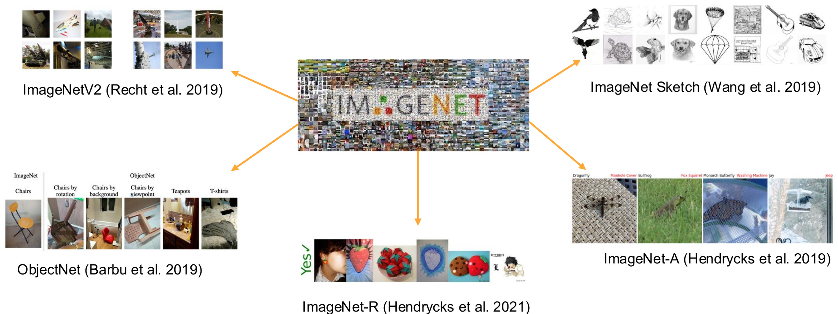
PART IV · EVALUATION
Evaluating robustness to distribution shift
ImageNetV2
new collection, same protocol
ImageNet-R
art, cartoons, renditions
ImageNet-Sketch
black-and-white sketches
ObjectNet
odd poses and backgrounds
ImageNet-A
adversarially filtered images
Same 1000 classes, different look: does accuracy survive?
Contrastive Vision–Language Models · CIS 5590 · Fall 2026

Slide 40
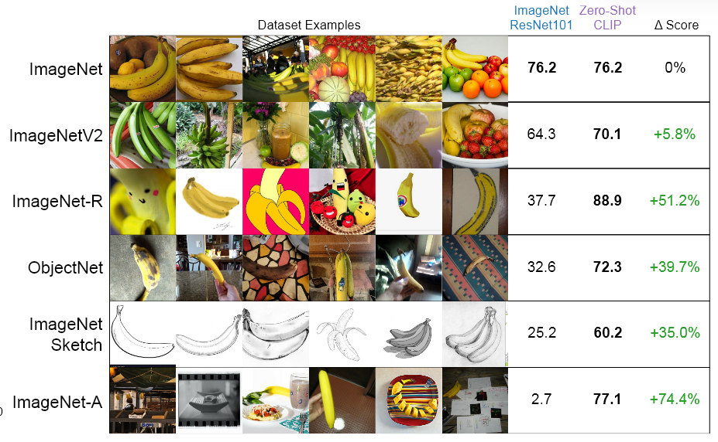
PART IV · EVALUATION
CLIP on natural distribution shifts
The farther from ImageNet photos, the larger CLIP's advantage.
Contrastive Vision–Language Models · CIS 5590 · Fall 2026

Slide 41
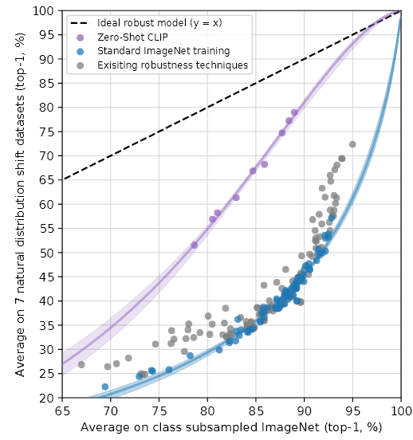
PART IV · EVALUATION
Effective robustness curve
x: ImageNet accuracy · y: average on 7 natural-shift datasets
Standard ImageNet models (blue) and robustness techniques (gray) follow one trend
Zero-shot CLIP (purple) lies far above it at comparable ImageNet accuracy
Closes up to 75% of the gap to the ideal y = x line
CLIP's gain is robustness, not just a better ImageNet score.
Radford et al. (2021), Fig. 13 (left).
Contrastive Vision–Language Models · CIS 5590 · Fall 2026

Slide 42
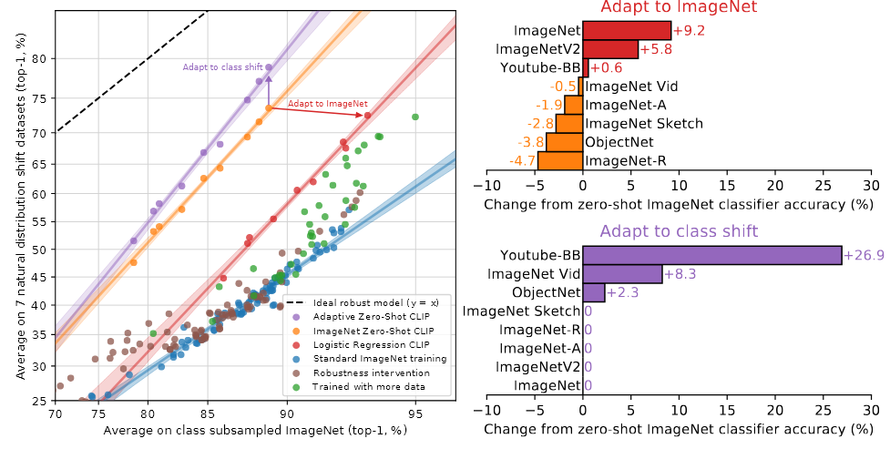
PART IV · EVALUATION
Adapting to ImageNet trades away robustness
Train a logistic-regression head on ImageNet features ("adapt to ImageNet")
ImageNet accuracy +9.2, but average shifted accuracy slightly drops
ImageNet-R −4.7, ObjectNet −3.8, Sketch −2.8 …
Fitting one distribution re-learns its quirks.
Radford et al. (2021), Fig. 14.
Contrastive Vision–Language Models · CIS 5590 · Fall 2026

Slide 43
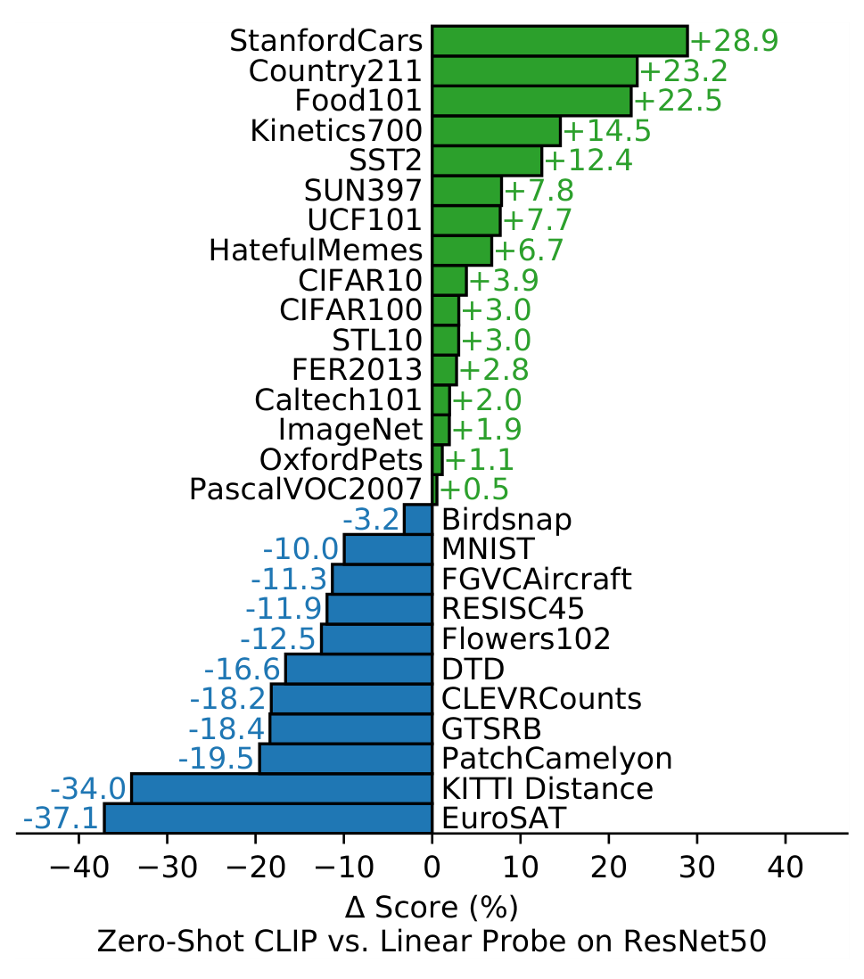
PART IV · EVALUATION
Where zero-shot wins and loses: 27 datasets
Zero-shot CLIP vs. a fully supervised linear probe on ResNet-50 features
Wins on 16 / 27 datasets, incl. ImageNet, Stanford Cars (+28.9), Food101
Loses on specialized or abstract tasks: satellite (EuroSAT), counting (CLEVR), tumor detection (PatchCamelyon), distance (KITTI)
Strong on concepts well covered by web captions; weak on specialized or abstract tasks.
Radford et al. (2021), Fig. 5.
Contrastive Vision–Language Models · CIS 5590 · Fall 2026

Slide 44
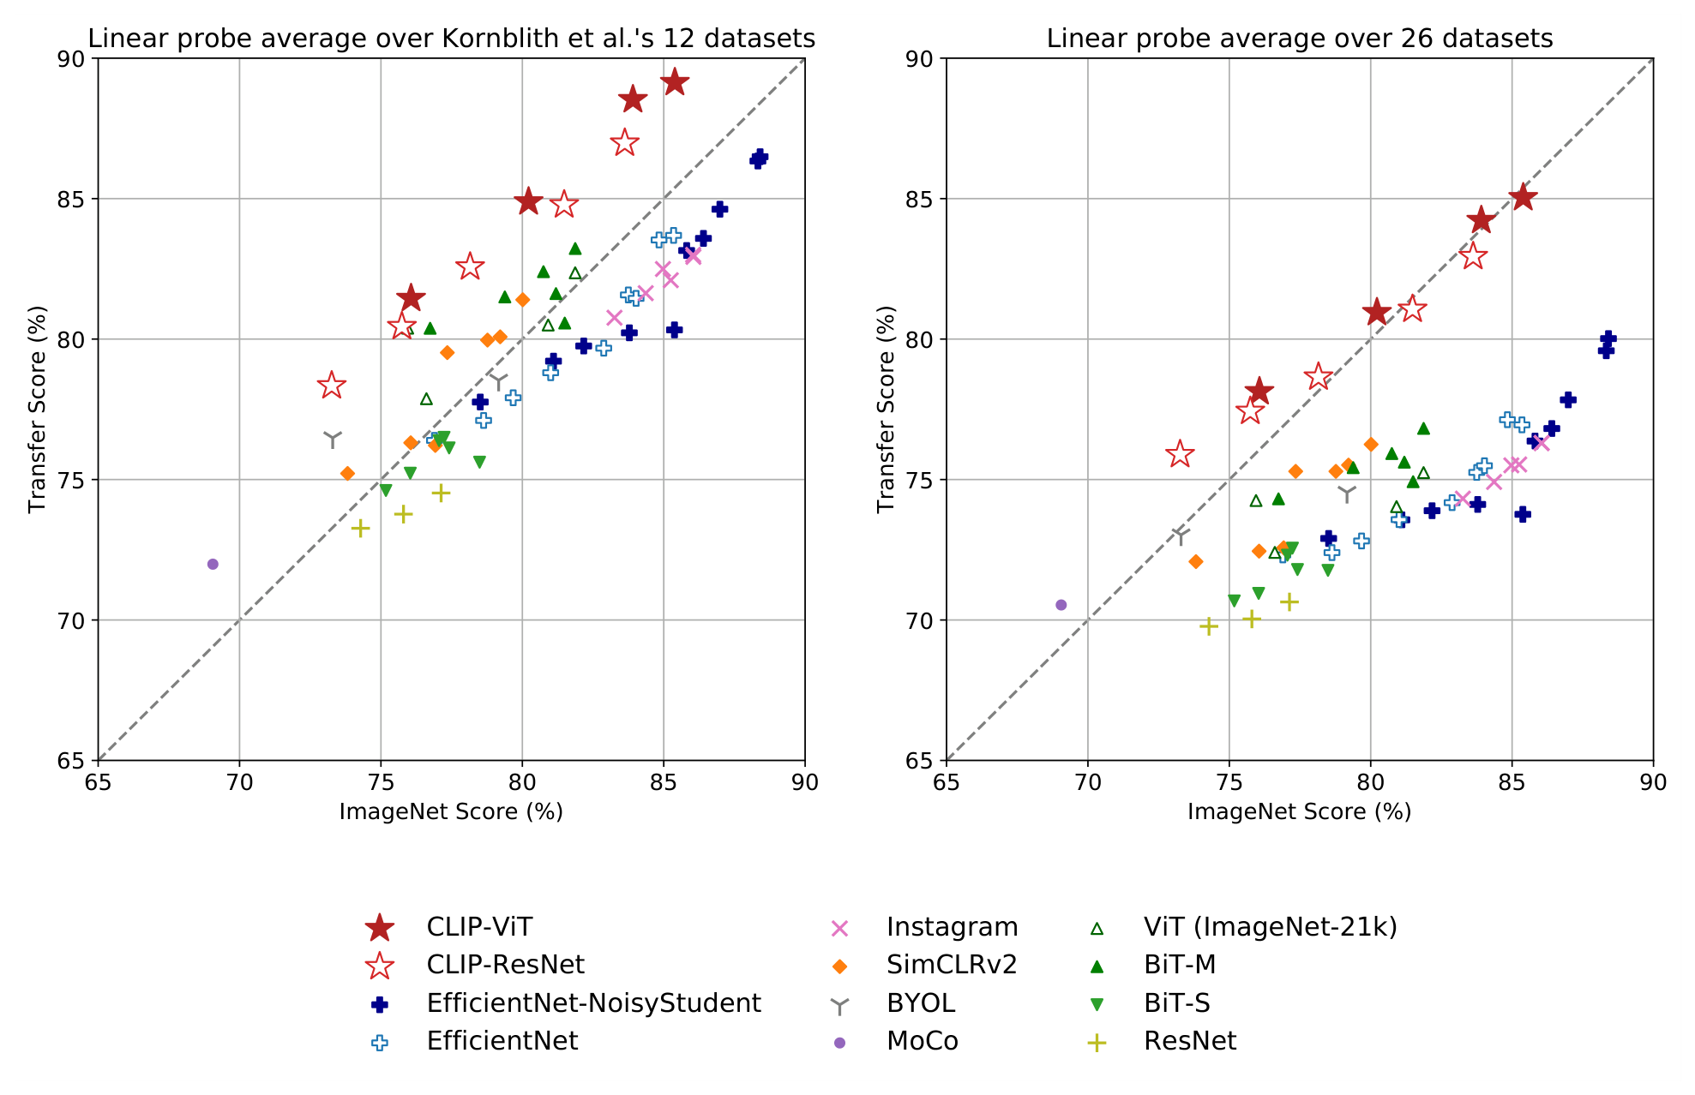
PART IV · EVALUATION
Robustness to task shift
Now the task changes, not the image style
x: ImageNet score · y: transfer score on other datasets
Supervised models lie on or below y = x
CLIP (red stars) lies above at equal ImageNet score
Robustness evaluation needs distribution shift AND task shift.
Radford et al. (2021), Fig. 12.
Contrastive Vision–Language Models · CIS 5590 · Fall 2026

Slide 45
COURSE MAP
Lecture roadmap
I
Motivation
II
Contrastive foundations
III
CLIP architecture and use
Why align images and language in one space?
How does a contrastive loss learn a shared space?
How is CLIP built, trained, and used?
IV
Evaluation and robustness
V
Reproduction
VI
Limitations and takeaways
Does it generalize under distribution and task shift?
Can we watch the mechanism run on a few examples?
Where does it break, and what should we remember?
Contrastive Vision–Language Models · CIS 5590 · Fall 2026

Slide 46
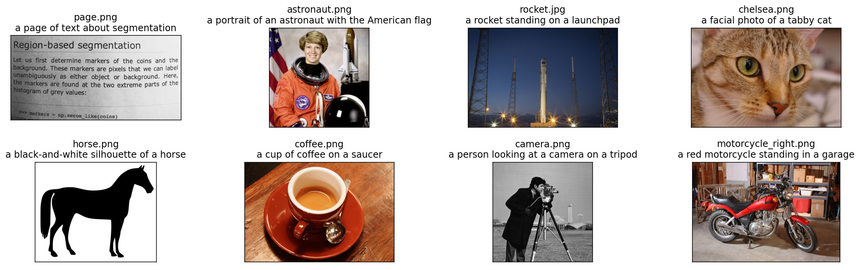
PART V · REPRODUCTION
Setup: load a released CLIP model
# pip install ftfy regex tqdm
# pip install git+https://github.com/
# openai/CLIP.git
import clip, torch
clip.available_models()
# ['RN50','RN101','RN50x4','RN50x16',
# 'ViT-B/32','ViT-B/16', ...]
model, preprocess = clip.load("ViT-B/32")
# Model parameters: 151,277,313
# Input resolution: 224
# Context length: 77
# Vocab size: 49408
Test inputs: 8 scikit-image photos with descriptions. OpenAI notebook.
Preprocess
Resize 224 · center crop · normalize with CLIP's mean/std · tokenize texts to 77 IDs.
Goal: see encode → normalize → compare, not re-train at 400M scale
Contrastive Vision–Language Models · CIS 5590 · Fall 2026

Slide 47
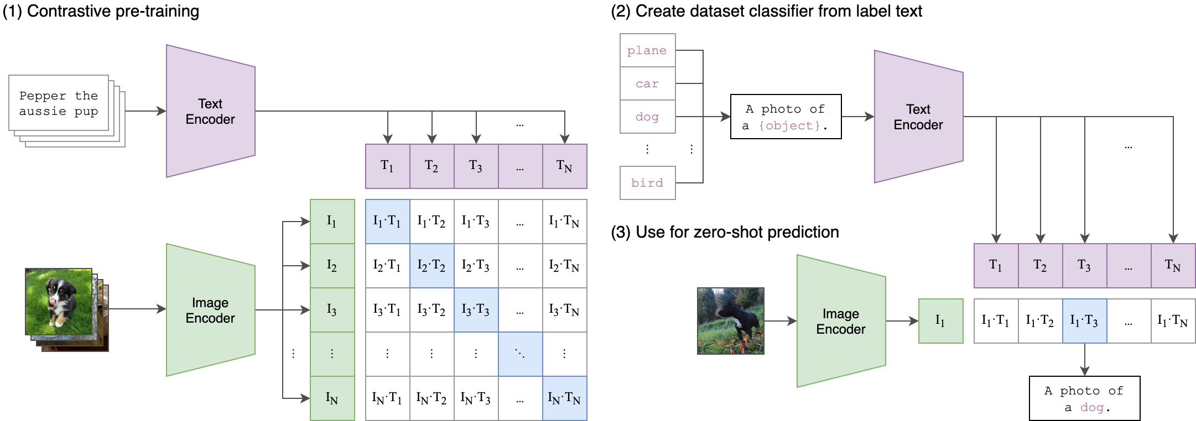
PART V · REPRODUCTION
Example 1: which caption matches the image?
image = preprocess(Image.open("CLIP.png"))[None]
text = clip.tokenize(["a diagram", "a dog", "a cat"])
with torch.no_grad():
logits_per_image, _ = model(image, text)
probs = logits_per_image.softmax(dim=-1)
print(probs)
# [[0.9927937 0.00421068 0.00299572]]
logits = 100 · cos(image, caption)
Softmax over the offered captions
Probabilities are relative to the candidate set
Contrastive Vision–Language Models · CIS 5590 · Fall 2026

Slide 48
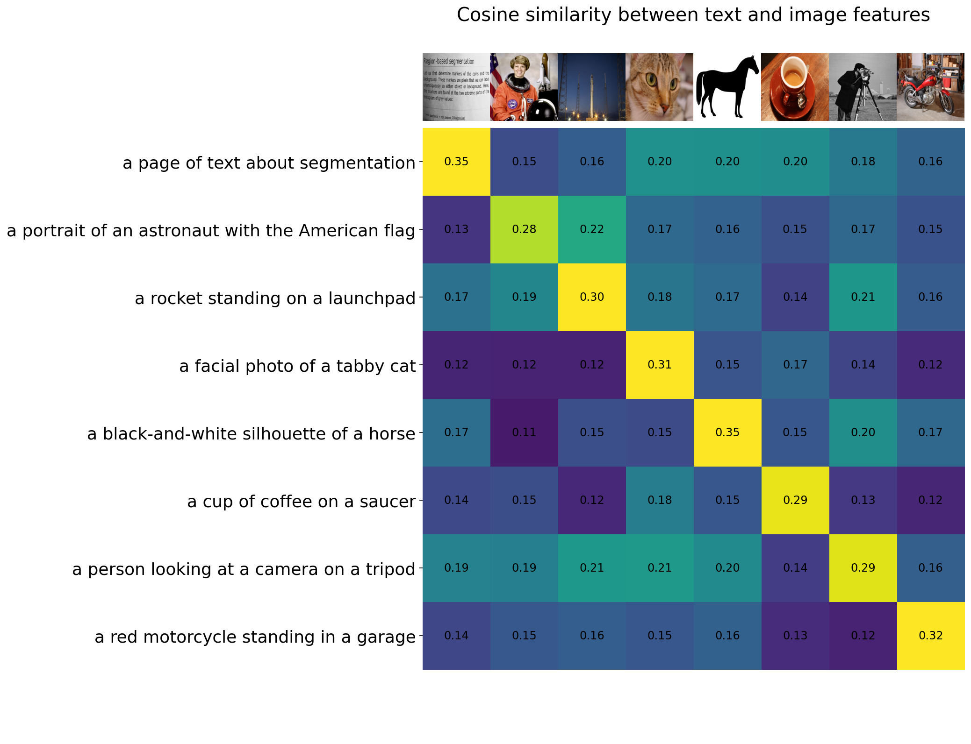
PART V · REPRODUCTION
Example 2: the image–text similarity matrix
image_features = model.encode_image(image_input)
text_features = model.encode_text(text_tokens)
image_features /= image_features.norm(dim=-1,
keepdim=True)
text_features /= text_features.norm(dim=-1,
keepdim=True)
similarity = text_features @ image_features.T
# shape [8, 8]
Diagonal = brightest cell in every row and column
Matches ≈ 0.3, mismatches ≈ 0.1–0.2 (the modality gap)
Exactly the batch matrix of Part II
Contrastive Vision–Language Models · CIS 5590 · Fall 2026

Slide 49
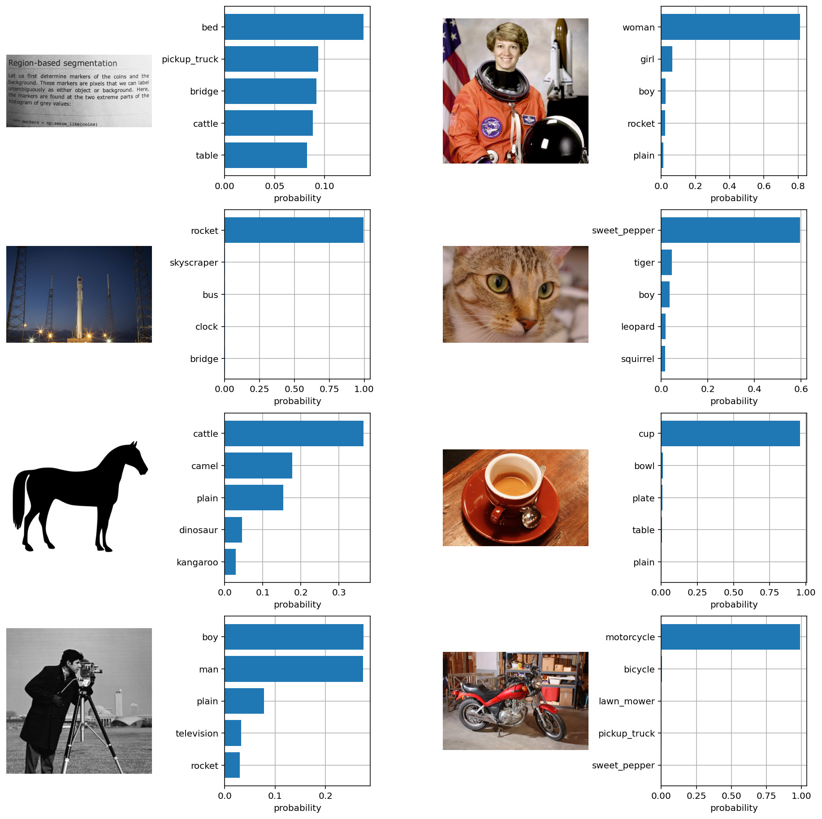
PART V · REPRODUCTION
Example 3: zero-shot classification on CIFAR-100
image, class_id = cifar100[3637]
text_inputs = torch.cat([clip.tokenize(
f"a photo of a {c}") for c in cifar100.classes])
img_f = model.encode_image(preprocess(image)[None])
txt_f = model.encode_text(text_inputs) # 100 classes
# normalize both, then
similarity = (100.0 * img_f @ txt_f.T).softmax(dim=-1)
values, indices = similarity[0].topk(5)
Top predictions:
snake: 65.31%
turtle: 12.29%
sweet_pepper: 3.83%
lizard: 1.88%
Contrastive Vision–Language Models · CIS 5590 · Fall 2026

Slide 50
COURSE MAP
Lecture roadmap
I
Motivation
II
Contrastive foundations
III
CLIP architecture and use
Why align images and language in one space?
How does a contrastive loss learn a shared space?
How is CLIP built, trained, and used?
IV
Evaluation and robustness
V
Reproduction
VI
Limitations and takeaways
Does it generalize under distribution and task shift?
Can we watch the mechanism run on a few examples?
Where does it break, and what should we remember?
Contrastive Vision–Language Models · CIS 5590 · Fall 2026

Slide 51
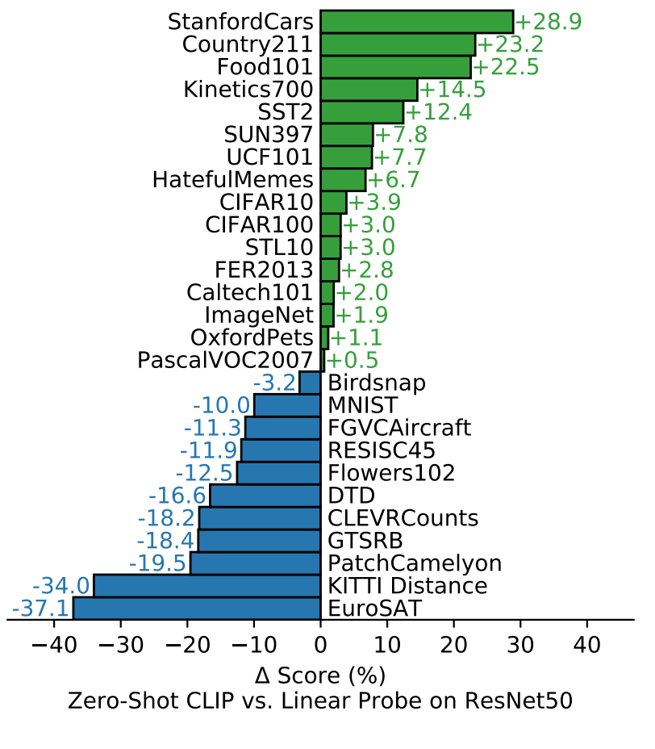
PART VI · LIMITATIONS
Where CLIP falls short
Counting, spatial, abstract tasks
Global embedding loses object counts, relations and fine detail.
No text generation
Scores and retrieves; cannot write captions.
Prompt sensitivity & distribution
Wording changes accuracy; specialized domains are weak.
Social bias from web data
Learns stereotypes present in image–text pairs.
Strong general representation — not a full solution to vision–language understanding.
Contrastive Vision–Language Models · CIS 5590 · Fall 2026

Slide 52
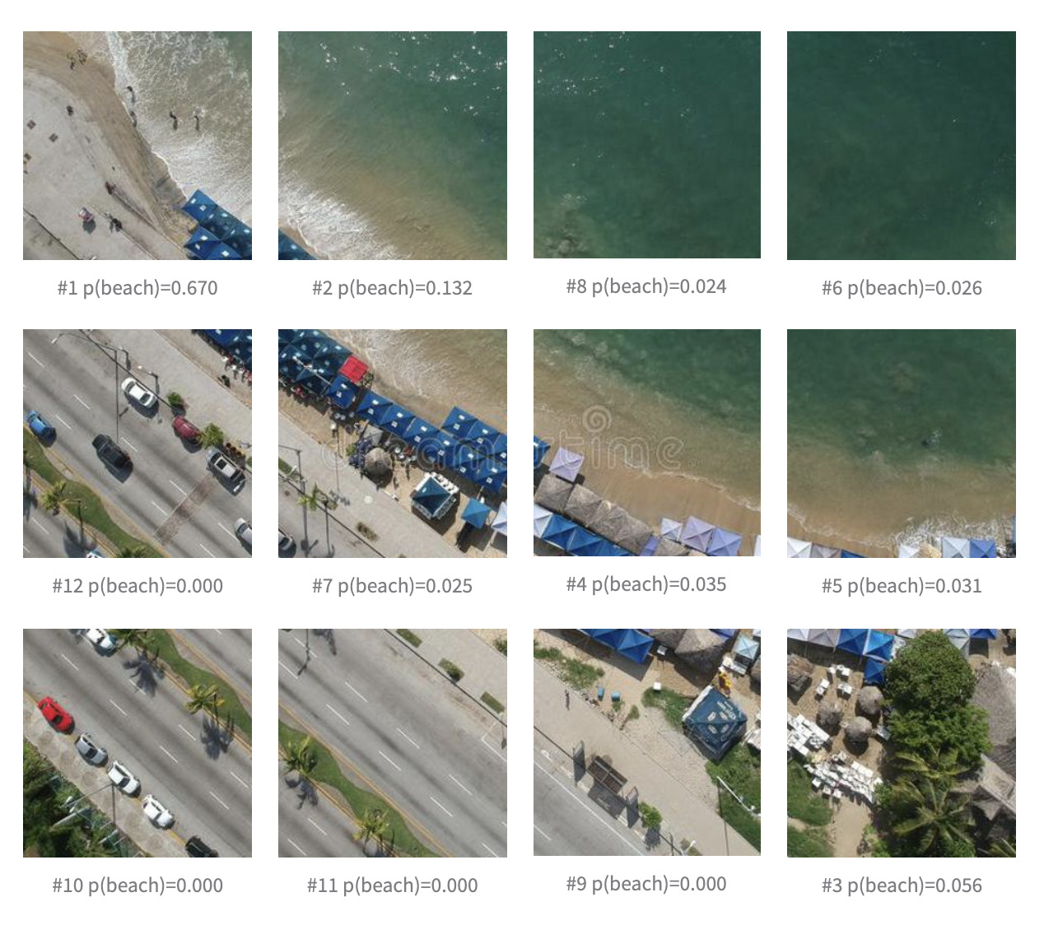
PART VI · LIMITATIONS
Prompt sensitivity and distribution dependence
Prompt sensitivity: "a photo of a {c}" vs. "a satellite photo of a {c}" can change accuracy by 10+ points (EuroSAT)
Distribution dependence: strong only where web captions cover the concept
Zero-shot MNIST ≈ 88% — below logistic regression on raw pixels
Weak on satellite, medical, synthetic counting tasks
Specialized domains usually need fine-tuning or prompt learning (e.g. CLIP-RSICD, CoOp)
CLIP fine-tuned on satellite captions (RSICD), query "beach".
Contrastive Vision–Language Models · CIS 5590 · Fall 2026

Slide 53
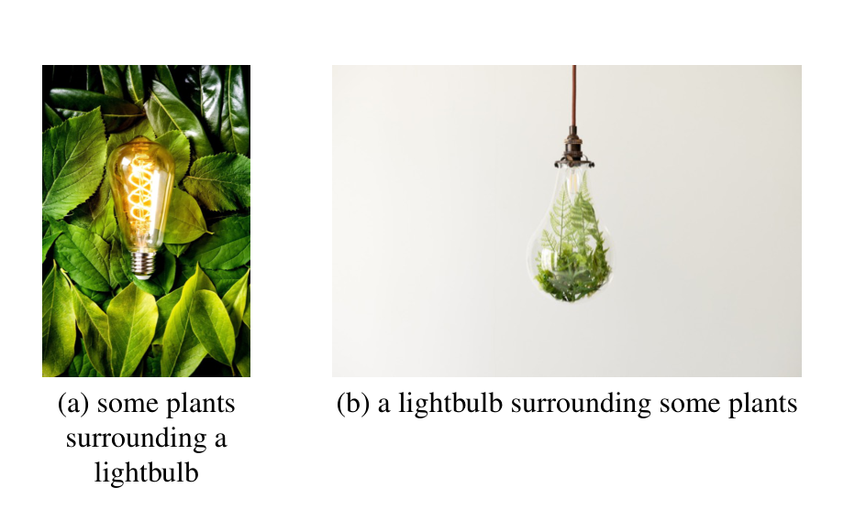
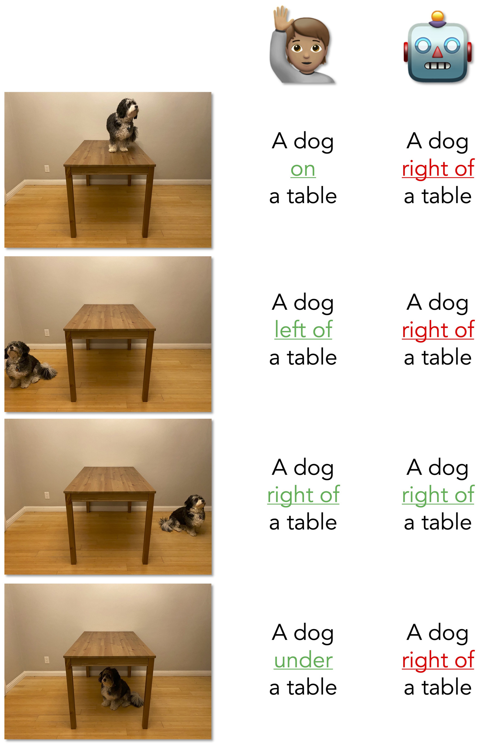
PART VI · LIMITATIONS
Compositionality: word order and spatial relations
A dog on / under / left of / right of a table
Humans: all correct
CLIP (robot column): picks "right of" almost always
Same words, different order. Thrush et al. (2022), Winoground Fig. 1.
"some plants surrounding a lightbulb" vs. "a lightbulb surrounding some plants"
CLIP-style models perform near chance on Winoground
What's up with VLMs (Kamath et al., 2023).
Contrastive Vision–Language Models · CIS 5590 · Fall 2026

Slide 54
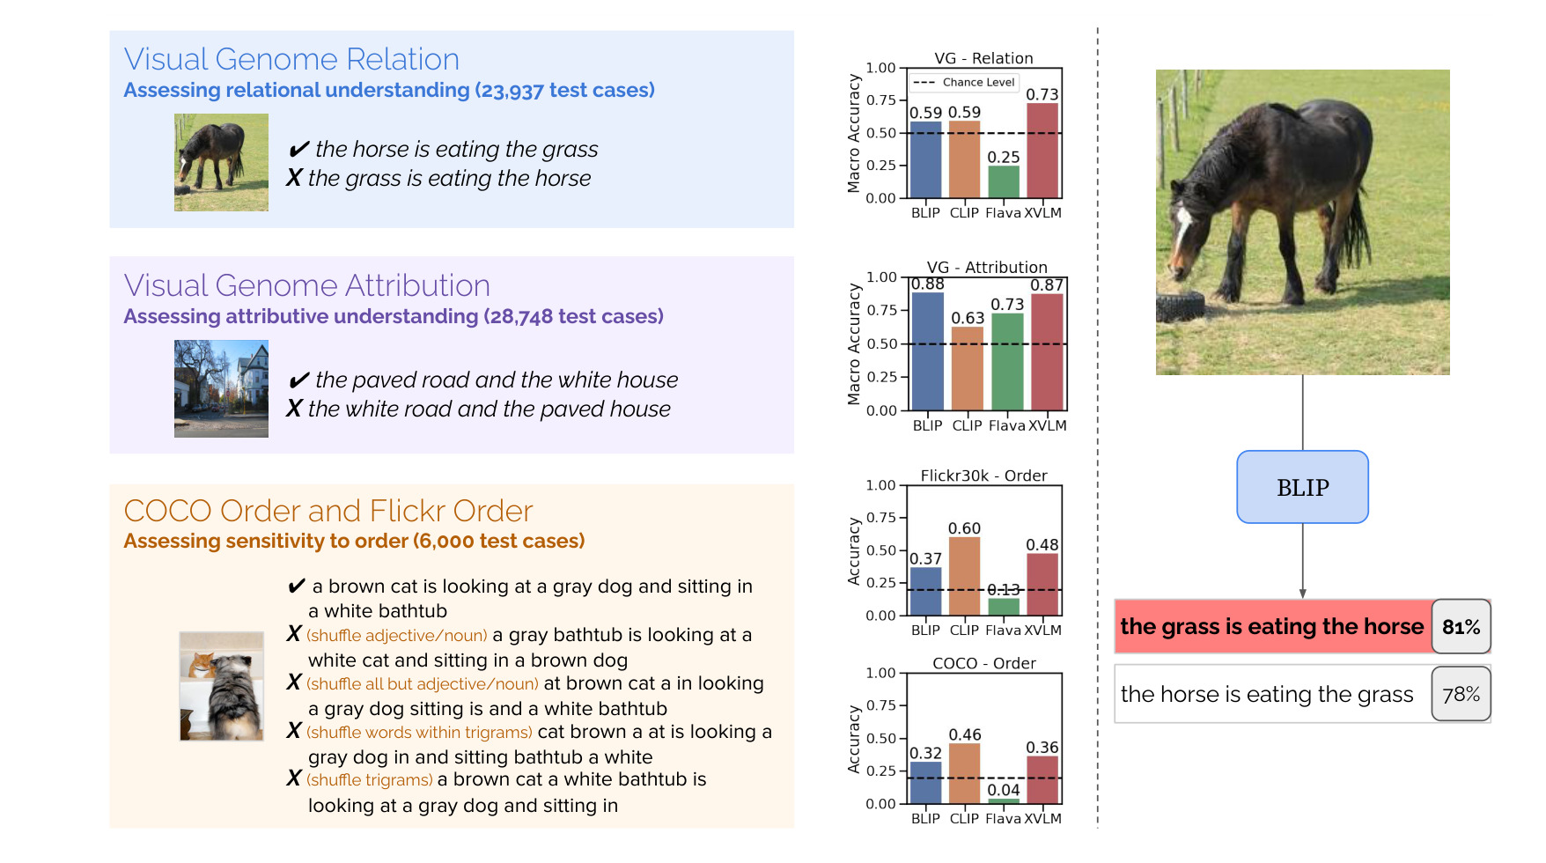
PART VI · LIMITATIONS
Why: CLIP can behave like a bag of words
"the horse is eating the grass" vs. "the grass is eating the horse" — similar scores
Shuffled captions still match their images
Contrastive batches rarely contain order-only negatives → no pressure to learn order
ARO benchmark: relations, attributes, order. Yuksekgonul et al. (2023), Fig. 1.
Fix explored in the paper: hard negatives with swapped word order (NegCLIP).
Contrastive Vision–Language Models · CIS 5590 · Fall 2026

Slide 55
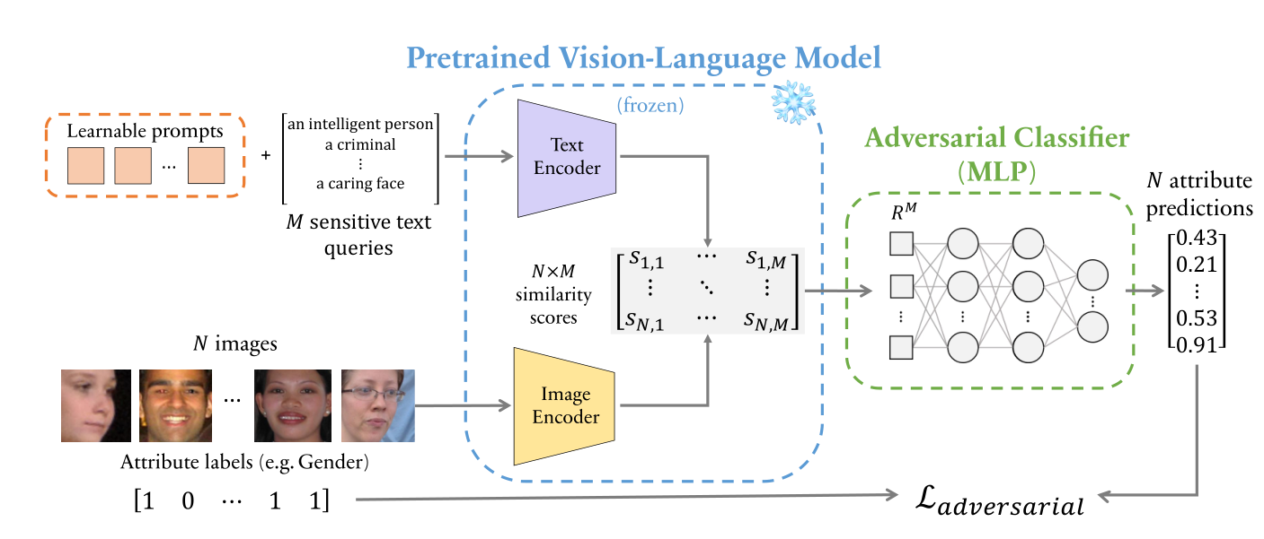
PART VI · LIMITATIONS
Social bias inherited from web-scale data
In the CLIP paper
FairFace images were assigned crime-related and non-human labels at different rates across groups.
Practice
Audit zero-shot classifiers before deployment; measure, then mitigate.
Measuring bias through image–text similarity. Berg et al. (2022).
Similarity to "a criminal" or "an intelligent person" can correlate with gender and race
Results depend on the chosen class names and prompts
Contrastive Vision–Language Models · CIS 5590 · Fall 2026

Slide 56

PART VI · LIMITATIONS
Global compatibility scoring, no caption generation
ClipCap: a mapping network turns the CLIP embedding into a GPT-2 prefix. Mokady et al. (2021), Fig. 2.
What CLIP gives
One global score per (image, text): ranks candidates, cannot write or localize.
How later models add generation
CLIP encoder + decoder: ClipCap, BLIP, CoCa, LLaVA.
Contrastive Vision–Language Models · CIS 5590 · Fall 2026

Slide 57
PART VI · TAKEAWAYS
Four ideas to remember
1
Shared space
2
Contrastive training
Images and text are encoded into one normalized embedding space.
Batch matrix: matched pairs on the diagonal, all others negative; symmetric InfoNCE with temperature.
3
Prompts as classifiers
4
Robust, with limits
Class names become text vectors; zero-shot classification is nearest-neighbor search.
Natural-language supervision transfers under shift, yet counting, bias and prompts remain issues.
CLIP = contrastive alignment + language as the label interface.
Contrastive Vision–Language Models · CIS 5590 · Fall 2026

