Slide 1

Image Retrieval & Image Similarity Measures
Trafford Hunt
MS Computational Data Science
Albert Alvarado MS Computer Science
Darshan Patel
MS Computational Data Science

Slide 2
Learning Objectives
Explain how images are represented as embeddings for retrieval tasks.
Diﬀerentiate cosine similarity from dot product and understand when each is appropriate.
Describe how learned metric spaces enable semantically meaningful similarity.
Explain how cross-modal retrieval maps text and images into a shared embedding space.
Evaluate retrieval performance using Recall@K and mAP.
Interpret retrieval results and reason about what makes a retrieval system succeed or fail.

Slide 3
Embedding Based Retrieval
Embedding Based Retrieval

Slide 4
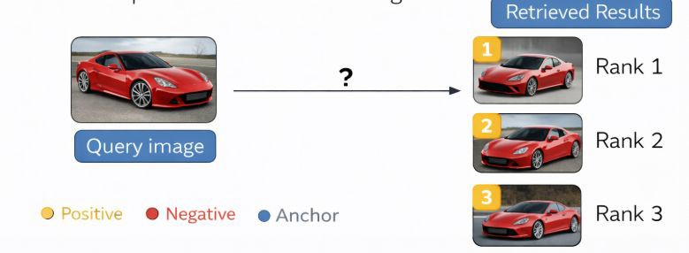
The Core Problem
Goal: retrieve similar images
Need a meaningful similarity measure
Pixel space ≠ semantic meaning

Slide 5
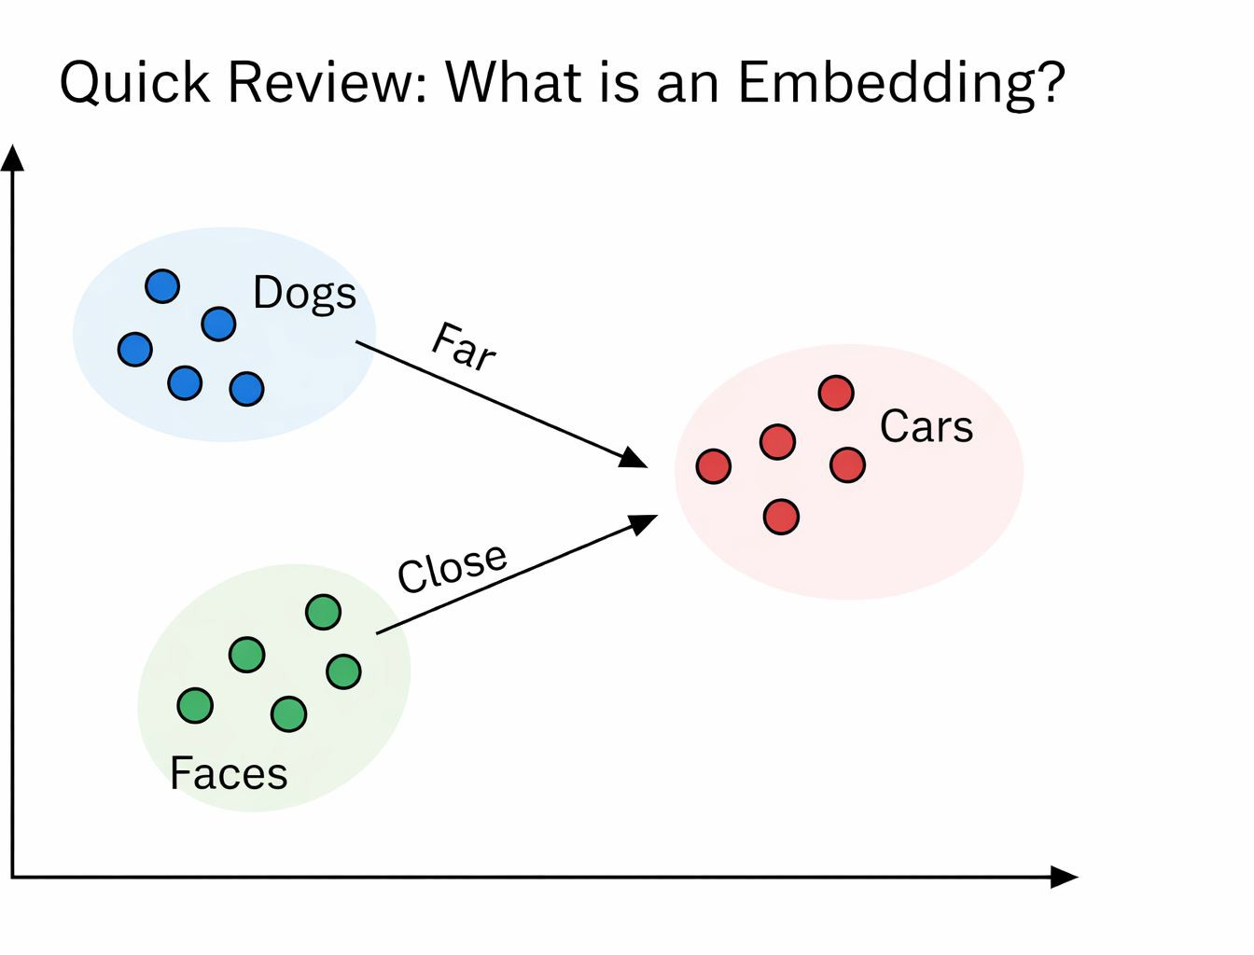

Embeddings (Brief Review)
Mapping: image → vector
Encodes semantic meaning, not raw pixels Goal:
Similar images → close in space
Dissimilar images → far apart

Slide 6
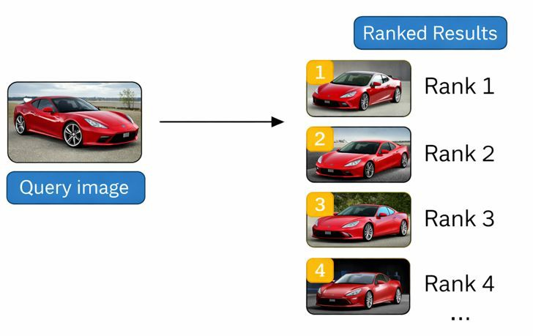


Image Retrieval as a Ranking Problem
Content:
Input: query image 𝙦
Database:
Output:
  Ranked list based on similarity

Slide 7
What Does “Similarity” Mean?
Same object? (instance-level)
Same category? (semantic-level)
Context similarity?
No single universal deﬁnition

Slide 8

How do we Compare Vectors?
Given two embeddings:
We need a similarity function:
Dot product
Cosine similarity
Distance metrics

Slide 9
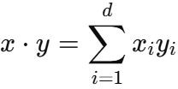
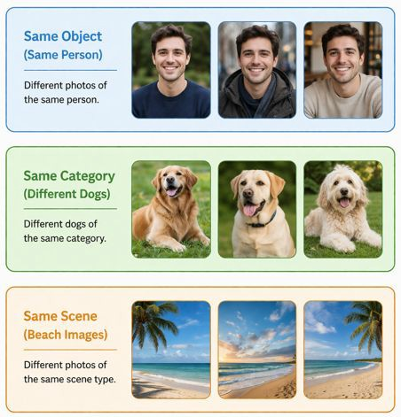
Dot Product Similarity
Depends on:
  Magnitude ∣∣x∣∣,∣∣y∣∣||x||, ||y||∣∣x∣∣,∣∣y∣∣
  Direction
Larger vectors → larger scores

Slide 10

Dot Product Intuition
High score can mean:
  Similar direction
  OR just large magnitude
Problem:
Magnitude may not reﬂect semantic similarity

Slide 11

Cosine Similarity
Measures angle only
Range: [−1,1][-1, 1][−1,1]

Slide 12
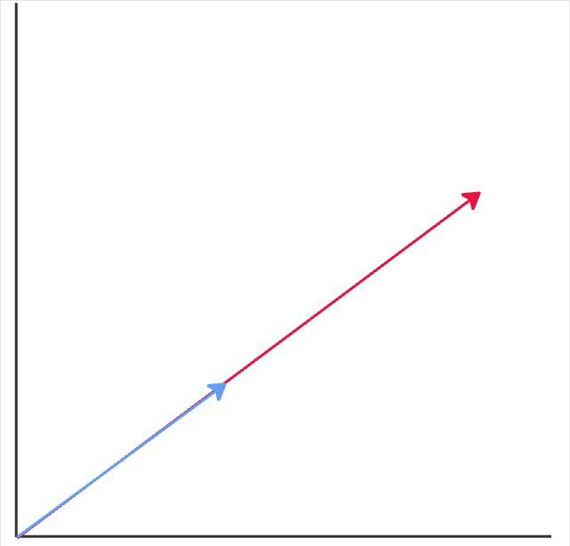
Geometric Interpretation
𝜃 = 0° → identical direction → max similarity
𝜃 = 90° → unrelated
𝜃 = 180° → opposite

Slide 13


Dot vs Cosine (Comparison)
Converts to unit vectors
Then:

Slide 14
Dot Product vs Cosine
Property | Dot Product | Cosine
Uses magnitude | Yes | No
Uses direction | Yes | Yes
Scale sensitive | Yes | No

Slide 15
Why Cosine Works
Embeddings encode meaning in direction
Magnitude may encode:
Conﬁdence
Scaling artifacts
Cosine removes irrelevant variation

Slide 16
High-Dimensional Spaces
In high dimensions:
  Vectors tend to be nearly orthogonal
Distances become less informative

Slide 17
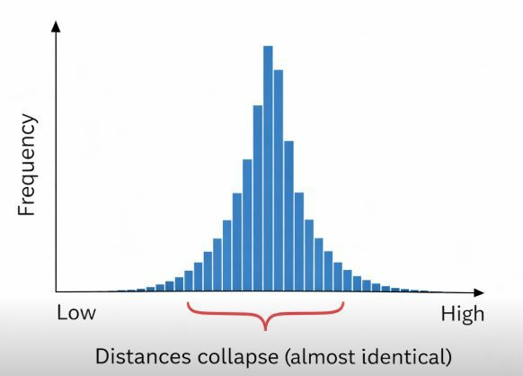
Distance Concentration
Distances cluster:
Hard to distinguish neighbors

Slide 18
Why Cosine Is Better
Angle still varies meaningfully
Preserves relative similarity
More stable for ranking

Slide 19
Learning a Good Embedding Space
Goal:
  Structure the space meaningfully
Done via metric learning

Slide 20

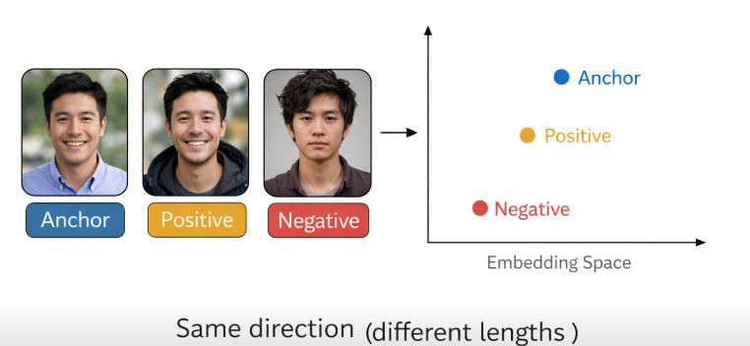
FaceNet Example
Input: face image
Output:
Same identity → close vectors

Slide 21
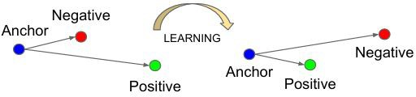
Triplet Setup
Anchor
Positive (same class)
Negative (diﬀerent class)

Slide 22
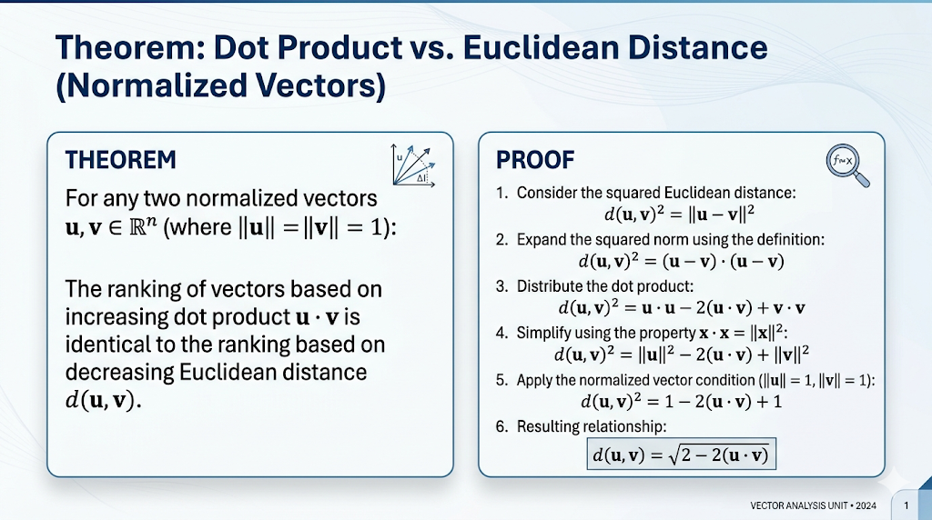

Slide 23

Triplet Loss
𝛂 = margin

Slide 24



Triplet Loss Intuition
Minimize:
Maximize: Constraint:

Slide 25
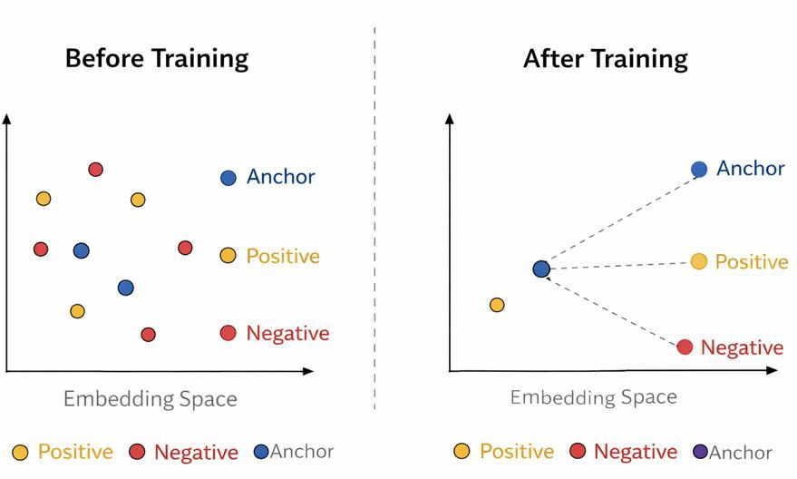
Effect on Embedding Space
Clusters form naturally
Separation between classes increases

Slide 26
Why This Helps Retrieval
Retrieval = nearest neighbors
Better geometry → better ranking
Works with cosine similarity

Slide 27
Full Pipeline
Image → embedding 𝑓(𝔁)
Compare using cosine similarity
Rank results
Return top-K

Slide 28
Key Takeaways
Embeddings → semantic representation
Cosine similarity → direction-based comparison
Triplet loss → learns meaningful structure

Slide 29

Check on Learning
You are given two embeddings:
Which statement is true?
Cosine similarity = 1
Dot product = 1
They are completely diﬀerent directions
Cosine similarity = 0

Slide 30
Check on Learning
Why might cosine similarity be preferred over dot product in retrieval?
It ignores magnitude
It is faster to compute
It increases vector length
It removes all noise

Slide 31
Cross Modal Retrieval
Embedding Based Retrieval

Slide 32
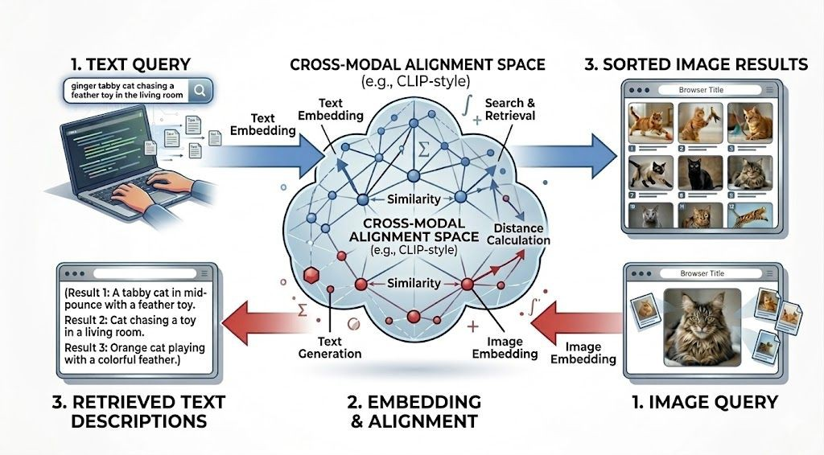
Introduction to Cross-Modal Search

Slide 33
Cross Modal Retrieval Outline
The Heterogeneity Gap: Understanding the fundamental disconnect between pixels and text.
Baseline Architecture (CLIP): Dual-encoders and contrastive learning.
Composed Image Retrieval (CIR): Modifying reference images with text-based instructions (TIRG).
The Evolution of Retrieval: Multimodal fusion (BLIP) and multi-vector search.
The Generative Shift: Reasoning-based retrieval with VLMs (LLaVA).
Searching at Scale: Vector databases and Approximate Nearest Neighbors (ANN).
Open Challenges: The Modality Gap and real-world implementation hurdles.

Slide 34
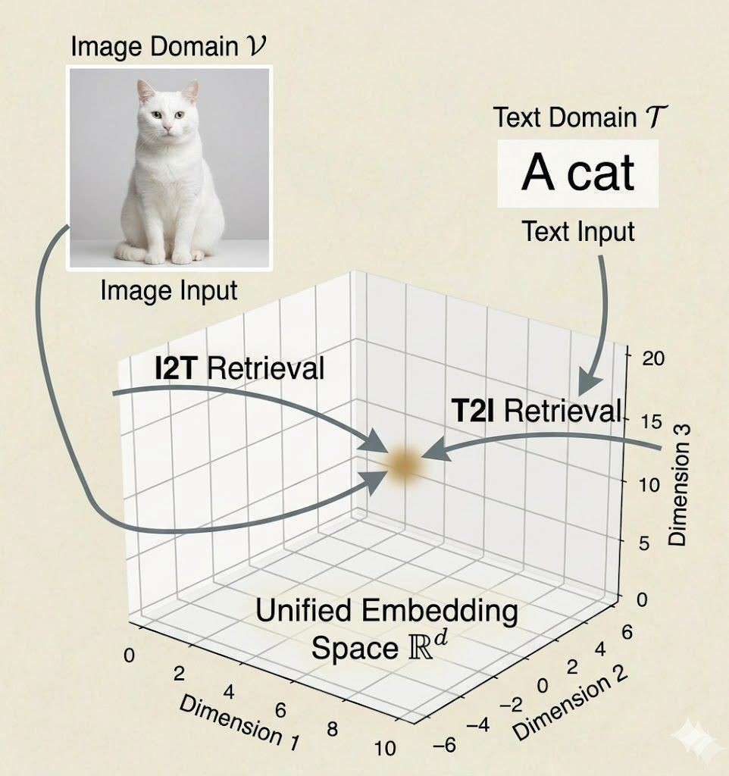

The Core Concept – Bridging the Heterogeneity Gap
The Heterogeneity Gap: Images (continuous pixels) and Text (discrete tokens) exist in disjoint mathematical spaces
The Goal: Learn a mapping function
Semantically identical inputs map to similar vector coordinates.

Slide 35
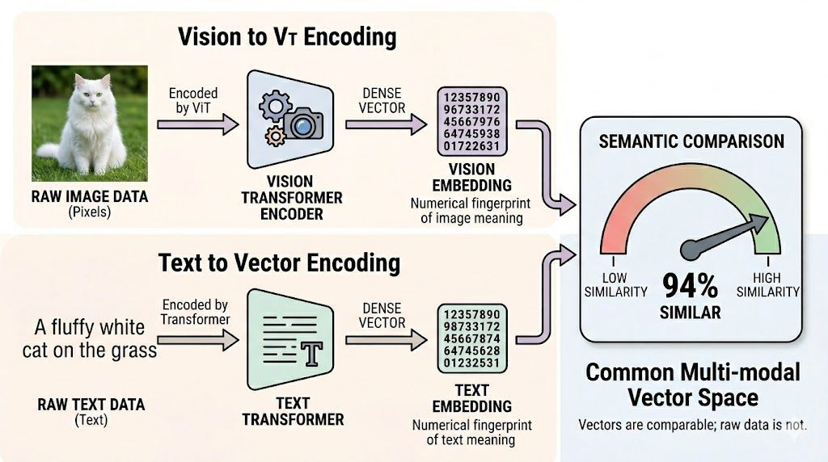
Preparing the Data – Modality Encoders
Vision Encoders: Compress high-dimensional pixel data into dense vectors (e.g., Vision Transformers/ViT, ResNet).
Text Encoders: Process language syntax into dense vectors (e.g., standard Transformers).
Raw data cannot be compared; we compare their encoded feature vectors

Slide 36
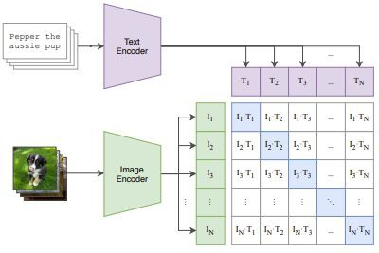
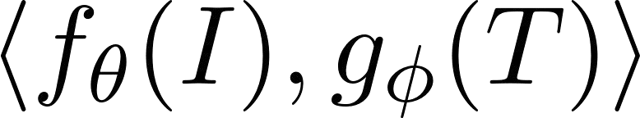
The Baseline Architecture – The Dual-Encoder (CLIP)
The Dual-Encoder Architecture: Pioneered by models like CLIP.
Independent Parameterization: Two strictly isolated networks, one for vision (fθ) and one for text (gΦ).
Strict Modality Isolation: Activations and weights are never shared during the forward pass.
Learning an Isomorphic Space: The architecture forces discrete tokens and continuous pixels to map onto the exact same d-dimensional manifold.
Semantic Alignment: The joint relationship between the modalities is modeled entirely by the inner product
.

Slide 37
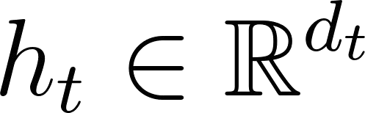
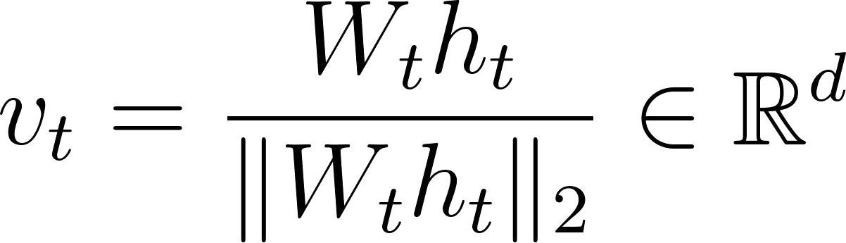
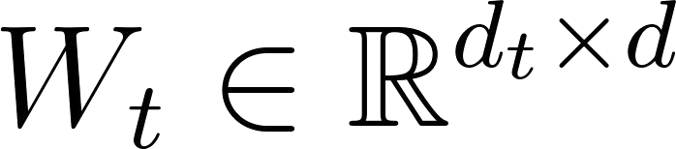
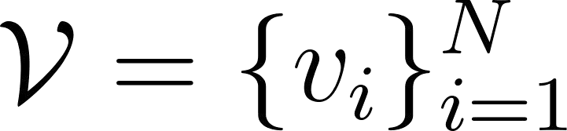
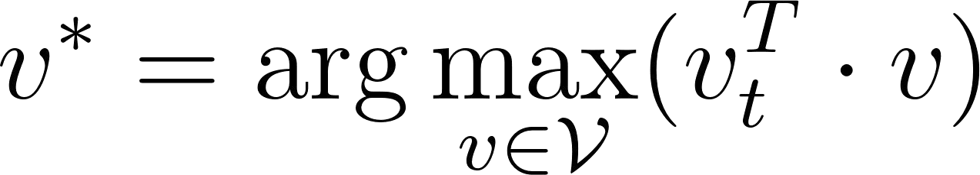
Example in Action – Text-to-Image (T2I) Search
Query Processing: Text sequence → BPE Tokenization → Text Transformer (e.g., masked self-attention architecture) → Extract hidden state of [EOS] token
.
Linear Projection & Normalization: Map to shared semantic space using learned weight matrix, followed by L2 normalization:
Database: A pre-computed manifold of normalized image embeddings
.
Retrieval (Maximum Inner Product Search):

Slide 38
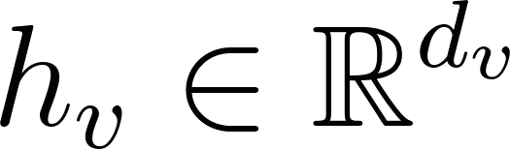
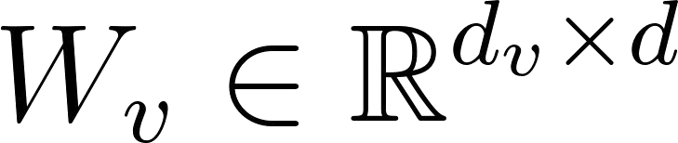
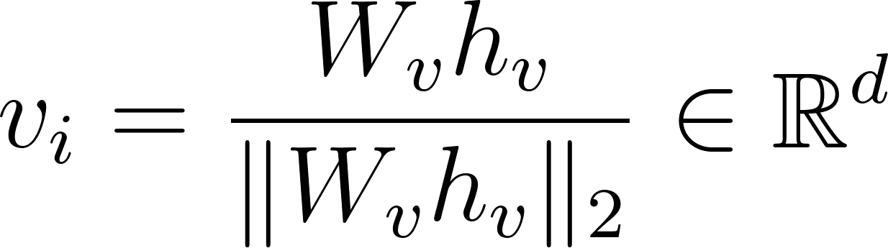
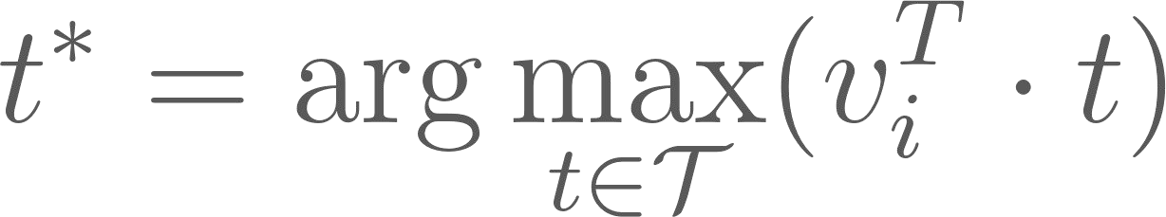
Example in Action – Image-to-Text (I2T) Retrieval
Query Processing: Image I → Patch Embedding (e.g., 16 x 16 patches) → Vision Transformer (ViT-B/32)
→ Extract hidden state of [CLS] token .
Linear Projection & Normalization: Map to shared semantic space using learned weight matrix :
Approximate Nearest Neighbor (ANN) Retrieval:

Slide 39
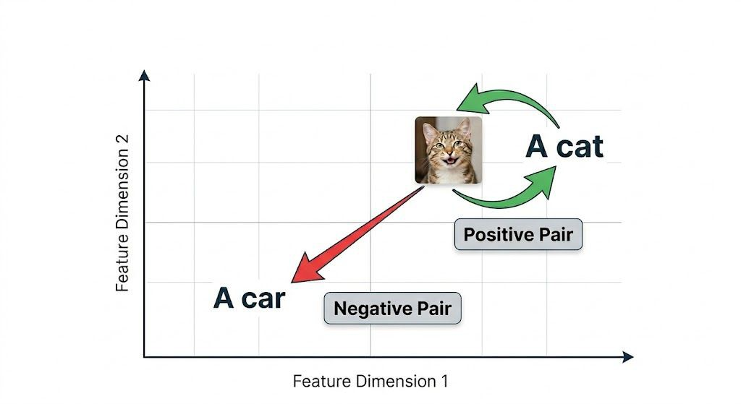
Contrastive Learning
The Learning Objective
How CLIP learns a shared semantic space without manual labels.
Maximize Similarity
Pull matching (positive) pairs together in the vector space.
Minimize Similarity
Push mismatched (negative) pairs apart within the same batch.

Slide 40
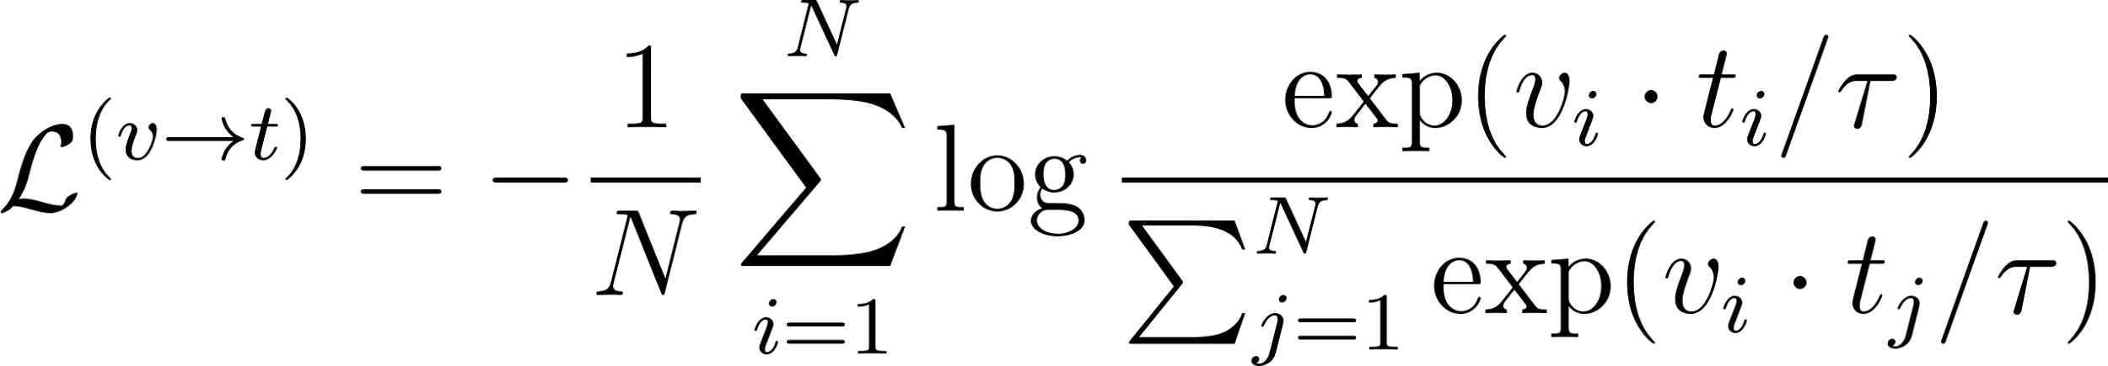
Contrastive Learning & Scale
The Symmetric Cross-Entropy Loss (InfoNCE):
CLIP's Secret Weapon: A massive batch size (N=32,768).
Deﬁning the Negatives:
Easy Negatives: Trivially mismatched pairs (e.g., "dog" vs. "car").
Hard Negatives: Highly similar but incorrect pairs (e.g., "red car" vs. "blue car").
A massive batch guarantees thousands of hard negatives per step, forcing the model to learn highly precise vector representations rather than taking the easy way out.
While Triplet Loss was the gold standard for years (especially after the FaceNet paper), most SOTA (State of the Art) image retrieval methods have moved toward InfoNCE.

Slide 41
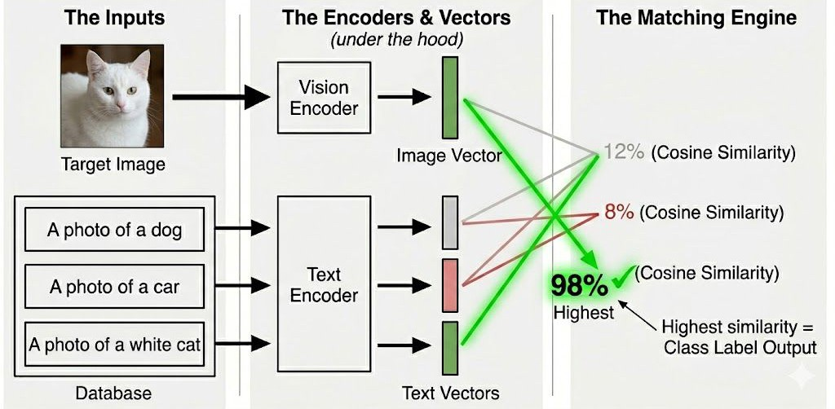
Emergent Capability – Zero-Shot Classification
Re-framing the Task: Classiﬁcation executed as Image-to-Text search.
Target Image: [Uploaded Photo of an white cat]
Generated Text Database: "A photo of a dog", "A photo of a car", "A photo of a white cat".
Result: CLIP retrieves the closest text vector, classifying without ﬁne-tuning.

Slide 42

The Evolution of Cross Modal Architectures
Beyond the Baseline: CLIP’s dual-encoder is fast but structurally limited in semantic reasoning.
Retrieve-then-Read
(CLIP)
Fast, late-interaction metric learning.
Composed Image Retrieval
(CIR)
Querying with image and text simultaneously.
End-to-End Fusion
(BLIP)
Mid/Early-interaction via Cross-Attention.
LLM + Retriever
(LLaVA)
Generative reasoning and autoregressive extraction.
Knowledge-Grounded
(QA)
Integrates external structured data for logical reasoning.
The Fundamental Trade-off
As semantic understanding increases, computational efficiency drops drastically.

Slide 43
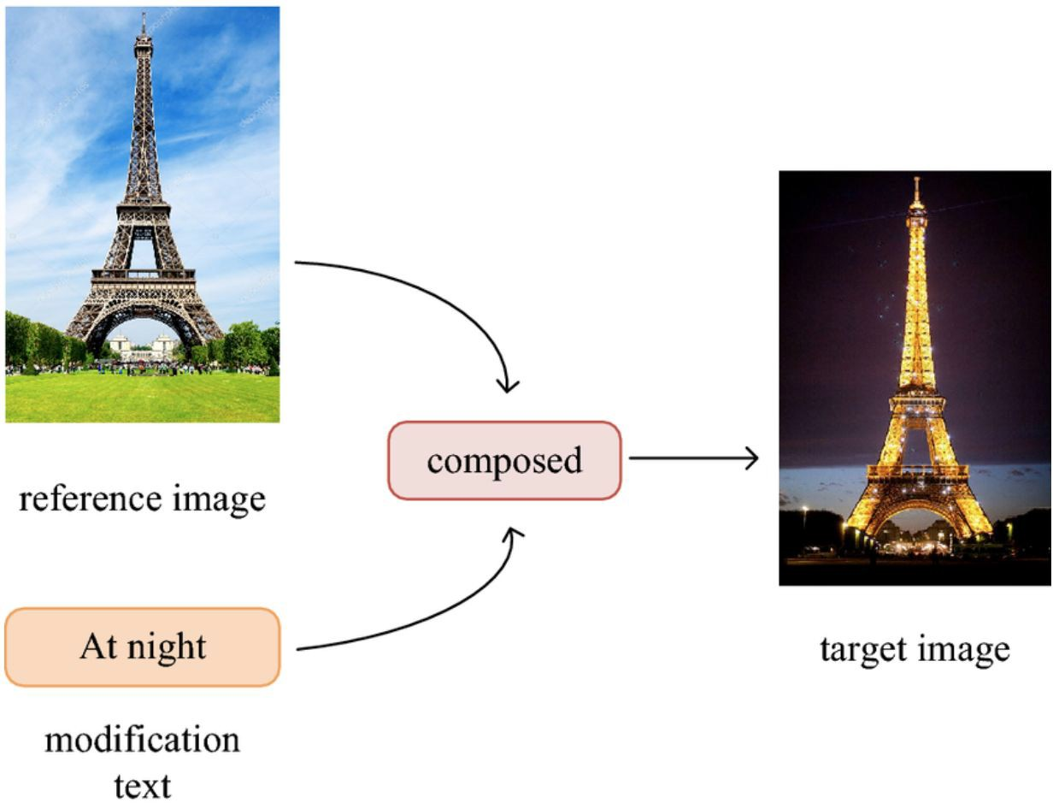
Composed Image Retrieval (CIR)
The Task: Find a "Target Image" using a multi-modal query:
Reference Image + Modiﬁcation Text.
Key Architectures & Systems:
CIRPLANT (2021): Liu et al. Uses Pretrained LANguage Transformers to reason over visual features.
VAL (2020): Chen et al. Introduced Vector Attention Learning to capture composite relationships.
Foundational Origin: TIRG (2019): Vo et al., "Composing Text and Image for Image Retrieval - An Empirical Odyssey" Deﬁned the core task and introduced the ﬁrst gating/residual architectures.

Slide 44
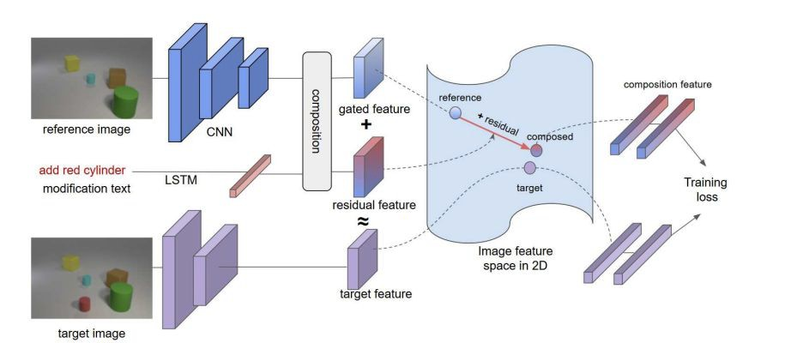
Text-Image Residual Gating (TIRG)
The Logic:
The Gate: Filters out irrelevant features from the reference image (e.g., erasing the daylight).
The Residual: Learns what to add from the text (e.g., the night lights).
Composition: Assembles the final query vector to locate the transformed target in the database.

Slide 45

Multi-Modal Composition Strategies
The Challenge: How to combine V_{Img} and V_{Text} without losing fine-grained detail.
System Implementations
Combinatorial Mapping
e.g., ARTEMIS
Gated Fusion
e.g., Fashion-IQ Impls
Zero-Shot CIR
e.g., SEARLE & Pic2Word
Learns a dedicated mapping function to combine queries into a single "composed" vector.
Uses a gating mechanism to decide which image features to 'keep' or 'override' with text.
Converts images into CLIP "pseudo-words" using LLMs or specialized mappers.
Standard Benchmark: CIRR (Real-life images), FashionIQ (Clothing attribute modifications)

Slide 46

BLIP: A Two-Stage Pipeline for I2T & T2I Retrieval
The Limitation of Dual-Encoders
Simple linear projections struggle with complex semantics and noisy web data. BLIP introduces a two-stage pipeline for precise retrieval.
The Retrieval Mechanics
Step 1: Image-Text Contrastive (ITC)
Fast dual-encoder search. Used to retrieve the top-k candidates from a massive database for both I2T and T2I queries.
Step 2: Image-Text Matching (ITM)
Deep cross-attention re-ranking. Fuses the query and top candidates at the patch/token level to output a precise binary match score.
Bootstrapping Language-Image Pre-training (BLIP) architecture effectively handles noisy web data through unified filtering and generation.

Slide 47
Fine-Grained Alignment via Late Interaction
The Old Way (Single-Vector Bottleneck)
Models (e.g., CLIP) compress the entire image and query into single vectors.
Drawback: Erases fine-grained details in dense documents.
The New Way: Late Interaction
Query and document are processed independently into token-level embeddings and only interact at the end.
The Multi-Vector Solution
Text Query: Represented as a matrix of word tokens.
Document Image: Split into a grid of visual patches via Vision Transformer.
The Key Takeaway: In visual retrieval, visual patches act as the document tokens (No OCR required).

Slide 48
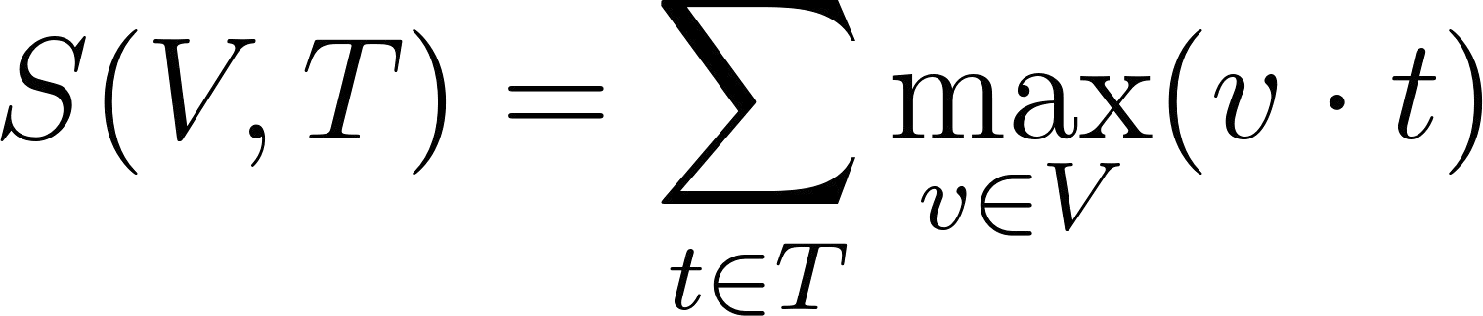
The MaxSim Operation & State-of-the-Art
The MaxSim (Maximum Similarity) Equation
How it works: For every query word (t), find the highest scoring image patch (v). Sum these maximum scores to get the document's total relevance.
State-of-the-Art Implementations
ColBERT (2020)
The foundational math; introduced Late Interaction for pure text.
ColPali (2024)
Applies MaxSim to the PaliGemma model for highly efficient, OCR-free visual document retrieval.
ColQwen
Adapts the exact same multi-vector strategy to the more powerful Qwen-VL architecture.

Slide 49
The Generative Shift: LLaVA in Retrieval
LLaVA: Large Language-and-Vision Assistant.
Concept: Shifting from metric-space similarity to autoregressive reasoning for complex search.
Architecture:
Vision Encoder extracts features X_{v}
Linear Projection maps them to language tokens: Hv=X_{v}W
LLM processes Hv alongside text prompt Hq
The Retrieval Upgrade:
Image-to-Text (I2T): Uploading a photo of a white cat chewing a frayed Jetson Nano wire to retrieve the exact PDF hardware repair manual.
Text-to-Image (T2I): Querying for "a white cat sitting BEHIND a laptop" and retrieving the exact image by logically ﬁltering out results where the cat is on the keyboard.

Slide 50
Complex Retrieval via VLMs
Re-framing Retrieval as a Reasoning Task:
  Traditional Query: "A blue car in the rain."
  LLaVA Prompt: "Analyze these 10 candidate images. Which one depicts a blue car driving through rain, and why? Return the image ID."
Use Cases: Highly complex, multi-hop extraction requiring spatial or logical reasoning.
Limitation: Strictly used as a ﬁnal-stage re-ranker due to massive inference costs.

Slide 51
The Vector Database: Storing & Searching

The Output
Encoders (like CLIP) convert images and text into high-dimensional mathematical vectors.

The Infrastructure
These vectors are loaded into a Vector Database.

The Baseline Search
To find a match, the database uses Cosine Similarity to measure the distance between query and stored vectors.

The Trap: Exact Search
Naive O(N) bottleneck: Checking 1 billion images this way takes minutes as it compares query to every single item.

Slide 52

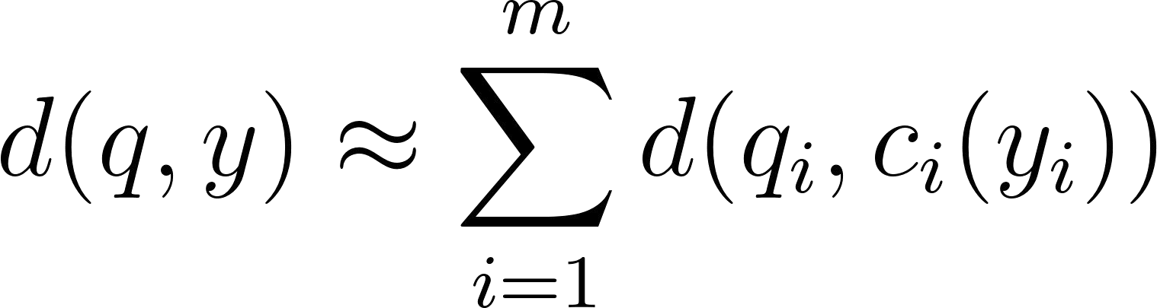
Scaling Multimodal Search for Vector Databases
The Problem: Exact Search (O(N))
Checks every vector. Too slow for real-time.
The Solution: ANN (Approximate Nearest Neighbors)
1. Space Reduction (IVF): Search only the closest vector "neighborhood." Ignore the rest.
2. Math Speedup (PQ): Run Asymmetric Distance directly on compressed codes.
The Impact
Trades perfect accuracy for extreme speed.
Complexity: O(N) \rightarrow O(log N)
Scale: 1 Billion image database $\approx$ 30 distance calculations.
Foundational Paper: Product quantization for nearest neighbor search (Jégou et al., 2010).

Slide 53
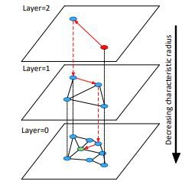
Hierarchical Navigable Small World and Vector Infrastructure
The HNSW Graph (Navigation)
  Top Layers: Sparse "highways" for instant regional jumps.
  Bottom Layers: Dense "local roads" for exact matching.
  The Math: Nodes are probabilistically layered to maintain an eﬃcient hierarchy:
Impact & Implementation
  Speed: Drops search complexity from O(N) to O(log N).
  Databases: FAISS, Pinecone, Milvus.
Foundational Literature:
HNSW: Eﬃcient and robust approximate nearest neighbor search using hierarchical navigable small world graphs (Malkov & Yashunin, 2018).

Slide 54

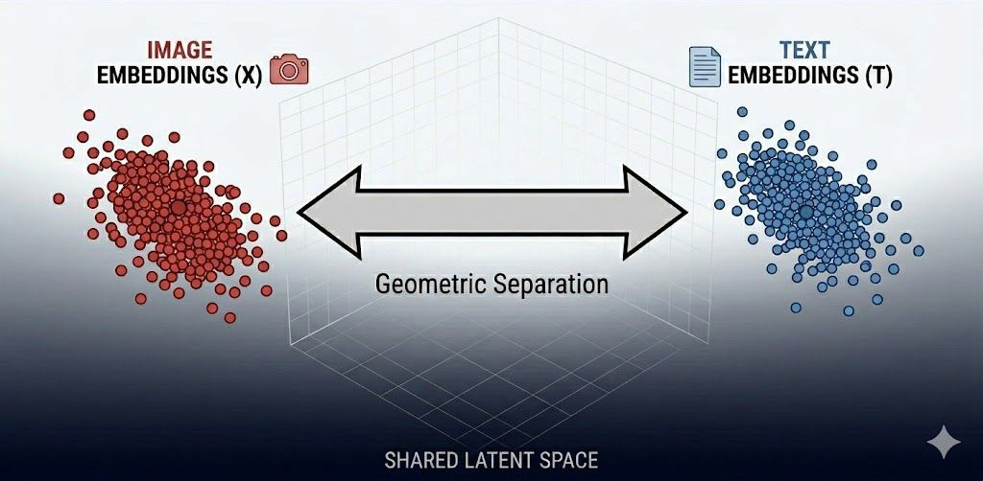
The Modality Gap
The Phenomenon:
The Translation: The mathematical center of all image vectors does not equal the center of all text vectors. Even in perfectly trained models, they segregate into separate "neighborhoods."
Why does this happen?
  Text is Dense: The word "Dog" is 100% pure meaning.
  Images are Messy: A photo of a dog contains thousands of "distracting" pixels (the grass, the lighting, the camera angle).
Because the data structures are fundamentally diﬀerent, the AI naturally pushes them into separate corners of the vector space.

Slide 55

Real-World Applications
E-Commerce
"Shop the look" via Image-to-Image or Text-to-Image routing.
Generative AI
Uses CLIP’s text-encoder to guide denoising. If encoding fails, generation fails.


Medical Imaging
Retrieving historical X-Rays using natural language symptom descriptions.
Content Moderation
Scanning uploads for restricted concepts using flexible text prompts.



Slide 56
Core Challenges in Modern Retrieval
The Expressivity vs. Eﬃciency Trade-oﬀ: Fast models lack reasoning; reasoning models are too slow for massive scale.
The Modality Gap: Persistent geometric separation between text and pixels.
Hallucinations: VLMs can conﬁdently hallucinate connections between mismatched text and images.
Modality Attribution: VLMs struggle to provide segment-level citations (e.g., pointing to the exact image patch or bounding box that proves their generated answer).
Fine-Grained Detail: Global vector models still struggle with counting objects or reading small text embedded in complex images.

Slide 57
Evaluation Metrics

Slide 58
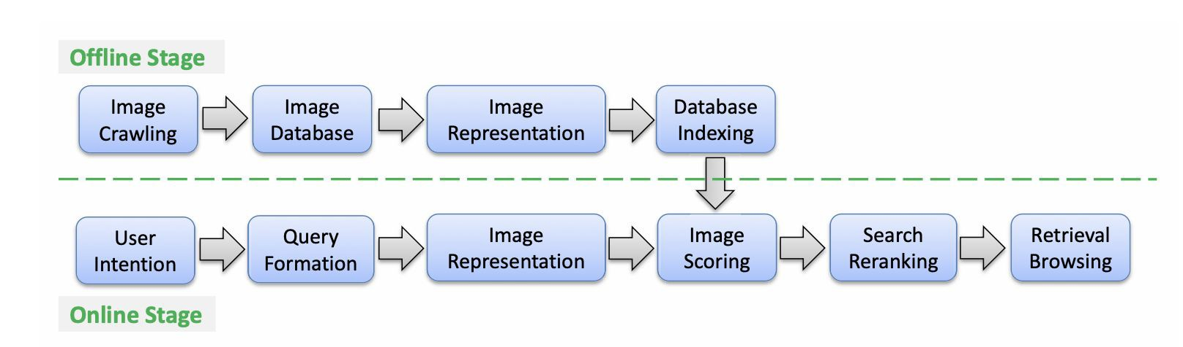
Image Retrieval System Overview
Key idea:
Retrieval is performed by comparing feature representations and ranking results by similarity

Slide 59
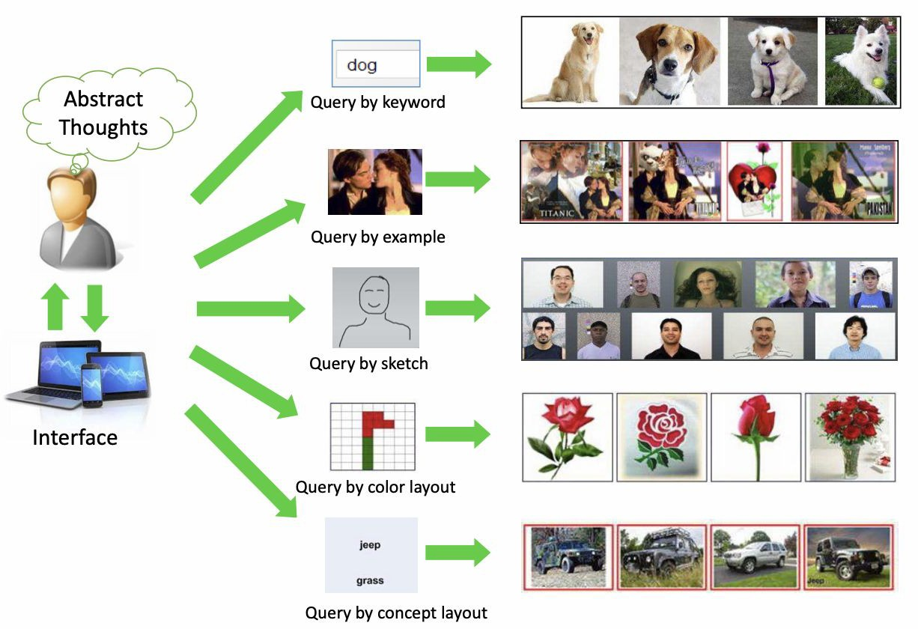
Query Modalities & User Intent
"Similarity" depends on the retrieval approach
Different Approaches:
Query-by-Example: "Find images that look like this photo."
Query-by-Sketch: Finding images based on a hand-drawn outline.
Query-by-Attribute: Searching via color or specific visual traits.
Key challenge:
The Challenge: To prove a system works, our metrics must show it can rank relevant results at the top regard

Slide 60
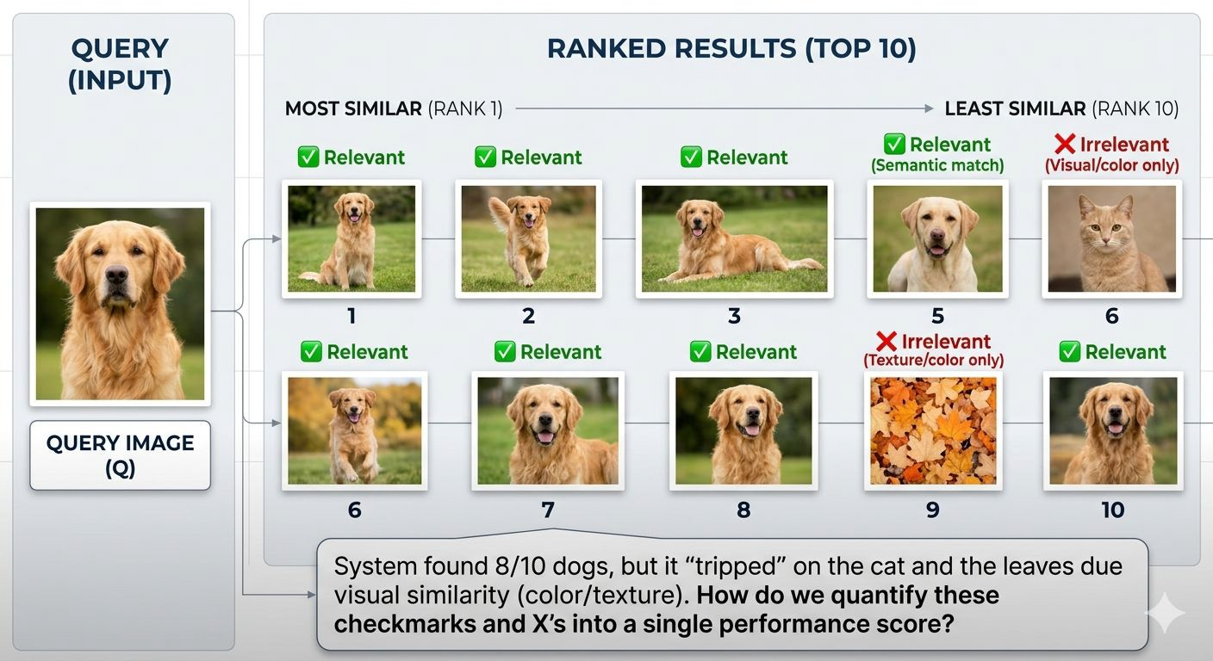
Visual Case Study: The top-10 ranked list
(Query-by-Example): * System found 8/10 dogs..
At Rank 6, a cat appears. It matches the color vector but fails the semantic category.
We need Ranking Quality metrics that penalize the system for putting that cat at Rank 6.
Similarity is not enough; we need Ranking Quality.

Slide 61
Evaluation Metrics for Image Retrieval
In image retrieval, the system outputs a ranked list of results, not a single prediction
Unlike classiﬁcation, evaluation must consider:
Multiple correct answers
Ranking order of results
Partial correctness
Key objective:
Retrieve relevant items
Rank them as early as possible
Poor ranking leads to bad user experience even if correct items exist Metrics must capture both:
Retrieval success (Did we ﬁnd it?)
Ranking quality (How early did we ﬁnd it?)
Two fundamental metrics:
Recall@K → coverage-based evaluation
Mean Average Precision (mAP) → ranking-aware evaluation

Slide 62
Formal Problem Definition
Given :Query q,Ground truth relevant set G_{q}
Retrieved ranked list:
Rq = [ r₁,r₂….r_{n}] Each retrieved item has:
A position (rank)
A relevance label (relevant / not relevant)
Evaluation involves:
Comparing retrieved list with ground truth
Measuring how many relevant items are retrieved
Measuring how early relevant items appear
Challenges:
Multiple relevant items per query
Large datasets (millions of images)
Imbalanced relevance distribution

Slide 63
Evaluation Requirements
A good evaluation metric should:
Reward retrieving relevant items
Penalize irrelevant items
Reward early ranking of relevant items
Penalize late ranking of relevant items
Additional considerations:
Scalability for large datasets
Interpretability of results
Sensitivity to ranking errors
No single metric captures everything → need multiple metrics

Slide 64

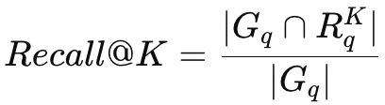
Recall@K- Definition and Interpretation
Measures how many relevant items are retrieved within top K
Focuses on coverage, not ranking
Uses binary relevance (relevant or not relevant)
Alternative set-based form:
Interpretation:
High Recall@K → system retrieves most relevant items
Low Recall@K → many relevant items missed

Slide 65
Recall@K: Detailed Example and Behavior
Example:
  Relevant items: {A, B, C, D}
  Retrieved: [X, A, Y, B, Z]
Relevant in top 5 = {A, B}
Recall@5= 2/4 = 0.5
Observations:
  Recall increases as K increases
  Recall@1 is strict, Recall@10 is relaxed
Key behavior:
  Monotonic increasing function
  Maximum value = 1
Does NOT diﬀerentiate:
  Rank 1 vs Rank 5 relevance

Slide 66
Recall@K: Strengths and Limitation
Strengths:
Simple and intuitive
Eﬃcient for large-scale retrieval
Widely used in systems like CLIP model
Good for evaluating retrieval success
Limitations:
Ignores ranking order
Treats all top-K positions equally
Cannot distinguish good vs poor ranking within top K
Binary relevance assumption

Slide 67
Why Recall@K is not enough
Consider two systems:
System A:
Relevant at ranks [1, 2] System B:
Relevant at ranks [9, 10]
Both may have same Recall@10
But System A is clearly better
Problem:
  Recall@K ignores position of relevant items
Need a metric that:
  Rewards early retrieval
  Penalizes late retrieval

Slide 68
Precision and Its Role
Precision@K=Relevant items in top K / K
Measures accuracy of retrieved results
Complements Recall:
Recall → completeness , Precision → correctness Trade-oﬀ:
High precision → fewer but accurate results
High recall → more results but less accurate
Limitation:
Still does not fully capture ranking quality

Slide 69
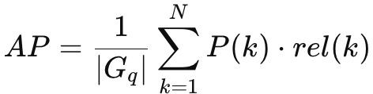
Average Precision(AP): Definition
P(k): precision at rank k
rel(k): 1 if relevant, else 0
Computes precision only at relevant positions
Averages these precision values

Slide 70
Average Precision: Detailed Example
Retrieved: [A, X, B, Y, C]
Relevant: {A, B, C}
Rank | Item | Relevant | Precisiom
1 | A | Yes | 1/1= 1
2 | X | No | -
3 | B | Yes | 2/3=0.67
4 | Y | No | -
5 | C | Yes | 3/5= 0.6
AP=(1+0.67+0.6)/3 ≈ 0.756
Early correct results increase AP

Slide 71
Why Average Precision Works Better
Considers ranking order explicitly Rewards:
Early correct retrieval Penalizes:
Late correct retrieval
Provides smooth and continuous evaluation More informative than Recall@K

Slide 72
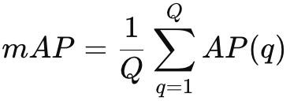
Mean Average Precision (mAP)
Q = number of queries
Computes average AP across all queries Provides global system performance Interpretation:
High mAP → consistently good ranking
Low mAP → poor ranking quality

Slide 73
Properties, Advantages, Limitations of mAP
Properties:
Sensitive to ranking errors
Penalizes incorrect ordering
Reﬂects both precision and recall
Advantages:
Gold standard for retrieval evaluation
Widely used in research benchmarks
Suitable for comparing models
Limitations:
Computationally expensive
Less intuitive than Recall@K
Requires full ranked list

Slide 74
Recall@K vs mAP (Critical Comparison)
Aspect | Recall | mAP
Measures | Coverage | Ranking+Precision
Ranking Sensitivity | No | Yes
Complexity | Low | High
Interpretability | Easy | Moderate
Recall@K answers: Did we retrieve relevant items?
mAP answers: How well did we rank them?

Slide 75
Paper Examples: Deep Ranking
Fine-Grained Similarity
Focus: distinguishing visually similar images
Uses triplet-based learning (anchor, positive, negative)
Evaluation metric:
  Score-at-Top-K (ranking correctness in top results)
Key Insight:
  Recall@K may be too coarse
  Fine-grained tasks need stricter ranking evaluation

Slide 76
Paper Examples: FaceNet
Veriﬁcation vs Retrieval
Learns embedding space using triplet loss
Evaluated using:
  Validation Rate at ﬁxed False Accept Rate (FAR)
Why this metric?
  False positives are costly in security systems
Uses:
  Threshold on embedding distance
  ROC curves for evaluation
Key Insight:
  Metric depends on application, not just model

Slide 77
Choosing the right metric
Decision Framework
Photo retrieval apps → Recall@K
  Focus: showing relevant results quickly
Research benchmarking → mAP
  Focus: ranking quality
Security systems → ROC / Precision-Recall
  Focus: minimizing false positives
Key Principle:
  Metric must align with task and user needs

Slide 78
Thank you

