Slide 1
GRADUATE-LEVEL LECTURE
Grounded Vision Models
Shuvam Agarwal Soundarya Dash Arbaz Khan shuvam.agarwal@temple.edu soundarya.dash@temple.edu arbaz.anis.ahmed.khan@temple.edu
CIS 5543 - Computer Vision

Slide 2
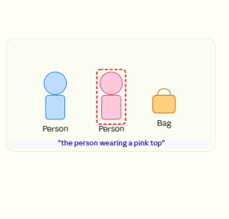
What is visual grounding?
The grounding problem: language -> region
Show a scene with multiple people. A natural language query picks out exactly one. The model must return the correct bounding box — not just classify the scene
Classic detection: outputs all "person" boxes with confidence scores
Grounding: takes a text phrase, returns the one matching region
Key difference: language is the selector, not just the label
"Imagine you say to a robot — 'hand me the red mug on the left.' It can't just find all mugs. It has to understand left, and red, and pick exactly one. That's visual grounding."

Slide 3
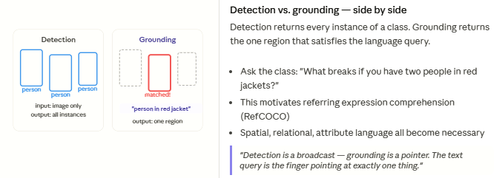
Detection vs. grounding
Detection identifies categories.
Grounding identifies specific individuals based on the context.
What breaks if you have two people in red jackets?
This motivates Referring Expression Comprehension (RefCOCO)
Spatial, relational, attribute language all become necessary
"Detection is a broadcast — grounding is a pointer. The text query is the finger pointing at exactly one thing."

Slide 4
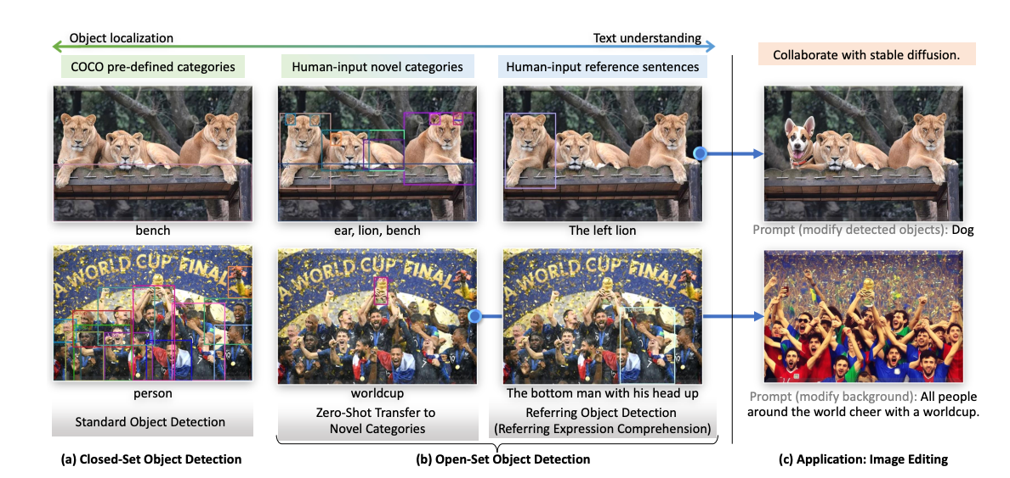
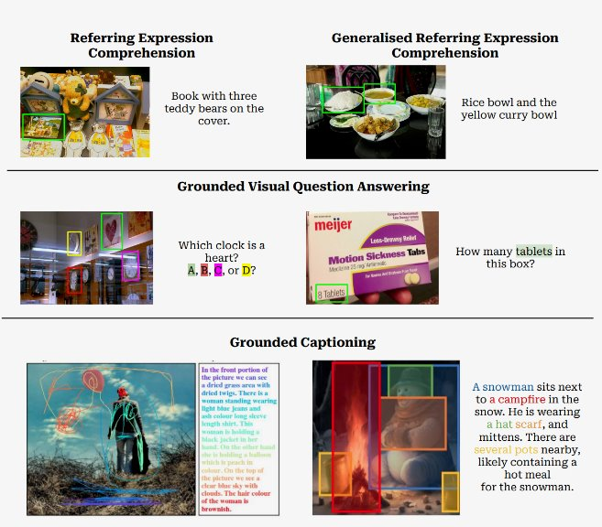

Slide 5
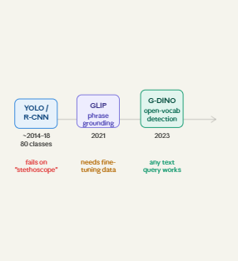
From closed-set to open-vocabulary detection
The closed-set wall — and why language breaks it
COCO-trained YOLO knows 80 classes. It will never detect a "surgical forceps" or a "traffic cone behind a bus." Fixed class lists are a ceiling.
Closed-set: class label is an integer index; vocabulary frozen at train time
Open-vocab: class label is a text string; model never seen at train time is fine
Language gives infinite vocabulary for free — if humans can describe it, the model can detect it
"YOLO trained on COCO has never seen a stethoscope. Show it one and it either says nothing or hallucinates 'remote.' The moment you swap class indices for text embeddings, that wall disappears."

Slide 6
Referring Expression Comprehension (REC)
Task Definition
Challenges
Given an image and a natural-language expression referring to an object, the model must locate that object (usually with a bounding box).
Handling spatial relationships (behind, next to, left of)
Understanding attributes (color, size, clothing)
Disambiguating between multiple similar objects
Example
Input: Image + "the boy in a blue shirt standing behind the table"
Output: Bounding box around that specific boy
Core Visual Grounding Task
This is often what "visual grounding" refers to in research literature. It requires understanding both the linguistic description and the visual content to identify the unique referent.
Complex Understanding
REC requires deep understanding of both language and vision to correctly identify the referred object among potentially many similar candidates.

Slide 7
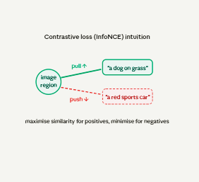
Loss function primer
Contrastive loss (InfoNCE)
Used by: GLIP, Grounding DINO, OWL-ViT
Pulls matched image-region and text pairs closer in embedding space
Pushes non-matching pairs apart
Temperature parameter τ controls sharpness
L = -log[ exp(sim(r,t+)/τ) / Σ exp(sim(r,ti)/τ) ]
sim – cosine similarity
τ - temperature parameter for scaling
"Think of it like a magnet. Matching pairs attract. Wrong pairs repel. The model learns to organise embedding space so that similar things cluster together — and it never needed a class list to do it."

Slide 8
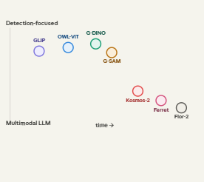
RefCOCO / RefCOCO+: referring expressions, one target per image
Visual Genome: dense scene graph — relations, attributes, regions
COCO-Captions: grounding dense captions to regions (linking full descriptions)
Metrics: Acc@0.5 (box hits GT), mIoU (mask accuracy)

Slide 9
Closed-Set vs Open-World Vision
Aspect | Closed-Set Models | Open-World (Grounded) Models
Vocabulary | Fixed, pre-defined set of classes (e.g., COCO's 80 classes) | Arbitrary natural language descriptions
Generalization | Cannot detect objects outside training labels | Zero-shot detection of novel categories
Flexibility | Limited to specific object categories | Handles rich descriptions with attributes and relationships
Adaptation | Requires retraining with new labeled data | Instant adaptation via text prompts
Real-World Use | Constrained to controlled environments | Applicable to uncontrolled, open environments

Slide 10
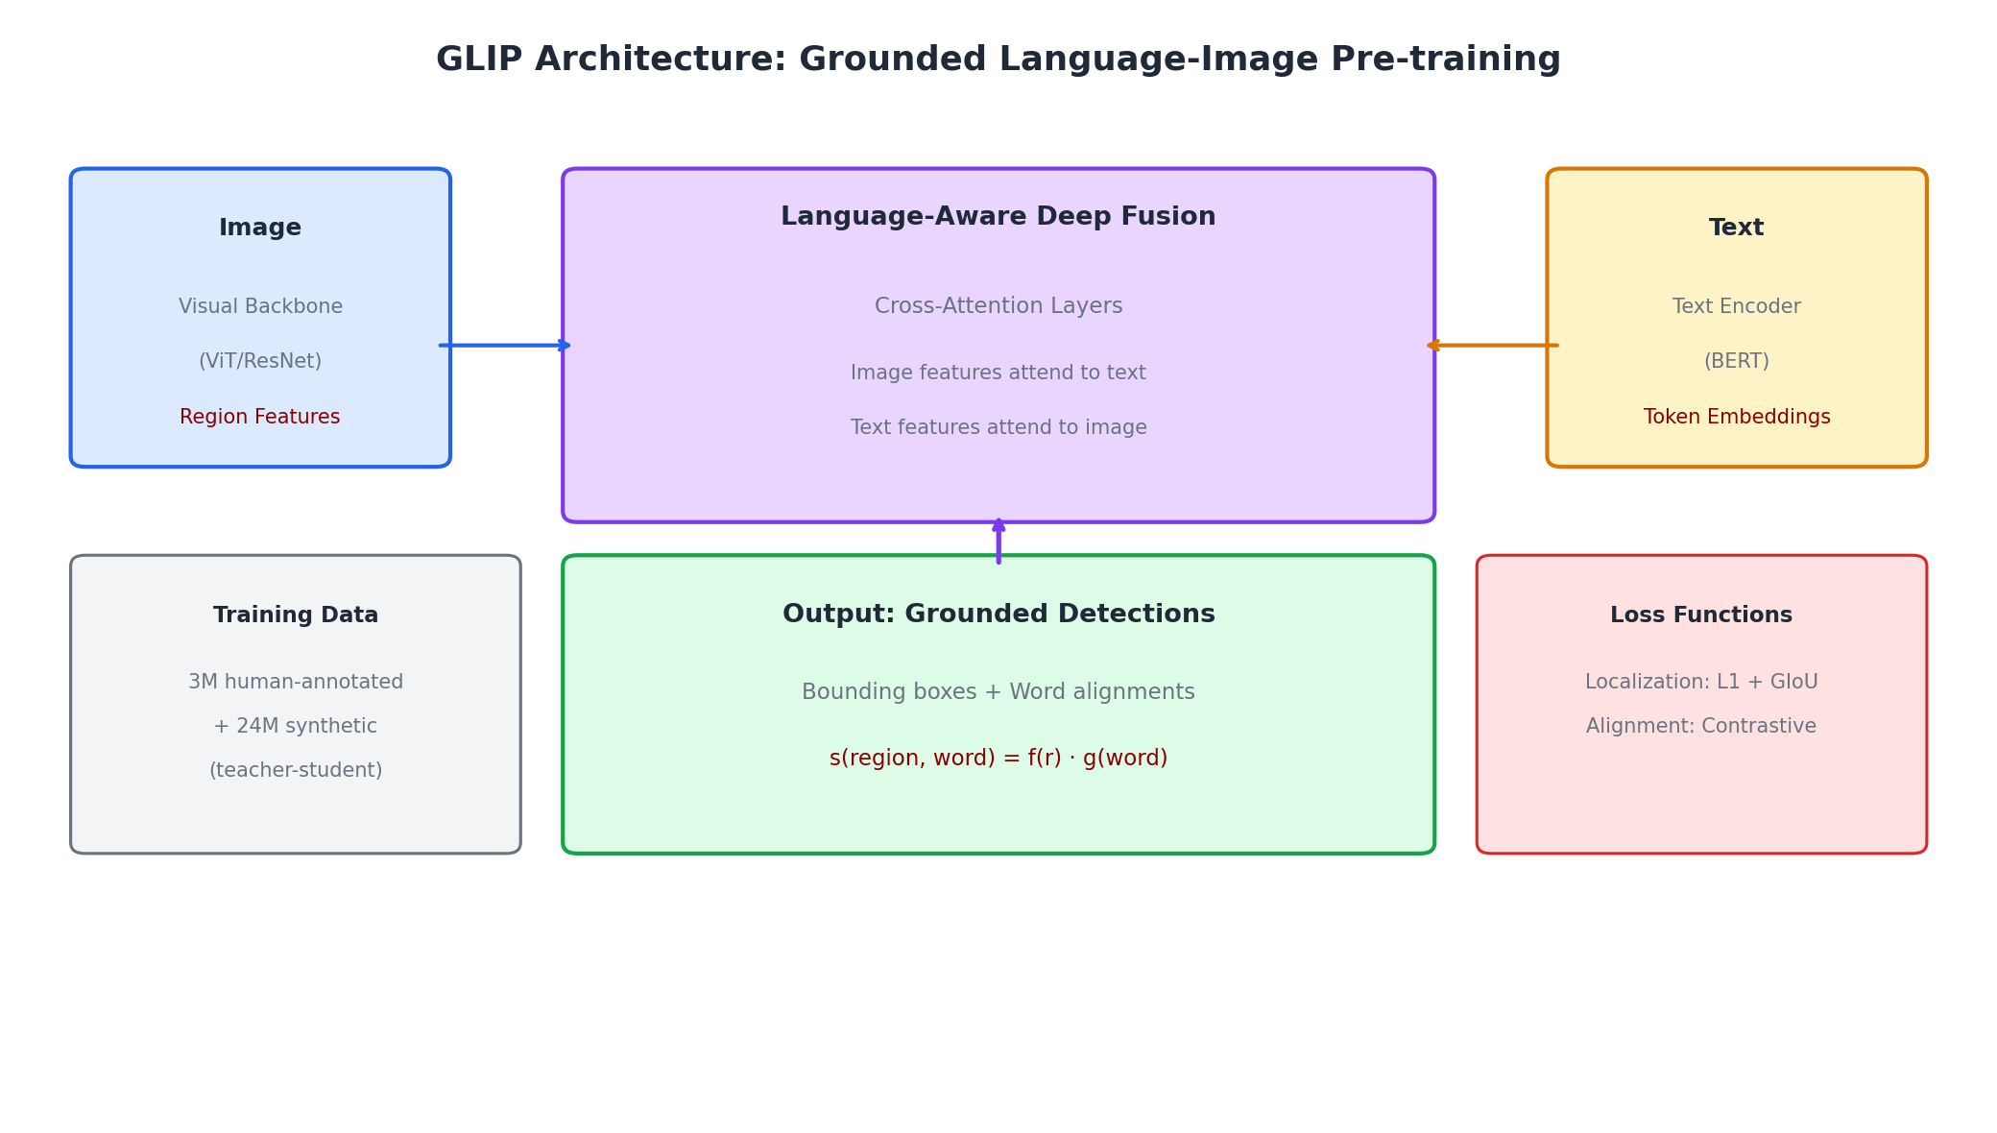
GLIP – Goal and Overview
GLIP (Grounded Language-Image Pre-training, 2022)
Significance
A landmark model with the goal to unify object detection and phrase grounding in one framework, enabling zero-shot detection of open-vocabulary objects via language.
GLIP demonstrated that language can serve as a universal interface for object detection, breaking free from closed-set limitations while maintaining strong performance.
Key Innovation
GLIP reframes detection as a grounding problem – instead of predicting fixed class labels, it aligns detected regions with text tokens:
Traditional Detection
GLIP Approach
Fixed classifier over N classes
Align regions with any text tokens
→ Limited to training categories
→ Open-vocabulary capability

Slide 11
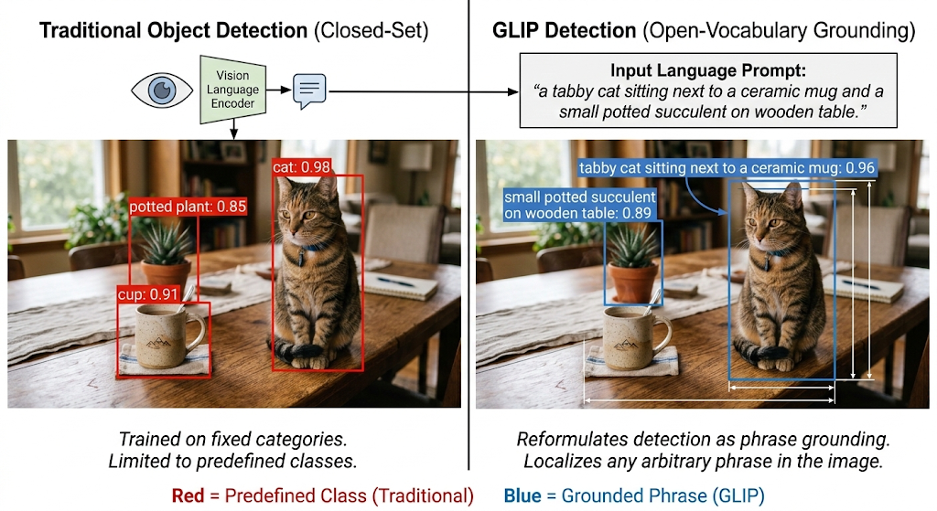

Slide 12
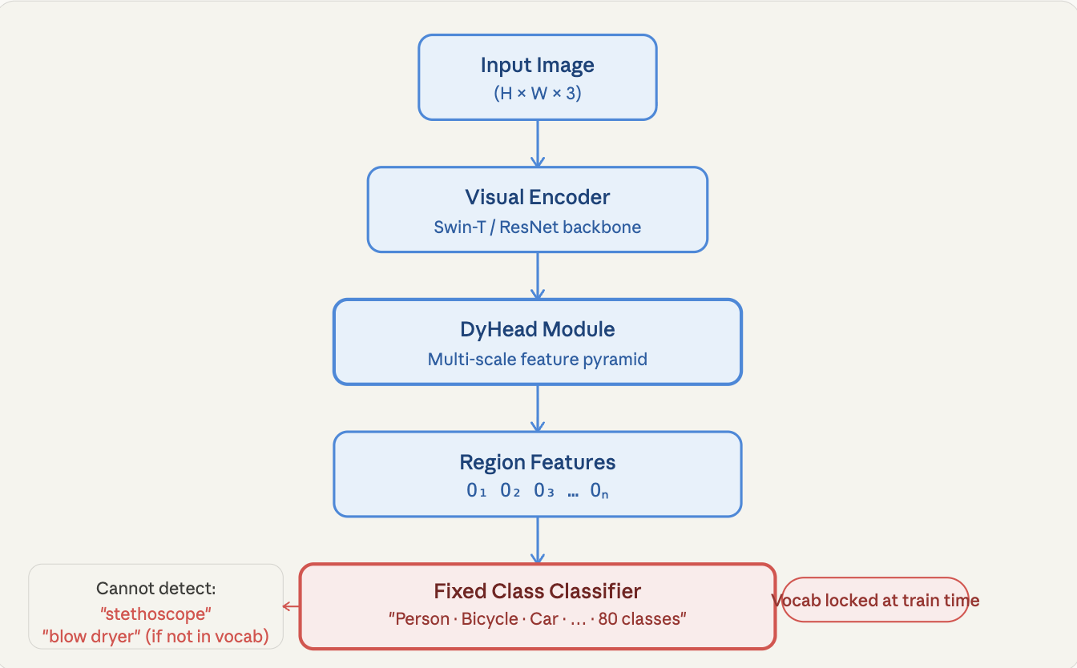
Classical closed-set detection
How a standard detector like DyHead + fixed classifier works

Slide 13
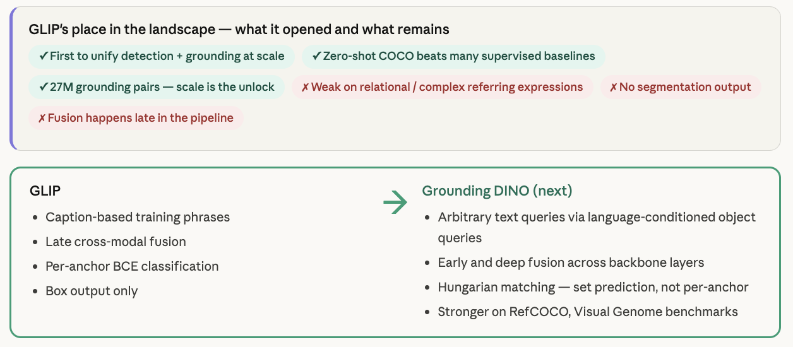

Slide 14
What is Grounding DINO and why does it exist?
Closed-set detection​
Pre-defined COCO categories only. Fixed vocab. ClassicDINO. Cannot generalise.​
​
Grounding DINO is an open-set object detector — meaning it can detect any object you name in plain language, not just a fixed list of categories. You tell it "find the red cat on the left," and it does. This is accomplished by marrying the powerful Transformer-based visual detector DINO with language understanding.
Open-set detection
Novel categories via text prompt. Zero-shot. No retraining needed.
Referring expression detection
"The left lion" · "The bottom man with head up" — outputs exactly that region.

Slide 15

Image Prompt:
Text prompt: "cat . cup . person ."

Slide 16
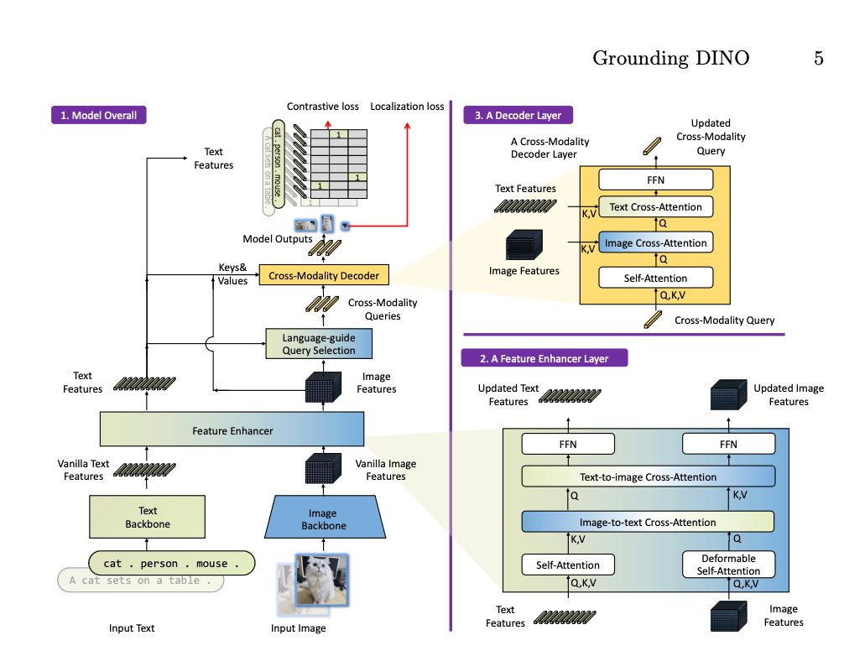
Architecture Overview

Slide 17
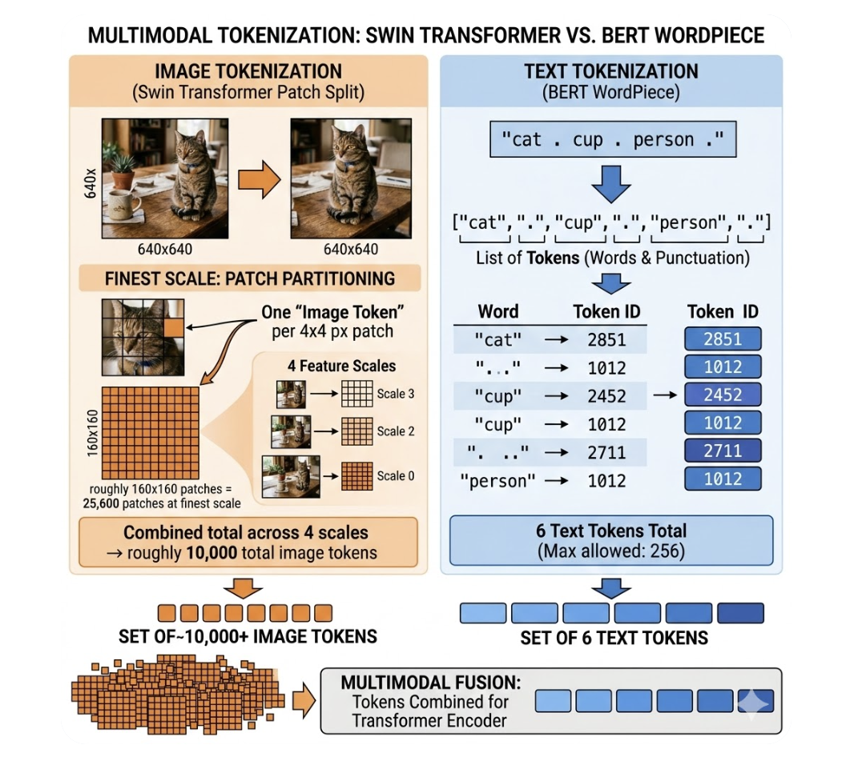
Tokenisation — before any neural network runs
Image tokenisation (Swin Transformer patch split): 640×640 image divided into 4×4 px patches at finest scale Each patch = one "image token" At 4 feature scales → roughly 10,000 image tokens total
Text tokenisation (BERT WordPiece): "cat . cup . person ." → ["cat", ".", "cup", ".", "person", "."] → token IDs: [2851, 1012, 2452, 1012, 2711, 1012] 6 text tokens total (max allowed: 256)

Slide 18
Output shapes after backbone
X_I (image features):
shape = [10000, 256] X_I[fur_patch] ≈ [0.90, 0.20, 0.10, 0.55, ...] ← strong in "texture"
dims X_I[cup_patch] ≈ [0.10, 0.10, 0.85, 0.30, ...] ← strong in "object"
dims X_I[wall_patch] ≈ [0.02, 0.03, 0.01, 0.04, ...] ← nearly zero (background)
X_T (text features):
shape = [6, 256] X_T["cat"] ≈ [0.80, 0.30, 0.10, 0.60, ...] ← similar to fur_patch!
X_T["cup"] ≈ [0.10, 0.10, 0.90, 0.25, ...] ← similar to cup_patch!
X_T["person"] ≈ [0.20, 0.90, 0.10, 0.15, ...] ← nothing like any patch

Slide 19
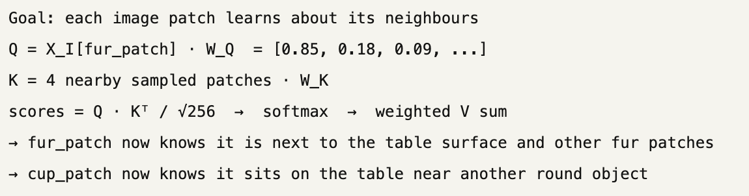
Stage 2: Feature Enhancer — 6 layers of bidirectional cross-attention ( Making Image and Text "Talk" )
Each layer runs 4 operations in sequence. Here is what happens in one layer for our specific tokens.
Op 1 — Image deformable self-attention

Slide 20
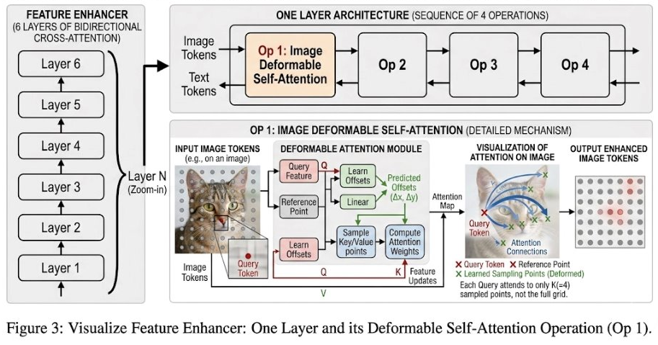

Slide 21
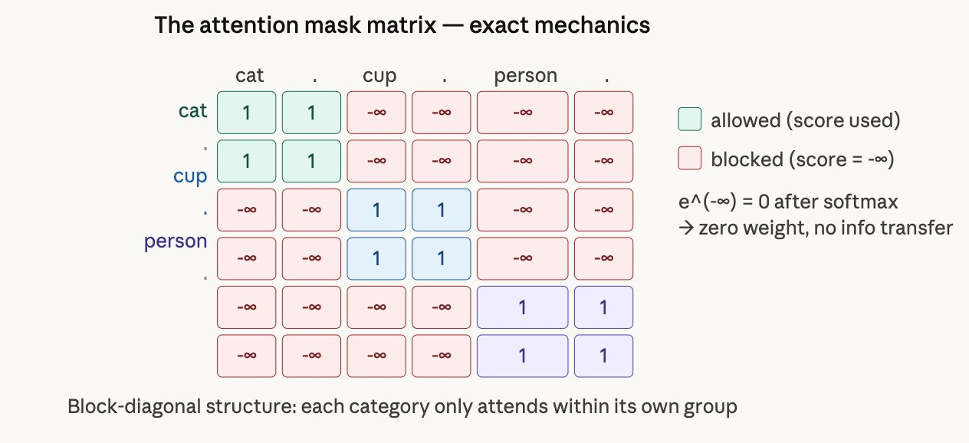
Op 2 — Text self-attention (with sub-sentence mask) ​
​
WITH mask:
raw score = 0.31
masked score = 0.31 + (-∞) = -∞
softmax input: [0.82, 0.74, -∞, -∞, -∞, -∞]
weights: [0.53, 0.47, 0, 0, 0, 0]
"cat" absorbs 0% of "cup" ← clean
Goal: each word learns about its own group only
"cat" attends to "cat" and its "." → sharpens cat concept
"cup" attends to "cup" and its "." → sharpens cup concept "person" attends to "person" and its "." → stays isolated
Sub-sentence masking — applied inside Op 2 of every enhancer layer
Tokens: [ "cat" "." "cup" "." "person" "." ]
Group ID: [ 0 0 1 1 2 2 ]
Mask value added BEFORE softmax:
same group → add 0 (score unchanged)
diff group → add -∞ (e⁻∞ = 0 after softmax, zero weight)
Example — "cat" attending to "cup":
WITHOUT mask:
raw score = 0.31
softmax input includes 0.31
"cat" absorbs ~14% of "cup"'s features ← pollution

Slide 22
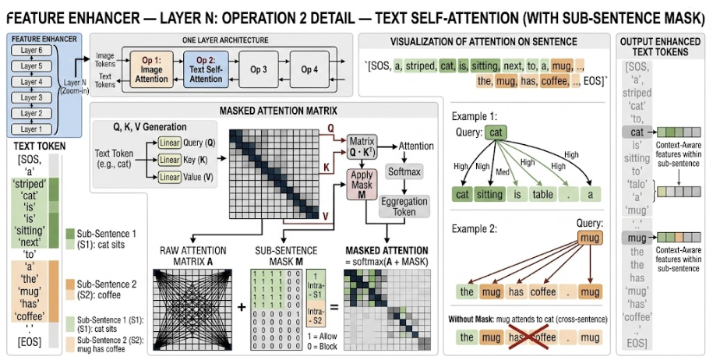

Slide 23
Op 3 — Image-to-text cross-attention Q=image K,V=text
For cup_patch:
score("cat") = 0.201 score("cup") = 0.731 ← HIGH score("person") = 0.145 → cup_patch absorbs mostly "cup" meaning
For fur_patch:
Q = X_I[fur_patch] · W_Q = [0.85, 0.18, 0.09, ...]
score("cat") = Q · K_cat / √256 = 0.705 ← HIGH score("cup") = Q · K_cup / √256 = 0.172 ← low
score("person") = Q · K_person / √256 = 0.318 ← medium weights = softmax([0.705, 0.172, 0.318]) = [0.395, 0.290, 0.315]
output = 0.395·V_cat + 0.290·V_cup + 0.315·V_person → fur_patch absorbs mostly "cat" meaning
For wall_patch:
score("cat") = 0.041 score("cup") = 0.038
score("person") = 0.052 ← all low → wall_patch absorbs nothing useful (background)

Slide 24
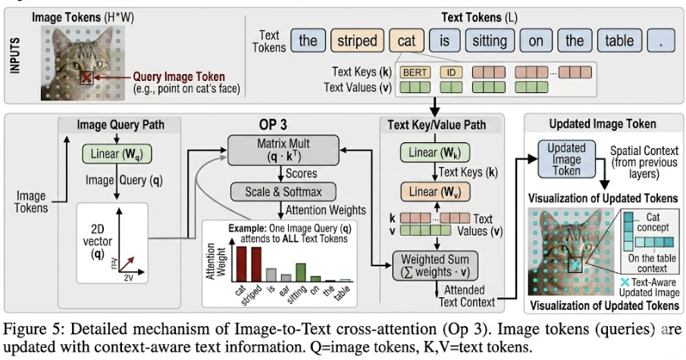

Slide 25
Op 4 — Text-to-image cross-attention Q=text K,V=image
Goal: every word finds its matching image region
"cat" token:
score(fur_patch) = Q_cat · K_fur / √256 = 0.724 ← HIGH
score(cup_patch) = Q_cat · K_cup / √256 = 0.190
score(wall_patch) = Q_cat · K_wall / √256 = 0.038 → "cat" token absorbs visual texture of fur
"person" token:
score(fur_patch) = 0.082
score(cup_patch) = 0.091
score(wall_patch) = 0.065 ← all low — no person in image!
→ "person" token stays visually ungrounded — important signal
After ×6 layers of this, the fur_patch and "cat" token have exchanged features repeatedly and are now strongly aligned. The "person" token has found nothing to ground to — this is how the model learns not to output a box for "person".

Slide 26
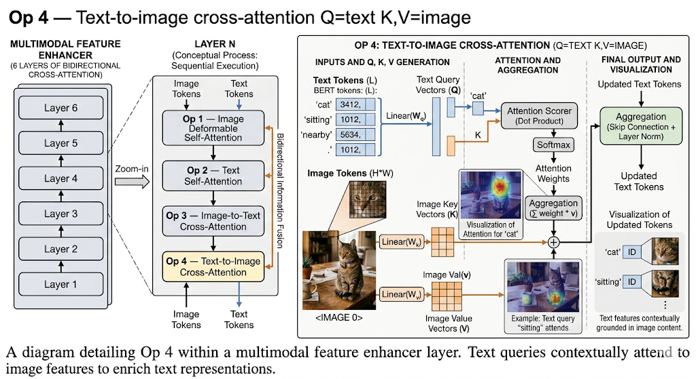

Slide 27
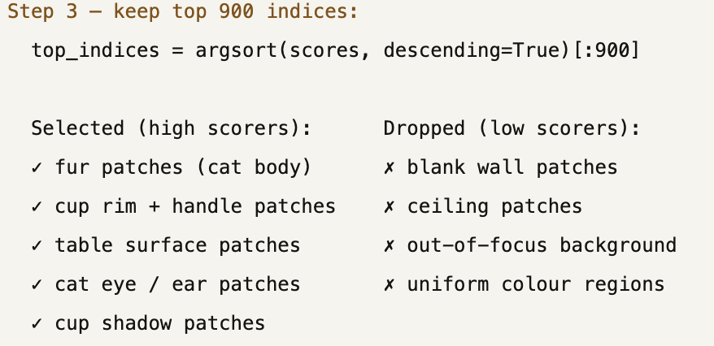
Language-guided query selection — reduce 10,000 tokens to 900
The feature enhancer produced cross-modal X_I [10000, 256] and X_T [6, 256]. We now pick the 900 image tokens most relevant to the text.
Step 1 — compute full similarity matrix:
logits = X_I · X_Tᵀ shape: [10000, 6]
logits[fur_patch] = [0.705, 0.172, 0.318, ...] ← strong on "cat" logits[cup_patch] = [0.201, 0.731, 0.145, ...] ← strong on "cup" logits[wall_patch] = [0.041, 0.038, 0.052, ...] ← weak on everything
Step 2 — max across text dimension (best match per image token):
score[fur_patch] = max(0.705, 0.172, 0.318) = 0.705 score[cup_patch] = max(0.201, 0.731, 0.145) = 0.731 score[table_edge_patch] = max(0.312, 0.480, 0.091) = 0.480 score[wall_patch] = max(0.041, 0.038, 0.052) = 0.052 ← dropped
score[ceiling_patch] = max(0.021, 0.019, 0.031) = 0.031 ← dropped

Slide 28
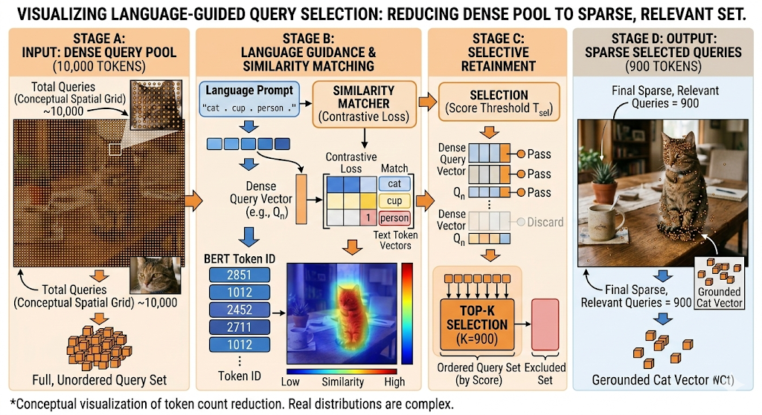

Slide 29
Cross-modality decoder — 6 layers, 900 queries each
Op 1 — Self-attention among all 900 queries
Op 2 — Image cross-attention Q=query K,V=image
Goal: queries compare with each other to avoid duplicate detections
query #47 (fur region) scores HIGH against other fur queries → learns: "there are 6 other queries near me covering the cat body" → adjusts its position estimate to cover the whole cat, not just one patch
query #312 (cup rim) scores HIGH against cup handle query → adjusts to cover full cup, not just rim
Goal: precisely localise where the object is
query #47:
Q = query_47 · W_Q = [0.83, 0.22, 0.11, ...] Attends to 4 learned sampling points around the cat region score(fur_centre) = 0.881 ← very high
score(cat_ear) = 0.742
score(table_below) = 0.312
score(wall_left) = 0.041
output = weighted V sum
→ query #47 now encodes: "dense furry texture centred at (0.30, 0.40)"
query #312:
score(cup_rim) = 0.863 score(cup_handle) = 0.701 score(table_below) = 0.290 → query #312 encodes: "circular rim + handle at (0.55, 0.30)"
Op 3 — Text cross-attention ★ Q=query K,V=text
Goal: assign a text label to each query query #47 (fur features in vector):
Q = query_47 · W_Q = [0.80, 0.20, 0.10, ...]
score("cat") = Q · K_cat / √256 = 0.705
score("cup") = Q · K_cup / √256 = 0.172
score("person") = Q · K_person / √256 = 0.318
weights = softmax → [0.395, 0.290, 0.315]
output = weighted V sum → query absorbs "cat" label meaning

Slide 30
query #312 (cup features in vector):
score("cat") = 0.210 score("cup") = 0.731 ← HIGH score("person") = 0.140 → query absorbs "cup" label meaning
query #8 (random background query):
score("cat") = 0.048 score("cup") = 0.051
score("person") = 0.039 ← all low → query remains ungrounded → will score below threshold → discarded
Box head — extract (cx, cy, w, h) from each query
A 3-layer MLP squeezes the 256-dim query down to 4 numbers.
For query #47 (cat query):
query_47 [256-dim]
→ Linear(256→256) + ReLU
→ Linear(256→256) + ReLU
→ Linear(256→4)
= [0.30, 0.40, 0.20, 0.25]
↑ ↑ ↑ ↑
cx cy w h (all relative to image size, 0–1)
Op 4 — FFN
Two linear layers + ReLU clean up and compress the updated query vector.
Runs identically for all 900 queries.
After ×6 decoder layers:
query #47 → strongly encodes cat location + cat label
query #312 → strongly encodes cup location + cup label
query #8 → weakly encodes anything → discarded at threshold
In pixels (on 640×640 image):
cx = 0.30 × 640 = 192 px from left
cy = 0.40 × 640 = 256 px from top
w = 0.20 × 640 = 128 px wide
h = 0.25 × 640 = 160 px tall
→ box covers x:[128..256], y:[176..336] ← the cat

Slide 31
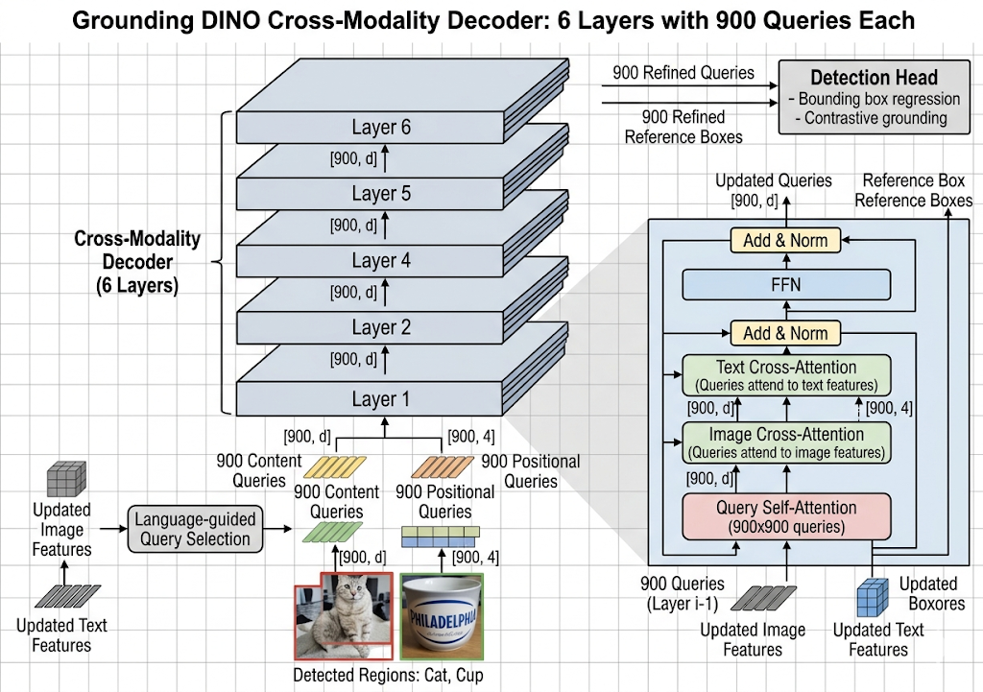

Slide 32
For query #312 (cup query):
output = [0.55, 0.30, 0.15, 0.20]
→ box covers x:[313..409], y:[128..192] ← the cup
Label = token with highest score = "cat" ✓
For query #312 (cup query):
P("cat") = sigmoid(0.61) = 0.648
P("cup") = sigmoid(2.51) = 0.925 ← very high
P("person") = sigmoid(0.44) = 0.608
Label = "cup" ✓
For ALL queries (person check):
best P("person") across all 900 queries = 0.31
threshold = 0.30 → just barely passes but NMS removes it because no query has image features grounded to a person
→ no "person" box in final output
✓ Training loss — focal loss:
focal_loss = -(1-p)^γ · log(p) where γ=2
For query #47 on "cat" (p=0.918):
loss = -(1-0.918)² × log(0.918) = -(0.006) × (-0.086) = 0.0005 ← tiny
For query #47 on "person" (p=0.735, but GT=0, person not in image):
loss = -(1-0.265)² × log(0.265)
= -(0.540) × (-1.328) = 0.717 ← large → forces model to suppress "person" for this query
Training losses (run during training, not at inference):
L1 loss = |0.30-0.29| + |0.40-0.41| + |0.20-0.21| + |0.25-0.24| = 0.04
GIoU = 1 - IoU + penalty = 0.03 (good overlap with ground truth)
Total box loss = 5.0 × L1 + 2.0 × GIoU ← weights from paper
Label head — score every text token for each query
No new parameters — just a dot product of the query against the text features, then sigmoid.
logits = query_47 · X_Tᵀ shape: [1, 6]
= [score_cat, score_., score_cup, score_., score_person, score_.]
= [ 2.41, 0.80, 0.58, 0.61, 1.02, 0.73 ]
sigmoid per logit (independent, not competing):
P("cat") = sigmoid(2.41) = 0.918 ← very high
P(".") = sigmoid(0.80) = 0.690 ← ignored (period token) P("cup") = sigmoid(0.58) = 0.641 ← below threshold P("person") = sigmoid(1.02) = 0.735 ← below threshold

Slide 33
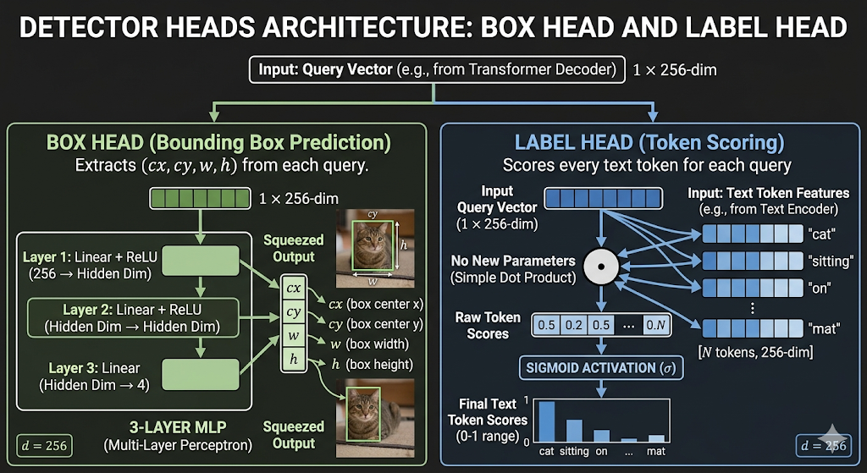

Slide 34
Final output — threshold + NMS + result
Step 3 — Hungarian matching (training only):
During training, predicted boxes are matched to ground truth using bipartite matching that minimises combined box + classification cost. At inference, this step is skipped.
Final output:
Detection 1:
Box: cx=0.30, cy=0.40, w=0.20, h=0.25
Label: "cat" Score: 0.918
Detection 2:
Box: cx=0.55, cy=0.30, w=0.15, h=0.20
Label: "cup" Score: 0.925 "person": no detection (no query was grounded to a person region)
because in Stage 2, "person" found no matching image patch → its K/V values were never absorbed by any query → no query's label head scored "person" above threshold
Step 1 — apply score threshold (0.30):
query #47: P("cat")=0.918 > 0.30 ✓ keep
query #312: P("cup")=0.925 > 0.30 ✓ keep
query #8: max score=0.051 < 0.30 ✗ drop ... (most of 900 queries dropped here)
Step 2 — non-maximum suppression (NMS):
Multiple queries may cover the same cat from slightly different positions
NMS keeps only the highest-scoring query per region
IoU threshold: if two boxes overlap > 0.5, keep only the better one
Cat region: 6 queries survived threshold, best is #47 (P=0.918) → keep #47
Cup region: 2 queries survived threshold, best is #312 (P=0.925) → keep #312

Slide 35
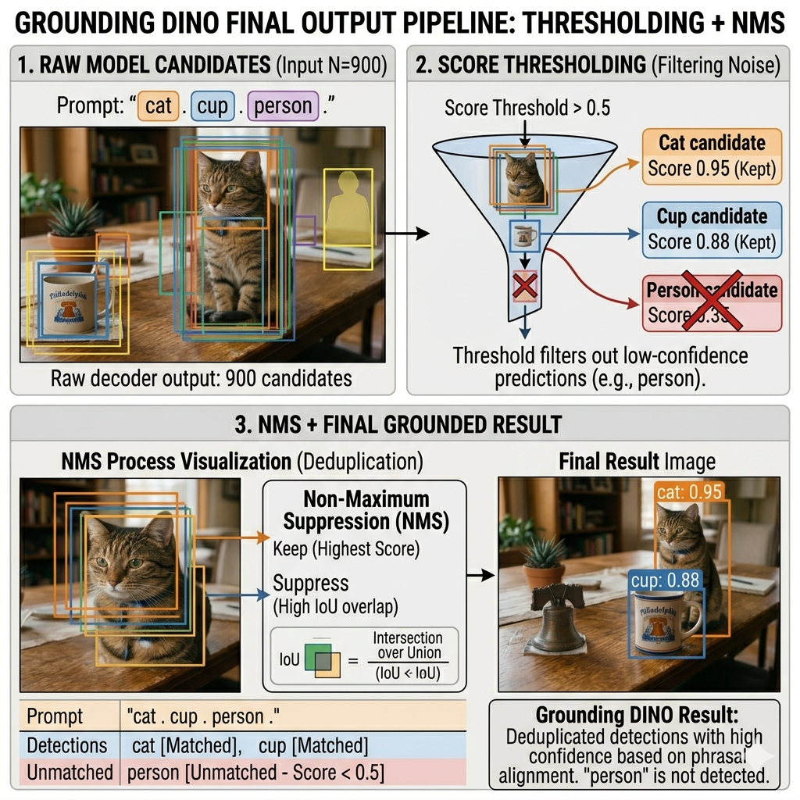

Slide 36
Final Output: Boxes + Phrases
The last decoder layer's output queries are used to simultaneously predict:
A bounding box (via L1 loss + GIoU loss) — [x, y, w, h] for the detected region
A noun phrase match — via contrastive loss comparing the query vector against all text token vectors
In our example, the output would be:
Box at cat's location → matched phrase: "cat"
Box at cup's location → matched phrase: "cup"
No box for "person" (not in the image, so no query scores high enough to pass the threshold)

Slide 37
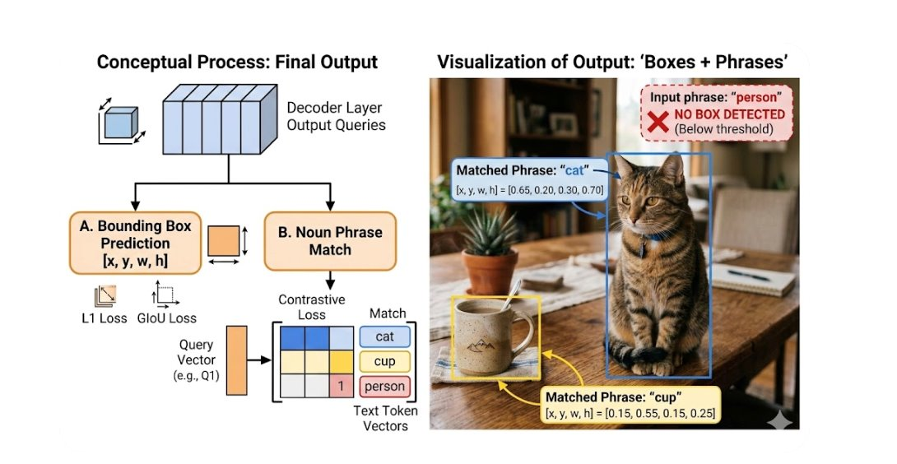

Slide 38
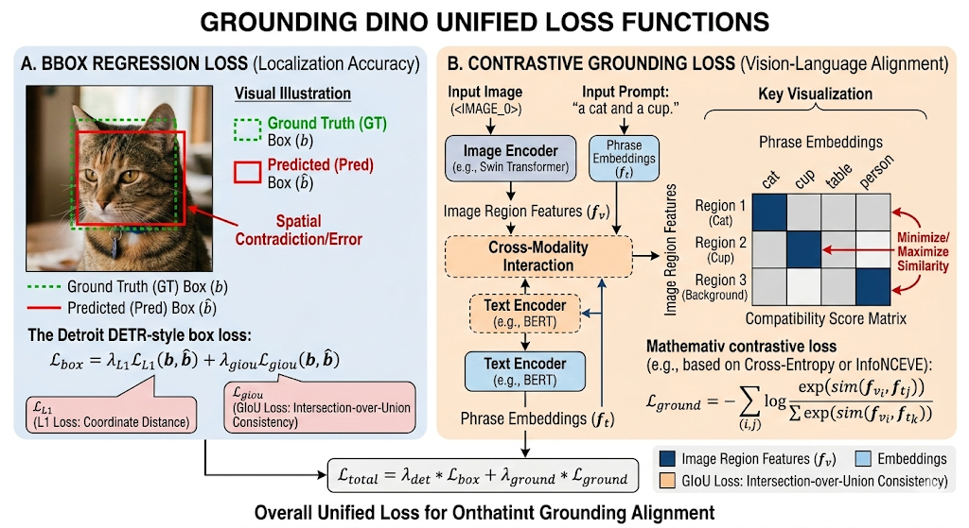

Slide 39
What Grounded SAM is and why it exists
The gap SAM fills
Grounding DINO outputs bounding boxes — rectangles. Many applications need pixel-precise outlines: image editing, background removal, medical imaging, robotics grasping.
The gap Grounding DINO fills
SAM alone can create perfect masks but needs a human to click on objects or draw boxes. It has no language understanding — you cannot ask it to "find the cat".
What chaining them gives you
Text prompt → Grounding DINO → bounding boxes → SAM → pixel masks. Language-driven open-set segmentation.
The two models and their weights
Model 1: Grounding DINO
Trained on: detection + grounding datasets (O365, GoldG, Cap4M, ...)
Input: (image, text prompt)
Output: bounding boxes + labels + confidence scores
Weights: frozen (not fine-tuned in Grounded SAM)
Model 2: SAM (Segment Anything Model, Meta AI)
Trained on: SA-1B — 11 million images, 1 billion masks
Input: image + prompt (box, point, or text)
Output: binary segmentation mask (0=background, 1=object)
Weights: frozen (not fine-tuned in Grounded SAM)
Pipeline: Text prompt ──► Grounding DINO ──► boxes ──► SAM ──► masks

Slide 40
Box head and label head produce the detection output
Box head (3-layer MLP per query):
query #47 → [cx=0.30, cy=0.40, w=0.20, h=0.25]
in pixels: x:[128..256], y:[176..336] ← cat bounding box
query #312 → [cx=0.55, cy=0.30, w=0.15, h=0.20]
in pixels: x:[304..400], y:[128..192] ← cup bounding box
Label head (dot product per query):
query #47: P("cat")=0.918 P("cup")=0.641 → label "cat"
query #312: P("cup")=0.925 P("cat")=0.648 → label "cup"
After threshold (0.30) + NMS:
Detection A: box [128,176,256,336] label "cat" score 0.918
Detection B: box [304,128,400,192] label "cup" score 0.925
"person": no detection (never grounded in feature enhancer)
These two boxes now get handed to SAM. SAM does not receive labels or scores — only the pixel coordinates of the boxes.

Slide 41
SAM Image Encoder — runs once, independent of prompts
SAM Image Encoder architecture:
A large Vision Transformer (ViT-H = 632M parameters)
Input: image resized to 1024×1024
Patch size: 16×16 → 64×64 = 4096 patches
Each patch: 256-dim embedding
Processing:
Step 1 — patch embeddings + positional encoding
Step 2 — 32 Transformer layers (ViT-H has 32 blocks)
each layer: self-attention across all 4096 patches + FFN
Step 3 — output: image embedding shape [64, 64, 256]
= a 64×64 grid of 256-dim feature vectors
= every 16×16 pixel block has a rich feature descriptor
What the image encoder produces for our scene:
F[8, 11] ≈ [0.91, 0.24, 0.10, ...] ← fur patch at cat's body
F[8, 16] ≈ [0.88, 0.31, 0.08, ...] ← fur patch at cat's ear
F[12, 6] ≈ [0.11, 0.09, 0.87, ...] ← cup rim patch
F[12, 8] ≈ [0.09, 0.12, 0.82, ...] ← cup handle patch
F[2, 2] ≈ [0.02, 0.01, 0.03, ...] ← blank wall patch
Key property: SAM's image encoder was trained on 1 billion masks. Its features are extraordinarily good at encoding object boundaries, texture transitions, and edge structure — far better than Grounding DINO's image features for the purpose of precise segmentation.

Slide 42
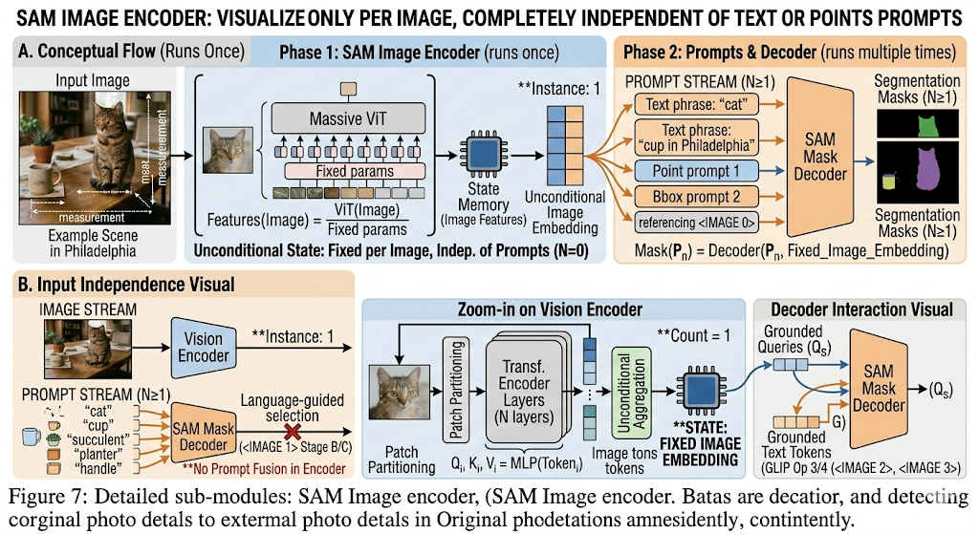

Slide 43
SAM Prompt Encoder — converts bounding boxes into embeddings
Prompt types SAM supports:
1. Point: a single (x, y) coordinate + foreground/background flag
2. Box: two corner points (x1,y1) and (x2,y2) ← what we use
3. Mask: a coarse binary mask as prior
4. Text: (experimental, not used in standard Grounded SAM)
Box prompt encoding for "cat" box [128, 176, 256, 336]:
Top-left corner (128, 176):
positional_encoding(128/1024, 176/1024) → [sin/cos features]
+ learned "top-left corner" token embedding
= corner_embed_TL shape [256]
Bottom-right corner (256, 336):
positional_encoding(256/1024, 336/1024) → [sin/cos features]
+ learned "bottom-right corner" token embedding
= corner_embed_BR shape [256]
Box prompt tokens = [corner_embed_TL, corner_embed_BR] shape [2, 256]
Box prompt encoding for "cup" box [304, 128, 400, 192]:
corner_embed_TL = positional_enc(304/1024, 128/1024) + token_TL
corner_embed_BR = positional_enc(400/1024, 192/1024) + token_BR
Box prompt tokens = [corner_embed_TL, corner_embed_BR] shape [2, 256]
Why positional encoding?
SAM needs to know where in the image the box is, not just that a box exists.
Sinusoidal positional encoding maps (x, y) coordinates to a continuous 256-dim vector where nearby positions have similar encodings.
The learned corner tokens tell SAM whether this point is a top-left or bottom-right corner — a positional encoding alone cannot distinguish them.​

Slide 44
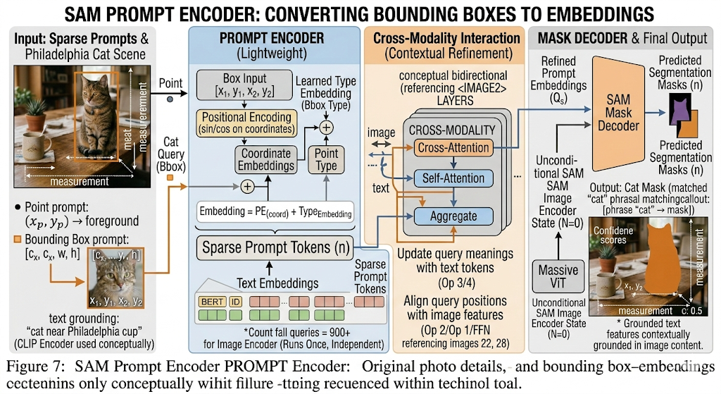

Slide 45
SAM Mask Decoder — cross-attention between prompt and image features
Mask decoder inputs (for cat box):
prompt_tokens = [corner_TL, corner_BR, output_token] shape [3, 256]
image_embed = F (from image encoder) shape [4096, 256]
positional_enc = spatial encoding of 64×64 grid shape [4096, 256]
Two-way transformer (2 layers, each with 2 cross-attention directions):
Direction 1 — Token-to-image cross-attention:
Q = prompt_tokens · W_Q (box corners ask: "what image features are near me?")
K = image_embed · W_K
V = image_embed · W_V
score(corner_TL, patch[8,8]) = Q_TL · K_patch / √256 = 0.71 ← near cat
score(corner_TL, patch[12,6]) = Q_TL · K_patch / √256 = 0.18 ← near cup (far)
score(corner_TL, patch[2,2]) = Q_TL · K_patch / √256 = 0.04 ← wall (far) → corner tokens learn about what is inside the box
Direction 2 — Image-to-token cross-attention:
Q = image_embed · W_Q (each image patch asks: "am I relevant to this box?")
K = prompt_tokens · W_K
V = prompt_tokens · W_V
score(patch[8,11], corner_TL) = 0.82 ← fur inside cat box → high relevance score
score(patch[2,2], corner_TL) = 0.03 ← wall outside box → low relevance score
→ image patches inside the box get amplified; outside get suppressed
This runs ×2 layers — patches near the box boundary get increasingly precise "inside vs outside" classification.
Output token cross-attention (final step):
The output_token attends to the updated image embedding:
output_token_updated = CrossAttn(Q=output_token, K=image_embed_updated)
shape [256] ← this single vector drives the final mask prediction

Slide 46
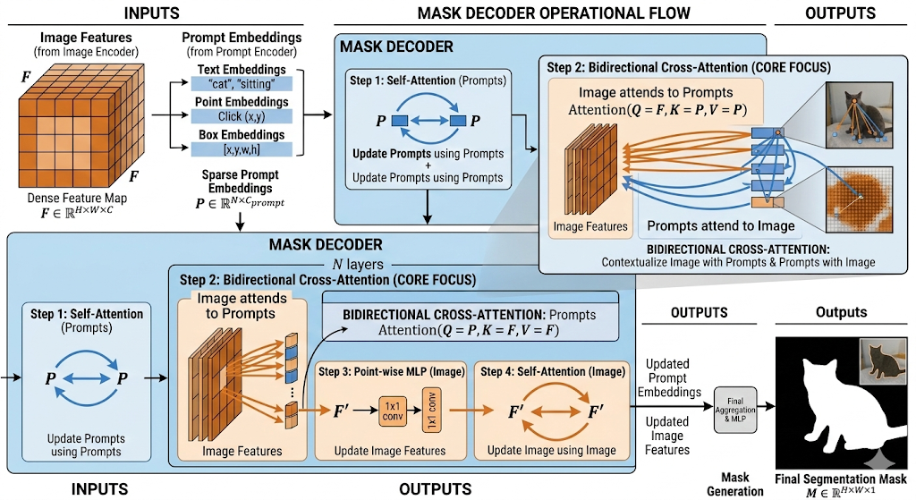

Slide 47
Final output — pixel-level masks with labels
Mask A — "cat":
Source label: from Grounding DINO ("cat", score 0.918)
Bounding box: [128, 176, 256, 336]
Mask shape: [640, 640] binary
Mask coverage: every pixel of the cat's body, fur, ears, tail including gaps between legs (pixel-precise)
NOT included: the table surface under the cat and the shadow behind the cat
Mask IoU pred: 0.94 (SAM's self-assessed quality score)
Mask B — "cup":
Source label: from Grounding DINO ("cup", score 0.925)
Bounding box: [304, 128, 400, 192]
Mask coverage: cup rim, body, handle — precise ceramic outline including the curved handle cutout (hollow inside handle)
NOT included: the table surface, cup shadow
Mask IoU pred: 0.96
"person" — no mask:
Grounding DINO produced no box for "person".
SAM never received a "person" prompt.
Therefore SAM never ran for "person".
Zero computation wasted on absent categories.
What Grounded SAM outputs overall:
[
{ label: "cat", score: 0.918, box: [...], mask: binary[640,640] },
{ label: "cup", score: 0.925, box: [...], mask: binary[640,640] }
]
Applications enabled by this output:
Image editing: replace background around the cat using inpainting
Object removal: fill the cup region with table texture
Counting: count all cups in an image by mask area
Measurement: estimate cat size from mask pixel count + depth
Robotics: pick up the cup using the mask centroid as grasp point

Slide 48
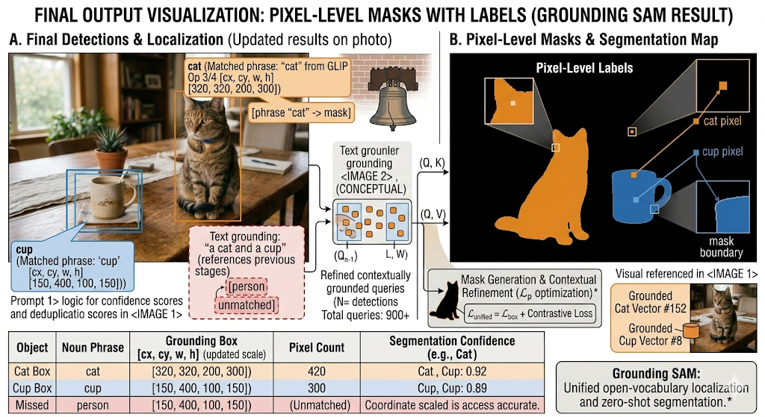

Slide 49
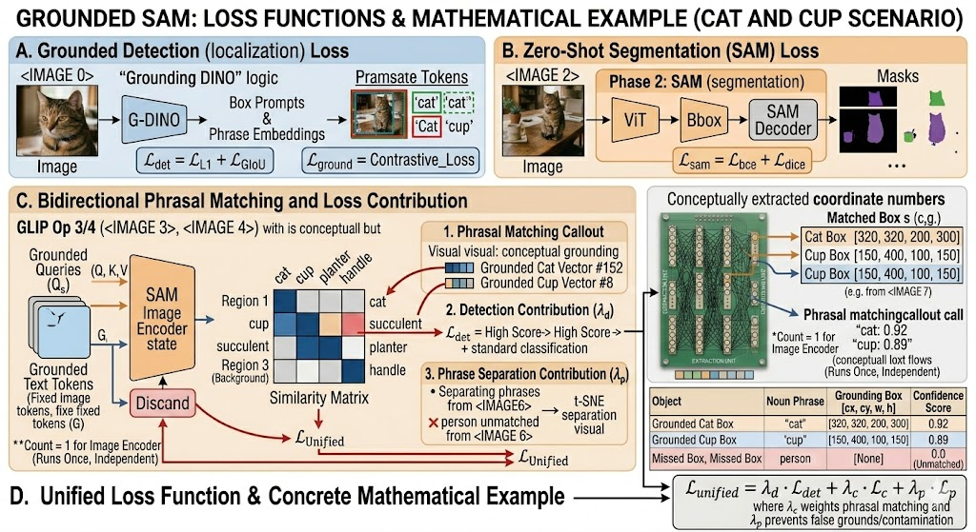

Slide 50
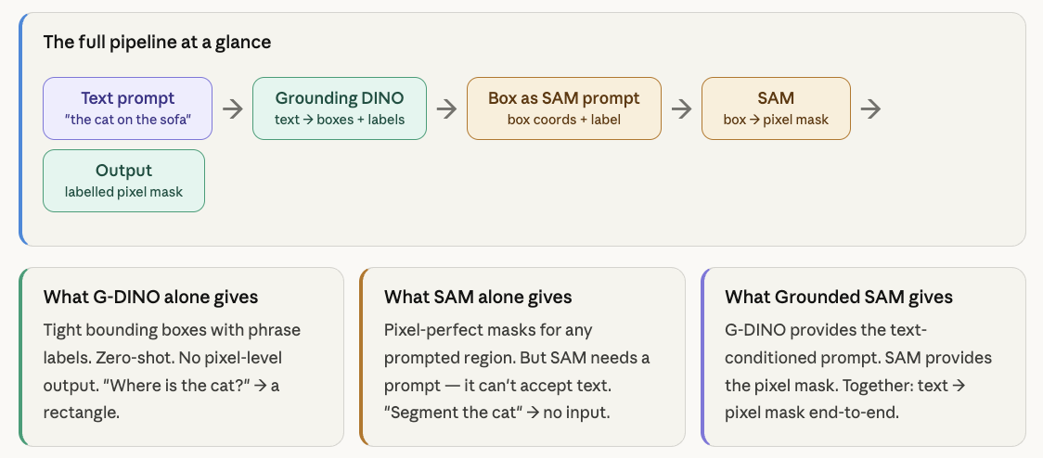

Slide 51
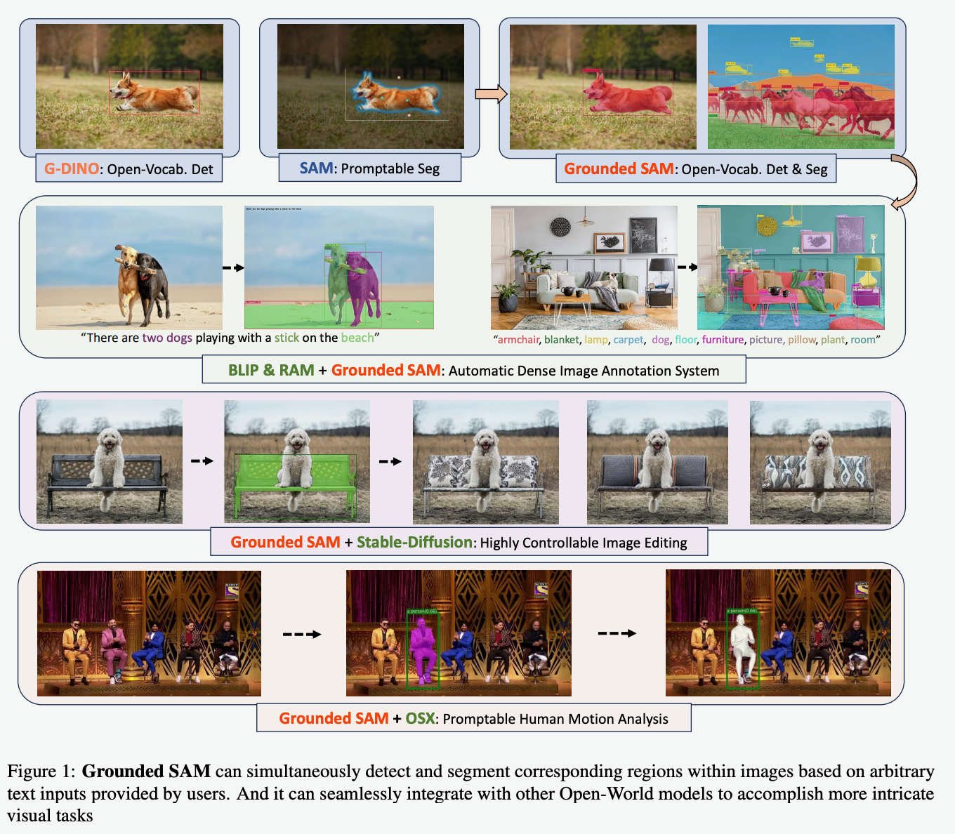

Slide 52
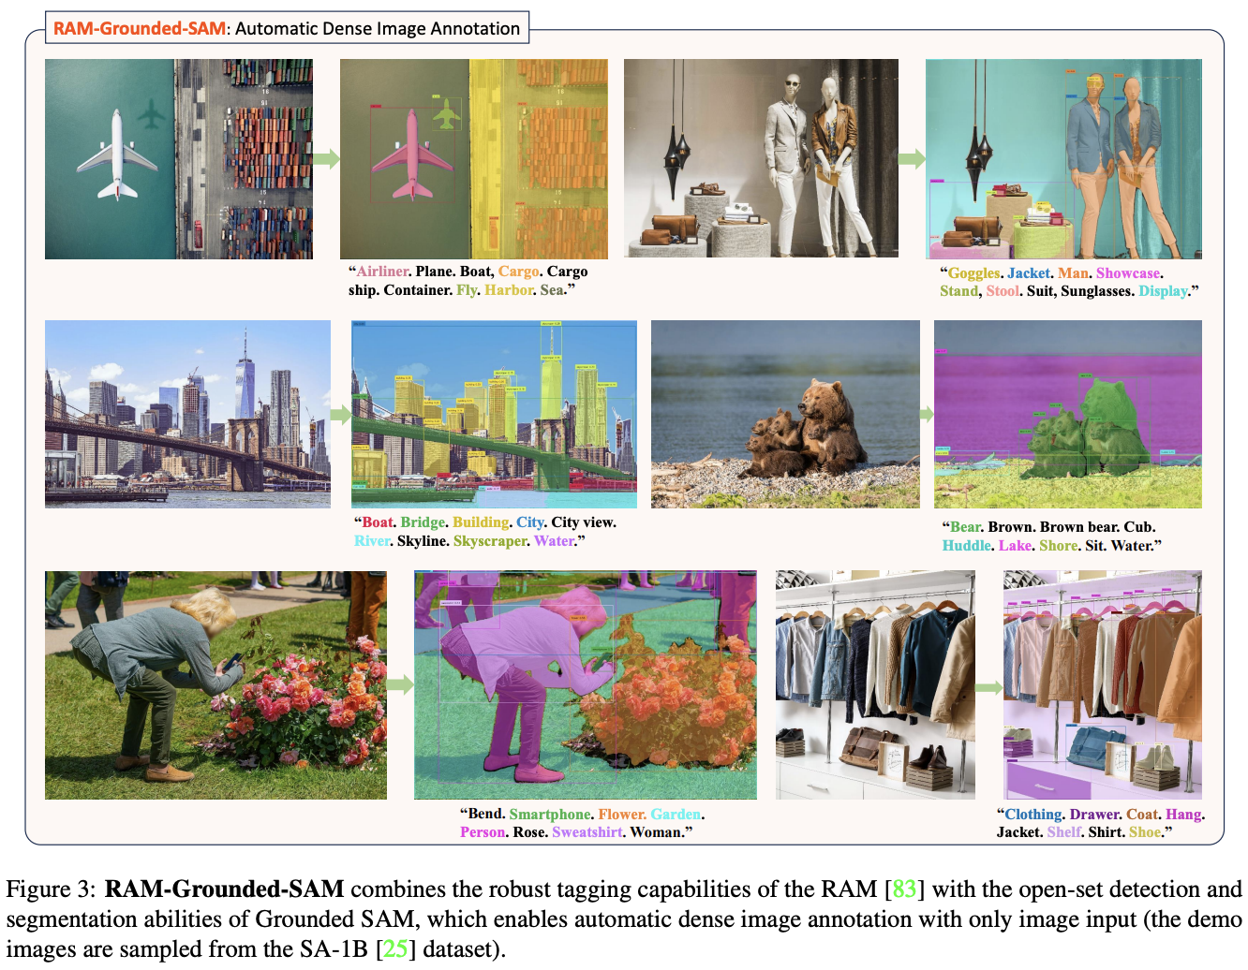

Slide 53
What OWL-ViT is and how it differs
The key idea
Start from CLIP — a model already trained to align images and text at scale. Remove only the final global pooling. Each image patch token becomes an object detector directly.
What it removes
No region proposals. No anchor boxes. No DyHead. No cross-attention between image and text during encoding. CLIP handles alignment entirely through contrastive pretraining.
Query format
Full natural language sentences per category. "a photo of a cat" not just "cat". One text query per class you want to detect. All encoded independently.
OWL-ViT vs GLIP vs Grounding DINO — the core difference
GLIP:
Text + Image → fused in neck (DyHead) → region proposals → contrastive match
Fusion: image asks text inside DyHead (one direction)
Grounding DINO:
Text + Image → deep bidirectional fusion (6 enhancer layers + decoder)
Fusion: image asks text AND text asks image at neck + head
OWL-ViT:
Text and Image → encoded INDEPENDENTLY, never interact during encoding
Fusion: only at the very end via a single dot product
Each patch token IS a detection query — no separate query mechanism needed
The CLIP pretraining does all the alignment work up front

Slide 54
Inputs — image patches and separate text queries
Text queries
Three separate strings, one per category:
"a photo of a cat"
"a photo of a cup"
"a photo of a person"
Image
768×768 px (OWL-ViT ViT-B/32 input size)
Cat on table, cup nearby, no person
Image patching — how the image becomes tokens
Text query format — why full sentences matter
Patch extraction (ViT-B/32 variant):
Input image: 768 × 768 pixels
Patch size: 32 × 32 pixels
Grid: 768/32 = 24 patches per side
Total: 24 × 24 = 576 image patch tokens + 1 [CLS] token prepended → 577 tokens total
Each patch is a 32×32 pixel square flattened to a 1024-dim vector, then projected to 768-dim via a linear layer.
Patch positions (important — each patch = one detection candidate):
Patch (8,10): covers pixels x:[256..288], y:[320..352] ← cat body (fur)
Patch (8,13): covers pixels x:[256..288], y:[416..448] ← cat body (back)
Patch (12,19): covers pixels x:[384..416], y:[608..640] ← cup rim
Patch (12,20): covers pixels x:[384..416], y:[640..672] ← cup handle
Patch (2,2): covers pixels x:[64..96], y:[64..96] ← blank wall
576 patches = 576 detection candidates. No region proposals needed.
OWL-ViT uses CLIP's text tokeniser:
"a photo of a cat" → ["a","photo","of","a","cat",EOT] 6 tokens
"a photo of a cup" → ["a","photo","of","a","cup",EOT] 6 tokens
"a photo of a person" → ["a","photo","of","a","person",EOT] 6 tokens
The phrase "a photo of a" matches CLIP's training distribution — CLIP was trained on image-caption pairs where images were described as "a photo of a [thing]". Using this prefix gives stronger alignment.
Each query is encoded COMPLETELY INDEPENDENTLY. "cat" query never sees "cup" query during encoding. No contamination problem at all — not even with word-level features.

Slide 55
Image encoder — CLIP ViT, patch tokens as detection features
Standard CLIP image encoding:
Input: 577 tokens (576 patches + 1 CLS)
Process: 12 transformer layers (ViT-B/32)
each layer: full self-attention across all 577 tokens + FFN
Standard CLIP output: average pool all patch tokens → 1 global vector
OWL-ViT modification — keep all patch tokens:
Output: 576 patch tokens + 1 CLS token
each token: 768-dim vector
Then apply a LINEAR PROJECTION (learnable) 768 → 512 Output: 576 image tokens shape [576, 512]
Each patch token now encodes:
- What is in that 32×32 pixel region (local visual content)
- Context from all other patches (global attention)
- CLIP's image-text alignment from pretraining
What the key patch tokens look like after encoding:
T_img[patch(8,10)] ≈ [0.88, 0.23, 0.09, 0.61, ...] ← cat fur patch
T_img[patch(8,13)] ≈ [0.85, 0.28, 0.11, 0.58, ...] ← cat back patch
T_img[patch(12,19)] ≈ [0.12, 0.08, 0.84, 0.29, ...] ← cup rim patch
T_img[patch(2,2)] ≈ [0.03, 0.02, 0.04, 0.01, ...] ← blank wall patch
Why CLIP self-attention helps here:
Even though patch(8,10) only covers 32×32 pixels of fur,
its 12 layers of self-attention give it context from the whole image.
It "knows" there is a table below it and sky above — this context
helps it represent itself as part of a cat on a surface, not random fur.

Slide 56
Classification head — dot product of every patch against every query
Image patch tokens first go through a small MLP:
T_img_proj[i] = MLP_cls(T_img[i]) shape [512]
(a 2-layer MLP that adapts the CLIP image features for detection)
Then L2 normalise each token.
Score matrix computation:
S = T_img_proj · T_txt^T shape [576, 3]
S[i, j] = cosine_similarity(patch_i, query_j)
= T_img_proj[i] · T_txt[j] (both L2-normalised → cosine sim)
Values range from -1 (opposite) to +1 (identical direction).
Scores for patch(8,10) — cat fur patch:
S[patch(8,10), "cat"] = T_img[fur] · T_txt["cat"]
= (0.88×0.82)+(0.23×0.31)+(0.09×0.09)
= 0.722 + 0.071 + 0.008 = 0.801 ← HIGH
S[patch(8,10), "cup"] = (0.88×0.11)+(0.23×0.10)+(0.09×0.89)
= 0.097 + 0.023 + 0.080 = 0.200 ← low
S[patch(8,10), "person"] = (0.88×0.20)+(0.23×0.91)+(0.09×0.12)
= 0.176 + 0.209 + 0.011 = 0.396 ← medium
Scores for patch(12,19) — cup rim patch:
S[patch(12,19), "cat"] = 0.198
S[patch(12,19), "cup"] = 0.821 ← HIGH
S[patch(12,19), "person"] = 0.141
Scores for patch(2,2) — blank wall patch:
S[patch(2,2), "cat"] = 0.031
S[patch(2,2), "cup"] = 0.028
S[patch(2,2), "person"] = 0.039 ← all near zero
Scores for "person" across ALL 576 patches: ​max over all patches of S[i, "person"] = 0.396 (fur patch) ​
This is below detection threshold (0.5 typical for OWL-ViT). ​
Why so low? Because CLIP was trained on real images of people. ​
The cat fur patch encodes "animal fur texture", which is not close to "a photo of a person" in CLIP's embedding space. ​
No contamination → cleaner suppression of absent categories.

Slide 57
Box head — each patch predicts its own bounding box
Box head architecture (one MLP per patch, shared weights):
input: T_img[i] shape [512] (same patch token, different MLP)
MLP: Linear(512→512) + GELU
Linear(512→512) + GELU
Linear(512→4)
output: [cx_offset, cy_offset, w, h] all in [0,1] relative to image
The predicted box is RELATIVE TO THE PATCH CENTRE:
Patch (8,10) is located at normalised position:
patch_cx = (10 + 0.5) / 24 = 0.438 (centre of patch col 10)
patch_cy = (8 + 0.5) / 24 = 0.354 (centre of patch row 8)
MLP predicts offsets and size:
cx_offset = +0.02 cy_offset = +0.05 w = 0.21 h = 0.26
Final box coordinates:
cx = 0.438 + 0.02 = 0.458 → wait, this is relative, so:
cx = sigmoid(cx_raw) = 0.30 cy = sigmoid(cy_raw) = 0.40
w = sigmoid(w_raw) = 0.21 h = sigmoid(h_raw) = 0.26
→ box [0.30, 0.40, 0.21, 0.26] ← cat bounding box
For cup rim patch(12,19):
cx = 0.55 cy = 0.29 w = 0.16 h = 0.21
→ box [0.55, 0.29, 0.16, 0.21] ← cup bounding box
For wall patch(2,2): ​
cx = 0.08 cy = 0.09 w = 0.12 h = 0.11 ← predicted but irrelevant ​
(this box will be discarded because classification score < threshold) ​
​
Important: ALL 576 patches predict a box simultaneously. The box andclassification heads run in parallel, not sequentially. This is why OWL-ViT is so fast — one forward pass gives both boxes and scores.

Slide 58
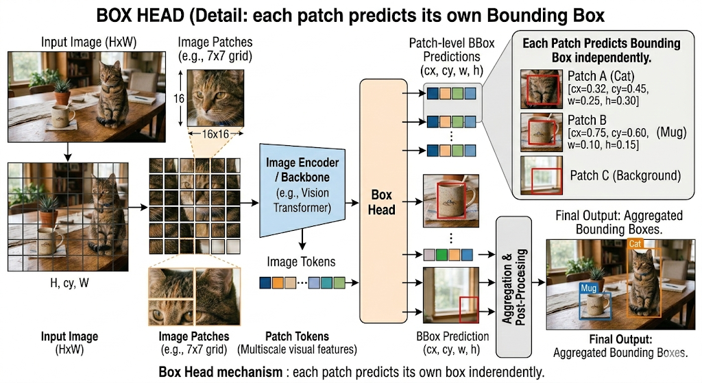

Slide 59
Score thresholding + NMS — filter 576 candidates to final detections
Step 1 — apply sigmoid to scores:
score_sigmoid = sigmoid(S[i,j]) converts dot product to 0–1
patch(8,10), "cat": sigmoid(0.801) = 0.690 ← keep
patch(8,13), "cat": sigmoid(0.781) = 0.686 ← keep (adjacent patch)
patch(8,10), "person": sigmoid(0.396) = 0.598 ← borderline!
patch(12,19), "cup": sigmoid(0.821) = 0.694 ← keep
patch(2,2), any: sigmoid(0.039) = 0.510 ← near threshold
Step 2 — apply score threshold (typically 0.1–0.5 depending on use case): OWL-ViT default threshold = 0.1 (lower than GLIP/Grounding DINO)
Reason: CLIP dot products are cosine similarities — more spread out.
A threshold of 0.1 after sigmoid ≈ 0.525 raw sigmoid value.
Surviving patches per query:
"cat": patches (8,9),(8,10),(8,11),(8,13),(9,10)... ~12 patches
"cup": patches (12,18),(12,19),(12,20),(13,19)... ~6 patches
"person": patches (8,10) score=0.598 maybe others < threshold
→ "person" barely survives at some thresholds!
This is OWL-ViT's weakness vs sub-sentence-aware models.
Step 3 — NMS per query (non-maximum suppression): ​
For "cat": 12 patches survived. Many overlap significantly. ​
IoU(patch(8,10), patch(8,11)) = 0.61 > 0.5 → keep higher score only ​
After NMS: 1 box for "cat" centred at (0.30, 0.40) ​
​
For "cup": 6 patches survived. ​
After NMS: 1 box for "cup" centred at (0.55, 0.30) ​
​
For "person": if patch(8,10) survived threshold: ​
It also has a high "cat" score (0.690 > 0.598). ​
NMS is per-query — it does NOT cross-suppress between queries. ​
So "person" box at same location as "cat" box may survive! ​
Mitigation: use higher threshold, or post-process to keep top-1 per region.

Slide 60
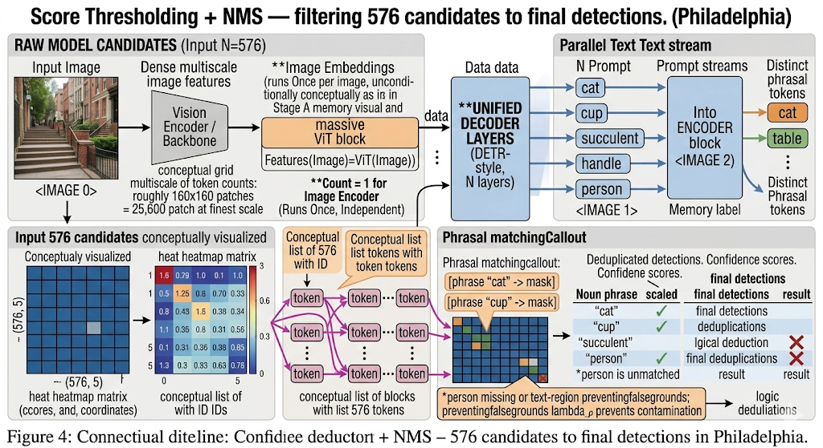

Slide 61
Final output — boxes and labels from patch-level predictions
Detection 1: "cat"
Source patch: (8,10) — the fur patch with highest cat score
Box: [cx=0.30, cy=0.40, w=0.21, h=0.26]
pixels: x:[109..243], y:[186..352] ← cat region
Score: 0.690 (sigmoid of cosine similarity)
The box MLP on this patch has learned to expand the box beyond the 32×32 patch to cover the whole cat (w=0.21 > patch_width=0.042)
Detection 2: "cup"
Source patch: (12,19) — the cup rim patch with highest cup score
Box: [cx=0.55, cy=0.29, w=0.16, h=0.21]
pixels: x:[304..406], y:[129..193] ← cup region
Score: 0.694
"person" — ideally no detection:
At threshold=0.60: patch(8,10) scores 0.598 → dropped ✓
At threshold=0.50: patch(8,10) scores 0.598 → kept as "person" ✗ false positive
OWL-ViT requires careful threshold tuning to suppress absent categories.
Unlike Grounding DINO (structural suppression via no image grounding),
OWL-ViT relies purely on the threshold.
Summary of OWL-ViT's pipeline on this example: ​
Stage 0: Image patches (576) + 3 separate text queries ​
Stage 1: CLIP image encoder → 576 patch tokens [576, 512] ​
Stage 2: CLIP text encoder → 3 query vectors [3, 512] ​
Stage 3: Classification MLP + dot product → score matrix [576, 3] ​
Stage 4: Box MLP → 576 boxes [576, 4] ​
Stage 5: Threshold + NMS per query → 2 detections ​
No region proposals, no anchors, no cross-attention between modalities duringencoding. ​
Entire detection = 2 small MLPs + 1 dot product on top of frozen CLIP.

Slide 62
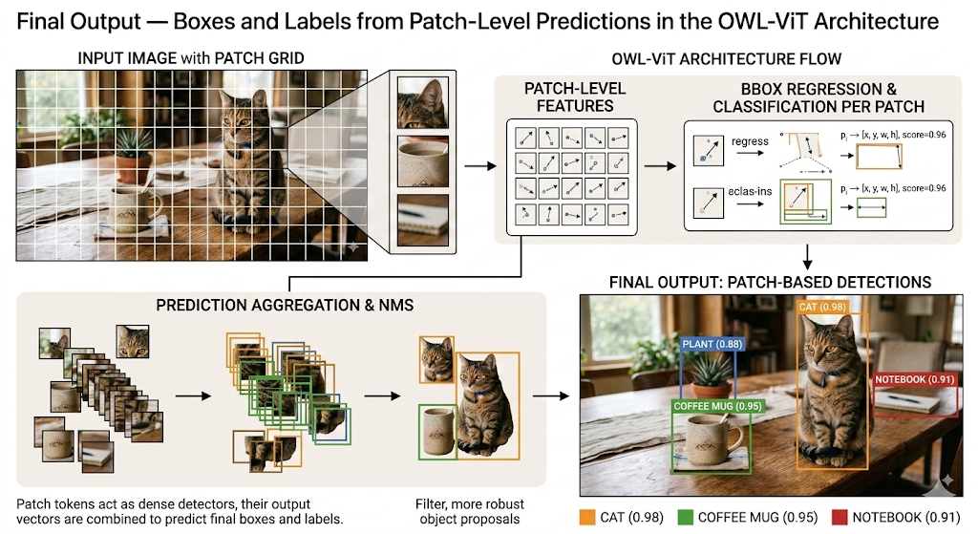

Slide 63
Kosmos-2 – Grounded Multimodal LLM
Multimodal Large Language Model
Kosmos-2 (Microsoft, 2023) is a Multimodal Large Language Model (MLLM) that incorporates visual grounding into a GPT-style language model. It's not purely a vision model; rather, it's an LLM that can process images and text together.
Key Idea: "Grounded LLM"
Unified Multimodal System
Kosmos-2 introduces visual perception and spatial grounding into an LLM. It can take image embeddings and textual inputs, and output text with special tokens that refer to image regions.
Kosmos-2 represents a shift toward unified multimodal systems that can both understand and generate grounded content.
Architecture
Based on Microsoft's UniLM architecture (a transformer that can act as encoder-decoder or decoder). It extends a text-only LLM to accept vision by adding visual token embeddings into its input sequence.
Paradigm Shift
Moving from specialized vision models to unified multimodal LLMs that handle vision and language together.

Slide 64
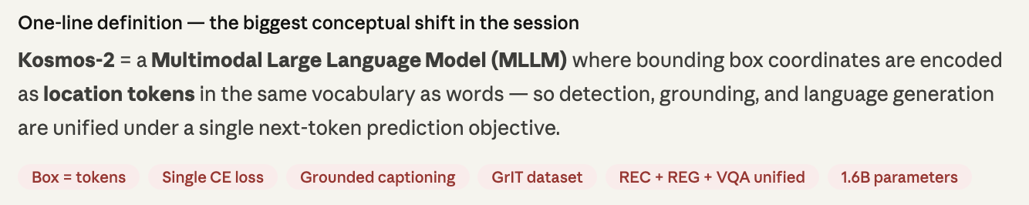
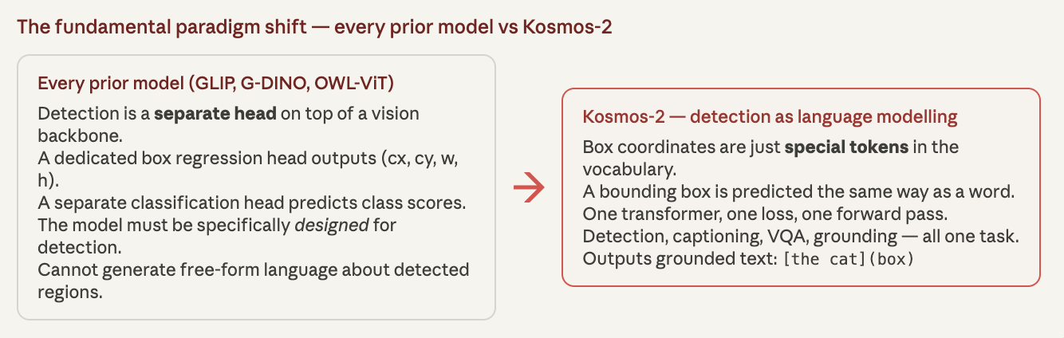
What is Kosmos-2 and why is it a paradigm shift?

Slide 65
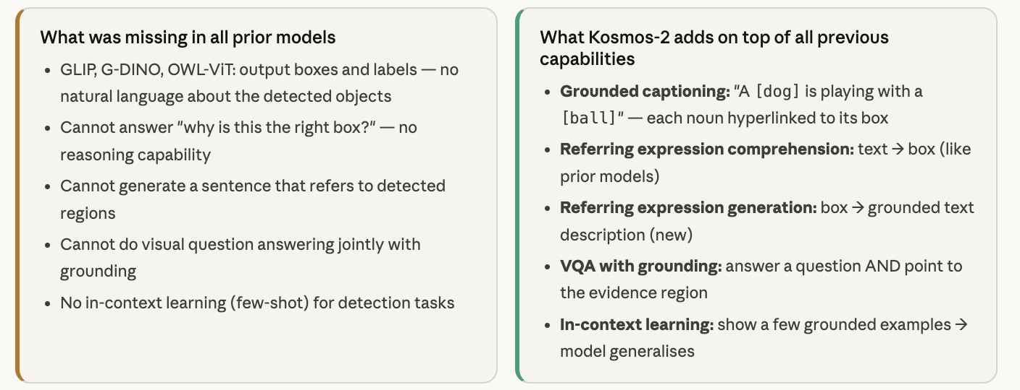

Slide 66
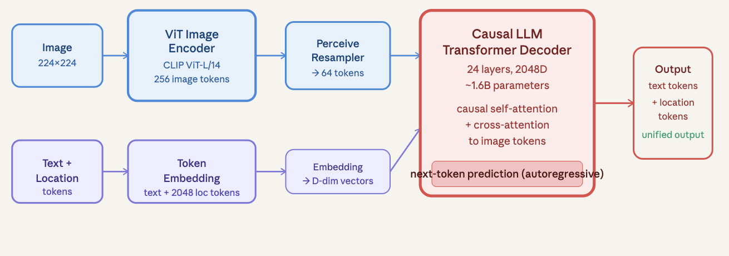
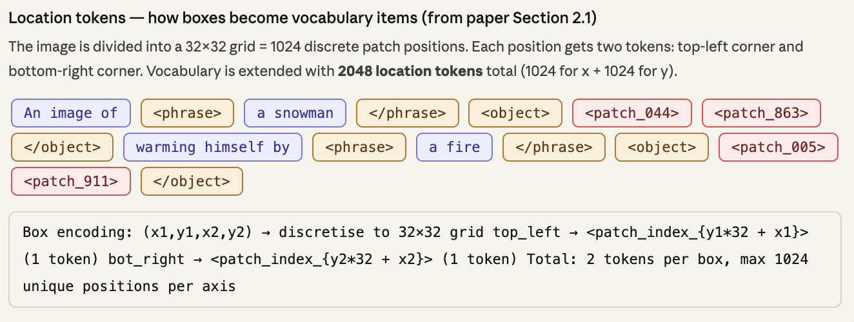
Kosmos-2 architecture — causal LLM + image encoder + location token vocabulary

Slide 67
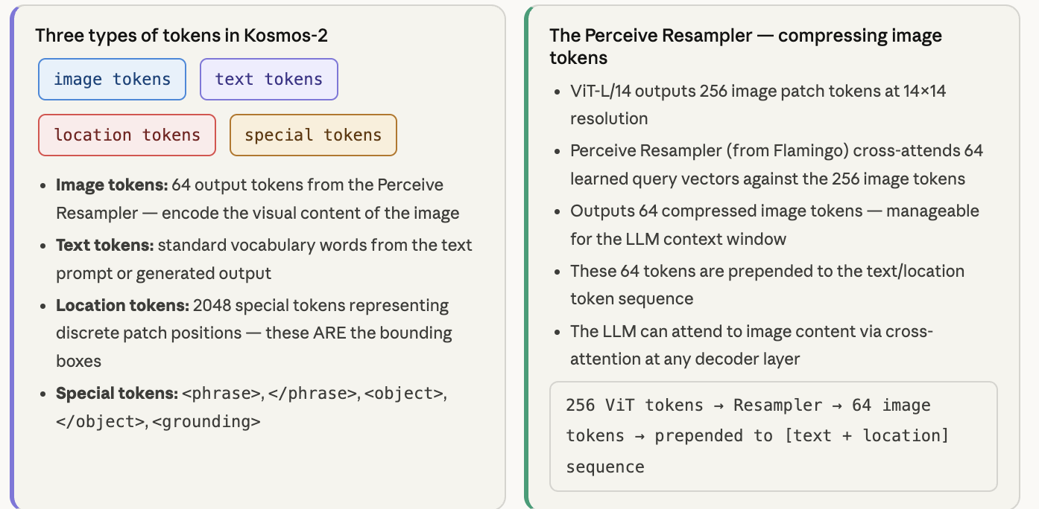

Slide 68
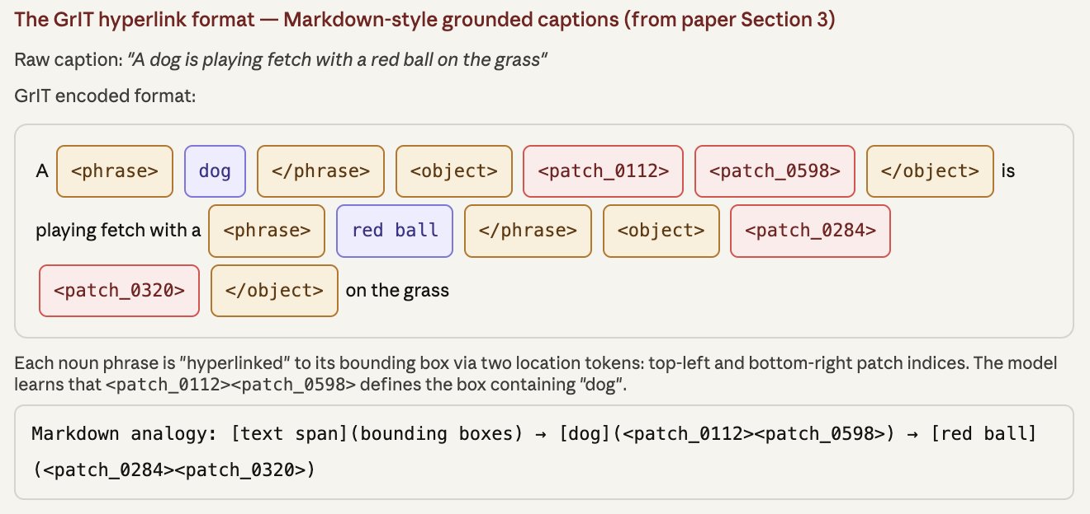
GrIT — Grounded Image-Text dataset and the hyperlink format

Slide 69
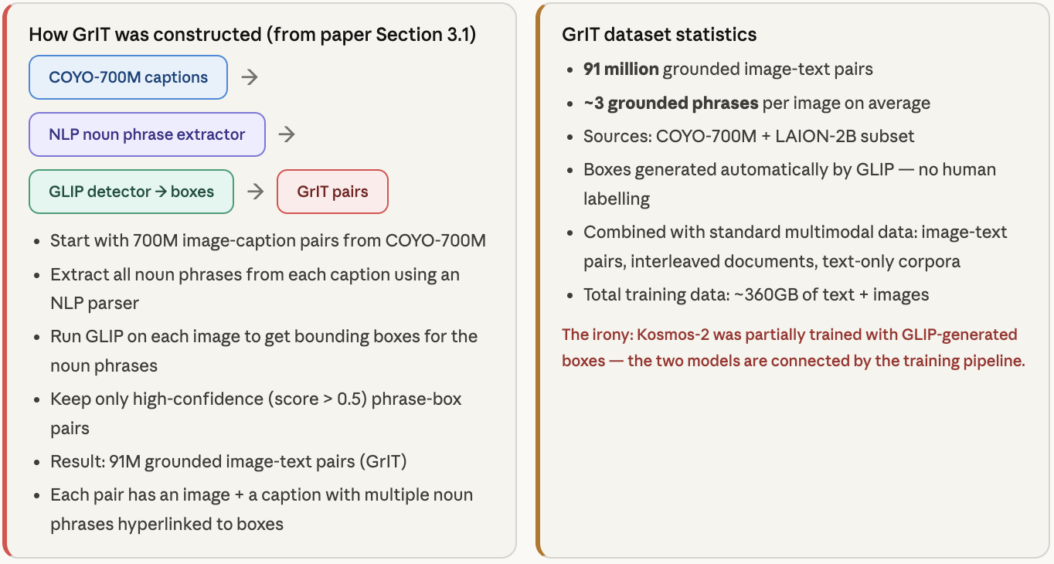

Slide 70
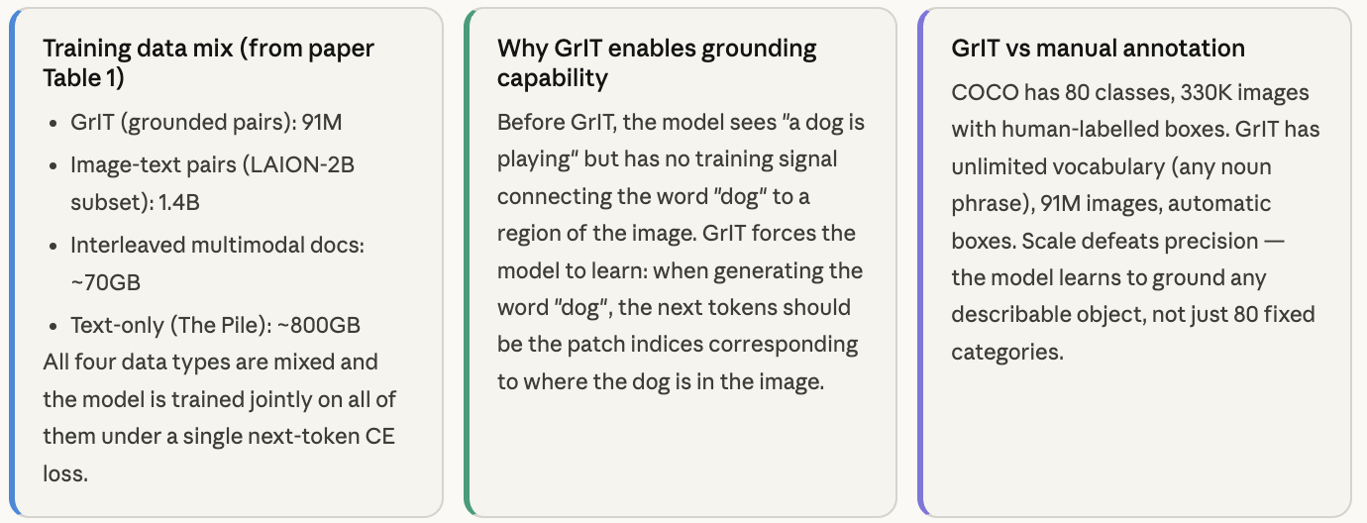

Slide 71
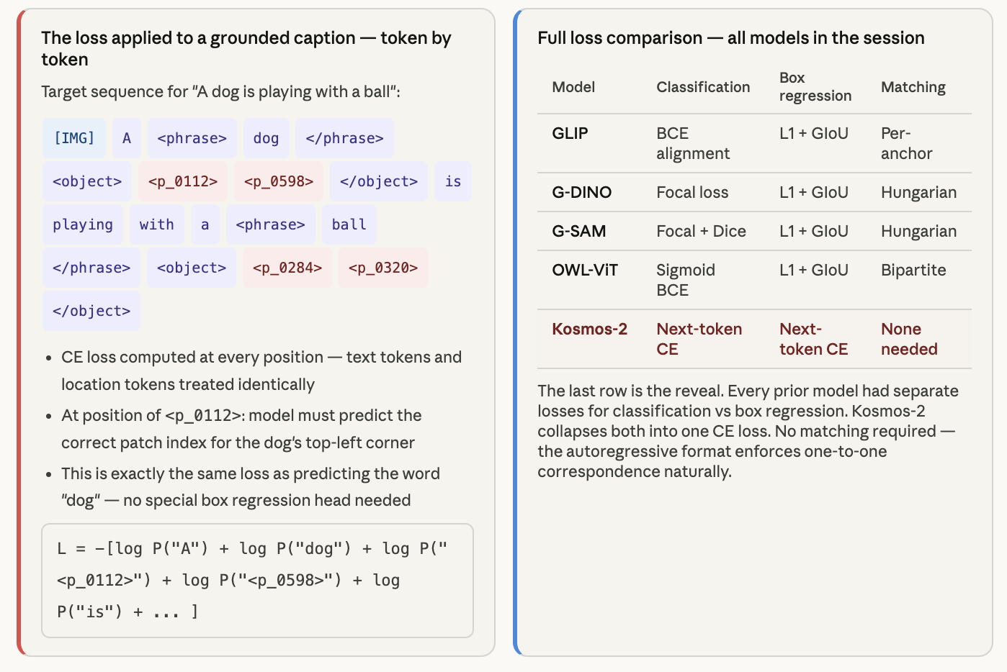
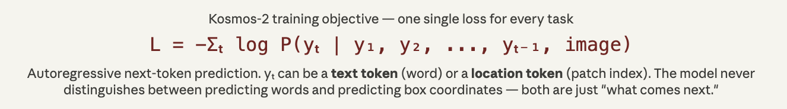
Kosmos-2 loss — one next-token cross-entropy for everything

Slide 72
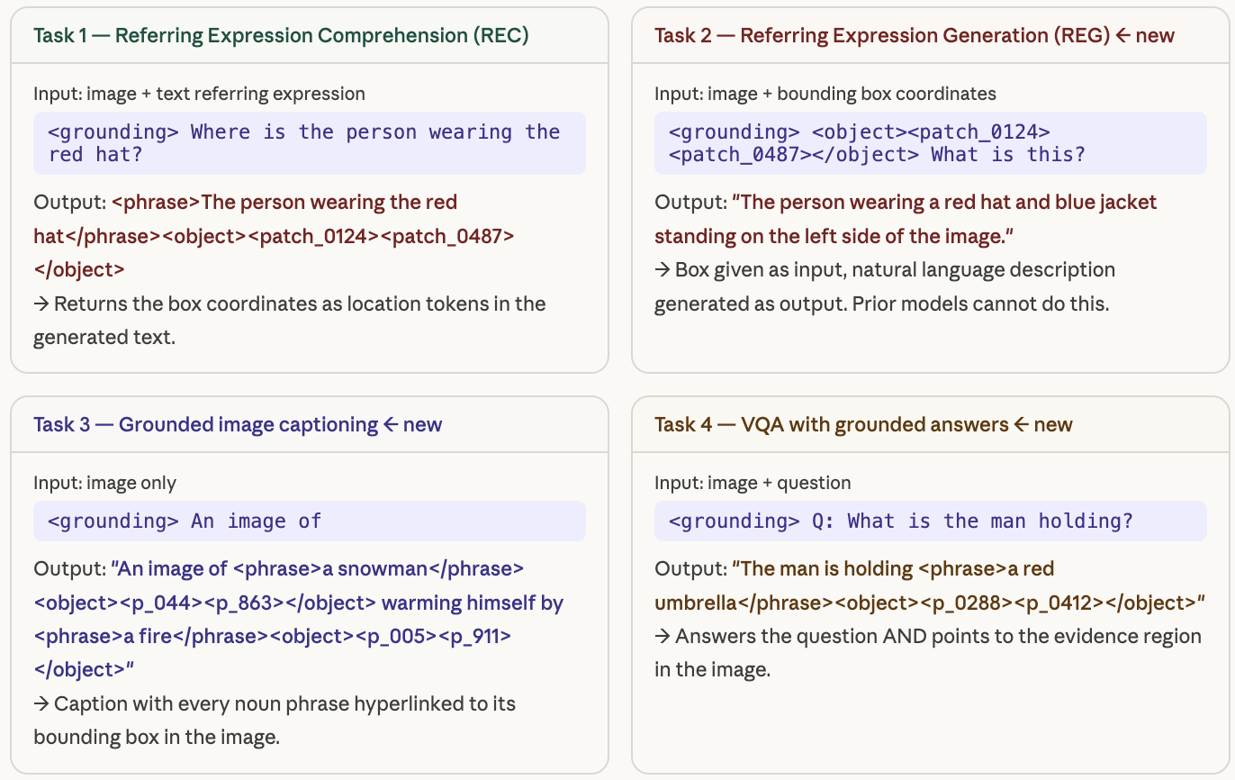
Kosmos-2 capabilities — four task types, one model

Slide 73
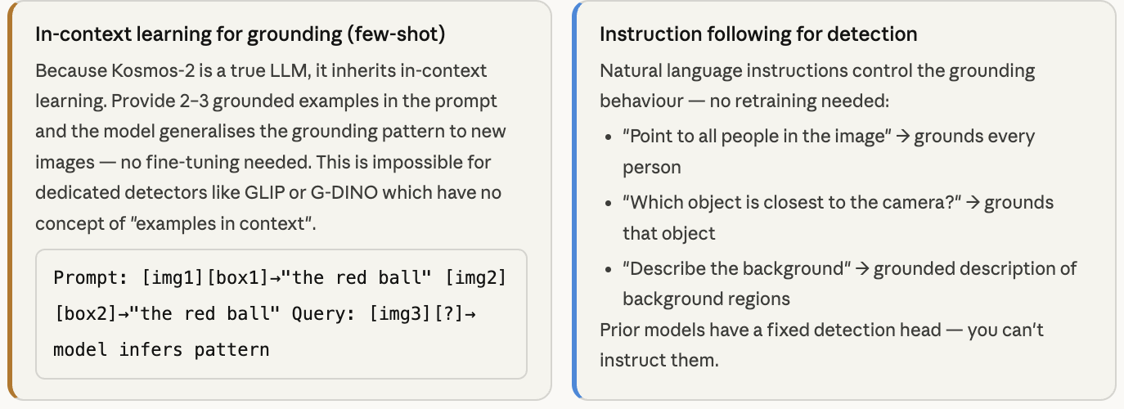

Slide 74


Slide 75
Comparative Perspectives: Model Comparison Table
Model | Vision Backbone | Fusion | Training Data | Outputs
GLIP | CNN/ViT + Region Head | Deep fusion at neck | 3M + 24M synthetic | Boxes + text tokens
Grounding DINO | DETR (Swin) | Multi-stage fusion | O365 + GoldG + 4M | Boxes + text tokens
SAM | ViT-Huge | Vision-only | 11M images, 1.1B masks | Segmentation masks
Grounded SAM | DINO + SAM | Model ensemble | Pre-trained models | Masks for text objects
OWL-ViT | ViT-L CLIP | Late fusion | CLIP + detection | Boxes + text labels
Kosmos-2 | Swin-T | Early fusion in LLM | GrIT dataset | Text + coordinates
Ferret | CLIP-ViT | Early fusion in LLM | Custom dataset | Text + regions
Florence-2 | Swin ViT | Unified seq2seq | FLD-5B (5.4B anno) | Text for all tasks

Slide 76
Datasets & Benchmarks Overview
LVIS
Key Evaluation Datasets
Large Vocabulary Instance Segmentation. 1203 categories with long-tail distribution
RefCOCO / RefCOCO+ / RefCOCOg
ODinW
Referring expressions on MS COCO images. Multiple textual descriptions referring to objects in images
Object Detection in the Wild. 35 diverse detection datasets combined
Flickr30k Entities
These datasets enable comprehensive evaluation of grounded vision models across different task types and difficulty levels.
Phrase grounding benchmark. 30k images with 276k region-phrase annotations

Slide 77
RefCOCO / RefCOCO+ / RefCOCOg
RefCOCO
RefCOCO+
RefCOCOg
Shorter, factual descriptions
Forbids absolute location words ("left/right")
Longer, more descriptive phrases
~20k images, ~140k expressions
Focuses on purely appearance-based descriptions
Includes both appearance and context. Usually one expression refers to a group
Metrics
Accuracy@0.5 – percentage of expressions where predicted region has IoU ≥ 0.5 with ground truth:
85-90%
50-65%
SOTA after fine-tuning
Zero-shot (GLIP/GroundingDINO)

Slide 78




Slide 79



Slide 80
Flickr30k Entities & LVIS
Flickr30k Entities
LVIS (Large Vocabulary Instance Segmentation)
30k
276k
164k
2M
1203
Images
Phrases
Images
Masks
Categories
From Flickr
Region-phrase annotations
Long-tail distribution with many rare classes. Tests open-vocab detection with AP metrics on rare, common, and frequent subsets.
Rich, relatively complex scenes with multiple phrases per caption linked to image regions. Used to evaluate phrase grounding – models output boxes for each phrase. Measured by recall: how many ground-truth phrase-region links the model predicts correctly.

Slide 81
ODinW: Object Detection in the Wild
Benchmark Description
Evaluation Settings
A benchmark composed of 35 diverse detection datasets to simulate "in the wild" conditions for open-set detectors.
Tests zero-shot, few-shot, and fully supervised performance across all datasets.
Grounding DINO Result
Dataset Diversity
Includes diverse domains:
26.1 mAP
Artworks
Deep-sea images
Traffic scenes
Zero-shot on ODinW (new state-of-the-art)
Aerial imagery
Medical images
And more...
Indicates robust ability to generalize to entirely new datasets without additional training

Slide 82
Dataset Comparison Table
Dataset | Task Type | Size | Notable Features
RefCOCO /+ /g | Referring Exp. Grounding | ~20k images, ~140k expr | COCO images; "+" forbids spatial words; "g" has longer sentences
Flickr30k Entities | Phrase Grounding | 31k images, 276k phrases | Rich complex scenes, multiple phrases per caption
LVIS | Detection & Segmentation | 164k images, 2M masks | 1200+ categories with long-tail distribution
ODinW | Detection (multi-domain) | 35 datasets combined | Composite benchmark for open-world detection

Slide 83

Evaluation Metrics: IoU and mAP
Intersection over Union (IoU)
IoU = |Maskpred ∩ Maskgt| / |Maskpred ∪ Maskgt|
Ranges from 0 to 1 (1 being perfect overlap). Used for segmentation tasks to measure pixel-level alignment.
Mean IoU (mIoU)
Average IoU across all classes or all instances:
• Semantic segmentation: Compute IoU for each category, average across categories
• Instance segmentation: Average IoU across all predicted masks
Mean Average Precision (mAP)
Standard COCO-style mAP for detection tasks, evaluated on subset of novel classes to measure open-set performance. Combines localization (via IoU threshold) and classification accuracy.

Slide 84
Applications: Human-Robot Interaction
Natural Language Commands
Robots that understand commands like "pick up the large green cup on the table" – requiring grounding language in the physical world.
Key Capability
Use Cases
Enabling robots to find the right objects or navigate to described locations without pre-programming for every possible object.
Home Robots
Warehouse Robots
Finding objects for everyday tasks
Locating specific inventory items
Navigation
Commands
Navigating to described locations
Following verbal navigation instructions
This is crucial for deploying robots in unstructured, real-world environments where objects and instructions are unpredictable.

Slide 85
Applications: Autonomous Driving & Surveillance
Autonomous Driving
Surveillance Systems
Open-vocabulary detection allows vehicles to recognize unusual objects or hazards without specific training:
Can be asked to find specific individuals or objects:
"Find a person in a red jacket carrying a black bag"
• "construction cones"
System locates them among many cameras, enabling natural language search across video feeds.
• "animals on road"
• "debris in lane"
Benefit
Increased robustness in unpredictable environments. Handling edge cases not in training data.

Slide 86
Applications: Medical Imaging & Accessibility
Medical Imaging
Assistive Technology
Doctors can query algorithms with natural language:
For visually impaired users, grounded models power assistive tech:
"Highlight any signs of tumor in this MRI"
Example Query: "Where are the exit doors in this room?"
Output: System identifies and provides haptic feedback or sound localized to object direction
The model can be trained to ground descriptive pathology terms (like "lesion with irregular border"), accelerating diagnosis by pointing radiologists to candidate regions of interest.
Image descriptions can be enriched with location: "There is a cup on the table [at the center]"

Slide 87


Slide 88
Live Demo Considerations
Online Resources
Interactive Exploration
Numerous online demos and Colab notebooks exist that let you try these models without deep technical background:
Encourage students to explore these demos themselves – hands-on experience is invaluable for understanding how these models behave with different prompts and images.
• HuggingFace demo of GroundingDINO
• Grounded-SAM demo
• Interactive notebooks with pre-loaded examples
Live Demo Suggestions
For the lecture, it might be engaging to do a live demo:
• Show an image on the slides
• Ask the audience for a phrase to ground
Hands-On Learning
• Run GroundingDINO+SAM to visualize the result
(Perhaps prepare in advance to avoid technical issues)
Interactive exploration helps build intuition about model capabilities and limitations.

Slide 89
Limitations: Computational Cost
Resource-Intensive Models
Edge Deployment Challenges
Large models (e.g., ViT-L or Huge backbones with billion-scale training) are resource-intensive to train and run.
Deploying on edge devices (AR glasses, robots) may require:
Model distillation – compressing large models
Efficient architectures – hybrid CNN-transformers
Challenges
Smaller backbones – Grounding DINO with Swin-T
Training
Inference
These techniques help at some accuracy cost – a fundamental trade-off in deploying large models.
• Requires significant compute resources
• Can be slow for real-time applications
• Long training times
• Memory requirements
• High energy consumption

Slide 90
Limitations: Hallucination
Unfounded Outputs
Mitigation Approaches
Multimodal models, especially those with language generation capabilities (like MLLMs), can sometimes produce unfounded outputs due to learned language priors.
Ferret's approach reducing hallucination through explicit grounding supervision – training on tasks that require pointing to actual image regions makes the model more faithful to the image.
Reducing hallucination requires careful grounding supervision and evaluation on challenging negative examples.
Examples
Language Hallucination
Saying "a dog on the left" when no dog is present. Model generates plausible-sounding but incorrect content
False Positives
Grounding DINO's authors noted some false detections of text-specified objects that weren't actually there
Grounding Helps
Explicit grounding supervision trains models to be more faithful to actual image content.

Slide 91
Limitations: Spatial Reasoning & Ambiguity
Complex Spatial Relations
Ambiguity Handling
Understanding complex spatial relations still poses difficulties:
Grounding can be ambiguous (e.g., "the dog by the tree" when there are several dogs and trees). Models like SAM address ambiguity by proposing multiple masks. Deciding how to handle ambiguity (choose one? ask user?) is an open problem.
"the second person from the left wearing a hat, standing behind the table"
Recent research explores injecting more spatial awareness into these models.
Challenges
Inconsistency with multiple spatial constraints
Mis-ordering things with complex sentence structures
Difficulty with relative vs absolute positions
Spatial Awareness
Improving spatial reasoning remains an active research direction in grounded vision.

Slide 92
Future Directions: Temporal Grounding in Videos
Extending to Video
Early Work
Extending grounded vision models to video – identifying frames or time segments corresponding to language queries:
Research like MetroVLAD for video moment retrieval is underway. We expect Transformer-based video-text models to improve rapidly.
Applications include video chapter generation, security footage analysis, and content moderation in video.
"find the moment the cat jumps on the table"
Challenges
Data Volume
Temporal Reasoning
• Huge volumes of video data
• Multiple frames, motion cues
• Storage and processing requirements
• Understanding action sequences
Video Understanding
Temporal grounding extends visual understanding to the time dimension, enabling rich video analysis.

Slide 93
Future Directions: 3D and Embodied Grounding
From 2D to 3D
Embodied AI
Moving from 2D images to 3D environments (point clouds, meshes) and real-world robotics:
Agent Interaction
Agent not only points to object but physically navigates to or interacts with it
Vision-and-Language Navigation (VLN)
Research Directions
An agent follows linguistic instructions in a visual environment – a key application area for embodied grounding
3D Visual Grounding
Identifying objects in 3D scans via language. Recent CVPR papers tackle this challenge
Spatial Reasoning in 3D
Understanding viewer perspective. "the chair behind the table" is trickier in 3D than 2D
3D Understanding
Extending grounding to 3D environments enables richer spatial understanding and robot interaction.

Slide 94



