Slide 1

Object Detection & Segmentation with Vision Transformers
CIS 5543: COMPUTER VISION
Spring 2026
Faith Sang
faith.sang@temple.eduMs Computer Science
Abhudaya Shrivastava
abhudaya.shrivastava@temple.edu
PhD Student
Computer & Information Science
Kyle Wilson
kyle.wilson0003@temple.edu
Ms Computer Science

Slide 2
Lecture Overview
Bounding Box (BB) prediction with ViT as a backbone
  Foundations of Object Detection
  Bounding Box Prediction with ViT Backbones
Transformer-based detection
  Transformer-Based Detection (DETR)
  End-to-End Detection
Attaching segmentation heads to ViT models
  Semantic vs. instance vs. panoptic segmentation
  Encoder- Decoder Segmentation with ViT
  Query-Based Mask Prediction
  Segment Anything Model (SAM)
Summary & Conclusion
  Wrap up
Notes:
Today we’ll explore how Vision Transformers are used in modern detection and segmentation systems.
We’ll begin with the fundamentals of object detection : understanding how detection differs from classification and why it is a harder problem.
Then we’ll look at how Vision Transformers can act as detection backbones and how multi-scale representations are handled.
After that, we’ll move into transformer-based detection like DETR, and finally segmentation approaches such as SAM.

Slide 3
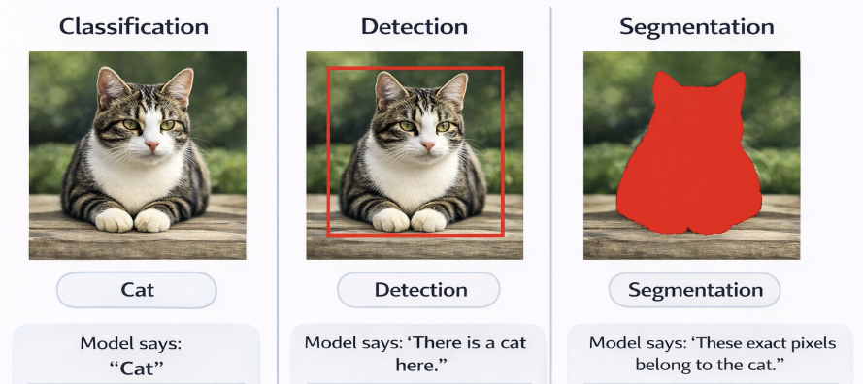
From Image Classification to Spatial Understanding
Notes:
“Let’s begin with a very simple image — a single cat.
Now, consider three different tasks applied to this same image.
In classification, the model answers only one question:
What is in this image?
It outputs a single label — ‘Cat.’
Formally, this is a vector of class probabilities.
There is no notion of location.
The model does not know where the cat is — only that one exists.
In detection, we introduce spatial reasoning.
Now the model answers:
What objects are present, and where are they?
It predicts:
A class label
A bounding box — defined by coordinates
So instead of a single vector, the output becomes a structured set of predictions.
The model must now localize the object in space.
In segmentation, we go even further.
The model answers:
Which exact pixels belong to the object?
Instead of a box approximation,
it produces a dense pixel-wise mask.
Now the output is no longer a list —
it is a spatial map aligned with the image resolution.
Notice what just happened.
The input image never changed.
But the output structure changed dramatically.
We moved from:
A single global prediction
to
Multiple spatial predictions
to
Dense, per-pixel structured outputs.
Each step increases:
Spatial precision
Output dimensionality
Learning complexity
Computational cost
And this shift —
from simple global classification
to structured spatial reasoning —
is exactly what modern detection and segmentation architectures are designed to handle.
Today, we’ll understand how we make that transition

Slide 4
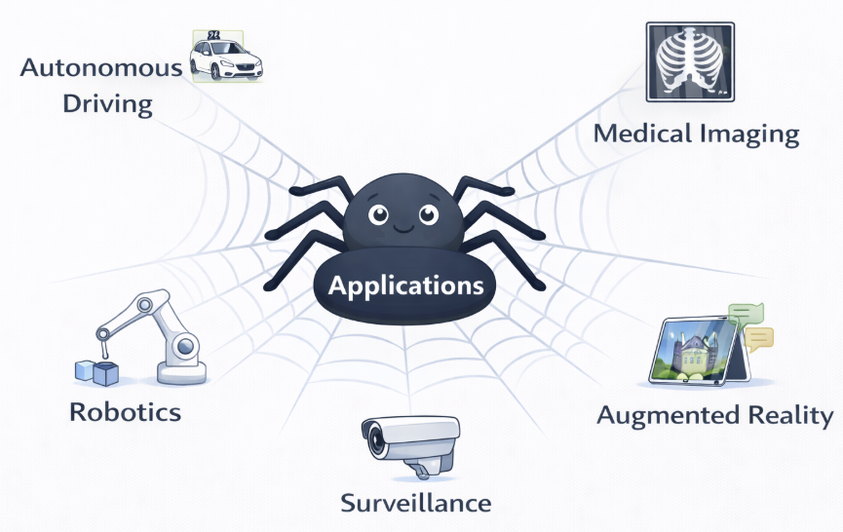
Why Object Detection & Segmentation Matter
Notes:
Detection is not just an academic benchmark problem.
It is fundamentally a spatial decision-making problem — and in real-world systems, spatial precision directly translates into consequences.
In autonomous driving, bounding box precision is not cosmetic — it is safety-critical.
A few pixels of localization error at 100 km/h can translate into meters of physical misinterpretation in the real world.
The system must estimate:
Object class
Distance
Velocity
Spatial extent
A loose bounding box might merge two pedestrians.
An inaccurate box might underestimate a cyclist’s width.
Detection errors here propagate into planning and control.
In medical imaging, segmentation is not just visualization.
Pixel-level masks define:
Tumor boundaries
Organ contours
Surgical margins
A small spatial error can:
Misestimate tumor volume
Affect radiation dosage
Change surgical decisions
Here, segmentation accuracy directly affects clinical outcomes.
In robotics, spatial reasoning determines physical interaction.
A robot does not just need to know what an object is.
It must know:
Where exactly to grasp
Which surface is accessible
Which pixels correspond to contact regions
Bounding boxes are often insufficient.
Pixel-level masks provide geometry-aware interaction cues.
A few pixels of error can mean a failed grasp.
Notice the pattern.
As we move from classification to detection to segmentation,
we are increasing the model’s responsibility for spatial structure.
This is no longer about labels.
It is about geometry.
These tasks require:
Dense spatial alignment
Multi-scale reasoning
Precise localization
Structured output modeling
And that is why modern architectures must move beyond simple classification pipelines.

Slide 5
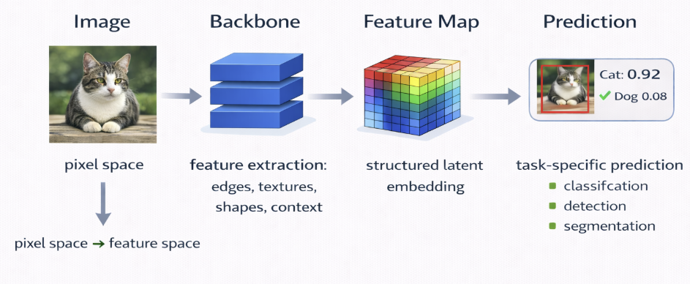
Modern Vision Architecture
Notes:
Before we dive into specific models — CNNs, Vision Transformers, DETR, or SAM — I want you to notice something fundamental.
Despite their architectural differences, all modern vision systems follow the same high-level structure.
They consist of two core components:
A backbone and a head.
Let’s start at the top.
We begin with an image — a tensor in pixel space.
The backbone transforms this raw image into a learned representation.
Formally, it maps:
pixel space → feature space.
The backbone’s job is not to classify, detect, or segment.
Its job is to extract structure.
It learns spatial patterns:
edges, textures, shapes, parts, context.
It compresses the image spatially,
while expanding it semantically.
By the time we reach the feature map,
we are no longer working with RGB pixels.
We are working with a structured latent embedding of the scene.
Now comes the second component: the head.
The head is task-specific.
It takes the feature map and converts it into predictions.
For classification:
the head outputs a single probability vector.
For detection:
the head outputs bounding boxes and class labels.
For segmentation:
the head outputs dense pixel-level masks.
The backbone is shared across tasks.
The head defines what the system is trying to accomplish.
This separation is powerful.
It allows us to:
• Swap CNN backbones for ViT backbones
• Replace anchor-based detection heads with transformer-based heads
• Attach segmentation decoders
• Scale models without redesigning everything
When we say:
‘CNN vs ViT’
we are usually talking about the backbone.
When we say:
‘Faster R-CNN vs DETR vs Mask2Former’
we are often talking about how the head produces structured predictions.
So today, as we explore modern detection and segmentation systems, keep this abstraction in mind.
Every model we discuss fits inside this pipeline:
Image → Backbone → Feature Map → Head → Prediction.
Understanding this separation gives us a clean mental framework to reason about architectural design.
Once you understand the backbone–head structure,
you understand the organizing principle of modern computer vision.

Slide 6
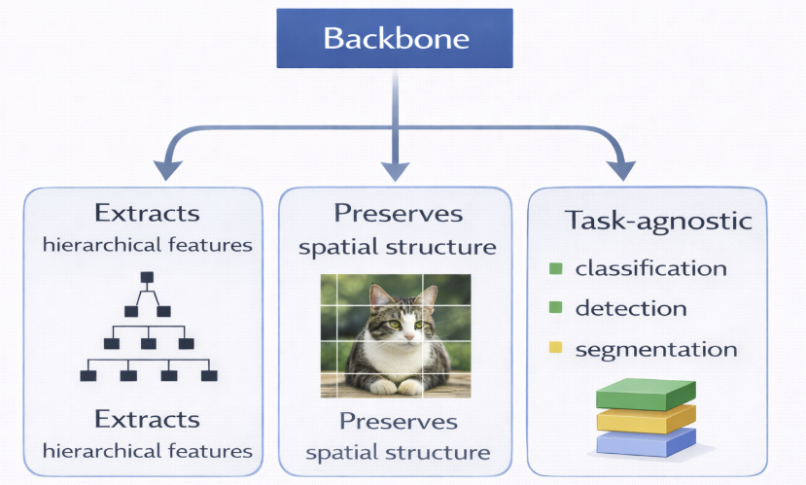
What is a Backbone?
Notes:
This figure summarizes what a backbone does.
It extracts hierarchical features,
preserves spatial structure,
and remains task-agnostic.
In simple terms:
it converts raw pixels into a structured feature representation.
Now let’s formalize that mathematically.

Slide 7
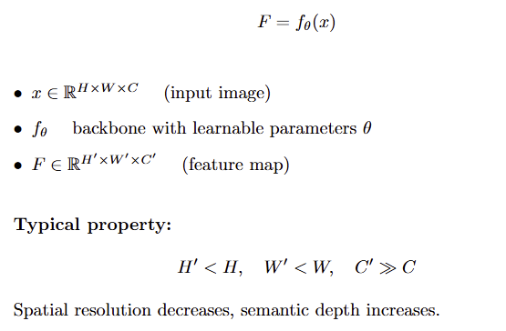
What is a Backbone?
Notes:
“Now let’s connect the math to this diagram.
Mathematically, we wrote:
F equals f_theta of x.
Here, x is the input image.
More precisely,
x belongs to R to the power H by W by C.
R simply means real numbers —
so the image is just a 3-dimensional tensor of real values:
height, width, and channels.
Now look at the diagram.
👉 (Point to the cat image)
This image here — that is x.
Now, f_theta is the backbone —
all the learnable parameters inside it.
👉 (Point to the blue ‘Backbone’ block at the top)
This entire module — whether it’s a CNN or a Vision Transformer —
that is f_theta.
It contains all the filters, attention weights, projections —
everything that is learned.
Now the output is F.
👉 (Point to the three boxes below)
What does F represent?
It is what enables these three properties:
First — hierarchical feature extraction.
Second — preservation of spatial structure.
Third — task-agnostic representation.
All of that together is the feature map F.
Formally, F belongs to R to the power H-prime by W-prime by C-prime.
And notice the typical property:
H-prime and W-prime are smaller than H and W —
so spatial resolution decreases.
But C-prime is much larger than C —
so semantic depth increases.
We compress geometry
and expand meaning.
And here’s the key point:
👉 (Point to “Task-agnostic”)
F is not a prediction.
It doesn’t yet know whether we are doing classification, detection, or segmentation.
It is just a rich spatial representation.
To actually solve a task,
we need another function.
That function is the head.”

Slide 8
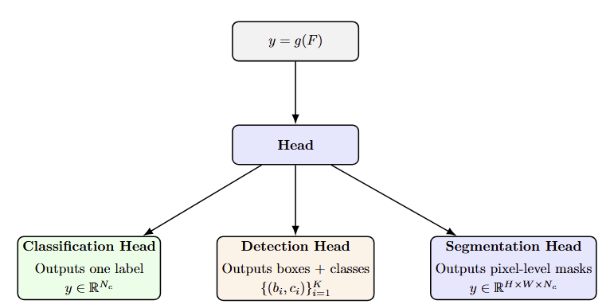
What is a Head?
The back bone encodes the world. The head defines the question.
y=g(fθ​(x))
Notes:
🎤 Script — Head Slide (Following the Backbone Slide)
“On the previous slide, we formalized the backbone as:
F = f_theta(x)
The backbone extracts structure from pixels and produces a feature map FFF.
But that feature map is not the final output.
Now we focus on the second function in the composition:
y=g(F)
Look at the top of this slide.
That equation represents the head.
The head is the task-specific mapping from representation space to prediction space.
Now visually, you can see the structure.
At the center, we have the Head block.
And from that block, three branches emerge.
This diagram emphasizes something important:
The backbone is shared.
The head defines the task.
🔹 Classification Head (Left)
If we choose a classification head, the output is:
y∈RNcy \in \mathbb{R}^{N_c}y∈RNc​
This is a vector of class scores.
The spatial feature map is collapsed into a single global representation.
Typically using:
Global average pooling
Fully connected layers
There is no localization here.
We are asking:
‘What is in this image?’
🔹 Detection Head (Middle)
Now look at the detection branch.
The output becomes structured
Instead of a single vector, we now predict a set of objects.
Each object has:
bib_ibi​: bounding box coordinates
cic_ici​: class label
KKK: number of predicted objects
This head must preserve spatial alignment.
We are now asking:
‘What objects are present, and where are they?’
The output space becomes more complex.
🔹 Segmentation Head (Right)
Now the right branch increases complexity further.
y∈RH×W×Ncy \in \mathbb{R}^{H \times W \times N_c}y∈RH×W×Nc​
The head outputs a dense spatial map.
Every pixel receives a prediction.
We are now asking:
‘Which exact pixels belong to each class?’
This is no longer global or structured prediction —
it is dense prediction.
🔹 Connecting to the Previous Slide
So if we combine both slides:
y=g(fθ(x))y = g(f_\theta(x))y=g(fθ​(x))
The backbone encodes the world.
The head defines the question.

Slide 9
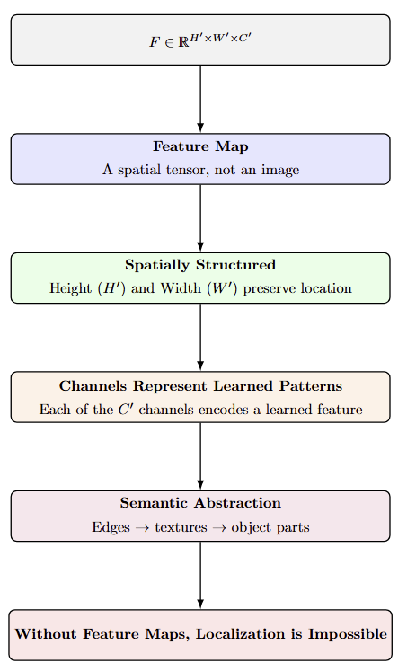
What is a Feature Map?
Notes:
On the previous slide, we decomposed the full system as:
y=g(fθ(x))y = g(f_\theta(x))y=g(fθ​(x))
We said the backbone produces a feature representation:
F=fθ(x)F = f_\theta(x)F=fθ​(x)
And the head maps that representation into predictions:
y=g(F)y = g(F)y=g(F)
Now, this slide focuses on the object in the middle.
The feature map FFF.
Formally, we defined:
}F∈R^H′×W′×C′
Let’s interpret that carefully.
This is no longer an image.
It is not RGB values anymore.
It is a spatial tensor.
The first two dimensions, H prime and W prime, preserve spatial structure.
Even though resolution may shrink compared to the original image,
each location (i,j)(i, j)(i,j) in the feature map still corresponds to a region in the input image.
That spatial alignment is critical.
Without it, detection and segmentation would be impossible.
Now look at the third dimension: C prime′.
These are not color channels.
They are learned feature channels.
Each channel represents a learned pattern detector.
In CNNs, one channel might respond strongly to vertical edges.
Another might activate for texture.
Another for object parts.
In deeper layers, channels encode increasingly abstract patterns.
So instead of three channels for red, green, and blue,
we now have dozens or hundreds of semantic channels.
This is why we say a feature map provides semantic abstraction.
As we move deeper into the backbone:
Edges → textures → shapes → object parts.
The geometry is compressed,
but meaning is expanded.
So the feature map is the bridge.
It preserves spatial structure.
It encodes semantic abstraction.
And it is entirely learned through parameters θ\thetaθ.
Without this intermediate representation,
there is nothing meaningful for the head to operate on.
The head does not see pixels.
It sees features.
And the quality of those features determines how well the system performs classification, detection, or segmentation

Slide 10
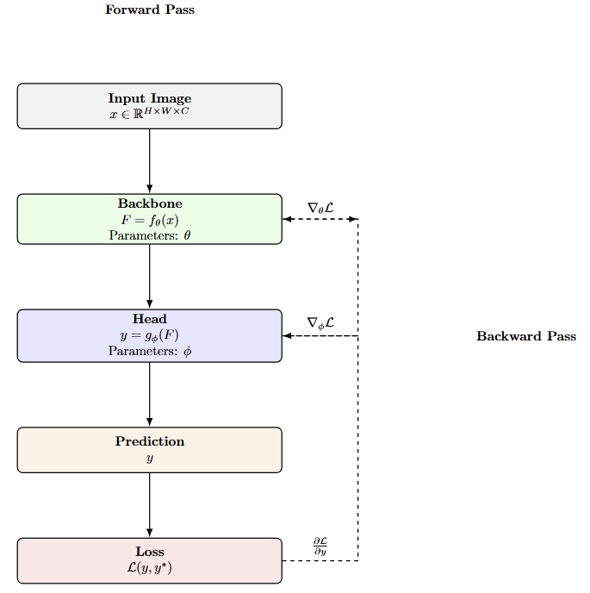
What is End-to-End Learning?
Notes:
Let’s walk through this carefully.
On the left, we see the forward pass.
We start with the input image xxx.
The backbone, parameterized by θ\thetaθ, transforms it into features:
F=fθ(x)F = f_\theta(x)F=fθ​(x)
The head, parameterized by ϕ\phiϕ, produces predictions:
y=gϕ(F)y = g_\phi(F)y=gϕ​(F)
Then we compute the loss:
L(y,y∗)\mathcal{L}(y, y^*)L(y,y∗)
Notice something important.
The loss is computed only at the final prediction.
Not on intermediate features.
Not inside the backbone.
Now look at the right side.
Gradients flow backward.
First through the head — updating ϕ\phiϕ.
Then through the backbone — updating θ\thetaθ.
Both modules are optimized jointly.
That is what makes this system end-to-end.

Slide 11
Classification vs Detection vs Segmentation
Notes:
Coming from slide 1 lets emphasize again on, how output dimensionality increases:
Classification → single vector
Detection → structured set
Segmentation → dense spatial tensor
So the model must reason not just about what is in the image…
…but also where it is.
And that raises a deeper question:
Why is detection so difficult in practice?

Slide 12
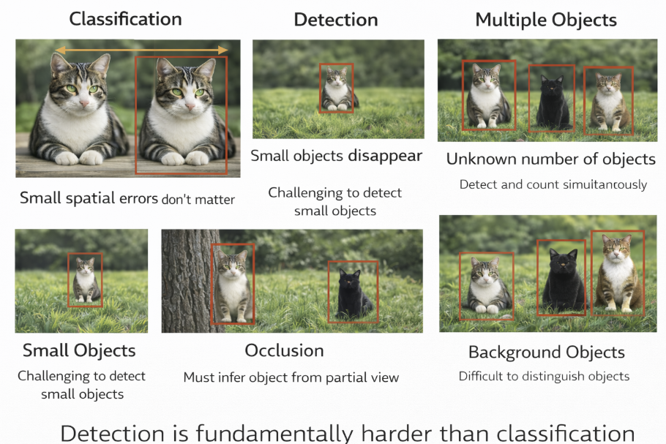
Why Detection Is Hard ?
Notes:
Let’s use this visual to understand why detection is fundamentally harder than classification.
Start with the top left.
In classification, if the cat shifts 5 pixels to the left… nothing changes.
The label is still ‘cat.’
Small spatial shifts don’t affect the outcome.
Now look at the next panel.
In detection, a 5-pixel error in the bounding box changes the overlap with the ground truth.
That directly reduces Intersection-over-Union.
And lower IoU lowers the detection score.
Spatial precision now matters.
Now move to the right.
Small objects.
When the cat is tiny in the frame, it might disappear entirely in deeper feature maps.
Resolution reduction in the backbone can cause small objects to vanish.
Detection must preserve enough spatial detail to recover them.
Next — occlusion.
When part of the cat is hidden behind a tree, the model must infer the object from incomplete evidence.
It must reason about context and partial shapes.
That’s not classification.
That’s spatial inference under uncertainty.
Look at the background-dominant case.
Most pixels in the image are not objects.
They are grass, trees, sky.
Detection must distinguish signal from overwhelming background noise.
This creates severe class imbalance.
And finally — multiple objects.
Detection does not know how many objects exist.
It must localize and count simultaneously.
The output is not a single label.
It is a structured set of predictions.
So what do we learn?
Detection is not classification with a rectangle drawn on top.
It is structured spatial reasoning under uncertainty.
And that is why we need carefully designed backbones and heads.

Slide 13
If Detection Is Hard… How Do We Solve It?
Detection requires:
• Spatial localization
• Structured prediction
• Multi-scale reasoning
• Precise geometry
So how does a model actually do this?
Answer: bounding box prediction!!!!
Notes:
“We’ve seen that detection is fundamentally harder than classification.
The model must:
Decide how many objects exist
Localize them precisely
Handle scale variation
Preserve spatial structure
So the question becomes:
How does a neural network actually predict bounding boxes?
What does it output?
How does it represent geometry?
Let’s zoom into the core mechanism: bounding box prediction.”

Slide 14
Bounding Box (BB) prediction with ViT as a backbone
What Does “Bounding Box Prediction” Mean?

Slide 15
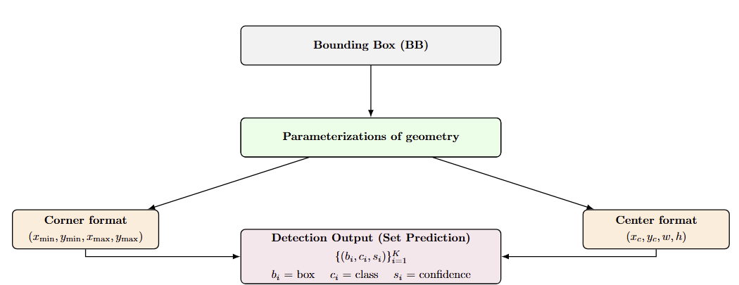
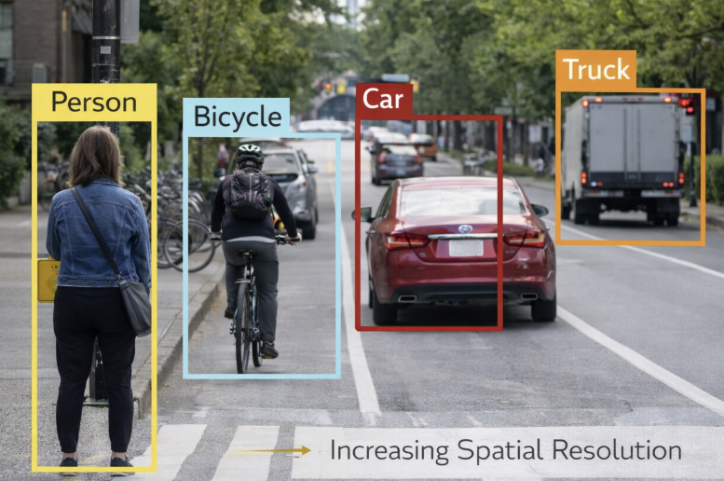
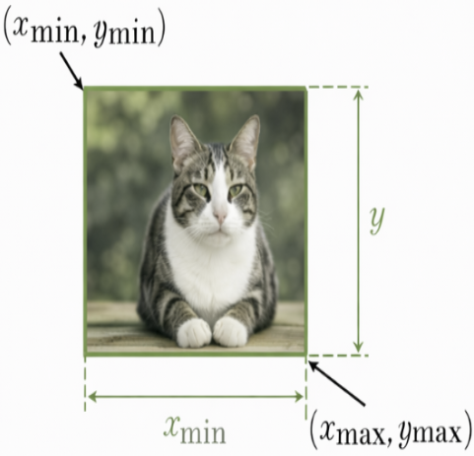
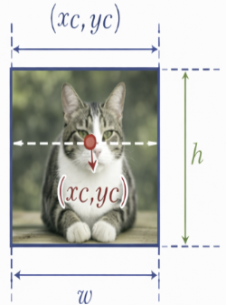
What is a Bounding Box?
Notes:
Let’s now connect the formal definition of bounding boxes with a real detection example.
we define a Bounding Box as a rectangular localization of an object.
Mathematically, it is simply a parameterized rectangle.
There are two equivalent ways to represent that rectangle.
Corner format:
(xmin​,ymin​,xmax​,ymax​)
This directly specifies the top-left and bottom-right corners.
It is intuitive and easy for IoU computation.
Center format:
(xc​,yc​,w,h)
This represents the center coordinate and box dimensions.
This format is often more stable for regression,
because the model predicts offsets relative to a reference.
Now look at the street-scene image.
Each colored rectangle corresponds to one predicted bounding box.
Each box is associated with:
• A class label (Person, Bicycle, Car, Truck)
• A confidence score
So detection output is not a single value.
It is a structured set:
{(bi,ci,si)}i=1K\{(b_i, c_i, s_i)\}_{i=1}^{K}{(bi​,ci​,si​)}i=1K​
Where:
bib_ibi​ = bounding box
cic_ici​ = class label
sis_isi​ = confidence score
The model must:
Decide how many objects exist
Predict box geometry
Assign a class
Estimate confidence
That is significantly more complex than classification.”

Slide 16
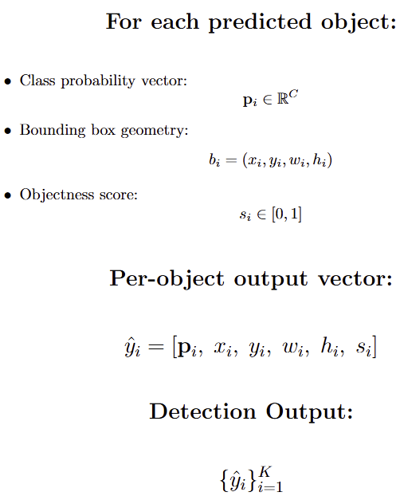
Detection as Structured Vector Prediction
Notes:
Let’s carefully unpack what this slide is saying.
At the top, we define what the model predicts for each detected object.
This is important — detection does not produce a single output.
It produces a structured vector per object.
First component:
pi∈RC\mathbf{p}_i \in \mathbb{R}^{C}pi​∈RC
This is the class probability vector.
It is not a single label.
It is a distribution over all CCC classes.
Each element represents:
P(class c∣object i)P(\text{class } c \mid \text{object } i)P(class c∣object i)
So even if we later choose the highest probability class, the model internally reasons probabilistically.
Second component:
bi=(xi,yi,wi,hi)b_i = (x_i, y_i, w_i, h_i)bi​=(xi​,yi​,wi​,hi​)
This is the bounding box geometry.
It encodes spatial localization.
These four values define where the object is and how large it is.
So now we have semantic prediction and spatial prediction combined.
Third component:
si∈[0,1]s_i \in [0,1]si​∈[0,1]
This is the objectness score.
It represents the model’s confidence that an object actually exists at this location.
This is crucial because detection models often predict many candidate boxes.
The objectness score helps filter them.
Now look at the combined vector:
y^i=[pi, xi, yi, wi, hi, si]\hat{y}_i = [\mathbf{p}_i,\; x_i,\; y_i,\; w_i,\; h_i,\; s_i]y^​i​=[pi​,xi​,yi​,wi​,hi​,si​]
This is the full prediction for one object.
It mixes:
• Probabilistic semantics
• Geometric parameters
• Confidence estimation
This is already more complex than classification.
Now comes the most important line:
{y^i}i=1K\{\hat{y}_i\}_{i=1}^{K}{y^​i​}i=1K​
Detection does not output one vector.
It outputs a set of vectors.
And KKK — the number of predicted objects — is unknown and varies per image.
That means the output dimensionality is dynamic.
This is fundamentally different from classification, where:
p∈R^C
is fixed-size.
Detection is structured set prediction.
The model must:
Decide how many objects exist.
Predict each object’s geometry.
Assign a class.
Estimate confidence.
That combination is what makes detection fundamentally harder than classification

Slide 17
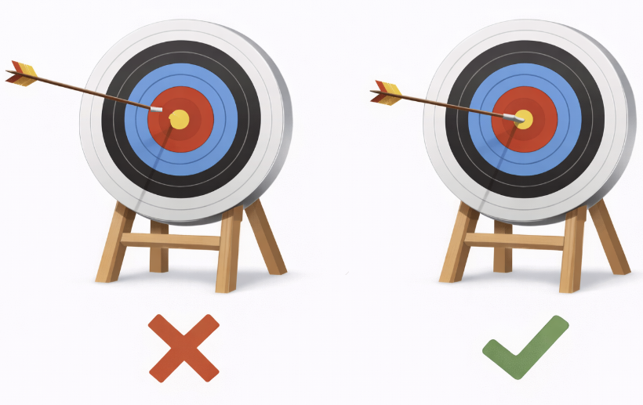
Why Spatial Precision Matters ?
Localization quality measured by IoU:
IoU = Intersection / Union
Small coordinate errors → large IoU drop
Applications:
• Autonomous driving
• Robotics
• Medical imaging
Notes:
Now you may be wondering why are we really pivoting such a complex task why cant we just have results with some errors and why does spatial reasoning really matters here?
In detection, spatial precision is critical.
IoU measures overlap between predicted box and ground truth.
A small shift can dramatically reduce IoU.
Small objects are especially sensitive.
And Detection is geometric reasoning.”
This enables us using of such applications like Medical imgaing, autonomous self driving in cars like teslas and taxis like waymos, AR/VR glasses and alot more even to the metro based safety doors which align with train doors before letting the public board.

Slide 18
Bounding Box (BB) prediction with ViT as a backbone
ViT as a Detection Backbone
Notes:
“So now we understand what we’re predicting.
The next question is:
What kind of backbone produces features that make this possible?
Traditionally, CNNs were used.
But now Vision Transformers are replacing them.”

Slide 19
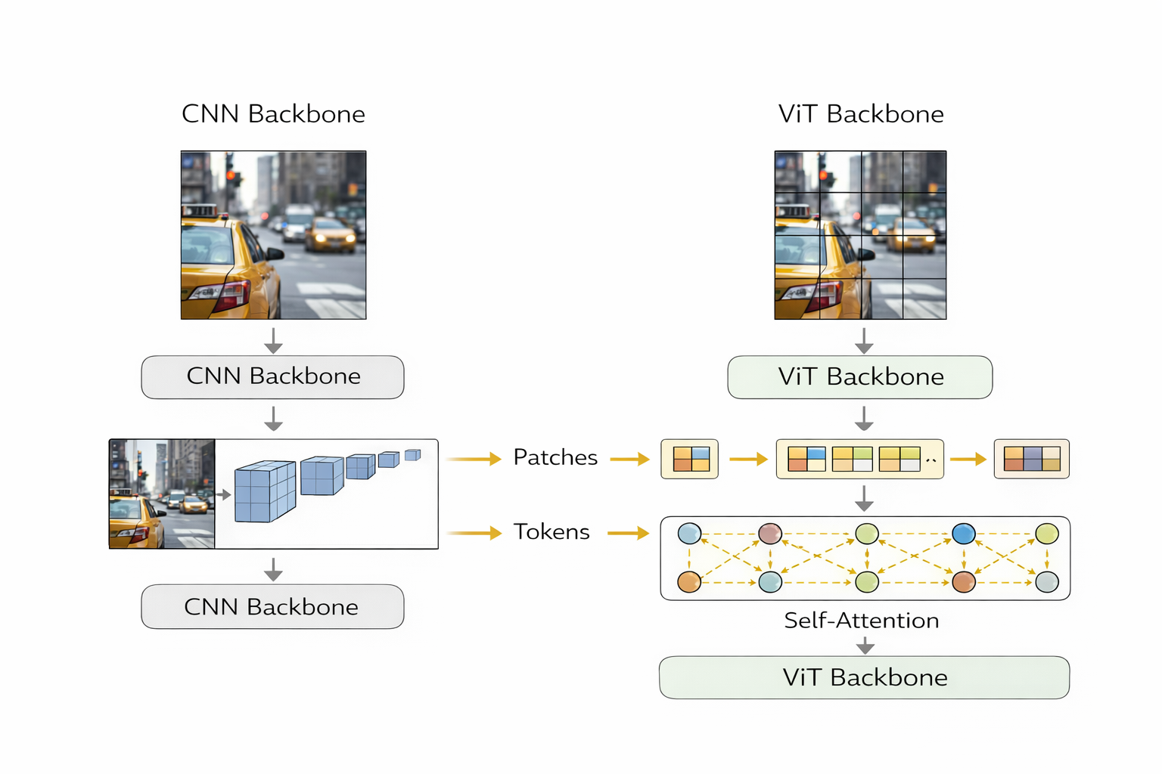
ViT Replacing CNN Backbones
Notes:
(Referring to the first image with CNN vs ViT side-by-side)
🎤 Script — Slide 14 (4 minutes)
“Let’s now look at how Vision Transformers replace traditional CNN backbones.
On the left side of this slide, we see the conventional pipeline.
An image enters a CNN backbone — something like ResNet.
Convolutions extract features using local receptive fields.
Spatial resolution decreases gradually.
Channel depth increases.
Global context emerges slowly as we stack layers.
That’s the hierarchical convolutional paradigm.
Now look at the right side.
Instead of applying convolutions, the Vision Transformer takes a different approach.
The image is first split into fixed-size patches.
Each patch is flattened and projected into an embedding vector.
That embedding becomes a token.
So instead of a 2D grid of pixels, we now have a sequence of tokens.
Then these tokens are processed by self-attention.
And this is the critical difference:
Every patch can attend to every other patch.
From the very first layer.
This means global context is available immediately.
CNNs build global context gradually.
Transformers model it directly.
So the architectural shift is:
From local filtering
to global token interaction.
That’s why ViTs can serve as powerful modern backbones.
“But this raises an important question.
If the transformer outputs tokens — not feature maps —
How do we use it for detection?
Detection heads expect spatial feature maps.
So how do tokens become spatial features?
Let’s look at that next.”

Slide 20
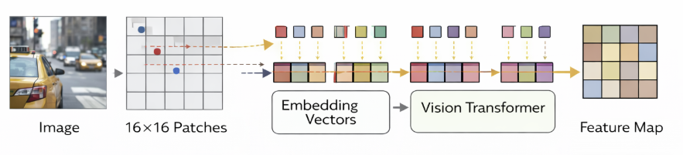
Patch Tokens → Spatial Features
Notes:
(Referring to the second image: Image → Patches → Embeddings → Transformer → Feature Map)
🎤 Script — Slide 15 (3 minutes)
“Here’s the key idea.
Although the Vision Transformer internally operates on tokens,
those tokens still correspond to spatial patches.
Start on the left.
The image is divided into 16×16 patches.
For a 224×224 image, that produces 14×14 patches.
Each patch is flattened and projected into an embedding vector.
That vector becomes a token.
Now look at the center.
The tokens are processed by transformer layers.
Self-attention allows interaction across all patches.
But importantly —
we do not lose spatial identity.
Because we add positional embeddings.
Each token still knows where it came from in the image.
Now look at the right side.
After the transformer layers, the sequence of tokens can be reshaped back into a 2D grid.
This is now a spatial feature map.
So even though the transformer works on sequences internally,
we can recover a spatial representation.
And that means:
ViT can function exactly like a CNN backbone.
It produces structured spatial features.
And those features can be passed directly to detection heads.”

Slide 21
Strengths & Weaknesses of ViT
Strengths:
• Global context from start
• Strong long-range modeling
• Scales well with data
Weaknesses:
• Data-hungry
• Less inductive bias
• Struggles with small objects (naively)
Notes:
“ViT sees the entire image at once.
This is powerful for context.
But it lacks built-in locality bias.
Small objects can disappear if patch size is large.”

Slide 22
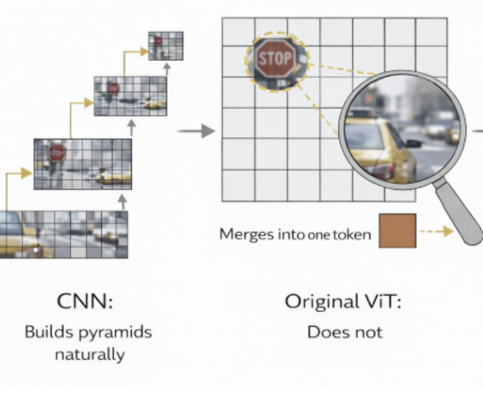
Why Naive ViT Struggles with Small Objects
Notes:
🎤 Script — Explaining the Figure Clearly
“Let’s carefully walk through this figure from left to right.
🔹 Left: CNN — Builds pyramids naturally
On the left side, you see the CNN pipeline.
Notice how the feature maps progressively shrink in spatial resolution.
Each downsampling stage creates a feature pyramid:
High resolution → captures small details
Medium resolution → captures mid-scale patterns
Low resolution → captures large objects
This means CNNs naturally preserve multi-scale information.
Small objects remain visible in early high-resolution layers.
That’s why CNN backbones work well for detection.
🔹 Middle: Original ViT — No hierarchy
Now look at the middle panel.
This shows the original Vision Transformer.
The image is split into fixed-size patches — for example, 16×16.
If an object — like the stop sign — is smaller than the patch size…
…it gets merged into a single token.
You can see that here.
The stop sign is absorbed into one square patch.
Fine spatial boundaries vanish.
The token represents the entire patch region, not the object precisely.
That means:
Small objects lose detail
Boundaries become coarse
Localization becomes harder
ViT treats all patches at the same resolution.
There is no progressive pyramid.
There is no higher-resolution branch for small objects.
No lower-resolution branch for large objects.
Everything is processed at the same spatial granularity.
🔹 Key Insight (Pause for emphasis)
“If an object is smaller than the patch size,
it is merged into one token.
Fine spatial boundaries vanish.”
This is fundamentally different from CNNs.
CNNs build pyramids naturally.
Original ViT does not.
🔹 Why This Matters for Detection
Detection requires:
Precise localization
Multi-scale reasoning
Preservation of small object detail
A single-resolution architecture is insufficient.
That is why hierarchical transformers like Swin were introduced.
And why multi-scale feature pyramids remain essential in detection. Which we are going to learn about in the coming slides

Slide 23
Bounding Box (BB) prediction with ViT as a backbone
Feature Pyramids with Transformers

Slide 24
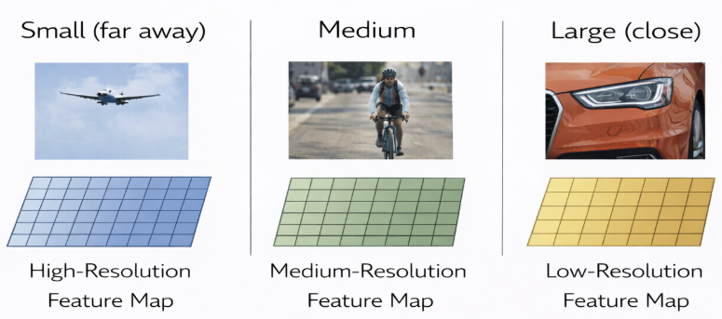
Why Multi-Scale Features Are Needed
Objects appear at different scales:
• Small (far away)
• Medium
• Large (close)
Single resolution is insufficient.
Notes:
Before jumping on Swin like transformers, lets look at the problem at large
“Small objects require high-resolution features.
Large objects benefit from deeper semantic abstraction.
Detection requires multi-scale representation.”

Slide 25
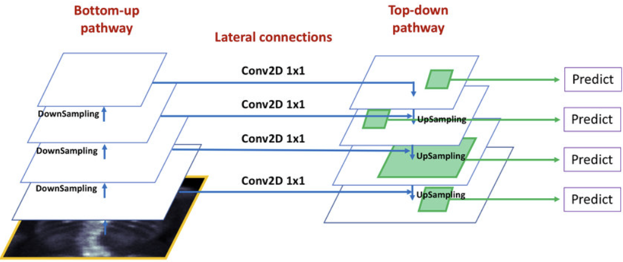
CNN Feature Pyramid Network (FPN)
Notes:
🎤 Flow Script — CNN Feature Pyramid Network (FPN)
“On the previous slide, we talked about why multi-scale features are necessary.
Objects appear at different sizes in an image.
Small objects require high spatial resolution.
Large objects require strong semantic context.
A single feature map cannot effectively handle both.
So how do CNN-based detectors solve this problem?
They use something called a Feature Pyramid Network — or FPN.
Let’s walk through the diagram from left to right.
On the left side, we see the bottom-up pathway.
This is simply the standard CNN backbone, like ResNet.
As we go deeper in the network, spatial resolution decreases because of downsampling.
But at the same time, semantic richness increases.
Early layers contain fine-grained spatial details but weak semantic meaning.
Deeper layers contain strong semantic information but very coarse spatial resolution.
This natural CNN hierarchy creates multiple scales — but they are imbalanced.
Deep layers are too coarse for detecting small objects.
Shallow layers are not semantically strong enough to classify objects confidently.
So we need a way to combine them.
Now look at the middle of the diagram — the lateral connections.
These are 1×1 convolutions.
They don’t change spatial resolution.
They simply align the channel dimensions so features can be merged cleanly.
Think of them as adapters that prepare feature maps for fusion.
Now look at the right side — the top-down pathway.
This is where the key idea happens.
We start from the deepest, most semantic feature map.
We upsample it — increasing its spatial resolution.
Then we add it to the corresponding feature map from the bottom-up pathway.
So at each level, we are combining:
High-level semantic information
with
High-resolution spatial detail.
This produces a new set of feature maps — often called P2, P3, P4, P5.
Each of these feature maps is now both semantically strong and spatially precise.
Finally, look at the far right of the diagram.
Each pyramid level makes its own prediction.
High-resolution levels detect small objects.
Lower-resolution levels detect large objects.
This is how FPN makes detection scale-aware.
So if the previous slide asked the question,
It combines resolution and semantics in a structured way.
And that’s why Feature Pyramid Networks became a foundational component in modern object detection systems.
But now let’s ask a deeper question.
What happens when we replace the CNN backbone with a Vision Transformer?
Transformers were not originally designed with spatial hierarchies.
The original ViT operates on fixed-size patches.
All tokens are processed at the same resolution.
There is no natural multi-scale pyramid.
No progressive downsampling stages.
No built-in hierarchy.
So if we directly plug a vanilla ViT into a detection framework,
we lose something important:
The multi-scale structure that FPN relies on.
This creates a new challenge.
How do we build hierarchical, multi-scale representations inside a Transformer?
How do we preserve the benefits of global attention
while also introducing scale awareness?
That question led to the development of hierarchical Transformers —
architectures like Swin Transformer.
Instead of processing all patches at one resolution,
they introduce patch merging,
progressive downsampling,
and window-based attention.
In other words,
they bring the idea of pyramids
into the transformer world.
So next, we’ll look at how Transformer-based pyramids are constructed —
and how they differ from CNN-based FPN.”

Slide 26
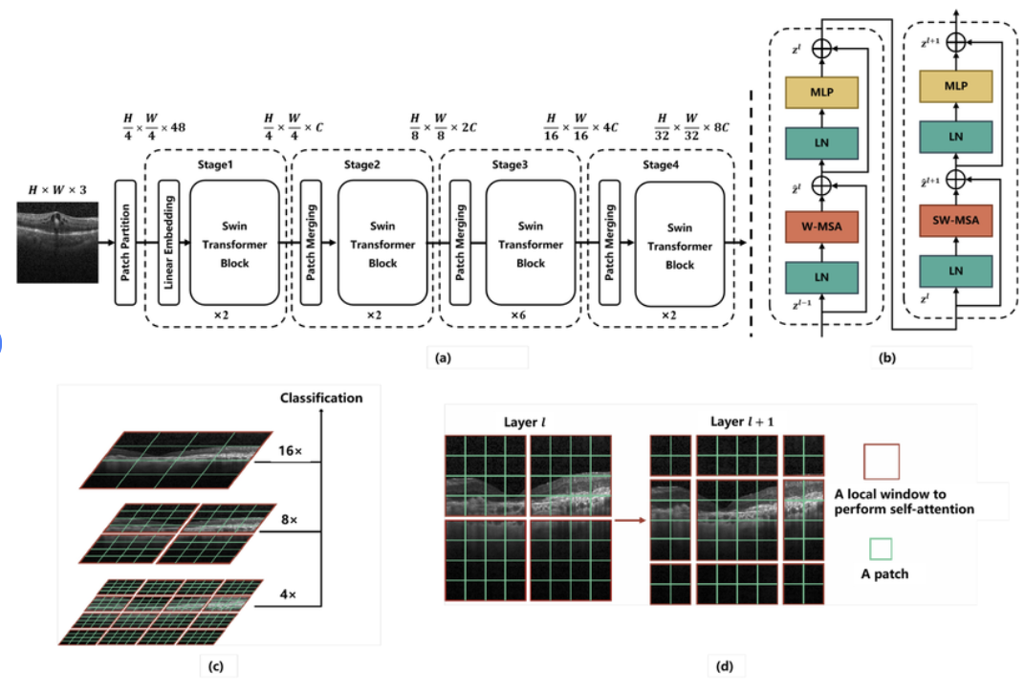
Transformer-Based Pyramids: Swin
Notes:
🎤 Script — Swin Transformer (Continuing from FPN)
“On the previous slide, we saw how CNNs solve the multi-scale problem using Feature Pyramid Networks.
CNN backbones naturally produce hierarchical feature maps.
FPN then combines high-resolution spatial features with deep semantic features.
But now we ask:
If we replace the CNN backbone with a Transformer,
how do we recover this hierarchical structure?
That’s exactly what Swin Transformer was designed to address. The research paper was established by group of researchers from MSR-asia
Let’s walk through this figure.
🔹 (a) Overall Architecture
Start at part (a).
This shows the full Swin Transformer backbone.
Just like ViT, we begin with patch partitioning.
The image is divided into non-overlapping patches.
These are linearly embedded into tokens.
But here’s the key difference from vanilla ViT:
Swin introduces multiple stages.
Between stages, we perform patch merging.
This reduces spatial resolution while increasing channel dimension.
So the representation evolves like this:
H/4→H/8→H/16→H/32H/4 \rightarrow H/8 \rightarrow H/16 \rightarrow H/32H/4→H/8→H/16→H/32
Exactly like a CNN backbone.
This means Swin naturally produces multi-scale feature maps.
Unlike vanilla ViT, we no longer have uniform resolution throughout the network.
Hierarchy is built directly into the architecture.
This mirrors what FPN was trying to construct on top of CNNs.
🔹 (b) Swin Transformer Block
Now look at part (b).
This shows two successive Swin Transformer blocks.
Each block consists of:
Layer Normalization
Window-based Multi-Head Self-Attention (W-MSA)
MLP
Residual connections
The first block uses regular window attention.
The second uses shifted window attention.
We’ll see why that matters in a moment.
The important idea here is:
Attention is restricted to local windows.
This makes computation efficient.
Instead of global attention over all tokens,
we compute attention within small regions.
🔹 (c) Hierarchical Multi-Scale Representation
Now look at part (c).
This illustrates the pyramid.
At higher resolutions, feature maps are larger spatially.
As we go deeper:
Resolution decreases.
Semantic abstraction increases.
Just like CNNs.
So Swin builds a feature pyramid internally.
This means that for detection tasks,
we already have multi-scale representations.
We don’t necessarily need to rely on an external FPN
to create the hierarchy.
Swin embeds the pyramid directly into the Transformer.
🔹 (d) Shifted Window Strategy
Now look at part (d).
This is the key innovation.
In one layer, attention is computed within fixed local windows.
In the next layer, those windows are shifted.
Why is this important?
If windows were fixed permanently,
tokens in different windows would never interact.
Shifting the windows allows cross-window communication.
So although attention is local per layer,
information propagates globally across layers.
This maintains efficiency
while enabling global reasoning.
But there is still a limitation.
Even in Swin, attention is computed only within the same scale.
Each stage operates independently at its resolution.
There is no explicit attention mechanism that allows
a token at high resolution
to directly attend to a token at low resolution.
Information flows sequentially —
through patch merging —
not interactively across scales.
And this becomes important for detection.
Because detection is inherently cross-scale.
Consider a small object next to a large object.
The small object needs fine spatial detail.
The large object provides contextual cues.
Ideally, features at different scales should communicate directly.
But hierarchical Transformers like Swin do not perform cross-scale attention.
They build scales — but they don’t let scales attend to each other.
This is where cross-attention-based transformer pyramids come in.
Instead of treating each scale separately,
we allow:
High-resolution tokens
to attend to
low-resolution tokens.
And vice versa.
This enables direct multi-scale interaction.
Now scale interaction becomes learnable —
not just sequential.
So the question becomes:
How do we design attention mechanisms
that operate not just within a scale —
but across scales?
That leads us to cross-attention transformer pyramids.”

Slide 27
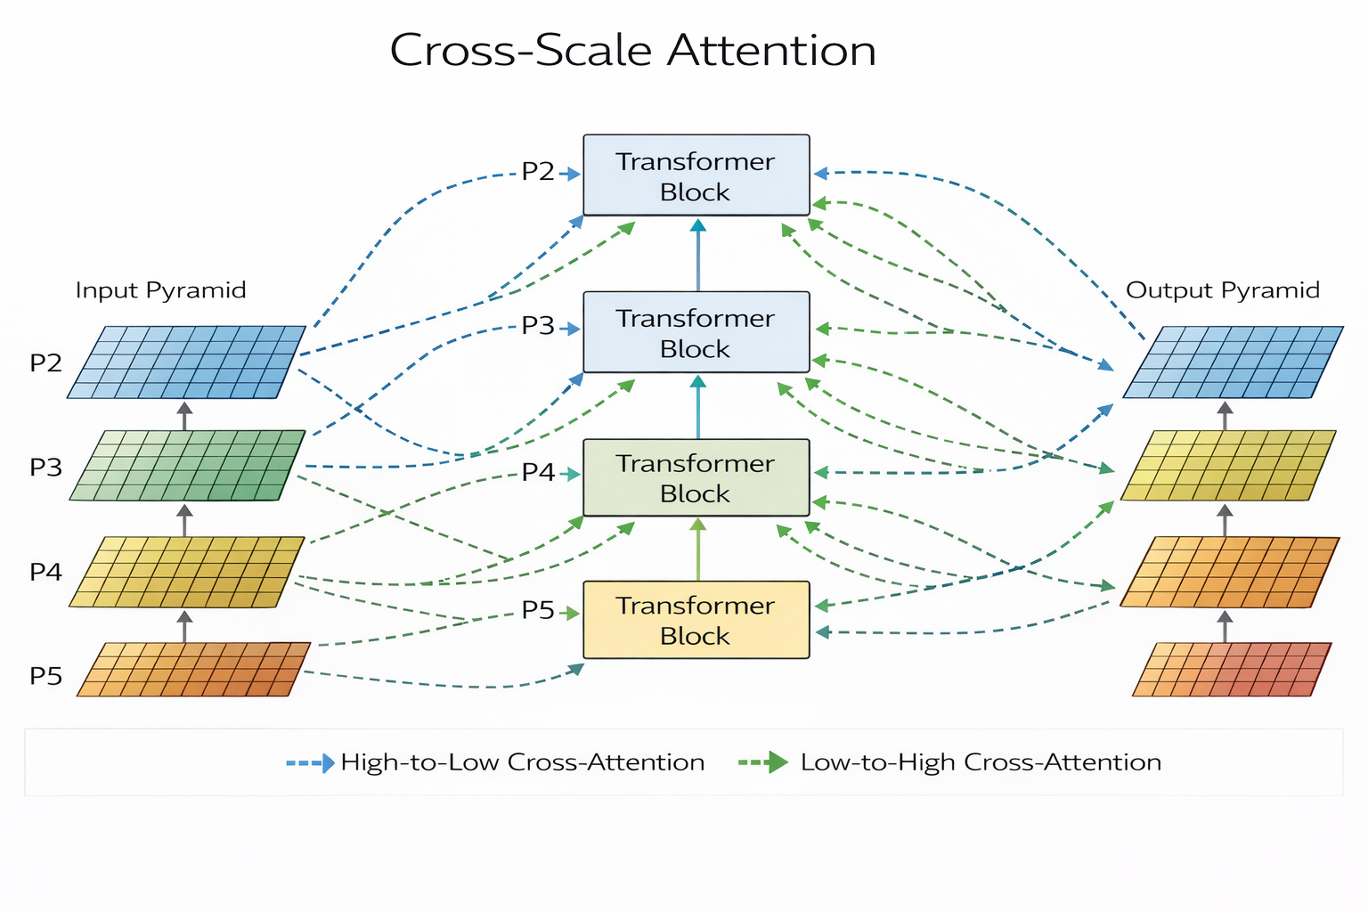
Transformer-Based Pyramids: Cross scale attention
Notes:
🎤 Script — Transition from Swin → Cross-Scale Attention
“On the previous slide, we saw that Swin Transformer introduces hierarchy.
It builds a pyramid using patch merging.
It performs local window attention.
And shifted windows allow cross-window communication.
But there is still a limitation.
Attention happens within the same scale.
Stage 2 does not directly attend to Stage 4.
Information flows sequentially through merging.
Now look at this diagram.
This is cross-scale attention.
On the left, we see a feature pyramid — P2, P3, P4, P5 — just like FPN.
Each level has a different spatial resolution.
In Swin, each level would process tokens independently.
But here, something different happens.
Look at the dashed arrows.
Blue arrows represent high-to-low attention.
Green arrows represent low-to-high attention.
This means:
High-resolution tokens can attend to low-resolution tokens.
Low-resolution tokens can attend to high-resolution tokens.
Now scale interaction is explicit and learnable.
Instead of merging features with fixed addition — like FPN —
we use attention to dynamically weight cross-scale information.
Each Transformer block receives information not only from its own scale,
but from other scales in the pyramid.
This enables:
Small objects to receive global context from coarse scales.
Large objects to refine boundaries using fine-scale detail.
Scale interaction becomes data-driven.
This is fundamentally more flexible than both:
CNN + FPN,
and
Hierarchical Swin.
So if hierarchy gave us multiple scales,
cross-scale attention lets those scales talk to each other.

Slide 28
Bounding Box (BB) prediction with ViT as a backbone
ViT vs CNN Backbones

Slide 29
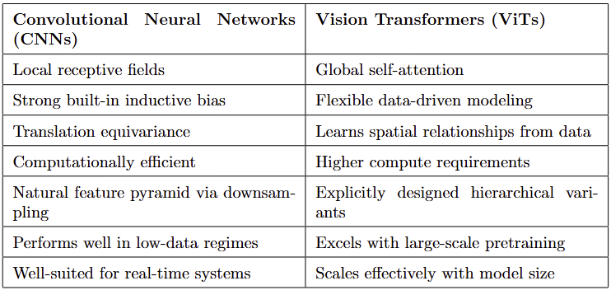
Side-by-Side Comparison
Notes:
“Let’s now step back and compare CNNs and Vision Transformers at a structural level.
This is not about which one is better.
It’s about understanding their design philosophy.
Start with CNNs.
CNNs operate with local receptive fields.
Convolutions process small spatial neighborhoods and build hierarchy gradually.
This gives them strong inductive biases:
Translation equivariance
Locality
Parameter sharing
These biases make CNNs extremely data-efficient.
They perform well even when data is limited.
They are computationally efficient and naturally form feature pyramids through spatial downsampling.
This makes them well-suited for real-time systems and resource-constrained environments.
Now consider Vision Transformers.
ViTs replace convolution with self-attention.
Instead of building context gradually,
each layer can model global interactions directly.
This removes built-in spatial bias.
The model must learn structure from data.
As a result:
ViTs are more flexible.
They scale better with large datasets.
They benefit enormously from large-scale pretraining.
But they are also more compute-intensive.
So the key difference is this:
CNNs encode spatial structure by design.
ViTs learn spatial structure from data.
In low-data regimes, inductive bias helps.
In large-data regimes, flexibility dominates.
That’s why, on very large datasets, ViTs now rival or outperform CNN backbones.
But in constrained settings, CNNs are still extremely competitive.
Architecture choice is contextual.
It depends on scale, compute, and deployment needs

Slide 30
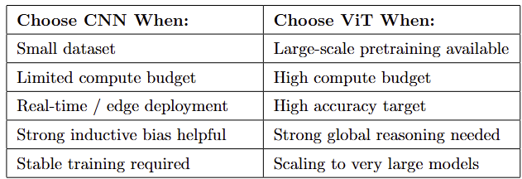
Practical Tradeoffs
Notes:
We’ve now seen how bounding boxes are predicted.
We understand that the head outputs box coordinates and class scores.
And we’ve discussed how Vision Transformers can serve as powerful backbones for detection.
But let’s pause.
Traditional detection pipelines still rely on several engineered components.
They use anchor boxes — predefined templates placed across the image.
They predict offsets relative to those anchors.
And then they apply Non-Maximum Suppression to remove duplicate detections.
So even though the network is learned…
The final system still depends on heuristics:
Anchor design.
IoU thresholds.
Post-processing rules.
This raises a deeper question.
If we truly believe in end-to-end learning…
Why are we still hand-designing anchor boxes?
Why are we manually removing duplicates with NMS?
What if we reformulate detection itself —
not as anchor classification and suppression —
but as direct set prediction?
Instead of predicting thousands of anchor boxes and pruning them…
What if the model directly outputs a set of objects?
No anchors.
No NMS.
No heuristic post-processing.
That conceptual shift leads us to the next evolution in detection:
DETR.
And this is where Kyle will take us

Slide 31
Traditional Detection Pipelines
Anchor-Based Pipelines to Set Predictions

Slide 32



Traditional Detection Pipelines
Anchors
Predefined bounding boxes
Anchors represent potential object regions
Anchors’ size and shape
Proposal Generation
Large numbers of generated anchors
Identification of promising regions
High-probability
regions → class
Non-Max Suppression
Multiple overlapping boxes prediction
Remove duplicate predictions
Optimized manual heuristics

Slide 33
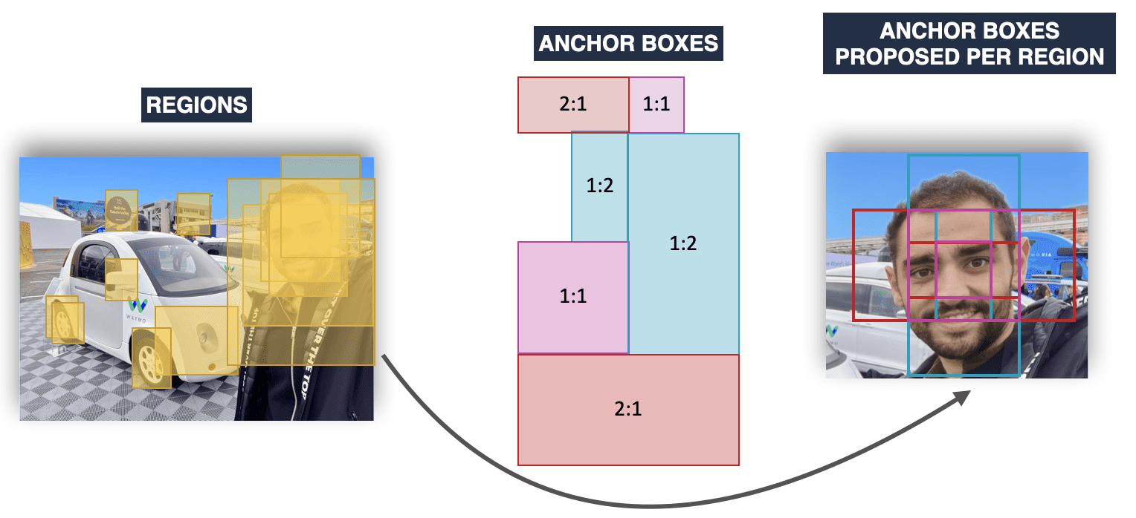
The Anchor-Based Approach (Anchors)
https://www.thinkautonomous.ai/blog/anchor-boxes/

Slide 34
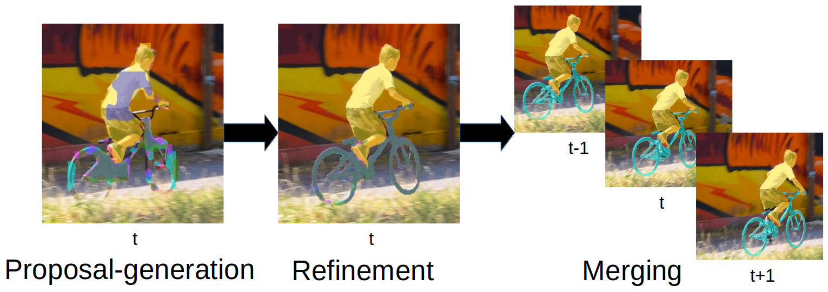
The Anchor-Based Approach (Proposal Generation)
https://www.vision.rwth-aachen.de/publication/00175/

Slide 35
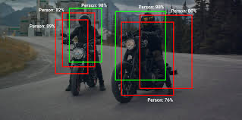
The Anchor-Based Approach (Non-Max Suppression)
https://www.analyticsvidhya.com/blog/2020/08/selecting-the-right-bounding-box-using-non-max-suppression-with-implementation/

Slide 36
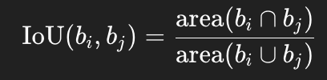


Non-max Suppression Procedure
Step 1 - Compute Overlap
Step 2 - Select Highest Score
Step 3 - Suppress Overlapping Boxes
Step 4 - Repeat
Continue until no boxes remain
Final output:

Slide 37
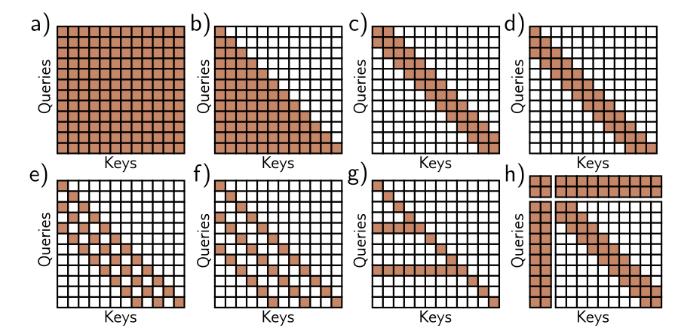
Complexity?
Detection - divided into separate stages
Localization, classification, and filtering
Multiple modules → engineering complexity
Training difficulty increased with pipeline complexity
https://udlbook.github.io/udlbook/

Slide 38
Detection as Set Prediction
A New Paradigm for Object Detection

Slide 39
Modern Detection Architecture
Object
Queries
CNN
Backbone
Transformer
Encoder
Transformer
Decoder
Prediction
Heads

Slide 40
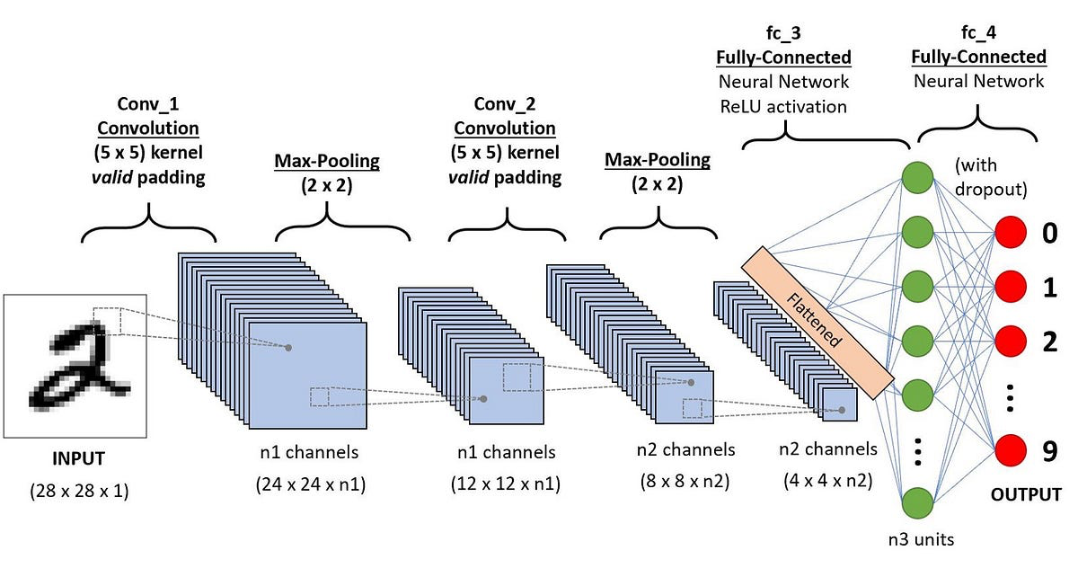
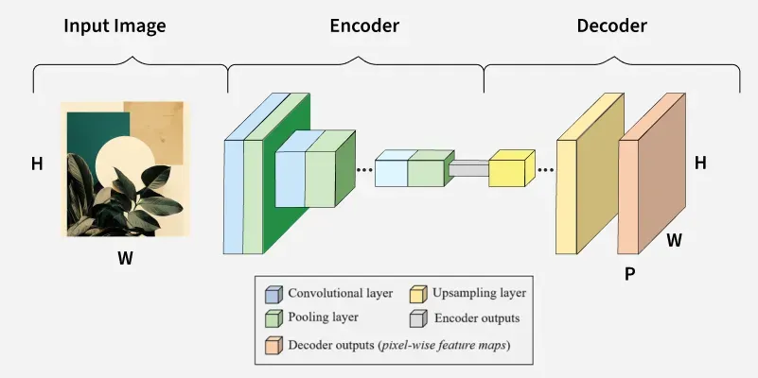
A New Way to Think About Detection
CNN Backbone
Transformer Encoder
https://madhuramiah.medium.com/convolution-neural-network-the-backbone-of-image-classification-ddd2a49a6efa
https://www.geeksforgeeks.org/deep-learning/working-of-encoders-in-transformers/

Slide 41
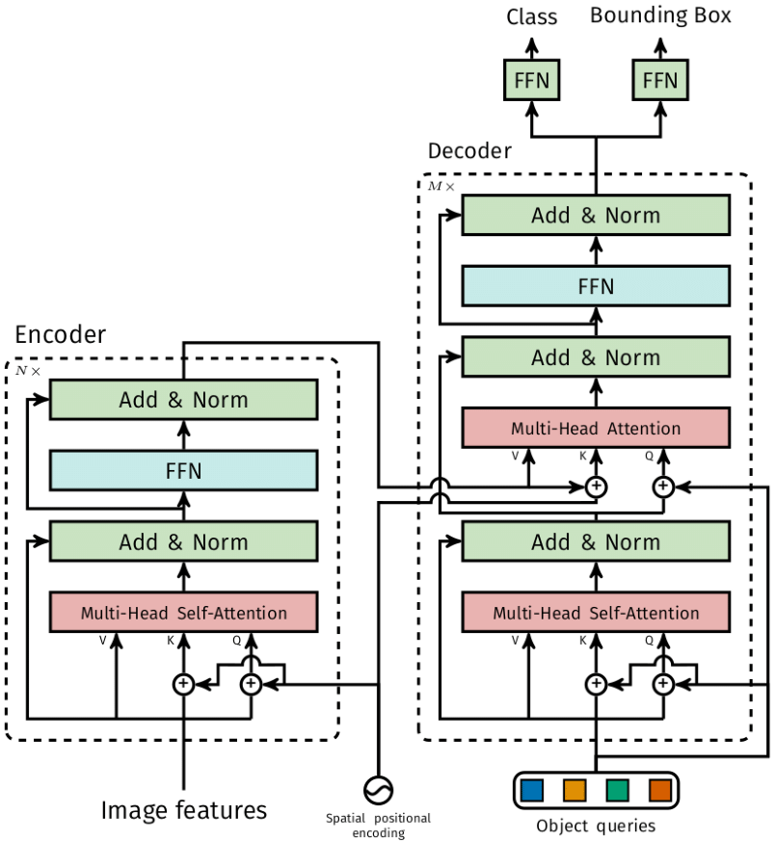
Object Queries: The Core Innovation
https://www.digitalocean.com/community/tutorials/introduction-detr-hungarian-algorithm-1

Slide 42
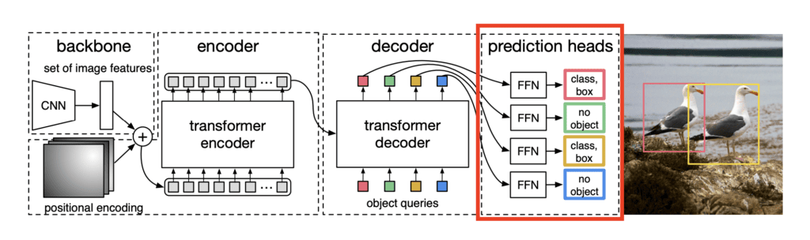
Prediction Heads
https://learnopencv.com/detr-overview-and-inference/

Slide 43
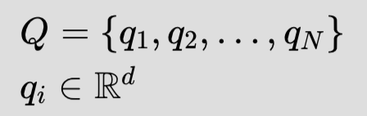
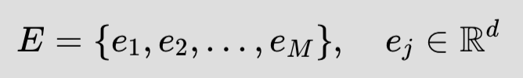

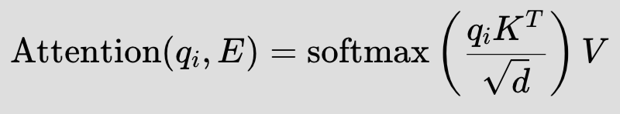

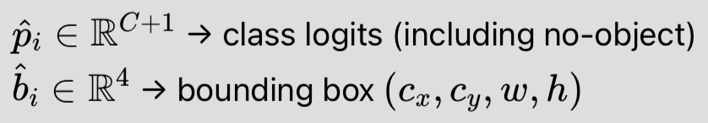
Object Queries: Mathematically
Learnable Query Embeddings |  | Where N = fixed number of object queries (e.g., 100) d = embedding dimension
Encoder Output (Image Representation) |  | Where M = number of image tokens (patches)
Decoder Cross Attention |  | Where K,V are projections of encoder features.
Prediction Heads
Notes:
“On the previous slide, we saw the DETR pipeline visually.
The backbone extracts image features.
The encoder builds a global understanding of the image.
The decoder takes object queries and produces one embedding per query.
Then the prediction heads turn each embedding into either a class and a bounding box — or ‘no object.’
Now let’s explain this mathematically,
1️⃣ Learnable Object Queries
We define:
Q={q1,q2,…,qN},qi∈R^d
What each symbol means:
N = fixed number of object queries (e.g., 100)
qi​ = the i-th query embedding
d = embedding dimension (e.g., 256)
Q = set of learnable object slots
Important:
These queries are parameters, not derived from the image.
They are learned during training.
You can think of them as:
“Object hypotheses waiting to bind to something in the image.”
If the image has only 3 objects, only 3 queries will predict real objects.
The remaining queries will predict “no object.”
2️⃣ Encoder Output (Image Representation)
Now we define:
E={e1,e2,…,eM},ej∈RdE = \{e_1, e_2, \dots, e_M\}, \quad e_j \in \mathbb{R}^dE={e1​,e2​,…,eM​},ej​∈Rd
Symbols:
MMM = number of encoded image tokens (e.g., 196 for 14×14 grid)
eje_jej​ = embedding of image token j
E⊂RdE \subset \mathbb{R}^dE⊂Rd = encoded spatial features
This comes from:
)F=fθ​(x)
Then possibly flattened and passed through a transformer encoder.
So:
xxx = input image
θ\thetaθ = backbone parameters
EEE = structured global representation of the image
Now we have:
Queries Q
Image representation E
The decoder connects them.
3️⃣ Cross-Attention Mechanism
Each query interacts with the encoded image via cross-attention:
zi=Decoder(qi,E)z_i = \text{Decoder}(q_i, E)zi​=Decoder(qi​,E)
More explicitly:
Attention(qi,E)=softmax(qiKTd)V\text{Attention}(q_i, E) = \text{softmax}\left( \frac{q_i K^T}{\sqrt{d}} \right)VAttention(qi​,E)=softmax(d​qi​KT​)V
Where:
K=WKEK = W_K EK=WK​E → key projections of encoder features
V=WVEV = W_V EV=WV​E → value projections
WK,WVW_K, W_VWK​,WV​ → learned projection matrices
ddd → scaling factor for stable gradients
Interpretation
Each query computes similarity with every image token:
αij=softmax(qi⋅kj)\alpha_{ij} = \text{softmax}(q_i \cdot k_j)αij​=softmax(qi​⋅kj​)
This gives attention weights over the entire image.
Then:
zi=∑j=1Mαijvjz_i = \sum_{j=1}^{M} \alpha_{ij} v_jzi​=j=1∑M​αij​vj​
So:
Each query gathers evidence from the whole image.
📌 Concrete Example
Suppose the image contains:
1 dog
1 bicycle
1 person
N=100 queries.
During inference:
Query 7 may attend strongly to the dog region.
Query 42 may attend to the bicycle.
Query 3 may attend to the person.
The other 97 queries output “no object.”
There is no spatial grid constraint.
No anchor boxes.
No predefined candidate locations.
Each query dynamically binds to a region.
4️⃣ Prediction Heads
Each decoded embedding produces:
y^​i​=(p^​i​,b^i​)
Where:
p^i∈RC+1\hat{p}_i \in \mathbb{R}^{C+1}p^​i​∈RC+1
class logits
includes “no object” class
b^i∈R4\hat{b}_i \in \mathbb{R}^4b^i​∈R4
bounding box
typically parameterized as (xc,yc,w,h)(x_c, y_c, w, h)(xc​,yc​,w,h)
So the final detection output is:
{y^i}i=1N\{\hat{y}_i\}_{i=1}^{N}{y^​i​}i=1N​
A fixed-size set of predictions.
5️⃣ Why This Is Fundamentally Different
Traditional detection:
Dense grid predictions
Anchor-based
Heuristic NMS
Many redundant boxes
Transformer detection:
Fixed N object slots
One prediction per slot
Global reasoning via attention
Set-based matching loss
No NMS
Mathematically:
Y^=gϕ(fθ(x))\hat{Y} = g_{\phi}(f_{\theta}(x))Y^=gϕ​(fθ​(x))
But now:
gϕ is permutation-invariant over a set.g_{\phi} \text{ is permutation-invariant over a set.}gϕ​ is permutation-invariant over a set.
That’s the key. Because objects are an unordered set.
Swapping predictions shouldn’t change the result.
That’s what permutation-invariant guarantees.
🧠 Big Conceptual Takeaway
Object queries transform detection into:
Set prediction with learned object slots.\text{Set prediction with learned object slots.}Set prediction with learned object slots.
Instead of asking:
“Which anchor predicts this object?”
We ask:
“Which query claims responsibility for this object?”
That is a fundamental shift in detection philosophy.

Slide 44
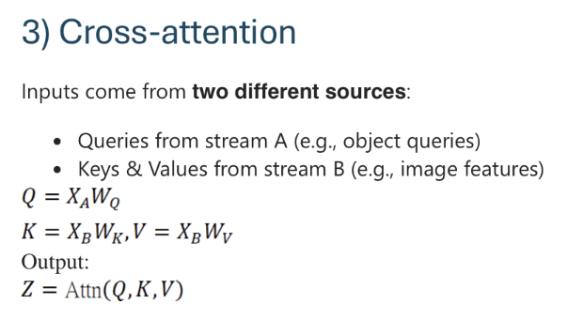
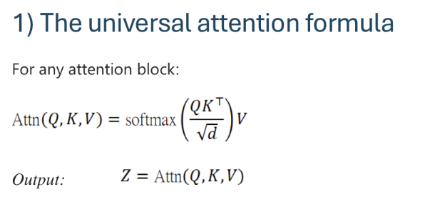
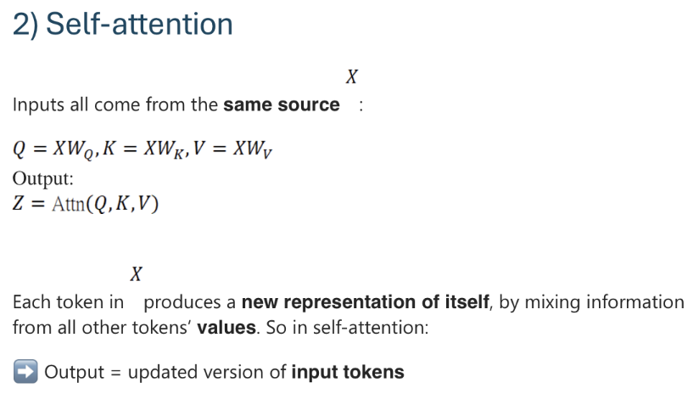
Cross-attention in DETR
Notes:
🎤 Slide 1 — Cross-Attention in DETR (Conceptual Foundation)
“On the previous slide, we introduced object queries.
We said that each query interacts with the encoded image features using cross-attention.
Now let’s slow down and understand what cross-attention actually means.
At the top left, you see the universal attention formula:
Attn(Q,K,V)=softmax(QKTd)V\text{Attn}(Q,K,V) = \text{softmax}\left(\frac{QK^T}{\sqrt{d}}\right)VAttn(Q,K,V)=softmax(d​QKT​)V
This formula is the same everywhere in Transformers.
Everything — self-attention, cross-attention — uses this equation.
The only thing that changes is:
Where do Q, K, and V come from?
1️⃣ Self-Attention (Middle of Slide)
In self-attention:
All inputs come from the same source.
Q=XWQ,K=XWK,V=XWVQ = XW_Q,\quad K = XW_K,\quad V = XW_VQ=XWQ​,K=XWK​,V=XWV​
That means:
Tokens attend to other tokens from the same sequence.
In ViT, image patches attend to other patches.
Each token updates itself using information from other tokens.
Output:
A new representation of the same tokens.
2️⃣ Cross-Attention (Right Side)
Now here’s the key difference.
In cross-attention:
Queries come from one source.
Keys and values come from another source.
In DETR:
Queries = object queries
Keys & Values = encoded image features
So mathematically:
Q=XAWQQ = X_A W_QQ=XA​WQ​ K=XBWK,V=XBWVK = X_B W_K, \quad V = X_B W_VK=XB​WK​,V=XB​WV​
Where:
XAX_AXA​ = object queries
XBX_BXB​ = image features
This is why we call it cross-attention.
It crosses two streams:
Object hypotheses
Image representation
That’s how queries “look at” the image.

Slide 45
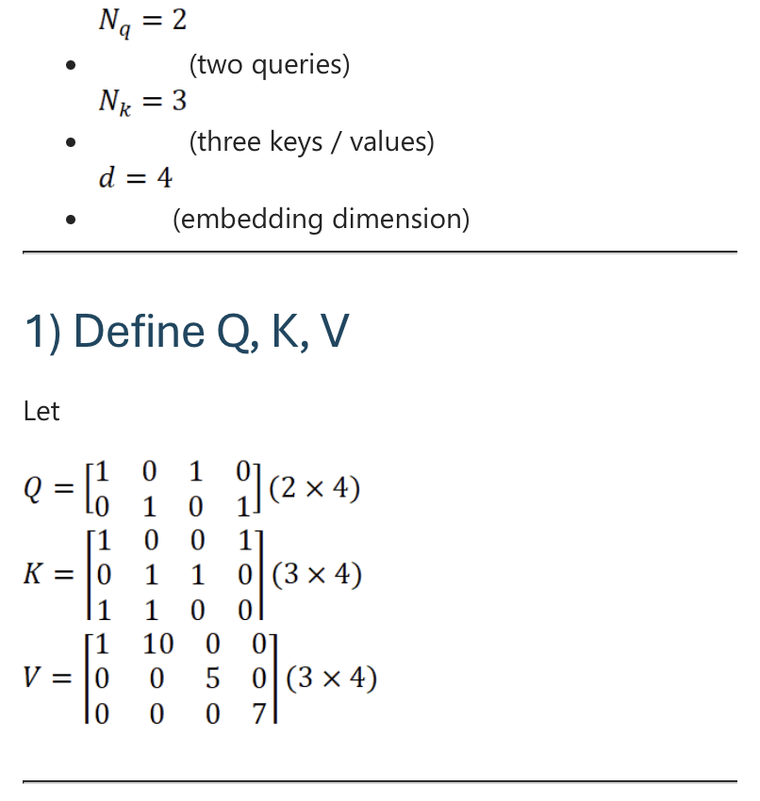
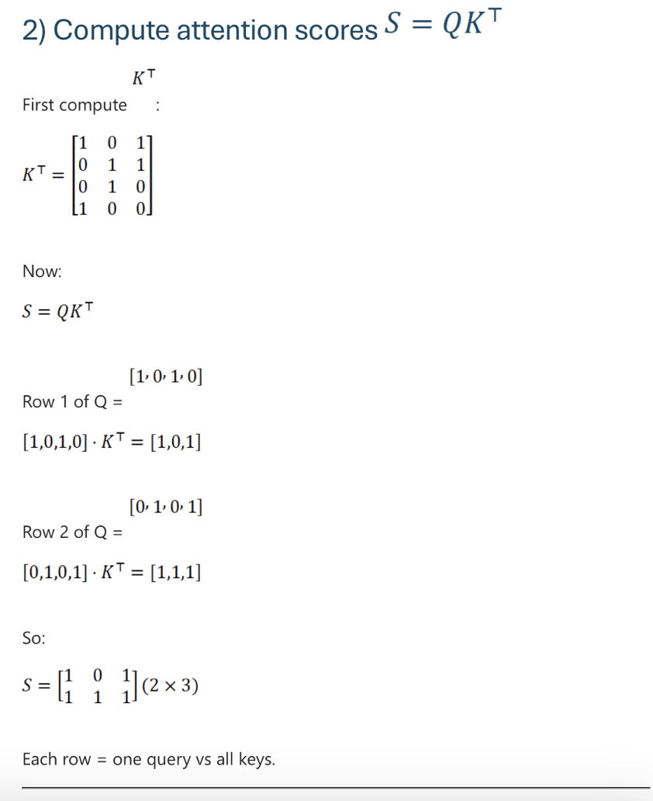
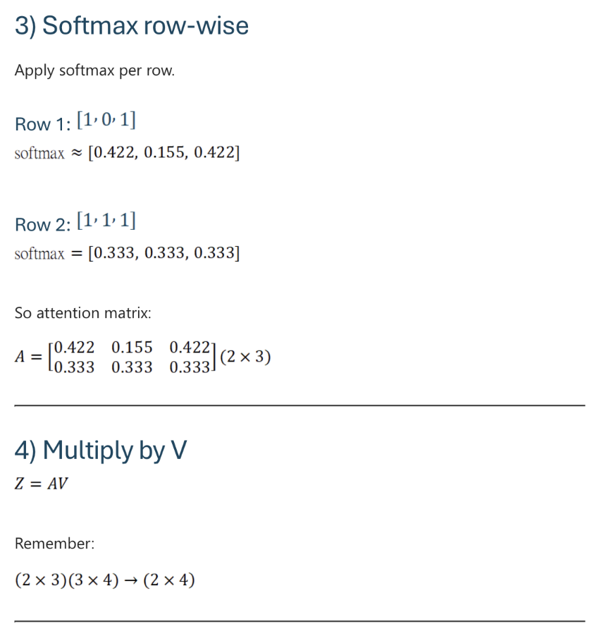
Cross-attention Example
Notes:
🎤 Slide 2 — Cross-Attention Example (Concrete Numbers)
“Now let’s make this concrete with a small numerical example.
Suppose:
We have 2 object queries
We have 3 image tokens
Embedding dimension = 4
So:
Q is a 2×4 matrix
K and V are 3×4 matrices
Step 1:
We compute attention scores:
S = QK^T
This gives us a 2×3 matrix.
Each row corresponds to one query.
Each column corresponds to one image token.
So:
Row 1 → how Query 1 relates to all image tokens
Row 2 → how Query 2 relates to all image tokens
Step 2:
Apply softmax row-wise.
Each query now produces a probability distribution over image tokens.
This is critical:
Each query decides where to look in the image.
Step 3:
Multiply by V (over here they are given but the general idea is; they’re learned projections of encoder features and query embeddings using trainable matrices)
Z=AVZ = A VZ=AV
Now each query produces one output vector.
Notice:
We had 3 value vectors.
But we produce only 2 outputs.
Why?
Because each query generates one weighted combination.
Each query = one object slot.
That’s the key idea.

Slide 46
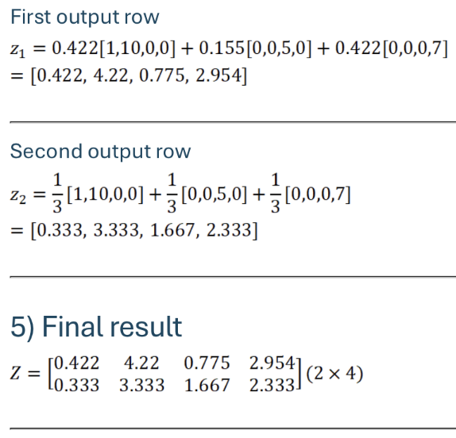
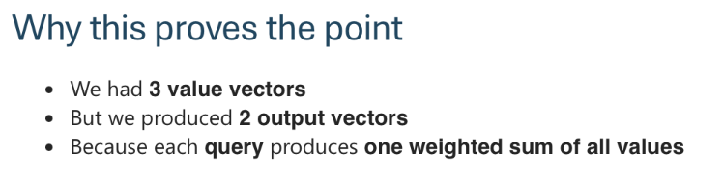
Cross-attention Example Output
Notes:
🎤 Slide 3 — Cross-Attention Output (Intuition)
“Now look at the final result.
Each output vector:
ziz_izi​
is a weighted sum of all value vectors.
For example:
z1=0.422v1+0.155v2+0.422v3z_1 = 0.422 v_1 + 0.155 v_2 + 0.422 v_3z1​=0.422v1​+0.155v2​+0.422v3​
This means:
Query 1 looked strongly at value 1 and value 3.
Query 2 produced a different weighted combination.
And this proves something very important:
We had 3 image feature vectors.
But we produced 2 object representations.
Why?
Because we had 2 queries.
Each query produces exactly one output vector.
This is why DETR naturally produces a fixed number of object predictions.
One query → one prediction.
🔥 Connecting Back to Detection
Now remember:
After cross-attention, we pass each ziz_izi​ to prediction heads.
Each one outputs:
(p^i,b^i)(\hat{p}_i, \hat{b}_i)(p^​i​,b^i​)
Class logits and bounding box.
So conceptually:
Query → attends to image → gathers evidence → predicts object
That’s the full pipeline.
🧠 Big Picture
Self-attention:
Image tokens talk to image tokens.
Cross-attention:
Object queries talk to image tokens.
That’s the core mechanism behind DETR.
No anchors.
No sliding windows.
No region proposals.
Just learned object slots that attend globally.

Slide 47
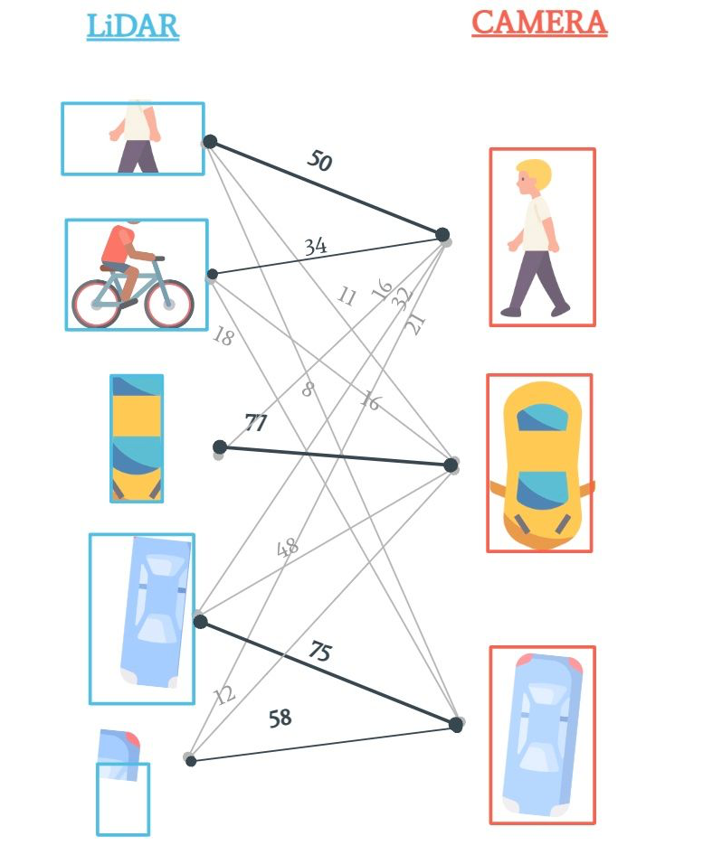
One-to-one matching
Predicted object → ground truth object
Eliminate duplicate predictions
No Non-Maximum Suppression post-processing
End-to-end differentiable training
https://www.thinkautonomous.ai/blog/hungarian-algorithm/

Slide 48
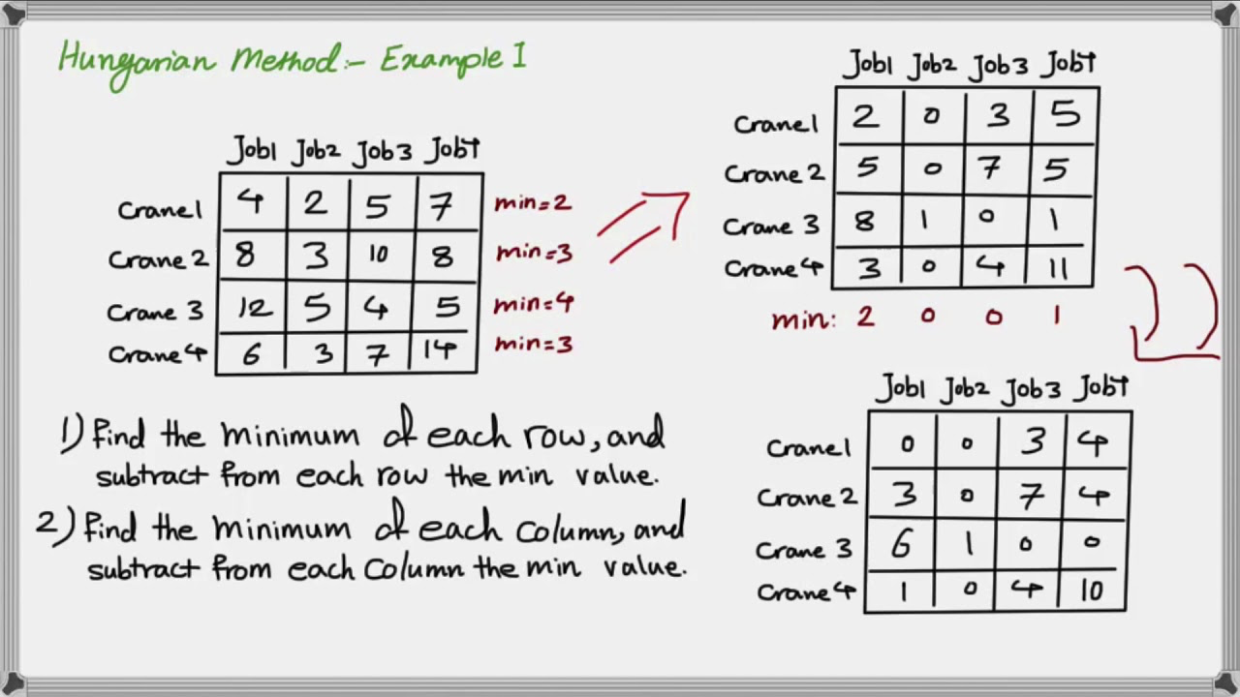
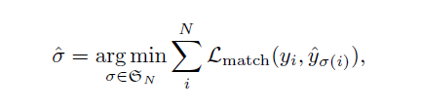
Hungarian Algorithm
https://www.youtube.com/watch?v=ezSx8OyBZVc

Slide 49
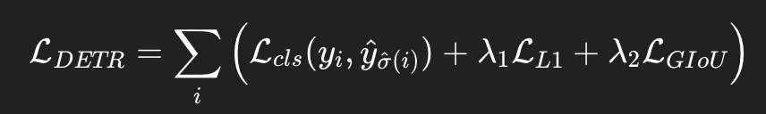
DETR Loss Functions

Slide 50
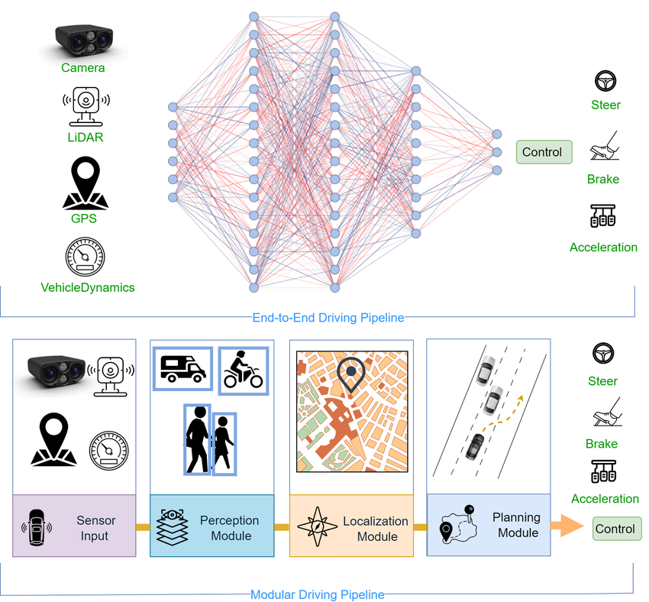
End-to-End Detection Pipelines
https://www.researchgate.net/figure/Comparison-between-End-to-End-and-modular-pipelines-End-to-End-is-a-single-pipeline-that_fig3_372248430

Slide 51
Detection as structured prediction
Shift from complex multi-stage pipelines →
direct set prediction =
fundamental rethinking of object detection.
Simpler
Faster
More Effective

Slide 52
Attaching Segmentation
heads to
ViT models

Slide 53

Motivation
Why segmentation with ViT?
What is Segmentation vs Detection(Bounding Boxes)
Bounding boxes:
Predict a rectangular box + class label
Coarse object localization
Does not give pixel-level shape
Segmentation:
Assigns a label to each pixel
Produces exact object boundaries
Needed for fine-grained understanding
https://www.researchgate.net/figure/Bounding-box-vs-instance-segmentation-on-players-and-ball-objects-4_fig1_340983355

Slide 54


Why Segmentation over Bounding boxes
Medical Imaging
Autonomous Driving
https://blogs.nvidia.com/blog/drive-labs-panoptic-segmentation/
https://medium.com/@nandinilreddy/medsam-e71f661b62dd

Slide 55


Why Segmentation over Bounding boxes
Robotics Manipulation
Image Editing
https://keymakr.com/blog/semantic-segmentation-vs-object-detection-understanding-the-differences/
https://www.geeksforgeeks.org/computer-vision/image-segmentation-techniques-and-applications/

Slide 56
Why global context matters for Segmentation
Why Global Context ⇒ Better Segmentation
Scenario CNN fails because … ViT succeeds because …..
Large Objects
Occlusion
Context-dependent labelling
Never sees whole object at once
Sees fragments, can’t fill in
“Water” vs “Swimming Pool” needs surrounding cues
Sees entire object in one pass
Uses distant context to infer hidden parts
Understands scene from global view

Slide 57

Types of segmentation
Semantic Segmentation
Goal: assign labels to every pixel
Key idea:
All objects of the same class share one label
Does not distinguish between different instances.
Example:
All cars → class “car”
Cannot tell car #1 vs car #2
Applications: Road scene understanding, Medical Imaging, Satellite imagery
https://towardsai.net/p/l/machine-learning-7

Slide 58

Types of segmentation
2) Instance Segmentation
Goal: Detect and segment each individual object instance
Key idea:
distinguishes object identity not just classes
Example:
Chair #1 → separate mask
Chair #2 → separate mask
Applications: Robotics grasping, Counting objects, Autonomous driving
https://blog.roboflow.com/instance-segmentation/

Slide 59


Types of segmentation
3) Panoptic Segmentation
Goal: Complete scene understanding
Key idea:
Unifies semantic + instance segmentation.
Two types of regions:
Things - countable objects like (cars, chairs)
Regions - amorphous regions (sky, road, grass
https://viso.ai/deep-learning/panoptic-segmentation/
Used in modern systems (MaskFormer, Mask2Former)
https://ai.stackexchange.com/questions/40310/what-is-panoptic-segmentation

Slide 60


Attaching Segmentation heads to Vision Transformers
We can’t use plain ViT for segmentation.
Why? Standard ViT:
Input image → splits into patches
Each patch → token
Transformers processes tokens
Output is tokens
Uses CLS tokens for prediction
https://medium.com/@ankitrajsh/image-segmentation-using-vision-transformers-vit-a-deep-dive-with-cityscapes-and-camvid-datasets-fc1ccdca295b
Example:
Image : 224 x 244 pixels
Patch size: 16 x 16
(224 / 16)² = 14 x 14
196 tokens
Problem - ViT outputs tokens, this is not a spatial Image anymore
How do we go from tokens back to pixel-level masks?
https://towardsdatascience.com/efficient-image-segmentation-using-pytorch-part-4-6c86da083432/

Slide 61

Attaching Segmentation heads to Vision Transformers
Segmentation requires:
Per pixel prediction
High resolution spatial output
Structured 2D Masks
From ViT Tokens → Pixel Mask
Step 1: Remove CLS Token if present
In classification
ViT uses a special CLS token
In segmentation
We discard the CLS token
Keep only the patch tokens
Next
Tokens → Feature Map (Reshape)

Slide 62

Attaching Segmentation heads to Vision Transformers
Step 2: Tokens → Feature Map
Tokens contain spatial information complicitly because
Token 0 = top left patch
Token 1 next patch
Order is known
So we reshape.
Now we have restored a 2D Grid.
This is a low resolution feature map.
Next
Upsample to pixel Resolution

Slide 63

Attaching Segmentation heads to Vision Transformers
Step 3: Upsample to pixel resolution
We now have a 14 x 14 D
But we need a 224 x 224 x C( class prediction)
So we apply a decoder.
Options:
Transposed convolutions
Bilinear upsampling + conv
FPN-style decoder
Lightweight MLP decoder (SegFormer)
Final output: H × W × C
Each pixel gets a class probability. This is our segmentation mask!
Notes:
After reshaping, we have a 14×14 feature map—but our original image is 224×224 pixels. That's a 16× resolution difference! Think of it like having a blurry thumbnail and needing to recreate a high-resolution photograph."
"So Step 3 is upsampling—blowing up this small feature map to full image size. But we can't just stretch it like a JPEG; we need to add detail intelligently."
"The decoder does this job. It takes our coarse 14×14 grid and gradually upsamples it to 224×224. There are several architectural choices here:"
"• Transposed convolutions (learned upsampling)
• Bilinear upsampling + conv (simple interpolation followed by refinement)
• FPN-style decoders (multi-scale feature fusion from Feature Pyramid Networks)
• Lightweight MLP decoders (used in SegFormer—just simple linear layers!)"
"The final output is a 224×224×C tensor—for every pixel, we have C class probabilities. This is our segmentation mask!"

Slide 64

Attaching Segmentation heads to Vision Transformers
Full Pipeline Summary Diagram

Slide 65

Encoder- Decoder ViT for Semantic Segmentation
What we have done so far:
ViT outputs patch tokens, not pixels
We reshaped tokens into a feature map
We introduced the idea of attaching a segmentation head
This Section:
Concrete implementation of:
ViT(Encoder) → CNN Decoder → Segmentation Mask
Goal: Semantic Segmentation
Each pixel receives a class score
Output : H X W X C
https://medium.com/@vinodpolinati/u-net-a-deep-dive-into-image-segmentation-05b872642ed1

Slide 66
Encoder- Decoder ViT for Semantic Segmentation
Problem formulation: Why Encoder - Decoder?
Semantic segmentation is formulated as :
Dense pixel-wise classification over a fixed set of classes.
Because the task requires:
A prediction at every spatial location
Output aligned with the image grid
Supervision at the pixel level
The model must:
Preserve spatial structure
Restore full image resolution
Produce H×W×C outputs
This motivates the Encoder–Decoder design:
ViT (Encoder) → extracts global semantic features
CNN Decoder → restores spatial resolution
Output → dense pixel-wise class logits

Slide 67

Encoder- Decoder ViT for Semantic Segmentation
Why Encoder - Decoder?
Why Combine ViT + CNN?
ViT strengths:
Global receptive field
Long-range dependency modelling
strong semantic understanding
CNN Strengths:
Local spatial bias
Precise boundary refinement
Efficient upsampling
Together:
Global understanding + Spatial detail

Slide 68

Encoder- Decoder ViT for Semantic Segmentation
Architecture Overview
The figure has three parts:
(a) ViT encoder
(b) Progressive upsampling decoder (SETR-PUP)
(c) Multi-level aggregation decoder (SETR-MLA)
ViT = feature extractor (backbone)
Decoder = restores spatial resolution
Output = per-pixel class logits
Schematic illustration of the SEgmentation TRansformer (SETR)
https://arxiv.org/pdf/2012.15840
Zheng, S., et al. "Rethinking Semantic Segmentation from a Sequence-to-Sequence Perspective with Transformers." CVPR 2021.

Slide 69





Encoder- Decoder ViT for Semantic Segmentation
Semantic Segmentation Output
Output tensor shape: HxWxC
Where:
H, W = image height and width (224x224)
C = number of classes (20)
Total predictions: 224 × 224 × 20 = 1,003,520 individual scores
Each pixel:
Has a vector of class scores(logits)
Softmax converts logits → probabilities
Each pixel
gets the class with highest probability:
  result: each pixel now has one label
Key Idea
Each pixel is treated as an independent classification problem

Slide 70

Loss Function for pixel-level Segmentation
Pixel-wise Cross Entropy Loss
For each pixel i:
Where:
y_{i} ,c = ground truth label
p_{i}, c = predicted probability
c = class index from 1 to C
Interpretation:
Penalizes incorrect class predictions per pixel
Average over all pixels
For each pixel:
Look at the predicted probability for the correct class only
Take the negative log of that probability
Sum over all pixels
Average
Common variations:
Weighted Cross Entropy (class imbalance)
Dice Loss (medical segmentation)
Combination losses

Slide 71

Query → Mask Pipeline
Mask Overlay
Each color region = one query
No overlapping duplicates
Works for instance and panoptic segmentation
Key idea:
Each query generates exactly one segmentation mask.

Slide 72

Query-Based Mask Prediction
(MaskFormer - Instance & Panoptic Segmentation)
From Pixels to Queries (Concept Shift)
From Pixel Classification → Mask Queries:
What we have done:
Every pixel predicted independently
Dense pixel-wise classification
Now:
We predict a set of object masks
Each query predicts: one class, one mask
Key idea:
Segmentation is treated as a set prediction problem

Slide 73
Query-Based Mask Prediction
(MaskFormer - Instance & Panoptic Segementation
Implications:
Output is a set, not a grid
Order does not matter
Number of objects is variable
Because the task is set prediction:
We introduce object queries
Each query generates exactly one mask
A transformer decoder performs matching
This naturally supports:
Instance segmentation: each query corresponds to one distinct object instance
Panoptic segmentation: queries collectively cover both object (“thing”) and background (“stuff”) regions in a unified framework
Problem Formulation: Why Mask-Query Transformers?
Goal:
Detect individual objects
Predict:
  One class per object
  One mask per object
Unlike semantic segmentation:
Objects of the same class must be separated
Number of objects varies per image
This is NOT dense pixel classification. It becomes:
Set prediction of object masks.

Slide 74

Query → Mask Pipeline
Architecture Overview
The diagram shows how a single query produces a segmentation mask::
Backbone & Pixel Decoder
Transformer decoder with queries
Generating Class & Mask
Forming the Binary Mask
Final prediction
Key Idea:
Each query specializes to one object.
MaskFormer overview.
https://arxiv.org/pdf/2107.06278
Cheng, B., et al. "Per-Pixel Classification is Not All You Need for Semantic Segmentation." NeurIPS 2021.

Slide 75

Loss Function
Set-Based Loss for Mask Queries
Problem: Queries have no order
Pixel classification: fixed grid, loss compares same position directly.
Query based: they are unordered
Because order does not matter we match:
Predicted masks
Ground-truth masks
Step 1: Using Hungarian bipartite matching.
This ensures:
One-to-one assignment
No duplicate predictions

Slide 76


Loss Function
Set-Based Loss for Mask Queries
Calculation:
Prediction (queries) : blue mask, green mask Ground truth : dog, cat, background
1) Hungarian matching
Predicted Masks Ground Truth Match Cost
[ORANGE] ────────► Dog 0.2
[BLUE] ───────────► Cat 0.1
[GREEN] ───────► Background 0.3
Step 2: Loss per Matched Pair
For each matched query:
Classification loss -Cross-entropy on predicted class
Mask loss - Binary Cross Entropy (pixel-wise) and Dice loss (overlap quality

Slide 77
Loss Function
Why This is Powerful - Query based solution
2) Loss to match pair:
ORANGE → Dog:
Class: -log(0.92) = 0.08
Mask: BCE(0.12) + Dice(0.06) = 0.18
**Total: 0.26**
BLUE → Cat: **Total: 0.19**
GREEN → Background: **Total: 0.36**
TOTAL LOSS = 0.26 + 0.19 + 0.36 = 0.81
Loss = -log(p_class) + (BCE + Dice) for each matched pair
Hungarian matching during training — model learns to avoid duplicates naturally
  Non-Max Suppression (NMS) — post-processing to remove duplicate detections in pixel-wise classification
End-to-end — one model, one loss, no manual tweaking
Unified framework — same model handles instance and panoptic segmentation.
  in pixel wise, we have Separate architectures for semantic vs. instance tasks

Slide 78
Segment Anything Model (SAM)
Foundation Model for Segmentation - Promptable Segmentation
SAM:
Prompt-based foundation segmentation
Key idea:
Segmentation becomes prompt-driven instead of class-driven.
From Segment Anything (2023), introduced by Meta AI:
A large-scale foundation model for segmentation
Built with a ViT-based image encoder
Performs promptable segmentation
Instead of predicting fixed categories:It segments anything given a prompt.
SAM is a foundation model for image segmentation Instead of:
Training per dataset
Predicting fixed categories
It can:
segment any object
From a user prompt
So far we saw:
Encoder–Decoder → Pixel-wise segmentation
MaskFormer → Query-based object segmentation

Slide 79
Segment Anything Model (SAM)
Problem Formulation: Why Foundation / Promptable Segmentation?
Unlike previous settings:
No fixed class vocabulary
No fixed number of objects
Objects may be unseen during training
Goal:
Predict a mask conditioned on a user prompt.
This is NOT:
Dense grid prediction (semantic)
Set prediction of objects (instance/panoptic)
It becomes:
Conditional mask generation given a prompt.
Because segmentation is prompt-conditioned:
Image features must be reusable
Model must generalize to unseen categories
Output depends on both image + prompt

Slide 80

Segment Anything Model (SAM)
Architecture Overview - Core Components of SAM
https://arxiv.org/pdf/2304.02643
SAM has three main parts:
ViT Image Encoder
  Large Vision Transformer backbone
  Extracts rich global image features
Prompt Encoder
  Encodes: points, Bounding boxes, text
Mask Decoder
  Lightweight transformer decoder
  Outputs segmentation mask
Segment Anything Playground | Meta

Slide 81

Segment Anything Model (SAM)
Why it matters - Future Direction
https://arxiv.org/pdf/2304.02643
Unified Segmentation Capability
Works for all segmentation all through prompting
Research impact
SAM shifts segmentation from Task-specific models →
General-purpose segmentation models
Promptable segmentation:
Unlike MaskFormer, Not limited to predefined object categories
Massive Training Scale
Trained on 1B+ masks,Millions of images
This makes it a foundation model.

Slide 82
Summary and Conclusion
From CNN Pipelines to Foundation Vision Models
1. Vision Tasks Evolved
Classification → One label per image
Detection → Set prediction of bounding boxes
Segmentation → Pixel, object, or prompt-based masks
Vision problems became increasingly structured.
2. Modeling Evolution
Traditional CNN pipelines:
Anchors Task-specific designs
Proposals Non-Max Suppression
Transformer-based models:
Global attention
Set prediction (DETR, MaskFormer)
End-to-end learning
3. Unifying Principle
Transformers shift vision from:
Hand-crafted pipelines → Learned structured prediction
4. The Big Picture
ViT as backbone replaces CNN feature extractors
DETR reframes detection as set prediction
MaskFormer extends set prediction to segmentation
SAM reframes segmentation as prompt-conditioned foundation modeling
We moved from:
Pixels → Boxes → Masks → Prompts

