Slide 1
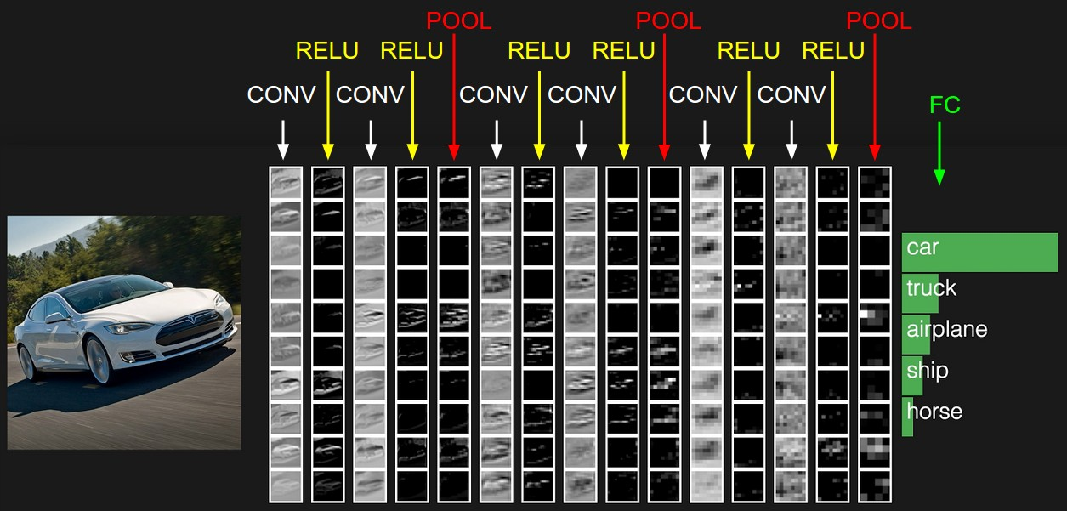
Convolutional neural networks
Computer Vision Lectures by Svetlana Lazebnik
Many slides from Rob Fergus, Andrej Karpathy

Slide 2
Outline
Basic convolutional layer
Variants: 1x1 convolutions, depthwise convolutions
Max pooling
In depth

Slide 3
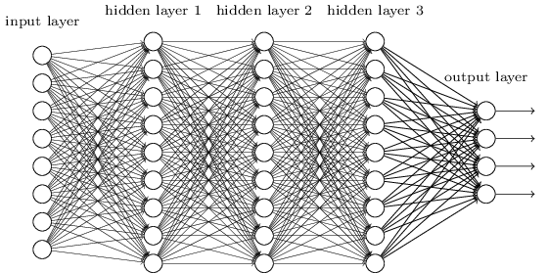
Let’s design a neural network for images
This kind of design is known as multi-layer perceptron (MLP)
image
Fully connected layer

Slide 4
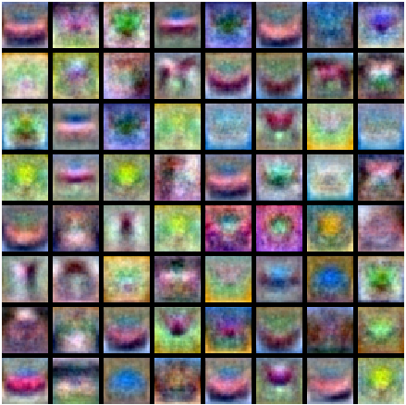
Let’s design a neural network for images
This kind of design is known as multi-layer perceptron (MLP)
What is wrong with this?
Recall: MLP as
bank of whole-image templates
image
Fully connected layer

Slide 5
Convolutional architecture
Let’s limit the receptive fields of units, tile them over the input image, and share their weights
image

Slide 6
Convolutional architecture
Let’s limit the receptive fields of units, tile them over the input image, and share their weights
image

Slide 7
Convolutional architecture
feature map
learned weights
Let’s limit the receptive fields of units, tile them over the input image, and share their weights
This is equivalent to sliding the learned filter over the image, computing dot products at every location
image

Slide 8









































Convolution example
Input
Filter
Output
$$x11$$
$$x12$$
$$x13$$
$$x14$$
$$x15$$
$$x16$$
$$x21$$
$$x22$$
$$x23$$
$$x24$$
$$x25$$
$$x26$$
$$w11$$
$$w12$$
$$w13$$
$$x31$$
$$x32$$
$$x33$$
$$x34$$
$$x35$$
$$x36$$
$$∗$$
$$w21$$
$$w22$$
$$w23$$
$$=$$
$$x41$$
$$x42$$
$$x43$$
$$x44$$
$$x45$$
$$x46$$
$$w31$$
$$w32$$
$$w33$$
$$x51$$
$$x52$$
$$x53$$
$$x54$$
$$x55$$
$$x56$$
Adapted from D. Fouhey and J. Johnson

Slide 9

































Convolution example
Input
Filter
Output
$$x11$$
$$x12$$
$$x13$$
$$x14$$
$$x15$$
$$x16$$
$$x21$$
$$x22$$
$$x23$$
$$x24$$
$$x25$$
$$x26$$
$$w11$$
$$w12$$
$$w13$$
$$y11$$
$$x31$$
$$x32$$
$$x33$$
$$x34$$
$$x35$$
$$x36$$
$$∗$$
$$w21$$
$$w22$$
$$w23$$
$$=$$
$$x41$$
$$x42$$
$$x43$$
$$x44$$
$$x45$$
$$x46$$
$$w31$$
$$w32$$
$$w33$$
$$x51$$
$$x52$$
$$x53$$
$$x54$$
$$x55$$
$$x56$$
$$y11 =x11∙w11 +x12∙w12+x13∙w13+ … +x33∙w33$$
Adapted from D. Fouhey and J. Johnson

Slide 10

Convolution example
Input
Filter
Output
$$x11$$
$$x12$$
$$x13$$
$$x14$$
$$x15$$
$$x16$$
$$x21$$
$$x22$$
$$x23$$
$$x24$$
$$x25$$
$$x26$$
$$w11$$
$$w12$$
$$w13$$
$$y11$$
$$y12$$
$$x31$$
$$x32$$
$$x33$$
$$x34$$
$$x35$$
$$x36$$
$$∗$$
$$w21$$
$$w22$$
$$w23$$
$$=$$
$$x41$$
$$x42$$
$$x43$$
$$x44$$
$$x45$$
$$x46$$
$$w31$$
$$w32$$
$$w33$$
$$x51$$
$$x52$$
$$x53$$
$$x54$$
$$x55$$
$$x56$$
$$y12 =x12∙w11 +x13∙w12+x14∙w13+ … +x34∙w33$$
Adapted from D. Fouhey and J. Johnson

Slide 11

Convolution example
Input
Filter
Output
$$x11$$
$$x12$$
$$x13$$
$$x14$$
$$x15$$
$$x16$$
$$x21$$
$$x22$$
$$x23$$
$$x24$$
$$x25$$
$$x26$$
$$w11$$
$$w12$$
$$w13$$
$$y11$$
$$y12$$
$$y13$$
$$x31$$
$$x32$$
$$x33$$
$$x34$$
$$x35$$
$$x36$$
$$∗$$
$$w21$$
$$w22$$
$$w23$$
$$=$$
$$x41$$
$$x42$$
$$x43$$
$$x44$$
$$x45$$
$$x46$$
$$w31$$
$$w32$$
$$w33$$
$$x51$$
$$x52$$
$$x53$$
$$x54$$
$$x55$$
$$x56$$
$$y13 =x13∙w11 +x14∙w12+x15∙w13+ … +x35∙w33$$
Adapted from D. Fouhey and J. Johnson

Slide 12

Convolution example
Input
Filter
Output
$$x11$$
$$x12$$
$$x13$$
$$x14$$
$$x15$$
$$x16$$
$$x21$$
$$x22$$
$$x23$$
$$x24$$
$$x25$$
$$x26$$
$$w11$$
$$w12$$
$$w13$$
$$y11$$
$$y12$$
$$y13$$
$$y14$$
$$x31$$
$$x32$$
$$x33$$
$$x34$$
$$x35$$
$$x36$$
$$∗$$
$$w21$$
$$w22$$
$$w23$$
$$=$$
$$x41$$
$$x42$$
$$x43$$
$$x44$$
$$x45$$
$$x46$$
$$w31$$
$$w32$$
$$w33$$
$$x51$$
$$x52$$
$$x53$$
$$x54$$
$$x55$$
$$x56$$
$$y14 =x14∙w11 +x15∙w12+x16∙w13+ … +x36∙w33$$
Adapted from D. Fouhey and J. Johnson

Slide 13

Convolution example
Input
Filter
Output
$$x11$$
$$x12$$
$$x13$$
$$x14$$
$$x15$$
$$x16$$
$$x21$$
$$x22$$
$$x23$$
$$x24$$
$$x25$$
$$x26$$
$$w11$$
$$w12$$
$$w13$$
$$y11$$
$$y12$$
$$y13$$
$$y14$$
$$x31$$
$$x32$$
$$x33$$
$$x34$$
$$x35$$
$$x36$$
$$∗$$
$$w21$$
$$w22$$
$$w23$$
$$=$$
$$y21$$
$$x41$$
$$x42$$
$$x43$$
$$x44$$
$$x45$$
$$x46$$
$$w31$$
$$w32$$
$$w33$$
$$x51$$
$$x52$$
$$x53$$
$$x54$$
$$x55$$
$$x56$$
$$y21 =x21∙w11 +x22∙w12+x23∙w13+ … +x43∙w33$$
Adapted from D. Fouhey and J. Johnson

Slide 14

Convolution example
Input
Filter
Output
$$x11$$
$$x12$$
$$x13$$
$$x14$$
$$x15$$
$$x16$$
$$x21$$
$$x22$$
$$x23$$
$$x24$$
$$x25$$
$$x26$$
$$w11$$
$$w12$$
$$w13$$
$$y11$$
$$y12$$
$$y13$$
$$y14$$
$$x31$$
$$x32$$
$$x33$$
$$x34$$
$$x35$$
$$x36$$
$$∗$$
$$w21$$
$$w22$$
$$w23$$
$$=$$
$$y21$$
$$y22$$
$$x41$$
$$x42$$
$$x43$$
$$x44$$
$$x45$$
$$x46$$
$$w31$$
$$w32$$
$$w33$$
$$x51$$
$$x52$$
$$x53$$
$$x54$$
$$x55$$
$$x56$$
$$y22 =x22∙w11 +x23∙w12+x24∙w13+ … +x44∙w33$$
Adapted from D. Fouhey and J. Johnson

Slide 15

Convolution example
Input
Filter
Output
$$x11$$
$$x12$$
$$x13$$
$$x14$$
$$x15$$
$$x16$$
$$x21$$
$$x22$$
$$x23$$
$$x24$$
$$x25$$
$$x26$$
$$w11$$
$$w12$$
$$w13$$
$$y11$$
$$y12$$
$$y13$$
$$y14$$
$$x31$$
$$x32$$
$$x33$$
$$x34$$
$$x35$$
$$x36$$
$$∗$$
$$w21$$
$$w22$$
$$w23$$
$$=$$
$$y21$$
$$y22$$
$$y23$$
$$x41$$
$$x42$$
$$x43$$
$$x44$$
$$x45$$
$$x46$$
$$w31$$
$$w32$$
$$w33$$
$$x51$$
$$x52$$
$$x53$$
$$x54$$
$$x55$$
$$x56$$
$$y23 =x23∙w11 +x24∙w12+x25∙w13+ … +x45∙w33$$
Adapted from D. Fouhey and J. Johnson

Slide 16





Convolution example
Input
Filter
Output
$$x11$$
$$x12$$
$$x13$$
$$x14$$
$$x15$$
$$x16$$
$$x21$$
$$x22$$
$$x23$$
$$x24$$
$$x25$$
$$x26$$
$$w11$$
$$w12$$
$$w13$$
$$y11$$
$$y12$$
$$y13$$
$$y14$$
$$x31$$
$$x32$$
$$x33$$
$$x34$$
$$x35$$
$$x36$$
$$∗$$
$$w21$$
$$w22$$
$$w23$$
$$=$$
$$y21$$
$$y22$$
$$y23$$
$$y24$$
$$x41$$
$$x42$$
$$x43$$
$$x44$$
$$x45$$
$$x46$$
$$w31$$
$$w32$$
$$w33$$
$$y31$$
$$y32$$
$$y33$$
$$y34$$
$$x51$$
$$x52$$
$$x53$$
$$x54$$
$$x55$$
$$x56$$
Adapted from D. Fouhey and J. Johnson

Slide 17
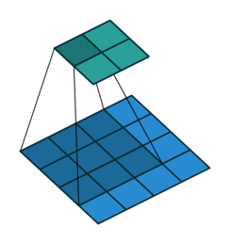
Convolutional architecture
feature map
Size of output feature map depends on padding and stride
learned weights
Output
Input
image
No padding, stride 1
Animation source

Slide 18
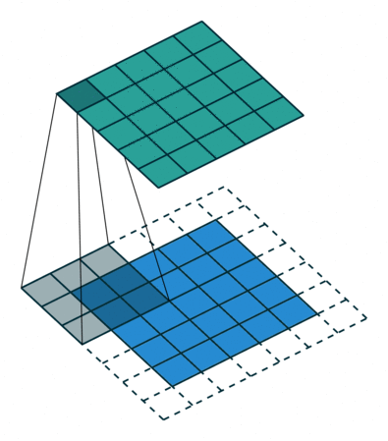
Convolutional architecture
feature map
Size of output feature map depends on padding and stride
learned weights
Output
Input
image
With padding, stride 1
Animation source

Slide 19
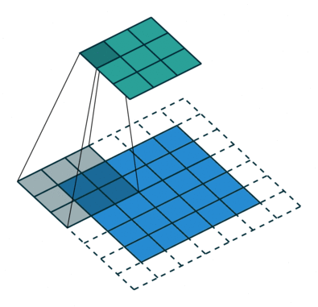
Convolutional architecture
feature map
Size of output feature map depends on padding and stride
learned weights
Output
Input
image
With padding, stride 2

Slide 20
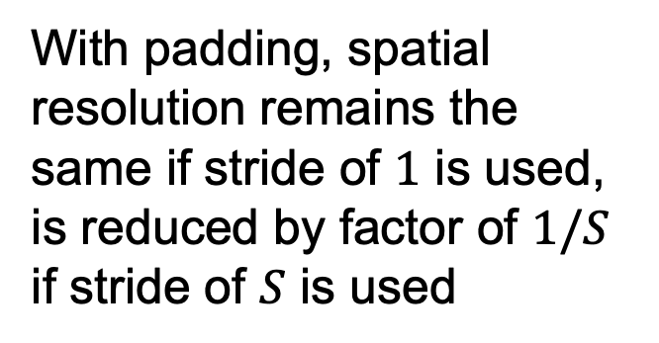
Convolutional architecture
feature map
Size of output feature map depends on padding and stride
learned weights
With padding, spatial resolution remains the same if stride of $1$ is used, is reduced by factor of $1/S$ if stride of $S$ is used
image

Slide 21
Convolutional architecture
feature map
learned weights
image

Slide 22
Convolutional architecture
another feature map
another set of learned weights
image

Slide 23
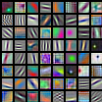
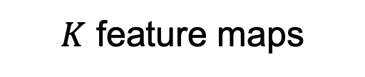
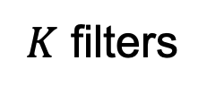
Convolutional architecture
$K$ feature maps
$K$ filters
Learned filters can be thought of as local templates
image

Slide 24
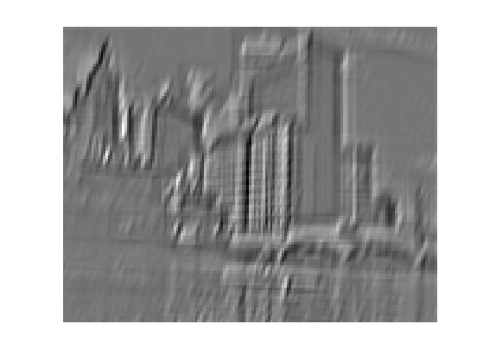
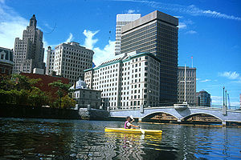
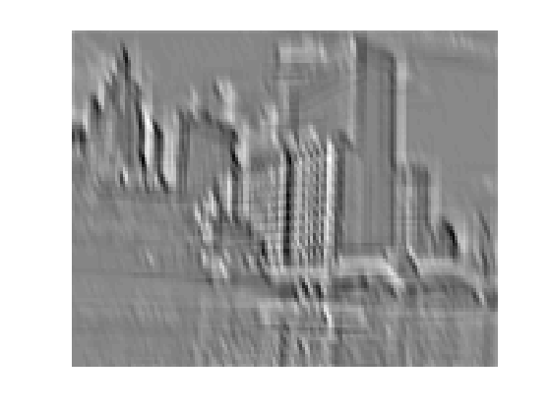
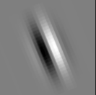
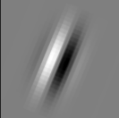

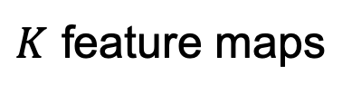
Convolution and traditional feature extraction
bank of $K$ filters
$K$ feature maps
...
image
feature map

Slide 25
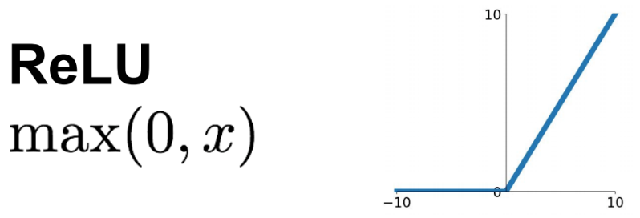
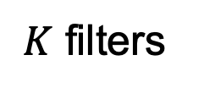
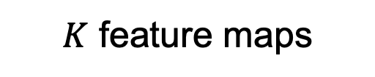
Convolutional architecture
$K$ feature maps
Almost always directly followed by a ReLU (or similar activation function)
$K$ filters
image
convolutional layer
Source: Stanford 231n

Slide 26
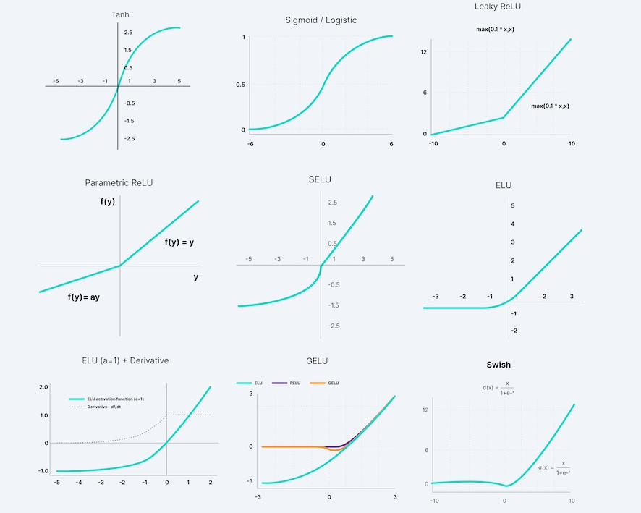
Recall: Activation functions
Source: V7labs

Slide 27
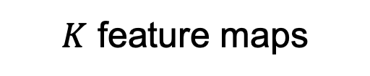
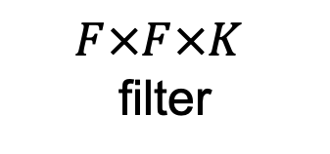

Three-dimensional convolutions
What if the input to a convolutional layer is a stack of $K$ feature maps?
$K$ feature maps
One output feature map
$$F×F×K$$
filter

Slide 28
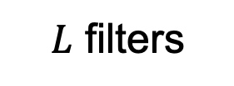
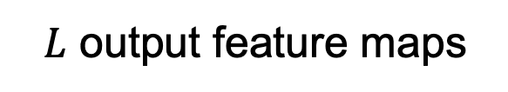
Three-dimensional convolutions
What if the input to a convolutional layer is a stack of $K$ feature maps?
$K$ feature maps
$L$ output feature maps
$$F×F×K$$
filter
$L$ filters

Slide 29
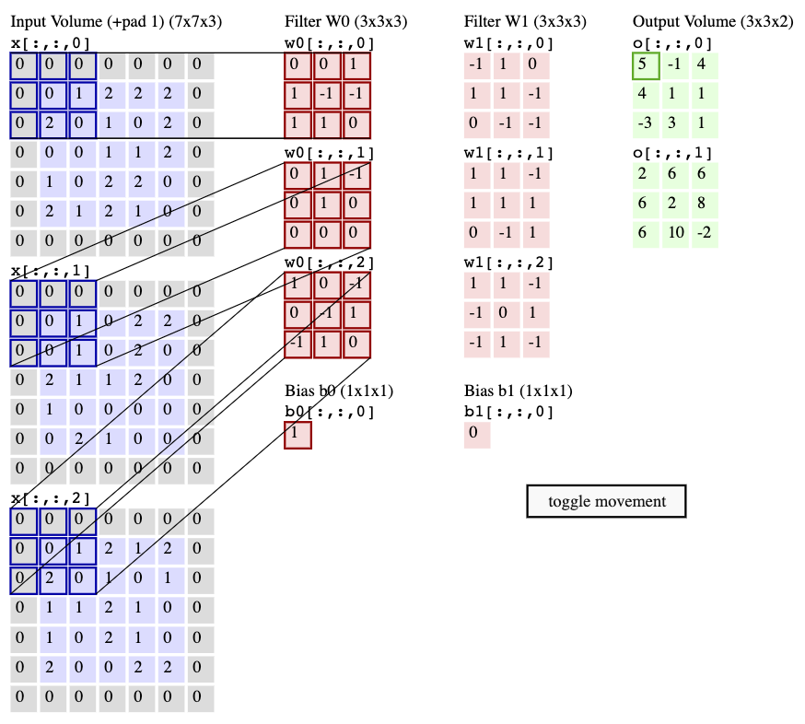
Convolutional layer example
Stride = 2
Animation:
http://cs231n.github.io/convolutional-networks/#conv

Slide 30
Convolutional layer example
?
Stride = 2
Animation:
http://cs231n.github.io/convolutional-networks/#conv

Slide 31
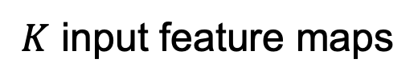
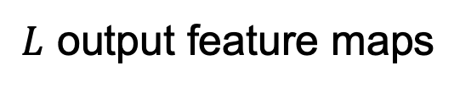

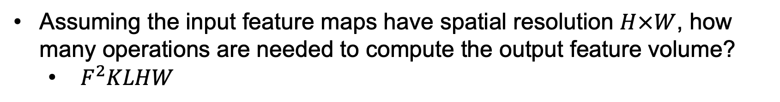
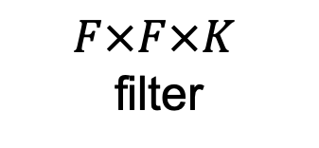
Convolutional layer: Computational cost
$K$ input feature maps
$L$ output feature maps
$$F×F×K$$
filter
$L$ filters
Assuming the input feature maps have spatial resolution $H×W$, how many operations are needed to compute the output feature volume?
  $F^{2}KLHW$

Slide 32
Outline
Basic convolutional layer
Variants: 1x1 convolutions, depthwise convolutions

Slide 33


1x1 convolutional layer
$K$ input feature maps
$L$ output feature maps
$$F×F×K$$
filter
$L$ filters
What if we make $F=1$?

Slide 34
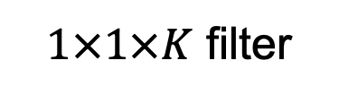
1x1 convolutional layer
$K$ input feature maps
$L$ output feature maps
$1×1×K$ filter
$L$ filters
What if we make $F=1$?

Slide 35
Convolutional layer: Details
Efficient implementation: reshape all image neighborhoods into columns (im2col operation), do matrix-vector multiplication
Image source

Slide 36
Convolutional layer: Details
Efficient implementation: reshape all image neighborhoods into columns (im2col operation), do matrix-vector multiplication
Backward pass: special case of linear layer, operations also turn out to be convolutions
  Downstream gradient (of error w.r.t. input) is a transposed convolution, or convolution of output with filter flipped both horizontally and vertically

Slide 37
Outline
Basic convolutional layer
Variants: 1x1 convolutions, depthwise convolutions
Max pooling

Slide 38
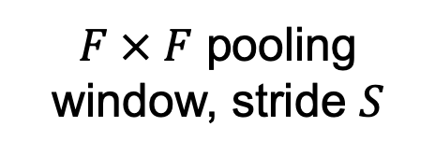

Max pooling layer
Feature map
max value
$F × F$ pooling window, stride $S$
Usually: $F=2$ or $3$, $S=2$

Slide 39
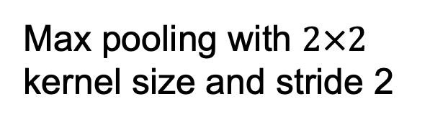
Max pooling: Example
Single channel
1 | 1 | 2 | 4
5 | 6 | 7 | 8
3 | 2 | 1 | 0
1 | 2 | 3 | 4
Max pooling with $2×2$ kernel size and stride 2
Source: J. Johnson

Slide 40
Max pooling: Example
Single channel
1 | 1 | 2 | 4
5 | 6 | 7 | 8
3 | 2 | 1 | 0
1 | 2 | 3 | 4
Max pooling with $2×2$ kernel size and stride 2
Source: J. Johnson

Slide 41
Max pooling: Example
Single channel
1 | 1 | 2 | 4
5 | 6 | 7 | 8
3 | 2 | 1 | 0
1 | 2 | 3 | 4
Max pooling with $2×2$ kernel size and stride 2
6 | 8
3 | 4
Source: J. Johnson

Slide 42
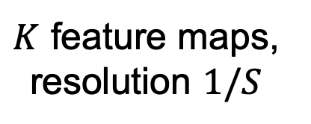

Max pooling layer
$K$ feature maps, resolution $1/S$
$K$ feature maps
max value
$F × F$ pooling window, stride $S$
Backward pass: upstream gradient is passed back only to the unit with max value
Usually: $F=2$ or $3$, $S=2$

Slide 43
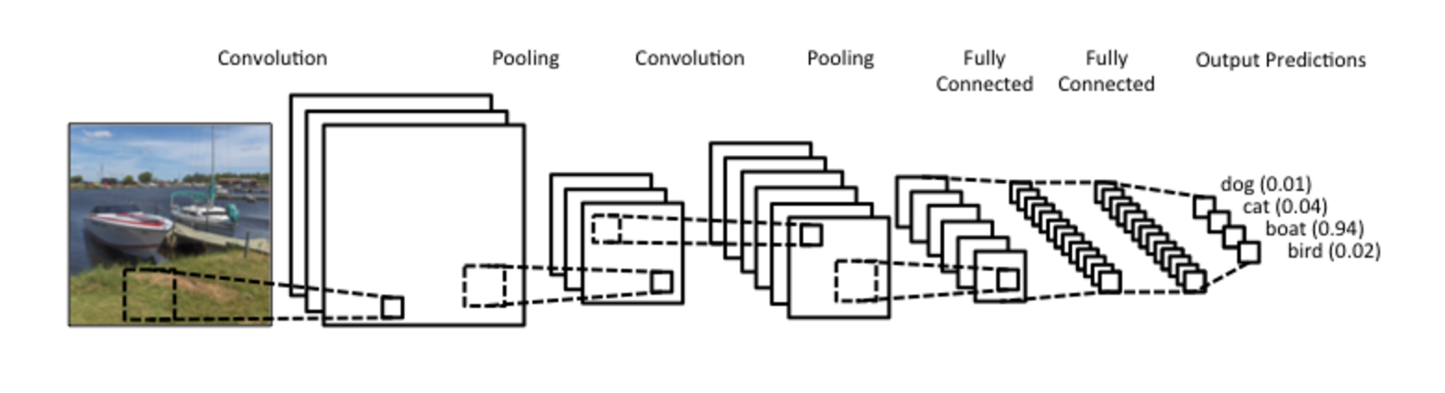
“Traditional” CNN pipeline

Slide 44
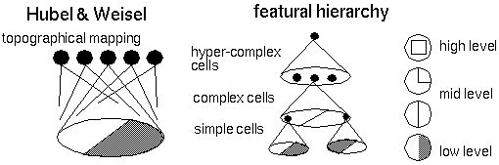
Backstory
Biological inspiration: D. Hubel and T. Wiesel (1959, 1962, Nobel Prize 1981)
  Visual cortex consists of a hierarchy of simple, complex, and hyper-complex cells
Source

Slide 45
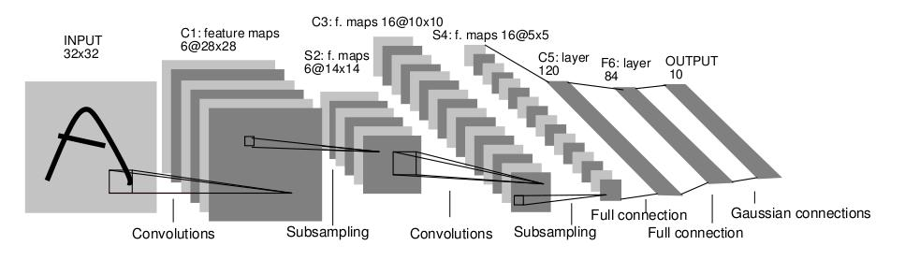
Backstory
Neocognitron
LeNet-5
K. Fukishima. Neocognitron: A Self-organizing Neural Network Model for a Mechanism of Pattern Recognition Unaffected by Shift in Position. Biological Cybernetics, 1980
Y. LeCun, L. Bottou, Y. Bengio, and P. Haffner,
Gradient-based learning applied to document recognition, Proc. IEEE 86(11): 2278–2324, 1998

Slide 46
Receptive fields

Slide 47
Receptive fields
3x3 convolutions, stride 1
Input
Output
The receptive field of a unit is the region of the input feature map whose values contribute to the response of that unit (either in the previous layer or in the initial image)
Receptive field size: 3

Slide 48
Receptive fields
3x3 convolutions, stride 1
Input
Output
Receptive field size: 5

Slide 49
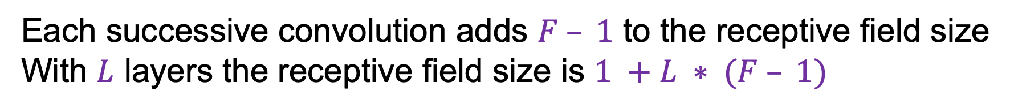
Receptive fields
3x3 convolutions, stride 1
Input
Output
Receptive field size: 7
Each successive convolution adds $F – 1$ to the receptive field size
With $L$ layers the receptive field size is $1 +L ∗ (F – 1)$

Slide 50
Receptive fields
3x3 convolutions, stride 2
Input
Output
Receptive field size: 3

Slide 51
Receptive fields
3x3 convolutions, stride 2
Input
Output

Slide 52
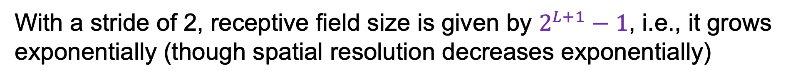
Receptive fields
3x3 convolutions, stride 2
Input
Output
Receptive field size: 7
With a stride of 2, receptive field size is given by $2^{L+1}−1$, i.e., it grows exponentially (though spatial resolution decreases exponentially)

Slide 53
Convolutional architectures
Image source

Slide 54
Outline
AlexNet (2012-2013)
VGGNet (2014)
GoogLeNet (2014)
ResNet (2015)
Beyond ResNet (2016 and onward): Wide ResNet, ResNeXT, DenseNet
Beyond ImageNet classification

Slide 55
ImageNet Large Scale Visual Recognition Challenge (ILSVRC)
Figure source
ILSVRC webpage

Slide 56
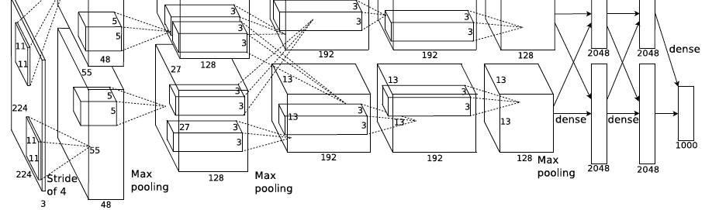
AlexNet: ILSVRC 2012 winner
Photo source
A. Krizhevsky, I. Sutskever, and G. Hinton, ImageNet Classification with Deep Convolutional Neural Networks, NIPS 2012
Notes:
Two-GPU architecture

Slide 57
AlexNet: ILSVRC 2012 winner
Successor of LeNet-5, but with a few crucial changes
Y. LeCun, L. Bottou, Y. Bengio, and P. Haffner,
Gradient-based learning applied to document recognition, Proc. IEEE 86(11): 2278–2324, 1998
A. Krizhevsky, I. Sutskever, and G. Hinton, ImageNet Classification with Deep Convolutional Neural Networks, NIPS 2012
Notes:
Two-GPU architecture

Slide 58
AlexNet: ILSVRC 2012 winner
Successor of LeNet-5, but with a few crucial changes
  Max pooling, ReLU nonlinearity
  Dropout regularization
  More data and bigger model (7 hidden layers, 650K units, 60M params)
  GPU implementation (50x speedup over CPU)
    Trained on two GPUs for a week
A. Krizhevsky, I. Sutskever, and G. Hinton, ImageNet Classification with Deep Convolutional Neural Networks, NIPS 2012
Notes:
Two-GPU architecture

Slide 59
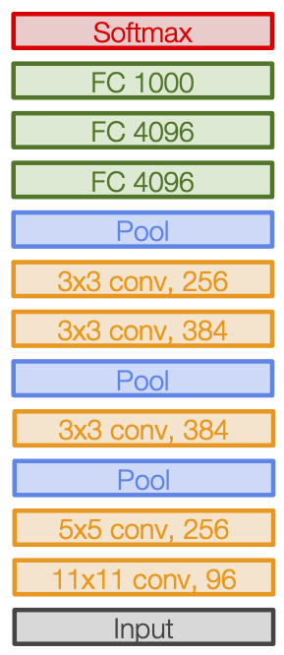
AlexNet: ILSVRC 2012 winner
Notes:
Two-GPU architecture

Slide 60
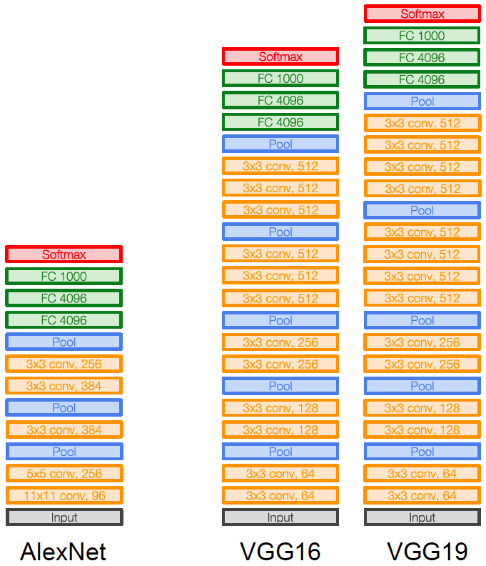
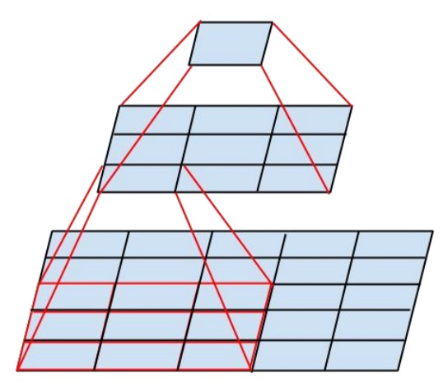
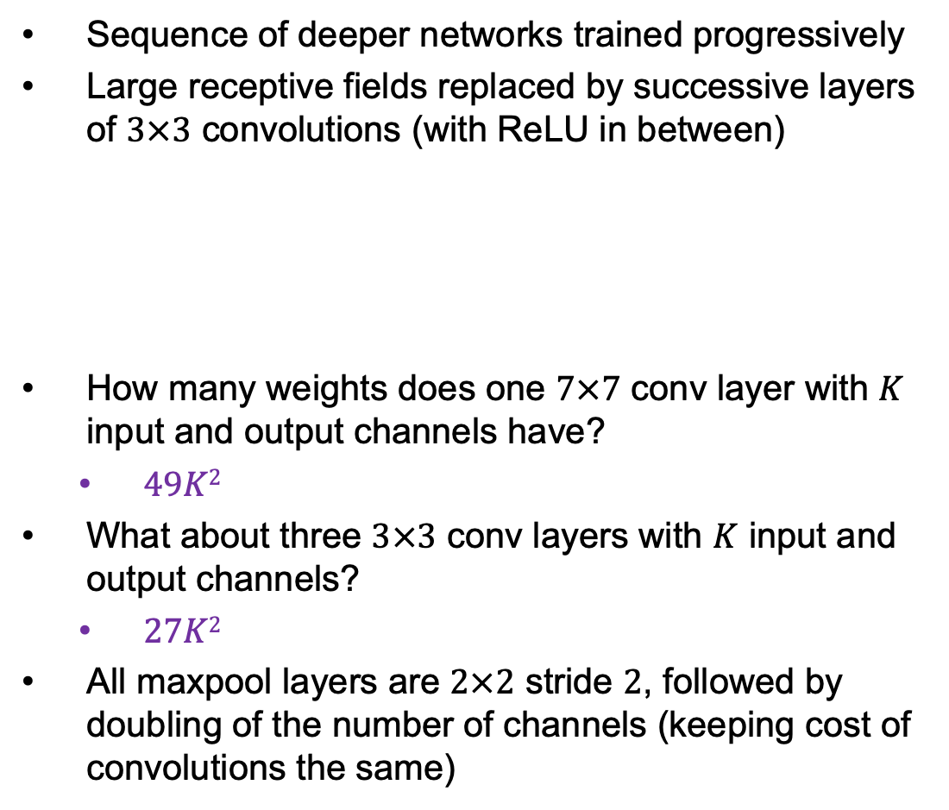
VGGNet: ILSVRC 2014 2nd place
Sequence of deeper networks trained progressively
Large receptive fields replaced by successive layers of $3×3$ convolutions (with ReLU in between)
How many weights does one $7×7$ conv layer with $K$ input and output channels have?
  $49K2$
What about three $3×3$ conv layers with $K$ input and output channels?
  $27K2$
All maxpool layers are $2×2$ stride $2$, followed by doubling of the number of channels (keeping cost of convolutions the same)
Notes:
LRN – local response normalization (doesn’t improve performance)

Slide 61
Another view of VGG-19 architecture (modified)
Image source

