Slide 1
From Noise to Image
A chronological tour of generative modeling and Image Generation processes.

Slide 2
Agenda
Overview of Generative Modeling
Paradigms and their Implementations
Diffusion Models
Forward & Reverse processes
Classifier-Free-Guidance
Text-to-Image Generation
Latent Diffusion - Architectures in Detail
Text Conditioned Image Generation
Limitations and Future Directions

Slide 3
Overview

Slide 4
The Question We're Trying to Answer
How do you teach a machine to imagine?
Not to classify, not to predict — but to create something that didn't exist
Specifically: to generate a photorealistic image from scratch, or from a text prompt
This sounds like art. It's actually a math problem about probability distributions

Slide 5
Why Does This Matter Beyond Pretty Pictures?
Image generation forced breakthroughs in how we represent, compress, and reason about data
The latent space machinery that powers Stable Diffusion also powers drug discovery models
Score matching, flow matching — these are general tools for learning distributions, not just for pixels
The architectures (UNet, DiT) influenced how we build all deep learning systems
And the open questions here — about discrete vs continuous generation — are reshaping language models too

Slide 6
How This Field Moved Research Forward
Pre-2013: generative models were mostly handcrafted (GMMs, restricted Boltzmann machines)
2013–2014: VAEs and GANs independently proposed learned latent-variable generation
2020: DDPM showed diffusion could match GANs without adversarial training instability
2021–2022: guidance, architecture, and efficiency improvements made it practical
2022–present: flow matching, distillation, and DiTs pushed toward real-time, scalable generation
Diffusion Language Models - Discrete Token & Masked Diffusion

Slide 7
Latent Variables, Embeddings & Tokens

Slide 8
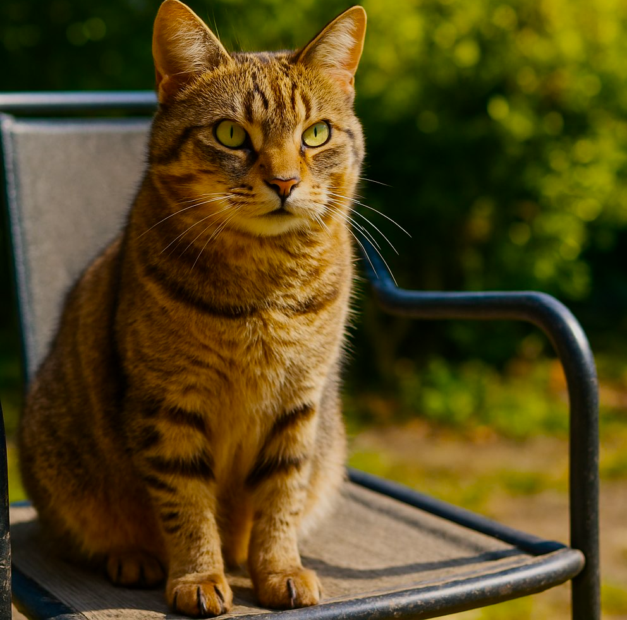
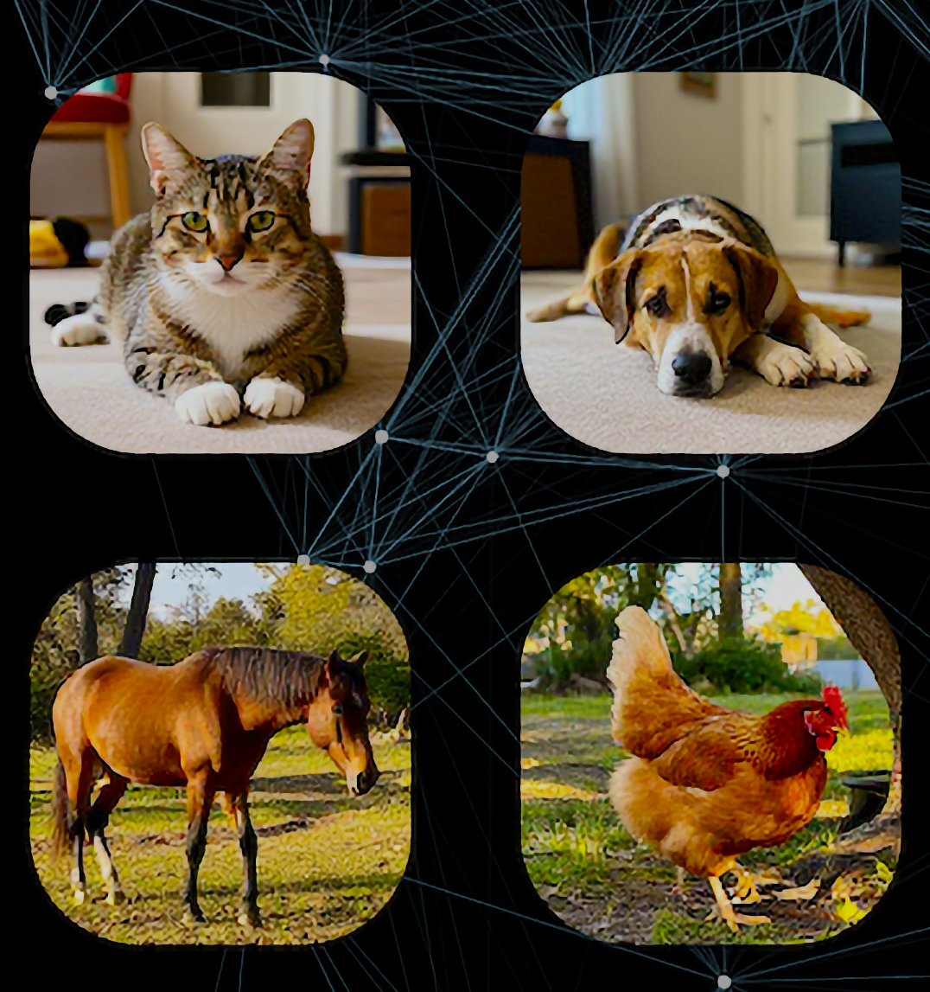
What Is a Latent Variable?
A latent variable is something that influences what you observe, but isn't directly observed itself
Classic example: a person's mood isn't directly measurable, but it influences what they say and do
In images: the 'content' of a photo (a cat sitting on a chair) is latent — the pixels are the observation
Latent variables are the model's internal representation of 'what's going on' in the data
Key property: the latent space is usually much lower-dimensional than the data

Slide 9
Latent Space: Geometry Has Meaning
Once trained, similar inputs map to nearby points in latent space
Arithmetic sometimes works: z(king) - z(man) + z(woman) ≈ z(queen)
Interpolating between two latent codes gives a smooth transition between two images
The latent space is the model's 'conceptual space': where meaning lives

Slide 10
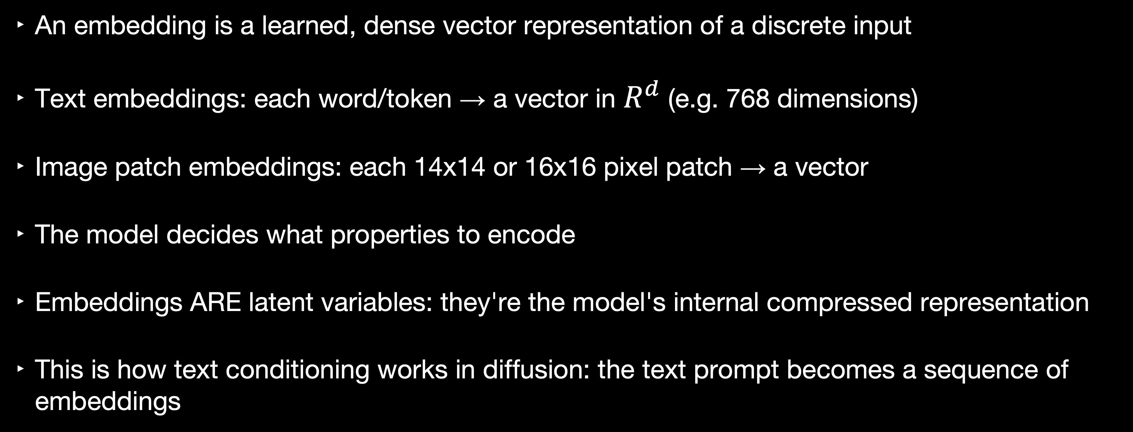
From Latent Variables to Embeddings
An embedding is a learned, dense vector representation of a discrete input
Text embeddings: each word/token → a vector in $R^{d}$ (e.g. 768 dimensions)
Image patch embeddings: each 14x14 or 16x16 pixel patch → a vector
The model decides what properties to encode
Embeddings ARE latent variables: they're the model's internal compressed representation
This is how text conditioning works in diffusion: the text prompt becomes a sequence of embeddings

Slide 11
A Decade of Generative Modeling
2013
2014
2019
2020
2021
2022
2023
2024
VAE
GAN
Score-Based
DDPM
LDM / CFG
DiT / FM
DMD / CM
FLUX / SD3

Slide 12
Questions to ask
Aspect | Question
Network output | What does f(𝜃) directly produce?
Distribution form | How is P(x) related to f(𝜃)?
Normalization | Is P(𝜃),dx = 1 enforced — and how?
Training signal | What loss drives 𝜃?
Inference | How do we draw a sample?
Fundamental limit | What does this parameterization structurally preclude?

Slide 13
Generative Modeling: A Unifying Template
Paradigm | Network outputs | Normalization | Training | Sampling
ARM | conditional probabilities | softmax per token, or Gaussian | exact max- likelihood | ancestral, token-by-token
VAE | mean/variance | KL to prior (soft) | ELBO (lower bound) | Z ~ P(Z), directly from prior
GAN | a sample - fake image for the discriminator. | none (implicit) | adversarial minimax | single forward pass
EBM | One scalar for any input | partition function (intractable) | contrastive divergence, score matching | MCMC (Langevin)
Score | A vector field pointing toward higher density | sidestepped — model the gradient | denoising score matching | Langevin dynamics
DDPM | Predicted Noise, same shape as input | sidestepped | L2 on injected noise | reverse chain
Flow Matching | Velocity vector | sidestepped | L2 on conditional velocity | ODE integration

Slide 14
VAE Origins: A Simultaneous Discovery

Slide 15
The VAE: A Simultaneous Discovery (2013–2014)
Kingma & Welling (2013): 'Auto-Encoding Variational Bayes' — arXiv:1312.6114
Rezende, Mohamed & Wierstra (2014): 'Stochastic Backpropagation and Approximate Inference'
The insight: Instead of encoding to a point z, encode to a distribution q(z|x)
This forces the latent space to be smooth and continuous — enables sampling
The decoder learns: given a sample from this distribution, reconstruct x

Slide 16
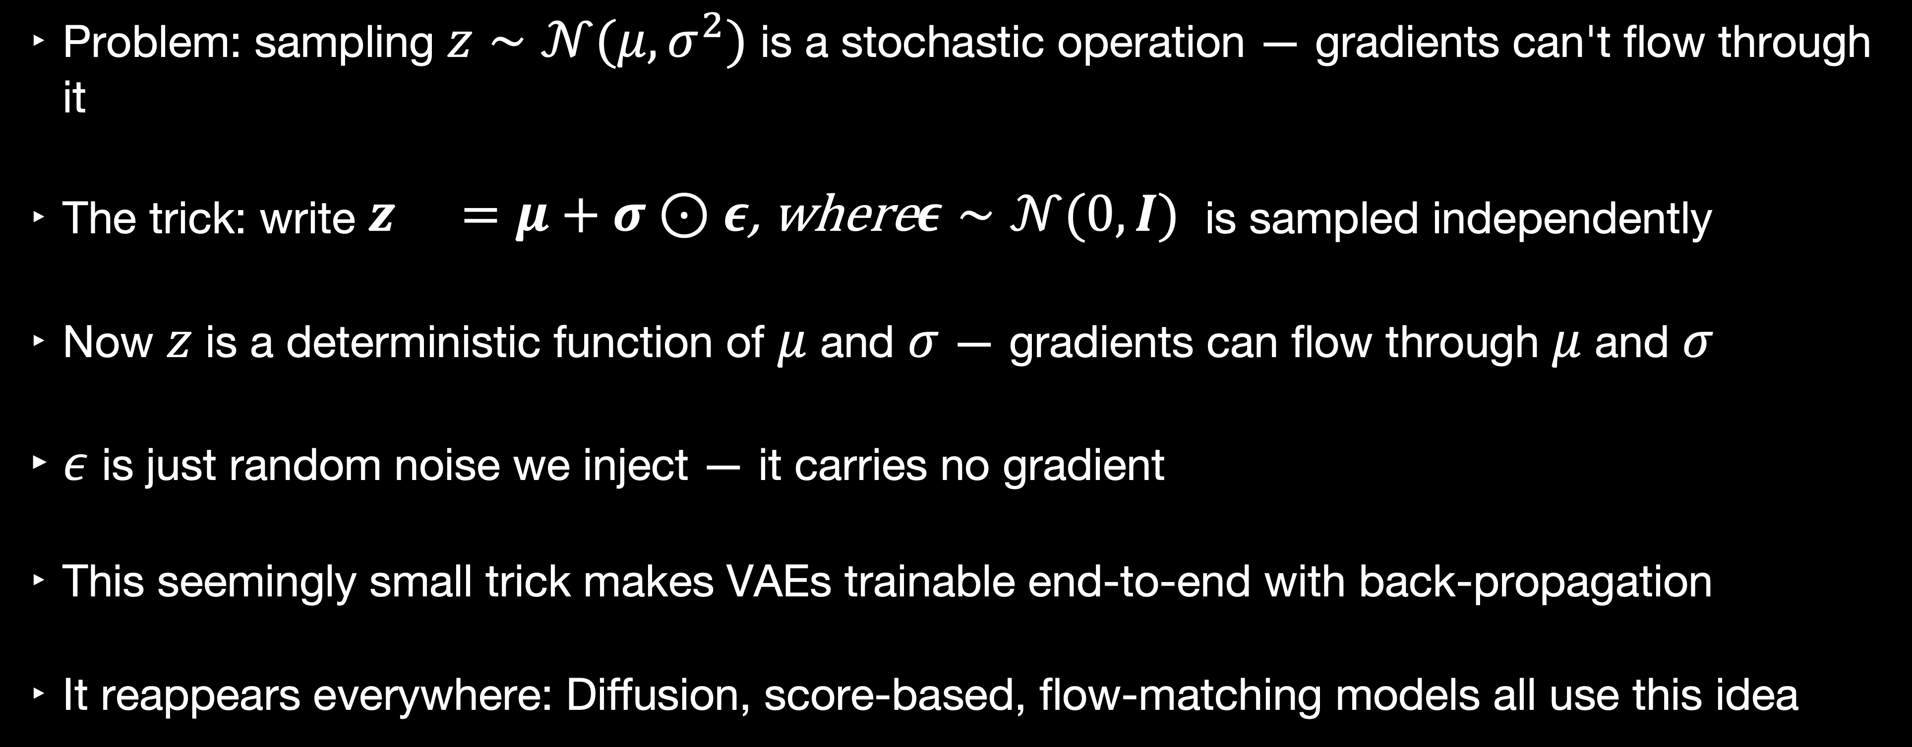
The Re-parameterization Trick
Problem: sampling $z∼𝒩(μ,σ^{2})$ is a stochastic operation — gradients can't flow through it
The trick: write $\begin{matrix}z & =μ+σ⊙ε\text{, }\text{where}ε∼𝒩(0,I)\end{matrix}$ is sampled independently
Now $z$ is a deterministic function of $μ$ and $σ$ — gradients can flow through $μ$ and $σ$
$ε$ is just random noise we inject — it carries no gradient
This seemingly small trick makes VAEs trainable end-to-end with back-propagation
It reappears everywhere: Diffusion, score-based, flow-matching models all use this idea

Slide 17
What VAEs Gave Us
A principled framework for learning structured latent spaces and smooth, continuous latent space you can actually sample from.
The re-parameterization trick — foundational for all subsequent work
The Variational/Evidence lower bound loss funstion — the conceptual template for diffusion model objectives
Latent diffusion models (Stable Diffusion) literally run diffusion inside a VAE's latent space
Limitation: VAE samples tend to be blurry — the reconstruction loss averages over uncertainty

Slide 18
GANs: The Adversarial Turn

Slide 19
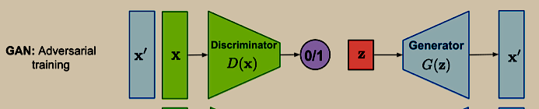
Goodfellow et al., 2014: A Thought Experiment
1412.6572
The idea: train two networks against each other
Generator G: takes random noise z, produces fake image G(z)
Discriminator D: given an image, outputs probability it's real vs fake
G tries to fool D. D tries to catch G. They improve together
At equilibrium: G produces images indistinguishable from real data

Slide 20
What GANs Proved and What They Couldn't Do
GANs could produce astonishingly sharp, photorealistic images — a step change in quality
The problem: training instability — mode collapse, vanishing gradients, sensitivity to hyper parameters
Mode collapse: the generator finds a few outputs that fool the discriminator and gets stuck
Training requires careful balancing of G and D — more art than science
Log-likelihood is undefined: you can't evaluate how 'good' a GAN is in a principled way

Slide 21
GANs vs VAEs: What Each Got Right
VAEs
GANs
Excellent perceptual quality (FID)*
Latent space less interpretable
Unstable training, mode collapse
No explicit likelihood — harder to evaluate
Sharp, photorealistic outputs
Principled probabilistic framework
Smooth, structured latent space
Stable training (standard backprop)
Can compute approximate likelihood
Samples tend to be blurry
*(Fréchet Inception Distance (FID) estimates the distance between a distribution of Inception-v3/CLIP features of
real images, and those of images generated by the model)

Slide 22
The Bridge: From Latents to Noise

Slide 23
Score-Based Models: A Different Way to Think About Generation
Song & Ermon (1907.05600): model the score function ∇_x log p(x) instead of p(x) directly
The score is the gradient of the log-density — it points toward regions of higher probability
To generate: start anywhere, follow the score (Langevin dynamics)
Problem: score is intractable in high-dimensional data spaces
Solution: add noise at many scales — score estimation becomes tractable at each scale
This is the conceptual bridge to DDPM (Denoising Diffusion Probabilistic Models): noising = making the distribution tractable

Slide 24
Before Denoising Diffusion Probabilistic Models
By 2019–2020: GANs were powerful but unstable; VAEs were stable but blurry
Score-based models were mathematically principled but slow and hard to train
The missing piece: a simple, practical training objective that anyone could implement
Ho et al. (2006.11239) found it: just predict the noise ε added at each step
This reframing — predict the noise, not the image — turned a hard problem into a simple regression

Slide 25
DDPM: Denoising Diffusion Probabilistic Models

Slide 26
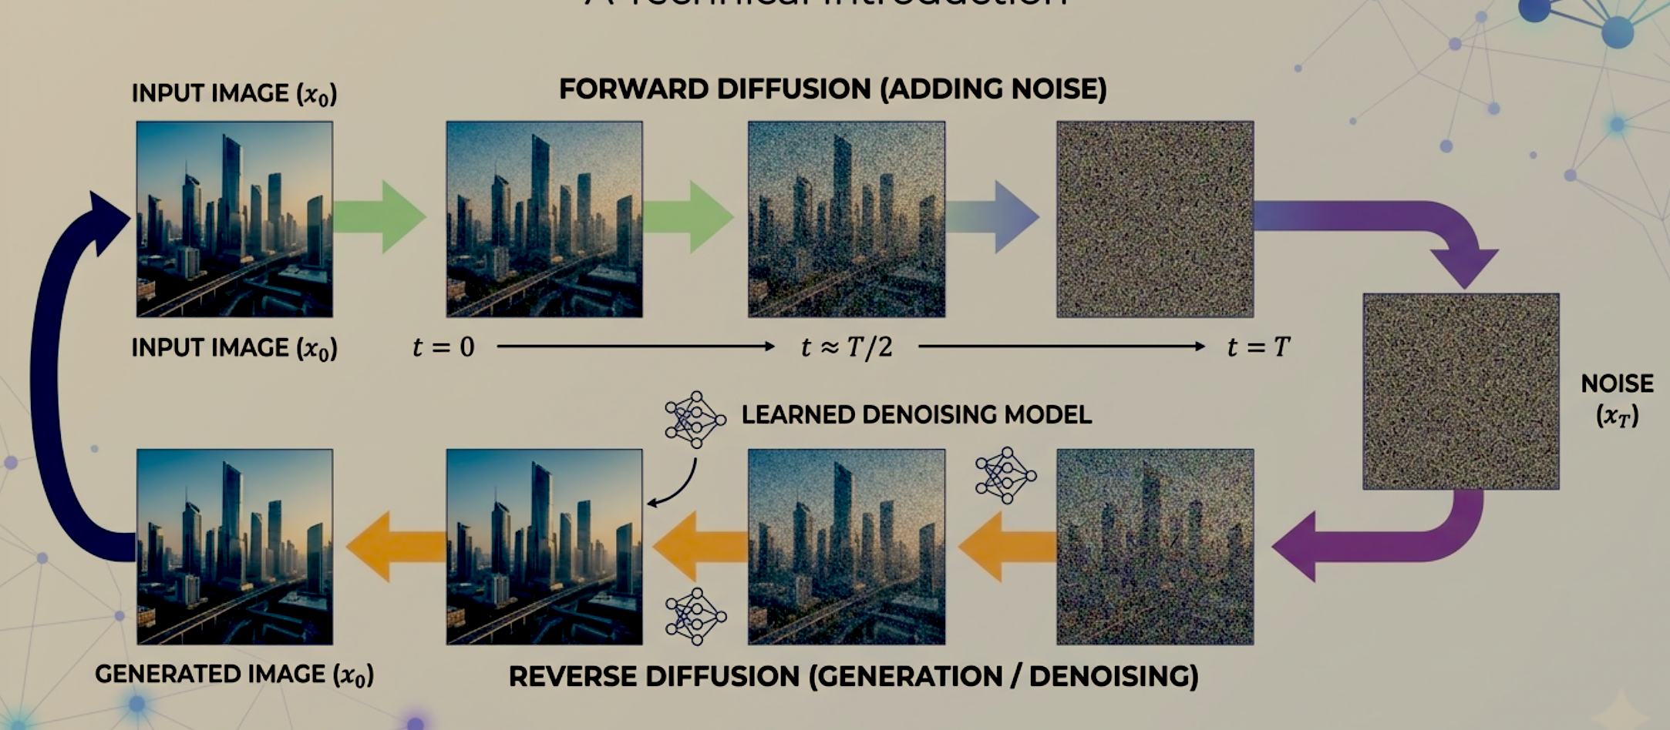
Gradually add noise and then reverse

Slide 27
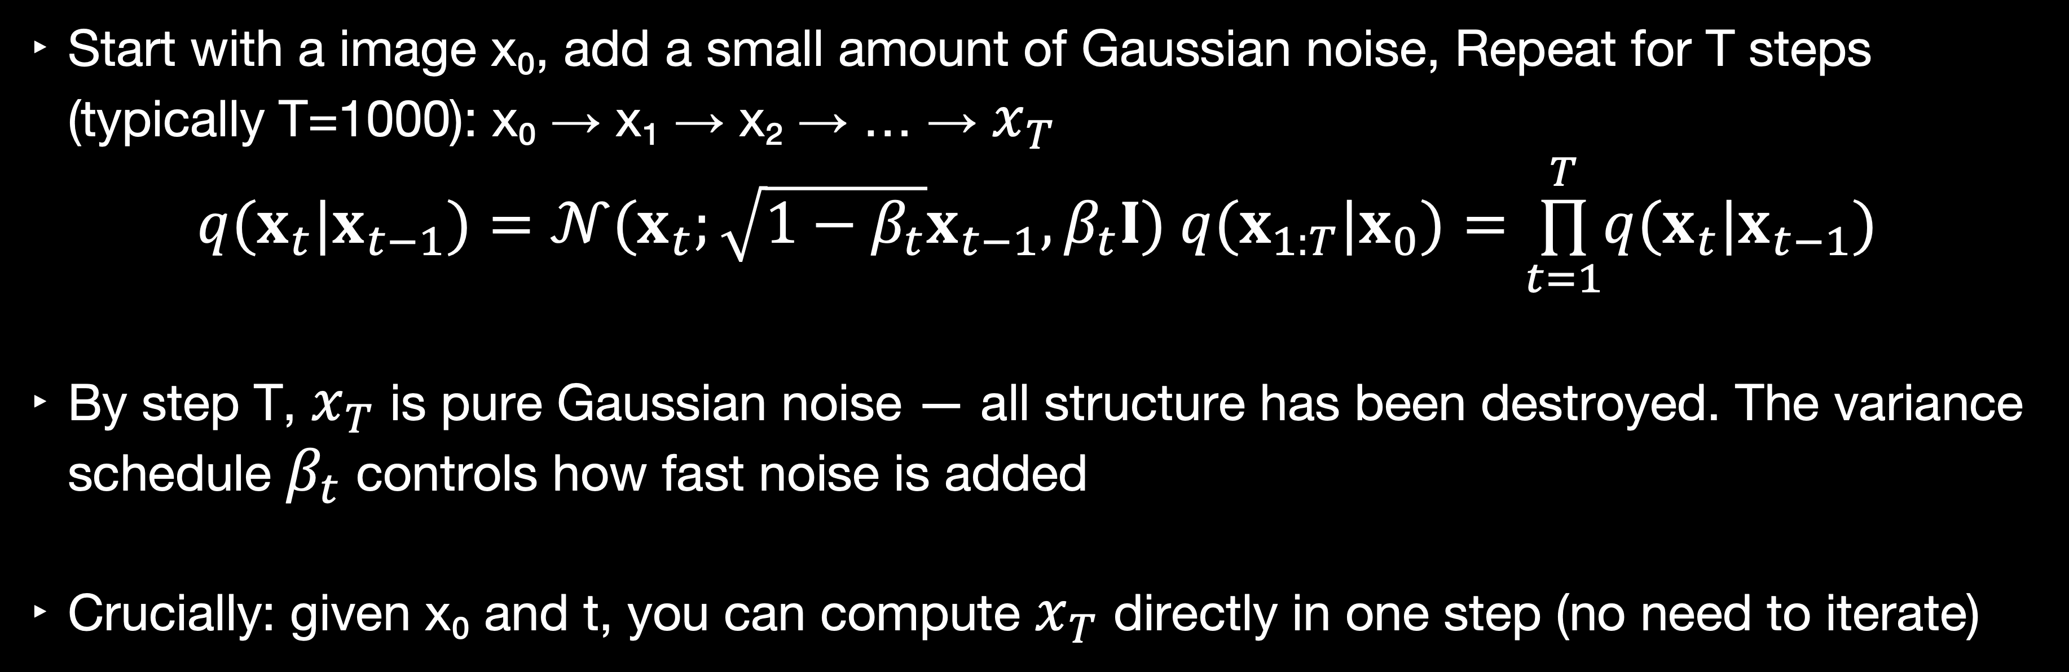
The Forward Process: Destroying Information Slowly
Start with a image x₀, add a small amount of Gaussian noise, Repeat for T steps (typically T=1000): x₀ → x₁ → x₂ → … → $x_{T}$
      $$q(x_{t}|x_{t−1})=𝒩(x_{t};\sqrt{1−β_{t}}x_{t−1},β_{t}I) q(x_{1:T}|x_{0})=\overset{T}{\underset{t=1}{∏}}q(x_{t}|x_{t−1})$$
By step T, $x_{T}$ is pure Gaussian noise — all structure has been destroyed. The variance schedule $β_{t}$ controls how fast noise is added
Crucially: given x₀ and t, you can compute $x_{T}$ directly in one step (no need to iterate)

Slide 28
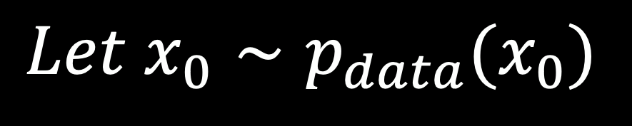
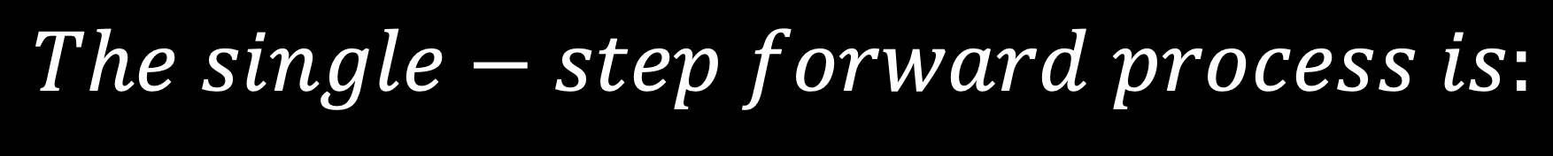
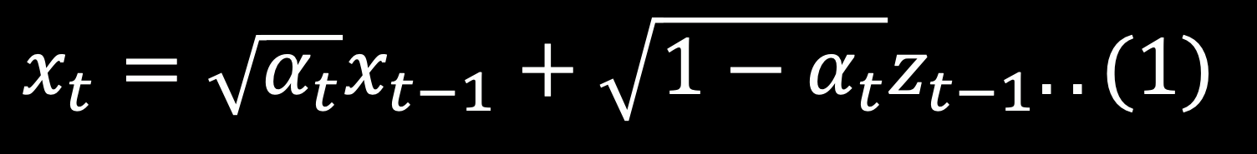
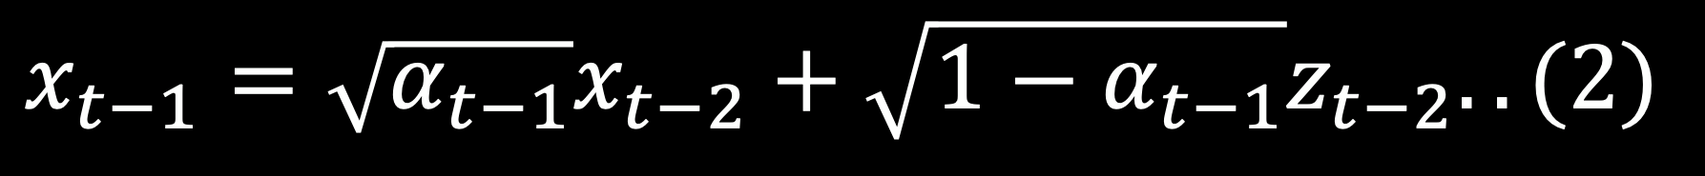
Single-step forward process
$$Let x_{0}∼p_{data}(x_{0})$$
$$Let β_{t} be the variance of the noise added at step t$$
$$To make math cleaner,we define α_{t}=1−β_{t} and the cumulative product {\overline{α}}_{t}=\overset{t}{\underset{i=1}{∏}}α_{i}$$
$$The single−step forward process is:$$
$$x_{t}=\sqrt{α_{t}}x_{t−1}+\sqrt{1−α_{t}}z_{t−1}..(1)$$
$$(where z_{t−1} is pure standard Gaussian noise𝒩(0,I))$$
$$Let us expand{ x}_{t−1 }by applying the same rule to previous step:$$
$$x_{t−1}=\sqrt{α_{t−1}}x_{t−2}+\sqrt{1−α_{t−1}}z_{t−2}..(2)$$
$$x_{t}=\sqrt{α_{t}}(\sqrt{α_{t−1}}x_{t−2}+\sqrt{1−α_{t−1}}z_{t−2})+\sqrt{1−α_{t}}z_{t−1}$$

Slide 29
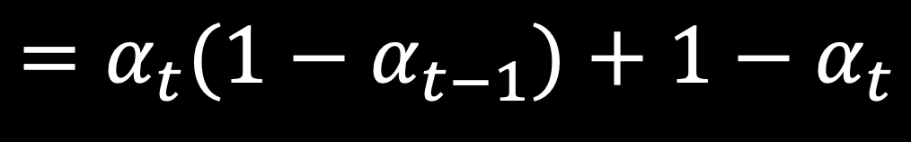
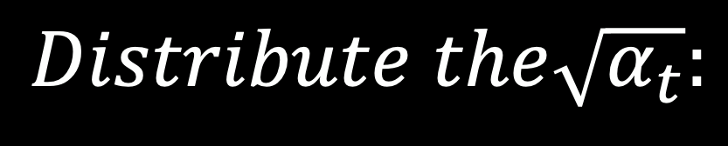
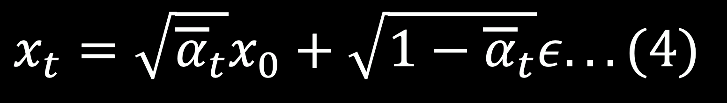
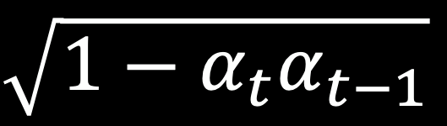
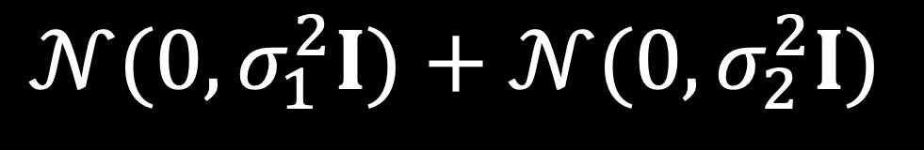
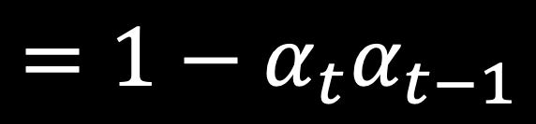
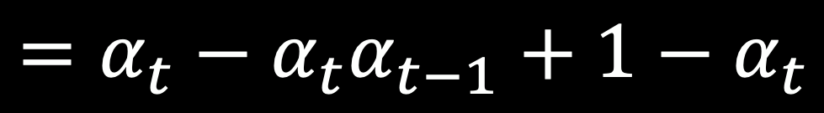
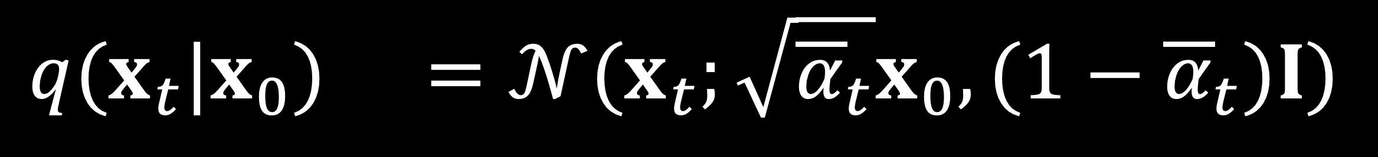
Single-step forward process (Continued)
$$Distribute the\sqrt{α_{t}}:$$
$$x_{t}=\sqrt{α_{t}α_{t−1}}x_{t−2}+\sqrt{α_{t}(1−α_{t−1})}z_{t−2}+\sqrt{1−α_{t}}z_{t−1}..(3)$$
$$𝒩(0,σ_{1}^{2}I)+𝒩(0,σ_{2}^{2}I)$$
$$is a new normal distribution 𝒩(0,(σ_{1}^{2}+σ_{2}^{2})I)$$
$$\text{Variance}=[\sqrt{α_{t}(1−α_{t−1})}]^{2}+[\sqrt{1−α_{t}}]^{2}$$
$$=α_{t}(1−α_{t−1})+1−α_{t}$$
$$=α_{t}−α_{t}α_{t−1}+1−α_{t}$$
$$=1−α_{t}α_{t−1}$$
The noise terms merge into a single noise term scaled by
$$\sqrt{1−α_{t}α_{t−1}}$$
$$x_{t}=\sqrt{{\overline{α}}_{t}}x_{0}+\sqrt{1−{\overline{α}}_{t}}ε...(4)$$
$$(where ε is the combined,single standard Gaussian noise 𝒩(0,I))$$
$$\begin{matrix}q(x_{t}|x_{0}) & =𝒩(x_{t};\sqrt{{\overline{α}}_{t}}x_{0},(1−{\overline{α}}_{t})I)\end{matrix}$$

Slide 30
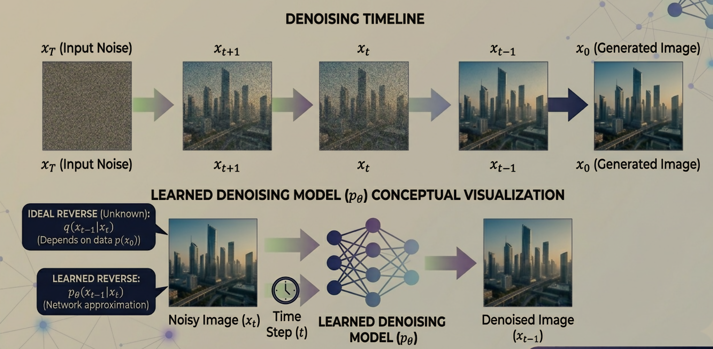
Reverse Process - De-noise

Slide 31
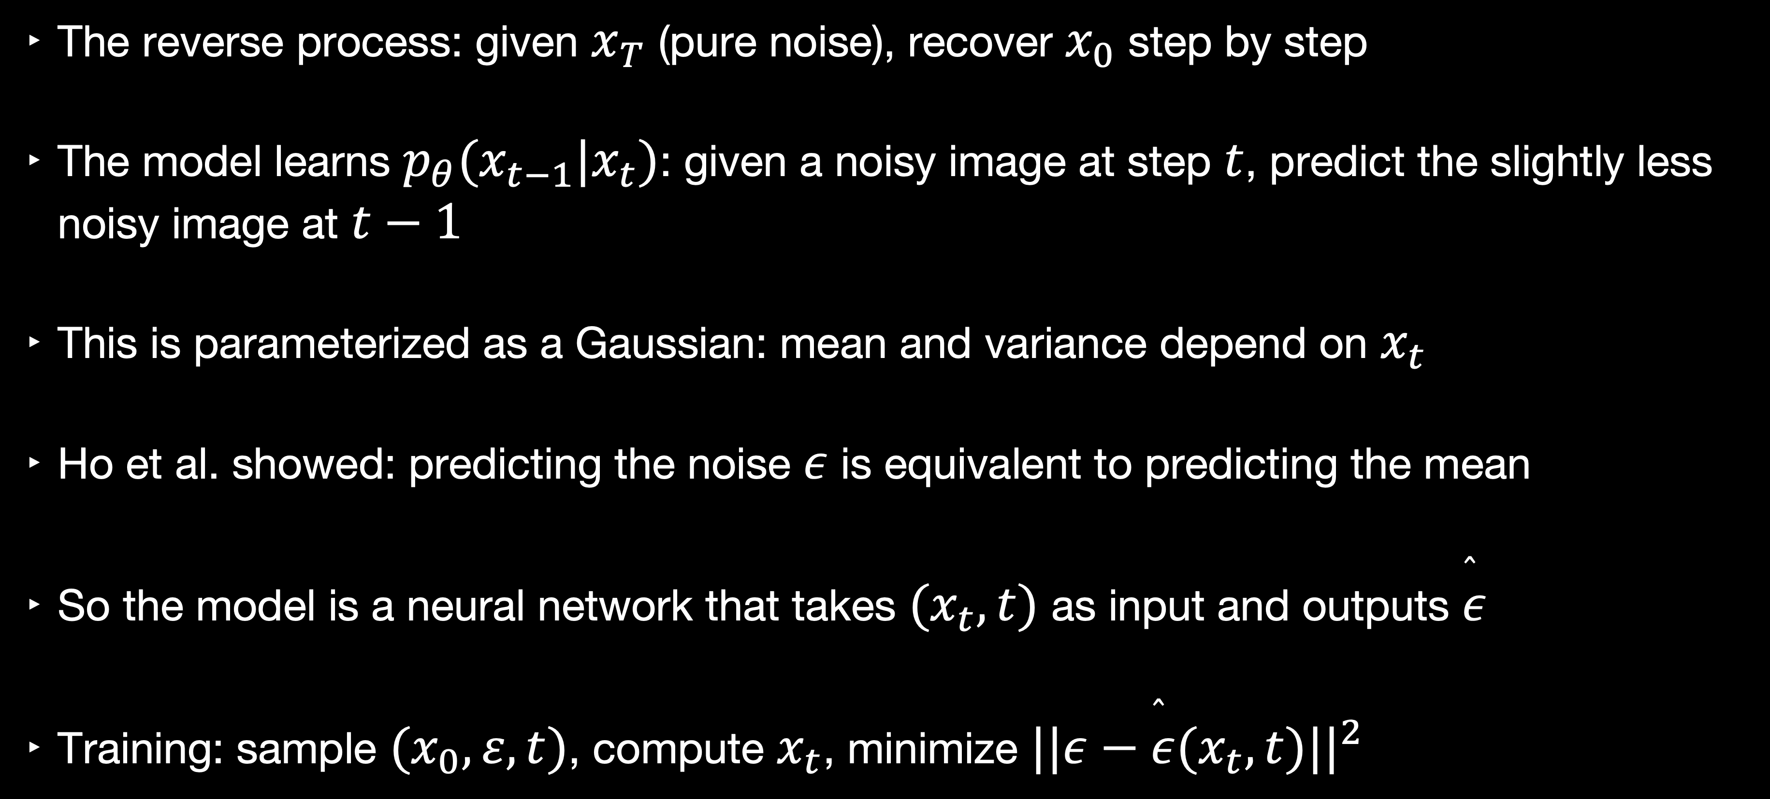
The Reverse Process: Learning to De-noise
The reverse process: given $x_{T}$ (pure noise), recover $x_{0}$ step by step
The model learns $p_{θ}(x_{t−1}|x_{t})$: given a noisy image at step $t$, predict the slightly less noisy image at $t−1$
This is parameterized as a Gaussian: mean and variance depend on $x_{t}$
Ho et al. showed: predicting the noise $ε$ is equivalent to predicting the mean
So the model is a neural network that takes $(x_{t},t)$ as input and outputs $\overset{̂}{ε}$
Training: sample $(x_{0},ε,t)$, compute $x_{t}$, minimize $||ε−\overset{̂}{ε}(x_{t},t)||^{2}$

Slide 32
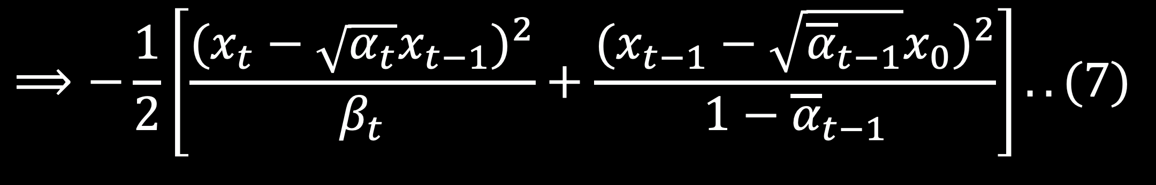
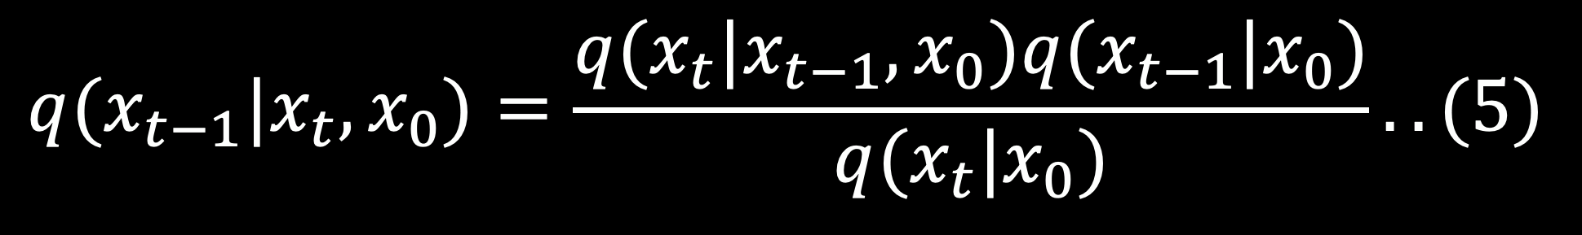
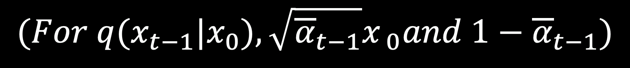
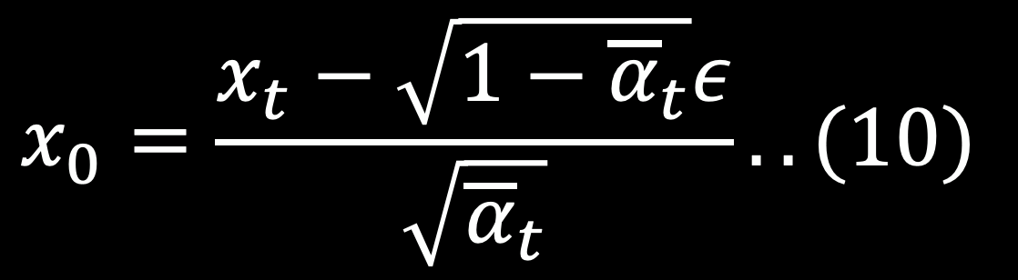
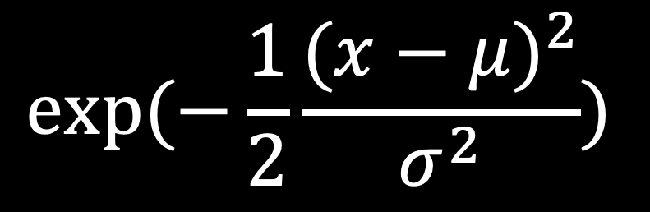
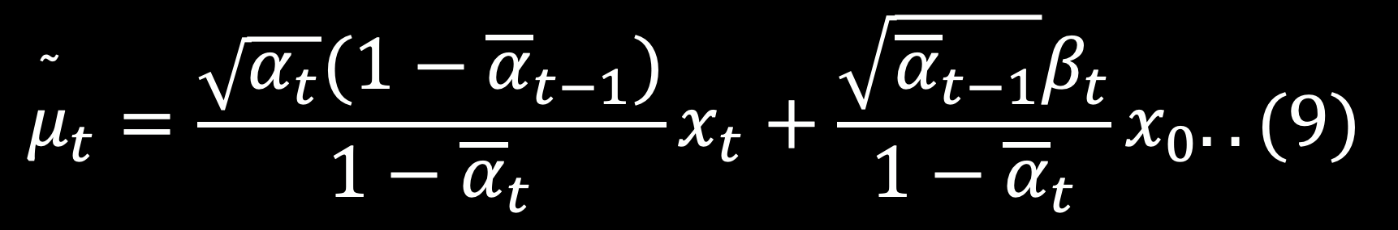
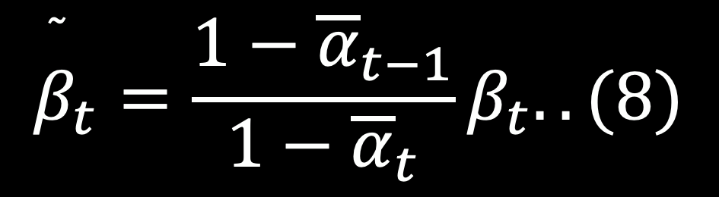
The Reverse Process: Learning to De-noise
Using Bayes’ Theorem:
$$q(x_{t−1}|x_{t},x_{0})=\frac{q(x_{t}|x_{t−1},x_{0})q(x_{t−1}|x_{0})}{q(x_{t}|x_{0})}..(5)$$
$$q(x_{t−1}|x_{t},x_{0})∝q(x_{t}|x_{t−1})⋅q(x_{t−1}|x_{0})..(6)$$
$$(For q(x_{t}|x_{t−1}), mean is \sqrt{α_{t}}x_{t−1} and variance is β_{t})$$
$$(For q(x_{t−1}|x_{0}),\sqrt{{\overline{α}}_{t−1}}x_{ 0}and 1−{\overline{α}}_{t−1})$$
$$exp(−\frac{1}{2}\frac{(x−μ)^{2}}{σ^{2}})$$
$$⟹−\frac{1}{2}\left[\frac{(x_{t}−\sqrt{α_{t}}x_{t−1})^{2}}{β_{t}}+\frac{(x_{t−1}−\sqrt{{\overline{α}}_{t−1}}x_{0})^{2}}{1−{\overline{α}}_{t−1}}\right]..(7)$$
$${\overset{˜}{β}}_{t}=\frac{1−{\overline{α}}_{t−1}}{1−{\overline{α}}_{t}}β_{t}..(8)$$
$${\overset{˜}{μ}}_{t}=\frac{\sqrt{α_{t}}(1−{\overline{α}}_{t−1})}{1−{\overline{α}}_{t}}x_{t}+\frac{\sqrt{{\overline{α}}_{t−1}}β_{t}}{1−{\overline{α}}_{t}}x_{0}..(9)$$
$$x_{0}=\frac{x_{t}−\sqrt{1−{\overline{α}}_{t}}ε}{\sqrt{{\overline{α}}_{t}}}..(10)$$

Slide 33
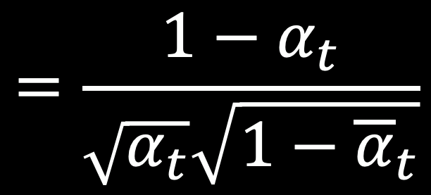
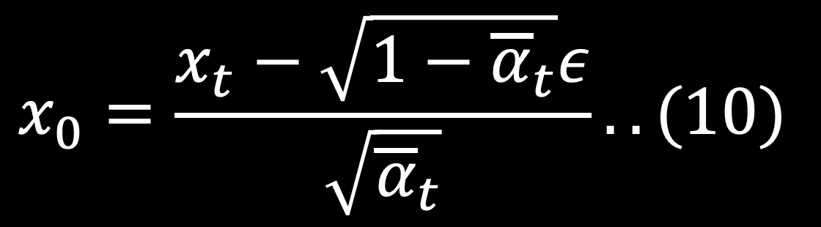
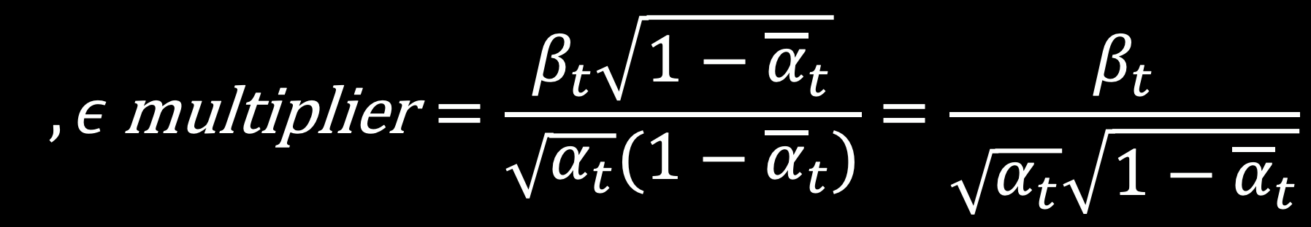
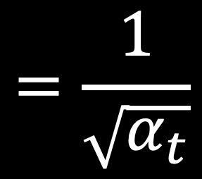
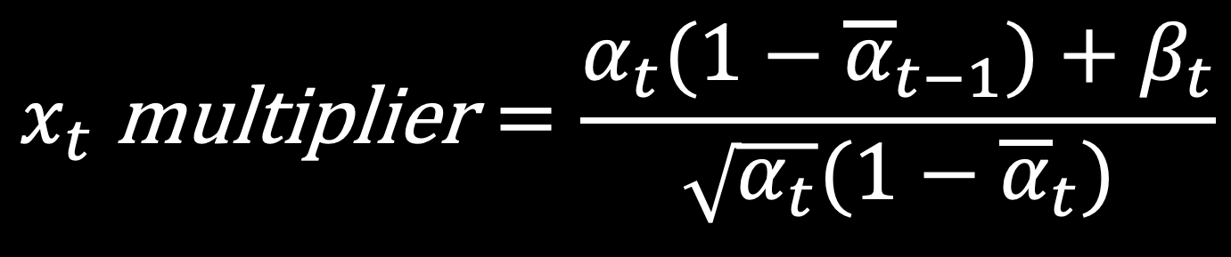
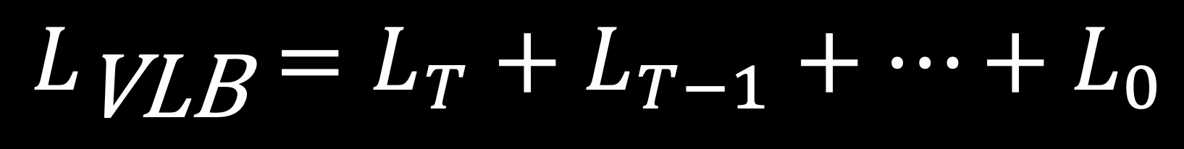
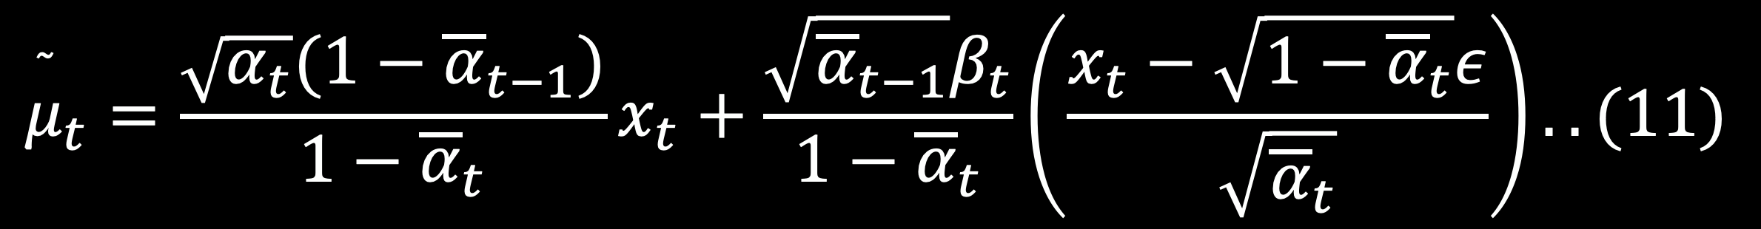
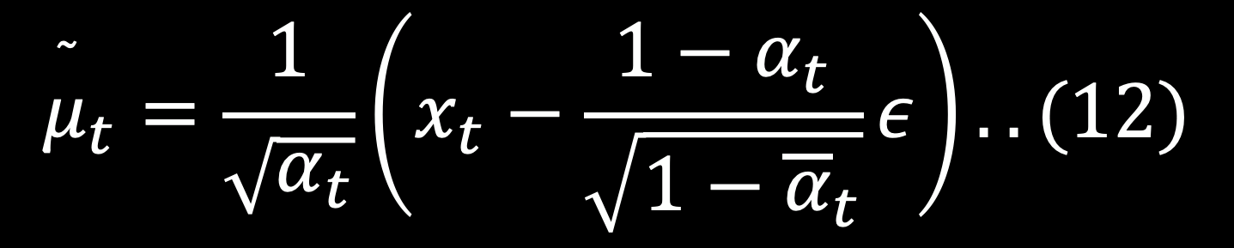
The Reverse Process: Learning to De-noise
$$x_{0}=\frac{x_{t}−\sqrt{1−{\overline{α}}_{t}}ε}{\sqrt{{\overline{α}}_{t}}}..(10)$$
$${\overset{˜}{μ}}_{t}=\frac{\sqrt{α_{t}}(1−{\overline{α}}_{t−1})}{1−{\overline{α}}_{t}}x_{t}+\frac{\sqrt{{\overline{α}}_{t−1}}β_{t}}{1−{\overline{α}}_{t}}\left(\frac{x_{t}−\sqrt{1−{\overline{α}}_{t}}ε}{\sqrt{{\overline{α}}_{t}}}\right)..(11)$$
$$x_{t} \text{multiplier}=\frac{α_{t}(1−{\overline{α}}_{t−1})+β_{t}}{\sqrt{α_{t}}(1−{\overline{α}}_{t})}$$
$$=\frac{1}{\sqrt{α_{t}}}$$
$$,ε \text{multiplier}=\frac{β_{t}\sqrt{1−{\overline{α}}_{t}}}{\sqrt{α_{t}}(1−{\overline{α}}_{t})}=\frac{β_{t}}{\sqrt{α_{t}}\sqrt{1−{\overline{α}}_{t}}}$$
$$=\frac{1−α_{t}}{\sqrt{α_{t}}\sqrt{1−{\overline{α}}_{t}}}$$
$${\overset{˜}{μ}}_{t}=\frac{1}{\sqrt{α_{t}}}\left(x_{t}−\frac{1−α_{t}}{\sqrt{1−{\overline{α}}_{t}}}ε\right)..(12)$$
$$L_{\text{VLB}}=L_{T}+L_{T−1}+…+L_{0}$$

Slide 34
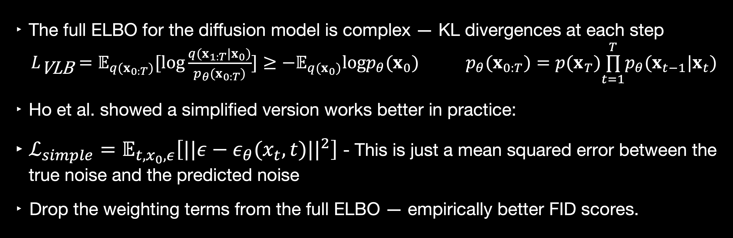
The Training Objective: Simplified ELBO
The full ELBO for the diffusion model is complex — KL divergences at each step
        $L_{\text{VLB}}=𝔼_{q(x_{0:T})}[log\frac{q(x_{1:T}|x_{0})}{p_{θ}(x_{0:T})}]≥−𝔼_{q(x_{0})}logp_{θ}(x_{0})$ $p_{θ}(x_{0:T})=p(x_{T})\overset{T}{\underset{t=1}{∏}}p_{θ}(x_{t−1}|x_{t})$
Ho et al. showed a simplified version works better in practice:
$ℒ_{simple}=𝔼_{t,x_{0},ε}\left[||ε−ε_{θ}(x_{t},t)||^{2}\right]$ - This is just a mean squared error between the true noise and the predicted noise
Drop the weighting terms from the full ELBO — empirically better FID scores.

Slide 35
Sampling: Walking Back Through Noise
Sample xT ~ N(0, I) — start from pure Gaussian noise
For t = T, T-1, ..., 1: compute x_{t-1} = (1/√α_t)(x_t - β_t/√(1-ᾱ_t) · ε_θ(x_t, t)) + σ_t·z
At each step: predict the noise, remove most of it, add a tiny bit of fresh noise
The fresh noise injection (σ_t · z) is important: it prevents the sample from collapsing
Requires T=1000 forward passes through the network — expensive!
This is the sampling bottleneck that motivates all subsequent distillation work

Slide 36
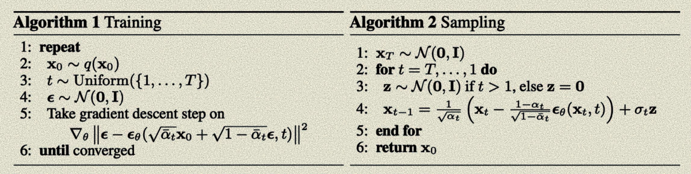
Sampling & Training algorithms

Slide 37
DDPM Results and Impact
DDPM matched or exceeded GAN quality on CIFAR-10 and 256x256 LSUN — without adversarial training
FID scores competitive with the best GANs of the time
Log-likelihoods better than any previous likelihood-based model
Stable, reproducible training — no mode collapse, no discriminator balancing
Within 18 months: Stable Diffusion, DALL-E 2, Imagen all built on this foundation

Slide 38
Classifier-Free Guidance

Slide 39
The Conditional Generation Problem
Unconditional generation: sample from p(x) — any image from the training distribution
Conditional generation: sample from p(x|c) — an image matching a condition c (text, class, etc.)
For text-to-image: the model should generate an image matching the text prompt
First approach: classifier guidance (Dhariwal & Nichol, 2021)
Train a noise-robust classifier p(c|x_t) and use its gradient to steer the diffusion process
Problem: requires a separate classifier trained on noisy images — double the training complexity

Slide 40
Classifier-Free Guidance: One Model, Two Roles
Ho & Salimans (2022): train a single model that handles both conditional and unconditional generation
During training: randomly drop the condition c with probability p (e.g. 10–20%)
When c is dropped, replace with a null token ∅ — the model learns unconditional generation
At inference: run the model twice — once with condition, once without
Guided score = unconditional score + w · (conditional score − unconditional score)
w is the guidance scale: higher w = more faithful to condition, less diverse

Slide 41
Why CFG Was a Turning Point
Eliminated the need for a second trained model — simpler pipeline
The guidance scale w became a user-controllable knob: creativity vs. fidelity
W ≈ 7.5 became the default for Stable Diffusion (a well-calibrated sweet spot)
Made high-quality text-to-image generation practical to train and deploy
Every major text-to-image model since 2022 uses CFG or a direct descendant
The null conditioning ∅ trick: elegant, general, applicable beyond text prompts

Slide 42
The Guidance Scale Tradeoff
Low w (1–3): diverse, creative, sometimes doesn't match the prompt well
Medium w (5–9): good balance — matches prompt, retains variety
High w (10–20): very prompt-faithful, but images can look oversaturated or distorted
Very high w (>20): artifacts, unrealistic images — the model is being pushed off-manifold
The tradeoff is fundamental: there's no free lunch between diversity and fidelity
Recent work (Perturbed-Attention Guidance, etc.) tries to get better tradeoffs

Slide 43
Negative Prompting: CFG's Unexpected Gift
CFG opened an unexpected door: negative prompting
Instead of null ∅, use a negative condition c_neg: 'blurry, low quality, watermark'
Guided score = ε(x_t, c_neg) + w · (ε(x_t, c_pos) - ε(x_t, c_neg))
Steers the generation away from the negative condition and toward the positive
Not in the original paper — discovered by the community through experimentation
Became a standard technique in Stable Diffusion workflows almost immediately

Slide 44
Architectures

Slide 45
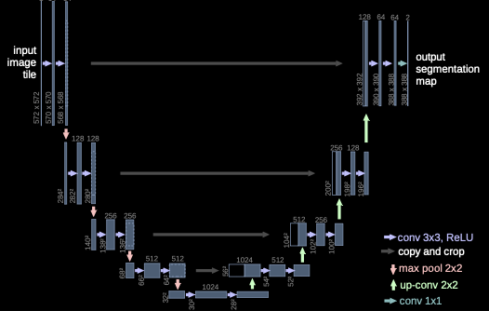
UNet (Ronneberger et al., 2015)

Slide 46
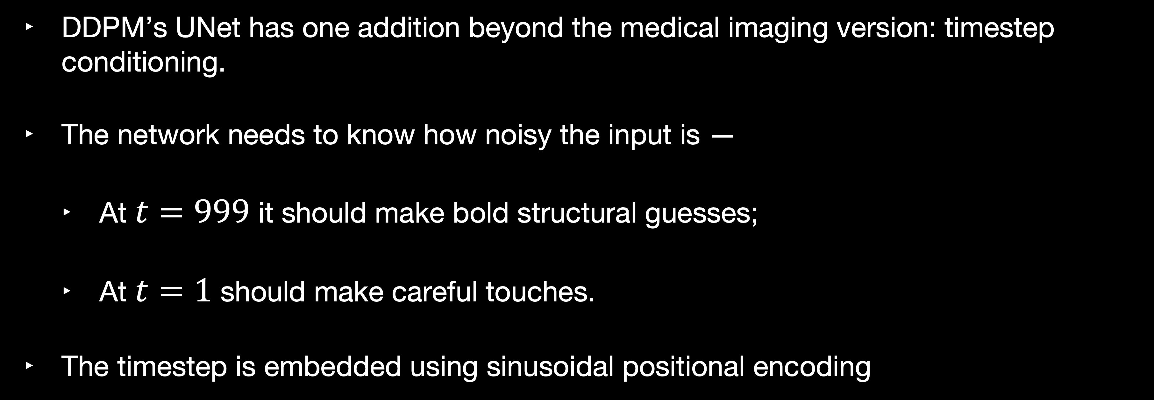
Modifications to UNet
DDPM’s UNet has one addition beyond the medical imaging version: timestep conditioning.
The network needs to know how noisy the input is —
  At $t=999$ it should make bold structural guesses;
  At $t=1$ should make careful touches.
The timestep is embedded using sinusoidal positional encoding

Slide 47
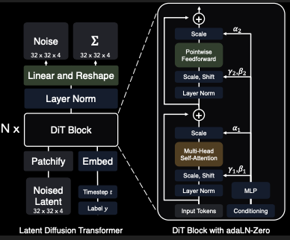
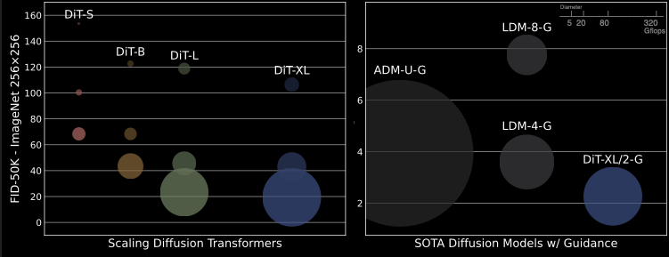
Scalable Diffusion Models with Transformers

Slide 48
DiT Architecture: Patches as Noisy Latents
Input: the noisy latent from the VAE (e.g. 32x32x4 for a 256x256 image in latent space)
Patchify: split into non-overlapping patches (e.g. 2x2), flatten each to a vector
Add positional embeddings to preserve spatial structure
Add timestep embedding and class/text conditioning via adaLN-Zero modulation
Stack N transformer blocks — standard self-attention + MLP
Unpatchify: reshape output back to spatial layout, predict noise ε

Slide 49
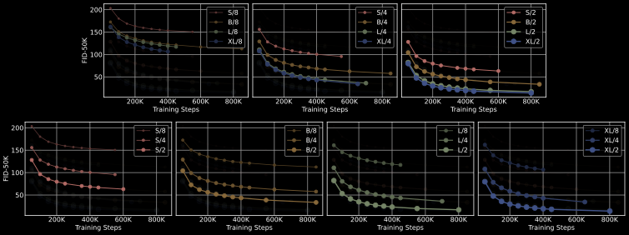
Scalable Diffusion Models with Transformers - Results

Slide 50
DiT Scaling: The Transformer Advantage
Peebles & Xie tested DiT-S, DiT-B, DiT-L, DiT-XL (28 to 675 million parameters)
Finding: FID improves smoothly and predictably with model size — no saturation
DiT-XL/2 achieved state-of-the-art FID on ImageNet 256x256, beating UNet-based ADM
The result held across compute budgets — more compute always helps, no ceiling visible
This is the transformer scaling law applied to image generation
Practical implication: you can plan your compute budget and predict output quality

Slide 51
Text-to-Image Generation

Slide 52
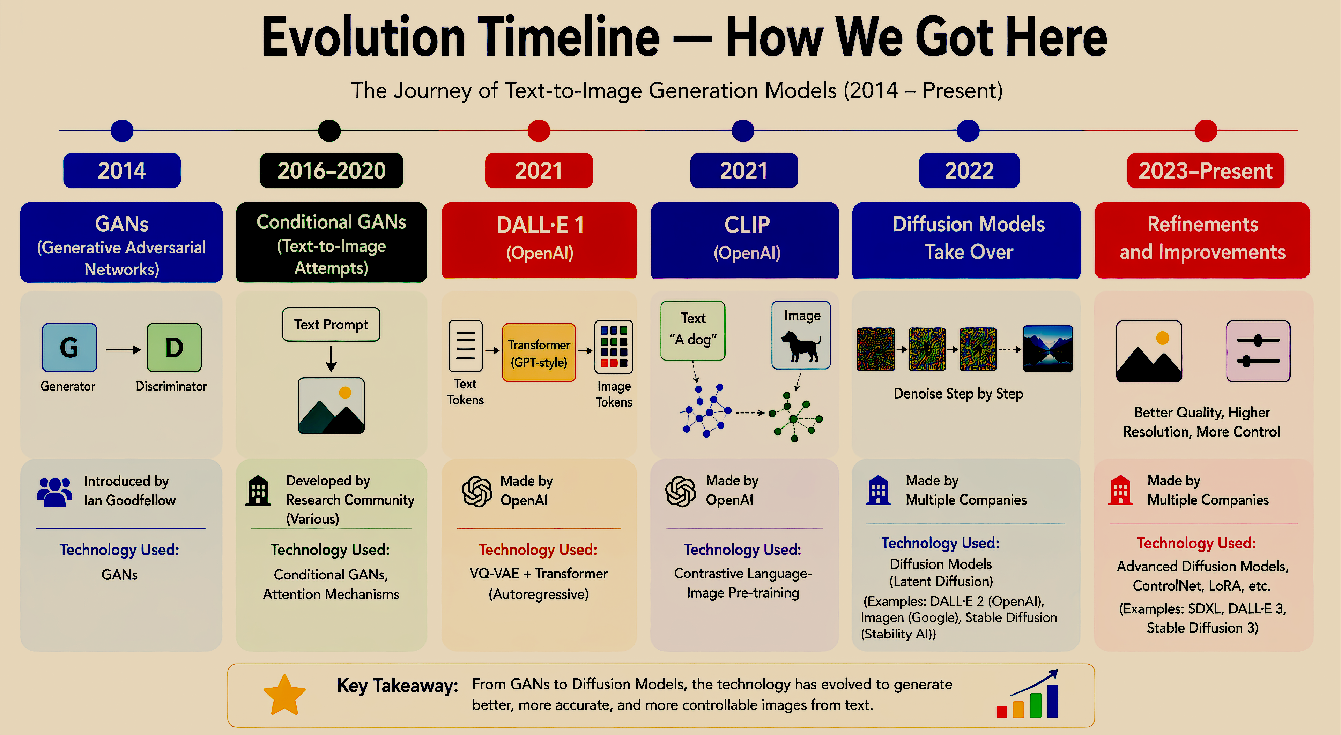

Slide 53
What is Text-to-Image Generation?
Text-to-Image Generation is the task of automatically synthesizing a realistic or artistic image from a natural language description (called a "prompt"). The model takes a sentence like "a red fox sitting on a snowy mountain at sunset" and produces a pixel-level image that matches that description.
Key characteristics:
Input: free-form natural language text
Output: high-resolution image (typically 512×512 or 1024×1024 pixels)
The model must understand both language semantics and visual concepts simultaneously
Real-World Text-to-Image Systems
DALL·E 3 — created by OpenAI (2023)
Stable Diffusion — created by Stability AI (2022)
Midjourney — created by Midjourney Inc. (2022)
Imagen — created by Google (2022)
Adobe Firefly — created by Adobe (2023)

Slide 54
Why is Text-to-Image Generation Hard?
Text-to-image generation is difficult because it has to connect text (words) with images (visuals).
There are three main challenges:
Challenge 1 — Large Image Size
Images have a huge number of pixels. For example, A 512×512 image has more than (700,000+) pixel values.
The model must figure out which pixel values make a real image.
Random pixels do not form a clear or meaningful image.
Challenge 2 — Understanding Text and Images Together
Words can have different meanings. For example, “apple” can mean a fruit or a company.
The model must learn how words match with correct images.
Challenge 3 — Understanding Relationships
Prompts can be complex. For example, A red ball next to a blue box.
The model must understand: objects, colors, positions.

Slide 55
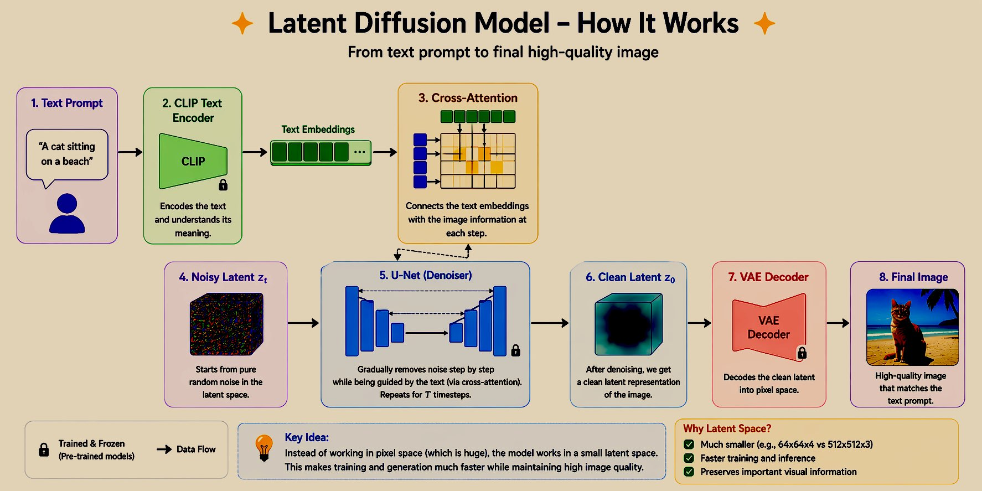

Slide 56
What is a Latent Diffusion Model?
A Latent Diffusion Model is a method used to generate images from text.
It does not work directly on full images. Instead, it works on a small compressed version of the image (called latent space) and then converts it into a full image.
Simple Idea (Core Concept)
Imagine you want to draw “a cat sitting on a beach”.
First, you make a rough sketch (small version).
Then you add details step by step.
Latent Diffusion Model works in the same way:
It first works on a small compressed version of the image, and then converts it into a full high-quality detailed image.
Why is this useful?
A full image (512×512) has a very large number of pixels (~700,000)
The compressed version has much fewer values (~16K)
Because of this:
Training becomes faster
Image generation is quicker
The quality of the image is still maintained

Slide 57
Why Latent Space? (Role of VAE)
Working directly on full images is difficult because images have a very large number of pixels. The model has to process all of them at every step. This makes training very slow and requires high computational power.
To solve this problem, we use a compressed version of the image, called latent. This is done using a Variational Auto-encoder (VAE), which helps reduce the size of the data while keeping important information.
What is VAE (Variational Auto-encoder)?
A VAE has two main parts:
Encoder (E): Converts the original image into a smaller compressed form (latent z)
Decoder (D): Converts the compressed form back into a full image
What does latent space look like?
Original image: 512 × 512 × 3
Latent representation: 64 × 64 × 4
Smaller but still keeps important features (shapes, colors)
Why is latent space useful?
Reduces computation
Makes training faster
Speeds up image generation
Maintains good image quality

Slide 58
VAE Architecture (Encoder & Decoder)
Encoder
Takes input image (512 × 512 × 3)
Gradually reduces size using convolution layers
Final output is a small compressed representation
Instead of directly giving latent z, it gives
Mean (μ)
Standard deviation (σ)
Sampling
Latent z is created using:
z = μ + ε · σ
Here, ε is random noise
This helps the model:
Learn better
Stay flexible during training

Slide 59
VAE Architecture (Encoder & Decoder)
Decoder.
Takes compressed latent (64 × 64 × 4)
Gradually increases size (upsampling)
Converts it back to full image (512 × 512 × 3)
Output is a reconstructed image
Loss Function
It has two parts
Reconstruction Loss: Makes output image similar to original
KL Divergence: Keeps latent space smooth and well-organized

Slide 60
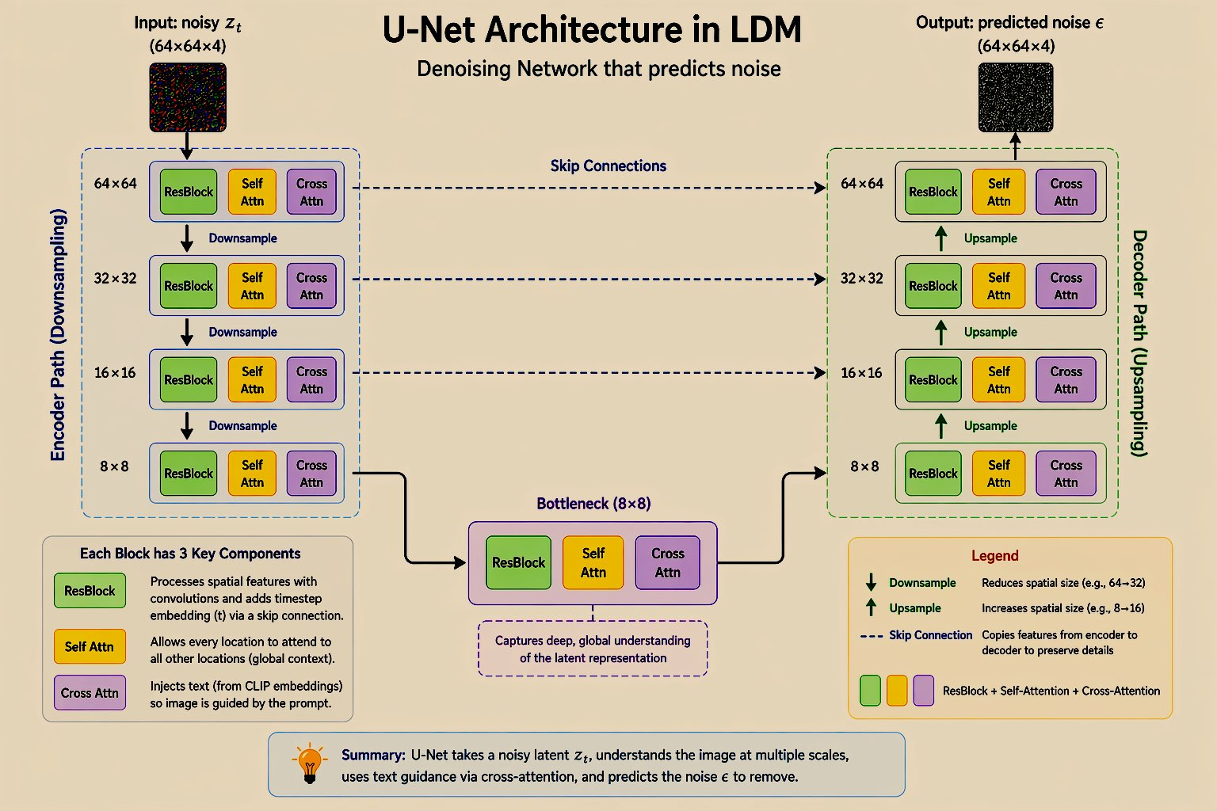
The U-Net is the main model used for denoising. It takes a noisy latent (zₜ) and predicts the noise. The U-Net can understand big structure and small details. This make it perfect for removing noise step by step.

Slide 61
U-Net Architecture (Heart of LDM)
Important Components
ResBlock
ResBlock processes the image features and also uses the timestep (t) to understand how much noise is present at that step, so the model can adjust accordingly
Self-Attention
Self-attention allows the model to connect all parts of the image, helping it maintain overall consistency and understand the global structure
Cross-Attention
Cross-attention connects the text with the image, allowing the model to focus on important words in the prompt and generate images that match the description
4. Skip Connections
Skip connections directly connect the encoder layers to the corresponding decoder layers. This helps transfer important information that might be lost during downsampling. As a result, the model can preserve fine details like edges, textures, and shapes, leading to a more accurate and clearer final image.

Slide 62
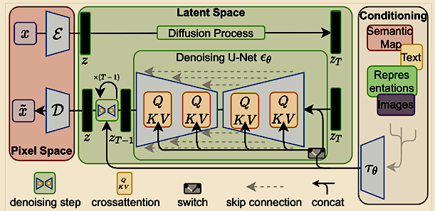
Modifications to UNet

Slide 63
CLIP Text Encoder — Turning Words into Guidance
CLIP(Contrastive Language-Image Pre-training) is a model developed by OpenAI. It learns how text and images are related. Words and matching images are placed close together in a shared space.
CLIP has two separate encoders:
          Text Encoder: Converts text into numerical vectors (embeddings).
          Image Encoder: Converts images into embeddings. It Used only during training, not in LDM.
How CLIP was Trained
It is Trained on many image–text pairs
It is learned to match correct text with correct image and separate wrong pairs
So, it understands meaning of words visually

Slide 64
CLIP Text Encoder — Turning Words into Guidance
What LDM Uses from CLIP.
LDM uses only the text encoder part of CLIP.
The text prompt is converted into embeddings (numerical form)
These embeddings are then used to guide the image generation process
Why CLIP is Important
It can understand different visual concepts such as objects, styles, colors, lighting, emotions, etc.
Because of this, it helps the model create images that closely follow the given prompt

Slide 65

Cross-Attention — How Text Controls the Image
Cross-Attention is the mechanism that connects text with image generation. It helps the model decide: “Which word is important for this part of the image?”. Each part of the image looks at the text and selects the most relevant words, so different parts of the image follow different words.
Inputs to Cross-Attention
Q (Query): from image latent features inside U-Net(latent features)
K (Key): from text embeddings (shape: tokens × channels)
V (Value): from text embeddings (same shape as K)
$$Attention\left(Q , K , V\right)=softmax\left(\frac{QK^{T}}{\sqrt{d}}\right)V$$
QKᵀ → finds similarity between image parts and words
softmax(...) → converts it into importance (which word matters more)
V → uses that important text information to guide the image
Example:
Prompt: “a red apple on a wooden table”
Apple area → focuses on “red”, “apple”
Table area → focuses on “wooden”, “table”

Slide 66
DDIM Sampler — Making Image Generation Fast
Problem with DDPM
Needs ~1000 denoising steps
Very slow (30–60 sec per image)
Requires many U-Net passes
What is DDIM?
A faster sampling method
Skips many steps during generation (Instead of 1000 steps → only 20–50 steps)
Key Idea
Take larger jumps while removing noise
Still produces similar quality images
Important Properties
Deterministic (Same input → same output image)
Fast (Much fewer steps needed)
Controllable (Can smoothly change or mix images)

Slide 67
Prompt Control — How You Guide the Image
What is Prompt Control?
  Using text to guide image generation
  Different prompts → different images
  Words directly affect the final output
Why it Matters
  Model converts text → numbers (via CLIP)
  These numbers guide image creation
Better prompt = better image
Structure of a Good Prompt
Subject: what to generate
Style: how it should look
Lighting: mood and effects
Quality: detail level (HD, sharp, etc.)
Negative Prompt: what to avoid

Slide 68
CFG (Guidance Scale)
Controls how strongly the model follows the prompt
Low → more random
Medium (7–12) → best balance
High → too strict, may look unnatural
Like a volume control for the prompt

Slide 69
Text-Conditioned Image Generation
What does it mean?
  Text guides the image at every step of generation
  Not just at the start → it continuously controls the output
How Text Enters the Model
Tokenization
          Text prompt → split into tokens (max 77)
Text Encoding (CLIP)
  Tokens → embeddings (numerical form)
Cross-Attention (U-Net)
  Image features connect with text
  Each part of image focuses on relevant words
Denoising Steps
  This happens at every step (20–50 times)
  Text keeps guiding until final image

Slide 70
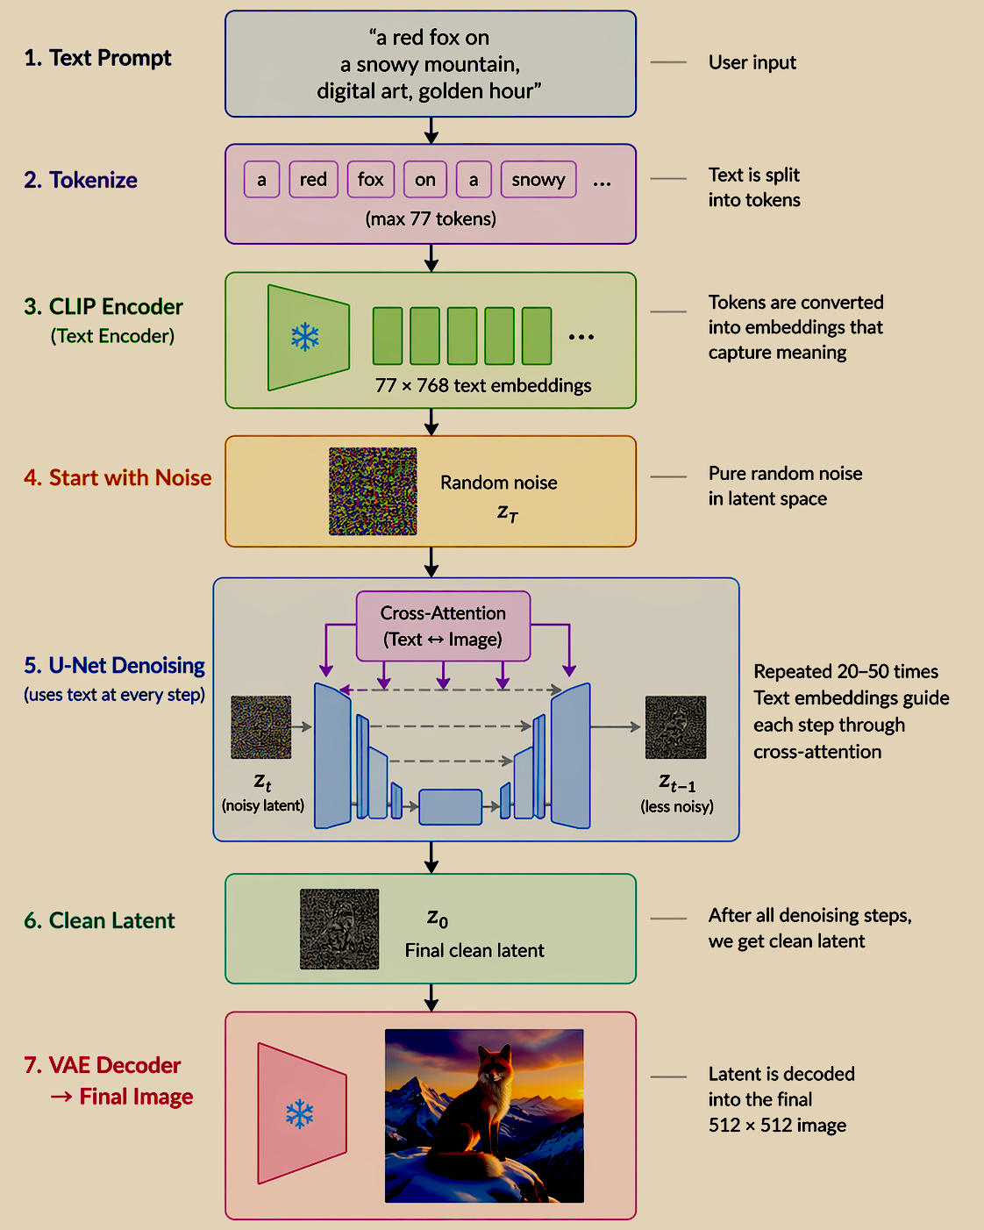
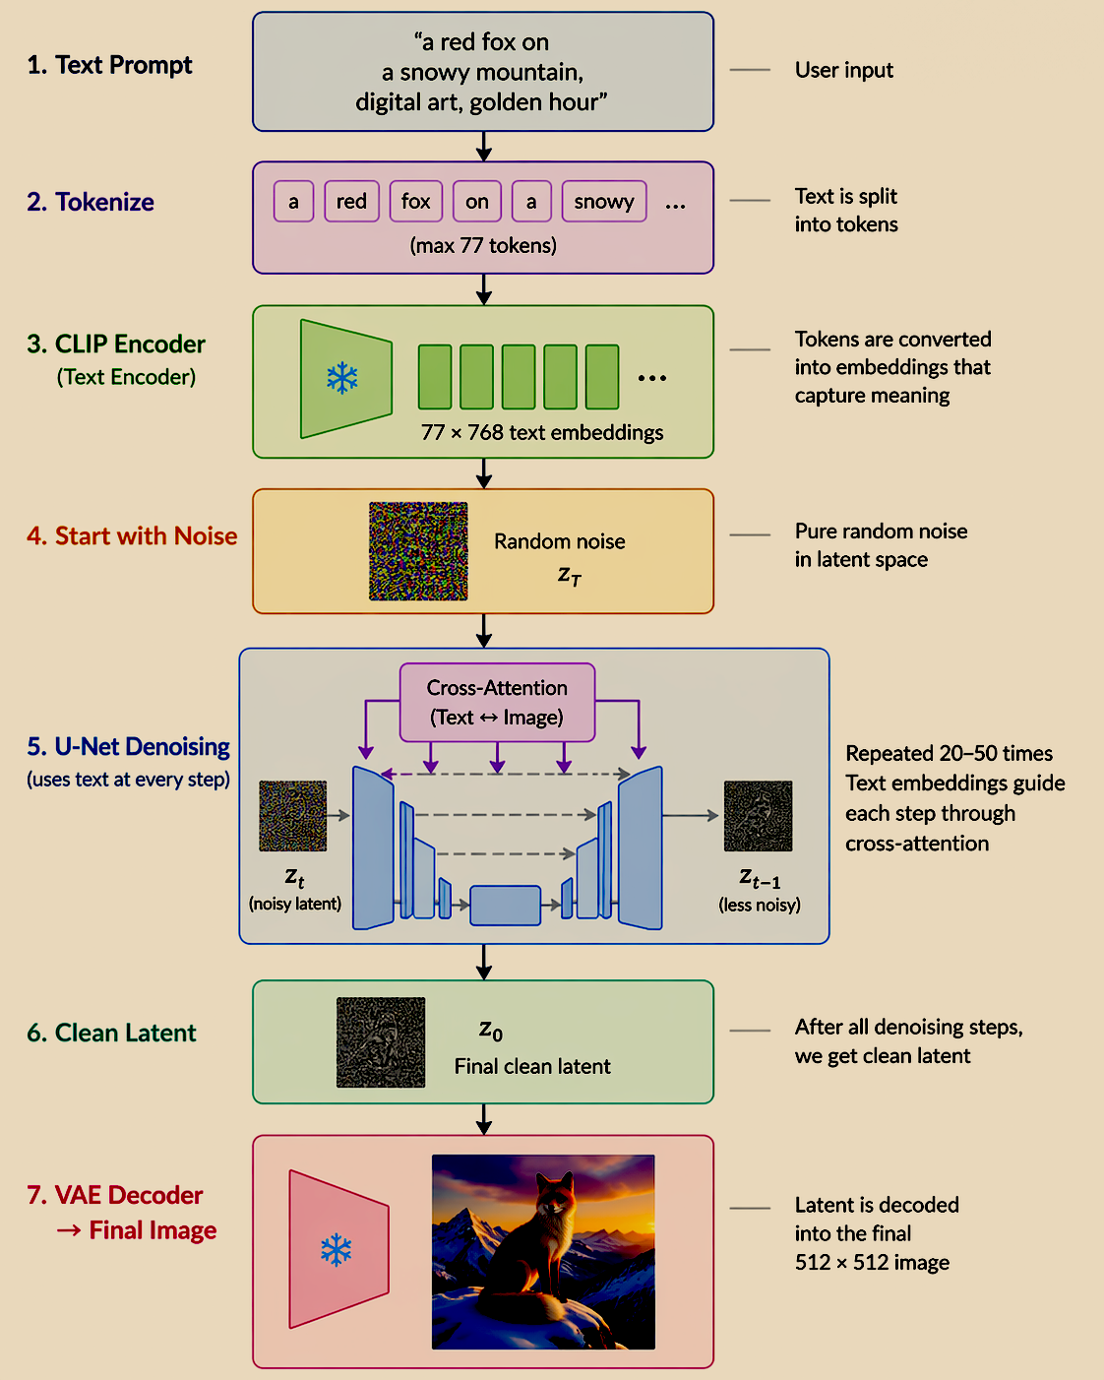
Text-Conditioned Image Generation

Slide 71
Text-Conditioned Image Generation - Fine Tuning
Why This is Important
Keeps image aligned with prompt.
Maintains both overall structure and fine details.
LoRA (Extra Customization)
Used to teach new styles or objects
Trains small layers instead of full model which is Fast and efficient fine-tuning

Slide 72
What These Systems Still Can't Do Well
Accurate text rendering in images (improving, but still unreliable)
Complex spatial compositions with many objects and relationships
Consistent character identity across multiple generated images
Long-horizon video with coherent narrative and object persistence
Truly novel concept combinations far from the training distribution
These are the open problems — and they point toward the next wave of research

Slide 73
A Glimpse of Where We're Going
Real-time image generation (4–8 steps, consumer GPU)
Video, 3D, audio — diffusion generalizes beyond images
The boundary between diffusion models and language models is dissolving
Discrete token diffusion: what happens when you apply this to text? To code?
The next 5 years: systems that don't distinguish between generating text and generating images

