Slide 1

Self-Supervised Learning
CheWei Hsu
tuu94754@temple.edu
Computer & Information Science
MingChun Lee
tuu95941@temple.edu
Computer & Information Science
Kavan Patel
tuu85435@temple.edu
Computer & Information Science
CIS 5543: COMPUTER VISION
Spring 2026

Slide 2


Three Learning Paradigms in Machine Learning
Supervised Learning
Unsupervised Learning
Self-Supervised Learning
Idea
Has labeled data
Learn mapping: input → label
Pros
High accuracy
Cons
Requires manual labeling
Idea
No labels
Discover structure
What it learns
Clustering
Density estimation
Problem
No clear objective
Idea
No manual labels
Generate supervision from data

Slide 3
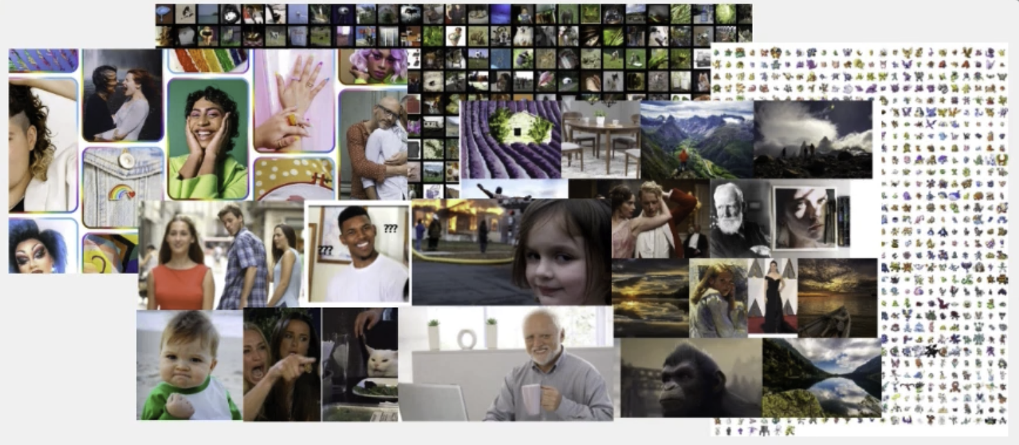

What is Self-Supervised Learning?
?
?
Task
Answer

Slide 4
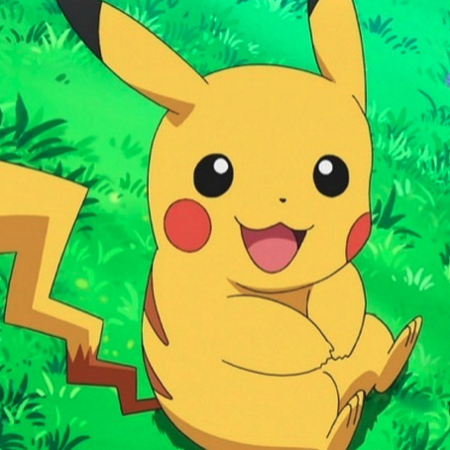
Examples
Task
Given
Predict
Answer

Slide 5
Examples
Task
Given
Predict
Answer
Image with missing parts
Missing part

Slide 6
Examples
Task
Given
Predict
Answer
Shuffled image patches
Spatial order

Slide 7



Examples: Contrastive Learning
Similar
Data Augmentation
Different
Different

Slide 8
Summary
Q: Why do we learn these “proxy tasks”? We don’t need a model that only solves puzzles.
A: These “proxy tasks” help build a foundation for the model to understand the world. With this foundation, it can learn new tasks more efficiently.
What is self-supervised?
Create supervision from unlabeled data
Hide part of the data and predict the missing parts from the rest
Learn from the data itself
Build a strong foundation for downstream tasks

Slide 9
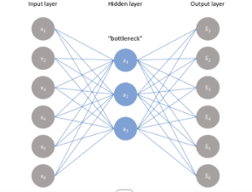
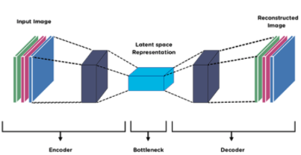
Autoencoders
What is Autoencoder?
An autoencoder is a neural network that learns compressed representations (latent space) of input data
It is trained to reconstruct the input from the latent code
Used for unsupervised representation learning

Slide 10
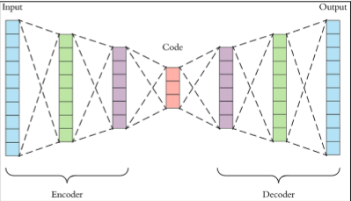
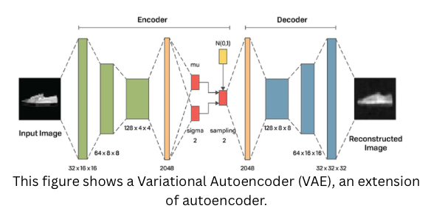
Architecture
Process: Input → Encoder → Latent → Decoder → Output
Encoder: compress input
Latent space: compact representation
Decoder: reconstruct data

Slide 11
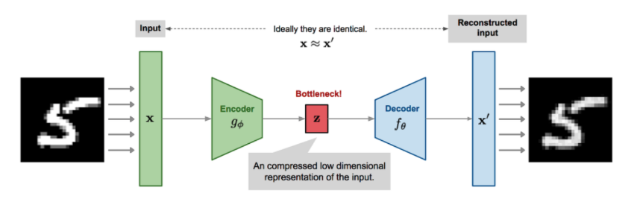
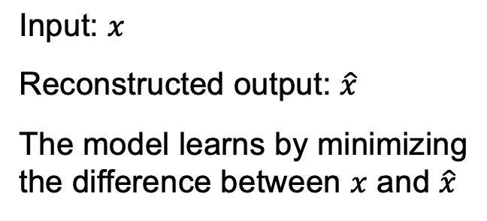
Reconstruction Loss
Objective
Make the reconstructed output as close as possible to the input
Measure the difference between input and output
Smaller loss means better reconstruction

Slide 12

Common Reconstruction Loss Functions
1. Mean Squared Error (MSE)
Measures squared difference between x and x^
Commonly used for continuous-valued data
Penalizes large errors more strongly
2. Binary Cross Entropy (BCE)
Often used when pixel values are normalized between 0 and 1
Suitable for binary or probability-like outputs
Comparison
MSE → focuses on numeric distance
BCE → focuses on probabilistic difference

Slide 13
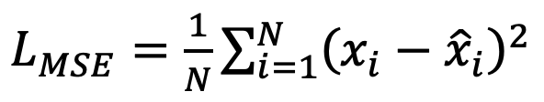
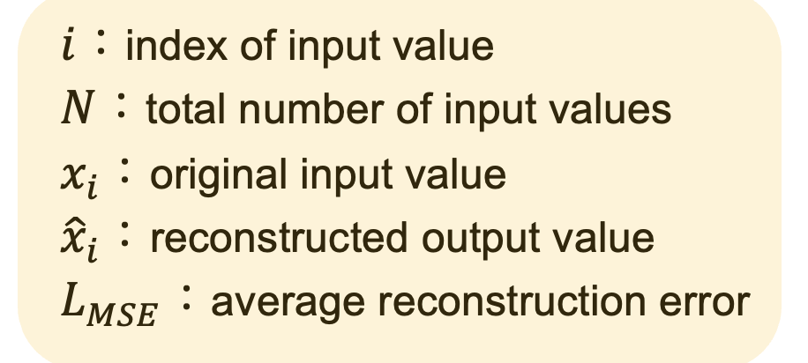


Formula and Interpretation
Example: Mean Squared Error
Key Points
The summation is taken over all input values i = 1,…, N
Measures squared difference between input and reconstruction
The result is averaged by dividing by N
Interpretation
If and are very similar → loss is small
If they are very different → loss is large
Training minimizes this loss

Slide 14
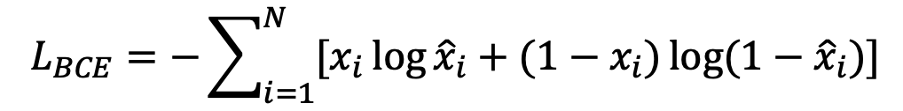
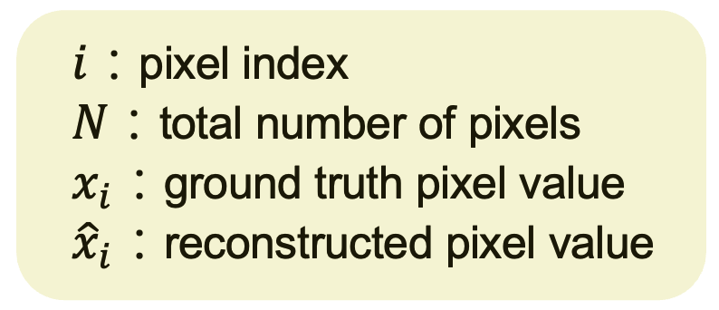
Formula and Interpretation
Example: Binary Cross Entropy
Key Points
The summation is taken over all pixels i = 1 ,…, N
Each pixel is treated as a Bernoulli random variable
Input values are normalized to [0,1]
Intuition
Make reconstructed image as close as possible to input
Penalize pixel-wise differences

Slide 15
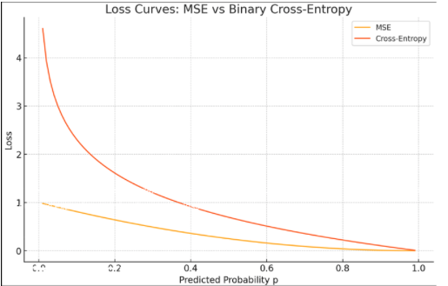
MSE vs BCE
MSE:
Measures difference between values
Focuses on pixel-level distance
Penalizes large errors more
BCE:
Measures difference between probabilities
Focuses on how confident the prediction is
Works well when values are between 0 and 1
Bottom
MSE focuses on how far, BCE focuses on how confident

Slide 16
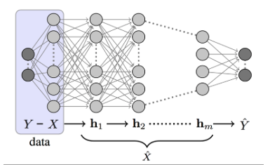
Bottleneck Representation
Bottleneck limits the amount of information
Forces model to compress data
Prevents trivial copying (identity mapping)
Without bottleneck, the model may just copy input and Bottleneck helps learn meaningful features

Slide 17
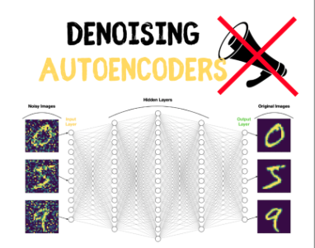
Applications of Autoencoder
Dimensionality Reduction
→ Learn compact representation of data
Denoising
→Remove noise and recover clean data
Anomaly Detection
→Detect abnormal data using reconstruction error
Feature Extraction
→ Learn useful features for other tasks
Autoencoders are widely used in real-world machine learning applications

Slide 18
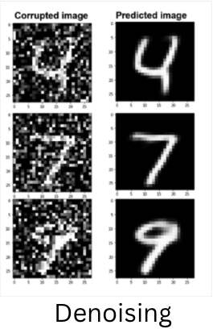
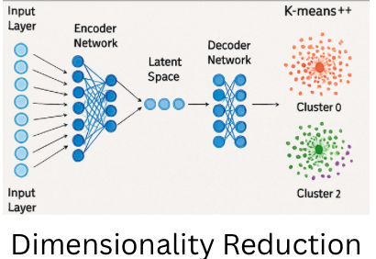
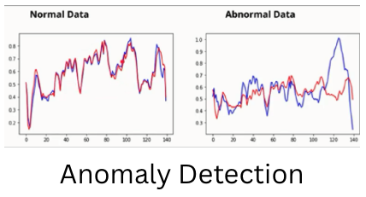
Applications of Autoencoder

Slide 19
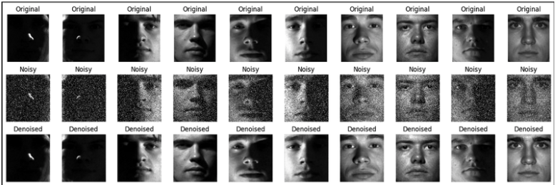
Example: Image Reconstruction
Input: noisy or incomplete image
Autoencoder compresses into latent space
Decoder reconstructs the image
Output becomes closer to original over training

Slide 20
Limitations of Autoencoders
May learn identity mapping (trivial solution)
→ Model simply copies input instead of learning features
Performance depends on bottleneck size
→ Too large: no compression
→ Too small: loss of important information
Other Challenges
Sensitive to noise and data quality
May not generalize well to unseen data
Training can be unstable or slow
Learned features may not be interpretable
→ Hard to understand what each dimension represents
Requires careful design and training
→ Architecture, loss function, and hyperparameters matter

Slide 21
What is Variational Autoencoder (VAE)?
Content:
VAE is a generative model based on autoencoders
Instead of learning a single latent vector, it learns a distribution
Encoder outputs mean (μ) and variance (σ²)
Latent variable is sampled from this distribution
Key Idea:
Learn a smooth and continuous latent space
Enable generation of new data

Slide 22
Why VAE?
Why do we need VAE?
Autoencoder learns a fixed latent vector
Fixed vectors → not smooth → hard to generate new data
Problem:
Cannot easily sample new meaningful data
Solution: Variational Autoencoder (VAE)
Learn a distribution instead of a single vector
q(z∣x)q(z∣x): latent distribution for each input
Key Idea
Instead of one point → learn a region in latent space
Enables sampling → generate new data

Slide 23
How VAE Works?
Step 1: Encoder
Learn q(z∣x)=N(μ,σ2)
Step 2: Reparameterization Trick
z=μ+σ⋅ϵ,ϵ∼N(0,1)
Allows backpropagation through sampling
Step 3: Decoder
Reconstruct input from z
Important: Prior
p(z)=N(0,1)
We want q(z∣x) close to p(z)

Slide 24
VAE Loss Overview
Goal:
Reconstruction → preserve input information
KL → regularize latent space

Slide 25
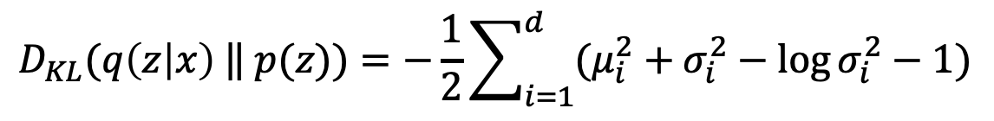
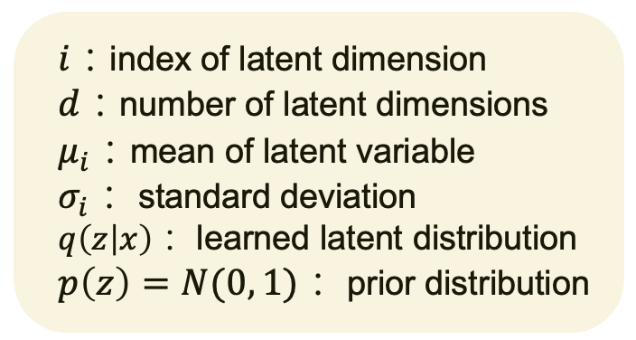
KL Divergence
Key Points
The summation is taken over all latent dimensions i = 1 ,…, d
Measures difference between learned distribution and prior
Closed-form solution for Gaussian distributions

Slide 26
From VAE to MAE
What we learned from VAE:
Learns representation by reconstructing input
Uses KL divergence to structure latent space
Limitation:
Still needs to reconstruct the entire input
May focus on low-level details instead of meaningful features
Key Question:
Do we really need to reconstruct everything?
Idea:
Mask part of the input
Learn by reconstructing only missing parts

Slide 27
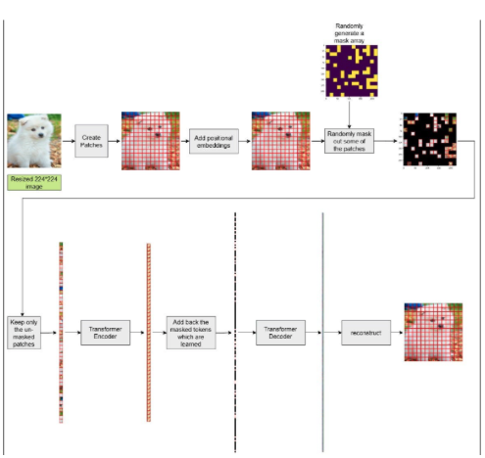
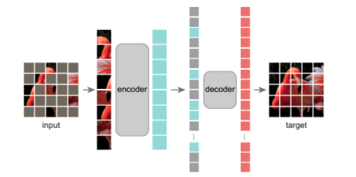
What is MAE？
MAE is a self-supervised learning method
Masks part of the input data
Learns to reconstruct missing parts
Learns to reconstruct only masked regions
Objective: reconstruction loss on masked patches only

Slide 28
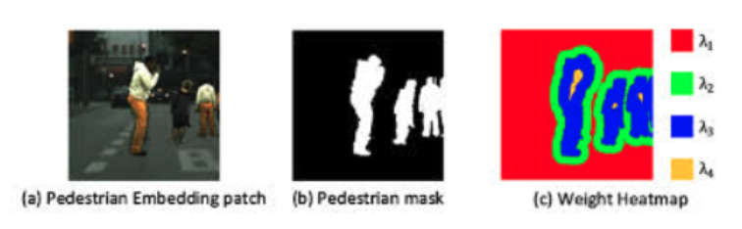
From AE → MAE
Content
AE: reconstructs the entire input
MAE: reconstructs only masked regions
AE uses full input
MAE uses partial input (~25% visible)
Key Differences
AE → may learn identity mapping (shortcut)
MAE → requires global understanding
AE → easier task
MAE → harder, more meaningful
MAE forces the model to learn semantic representations instead of simply copying the input.

Slide 29
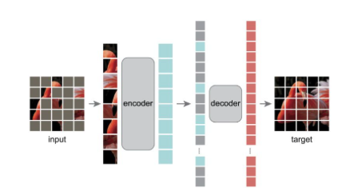
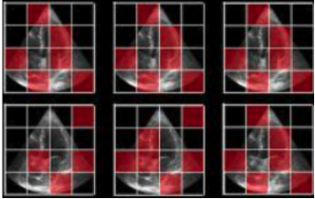
Masking Strategy
Content
Randomly mask ~75% of patches
Only visible patches are input
Model predicts missing regions
Analysis
h masking → harder task
Forces learning of global structure
Prevents shortcut learning

Slide 30
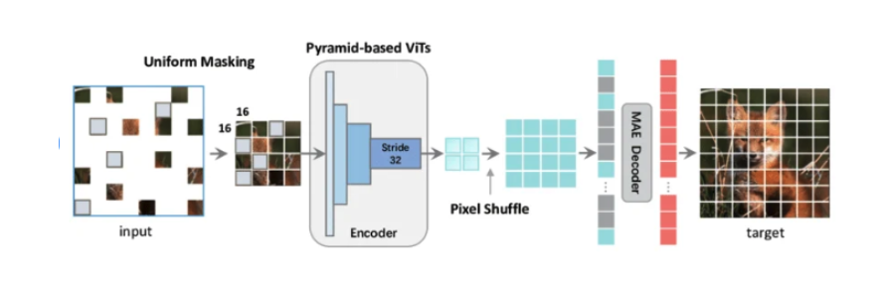
ViT-based Architecture
Content
Image is split into patches (tokens)
Encoder processes only visible patches
Decoder reconstructs missing regions
Mask tokens are added in decoder
Analysis
Reduces computation
Efficient for large datasets
Enables scalable pretraining

Slide 31
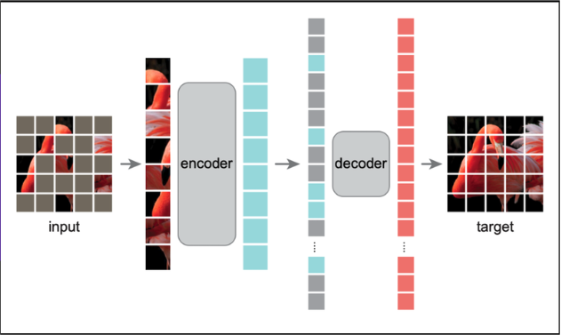
MAE Example
Content
Input image
Masked image (~75% removed)
Reconstructed output

Slide 32
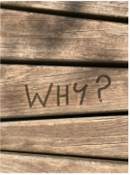
Why MAE is Important?
Content
Learns high-quality representations from incomplete (masked) inputs
High masking ratio forces understanding of global structure instead of local details
Prevents trivial/shortcut learning seen in traditional autoencoders
Does not require labeled data (self-supervised learning)
Scales efficiently to large-scale datasets
Improves performance on downstream tasks (classification, detection, segmentation)
Analysis
Bridges the gap between supervised and unsupervised learning
Encourages semantic feature learning rather than pixel-level memorization
Provides a strong pretraining strategy for Vision Transformers

Slide 33
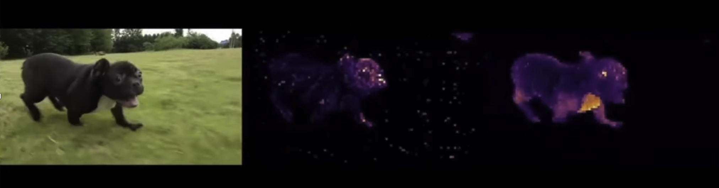
DINO: Self-Distillation with No Labels
(Because the video file is too large that I cannot upload on outlook, I used images instead.)

Slide 34
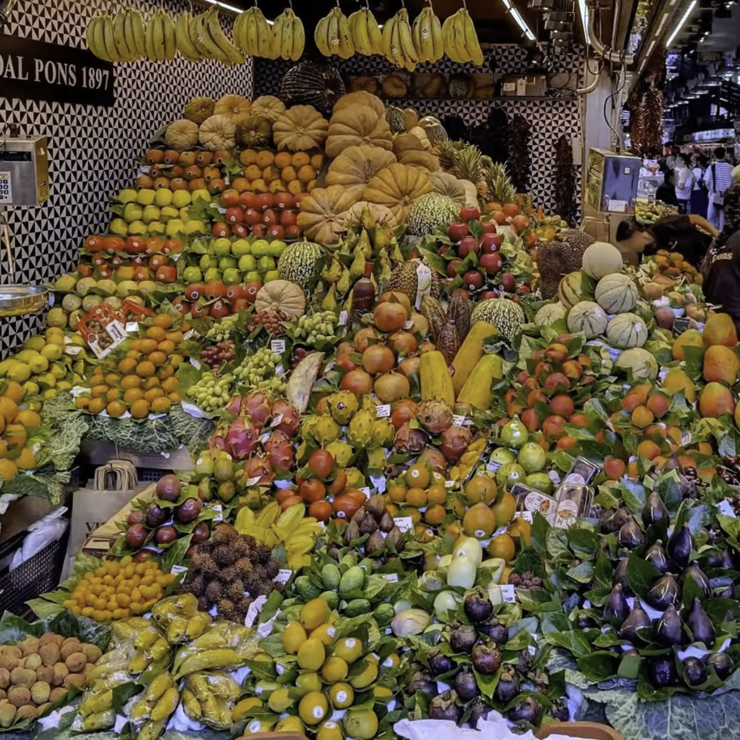
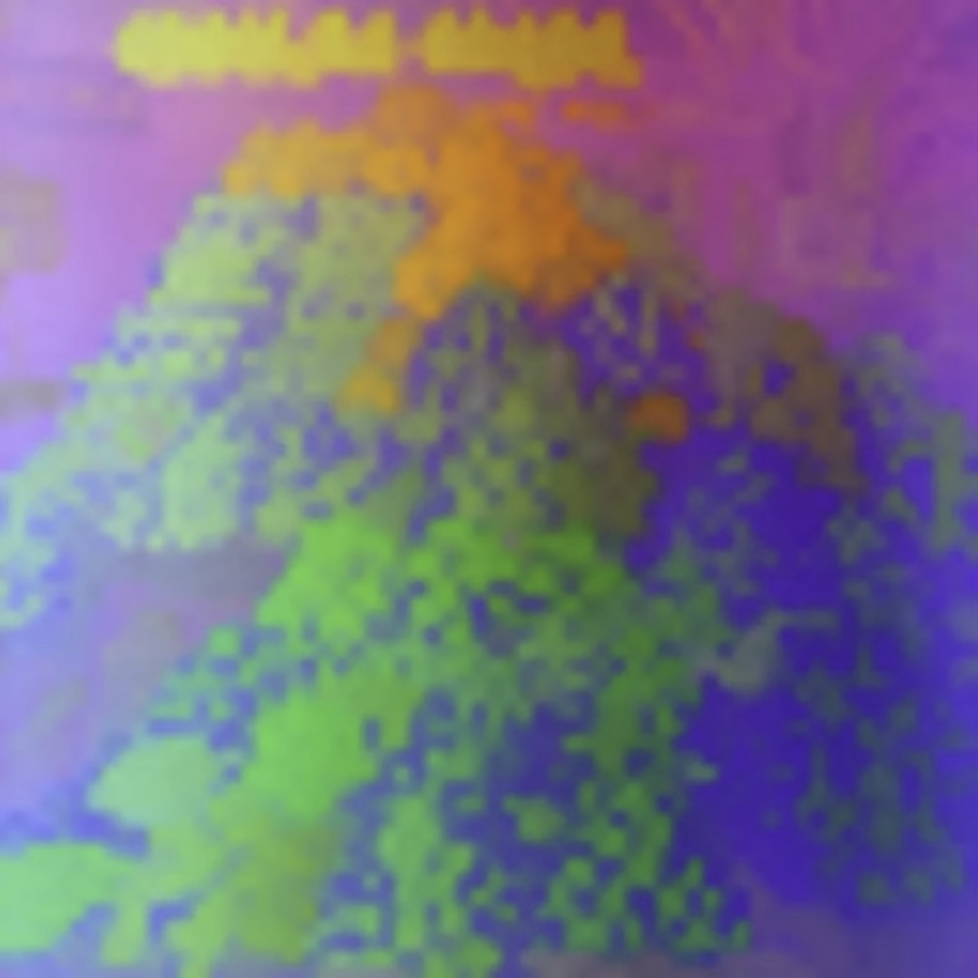
From Image to Feature
Image = grid of numbers (pixels)
Each pixel has 3 channels:
Red (255, 0, 0)
Green (0, 255, 0)
Blue (0, 0, 255)
Image → ViT Backbone
Split image into patches
Flatten patches into tokens
Pass through Vision Transformer
Output: feature vector (CLS token)

Slide 35
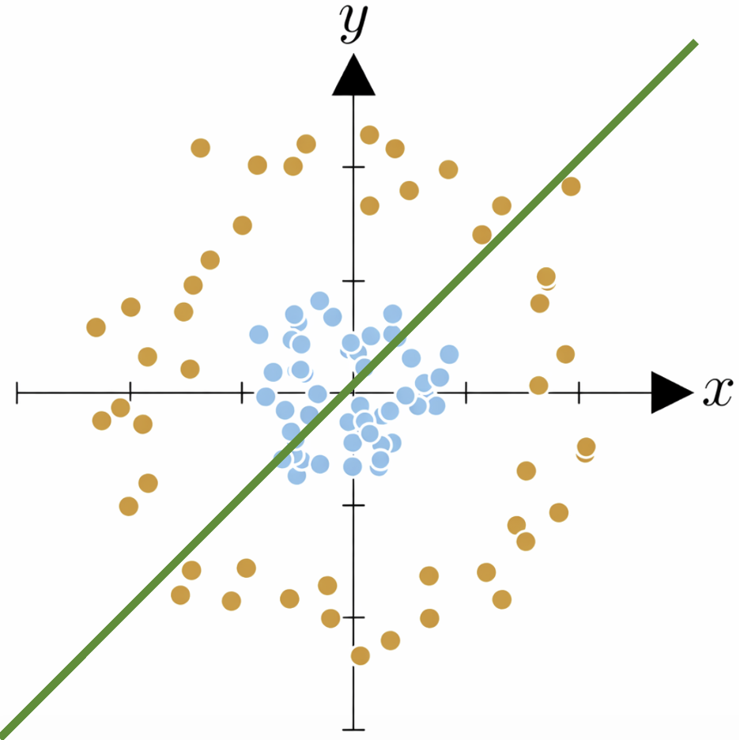
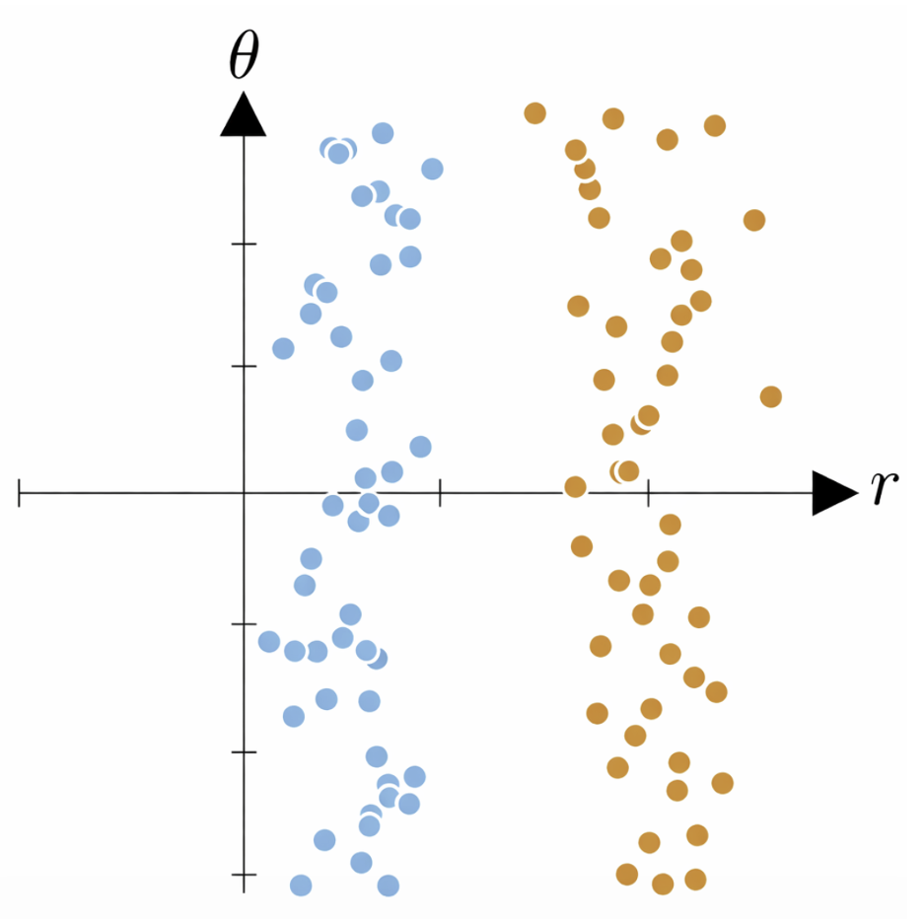
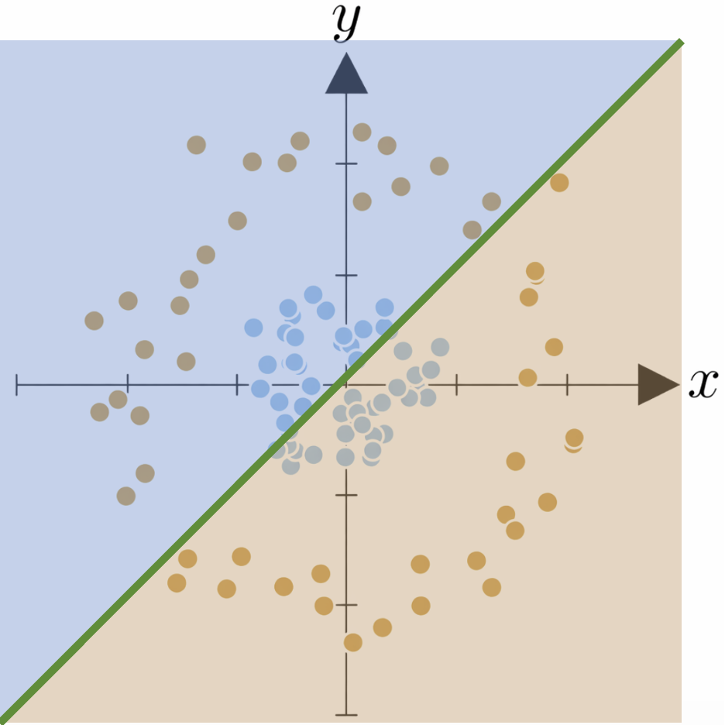
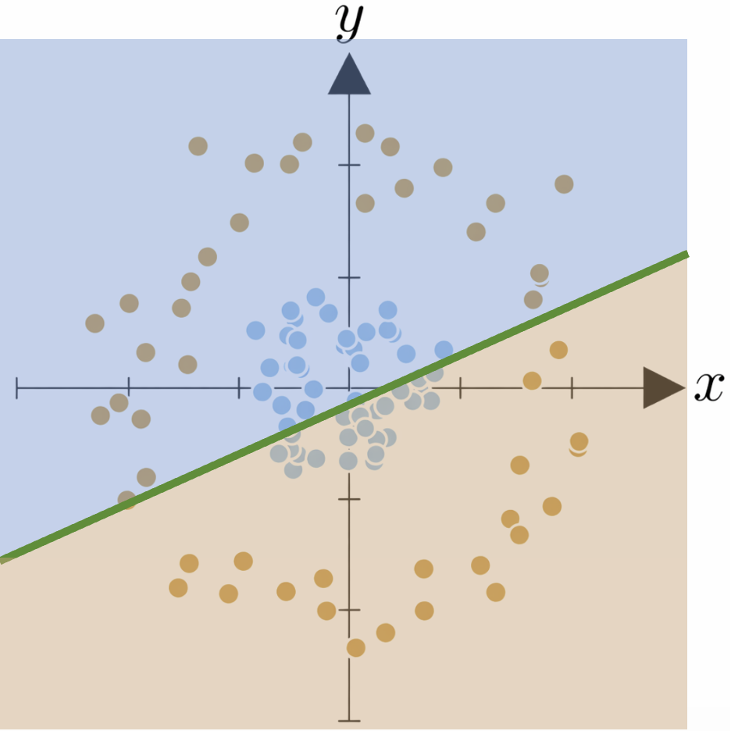
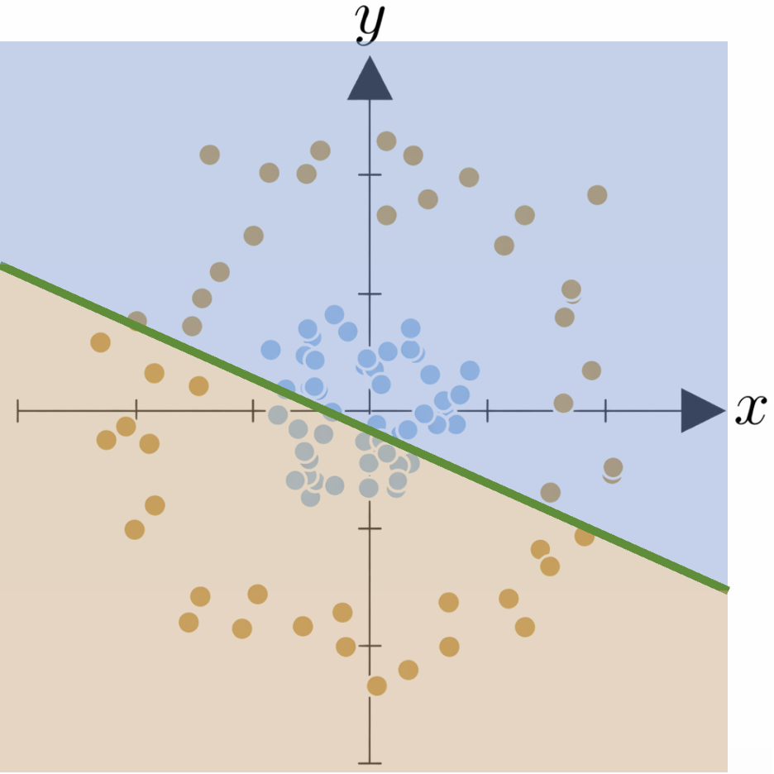
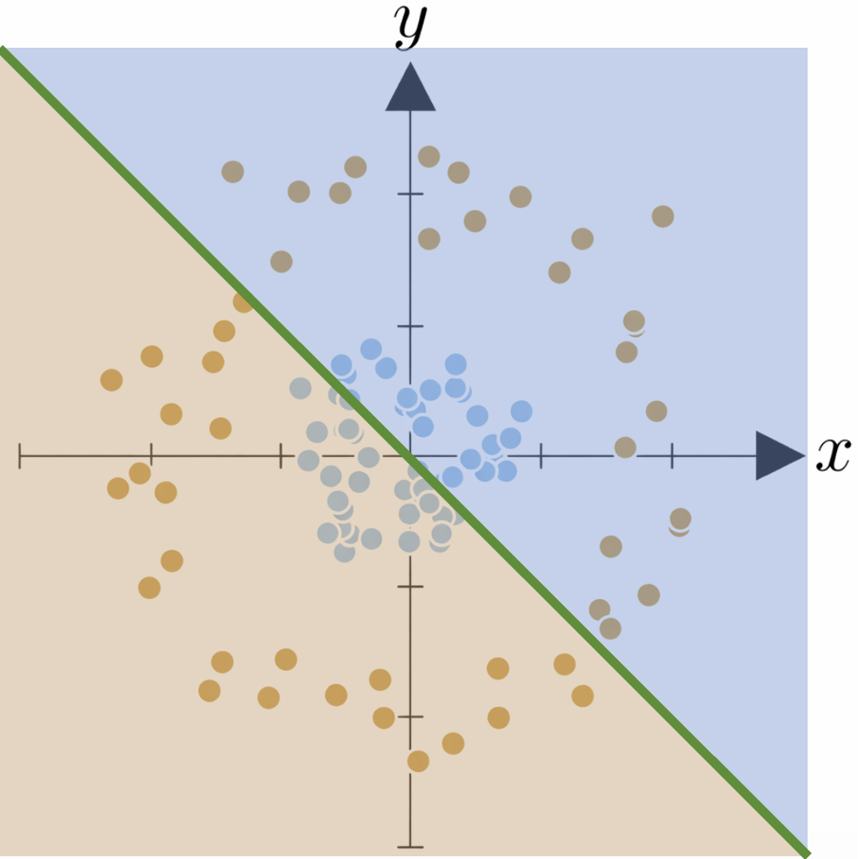
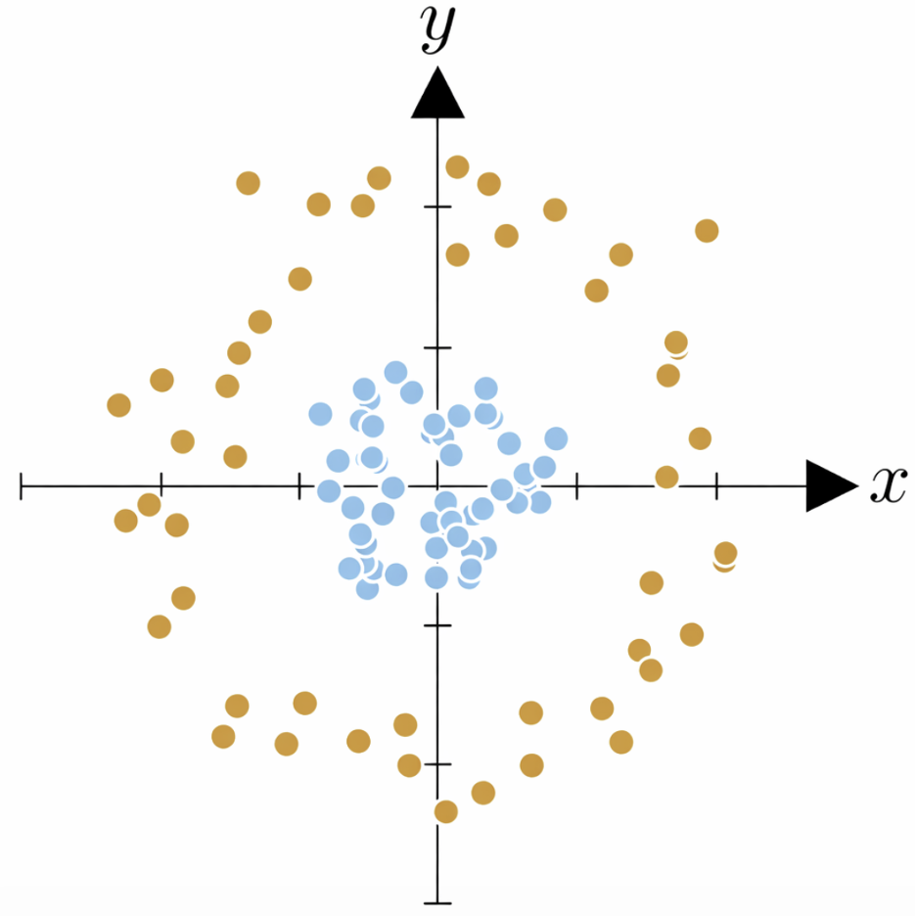
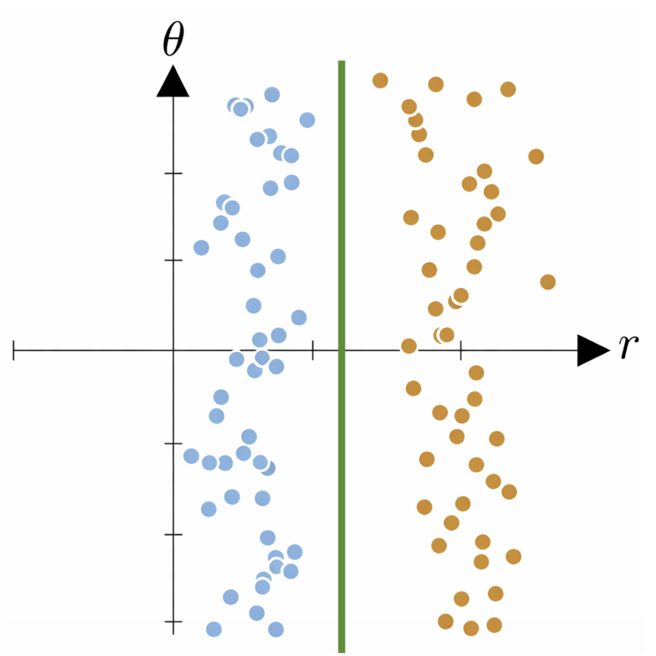
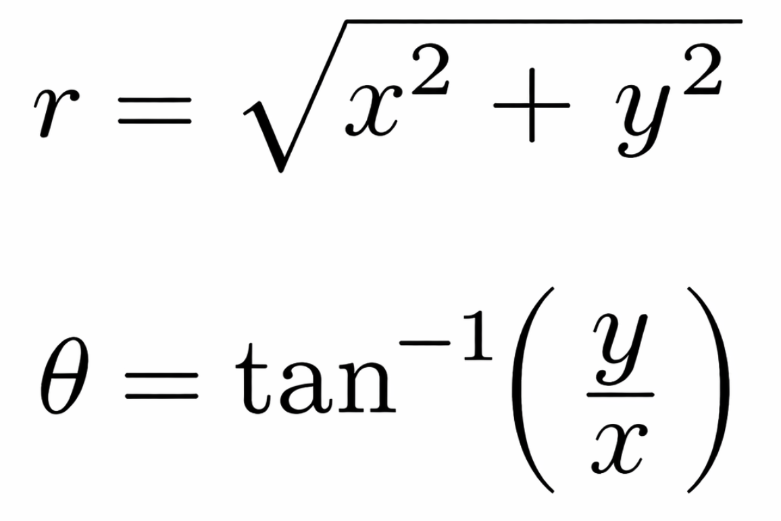
Why Feature is important?
?

Slide 36
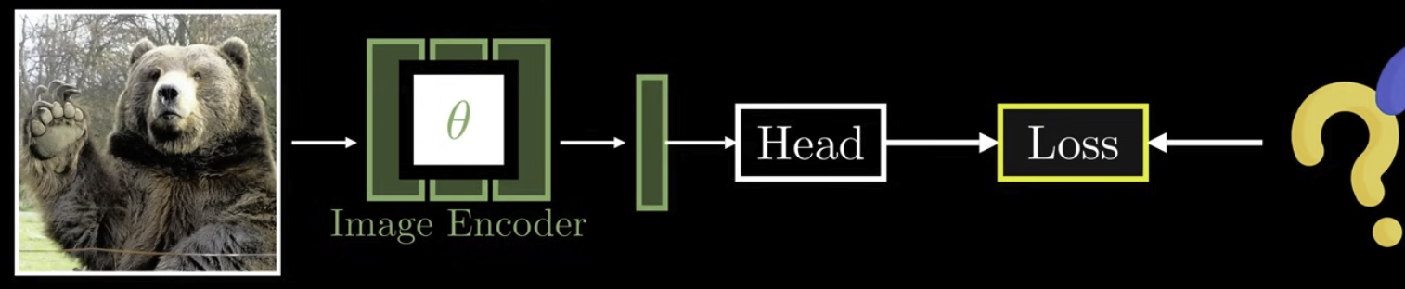
Projection Head
?
Head
Multi-layer perceptron (MLP)
Maps features to new space
Adds non-linearity
Improves representation

Slide 37
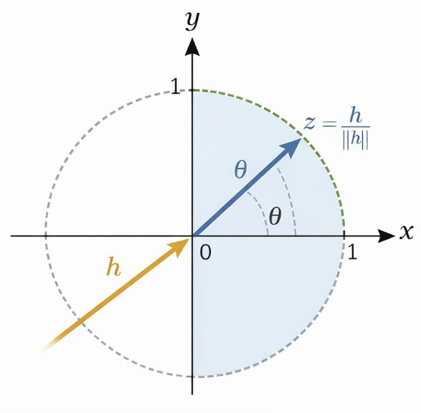
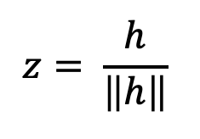
Normalization
Convert vector to unit length
Remove magnitude effect
Use cosine similarity
𝒉 → unit vector
use cosine similarity

Slide 38


Logits (Prototype Similarity)
Prototypes & Logits
Each = prototype direction
Compare feature with prototypes
Logits = similarity scores

Slide 39

Softmax → Probability
Softmax
Convert logits to probability
Soft assignment to prototypes
What DINO uses for matching teacher ↔ student

Slide 40
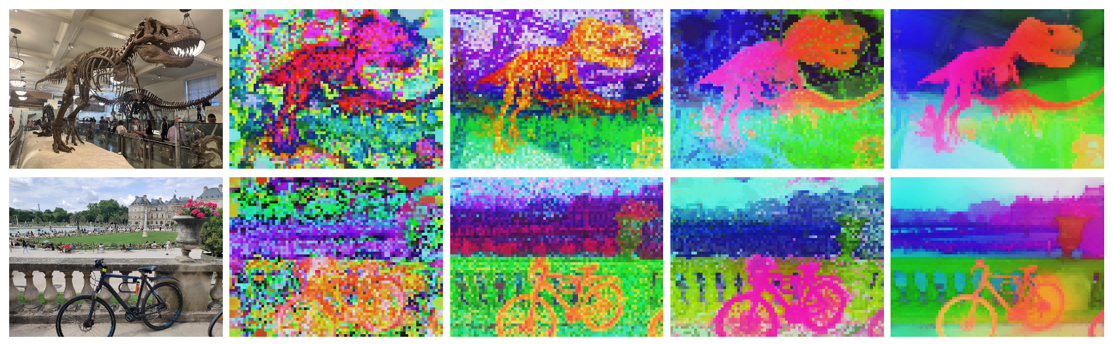
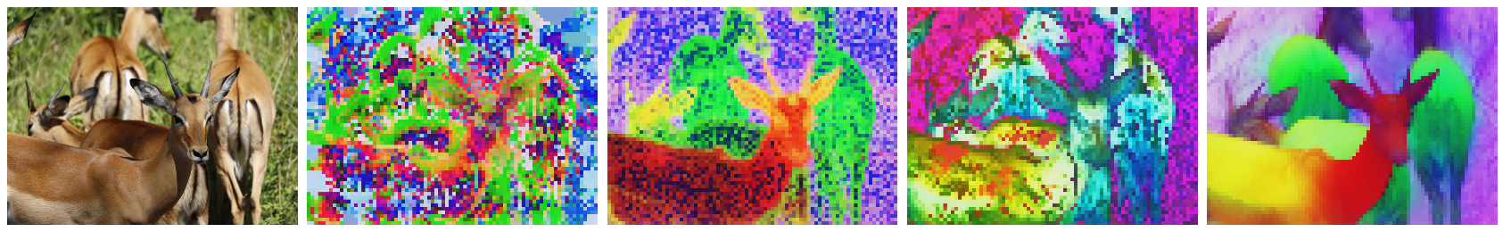
What is DINO?
Content
Self-supervised learning method
No labels required
Learns image representations
Based on self-distillation
DINO Framework
• Teacher–Student architecture
• Self-distillation without labels
• Student learns from teacher outputs
• Teacher updated via EMA

Slide 41
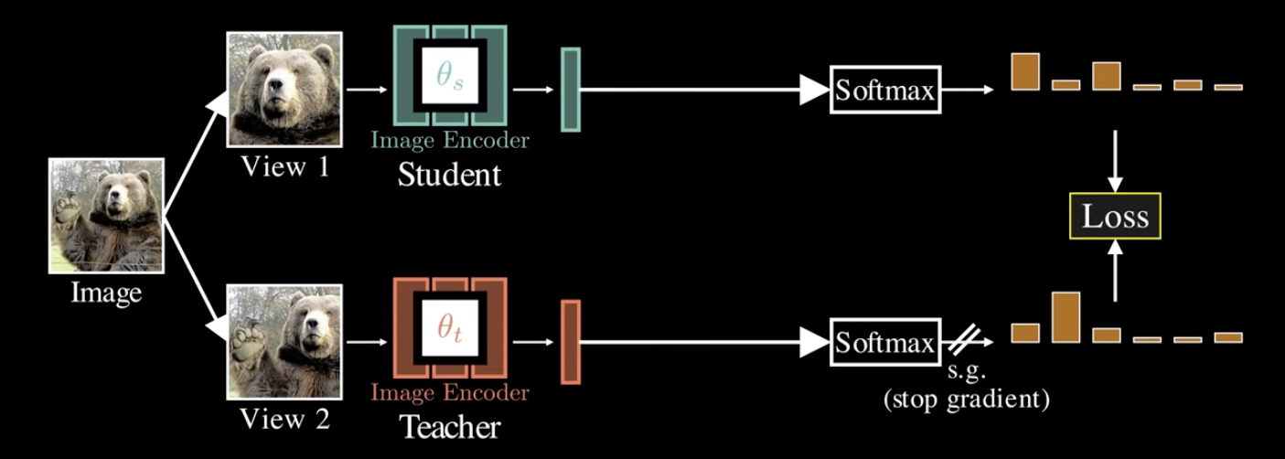
Teacher–Student Architecture
Architecture
Two networks (same backbone)
Student → backpropagation
Teacher → EMA update
Training
Multi-crop views
Student: global + local
Teacher: global only

Slide 42
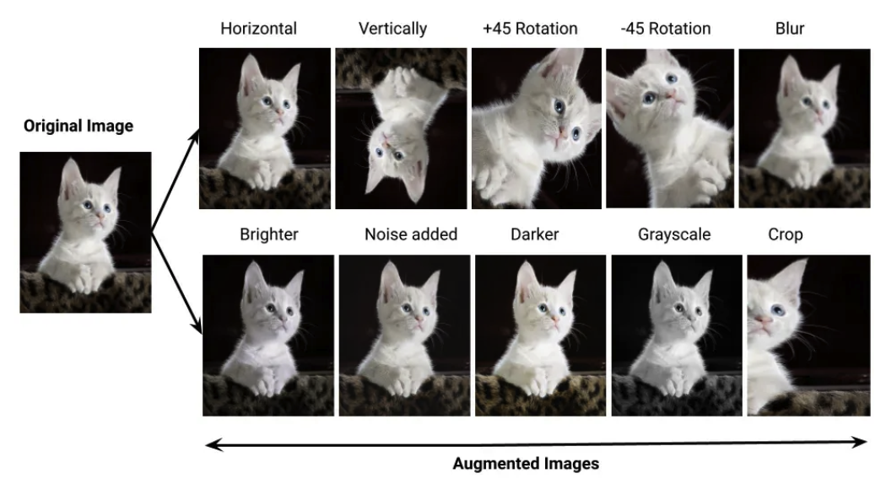
Multi-View Learning
Global crops
Local crops
• Same image → multiple views
• Global crops and local crops
• Different augmentations (crop, blur, color)
• Learn invariance across views

Slide 43

Loss Function
Cross-Entropy Loss
• Match probability distributions
• Teacher provides soft targets
• Student learns representation space

Slide 44

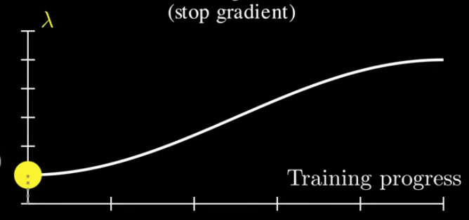
EMA Update
How do we get the teacher model?
Exponential Moving Everage(EVA)
Teacher = moving average of student
Provides stable targets
Prevents noisy updates
λ: control the update rate for the teacher model
λ=1.000
λ=0.996

Slide 45
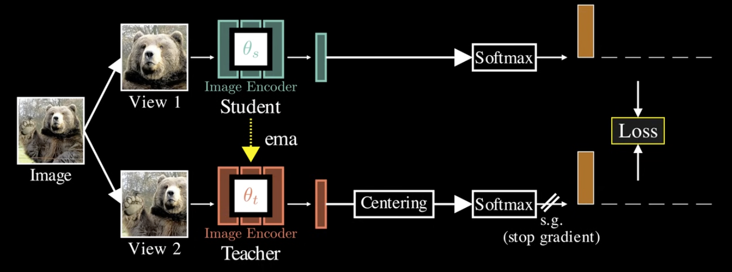
How to avoid Collapse?
Centering
Centering
[3.20, 3.10, 3.00]
[3.30, 3.00, 2.90]
[3.10, 3.00, 2.90]
[3.25, 3.05, 2.95]
Raw logits
[0.665, 0.245, 0.090]
[0.936, 0.047, 0.017]
[0.665, 0.245, 0.090]
[0.844, 0.114, 0.042]
Probs w/o centering
[3.212, , ]
Average logits
[ , 3.038, ]
[ , , 2.938]
[ , , ]
Average logits

Slide 46
How to avoid Collapse?
Centering
Centering
[3.20, 3.10, 3.00]
[3.30, 3.00, 2.90]
[3.10, 3.00, 2.90]
[3.25, 3.05, 2.95]
Raw logits
[-0.013, 0.062, 0.062]
[ 0.087, -0.037, -0.037]
[-0.113, -0.037, -0.037]
[ 0.037, 0.013, 0.013]
Centered logits
[0.191, 0.404, 0.404]
[0.636, 0.182, 0.182]
[0.191, 0.404, 0.404]
[0.391, 0.305, 0.305]
Probs with centering
[0.665, 0.245, 0.090]
[0.936, 0.047, 0.017]
[0.665, 0.245, 0.090]
[0.844, 0.114, 0.042]
Probs w/o centering

Slide 47
How to avoid Collapse?
Centering
Centering
[-0.013, 0.062, 0.062]
[ 0.087, -0.037, -0.037]
[-0.113, -0.037, -0.037]
[ 0.037, 0.013, 0.013]
Centered logits
[0.665, 0.245, 0.090]
[0.936, 0.047, 0.017]
[0.665, 0.245, 0.090]
[0.844, 0.114, 0.042]
Probs w/o centering

Slide 48
How to avoid Collapse?
Centering
Centering
[0.191, 0.404, 0.404]
[0.636, 0.182, 0.182]
[0.191, 0.404, 0.404]
[0.391, 0.305, 0.305]
Probs with centering
[0.665, 0.245, 0.090]
[0.936, 0.047, 0.017]
[0.665, 0.245, 0.090]
[0.844, 0.114, 0.042]
Probs w/o centering

Slide 49

Softmax + Temperature
Softmax with Temperature
• Converts logits to probabilities
• Temperature controls sharpness
• Teacher: low T (sharp)
• Student: higher T (smooth)

Slide 50

Results
Emergent Properties
• Attention maps highlight objects
• No supervision required
• Implicit object segmentation
• Strong feature representation

Slide 51

DINOv2
DINOv2
• Large-scale curated dataset
• Improved feature quality
• Works for dense prediction tasks
• No fine-tuning needed

Slide 52

DINOv3
DINOv3
• Vision foundation model
• Single model for multiple tasks
• Strong generalization ability
• Minimal task-specific training

Slide 53
Conclusion
 | DINO | DINOv2 | DINOv3
Scale | Mid | Large | Very Large
Task | Feature | General | Universal
• No labels required
• Learn representations, not classes
• Scalable to large data
• Toward vision foundation models

Slide 54

The Segment Anything Model
Applying Self-Supervised Learning to achieve promptable, zero-shot generalization in computer vision.

Slide 55
The Foundation Model Shift
Transitioning from task-specific networks to generalized, promptable systems in Computer Vision.

Slide 56






Core Pillars of SAM
Promptable Task
Modular Architecture
Data Engine
Introduces a new NLP-inspired paradigm to CV. The model returns a valid segmentation mask given any prompt (point, box, text) specifying what to segment in an image.
A continuous loop of model-in-the-loop annotation that generated SA-1B: the largest segmentation dataset ever created, containing over 1 billion high-quality masks.
A three-part system: an Image Encoder (ViT), a Prompt Encoder, and a Mask Decoder. This separation improves flexibility, efficiency, and real-time usability.

Slide 57


The Promptable Segmentation Task
Much like Large Language Models respond to text prompts, SAM is designed to return a valid segmentation mask given a hint or guide.
Points: A single click specifies the foreground or background object.
Bounding Boxes: A rough box enclosing the object of interest.
Previous Masks: A coarse input mask can be updated or refined.
The core challenge is ambiguity. A point on a shirt could mean the shirt, or the person wearing it. SAM solves this by outputting multiple valid masks simultaneously.

Slide 58




General Architecture Overview
1. Image Encoder (ViT)
2. Prompt Encoder
3. Mask Decoder
A deep neural network (Vision Transformer). Splits the image into patches and captures features to output a dense image embedding.
Embeds the user's hints (points, boxes, masks) into positional encodings. Acts as a guide directing the model where to focus.
A fast, lightweight network that combines the Image and Prompt embeddings to generate multiple masks with IoU scores in real-time.

Slide 59


Step 1: The Image Encoder (Tokens & Patches)
The first step in SAM is processing the raw image through a heavyweight Vision Transformer (ViT). Similar to how NLP models process words as tokens, the ViT splits the input image into smaller patches.
These patches are embedded into vectors and processed to capture local and global visual features, resulting in a compact, information-rich "dense image embedding."

Slide 60


Step 2: The Prompt Encoder (Translating Hints)
To tell the model what to segment, users provide prompts. SAM maps these sparse hints (points and bounding boxes) into mathematical vectors using Positional Encodings.
If the user provides a previous mask to refine, it is treated as a dense prompt. A low-resolution version of this mask is projected via CNNs into the exact same embedding space as the image.

Slide 61





Step 3: Mask Decoder (Resolving Ambiguity)
The Mask Decoder uses a Two-Way Transformer block to synthesize the Image Embeddings and the Prompt Embeddings via cross-attention.
Because a single point (like a collar) is ambiguous, SAM doesn't just output one mask. It predicts multiple masks simultaneously (e.g., the collar, the dog's head, the whole dog), each with a predicted IoU (Intersection over Union) score.

Slide 62


The Crucial Role of Self-Supervised Learning
Extracting Robust Features Without Labels
MAE
Building directly on what we discussed earlier regarding Autoencoders and Masked Autoencoders (MAE), SAM utilizes these exact paradigms in Step 1 to learn the visual world before it ever tries to segment anything.
Masked Autoencoder Pre-training
By masking random patches of an image and forcing the ViT to reconstruct missing pixels, MAE teaches the network robust, generalized feature representations without human annotations.
ViT
Vision Transformer Backbone
This SSL foundation is the core reason SAM can achieve zero-shot generalization across entirely novel datasets.

Slide 63


Deep Dive: The Training Loss Objective
Focal Loss
Dice Loss
Focal Loss prevents the model from being overwhelmed by the massive amount of "background" pixels in an image by mathematically down-weighting easy, confident predictions.
Dice Loss directly optimizes the Intersection over Union (IoU), ensuring the predicted mask perfectly overlaps the ground truth, regardless of the object's physical size.
SAM optimizes its mask predictions using a linear combination of both: L = λ_focal * L_focal + λ_dice * L_dice

Slide 64




Focal Loss (for one pixel):

Slide 65


The Data Engine Loop
Model-in-the-Loop Training
SAM was trained on SA-1B using a three-stage data engine. It began with human-assisted annotation, progressed to semi-automatic correction of challenging objects, and culminated in a fully automatic stage where SAM autonomously generated billions of highly accurate masks.

Slide 66

The Unprecedented Scale of SA-1B
The fully automatic data engine produced the SA-1B dataset. It contains 11 million diverse, high-resolution images and over 1.1 billion high-quality masks—making it roughly 400x larger than previous standard datasets like COCO.

Slide 67
Zero-Shot Generalization Capabilities
Zero-Shot Edge Detection: By prompting SAM with a grid of points and extracting boundary maps from the resulting masks, SAM produces highly competitive edge detection without any task-specific fine-tuning.
Zero-Shot Object Proposals: SAM can automatically generate mask proposals for mid-level vision tasks. Its proposals outperform fully supervised baselines in both quantity and quality of object recall.
Zero-Shot Instance Segmentation: By pairing SAM with a pre-trained object detector (like Faster R-CNN predicting bounding boxes), SAM takes those boxes as prompts to output precise instance masks.

Slide 68

Zero-Shot vs. Fully Supervised Performance
When evaluating instance segmentation across 23 diverse downstream datasets, SAM's zero-shot performance is highly competitive. In several novel domains, zero-shot SAM actually outperforms fully supervised baselines trained explicitly on those datasets.

Slide 69


Advantages vs. Disadvantages
Advantages
Disadvantages
•
Zero-Shot Generalization: Works flawlessly on unseen objects across completely new domains without retraining.
•
Computationally Expensive: The ViT backbone requires a high-end GPU. Very hard to deploy on edge devices or mobile phones.
•
Real-Time Efficiency: Once the image is encoded (done once), prompt-based segmentation is instantaneous.
•
Not Fully Autonomous: Requires a user prompt to initiate segmentation (lacks out-of-the-box full scene understanding).
•
Prompt Flexibility: Interactivity allows users fine control over complex selections.
•
No Temporal Understanding: Operates on single images. Cannot natively track objects across video frames without external models.

Slide 70




Real-World Applications
Medical Imaging: Assists in segmenting organs, tumors, or abnormalities in MRI/CT scans. Accelerates dataset annotation for building diagnostic AI systems.
Autonomous Driving: Enhances perception systems by identifying vehicles, pedestrians, and road signs in complex traffic environments for safer navigation.
Agriculture: Identifies crops, weeds, pests, and plant diseases using drone imagery. Enables precision farming and targeted treatment.
Image Editing: Enables interactive object selection with a single click for background removal, smart cropping, and content-aware editing in creative software.

Slide 71


Conclusion & Key Takeaways
The Era of Vision Foundation Models: SAM proves that the prompt-based, generalized paradigm (historically dominated by NLP) is highly effective for complex Computer Vision tasks.
SSL is the Catalyst: The zero-shot capabilities of SAM are fundamentally rooted in the rich, unbiased feature representations learned through Self-Supervised pre-training (MAE).
The Data Engine Blueprint: The massive SA-1B dataset demonstrates that "model-in-the-loop" annotation is the future for scaling datasets exponentially.

Slide 72

References & Further Reading
Segment Anything: Kirillov, A., Mintun, E., Ravi, N., Mao, H., Rolland, C., Gustafson, L., ... & Girshick, R. (2023). Segment anything. arXiv preprint arXiv:2304.02643.
Masked Autoencoders: He, K., Chen, X., Xie, S., Li, Y., Dollár, P., & Girshick, R. (2022). Masked autoencoders are scalable vision learners. In Proceedings of the IEEE/CVF Conference on Computer Vision and Pattern Recognition.
Architecture Overview: "What is SAM (Segment Anything Model)". GeeksforGeeks. https://www.geeksforgeeks.org/data-science/what-is-sam-segment-anything-model/

Slide 73
Thank You!
Any questions?

