Slide 1
Chapter 1
Systems of Linear Equations
Fundamentals of Matrix Algebra By Gregory Hartman
Instructor Longin Jan Latecki
We will cover most but not all sections in Hartman’s book.
Read the corresponding sections!

Slide 2
1.1 Introduction to Linear Equations
By David Dobor

Slide 3
Example 1
Suppose a jar contains red, blue and green marbles. You are told that there are a total of 30 marbles in the jar; there are twice as many red marbles as green ones; the number of blue marbles is the same as the sum of the red and green marbles. How many marbles of each color are there?

Slide 4
Example 1 : Solution by Elimination of Variables
r + b + g = 30 (1.1)
r = 2g (1.2)
b = r + g (1.3)
From this stage, there isn’t one “right” way of proceeding… One way is to combine equations 1.2 and 1.3; in 1.3 replace r with 2g. This gives us
b = 2g + g = 3g (1.4)
We can then combine equations 1.1, 1.2, and 1.4 by replacing r in 1.1 with 2g like before, and replacing b with 3g to get
r + b + g = 30
2g + 3g + g = 30
6g = 30
g = 5 (1.5)
We can now use equation 1.5 to find r and b; we know from 1.2 that r = 2g = 10 and then since r + b + g = 30, we easily find that b = 15.
Page 4

Slide 5
Example 1 : What If
Mathematicians often see solutions to given problems and then ask “What if…?”
For instance
1. Did we really have to call the red balls “r”? Could we call them “q”?
2. What if we had 60 balls at the start instead of 30?
Conclusion: it doesn’t matter what we call our variables, and while changing constants in the equations changes the solution, they don’t really change the method of how we solve these equations.

Slide 6
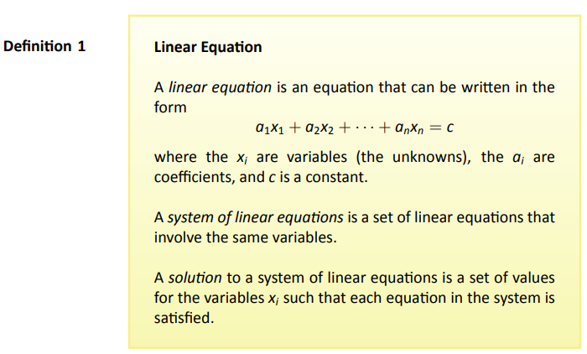
Definition

Slide 7
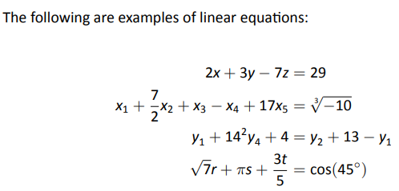
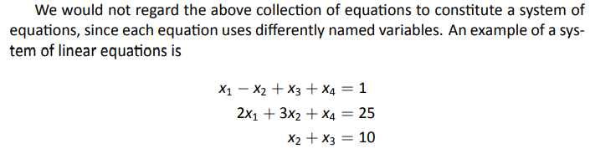
Linear Equations - Examples

Slide 8
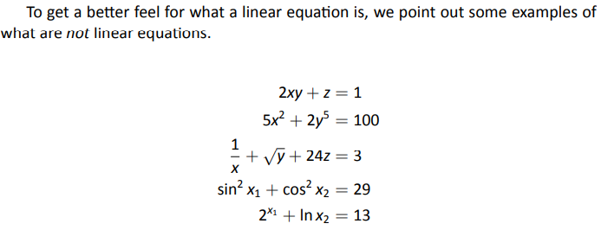
NOT Linear Equations - Examples

Slide 9
1.2 Using Matrices To Solve Systems of Linear Equations

Slide 10


Same Problem from 1.1
Augmented
matrix

Slide 11
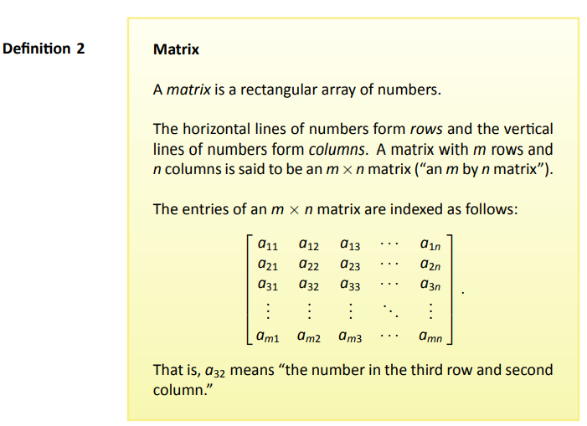
Or More Formally…

Slide 12
Using Augmented Matrices and Gaussian Elimination
We can use augmented matrices to find solutions to linear equations by using essentially the same steps we used above. Every time we used the word “equation” above, substitute the word “row,” as we show below. The comments explain how we get from the current set of equations (or matrix) to the one on the next line.
We can use a shorthand to describe matrix operations; let R1, R2 represent “row 1” and “row 2,” respectively. We can write “add row 1 to row 3, and replace row 3 with that sum” as “R1 + R3 → R3.” The expression “R1 ↔ R2” means “interchange row 1 and row 2.”

Slide 13
1.3 Elementary Row Operations and Gaussian Elimination

Slide 14
Quick Review
We saw earlier how we could write all the information of a system of equations in a matrix.
Simply replace the word “equation” above with the word “row”.

Slide 15
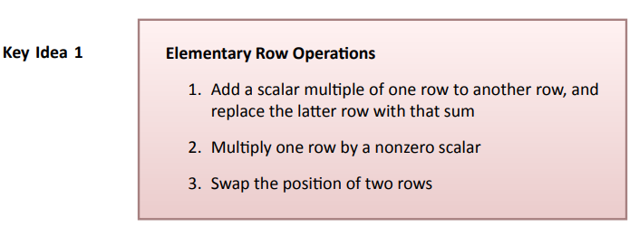
Key Idea
R3 + 5R1 → R3
5R2 → R2
R1 ↔ R2

Slide 16
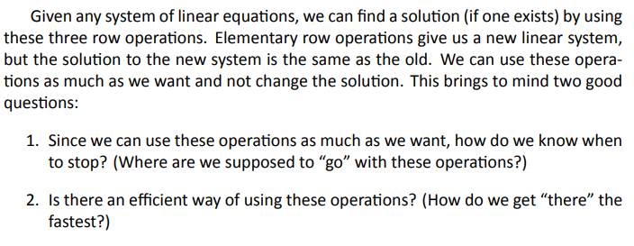
The Effects of Elementary Row Operations…

Slide 17
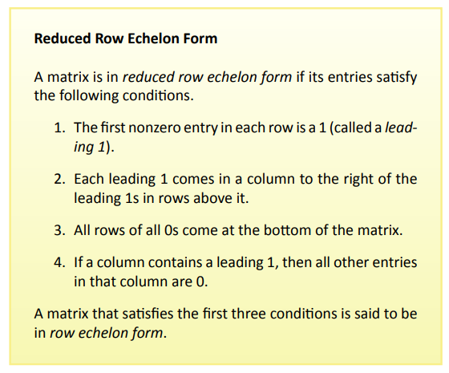
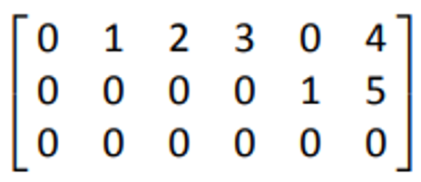
Definition

Slide 18
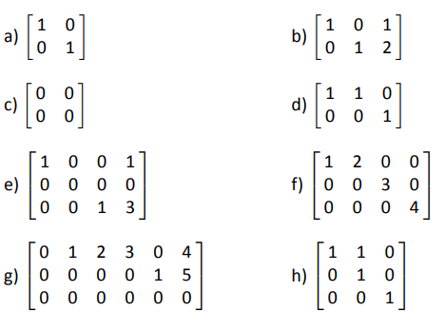
Example 3
Which of the following matrices is in reduced row echelon form?

Slide 19



Example 3 : Solution
All of the them except for e), f), and h) are in reduced row echelon form.
The row of all zeros should be at the bottom.
The first nonzero entries in rows 2 and 3 should be 1.
The first entry in column 2 should be zero; the second 1 in column 2 is
a leading one, hence all other entries in that column should be 0.

Slide 20
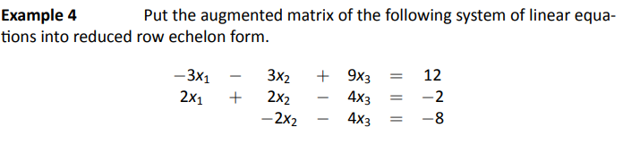
Example 4

Slide 21
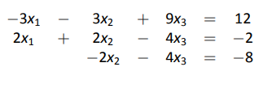
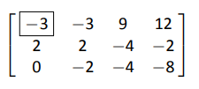
Example 4 : Solution
Our next step is to change the
entry in the box to a 1.

Slide 22
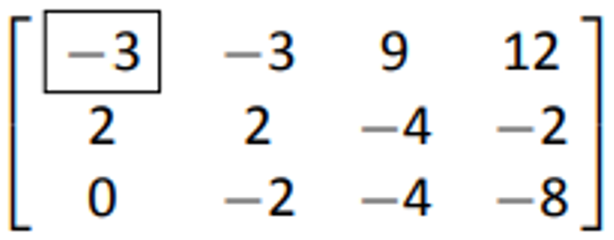
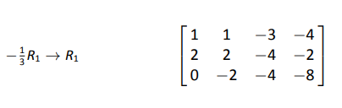
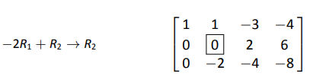
Example 4 : Solution (cont)
We have now created a leading 1.
Our next step is to put zeros under this 1.
We again want to put a 1 (if possible)
in the entry where the box is.

Slide 23
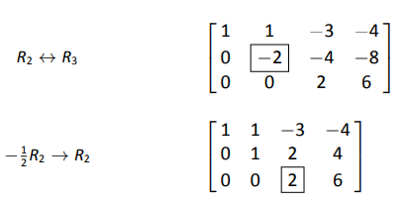
Example 4 : Solution (cont)
We have now created another leading 1.
We now want to put zeroes underneath it,
but this has already been done by our
previous steps
Now we want to turn the number
in the box to 1 again.

Slide 24
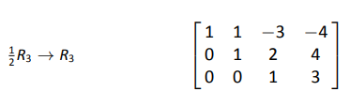
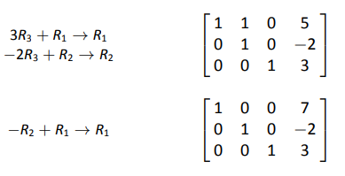
Example 4 : Solution (cont)
This ends what we will refer to
as forward steps.
These steps are referred to
as backward steps
It is now easy to read off the solution as x₁ = 7, x₂ = -2 and x₃ = 3;

Slide 25
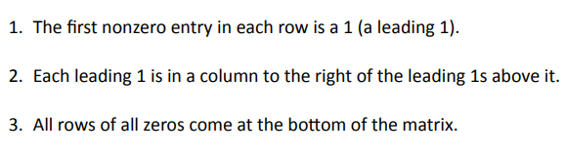
Forward Steps Result in:
Backward Steps:

Slide 26
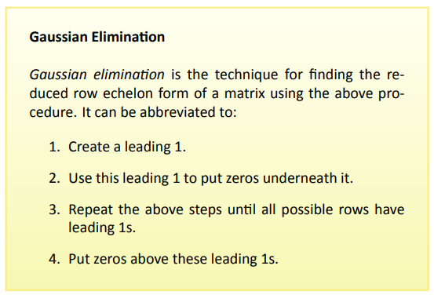
Definition

Slide 27
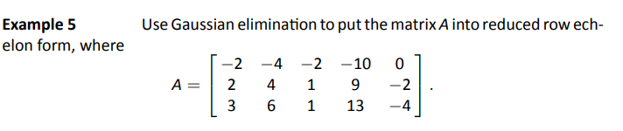
Example 5

Slide 28
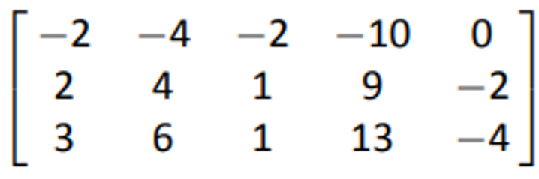


Example 5 : Solution
1. Make the entry in the first column and first row a 1 (a leading 1).
2. Put zeroes in the column below this newly formed leading 1.
3. We now want to put a 1 (a leading 1) in the above box (if possible).
As it turns out, this is not possible.
4. Next we want to put a 1 where the -1 is (in the 3rd column of the 2nd row).

Slide 29


Example 5 : Solution (cont)
5. Now we want to put a 1 in the position where the box is.
Because this is not possible, we are done with our forward steps.
6. Our last goal is to put a 0 above each of the leading 1s (in this case
there is only one leading 1 to deal with). See next page.

Slide 30

Example 5 : Solution (cont)
#6

Slide 31
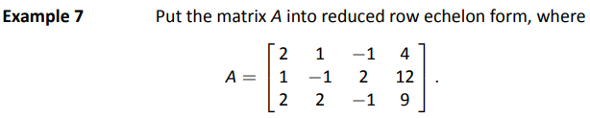
Example 7
From Matrix to Systems of Linear Equations

Slide 32
Example 7 – Reviewing Systems of Linear Eq.
Here we skip a few steps…

Slide 33
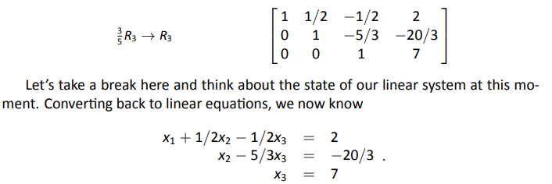
Example 7 – Reviewing Systems of Linear Eq.

Slide 34
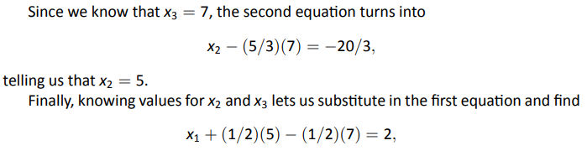

Example 7 – Reviewing Systems of Linear Eq.

Slide 35
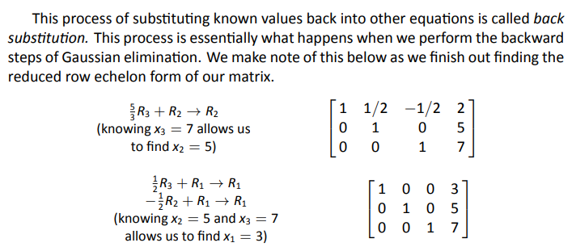
Example 7 – Reviewing Systems of Linear Eq.

Slide 36
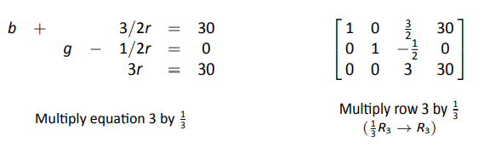
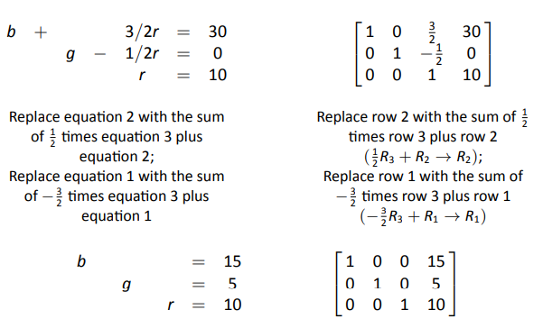
Example for first system of linear equations
The first row of the matrix can be interpreted as
“b + 0g + 0r = 15,” or more concisely, “b = 15.”

Slide 37
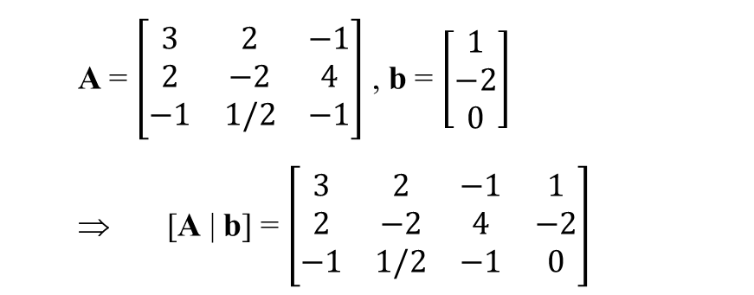
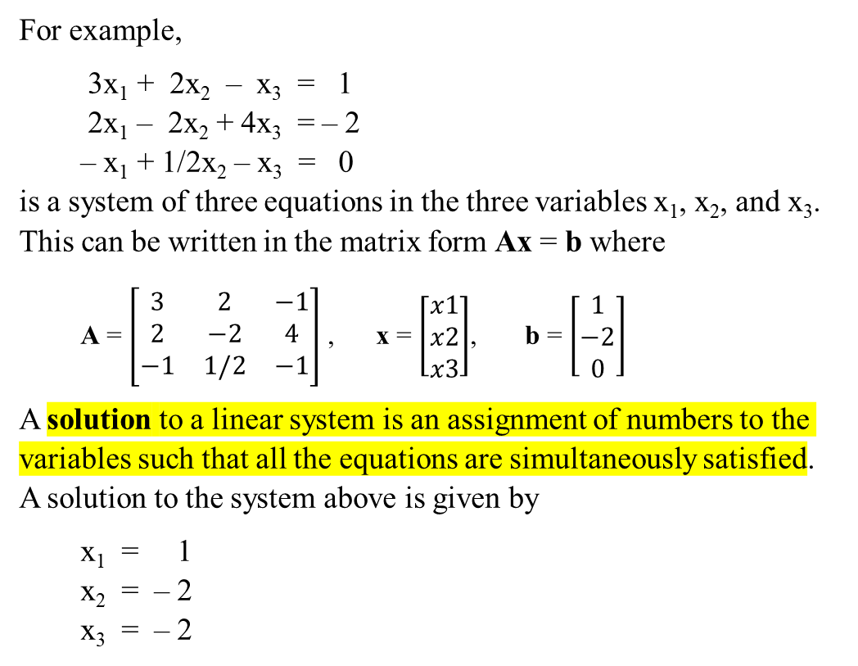
Summary
Given a system of linear equations represented in the matrix form as Ax = b, its augmented matrix is obtained by concatenating m-by-1 column vector b to m-by-n A and creating m-by-(n+1) augmented matrix [A | b]:
For example,
3x₁ + 2x₂ – x₃ = 1
2x₁ – 2x₂ + 4x₃ = – 2
– x₁ + 1/2x₂ – x₃ = 0
is a system of three equations in the three variables x₁, x₂, and x₃. This can be written in the matrix form Ax = b where
A = $\left[\begin{matrix}3 & 2 & −1 \\ 2 & −2 & 4 \\ −1 & 1/2 & −1\end{matrix}\right]$ , x = $\left[\begin{matrix}x1 \\ x2 \\ x3\end{matrix}\right]$, b = $\left[\begin{matrix}1 \\ −2 \\ 0\end{matrix}\right]$
A solution to a linear system is an assignment of numbers to the variables such that all the equations are simultaneously satisfied.
A solution to the system above is given by
x₁ = 1
x₂ = – 2
x₃ = – 2
A = $\left[\begin{matrix}3 & 2 & −1 \\ 2 & −2 & 4 \\ −1 & 1/2 & −1\end{matrix}\right]$ , b = $\left[\begin{matrix}1 \\ −2 \\ 0\end{matrix}\right]$
⇒ [A | b] = $\left[\begin{matrix}3 & 2 & −1 & 1 \\ 2 & −2 & 4 & −2 \\ −1 & 1/2 & −1 & 0\end{matrix}\right]$
We can then solve the Ax = b,
by applying Gaussian elimination to [A | b],
and transforming it into a reduced row echelon form.

Slide 38

Solve the system of linear equations using Gaussian elimination:

Slide 39
1.4 Existence and Uniqueness of Solutions

Slide 40
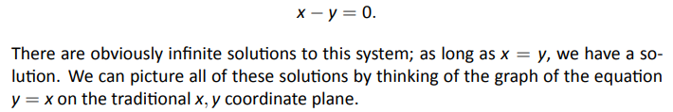
How Many Solutions?

Slide 41
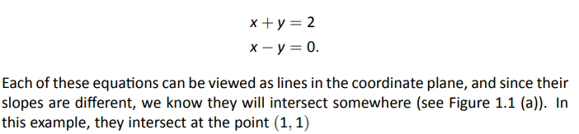
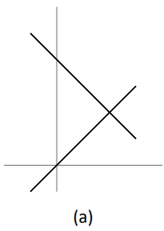
How Many Solutions?

Slide 42
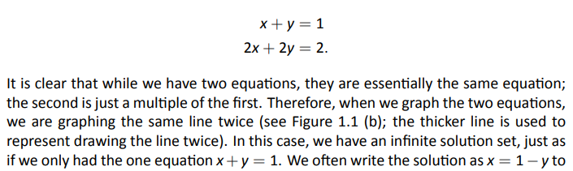
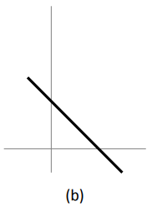
How Many Solutions?

Slide 43
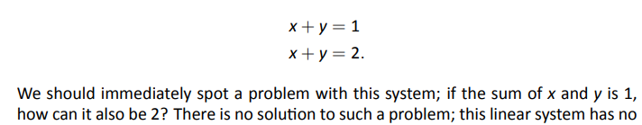
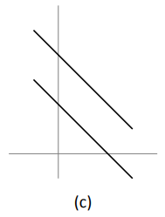
How Many Solutions?

Slide 44
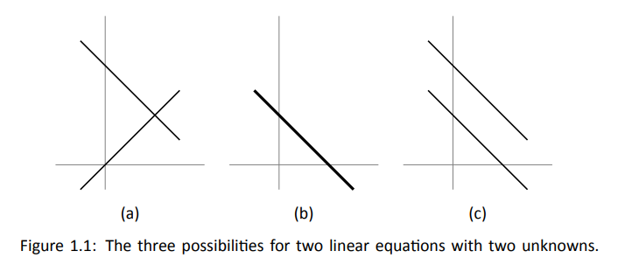
Summary

Slide 45
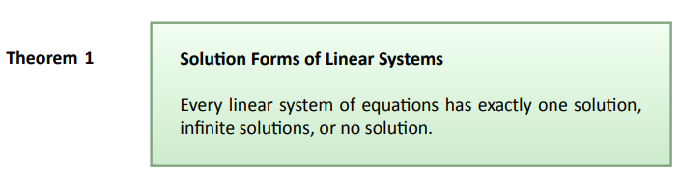
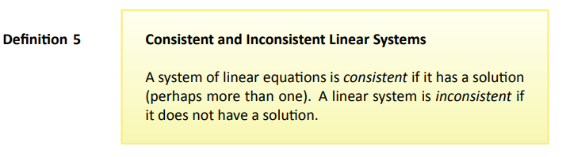
Theorem & Definition

Slide 46


Notice

Slide 47
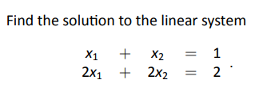

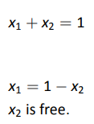
Example 8
Therefore infinitely many solutions
“free” means we are “free” to choose any value for x₂

Slide 48

Example 8 : Review

Slide 49
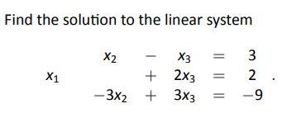
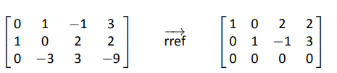
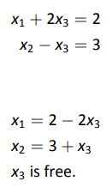

Example 9
Therefore, infinitely many solutions

Slide 50
Example 9 : Solution
Therefore, infinitely many solutions

Slide 51
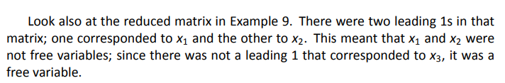
Example 9 : Review

Slide 52
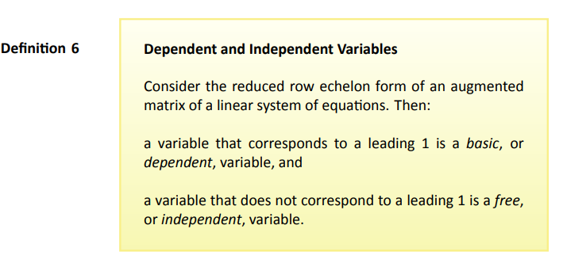
Definition

Slide 53
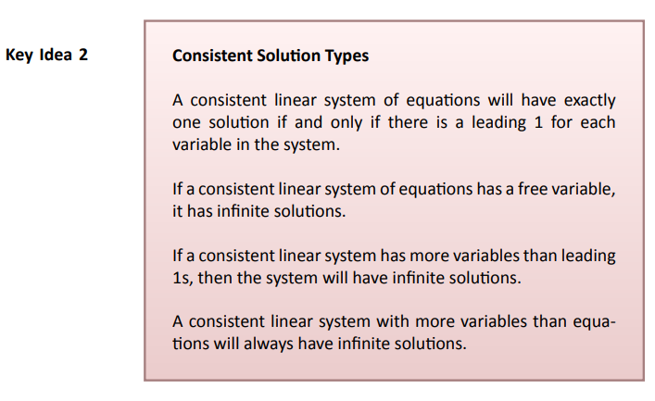
Key Idea
Notice

Slide 54
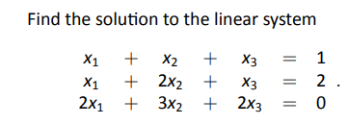



Example (10) of an Inconsistent System

Slide 55



Key Idea

Slide 56



Example 11

Slide 57

Definition

Slide 58




Example 12

Slide 59




Example 14

Slide 60
Solve the following system by using the Gauss-Jordan elimination method. Conclude that the system of equations is inconsistent, i.e., it has no solutions.

Slide 61
Elementary Row Operations as Matrix Multiplication

Slide 62
We performed three types of elementary row operations on a matrix A of dimension m-by-n:
Row addition: adding a scalar multiple of one row to another, and replace the later row with the sum
Row multiplication: multiplying all entries of a row by a non-zero constant
Row switching: interchanging the position of two rows.
The elementary row operations can be implemented by multiplying matrix A from left with an elementary matrix E of dimension m-by-m: E⋅A. For this we will use three types of elementary matrices E obtained from the identity matrix.

Slide 63


1. Row-addition transformations
The corresponding elementary matrix is the identity matrix but with an m in the (i,j) position.
$T\left(5\right) 31$ A= $\left[\begin{matrix}1 & 0 & 0 \\ 0 & 1 & 0 \\ 5 & 0 & 1\end{matrix}\right]$ $\left[\begin{matrix}1 & 1 & 1 \\ 2 & 2 & 2 \\ 3 & 3 & 3\end{matrix}\right]$=
So, T_{i,j}(m)⋅A is the matrix produced from A by adding m times row j to row i.

Slide 64


2. Row-multiplying transformations
The corresponding elementary matrix is a diagonal matrix, with diagonal entries 1 everywhere except in the i-th position, where it is m:
$T\left(5\right)1$A= $\left[\begin{matrix}5 & 0 & 0 \\ 0 & 1 & 0 \\ 0 & 0 & 1\end{matrix}\right]$ $\left[\begin{matrix}1 & 1 & 1 \\ 2 & 2 & 2 \\ 3 & 3 & 3\end{matrix}\right]$=
So, T_{i}(m)⋅A is the matrix produced from A by multiplying row i by m.

Slide 65


3. Row-switching transformations
The corresponding elementary matrix is obtained by swapping row i and row j of the identity matrix:
$T32$ A= $\left[\begin{matrix}1 & 0 & 0 \\ 0 & 0 & 1 \\ 0 & 1 & 0\end{matrix}\right]$ $\left[\begin{matrix}1 & 1 & 1 \\ 2 & 2 & 2 \\ 3 & 3 & 3\end{matrix}\right]$=
So T_{ij}⋅A is the matrix produced by exchanging row i and row j of A.

