Slide 1
Algorithms
Chapter 3
Kenneth Rosen, Discrete Mathematics and its Applications,
8th edition, McGraw Hill
Modified and extended: Longin Jan Latecki, latecki@temple.edu

Slide 2
Chapter Summary
Algorithms
  Example Algorithms
  Algorithmic Paradigms
Growth of Functions
  Big-O and other Notation
Complexity of Algorithms

Slide 3
Algorithms
Section 3.1

Slide 4
Section Summary
Properties of Algorithms
Algorithms for Searching and Sorting
Greedy Algorithms
Halting Problem

Slide 5
Problems and Algorithms
In many domains there are key general problems that ask for output with specific properties when given valid input.
The first step is to precisely state the problem, using the appropriate structures to specify the input and the desired output.
We then solve the general problem by specifying the steps of a procedure that takes a valid input and produces the desired output. This procedure is called an algorithm.

Slide 6
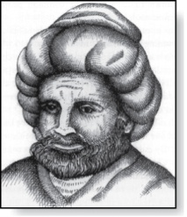
Algorithms
Abu Ja’far Mohammed Ibin Musa Al-Khowarizmi
(780-850)
Definition: An algorithm is a finite set of precise instructions for performing a computation or for solving a problem.
Example: Describe an algorithm for finding the maximum value in a finite sequence of integers.

Slide 7
Algorithms
Abu Ja’far Mohammed Ibin Musa Al-Khowarizmi
(780-850)
Definition: An algorithm is a finite set of precise instructions for performing a computation or for solving a problem.
Example: Describe an algorithm for finding the maximum value in a finite sequence of integers.
Solution: Perform the following steps:
    Set the temporary maximum equal to the first integer in the sequence.
    Compare the next integer in the sequence to the temporary maximum.
      If it is larger than the temporary maximum, set the temporary maximum equal to this integer.
    Repeat the previous step if there are more integers. If not, stop.
    When the algorithm terminates, the temporary maximum is the largest integer in the sequence.

Slide 8
Specifying Algorithms
Algorithms can be specified in different ways. Their steps can be described in English or in pseudocode.
Pseudocode is an intermediate step between an English language description of the steps and a coding of these steps using a programming language.
The form of pseudocode we use is specified in Appendix 3. It uses some of the structures found in popular languages such as C++ and Java.
Programmers can use the description of an algorithm in pseudocode to construct a program in a particular language.
Pseudocode helps us analyze the time required to solve a problem using an algorithm, independent of the actual programming language used to implement algorithm.

Slide 9
Properties of Algorithms
Input: An algorithm has input values from a specified set.
Output: From the input values, the algorithm produces the output values from a specified set. The output values are the solution.
Correctness: An algorithm should produce the correct output values for each set of input values.
Finiteness: An algorithm should produce the output after a finite number of steps for any input.
Effectiveness: It must be possible to perform each step of the algorithm correctly and in a finite amount of time.
Generality: The algorithm should work for all problems of the desired form.

Slide 10
Finding the Maximum Element in a Finite Sequence
The algorithm in pseudocode:
Does this algorithm have all the properties listed on the previous slide?
procedure max(a₁, a₂, …., a_{n}: integers)
max := a₁
for i := 2 to n
if max < a_{i} then max := a_{i}
return max{max is the largest element}

Slide 11
Some Example Algorithm Problems
Three classes of problems will be studied in this section.
  Searching Problems: finding the position of a particular element in a list.
  Sorting problems: putting the elements of a list into increasing order.
  Optimization Problems: determining the optimal value (maximum or minimum) of a particular quantity over all possible inputs.

Slide 12
Searching Problems
Definition: The general searching problem is to locate an element x in the list of distinct elements a₁,a₂,...,a_{n}, or determine that it is not in the list.
  The solution to a searching problem is the location of the term in the list that equals x (that is, i is the solution if x = a_{i}) or 0 if x is not in the list.
  For example, a library might want to check to see if a patron is on a list of those with overdue books before allowing him/her to checkout another book.
  We will study two different searching algorithms; linear search and binary search.

Slide 13
Linear Search Algorithm
The linear search algorithm locates an item in a list by examining elements in the sequence one at a time, starting at the beginning.
  First compare x with a₁. If they are equal, return the position 1.
  If not, try a₂. If x = a₂, return the position 2.
  Keep going, and if no match is found when the entire list is scanned, return 0.
procedure linear search(x:integer,
a₁, a₂, …,a_{n}: distinct integers)
i := 1
while (i ≤ n and x ≠ a_{i})
i := i + 1
if i ≤ n then location := i
else location := 0
return location{location is the subscript of the term that equals x, or is 0 if x is not found}

Slide 14
Binary Search
Assume the input is a list of items in increasing order.
The algorithm begins by comparing the element to be found with the middle element.
  If the middle element is lower, the search proceeds with the upper half of the list.
  If it is not lower, the search proceeds with the lower half of the list (through the middle position).
Repeat this process until we have a list of size 1.
  If the element we are looking for is equal to the element in the list, the position is returned.
  Otherwise, 0 is returned to indicate that the element was not found.
In Section 3.3, we show that the binary search algorithm is much more efficient than linear search.

Slide 15
Binary Search
Description of the binary search algorithm in pseudocode.
procedure binary search(x: integer, a₁,a₂,…, a_{n}: increasing integers)
i := 1 {i is the left endpoint of interval}
j := n {j is right endpoint of interval}
while i < j
m := ⌊(i + j)/2⌋
if x > a_{m} then i := m + 1
else j := m
if x = a_{i} then location := i
else location := 0
return location{location is the subscript i of the term a_{i} equal to x,
or 0 if x is not found}

Slide 16

procedure binary search(x: integer, a₁,a₂,…, a_{n}: increasing integers)
i := 1 {i is the left endpoint of interval}
j := n {j is right endpoint of interval}
while i < j
m := ⌊(i + j)/2⌋
if x > a_{m} then i := m + 1
else j := m
if x = a_{i} then location := i
else location := 0
return location{location is the subscript i of the term a_{i} equal to x,
or 0 if x is not found}
Example: The steps taken by a binary search for 19 in the list:
1 2 3 5 6 7 8 10 12 13 15 16 18 19 20 22
The list has 16 elements, so the midpoint is 8. The value in the 8th position is 10. Since 19 > 10, further search is restricted to positions 9 through 16.
1 2 3 5 6 7 8 10 12 13 15 16 18 19 20 22
The midpoint of the list (positions 9 through 16) is now the 12th position with a value of 16. Since 19 > 16, further search is restricted to the 13th position and above.
1 2 3 5 6 7 8 10 12 13 15 16 18 19 20 22
The midpoint of the current list is now the 14th position with a value of 19. Since 19 ≯ 19, further search is restricted to the portion from the 13th through the 14th positions .
1 2 3 5 6 7 8 10 12 13 15 16 18 19 20 22
The midpoint of the current list is now the 13th position with a value of 18. Since 19> 18, search is restricted to the portion from the 18th position through the 18th.
1 2 3 5 6 7 8 10 12 13 15 16 18 19 20 22
Now the list has a single element and the loop ends. Since 19=19, the location 16 is returned.

Slide 17
Sorting
To sort the elements of a list is to put them in increasing order (numerical order, alphabetic, and so on).
Sorting is an important problem because:
  A nontrivial percentage of all computing resources are devoted to sorting different kinds of lists, especially applications involving large databases of information that need to be presented in a particular order (e.g., by customer, part number etc.).
  An amazing number of fundamentally different algorithms have been invented for sorting. Their relative advantages and disadvantages have been studied extensively.
  Sorting algorithms are useful to illustrate the basic notions of computer science.
A variety of sorting algorithms are studied in this book; binary, insertion, bubble, selection, merge, quick, and tournament.
In Section 3.3, we’ll study the amount of time required to sort a list using the sorting algorithms covered in this section.

Slide 18
Bubble Sort
Bubble sort makes multiple passes through a list. Every pair of consecutive elements that are found to be out of order are interchanged.
procedure bubblesort(a₁,…,a_{n}: real numbers
with n ≥ 2)
for i := 1 to n− 1
for j := 1 to n − i
if a_{j} >a_{j+1} then interchange a_{j} and a_{j+1}
{a₁,…, a_{n} is now in increasing order}
Bubble Sort Animation

Slide 19
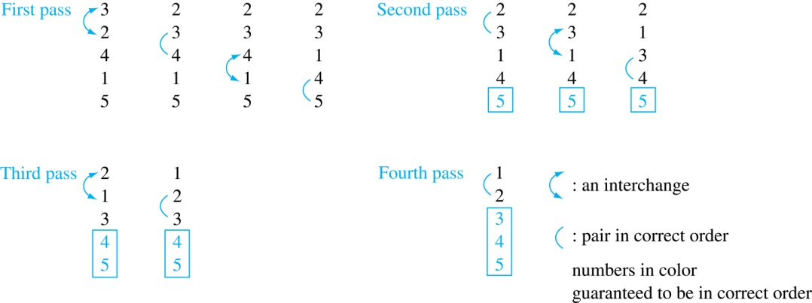
procedure bubblesort(a₁,…,a_{n}: real numbers
with n ≥ 2)
for i := 1 to n− 1
for j := 1 to n − i
if a_{j} >a_{j+1} then interchange a_{j} and a_{j+1}
{a₁,…, a_{n} is now in increasing order}
Example: Show the steps of bubble sort with 3 2 4 1 5
At the first pass the largest element has been put into the correct position
At the end of the second pass, the 2nd largest element has been put into the correct position.
In each subsequent pass, an additional element is put in the correct position.

Slide 20
Insertion Sort
Insertion sort begins with the 2nd element. It compares the 2nd element with the 1st and puts it before the first if it is not larger.
procedure insertion sort
(a₁,…,a_{n}:
real numbers with n ≥ 2)
for j := 2 to n
i := 1
while a_{i} < a_{j}
i := i + 1
m := a_{j}
for k := 0 to j − i − 1
a_{j-k} := a_{j-k-1}
a_{i} := m
{Now a₁,…,a_{n} is in increasing order}
Next the 3rd element is put into the correct position among the first 3 elements.
In each subsequent pass, j-th element is put into its correct position among the first j elements.
Linear search is used to find the correct position.
Insertion Sort Animation
(different from our alg)

Slide 21
Example: Show all the steps of insertion sort with the input: 3 2 4 1 5
2 3 4 1 5 (first two positions are interchanged)
2 3 4 1 5 (third element remains in its position)
1 2 3 4 5 (fourth is placed at beginning)
1 2 3 4 5 (fifth element remains in its position)
procedure insertion sort
(a₁,…,a_{n}:
real numbers with n ≥ 2)
for j := 2 to n
i := 1
while a_{i} < a_{j}
i := i + 1
m := a_{j}
for k := 0 to j − i − 1
a_{j-k} := a_{j-k-1}
a_{i} := m
{Now a₁,…,a_{n} is in increasing order}

Slide 22
Greedy Algorithms
Optimization problems minimize or maximize some parameter over all possible inputs.
Among the many optimization problems we will study are:
  Finding a route between two cities with the smallest total mileage.
  Determining how to encode messages using the fewest possible bits.
  Finding the fiber links between network nodes using the least amount of fiber.
Optimization problems can often be solved using a greedy algorithm, which makes the “best” choice at each step. Making the “best choice” at each step does not necessarily produce an optimal solution to the overall problem, but in many instances, it does.
After specifying what the “best choice” at each step is, we try to prove that this approach always produces an optimal solution or find a counterexample to show that it does not.
The greedy approach to solving problems is an example of an algorithmic paradigm, which is a general approach for designing an algorithm. We return to algorithmic paradigms in Section 3.3.

Slide 23
Greedy Algorithms: Making Change
Example: Design a greedy algorithm for making change (in U.S. money) of n cents with the following coins: quarters (25 cents), dimes (10 cents), nickels (5 cents), and pennies (1 cent), using the least total number of coins.
Idea: At each step choose the coin with the largest possible value that does not exceed the amount of change left.
  If n = 67 cents, first choose a quarter leaving 67−25 = 42 cents. Then choose another quarter leaving 42 −25 = 17 cents
  Then choose 1 dime, leaving 17 − 10 = 7 cents.
  Choose 1 nickel, leaving 7 – 5 = 2 cents.
  Choose a penny, leaving one cent. Choose another penny leaving 0 cents.

Slide 24
Greedy Change-Making Algorithm
Greedy algorithm: always return the largest coin ≤ remaining amount.
Solution: Greedy change-making algorithm for n cents. The algorithm works with any coin denominations c₁, c₂, …,c_{r} .
  For the example of U.S. currency, we may have quarters, dimes, nickels and pennies, with c₁ = 25, c₂ = 10, c₃ = 5, and c₄ = 1.
procedure change(c₁, c₂, …, c_{r}: values of coins, where c₁> c₂> … > c_{r} ; n: a positive integer)
for i := 1 to r
d_{i} := 0 [d_{i} counts the coins of denomination c_{i}]
while n ≥ c_{i}
d_{i} := d_{i} + 1 [add a coin of denomination c_{i}]
n = n - c_{i}
[d_{i} counts the coins c_{i}]

Slide 25
Proving Optimality for U.S. Coins
Theorem: The greedy change-making algorithm for U.S. coins produces change using the fewest coins possible.
Optimality depends on the denominations available.
For U.S. coins, optimality still holds if we add half dollar coins (50 cents) and dollar coins (100 cents).
But if we allow only quarters (25 cents), dimes (10 cents), and pennies (1 cent), i.e., no nickels (5 cents), the algorithm no longer produces the minimum number of coins.
  Consider the example of 31 cents. The optimal number of coins is 4, i.e., 3 dimes and 1 penny. What does the algorithm output?

Slide 26
Proving Optimality for U.S. Coins
Theorem: The greedy change-making algorithm for U.S. coins produces change using the fewest coins possible.
Proof: By contradiction.
  Assume there is a positive integer n such that change can be made for n cents using quarters, dimes, nickels, and pennies, with a fewer total number of coins than given by the algorithm.
  Then, q̍ < q where q̍ is the number of quarters used in this optimal way and q is the number of quarters in the greedy algorithm’s solution. But this is not possible by Lemma 1, since the value of the coins other than quarters can not be greater than 24 cents.
  Similarly, by Lemma 1, the two algorithms must have the same number of dimes, nickels, and quarters.

Slide 27
Proving Optimality for U.S. Coins
Show that the change making algorithm for U.S. coins is optimal.
Lemma 1: If n is a positive integer, then n cents in change using quarters, dimes, nickels, and pennies, using the fewest coins possible has at most 2 dimes, 1 nickel, 4 pennies, and cannot have 2 dimes and a nickel. The total amount of change in dimes, nickels, and pennies must not exceed 24 cents.
Proof: By contradiction
  If we had 3 dimes, we could replace them with a quarter and a nickel.
  If we had 2 nickels, we could replace them with 1 dime.
  If we had 5 pennies, we could replace them with a nickel.
  If we had 2 dimes and 1 nickel, we could replace them with a quarter.
  The allowable combinations, have a maximum value of 24 cents; 2 dimes and 4 pennies.

Slide 28
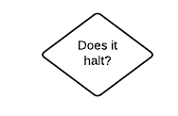
Halting Problem (intuition)
Is there a program that never stops but you can’t determine it?
The answer turns out to be "yes", and we can even prove it.
Suppose that we have an algorithm that could answer the halting problem. However, complicated it might be, we just wrap it up in a decision box. We do not worry about what is inside; we are just positing that there could be something in there.
This and next slide based on Quara by Joshua Engel

Slide 29
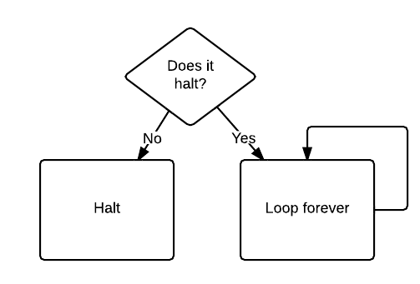
Now, let us make up a program that uses it:
OK, now... what happens if we feed this program to itself? If it doesn't halt, then it halts. If it does halt, then it doesn't halt. So, does it halt or not?
The answer is that there is no answer. It is the computer programming equivalent of saying "I always lie": if it's true, then it's not true, and if it's not true, then it's true.
In other words, the answer to the question is undecidable, neither true nor false. We conclude that the magic diamond "does it halt" box doesn't exist, which is interesting. But even more interesting is the fact that we have taken a simple yes/no question and found that we cannot know the answer in all cases.
So, such a program does not exist → not everything can be computed!

Slide 30
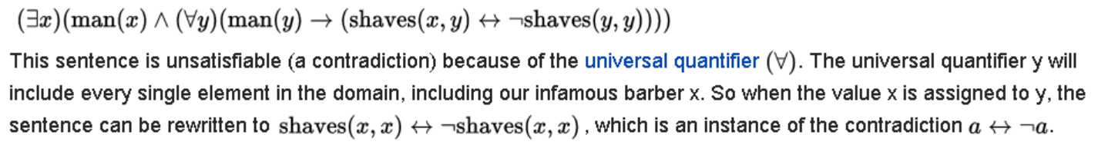
Barber paradox
It was used by Bertrand Russell as an illustration of a paradox.
The barber is the "one who shaves all those, and those only, who do not shave themselves."
The question is, does the barber shave himself?
Answering this question results in a contradiction. The barber cannot shave himself as he only shaves those who do not shave themselves. As such, if he shaves himself he ceases to be a barber.
In first order logic:

Slide 31
Halting Problem (more formal)
Can we develop a procedure that takes as input a computer program along with its input and determines whether the program will eventually halt with that input.
Solution: Proof by contradiction.
Assume that there is such a procedure and call it H(P,I). The procedure H(P,I) takes as input a program P and the input I to P.
  H outputs “halt” if it is the case that P will stop when run with input I.
  Otherwise, H outputs “loops forever.”

Slide 32
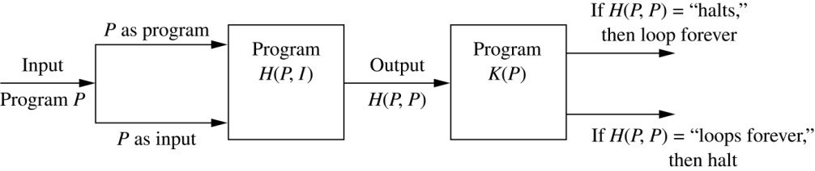
Halting Problem
Since a program is a string of characters, we can call H(P,P). Construct a procedure K(P), which works as follows.
  If H(P,P) outputs “loops forever”, then K(P) halts.
  If H(P,P) outputs “halt”, then K(P) goes into an infinite loop printing “ha” on each iteration.

Slide 33
Halting Problem
Now we call K with K as input, i.e. K(K).
  If the output of H(K,K) is “halts”, then K(K) loops forever. A Contradiction.
  If the output of H(K,K) is “loops forever”, then K(K) halts. A Contradiction.
Therefore, there cannot be a procedure that can decide whether or not an arbitrary program halts. The halting problem is unsolvable.

Slide 34
The Growth of Functions
Section 3.2

Slide 35
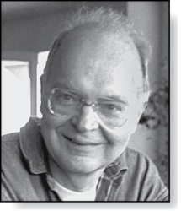
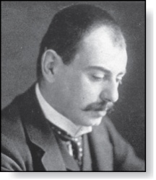
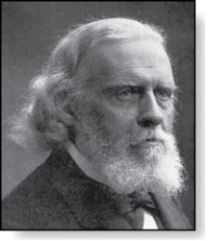
Section Summary
Donald E. Knuth
(Born 1938)
Big-O Notation
Big-O Estimates for Important Functions
Big-Omega and Big-Theta Notation
Edmund Landau
(1877-1938)
Paul Gustav Heinrich Bachmann
(1837-1920)

Slide 36
The Growth of Functions
In both computer science and in mathematics, there are many times when we care about how fast a function grows.
In computer science, we want to understand how quickly an algorithm can solve a problem as the size of the input grows.
  We can compare the efficiency of two different algorithms for solving the same problem.
  We can also determine whether it is practical to use a particular algorithm as the input grows.
  We’ll study these questions in Section 3.3.
Two of the areas of mathematics where questions about the growth of functions are studied are:
  number theory (covered in Chapter 4)
  combinatorics (covered in Chapters 6 and 8)

Slide 37
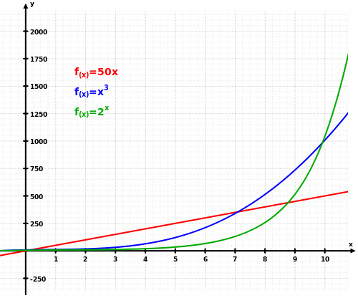

Slide 38
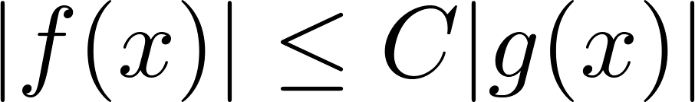
Big-O Notation
Definition: Let f and g be functions from the set of integers or the set of real numbers to the set of real numbers. We say that f(x) is O(g(x)) if there are constants C and k such that
whenever x > k. (illustration on next slide)
This is read as “f(x) is big-O of g(x)” or “g asymptotically dominates f.”
The constants C and k are called witnesses to the relationship f(x) is O(g(x)). Only one pair of witnesses is needed.

Slide 39
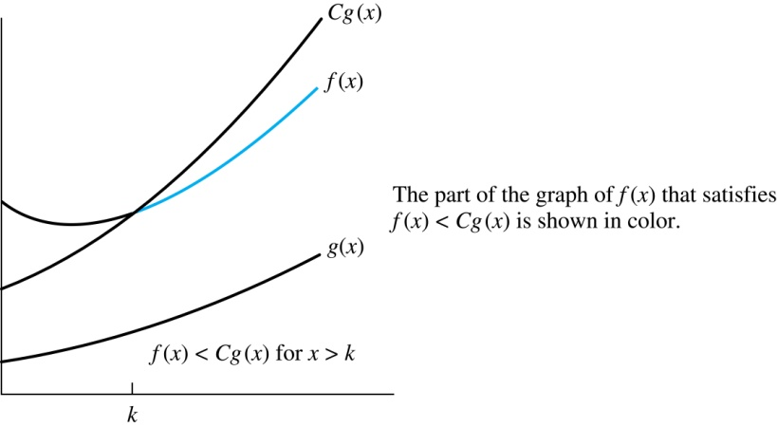
Illustration of Big-O Notation
f(x) is O(g(x))

Slide 40
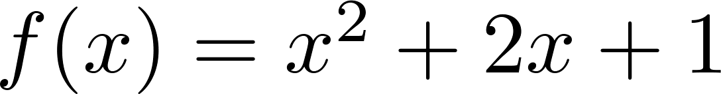
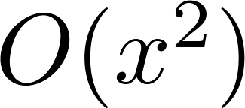
Using the Definition of Big-O Notation
Example: Show that is .

Slide 41
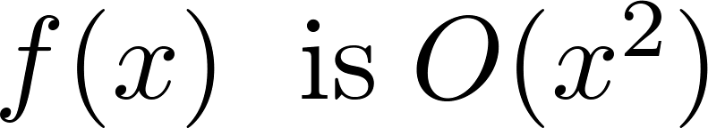
Using the Definition of Big-O Notation
Example: Show that is .
Solution: Since 1 < x ⇒ x < x² and 1 < x²
  Can take C = 4 and k = 1 as witnesses to show that
(see graph on next slide)
Alternatively, when 2 < x, we have 2x ≤ x² and 1 < x². Hence, when x > 2.
  Can take C = 3 and k = 2 as witnesses instead.

Slide 42
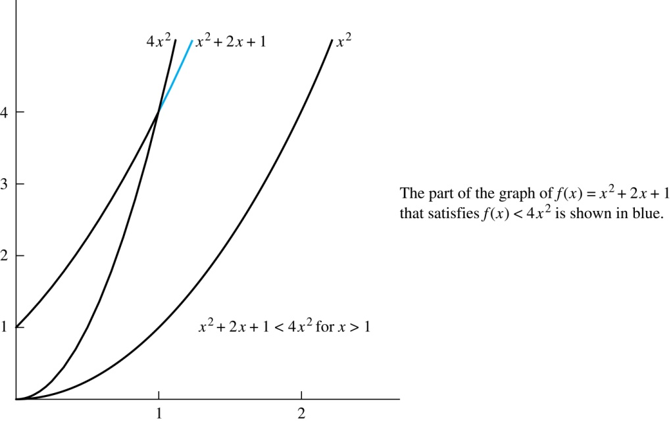
Illustration of Big-O Notation
is

Slide 43

Some Important Points about Big-O
If one pair of witnesses is found, then there are infinitely many pairs. We can always make the k or the C larger and still maintain the inequality .
  Any pair C ̍ and k̍ where C < C̍ and k < k ̍ is also a pair of witnesses since whenever x > k̍ > k.
You may see “ f(x) = O(g(x))” instead of “ f(x) is O(g(x)).”
  But this is an abuse of the equals sign since the meaning is that there is an inequality relating the values of f and g, for sufficiently large values of x.
  It is ok to write f(x) ∊ O(g(x)), because O(g(x)) represents the set of functions that are O(g(x)).
Usually, we will drop the absolute value sign since we will always deal with functions that take on positive values.

Slide 44
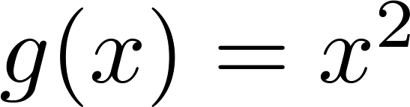
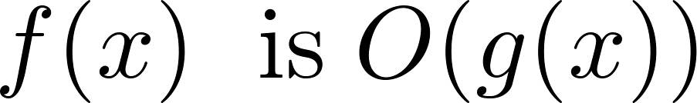

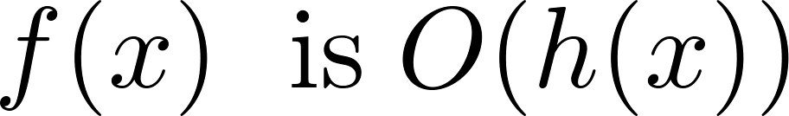
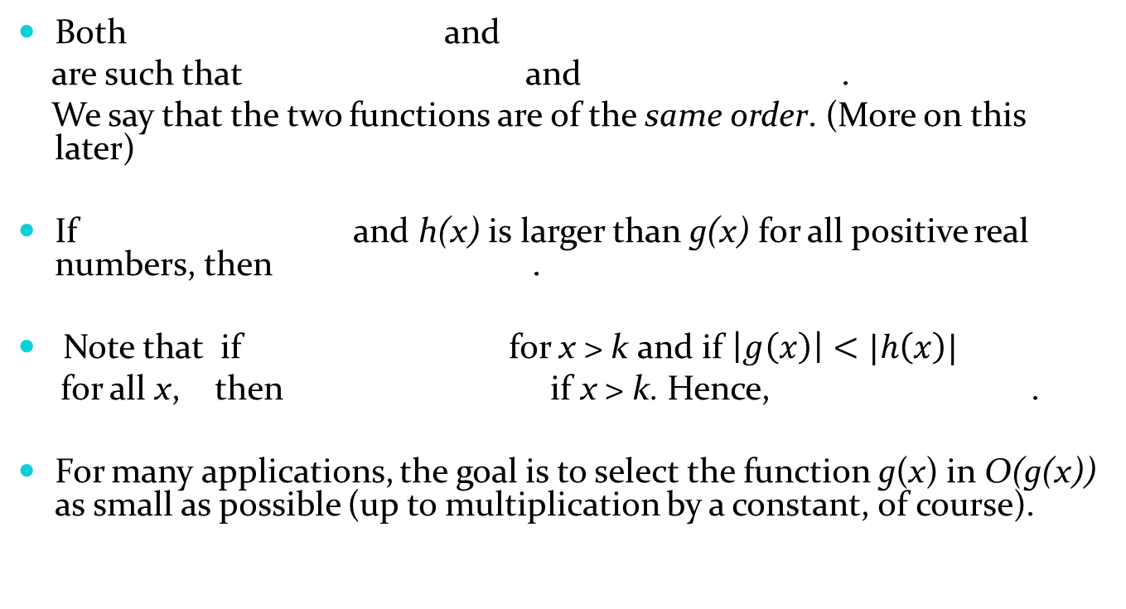
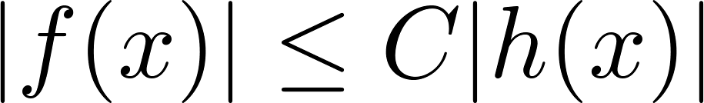
Big-O Notation
Both and
are such that and .
We say that the two functions are of the same order. (More on this later)
If and h(x) is larger than g(x) for all positive real numbers, then .
Note that if for x > k and if $\left|g\left(x\right)\right|<|h\left(x\right)|$
for all x, then if x > k. Hence, .
For many applications, the goal is to select the function g(x) in O(g(x)) as small as possible (up to multiplication by a constant, of course).

Slide 45
Using the Definition of Big-O Notation
Example: Show that 7x² is O(x³).
Solution: When 7 < x, 7x² < x³. Take C =1 and k = 7 as witnesses to establish that 7x² is O(x³).
Example: Show that n² is not O(n).
Solution: Suppose there are constants C and k>0 for which
n² ≤ Cn, whenever n > k.
Then (by dividing both sides by n),
n ≤ C must hold for all n > k.
A contradiction!

Slide 46
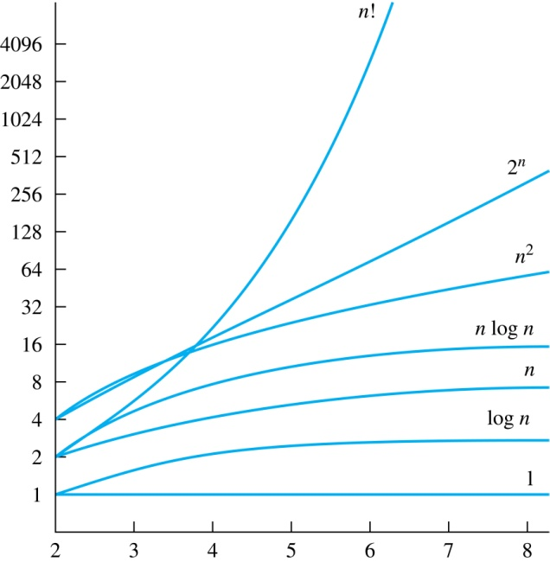
Display of Growth of Functions
Note the difference in behavior of functions as n gets larger

Slide 47

Big-O Estimates for Polynomials
Theorem: Let
where are real numbers with a_{n} ≠0.
Then f(x) is O(x^{n}).
Proof: |f(x)| = |a_{n}x^{n} + a_{n-1} x^{n-1} + ∙∙∙ + a₁x¹ + a₀|
≤ |a_{n}|x^{n} + |a_{n-1}| x^{n-1} + ∙∙∙ + |a₁|x¹ + |a₀|
= x^{n} (|a_{n}| + |a_{n-1}| /x + ∙∙∙ + |a₁|/x^{n-1} + |a₀|/ x^{n})
≤ x^{n} (|a_{n}| + |a_{n-1}| + ∙∙∙ + |a₁|+ |a₀|)
Take C = |a_{n}| + |a_{n-1}| + ∙∙∙ + |a₁|+ |a₀| and k = 1. Then f(x) is O(x^{n}).
The leading term a_{n}x^{n} of a polynomial dominates its growth.
Uses triangle inequality, an exercise in Section 1.8.
Assuming x > 1

Slide 48
Big-O Estimates for some Important Functions
Example: Use big-O notation to estimate the sum of the first n positive integers.
Solution:
Example: Use big-O notation to estimate the factorial function
Solution:

Slide 49
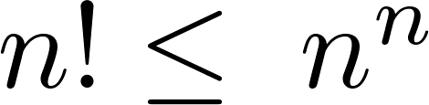
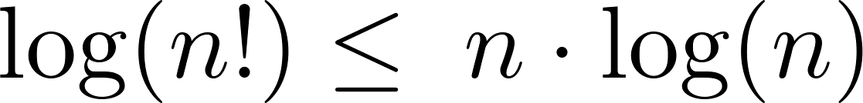
Big-O Estimates for some Important Functions
Example: Use big-O notation to estimate log n!
Solution: Given that (previous slide)
then
Hence, log(n!) is O(n∙log(n)) taking C = 1 and k = 1.

Slide 50
Useful Big-O Estimates Involving Powers and Exponents
If d > c > 1, so, n^{c} < n^{d}, then
n^{c} is O(n^{d}), but n^{d} is not O(n^{c}).
If c > b > 1, so b^{n} < c^{n}, then
b^{n} is O(c^{n}), but c^{n} is not O(b^{n}).
Useful log rules:
log (a * b) = log(a) + log (b)
log (a^{b}) = b * log(a)
Here, log has a base of 2

Slide 51
Combinations of Functions
If f₁ (x) is O(g₁(x)) and f₂ (x) is O(g₂(x)) then
( f₁ + f₂ )(x) is O(max(|g₁(x)|,|g₂(x)|)).
  See next slide for proof
If f₁ (x) and f₂ (x) are both O(g(x)) then
( f₁ + f₂ )(x) is O(g(x)).
  See next slide for argument
If f₁ (x) is O(g₁(x)) and f₂ (x) is O(g₂(x)) then
( f₁ f₂ )(x) is O(g₁(x)g₂(x)).
  See text for argument

Slide 52
Combinations of Functions
If f₁ (x) is O(g₁(x)) and f₂ (x) is O(g₂(x)) then
( f₁ + f₂ )(x) is O(max(|g₁(x) |,|g₂(x) |)).
  By the definition of big-O notation, there are constants C₁,C₂ ,k₁,k₂ such that | f₁ (x)| ≤ C₁|g₁(x) | when x > k₁ and f₂ (x) ≤ C₂|g₂(x) | when x > k₂ .
  |( f₁ + f₂ )(x)| = |f₁(x) + f₂(x)|
≤ |f₁ (x)| + |f₂ (x)| by the triangle inequality |a + b| ≤ |a| + |b|
  |f₁ (x)| + |f₂ (x)| ≤ C₁|g₁(x) | + C₂|g₂(x) |
≤ C₁|g(x) | + C₂|g(x) | where g(x) = max(|g₁(x)|,|g₂(x)|)
= (C₁ + C₂) |g(x)|
= C|g(x)| where C = C₁ + C₂
  Therefore |( f₁ + f₂ )(x)| ≤ C|g(x)| whenever x > k, where k = max(k₁,k₂).

Slide 53
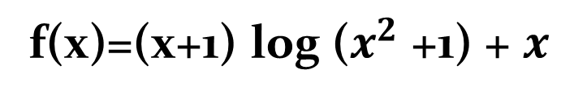
Give big-O estimate of
f(x)=(x+1) log ($x^{2}$ +1) + $x^{}$

Slide 54
Ordering Functions by Order of Growth
Put the functions below in order so that each function is big-O of the next function on the list.
f₁(n) = (1.5)^{n}
f₂(n) = 8n³+17n² +111
f₃(n) = (log n )²
f₄(n) = 2^{n}
f₅(n) = log (log n)
f₆(n) = n² (log n)³
f₇(n) = 2^{n} (n² +1)
f₈(n) = n³+ n(log n)²
f₉(n) = 10000
f₁₀(n) = n!
We solve this exercise by successively finding the function that grows slowest among all those left on the list.
f₉(n) = 10000 (constant, does not increase with n)
f₅(n) = log (log n) (grows slowest of all the others)
f₃(n) = (log n )² (grows next slowest)
f₆(n) = n² (log n)³ (next largest, (log n)³ factor smaller than any power of n)
f₂(n) = 8n³+17n² +111 (tied with the one below)
f₈(n) = n³+ n(log n)² (tied with the one above)
f₁(n) = (1.5)^{n} (next largest, an exponential function)
f₄(n) = 2^{n} (grows faster than one above since 2 > 1.5)
f₇(n) = 2^{n} (n² +1) (grows faster than above because of the n² +1 factor)
f₁₀(n) = n! ( n! grows faster than c^{n} for every c)

Slide 55
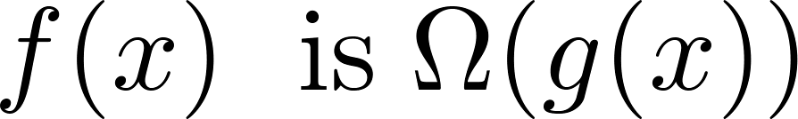
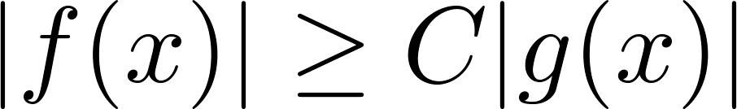
Big-Omega Notation
Definition: Let f and g be functions from the set of integers or the set of real numbers to the set of real numbers. We say that
if there are constants C and k such that
when x > k.
We say that “f(x) is big-Omega of g(x).”
Big-O gives an upper bound on the growth of a function, while Big-Omega gives a lower bound. Big-Omega tells us that a function grows at least as fast as another.
f(x) is Ω(g(x)) if and only if g(x) is O(f(x)). This follows from the definitions. See the text for details.
Ω is the upper case version of the lower case Greek letter ω.

Slide 56
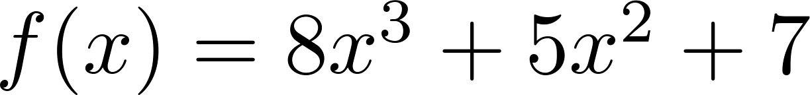
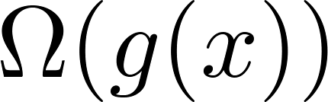
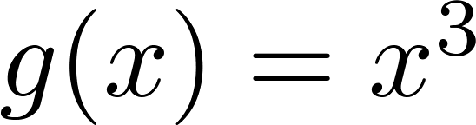
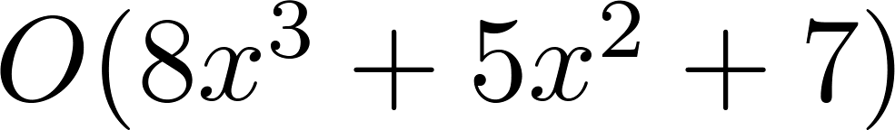

Big-Omega Notation
Example: Show that is
where .
Solution: $f\left(x\right)=8x^{3}$+ $5x^{2}+7≥$ $x^{3}$ for all positive real numbers x.
  Is it also the case that is ?

Slide 57
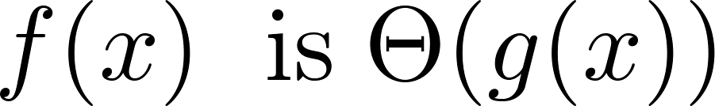
Big-Theta Notation
Θ is the upper case version of the lower case Greek letter θ.
Definition: Let f and g be functions from the set of integers or the set of real numbers to the set of real numbers. The function if
and .
We say that “f is big-Theta of g(x)” and also that “f(x) is of order g(x)” and also that “f(x) and g(x) are of the same order.”
if and only if there exists constants C₁ , C₂ and k such that C₁g(x) < f(x) < C₂ g(x) if x > k. This follows from the definitions of big-O and big-Omega.

Slide 58
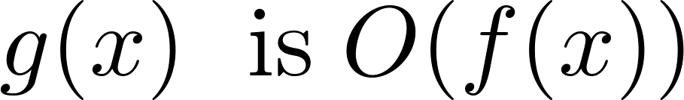
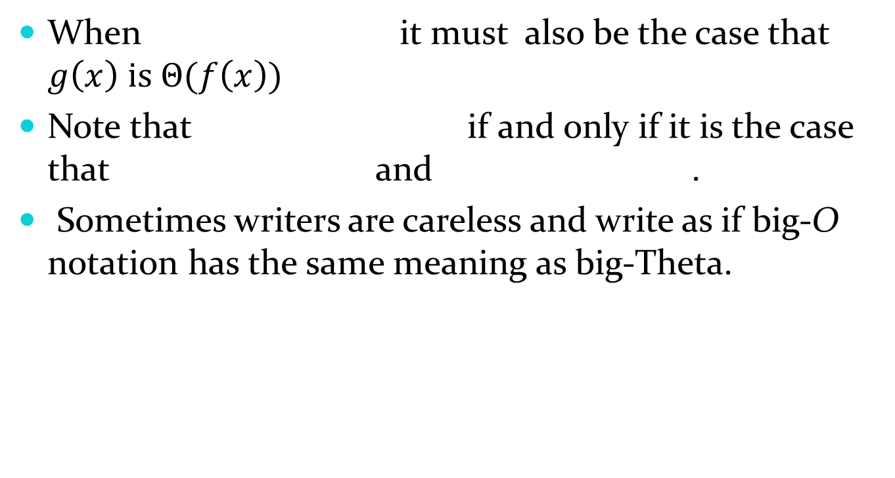
Big-Theta Notation
When it must also be the case that $g\left(x\right) \text{is} Θ(f\left(x\right))$
Note that if and only if it is the case that and .
Sometimes writers are careless and write as if big-O notation has the same meaning as big-Theta.

Slide 59
Big-Theta Notation
Example: Sh0w that f(x) = 3x² + 8x log x is Θ(x²).
Solution:

Slide 60
Big-Theta Notation
Example: Sh0w that f(x) = 3x² + 8x log x is Θ(x²).
Solution:
    x² is clearly O(3x² + 8x log x)
    3x² + 8x log x ≤ 11x² for x > 1, since 0 ≤ 8x log x ≤ 8x² .
      Hence, 3x² + 8x log x is O(x²).
    Hence, 3x² + 8x log x is Θ(x²).

Slide 61
Big Theta Notation
Example: Show that the sum of the first n positive integers is Θ(n²).
Solution: Let f(n) = 1 + 2 + ∙∙∙ + n.
  We have already shown that f(n) is O(n²).
  To show that f(n) is Ω(n²), we need a positive constant C such that f(n) > Cn² for sufficiently large n. Summing only the terms greater than n/2 we obtain the inequality
  1 + 2 + ∙∙∙ + n ≥ ⌈ n/2⌉ + (⌈ n/2⌉ + 1) + ∙∙∙ + n
  ≥ ⌈ n/2⌉ + ⌈ n/2⌉ + ∙∙∙ + ⌈ n/2⌉
  = (n − ⌈ n/2⌉ + 1 ) ⌈ n/2⌉
  ≥ (n/2)(n/2) = n²/4
  Taking C = ¼, f(n) > Cn² for all positive integers n. Hence, f(n) is Ω(n²), and we can conclude that f(n) is Θ(n²).

Slide 62
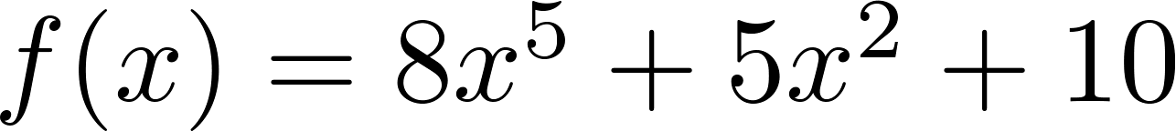
Big-Theta Estimates for Polynomials
Theorem: Let
where are real numbers with a_{n} ≠0.
Then f(x) is of order x^{n} (or Θ(x^{n})).
(The proof is an exercise.)
Example:
The polynomial is order of x⁵ (or Θ(x⁵)).
The polynomial is order of x¹⁹⁹ (or Θ(x¹⁹⁹) ).

Slide 63
What is big-O estimate of

Slide 64
Complexity of Algorithms
Section 3.3

Slide 65
Section Summary
Time Complexity
Worst-Case Complexity
Algorithmic Paradigms
Understanding the Complexity of Algorithms

Slide 66
The Complexity of Algorithms
Given an algorithm, how efficient is this algorithm for solving a problem given input of a particular size? To answer this question, we ask:
  How much time does this algorithm use to solve a problem?
  How much computer memory does this algorithm use to solve a problem?
When we analyze the time the algorithm uses to solve the problem given input of a particular size, we are studying the time complexity of the algorithm.
When we analyze the computer memory the algorithm uses to solve the problem given input of a particular size, we are studying the space complexity of the algorithm.

Slide 67
The Complexity of Algorithms
In this course, we focus on time complexity. The space complexity of algorithms is studied in later courses.
We will measure time complexity in terms of the number of operations an algorithm uses and we will use big-O and big-Theta notation to estimate the time complexity.
We can use this analysis to see whether it is practical to use this algorithm to solve problems with input of a particular size. We can also compare the efficiency of different algorithms for solving the same problem.
We ignore implementation details (including the data structures used and both the hardware and software platforms) because it is extremely complicated to consider them.

Slide 68
Time Complexity
To analyze the time complexity of algorithms, we determine the number of operations, such as comparisons and arithmetic operations (addition, multiplication, etc.). We can estimate the time a computer may actually use to solve a problem using the amount of time required to do basic operations.
We ignore minor details, such as the “house keeping” aspects of the algorithm.
We will focus on the worst-case time complexity of an algorithm. This provides an upper bound on the number of operations an algorithm uses to solve a problem with input of a particular size.
It is usually much more difficult to determine the average case time complexity of an algorithm. This is the average number of operations an algorithm uses to solve a problem over all inputs of a particular size.

Slide 69
Complexity Analysis of Algorithms
Example: Describe the time complexity of the algorithm for finding the maximum element in a finite sequence.
procedure max(a₁, a₂, …., a_{n}: integers)
max := a₁
for i := 2 to n
if max < a_{i} then max := a_{i}
return max{max is the largest element}
Solution: Count the number of comparisons.
  The max < a_{i} comparison is made n − 1 times.
  Exactly n − 1 comparisons are made.
  f(n) = n − 1 is Θ(n).
Hence, the time complexity of the algorithm is Θ(n).

Slide 70
Worst-Case Complexity of Linear Search
Example: Determine the time complexity of the linear search algorithm.
procedure linear search(x:integer,
a₁, a₂, …,a_{n}: distinct integers)
i := 1
while (i ≤ n and x ≠ a_{i})
i := i + 1
if i ≤ n then location := i
else location := 0
return location{location is the subscript of the term that equals x, or is 0 if x is not found}
Solution: Count the number of comparisons.
  At each step two comparisons are made: i ≤ n and x ≠ a_{i} .
  After the while loop, one more i ≤ n comparison is made.
If x = a_{i} , 2i + 1 comparisons are used. If x is not on the list, 2n + 1 comparisons are made. So, in the worst case 2n + 1 comparisons are made. Hence, the complexity is Θ(n).

Slide 71
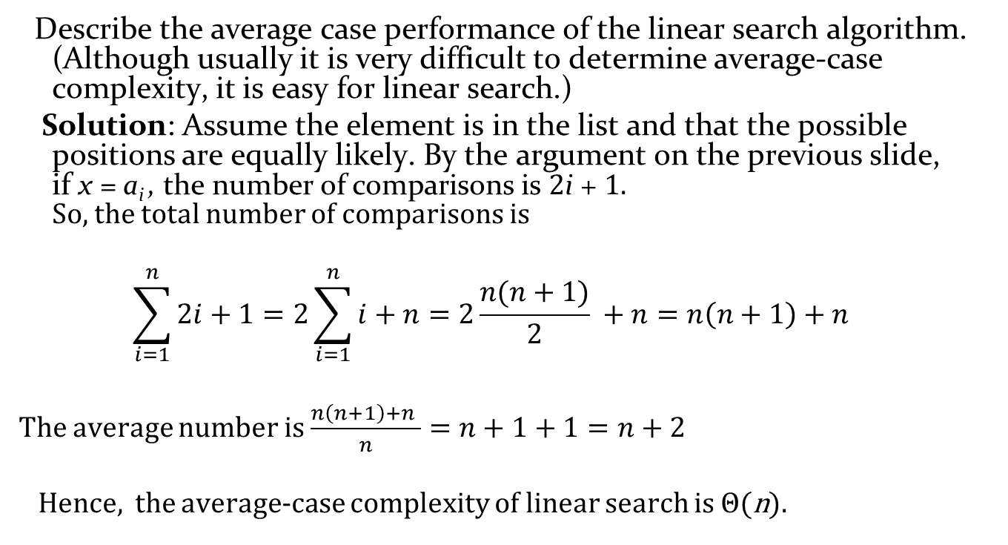
Average-Case Complexity of Linear Search
Describe the average case performance of the linear search algorithm. (Although usually it is very difficult to determine average-case complexity, it is easy for linear search.)
Solution: Assume the element is in the list and that the possible positions are equally likely. By the argument on the previous slide,
if x = a_{i} , the number of comparisons is 2i + 1.
So, the total number of comparisons is
$$\sum_{i=1}^{n}{2i+1=2\sum_{i=1}^{n}{i+n=2\frac{n(n+1)}{2} }}+n=n\left(n+1\right)+n$$
The average number is $\frac{n\left(n+1\right)+n }{n}=n+1+1=n+2$
Hence, the average-case complexity of linear search is Θ(n).

Slide 72
Worst-Case Complexity of Binary Search
Example: Describe the time complexity of binary search in terms of the number of comparisons used.
procedure binary search(x: integer, a₁,a₂,…, a_{n}: increasing integers)
i := 1 {i is the left endpoint of interval}
j := n {j is right endpoint of interval}
while i < j
m := ⌊(i + j)/2⌋
if x > a_{m} then i := m + 1
else j := m
if x = a_{i} then location := i
else location := 0
return location{location is the subscript i of the term a_{i} equal to x, or 0 if x is not found}
Solution: Assume (for simplicity) n = 2^{k} elements. Note that k = log n.
  Two comparisons are made at each stage; i < j, and x > a_{m} .
  At the first iteration the size of the list is 2^{k} and after the first iteration it is 2^{k-1}. Then 2^{k-2} and so on until the size of the list is 2¹ = 2.
  At the last step, a comparison tells us that the size of the list is the size is 2⁰ = 1 and the element is compared with the single remaining element.
  Hence, at most 2k + 2 = 2 log n + 2 comparisons are made.
  Therefore, the time complexity is Θ (log n), better than linear search.

Slide 73
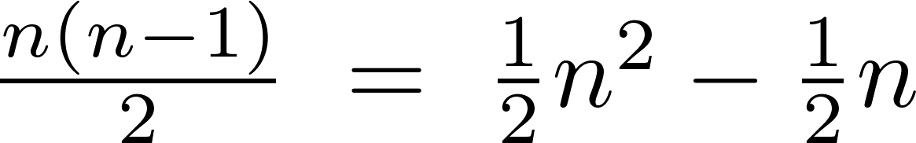
Worst-Case Complexity of Bubble Sort
Example: What is the worst-case complexity of bubble sort in terms of the number of comparisons made?
procedure bubblesort(a₁,…,a_{n}: real numbers
with n ≥ 2)
for i := 1 to n− 1
for j := 1 to n − i
if a_{j} >a_{j+1} then interchange a_{j} and a_{j+1}
{a₁,…, a_{n} is now in increasing order}
Solution: A sequence of n−1 passes is made through the list. On each pass n − i comparisons are made.
The worst-case complexity of bubble sort is Θ(n²) since .

Slide 74
Worst-Case Complexity of Insertion Sort
Example: What is the worst-case complexity of insertion sort in terms of the number of comparisons made?
procedure insertion sort(a₁,…,a_{n}:
real numbers with n ≥ 2)
for j := 2 to n
i := 1
while a_{j} > a_{i}
i := i + 1
m := a_{j}
for k := 0 to j − i − 1
a_{j-k} := a_{j-k-1}
a_{i} := m
Solution: The total number of comparisons are:
Therefore, the complexity is Θ(n²).

Slide 75
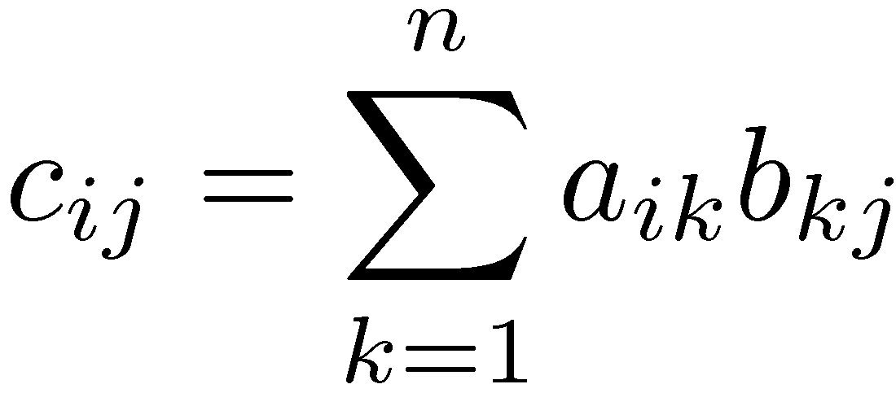
Matrix Multiplication
j
i
×
=

Slide 76
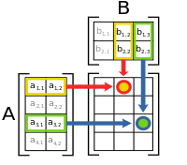


Matrix Multiplication
For example, the underlined entry 2340 in the product is calculated as
(2 × 1000) + (3 × 100) + (4 × 10) = 2340:

Slide 77

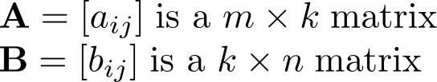
Matrix Multiplication Algorithm
The definition for matrix multiplication can be expressed as an algorithm; C = A B where C is an m n matrix that is the product of the m k matrix A and the k n matrix B.
This algorithm carries out matrix multiplication based on its definition.
procedure matrix multiplication(A,B: matrices)
for i := 1 to m (rows of A)
for j := 1 to n (cols of B)
c_{ij} := 0
for q := 1 to k (cols of A = rows of B)
c_{ij} := c_{ij} + a_{iq} b_{qj}
return C{C = [c_{ij}] is the product of A and B}

Slide 78
Complexity of Matrix Multiplication
Example: How many additions and multiplications are used by the matrix multiplication algorithm to multiply two n n matrices.
Solution: There are n² entries in the product. Finding each entry requires n multiplications and n additions. Hence, n³ multiplications and n³ additions are used.
Hence, the complexity of matrix multiplication is O(n³).

Slide 79
Algorithmic Paradigms
An algorithmic paradigm is a general approach based on a particular concept for constructing algorithms to solve a variety of problems.
  Greedy algorithms were introduced in Section 3.1.
  We discuss brute-force algorithms in this section.
  Also in the book are divide-and-conquer algorithms (Chapter 8), dynamic programming (Chapter 8), backtracking (Chapter 11), and probabilistic algorithms (Chapter 7). There are many other paradigms that you may see in later courses.

Slide 80
Brute-Force Algorithms
A brute-force algorithm is solved in the most straightforward manner, without taking advantage of any ideas that can make the algorithm more efficient.
Brute-force algorithms we have previously seen are sequential search, bubble sort, and insertion sort.

Slide 81
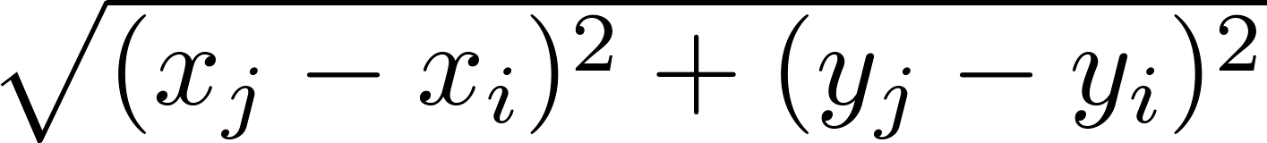
Computing the Closest Pair of Points by Brute-Force
Example: Construct a brute-force algorithm for finding the closest pair of points in a set of n points in the plane and provide a worst-case estimate of the number of arithmetic operations.
Solution: Recall that the distance between (x_{i},y_{i}) and (x_{j}, y_{j}) is . A brute-force algorithm simply computes the distance between all pairs of points and picks the pair with the smallest distance.
Note: There is no need to compute the square root, since the square of the distance between two points is smallest when the distance is smallest.
Continued →

Slide 82
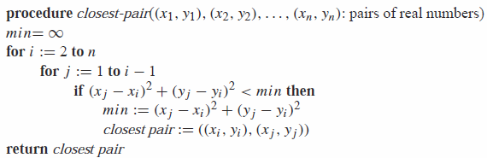
Computing the Closest Pair of Points by Brute-Force
Algorithm for finding the closest pair in a set of n points.
The algorithm loops through n(n -1)/2 pairs of points,
computes the value (x_{j} − x_{i})² + (y_{j} − y_{i})² and compares it with the minimum, etc. So, the algorithm uses Θ(n²) arithmetic and comparison operations.
An algorithm with O(n log n) worst-case complexity is given in Section 8.3.

Slide 83
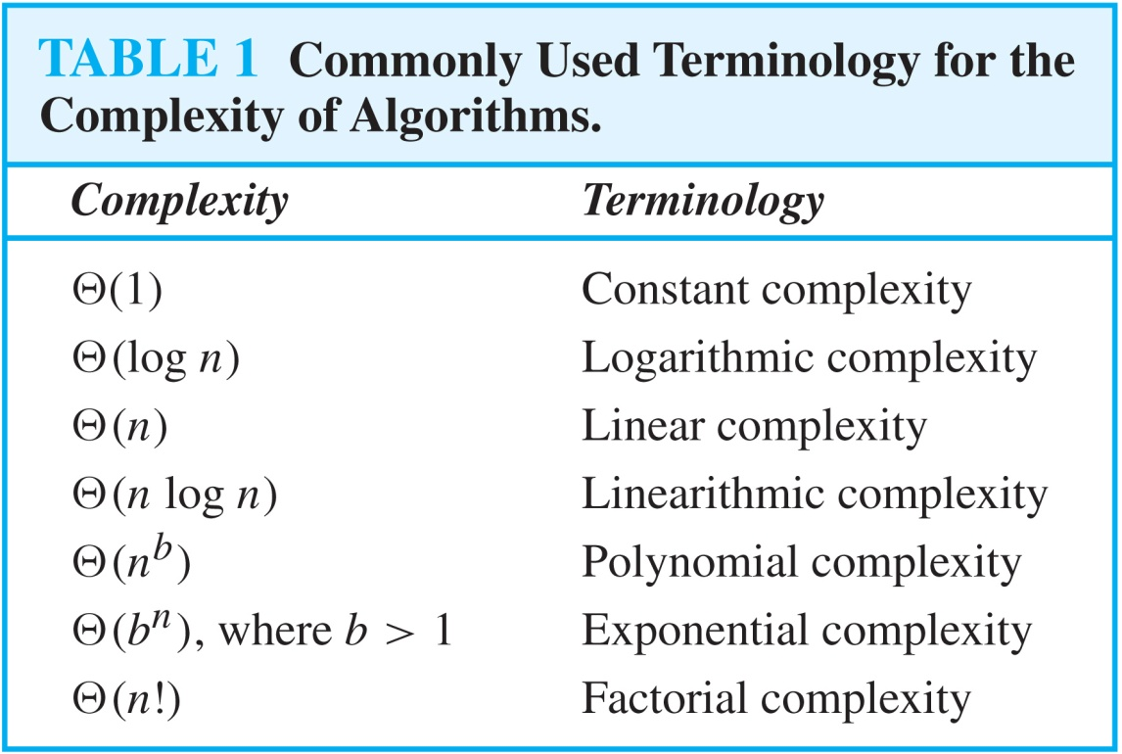
Understanding the Complexity of Algorithms

Slide 84
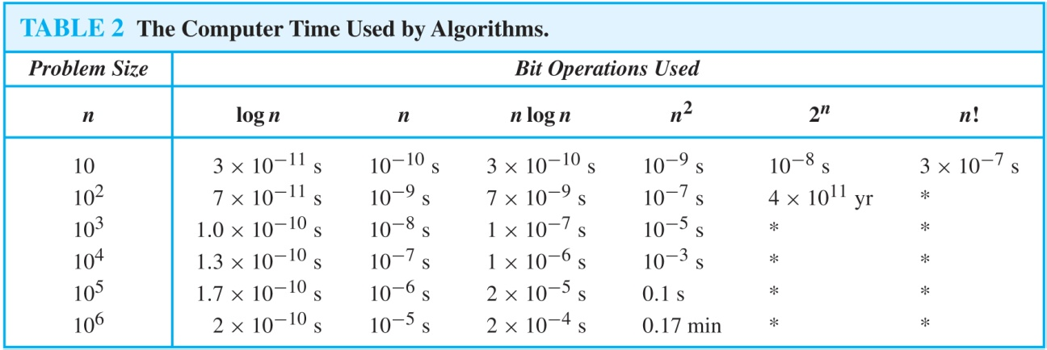
Understanding the Complexity of Algorithms
Times of more than 10¹⁰⁰ years are indicated with an *.

Slide 85
Complexity of Problems
Tractable Problem: There exists a polynomial time algorithm to solve this problem. These problems are said to belong to Class P.
Intractable Problem: There does not exist a polynomial time algorithm to solve this problem
Unsolvable Problem : No algorithm exists to solve this problem, e.g., halting problem.
Class NP: Solution can be checked in polynomial time. But no polynomial time algorithm has been found for finding a solution to problems in this class.

Slide 86

P Versus NP Problem
Stephen Cook
(Born 1939)
The P versus NP problem asks whether the class P = NP? Are there problems whose solutions can be checked in polynomial time, but cannot be solved in polynomial time?
  Note that just because no one has found a polynomial time algorithm is different from showing that the problem cannot be solved by a polynomial time algorithm.
It is generally believed that P≠NP since no one has been able to find a polynomial time algorithm for any of the problems in the NP complete class.
The problem of P versus NP remains one of the most famous unsolved problems in mathematics (including theoretical computer science). The Clay Mathematics Institute has offered a prize of $1,000,000 for a solution.

