Slide 1
Chapter 4
Eigenvalues and Eigenvectors
Fundamentals of Matrix Algebra By Gregory Hartman
Instructor Longin Jan Latecki

Slide 2
4.1 Eigenvalues and Eigenvectors
Do we ever have the case where where a is some scalar?

Slide 3
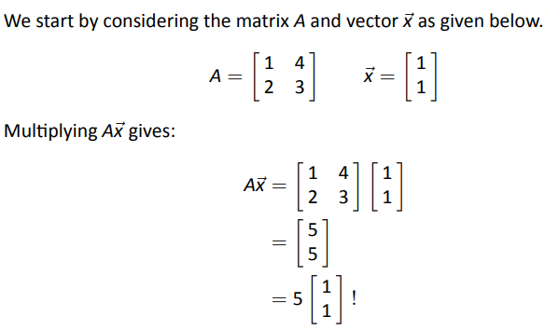
Predefinition Workup
Page 3

Slide 4
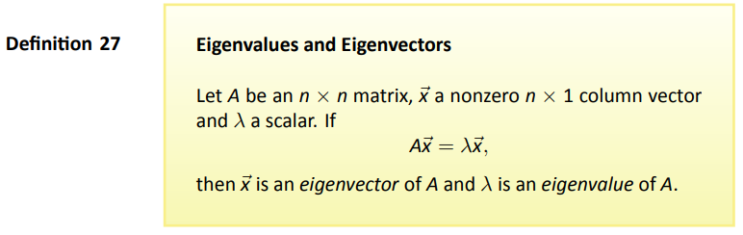


Slide 5




More Math
not
We want a solutions to $\left(A−λI\right)\vec{x}=\vec{0}$ other than $\vec{x}=\vec{0}$
Recall:
Theorem 8: any invertible matrix $−$ $\left(A−λI\right)$ $−$ only has one solution.
Therefore, $\left(A−λI\right)$ needs to not be invertible, and
Theorem 16: noninvertible matrices all have a determinant of 0.
Thus det $\left(A−λI\right)$ needs to equal 0.
Now we move forward by finding $λ$ such that det $\left(A−λI\right)$ = 0
Page 5

Slide 6
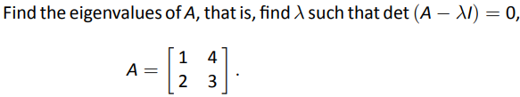
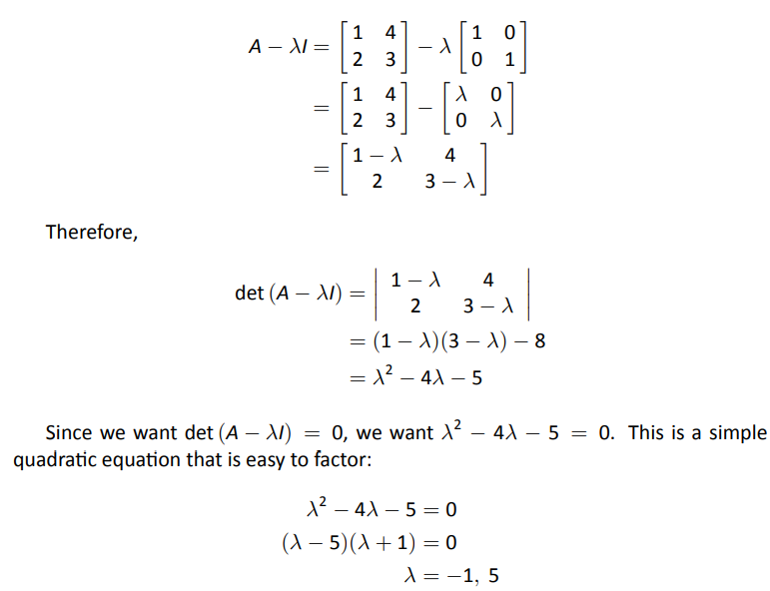
Example 84
Problem
Solution
Page 6

Slide 7
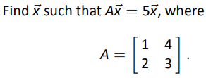

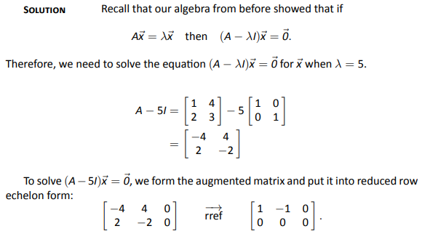
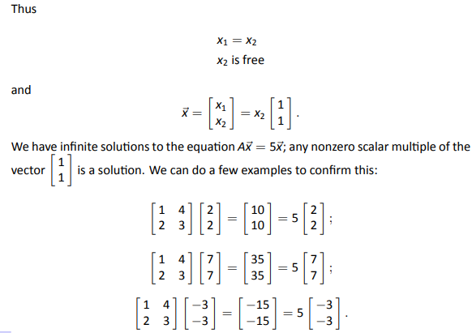
Example 85
Problem
Solution

Slide 8
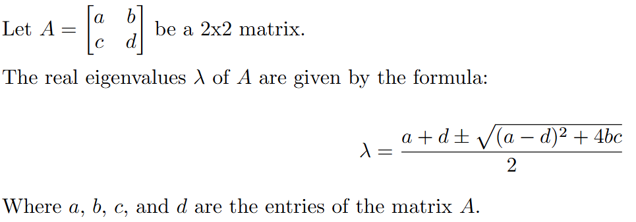
Calculating the Eigenvectors/values
Of course, the real eigenvalues only exist if the term under the square root ≥ 0.

Slide 9
Eigenvalues summery
Given a matrix, A, x is the eigenvector and λ is the corresponding eigenvalue if Ax = λx
  A must be square and the determinant of A - λ I must be equal to zero
  Ax - λx = 0 iff (A - λI) x = 0
    Trivial solution is if x = 0
    The nontrivial solution occurs when det(A - λI) = 0
Are eigenvectors unique?
  If x is an eigenvector, then βx is also an eigenvector and λ is an eigenvalue
  A(βx) = β(Ax) = β(λx) = λ(βx)

Slide 10
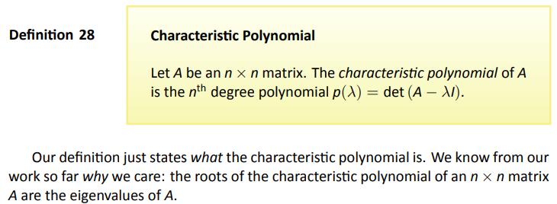
Definition
Page 10

Slide 11
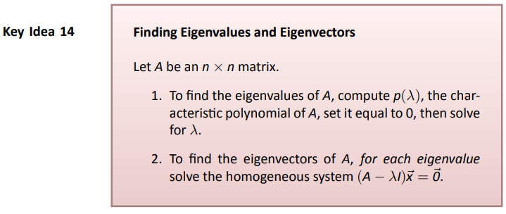
Key Idea

Slide 12
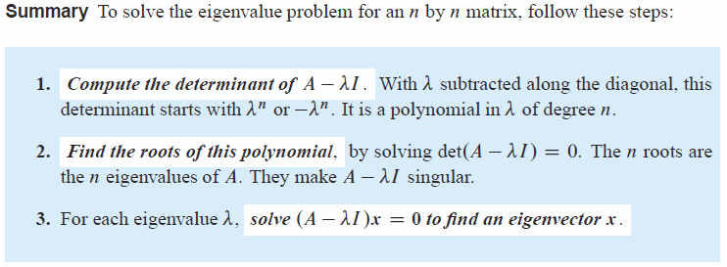
Put Another Way

Slide 13

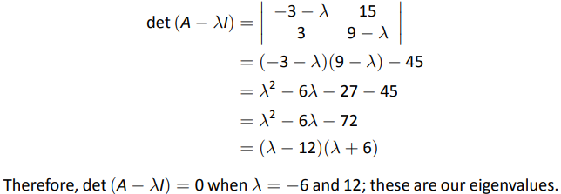
Example 86
Find the eigenvalues of A, and for each eigenvalue, find an eigenvector where
Problem
Solution

Slide 14
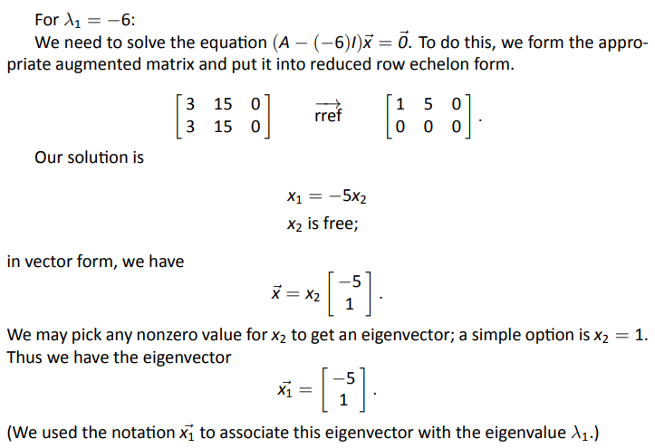
Example 86
Find the eigenvalues of A, and for each eigenvalue, find an eigenvector where
Problem
Solution

Slide 15
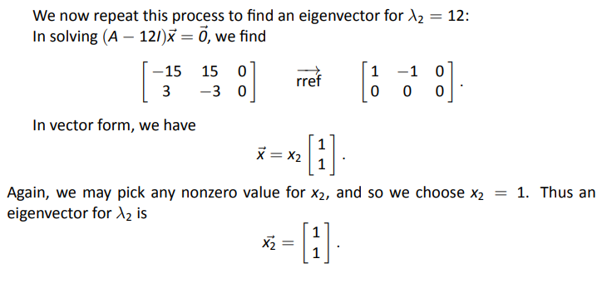
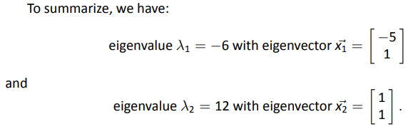
Example 86
Find the eigenvalues of A, and for each eigenvalue, find an eigenvector where
Problem
Solution
Summary

Slide 16
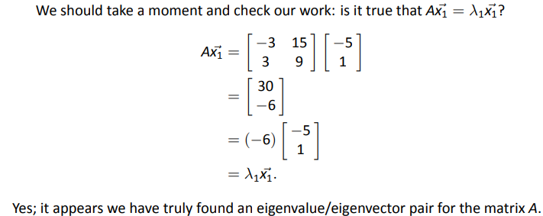
Example 86
Find the eigenvalues of A, and for each eigenvalue, find an eigenvector where
Problem
Solution

Slide 17

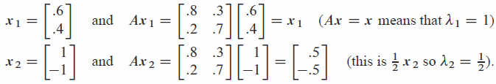
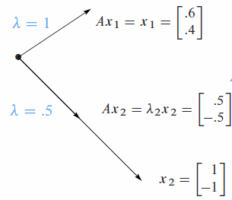

Slide 18
4.2 Properties of Eigenvalues and Eigenvectors

Slide 19
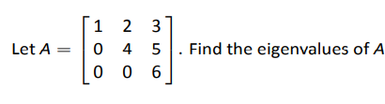

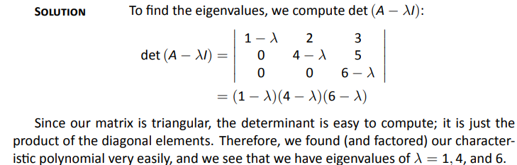
Example 90
Problem
Solution

Slide 20
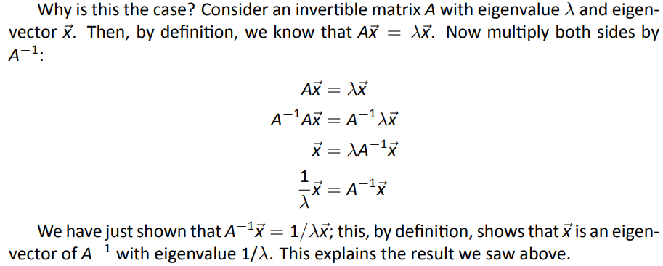

The Eigenvectors and Eigenvalues of A and A⁻¹
If $λ$ is an eigenvalue of A, then 1/$λ$ is an eigenvalue of A⁻¹.
The corresponding eigenvectors are the same.

Slide 21
The Eigenvectors and Eigenvalues of A and A^{T}
The Eigenvalues of A and A^{T} are the same, but eigenvectors are different.

Slide 22
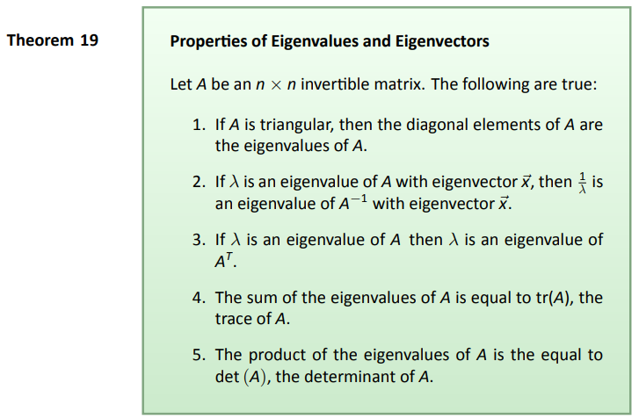



Slide 23


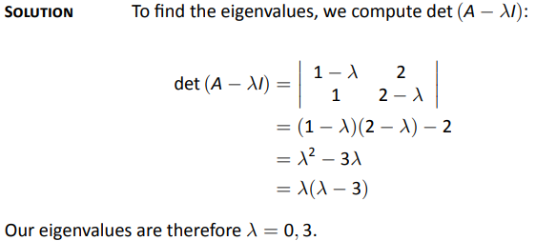
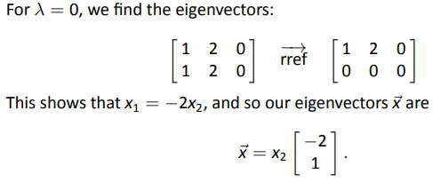
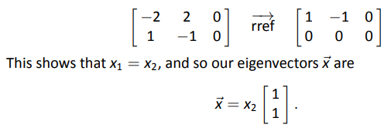
Example 92
Problem
Solution

Slide 24
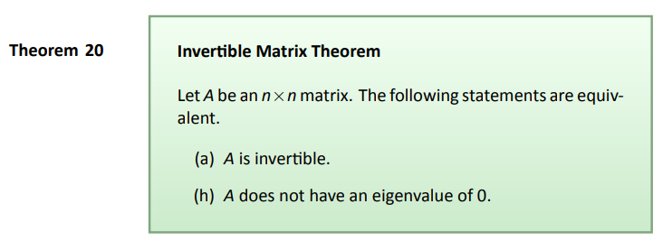
Theorem

Slide 25
Observe that a 2x2 matrix may have
only one eigenvalue.
Eigenvalues can also be complex numbers.
These facts should not be surprising,
since eigenvalues are solutions of
polynomials.

Slide 26
Finding Eigenvalues in Real Applications
The eigenvalues of a matrix A can be determined by finding the roots of the characteristic polynomial. Explicit algebraic formulas for the roots of a polynomial exist only if the degree n is 4 or less. Therefore, for matrices of order 5 or more, the eigenvalues and eigenvectors cannot be obtained by an explicit algebraic formula and must be computed by approximate numerical methods.
We would expect that for larger matrices a computer would be used to factor the characteristic polynomials. In reality, this method is unreliable as roundoff errors cause unpredictable results. Furthermore, before computing the characteristic polynomial, we need to compute the determinant, also a very expensive process. Efficient, accurate methods to compute eigenvalues and eigenvectors of arbitrary matrices were not known until the advent of the QR algorithm in 1961.
Question: how then are eigenvalues found?
Answer: Via iterative processes that transform matrix A into a matrix that is almost an upper triangular
matrix. The more iterations, the better approximation.
Once the value of an eigenvalue is known, the corresponding eigenvectors can be found by finding non-zero solutions of the eigenvalue equation, which becomes a system of linear equations with known coefficients.

Slide 27
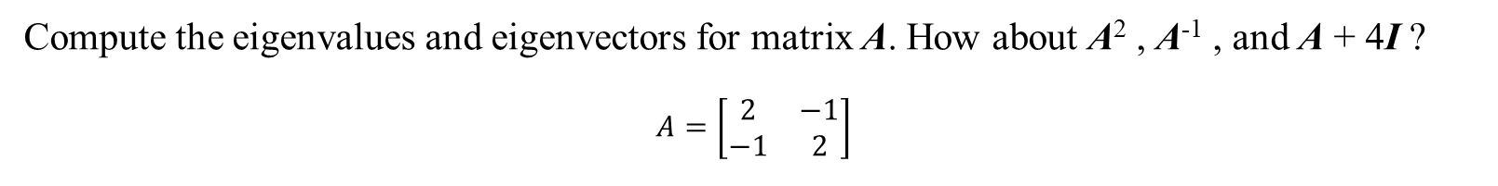
Example
Compute the eigenvalues and eigenvectors for matrix A. How about A² , A⁻¹ , and A + 4I ?
$$A=\left[\begin{matrix}2 & −1 \\ −1 & 2\end{matrix}\right]$$

