Slide 1
Chapter 3
Operations on Matrices and Determinant
Fundamentals of Matrix Algebra By Gregory Hartman
Instructor Longin Jan Latecki

Slide 2
3.1 The Matrix Transpose

Slide 3
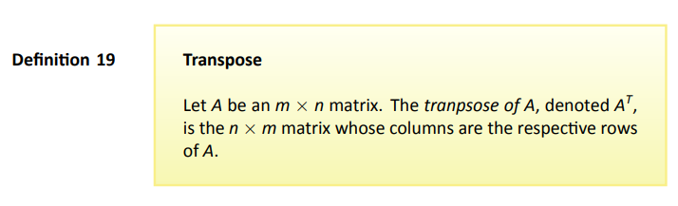



Example 60

Slide 4
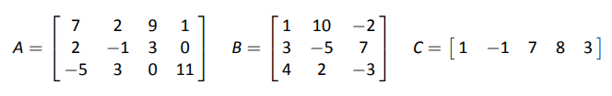
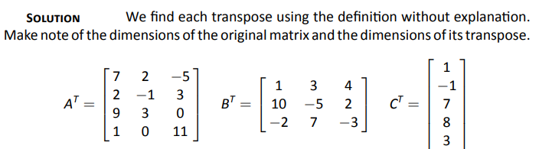
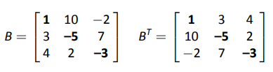
Example 61
Problem
Solution
Note
Page 4

Slide 5
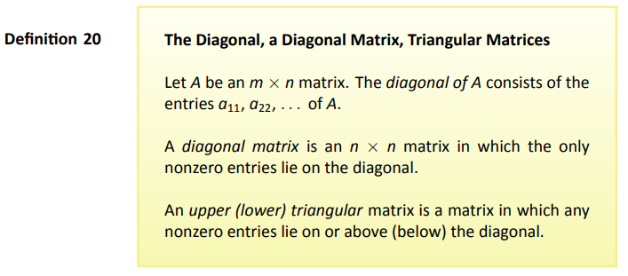
Definition
Page 5

Slide 6
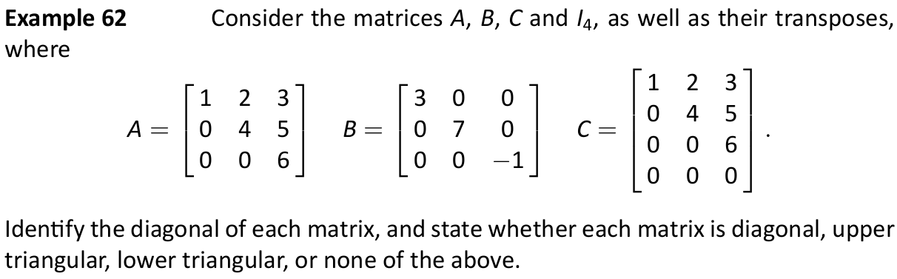
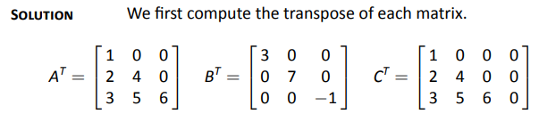
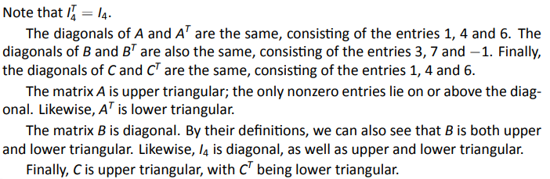
Solution

Slide 7
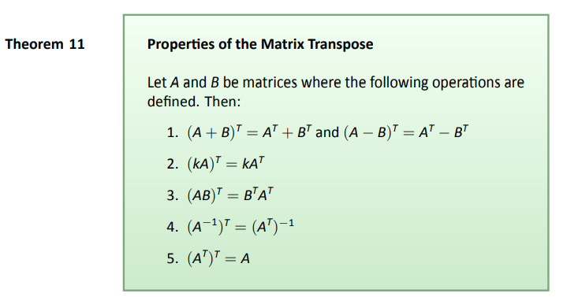
Theorem 11

Slide 8
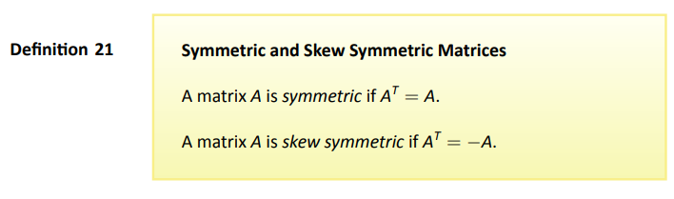
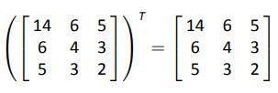

Example
AA^{T} is always symmetric.

Slide 9
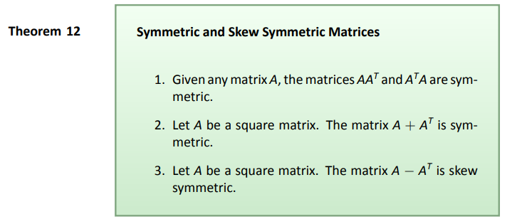
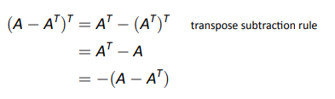
Theorem
Proof

Slide 10

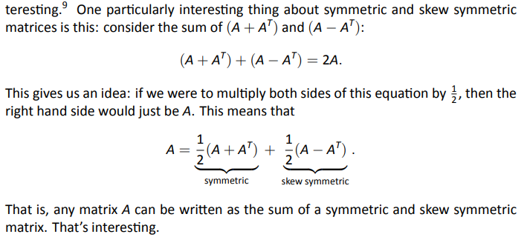
Interesting Thought

Slide 11
3.2 The Matrix Trace

Slide 12
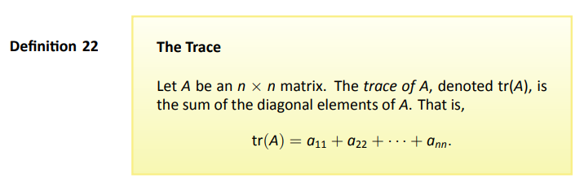
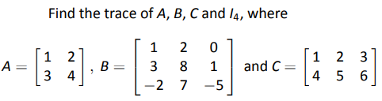


Example 67

Slide 13
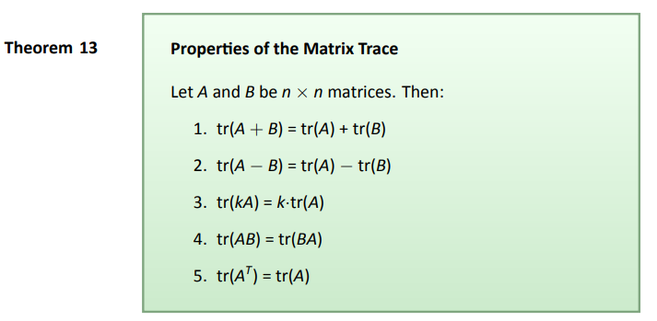
Theorem

Slide 14
3.3 The Determinant
We skip most of Section 3.3.
It defines the determinant using cofactor expansion,
but we will not cover it.

Slide 15

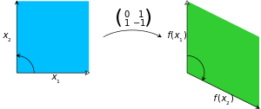
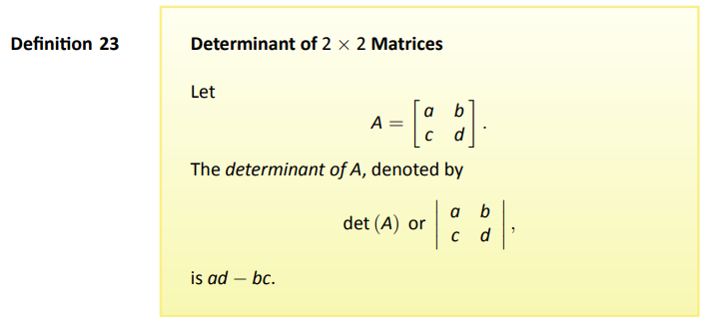
Definition
The determinant of this matrix is −1,
as the area of the green parallelogram is 1,
but the map reverses the orientation,
counterclockwise → clockwise orientation
The absolute value of determinant equals the area (in R²) or volume (in R³) of the image of the unit square (or cube), while its sign corresponds to the orientation of the corresponding linear map: the determinant is positive if and only if the orientation is preserved.

Slide 16
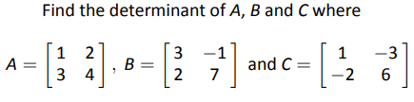
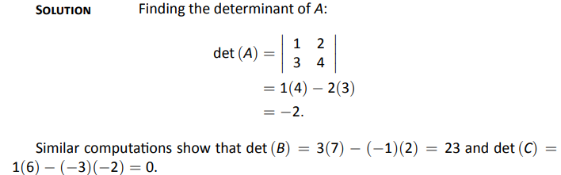
Example 68
Problem
Solution

Slide 17
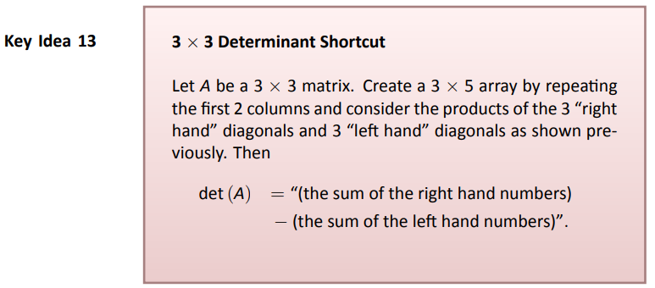
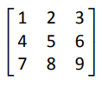

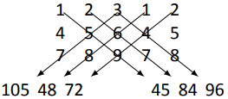
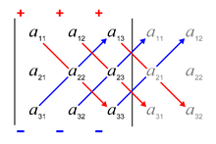
Rule of Sarrus: 3 X 3 Determinant Computing Shortcut
The determinant of the 3x3 matrix
is the sum of the products along the red diagonals
minus the sum of the products along the blue diagonals.

Slide 18
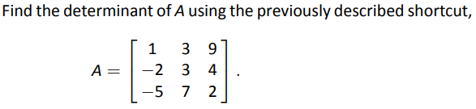
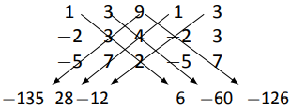
Example 81
Problem
Solution

Slide 19
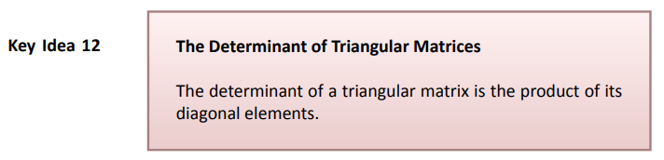

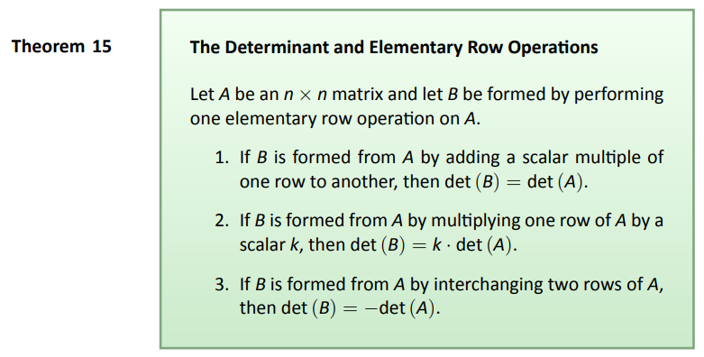
We can use Gaussian elimination
to compute the determinant.

Slide 20
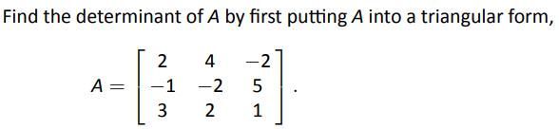



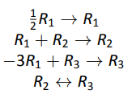
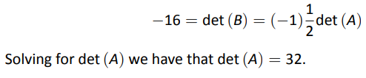
Example 78
Problem
Solution

Slide 21
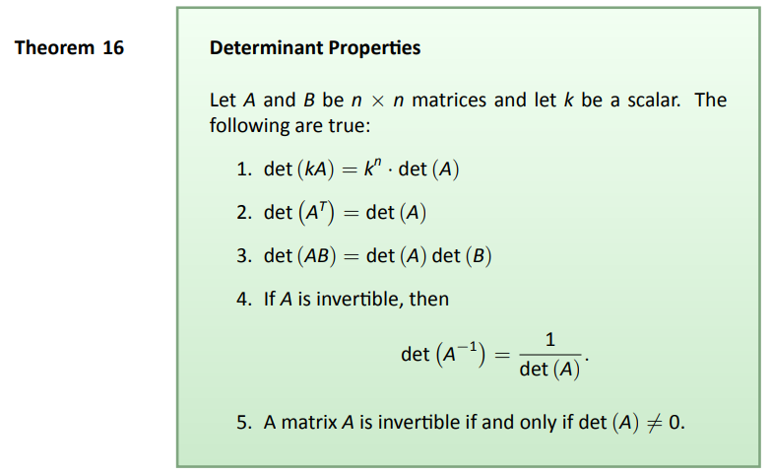
Theorem

Slide 22
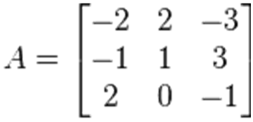
Use Gaussian elimination to find the determinant of this matrix:

