Slide 1
Math for Neural Networks
Longin Jan Latecki
latecki@temple.edu

Slide 2
Based on
Deep Learning Course by Mitesh M. Khapra, Indian Institute of Technology, Madras, http://www.cse.iitm.ac.in/~miteshk/CS6910.html
Akshay L Chandra. Perceptron Learning Algorithm: A Graphical Explanation Of Why It Works. Towards Data Science
https://pabloinsente.github.io/the-multilayer-perceptron
Deep Learning, Chapter 6, Goodfellow et al., 2016
Other Internet sources

Slide 3
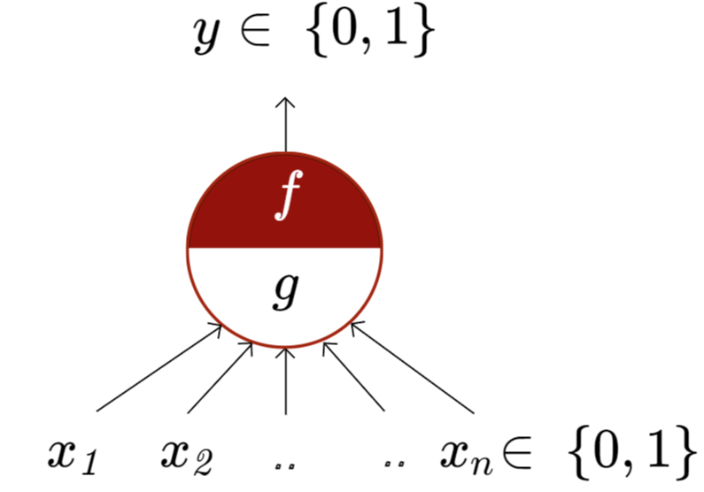
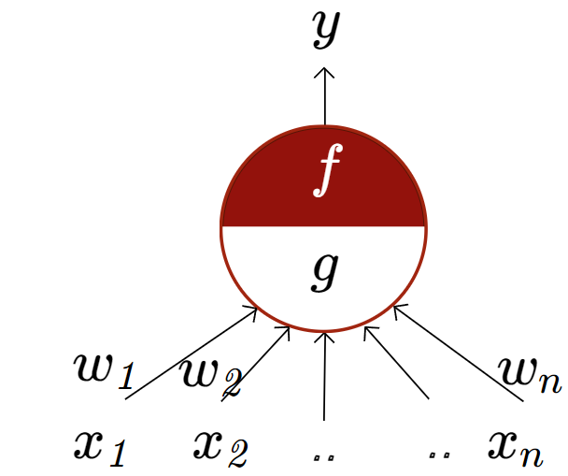
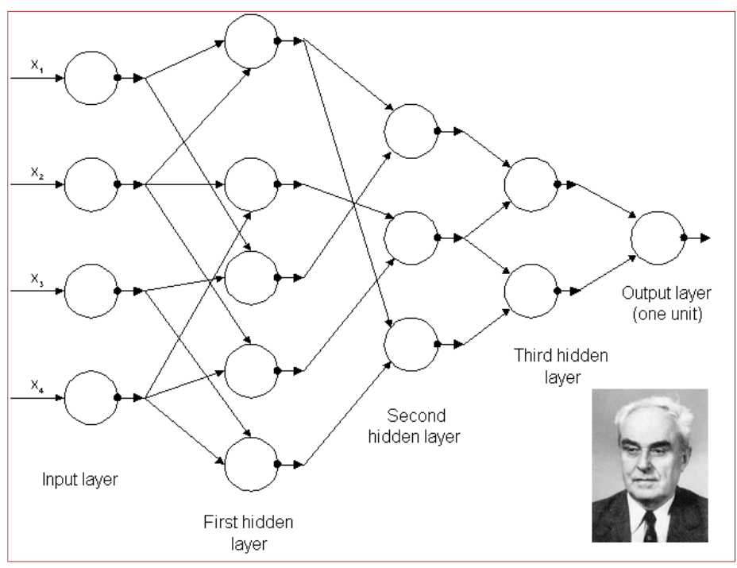
McCulloch Pitts Neuron
McCulloch (neuroscientist) and Pitts (logician) proposed a highly simplified model of the neuron (1943).
the perceptron may eventually be able to learn, make decisions, and translate languages” -Frank Rosenblatt, 1957-8
First generation Multilayer Perceptrons published by A. Ivakhnenko and V. G. Lapa,
CYBERNETIC PREDICTING DEVICES, 1966.

Slide 4
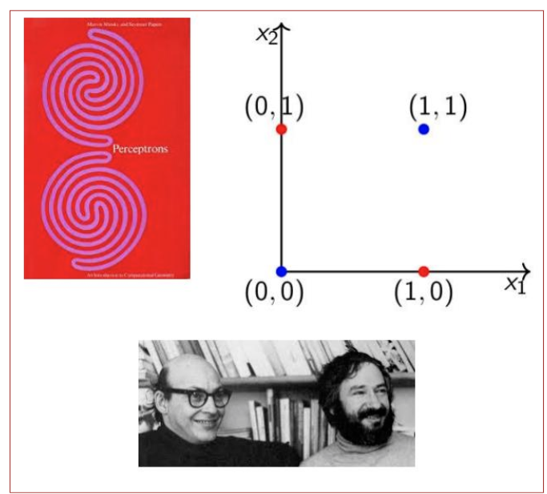
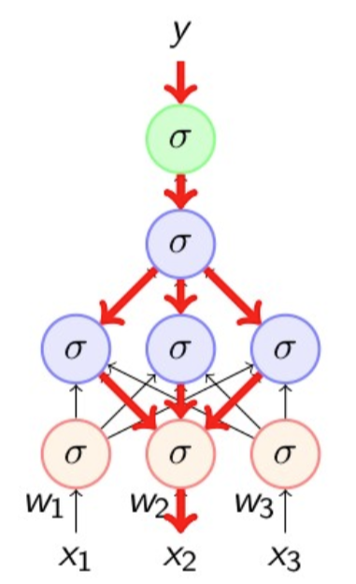
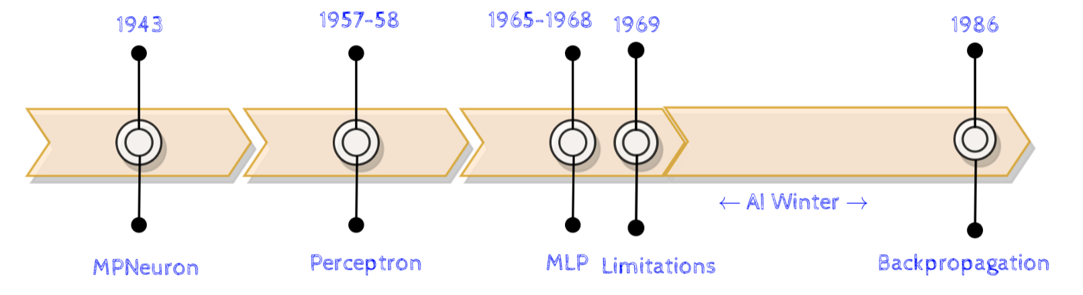
Perceptron Limitations
In book “Perceptrons” 1969, Minsky and Papert outlined the limits of what perceptrons could do and killed them.
Backpropagation
Discovered and rediscovered several times throughout 1960’s and 1970’s
Werbos (1982) first used it in the context of artificial neural networks
Eventually popularized by the work of Rumelhart et. al. (David Rumelhart, Geoffrey Hinton, and Ronald Williams) in 1986. More info.

Slide 5
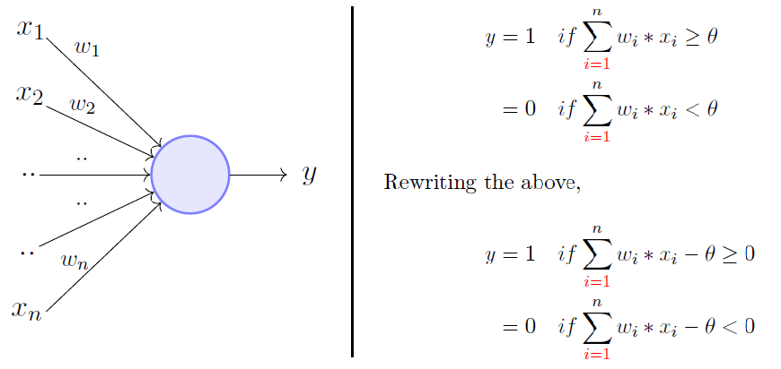
Perceptron
The perceptron model is a more general computational model than McCulloch-Pitts neuron.
It takes an input, aggregates it (weighted sum), and returns one only if the aggregated sum is more than some threshold otherwise, it returns zero.
A single perceptron can only be used to implement linearly separable functions.
It takes both real and Boolean inputs and associates a set of weights to them.

Slide 6
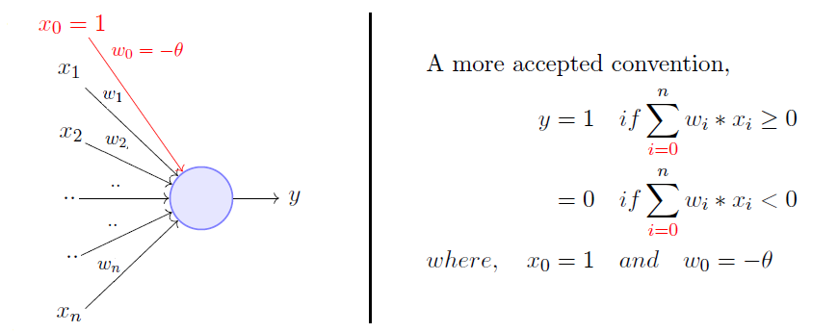
Rewriting the threshold (called bias) and making it a constant input with a variable weight, we get:
A perceptron will fire if the weighted sum of its inputs is greater than the threshold (−w₀).
Minsky and Papert proposed a more principled way of learning the weights using a set of examples (data). It did not use the Gradient Descent.
After weights are learned, we get the function.

Slide 7
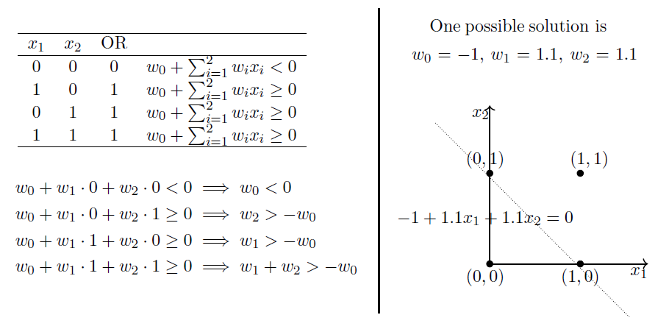
OR Function Using A Perceptron

Slide 8
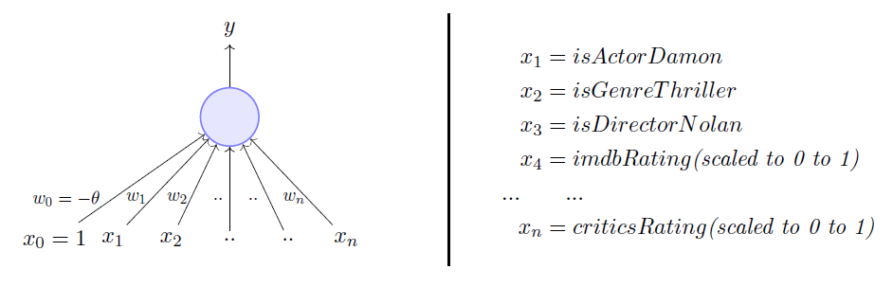
Predicting whether one would like to watch a movie or not: binary decision
The weights (including the bias w₀) are learned from data: (<vector of observations>_{k}, <label>_{k})
for k = 1, …, N, where <label>_{k}= 0 or 1 depending on whether the viewer watched movie k before.
For perceptron, we assume that the data is linearly separable and we want a perceptron to learn how to make this decision.
A different set of weights is learned for each viewer. For example:
A movie buff may have a very low bias θ=0 and may watch any movie irrespective of the genre, actor, or director. On the other hand, a selective viewer may only watch thrillers starring Matt Damon and directed by Nolan, e.g., θ=3.

Slide 9
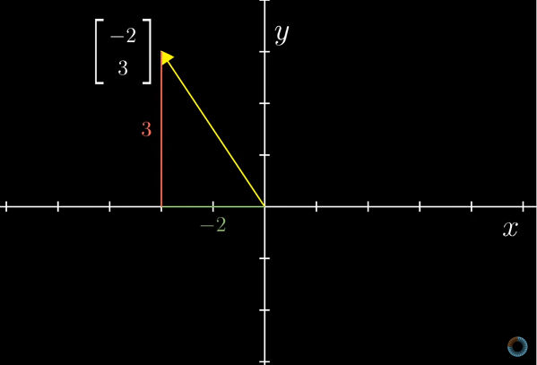
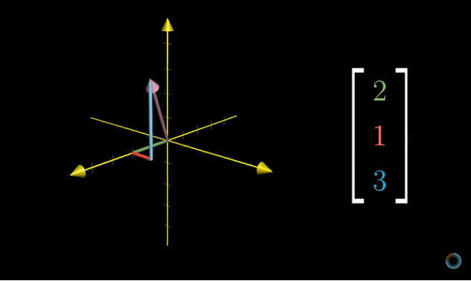
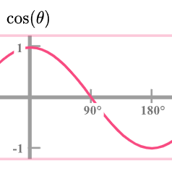
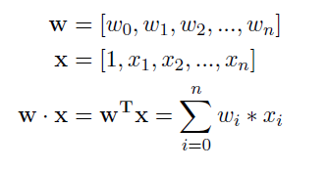
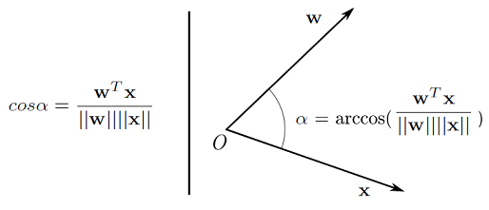

Angle Between Two Vectors
Source: 3Blue1Brown’s video on Vectors

Slide 10
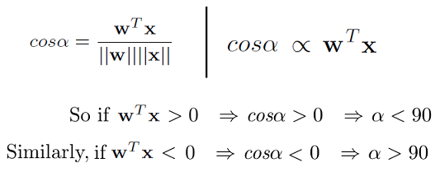
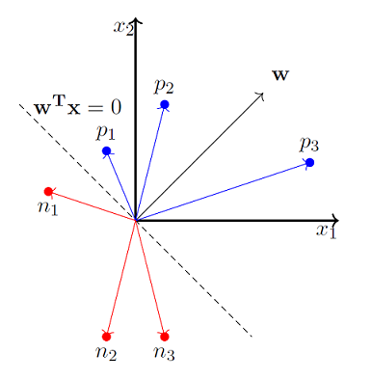
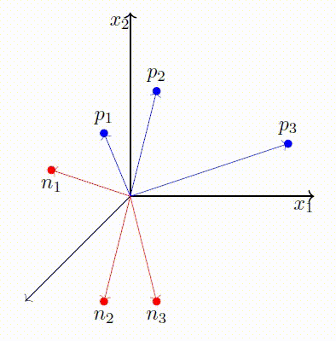
Perceptron Learning Algorithm: Geometry

Slide 11
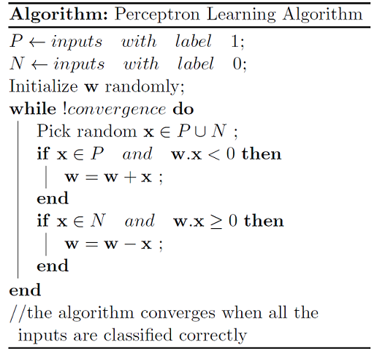
Stochastic Gradient Descent Version
-1;
1. Initialize weights (and bias) randomly
2. For each training example:
a. Calculate the predicted output:
ŷ = sign(w · x)
b. Update weights if the prediction is incorrect:
w = w + β (y – ŷ) · x
3. Repeat step 2 until convergence
or max iterations are reached,
where y is 1 or -1, ŷ predicted the label,
and β learning rate, which we set to β = ½.
We switched the labels from 1 or 0 to 1 or -1.
The perceptron learning algorithm is a simple supervised learning algorithm for binary classification.

Slide 12
Perceptron Learning Algorithm as Stochastic Gradient Descent
1. Initialize weights (and bias) randomly
2. For each training example:
a. Calculate the predicted output: ŷ = sign(w · x)
b. Update weights if the prediction is incorrect: w = w + β (y – ŷ) · x
3. Repeat step 2 until convergence or max iterations are reached,
where y is the true label (1 or -1), ŷ predicted the label, and β learning rate.
The perceptron update rule can be viewed as a stochastic gradient descent algorithm instance.
The gradient descent update rule: w = w – η ∂L/∂wL(w)
∂L/∂w = {
0, if y(w · x) > 0 (correct classification)
-y · x, if y(w · x) ≤ 0 (incorrect classification)
}
The loss function that the perceptron algorithm is minimizing is L(w) = max(0, -y(w · x))
Observe that if y(w · x) ≤ 0, then w = w – η ∂L/∂wL(w) = w - η(-y · x) = w + η(y · x), where β = ½ η.

Slide 13
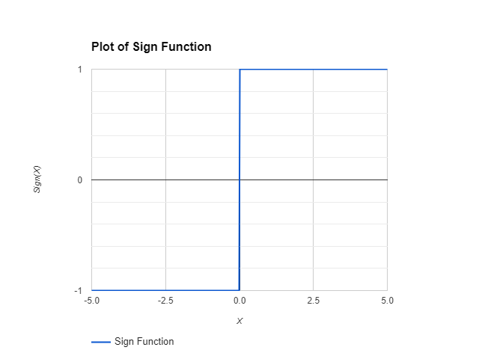
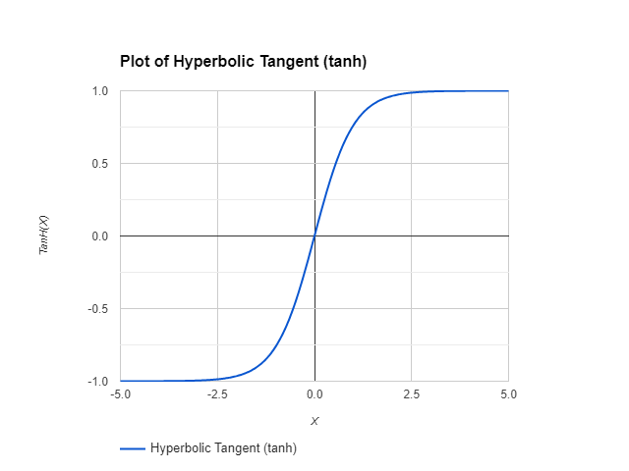
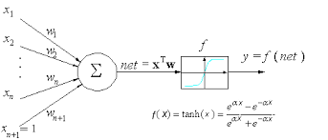
Perceptron Learning Algorithm → Single Layer Neural Network (NN)
If we replace the sign function (step function) with tanh (or other nonlinear function)
as an activation function,
we obtain a single-layer neural network
from the perceptron.
We switched the labels
from 1 or 0 to 1 or -1.

Slide 14
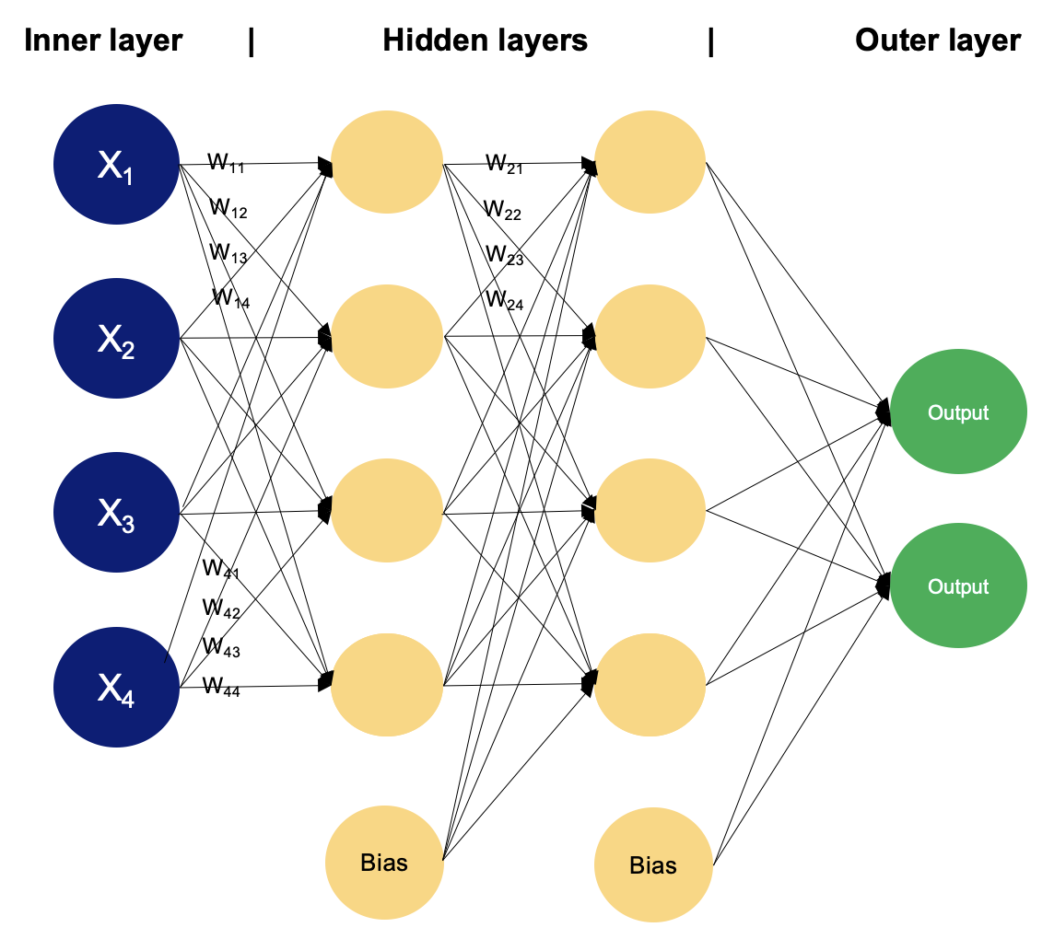
Multilayer Perceptron or Neural Network (NN)

Slide 15
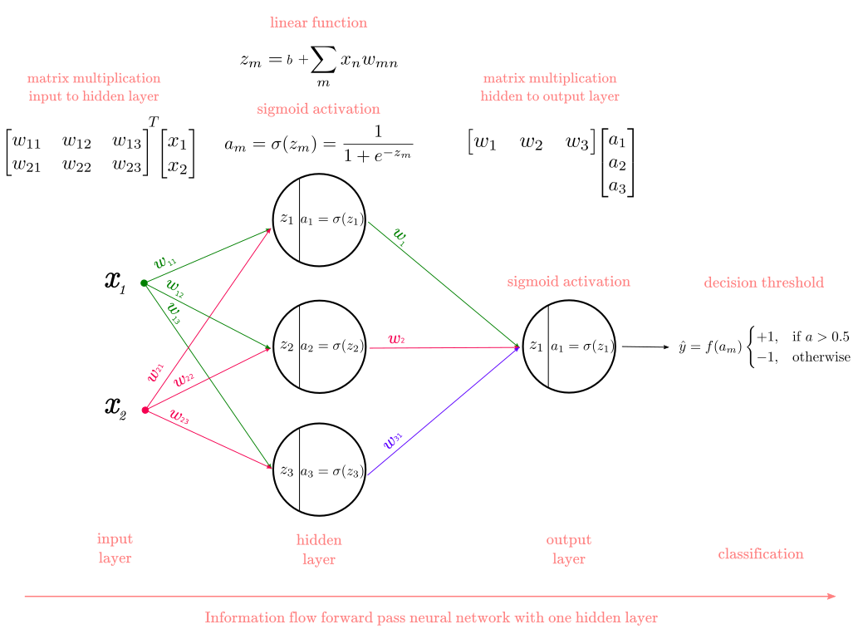
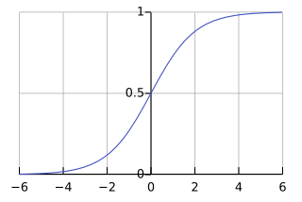
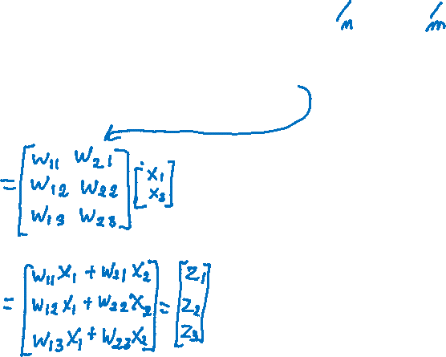

Slide 16
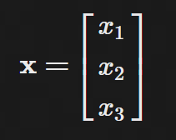
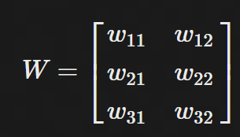
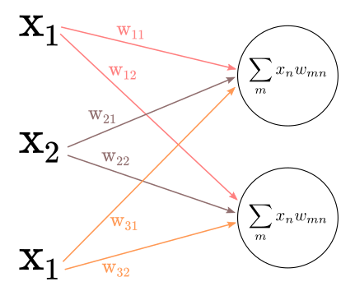
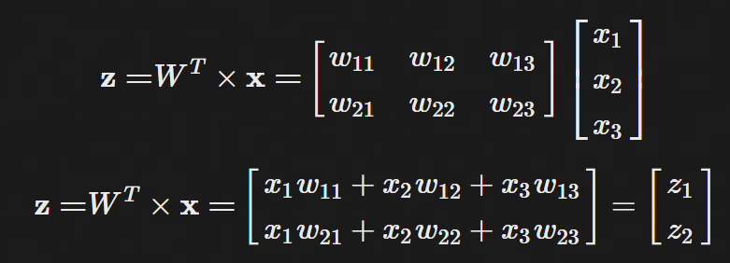

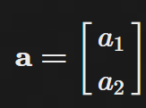

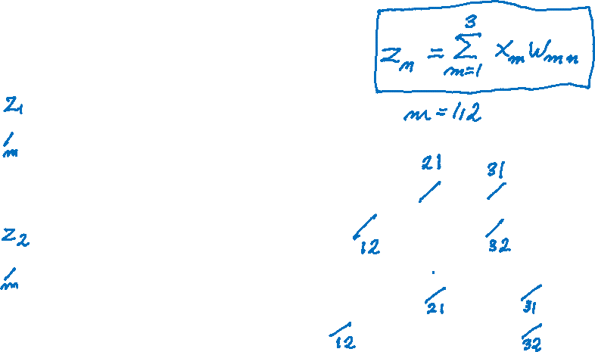

we have 3 input units connecting to hidden 2 units we have 3x2 weight matrix:
$$σ\left(z\right)=a$$
$$σ\left(z\right)=ReLU or \frac{1}{1+e^{−z}}$$

Slide 17
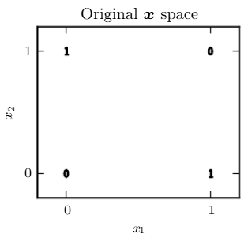
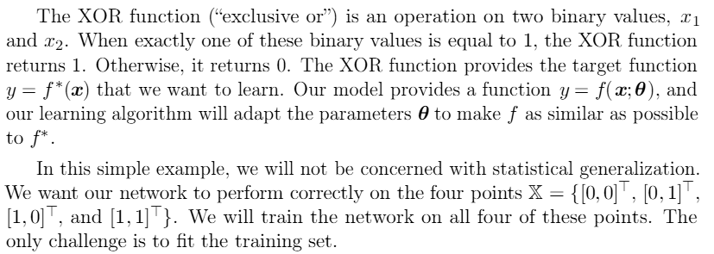
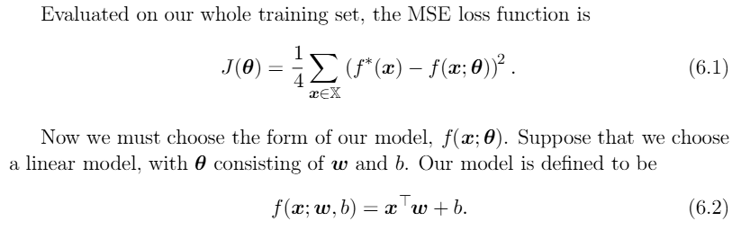

Learning XOR (exclusive or)
Does not work since our data is not linearly separable.

Slide 18
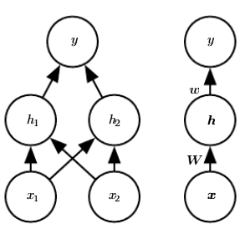
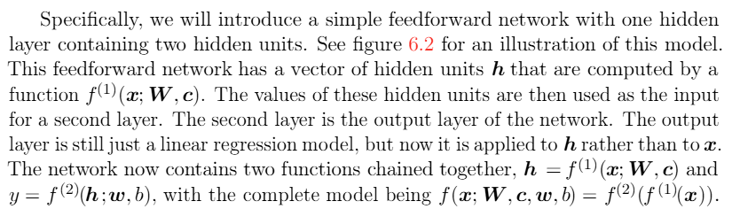
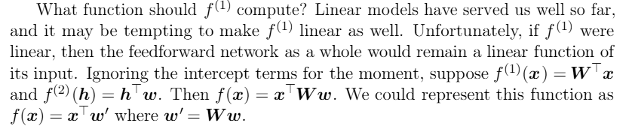



How about we add another network layer?

Slide 19
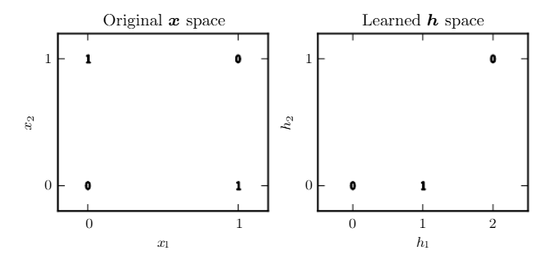
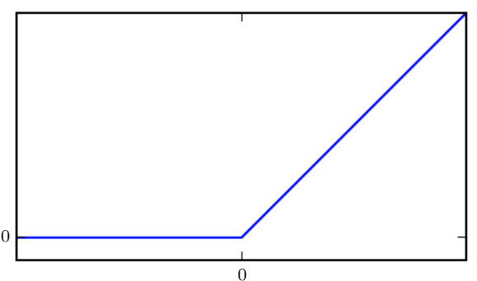
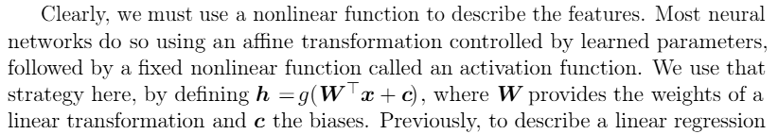





One way to solve this problem is to use a model that learns a diﬀerent feature space in which a linear model is able to separate the data.
for network parameters on the next slide
We use the rectiﬁed linear unit (ReLU) as g:

Slide 20
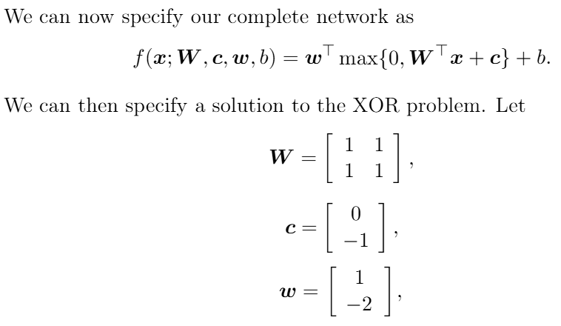

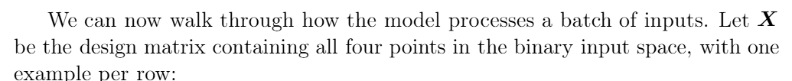


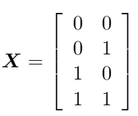
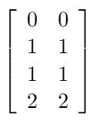
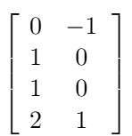
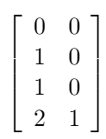







Slide 21
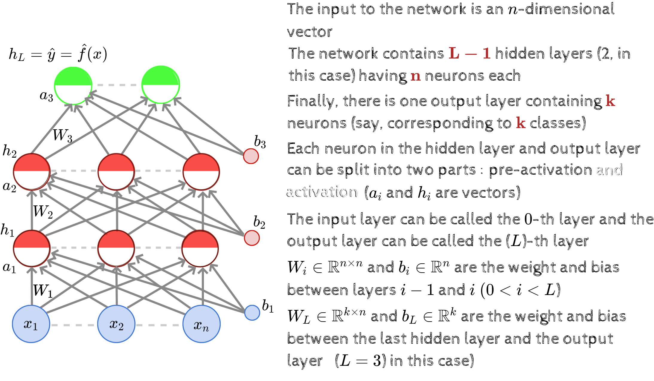

Slide 22
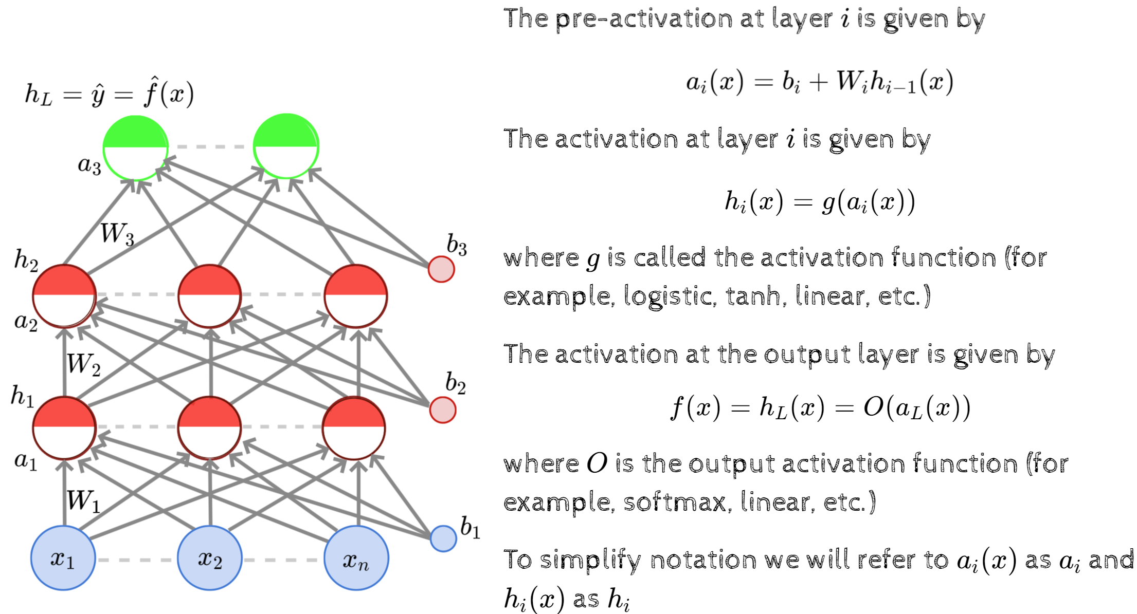

Slide 23
