Slide 1

Ch. 21 Maximum Likelihood
CIS 2033: Computational Probability and Statistics
Prof. Longin Jan Latecki

Slide 2


Slide 3
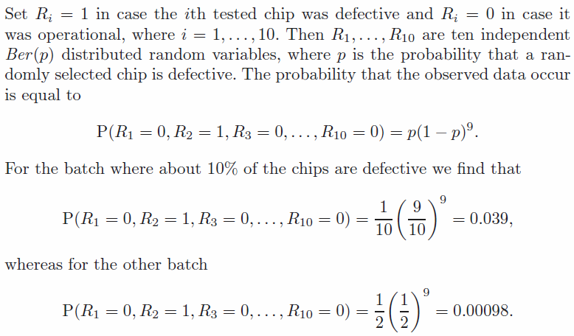

Slide 5
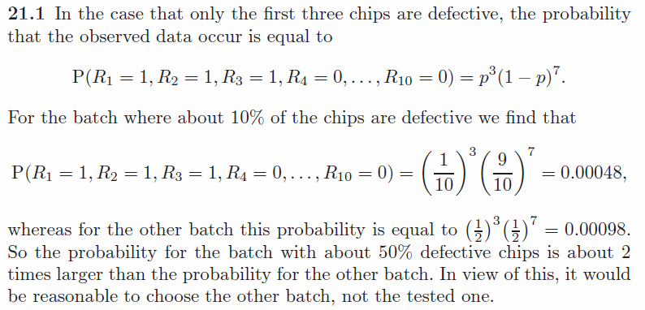

Slide 6




Since we model the data as a random sample from a geometric distribution, the probability of the data for smokers—as a function of p—is given by

Slide 7
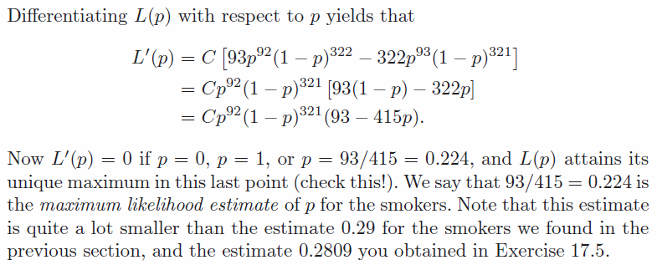
Since C does not depend on p, we do not need to know the value
of C explicitly to find for which p the function L(p) is maximal.

Slide 8


Slide 9

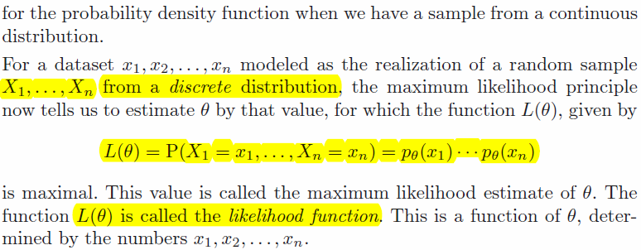

Slide 10
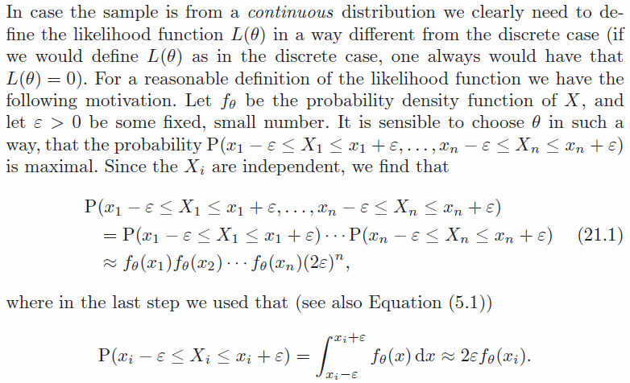

Slide 11
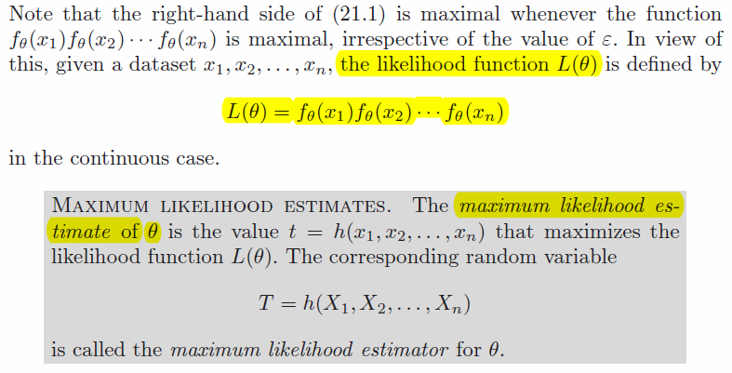

Slide 12
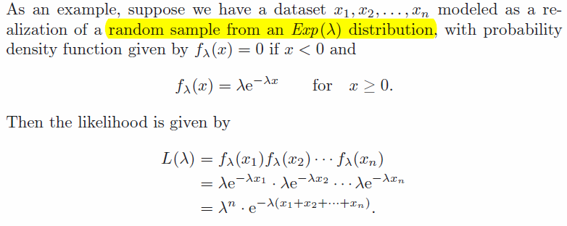

Slide 13

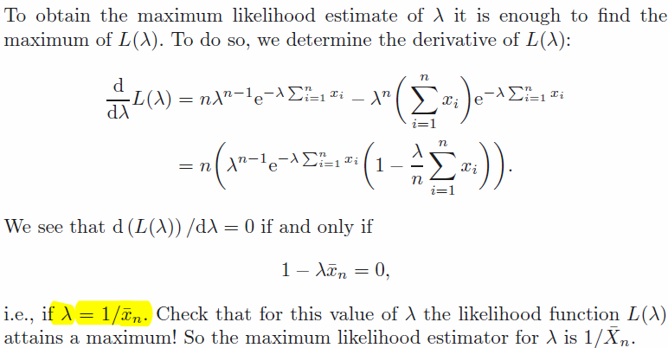

Slide 14
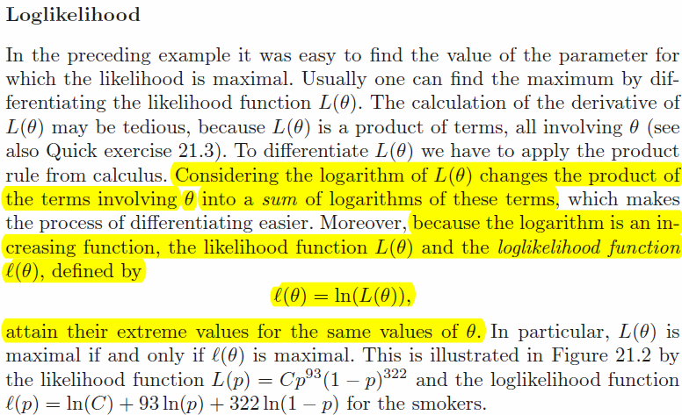

Slide 15
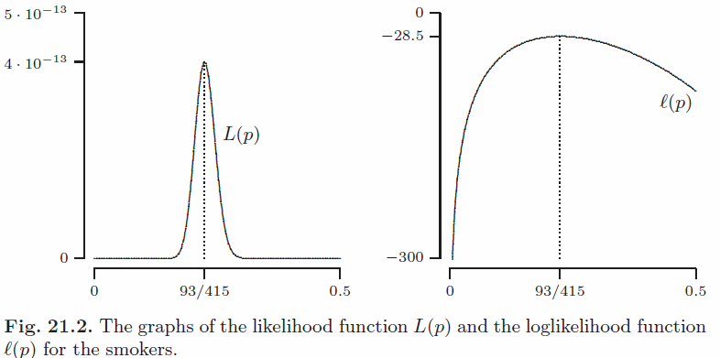

Slide 16



Slide 17
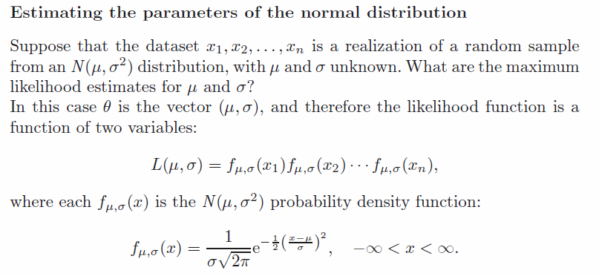

Slide 18

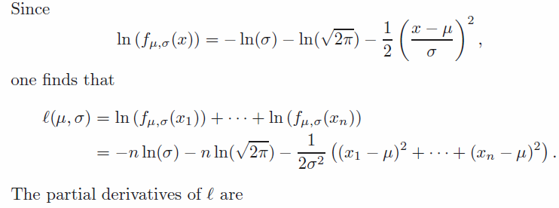


Slide 19
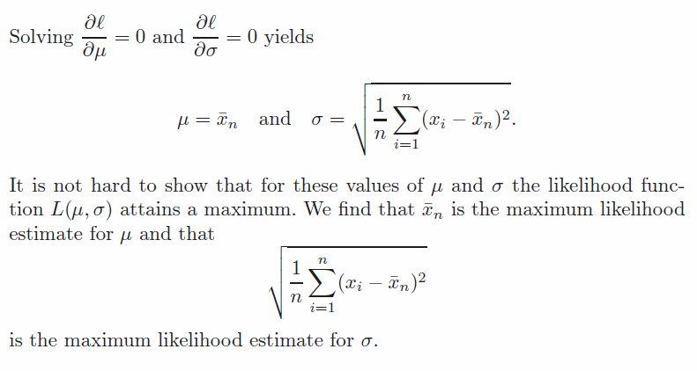

Slide 20
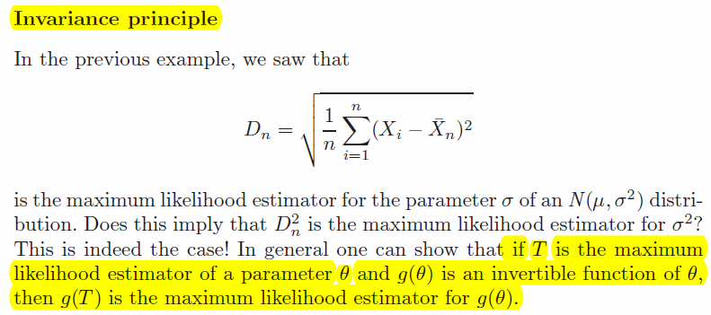


Slide 21


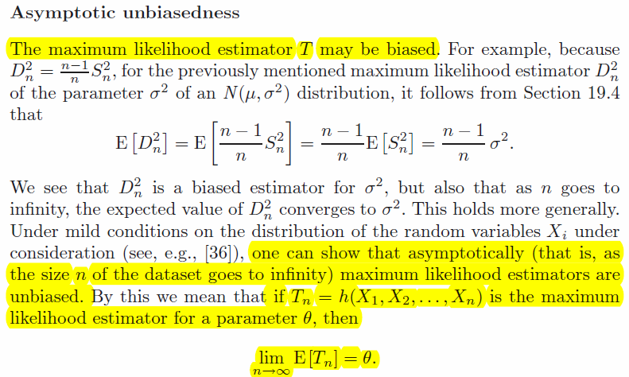

Slide 22
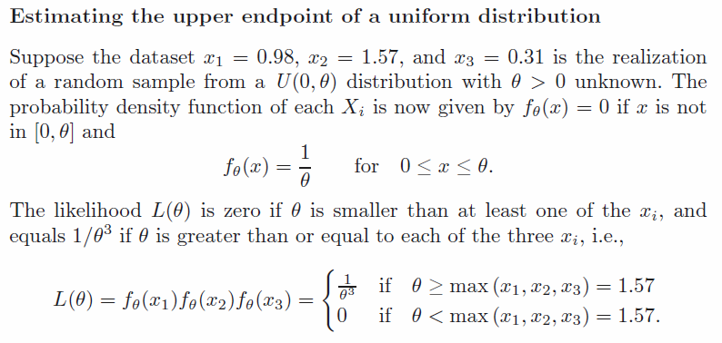

Slide 23
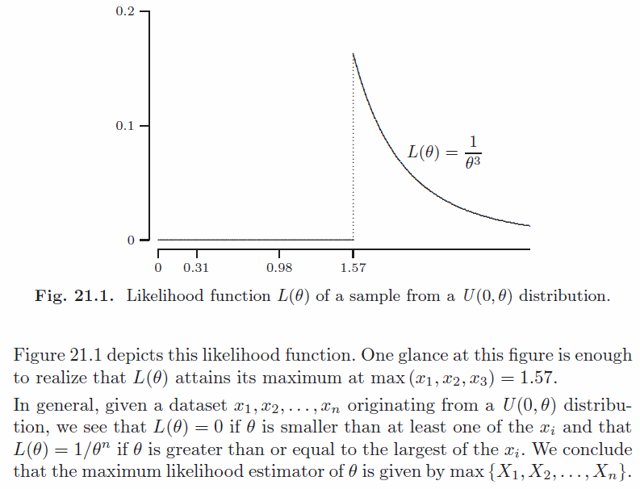

Slide 24
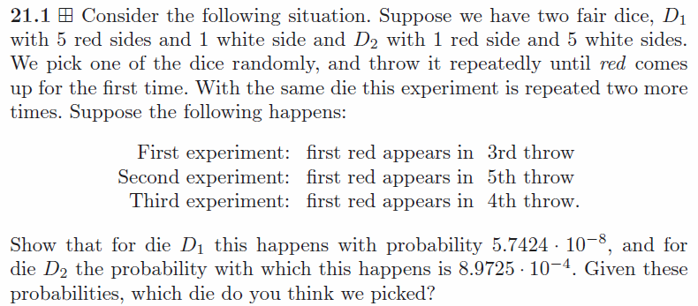

Slide 25


