Slide 1

Ch. 19 Unbiased Estimators
Ch. 20 Efficiency and Mean Squared Error
CIS 2033: Computational Probability and Statistics
Prof. Longin Jan Latecki
Prepared in part by: Nouf Albarakati

Slide 2
An Estimate
An estimate is a value that only depends on the dataset x₁, x₂,...,x_{n}, i.e.,
t is some function of the dataset only:
t = h(x₁, x₂,...,x_{n})
That means:
value t, computed from our dataset x₁, x₂,...,x_{n}, gives some indication of the “true” value of the parameter of interest θ

Slide 3
An Example
Consider the example of arrivals of packages at a network server
a dataset x₁, x₂,...,x_{n}, where x_{i} represents the number of arrivals in the i^{th} minute
The intensity of the arrivals is modeled by the parameter µ
The percentage of minutes during which no packages arrive (idle) is modeled by the probability of zero arrivals: e^{−µ}

Slide 4
An Example (cont.)
The percentage of idle minutes is modeled by the probability of zero arrivals
Since the parameter µ is the expectation of the model distribution,
the law of large numbers suggests the sample mean as a natural estimate for µ
If µ is estimated by , e^{−µ} also is estimated by

Slide 5
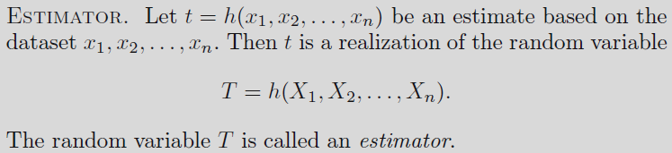
An Estimator
Since dataset x₁, x₂,...,x_{n} is modeled as a realization of a random sample X₁, X₂,...,X_{n}, the estimate t is a realization of a random variable T

Slide 6

The Behavior of an Estimator
Network server example: The dataset is modeled as a realization of a random sample of size n = 30 from a Pois(μ) distribution
Estimating the probability p₀ of zero arrivals?
Two estimators S and T
pretend we know μ , simulate the estimation process in the case of n = 30 observations
choose μ = ln 10, so that p₀ = e^{−μ} = 0.1.
draw 30 values from a Poisson distribution with parameter μ = ln 10 and compute the value of estimators S and T

Slide 7
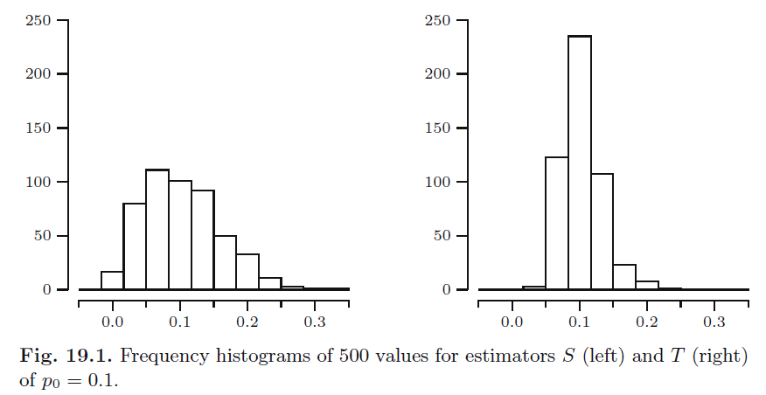
The Behavior of an Estimator

Slide 8

Sampling Distribution
Let T = h(X₁,X₂, . . . , X_{n}) be an estimator based on a random sample X₁,X₂, . . . , X_{n}. The probability distribution of T is called the sampling distribution of T
  The sampling distribution of S can be found as follows
  where Y is the number of X_{i} equal to zero. If for each i we label X_{i} = 0 as a success, then Y is equal to the number of successes in n independent trials with p₀ as the probability of success. It follows that Y has a Bin(n, p₀) distribution. Hence the sampling distribution of S is that of a Bin(n, p₀) distributed random variable divided by n

Slide 9
Unbiasedness
An estimator T is called an unbiased estimator for the parameter θ, if
E[T] = θ
irrespective of the value of θ
The difference E[T ] − θ is called the bias of T ; if this difference is nonzero, then T is called biased
  For S and T estimators example, the estimator T has positive bias, though the bias decreases to zero as the sample size becomes larger , while estimator S is unbiased estimator.

Slide 10
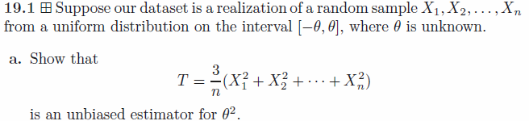
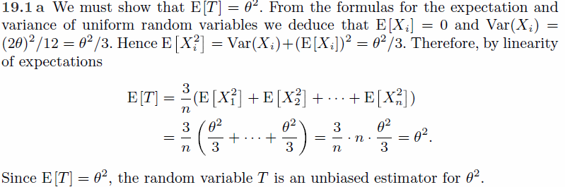
Since E[X_{i}]=0, Var[X_{i}] = E[X_{i}²] – (E[X_{i}])² = E[X_{i}²].

Slide 11
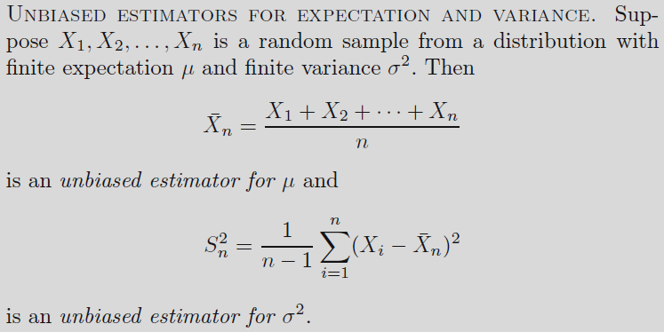


Unbiased estimators for expectation and variance

Slide 12


We show first that
is an unbiased estimator for μ.
We assume that for every i, E(X_{i})= μ .
Using the linearity of the expectation we find that

Slide 13

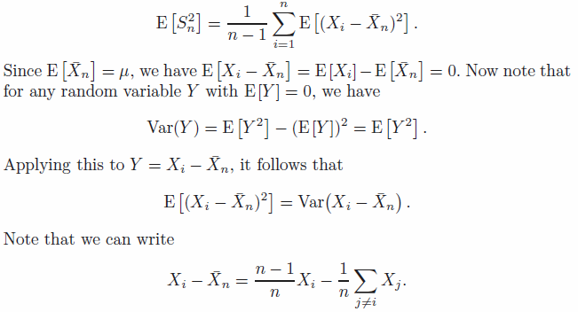
We show now that
is an unbiased estimator for σ².

Slide 14
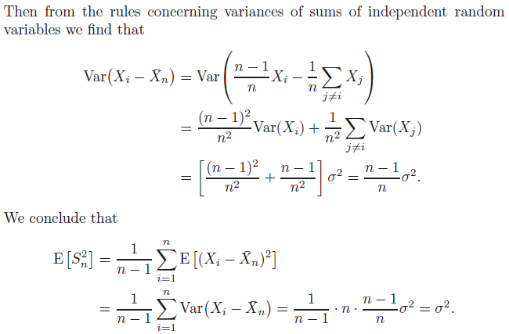
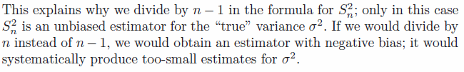

Slide 15

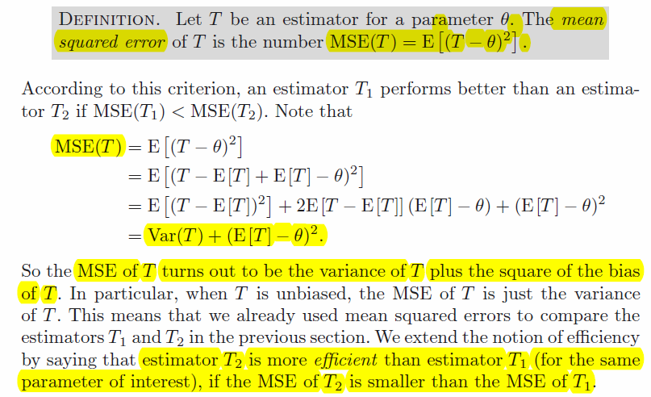

Slide 16

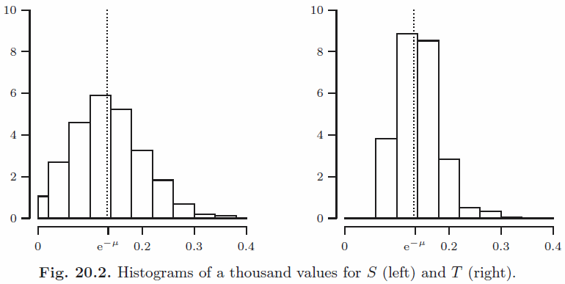
Recall that our goal was to estimate the probability p₀ = e^{−μ} of zero arrivals (of packages) in a minute. We did have two promising candidates as estimators:
In Figure 20.2 we depict histograms of one thousand simulations of the values of S and T computed for random samples of size n = 25 from a Pois(μ)
distribution, where μ = 2. Considering the way the values of the (biased!)
estimator T are more concentrated around the true value e^{−μ} = e⁻² = 0.1353,
we would be inclined to prefer T over S.

Slide 17
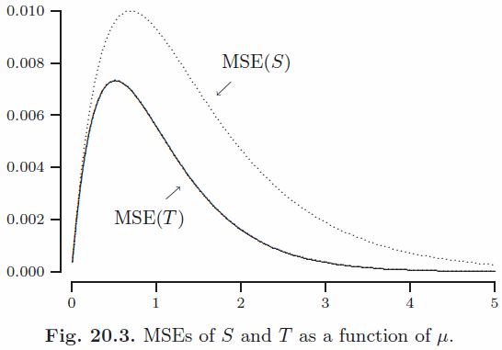
This choice is strongly supported by the fact that T is more efficient than S: MSE(T ) is always smaller than MSE(S), as illustrated in Figure 20.3.

Slide 18
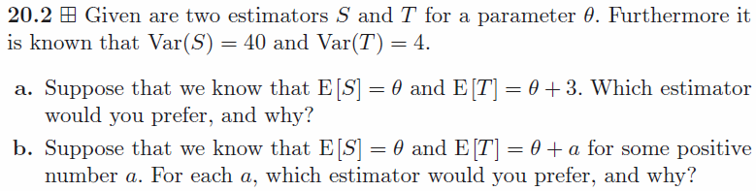
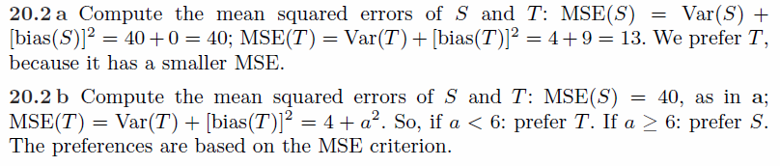

Slide 19
