Slide 1

Ch. 17 Basic Statistical Models
CIS 2033: Computational Probability and Statistics
Prof. Longin Jan Latecki
Prepared by: Nouf Albarakati

Slide 2
Basic Statistical Models
Random samples
Statistical models
Distribution features and sample statistics
Estimating features of the “true” distribution
Linear regression model

Slide 3
Random samples
A random sample is a collection of random variables X₁, . . . , X_{n}, that have the same probability distribution and are mutually independent
  If F is a distribution function of each random variable X_{i} in a random sample, we speak of a random sample from F.
  Similarly we speak of a random sample from a density f, a random sample from an N(µ, σ²) distribution, etc

Slide 4
An Example of Random sample
From the properties of the Poisson process, the inter-failure times are independent and have the same exponential distribution
Hence the software data is modeled as the realization of a random sample from an exponential distribution
In some cases we may not be able to specify the type of distribution

Slide 5
Statistical Models
For Repeated Measurements
A dataset consisting of values x₁, x₂,...,x_{n} of repeated measurements of the same quantity is modeled as the realization of a random sample X₁, X₂,...,X_{n}
The model may include a partial speciﬁcation of the model distribution, the probability distribution of each X_{i}

Slide 6
A Sample Statistic
A sample statistic is a random object h(X₁,X₂,…,X_{n}), which depends on the random sample X₁,X₂, …, X_{n} only
  e.g., sample mean, sample median, etc
  - An object, h(x₁,x₂,…,x_{n}) is a realization of corresponding sample statistic h(X₁,X₂,…,X_{n}) since the dataset x₁,x₂, …, x_{n} is modeled as a realization of random sample X₁,X₂, …, X_{n}

Slide 7

Sample Statistics
The sample statistics corresponding to the empirical summaries should somehow reﬂect corresponding features of the model distribution
The law of large numbers:
, for every
  For large sample size n, the sample mean of most realizations of the random sample is close to the expectation of the corresponding distribution
For instance, in a physical experiment, one usually thinks of each measurement as
measurement = quantity of interest + measurement error

Slide 8



Distribution Features and Sample Statistics
Let X₁,X₂, . . . , X_{n} be a random sample from distribution function F, and the empirical distribution function of the sample is:
for every ε > 0,
This means that for most realizations of the random sample the empirical distribution function F_{n} is close to F

Slide 9


Distribution Features and Sample Statistics
The histogram and the kernel density estimate:
  another consequence of the law of large numbers:
  H_{n}(x)=
  H_{n}(x)=
  Similarly, the kernel density estimate of a random sample approximates the corresponding probability density f
It should be noted that with a smaller dataset the similarity can be much worse.

Slide 10
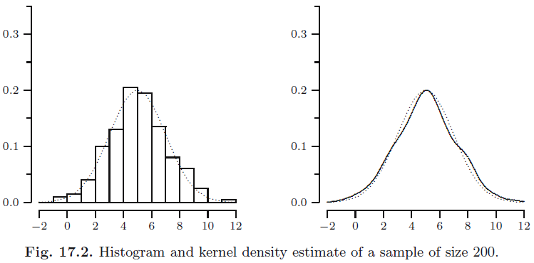
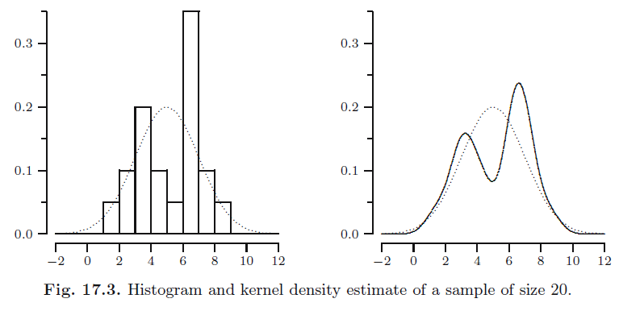

Slide 11



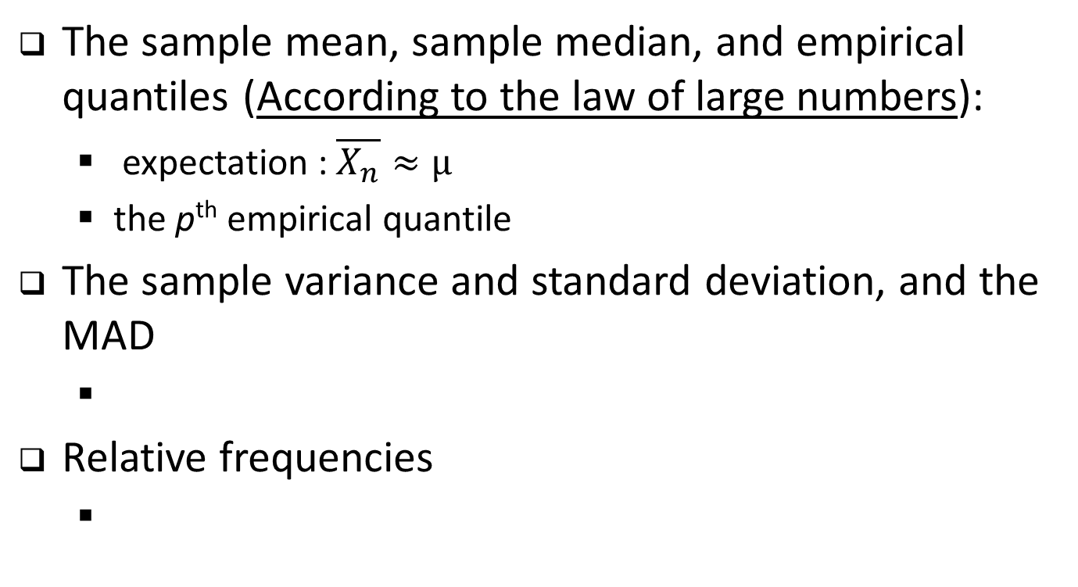
Distribution Features and Sample Statistics
The sample mean, sample median, and empirical quantiles (According to the law of large numbers):
  expectation : $\overline{X_{n}}≈μ$
  the p^{th} empirical quantile
The sample variance and standard deviation, and the MAD
Relative frequencies

Slide 12
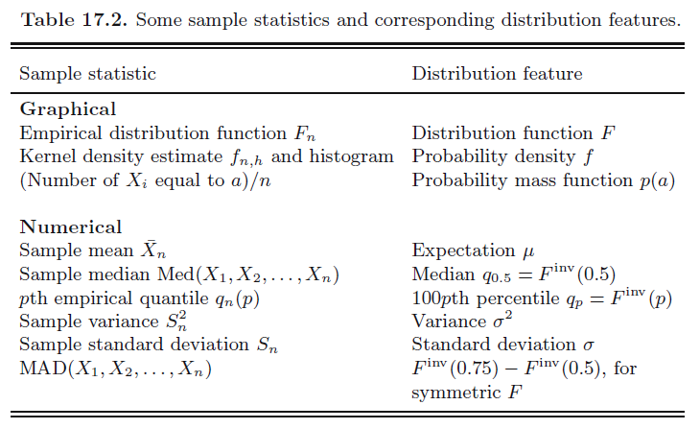
Distribution Features

Slide 13
Estimating Features of the “true” Distribution
we have a dataset of n elements that is modeled as the realization of a random sample with a probability distribution that is unknown to us. Our goal is to use our dataset to estimate a certain feature of this distribution that represents the quantity of interest.

Slide 14
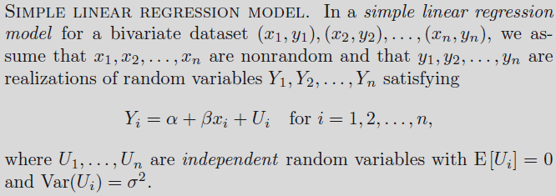
Linear Regression Model
  hardness = g(density of timber)
  hardness = g(density of timber) + random fluctuation
  hardness = α + β・ (density of timber) + random fluctuation
  This is a loose description of a simple linear regression model

