Slide 1
Relevant Subgraph Extraction
Longin Jan Latecki
Based on :
P. Dupont, J. Callut, G. Dooms, J.-N. Monette and Y. Deville.
Relevant subgraph extraction from random walks in a graph.
RR 2006-07, Catholic University of Louvain , November 2006.

Slide 2
Relevant Subgraph Extraction
This part is based on
P. Dupont, J. Callut, G. Dooms, J.-N. Monette and Y. Deville.
Relevant subgraph extraction from random walks in a graph.
RR 2006-07, Catholic University of Louvain , November 2006.
Let G = (V, E, A) denote a graph formed by a set V of vertices and a set E of edges,
with n = |V | is the number of nodes.
A is a weighted n x n adjacency matrix of G. Weights are assumed to be zero if and
only if their corresponding edge does not belong to the graph. Otherwise,
the weight between any pair of connected nodes is assumed strictly positive.
An undirected graph is represented by a symmetric matrix A.
We have a special set of nodes of interest
We define a node relevance function
and will use it to find
the relevant subgraph containing K

Slide 3

Random Walk
A random walk in a graph can be modeled by a Markov chain describing the sequence of nodes visited during the walk. A state of the Markov chain is associated with each node of the graph. Hence the terms nodes and states are used interchangeably.
A random variable X(t) represents the current state of the Markov chain at time t.
The probability of transiting to state j at time t+1, given that the current state is i at time t, is given by
Thus, from any state i, the (stationary) probability to jump to state j is proportional to the weight a_{ij} of the edge from i to j. The transition matrix P = [p_{ij} ] of the Markov chain is related to the degree and adjacency matrix as P = D⁻¹A.
P is a row-stochastic matrix. P is generally asymmetric.
Node relevance nr(i) is the expected number of times a walk starting in a node in K goes through node i before getting absorbed by another node in K.
Our goal is to compute the node relevance.

Slide 4
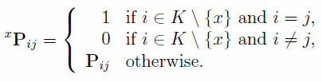

We first consider random walks starting from a given node of interest x in K
and ending in any other node of interest y in K with y ≠ x.
We define a modified transition matrix for which all nodes of interest but x have been transformed into absorbing states:
k = |K|, ^{x}Q denotes the (n x k + 1) (n x k + 1) transition matrix between transient states, I is the identity matrix of order k - 1 and ^{x}R is a (n x k+1) x (k - 1) matrix.
^{x}R_{ir} denotes the probability of a walk being in a transient state i to be absorbed in state r in one step.
In an absorbing Markov chain, the node passage time n(x, i) is defined as the number of times a random walk starting in x goes through state i before getting absorbed.

Slide 5



Let {X_{l} = i | X₀ = x} denote the random event of visiting state i in the
lth step of a random walk starting in x. The expectation of n(x, i) is the
expected number of times such events occur, in other words their respective
probabilities, for any time index l:
The infinite sum of the successive powers of the matrix ^{x}Q is known as the Neumann series and the last equality follows from the theory of stochastic matrices.
The matrix
is called
the fundamental matrix of an absorbing Markov chain.
^{x}N_{xi} is the expected number of times a walk starting in the node of interest x
goes through state i before getting absorbed in any node of K – {x}, that is,
before reaching a distinct node of interest.
The expected length n_{x} of any walk starting in x and ending in another node of interest K – {x}, is also the node passage times summed over all transient states:
where V_{T} = V – (K – {x})

Slide 6
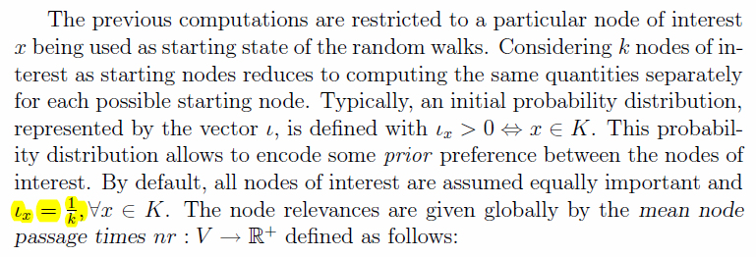

Recall that node relevance nr(i) is the expected number of times a walk starting in a node in K goes through node i before getting absorbed by another node in K.

Slide 7
K-relevant subgraph
Once we have node relevance nr, we can easily select the K-relevant subgraph as the largest connected subgraph S,
i.e., S is a connected subgraph with the largest sum
It is easy to get S:
we add nodes starting with the largest value of nr.
We stop once the subgraph becomes disconnected.

