Slide 1

Feature Matching
Longin Jan Latecki

Slide 2
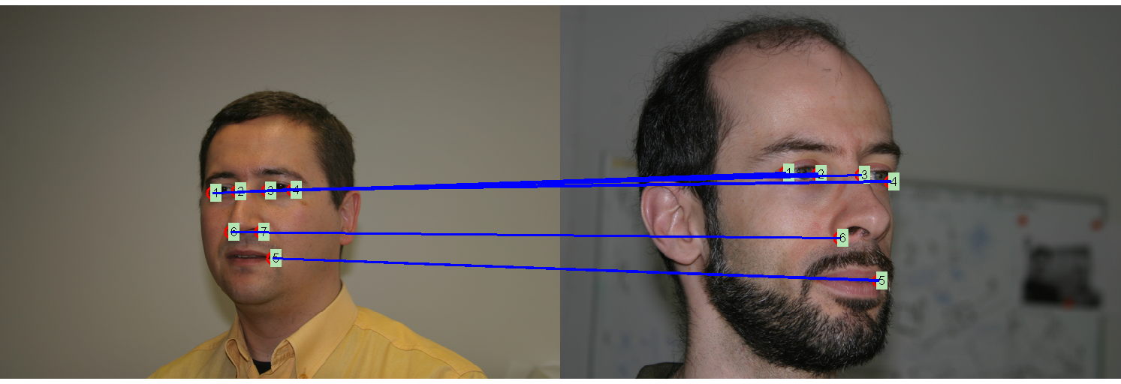
Matching example
Observe that some features may be missing due to instability of feature detector, view change, or occlusion.

Slide 3
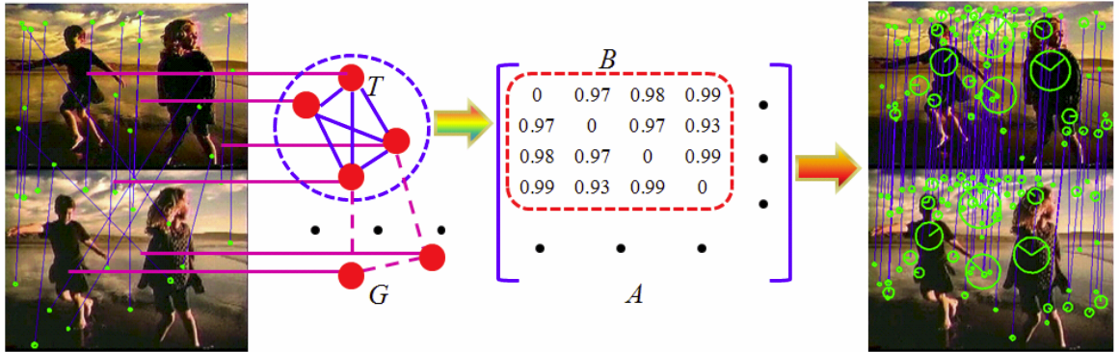
Matching as dense subgraph in association graph
Figure from Hairong Liu, Shuicheng Yan. Common Visual Pattern Discovery via Spatially Coherent Correspondences. CVPR 2010.

Slide 4
Association graph
Given are two sets: points P={p₁, …, p_{k}} and labels L={l₁, …l_{m}}.
The nodes of the association graph are pairs (point, label), i.e.,
V =P x L
The affinity between u=(p_{u}, l_{u}) and v=(p_{v}, l_{v}) is given by
A(u, v) = similarity of pair (p_{v}, p_{u}) to pair (l_{v},l_{u}) if u ≠ v
A(u, v) = similarity of p_{u} to l_{u} if u = v
A(u,u) can be set to zero

Slide 5
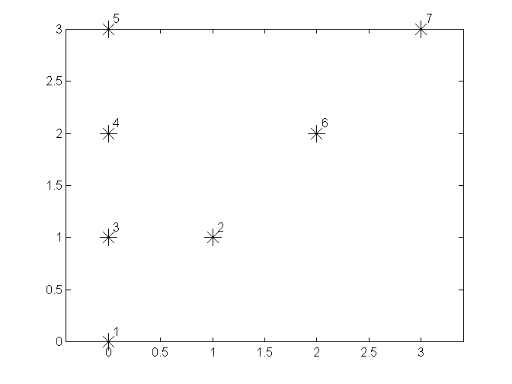
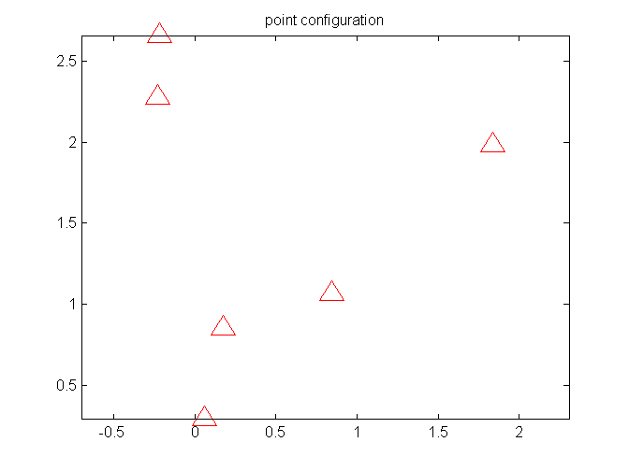
Example
Given are 7 points (stars) and 6 labels (triangles).
Goal is to find their correspondence.
5
?
4
6
3
2
1

Slide 6
First step: build the association matrix
It is an 42 x 42 matrix A of pairs (*,∆), i.e., each node of the association graph is a possible correspondence.
A(u,v) entry of matrix A,
where u=(*_{u},∆_{u} ) and v=(*_{v},∆_{v}),
is based on the compatibility of matching
*_{u}→ ∆_{u} and *_{v}→∆_{v}
It is defined as
if u ≠ v
if u=v

Slide 7
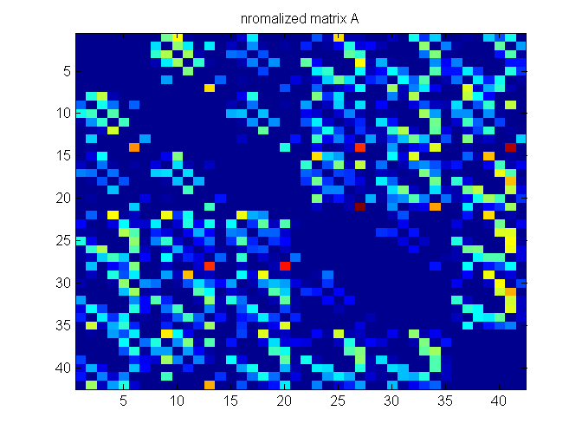
First step: build the association matrix

Slide 8
Maximum weight subgraphs
Given is a graph (V, A), where V is a set of n vertices and A is an affinity matrix A representing edge weights. Each entry of A is nonnegative. A(u,v)=0 iff there is no edge between u and v. Graph G is undirected, i.e., matrix A is symmetric.
The weight of a subgraph S is defined as the sum of all edge weights of edges connecting the nodes in S:
This definition only makes sense if we constrain the class of subgraphs to contain K nodes.
S

Slide 9
Maximum Weight Subgraphs
Let x=(x₁, …, x_{n}) in {0, 1}^{n} be an indicator vector over nodes of graph G, i.e., node u belongs to S iff x_{u}=1.
Then the weight of a subgraph S with K nodes can be expressed as:

Slide 10
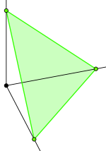
Maximum Density Subgraphs
An analogous concept is of subgraph density, it differs from the weight of the subgraph only by a normalization by the size.
The density a subgraph S is given by:
However, now x_{u} = if x in S and x_{u}=0 otherwise.
The problem of finding a densest subgraph can be relaxed to max
where Δ is an n dim simplex:

Slide 11
Target Function
We are interested in finding subgraphs H of G that are local maxima of the average affinity score defined as:

Slide 12
Solution with replicator equation
[Pavan and Pelillo IEEE PAMI 2007] has established a connection between dominant sets in a weighted graph and local maximizers of the quadratic function:
To solve this problem, they propose to use a replicator equation.
Once an initialization is given, the discrete replicator equation can be used to obtain a local solution :

Slide 13
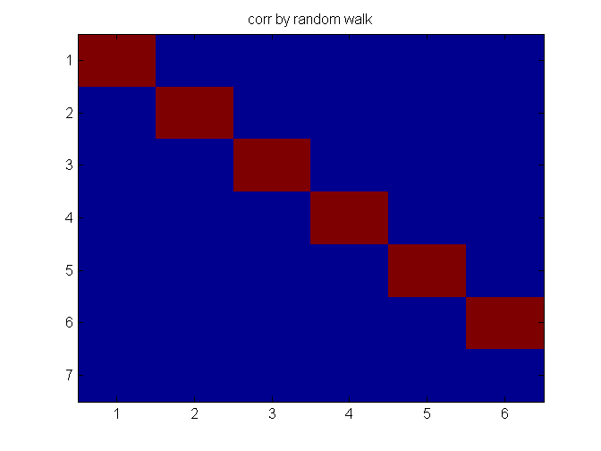
Solution is a dense or maximum weight subgraph
Since the target function f is not convex, we initialize it with every node of the association graph, i.e., with every possible assignment u=(*_{u},∆_{u}) for u in V.
The solution is a set of nodes that yields the largest value of f.
In our example,
the solution is a set of
six nodes:

Slide 14
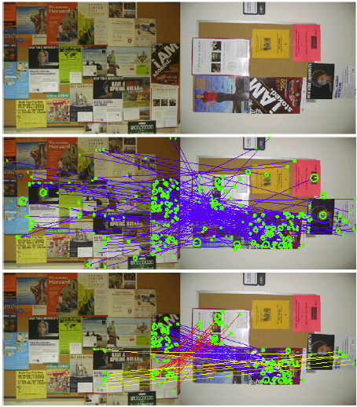
Applications
Common pattern
discovery
Possible matches
Common patterns
identified
as dense subgraphs

Slide 15
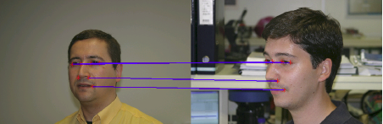
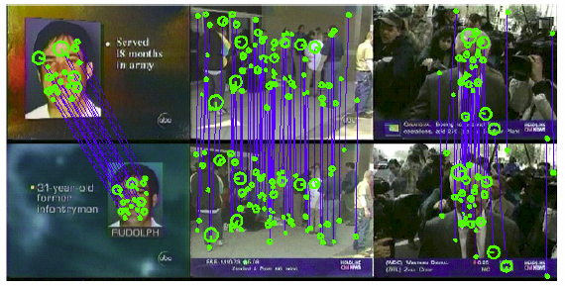
Applications
Feature point
matching
Near
duplicate
retrieval

