Slide 1


The Benefits of Cooperation Between the Cloud and Private Data Centers for Multi-Rate Video Streaming
Pouya Ostovari, Jie Wu, and Abdallah Khreishah
Computer and Information Sciences
Temple University
ICCCN 2014
Center for Networked Computing
http://www.cnc.temple.edu

Slide 2
Agenda
Introduction
  Motivation
Problem statement
Cooperative video streaming
  Single-layer video streaming
  Multi-layer video streaming
Conclusions

Slide 3




Motivation
Advances in technology
  Smartphones and tablets
  Internet is accessible everywhere
  Video streaming is used widely and frequently
Video streaming is a dominant form of traffic on the Internet
  YouTube and Netflix:
    Produce 20-30% of the web traffic on the Internet
  High energy consumption

Slide 4


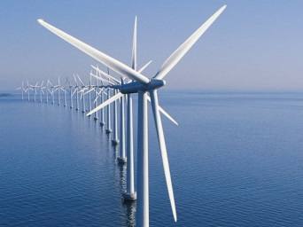
Motivation
Green computing
  Limited fossil fuels resources
  Global warming
Reducing energy consumption is more important in the case that data centers use renewable energy
  The cost of servers change over time
    Depends on availability of renewable energy resources
  Reduce workload on servers, especially when the energy cost increases

Slide 5
System Model
A set of video servers (data centers)
  Geographically distributed all over the world
  Energy cost:
    storage and bandwidth
  Use renewable energy as their primary source of energy
  Renewable energy sources may not be available
    Or may not be available in the right quantity
    Using other power sources
    Increase the cost

Slide 6
System Model
Several user regions
Costs and requests
  Expected number of requests from each region for a video
  Expected storage and bandwidth costs
Objective
  Minimizing the cost of providing videos to the users

Slide 7
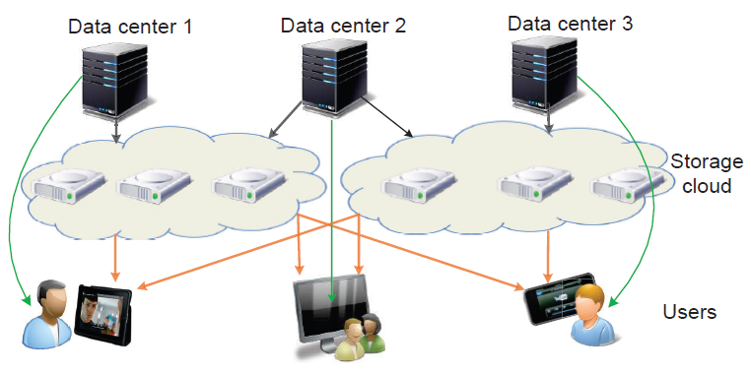
System Model
Solution:
  Using proxies (cloud) when the cost of the servers increases
  Estimating the cost based on the available predictions
    The amount of requests for the videos
    The cost of the servers
    Cost of the cloud service
  Transferring the popular videos to the cloud when the server cost is high
  Providing the streaming through the cloud

Slide 8
How to distribute the videos?
Storing videos
  Storing the videos in full on the cloud or in part?
  How to store the videos in part?
Network coding can help
  Provides a fluid data model

Slide 9
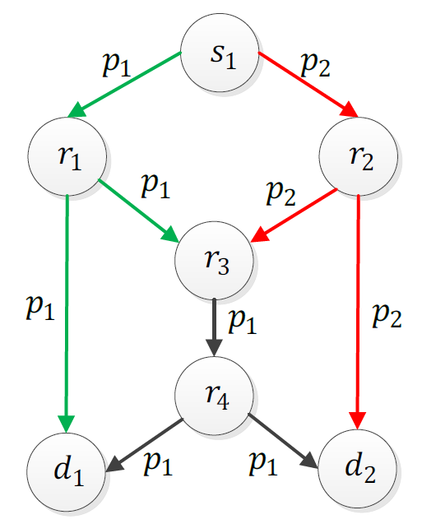
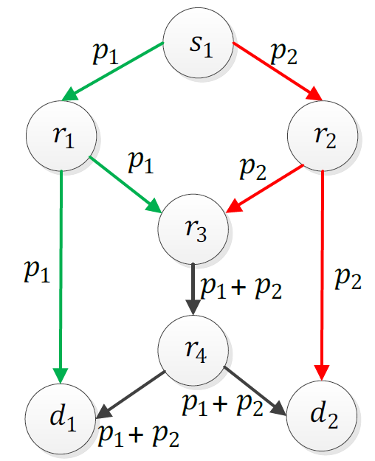
Network Coding in Wired Networks
Single multicast session
  Bottleneck problem (Ahlswede’00)
No coding
Coding
Notes:
Network coding first introduced for wired networks and showed that it can solve the bottleneck problem.

Slide 10
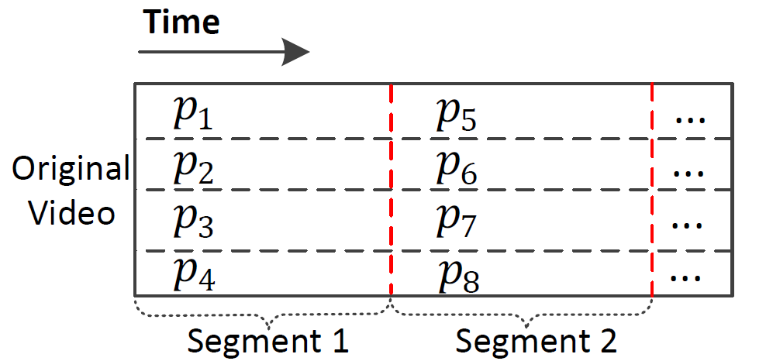
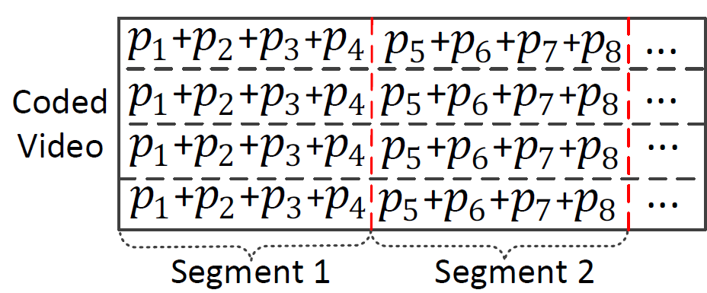
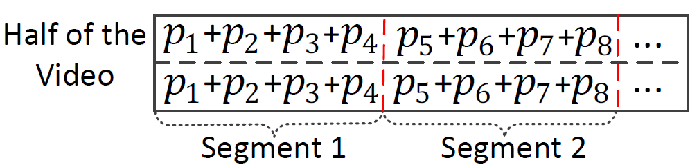
Video Coding Scheme
Partitioning the video
Performing random linear network coding
  Coefficients are not shown for simplicity
Storing the video in part
  f portion of each segment

Slide 11
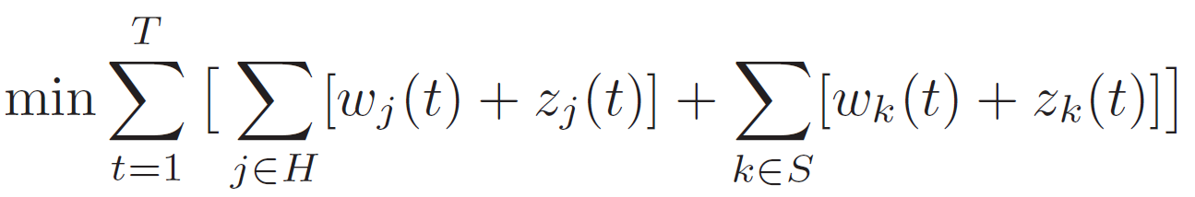
Optimization
Linear programming
Storage cost
Storage cost
Download cost
Download cost
Rate of movie m
Unit transmission cost
Transmission rate of movie m from cloud j to region i

Slide 12
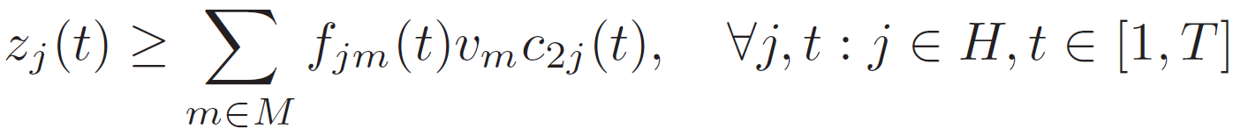
Optimization
Rate of movie m
Unit transmission cost
Size of movie
Transmission rate of movie m from server k to region i
Transmission rate of movie m from server k to cloud j
Unit storage cost
Fraction of stored movie on cloud j

Slide 13
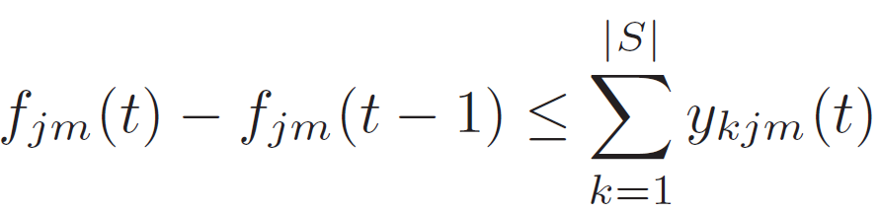
Optimization
Transmission rate of movie m from server k to region i
Size of movie
Unit transmission cost
Expected requests for movie m from region i
Fraction of stored movie m on cloud j at time t
Amount of download of movie m from server k to cloud j

Slide 14
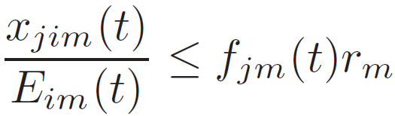
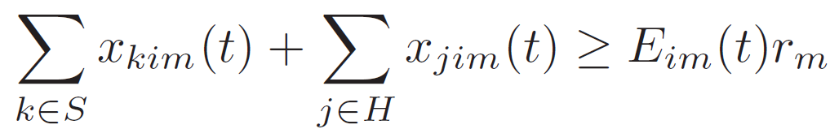
Optimization
Fraction of movie m on cloud j
Rate of movie m
Expected requests for movie m from region i
Transmission rate of movie m from server k to region i
Transmission rate of movie m from cloud j to region i

Slide 15
Multi-Layer Video
Delivering video stream using different resolutions to satisfy different client needs/constraints
Multi-layer video (Multi-resolution)
  Example: H.264/SVC (scalable video coding)
  Base layer
  Enhancement layers

Slide 16
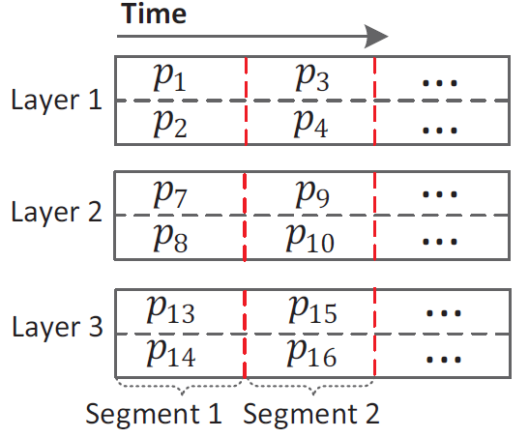
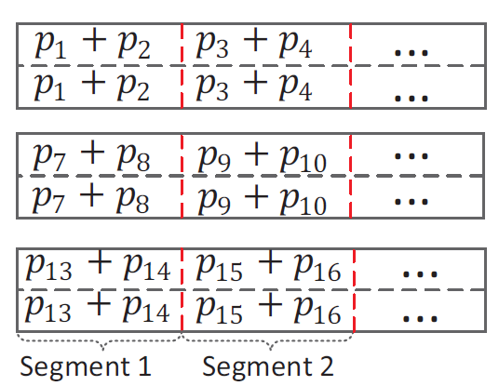
Multi-Resolution Video Streaming
Partitioning the video
Random linear network coding
Optimization
  The proposed linear programming can be modified to the case of multi-layer videos
    For each layer we have separate variables
    The constraints are generalized to the case of multiple layers

Slide 17
Simulation Setting
We developed a simulator in the MATLAB environment
We compare our method with the case of streaming without cloud
100 runs for each setting
  Random costs, video sizes, video rates, and expected requests

Slide 18
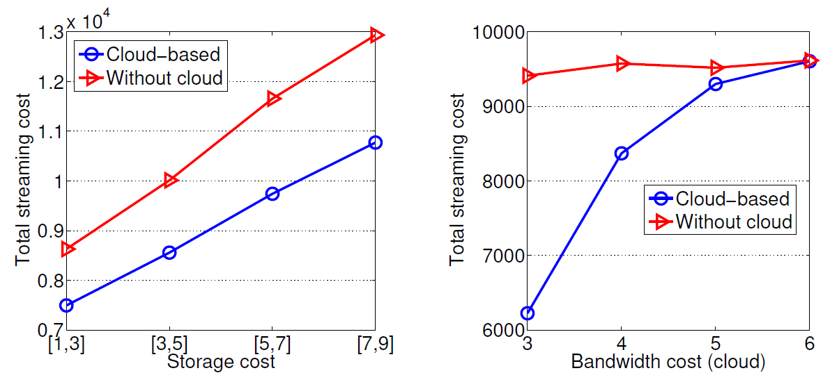
Simulation Results
Single-Layer Video Streaming
Fixed bandwidth cost
Fixed storage cost

Slide 19
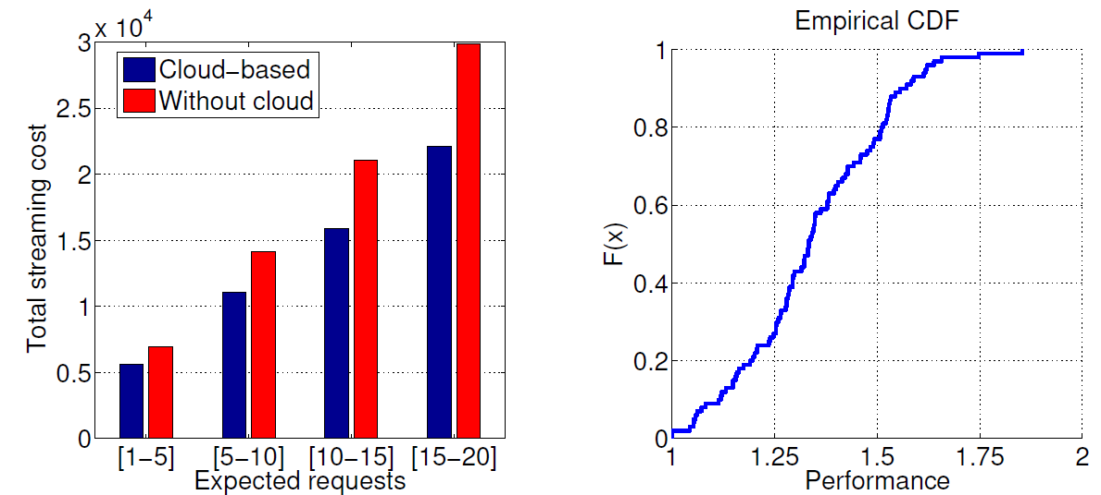
Simulation Results
Single-Layer Video Streaming
Performance: cost without cloud/cost with cloud

Slide 20
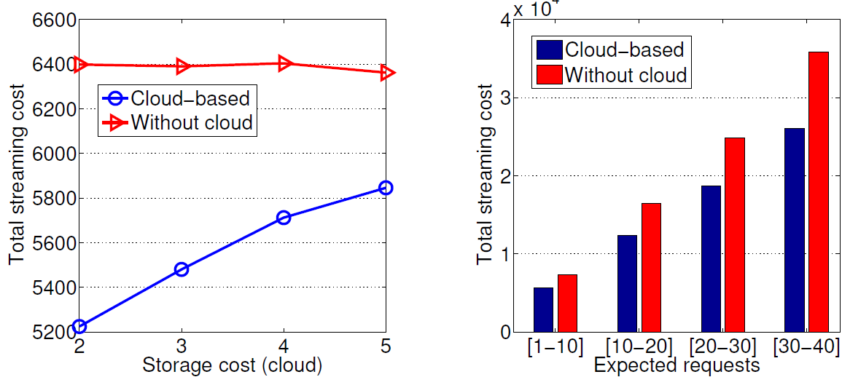
Simulation Results
Multi-Resolution Video Streaming
Fixed bandwidth cost

Slide 21
Conclusion
Increasing data traffic
  Video streaming is a dominant form of Internet traffic
  Increase in energy cost
Using renewable energy as the primary source
Using the help of clouds to reduce energy cost
Optimal solution using linear programming
Extension to the case of multi-layer videos

Slide 22
Questions?
Pouya Ostovari:
ostovari@temple.edu

