Slide 1
An Indoor Hybrid WiFi-VLC Internet Access System
Authors: Sihua Shao (NJIT), Abdallah Khreishah (NJIT),
Michael B. Rahaim (BU), Hany Elgala (BU), Thomas D.C. Little (BU),
Moussa Ayyash (CSU), Jie Wu (Temple University)

Slide 2
Why VLC?
Capacity
Availability
Efficiency
Security

Slide 3
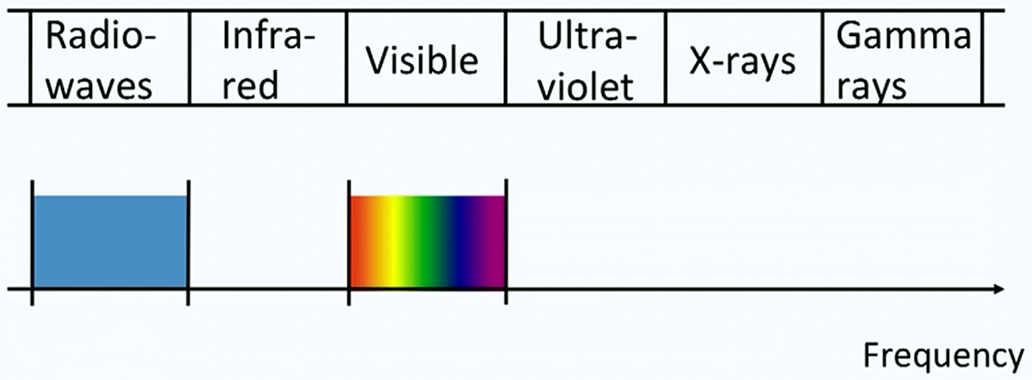
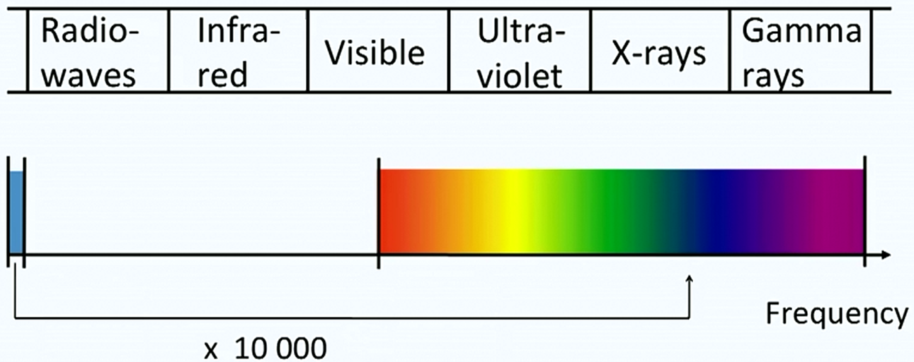
Electromagnetic Spectrum

Slide 4
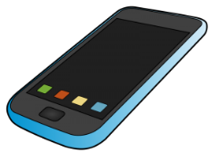
Why Hybrid?
Optical Uplink may cause four issues:
Device orientation
Glare
Energy constraint
Infrastructure
receiver

Slide 5
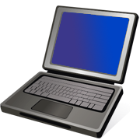
Proposed Hybrid WiFi-VLC System Model
Wired Interconnection
Internet
Optical wireless channel
Wi-Fi wireless channel
Router and Wi-Fi Access Point

Slide 6
Hybrid System Architecture and Traffic Flow Demo
Internet
PC I
(Relay)
unidirectional
NIC A-1
NIC A-2
Wired
Wireless
VLC
Downlink
Router and Wi-Fi Access Point
PC II
(Client)
Uplink
NIC B-1
NIC B-2
DIP: NIC B-2’s IP
DIP: Server’s IP
DIP: NIC B-1’s IP
DIP: Router WAN
DIP: Server’s IP
SIP: Router WAN
SIP: Server’s IP
SIP: Server’s IP
SIP: Server’s IP
SIP: NIC B-1’s IP
DMAC: Router LAN
DMAC: Next hop
DMAC: NIC B-2
DMAC: NIC A-1
Packet MAC/IP headers
DMAC: Router WAN
SMAC: NIC B-1
SMAC: Router WAN
SMAC: NIC A-2
SMAC: Router LAN
SMAC: Last hop

Slide 7
Operating System Spoofing
$$?$$
Example:
IP of NIC B-1: 192.168.1.100/24
IP of NIC B-2: 192.168.2.100/24
PC II
(Client)
NIC B-1
NIC B-2
Step 1: Delete all information of NIC B-1 in the routing table. Add a default gateway as 192.168.2.1/24 with ARP 192.168.2.1 ab:ab:ab:ab:ab:ab.
Step 2: Capture all the packets flowing through NIC B-2.
Step 3: Make copies of the packets. Alter the source IP and MAC as NIC B-1 and the destination MAC as route LAN.
Step 4: Send the copies out through NIC B-1.

Slide 8
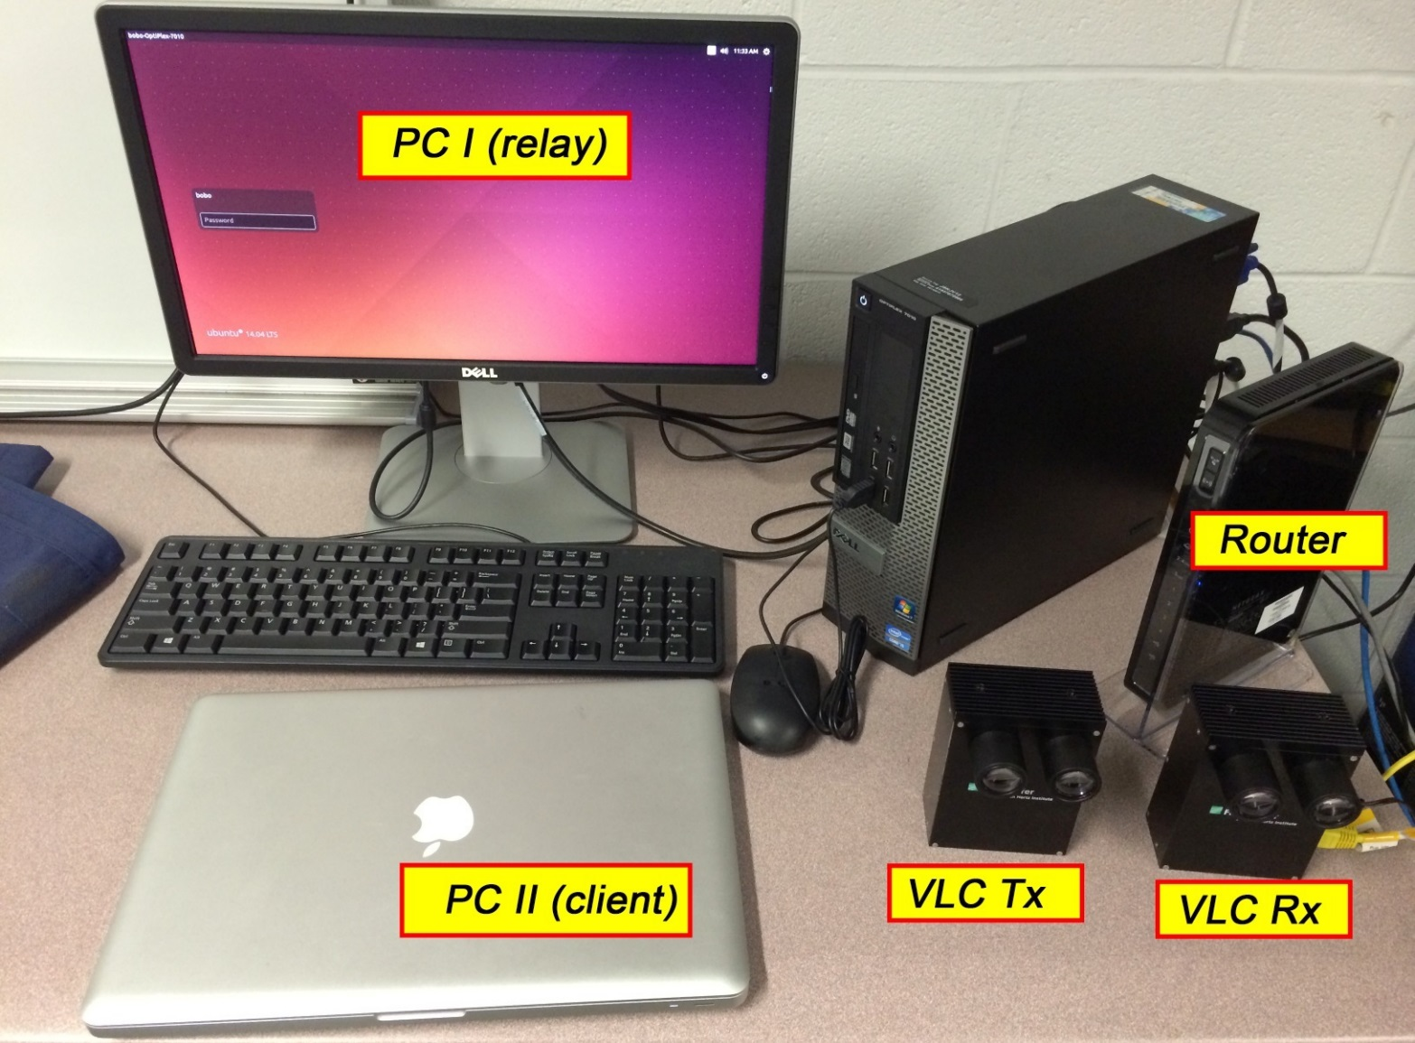
Testbed

Slide 9
Video Show

Slide 10
Experiments Results (Throughput)
OLD

Slide 11
Experiments Results (Throughput)
NEW

Slide 12
Experiments Results (Webpage Loading)
OLD

Slide 13
Experiments Results (Webpage Loading)
NEW

Slide 14
Thank you!

